Slide 1
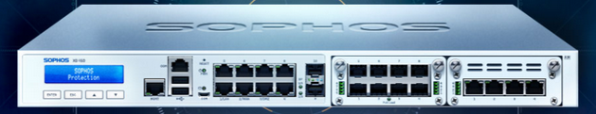

Implementing Sophos Web Application Firewall
Presented by:
17it127 Niket Vania

Slide 2
Outline
What is Web Application Firewall?
Where it is being deployed?
Main Task
Different from IPS/IDS
Development Requirements
Configuration
References

Slide 3
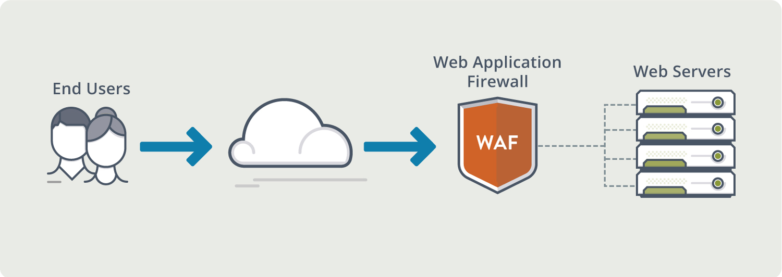
What is a Web Application Firewall?

Slide 4
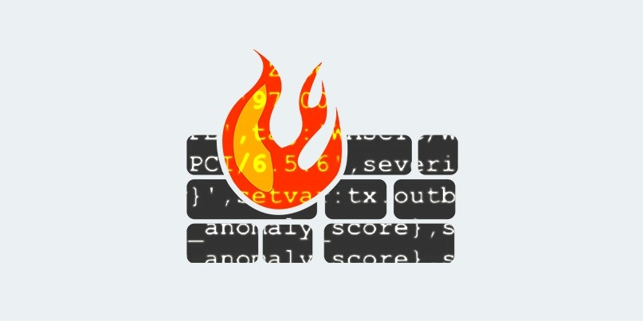
Web Application Firewall: a security device

Slide 5
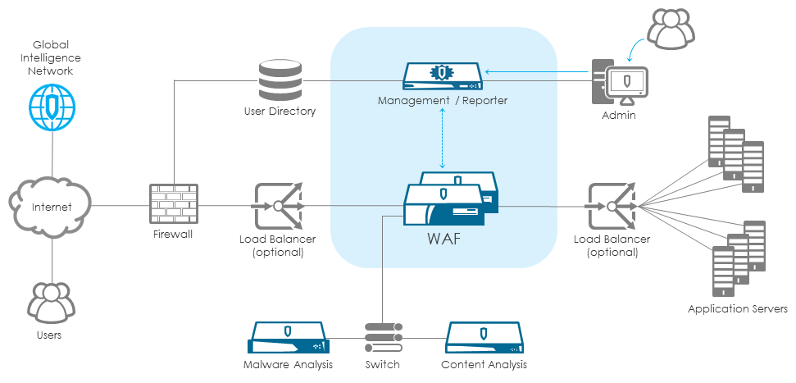
Deployed: usually at the demilitarized zone, to protect the server farm

Slide 6
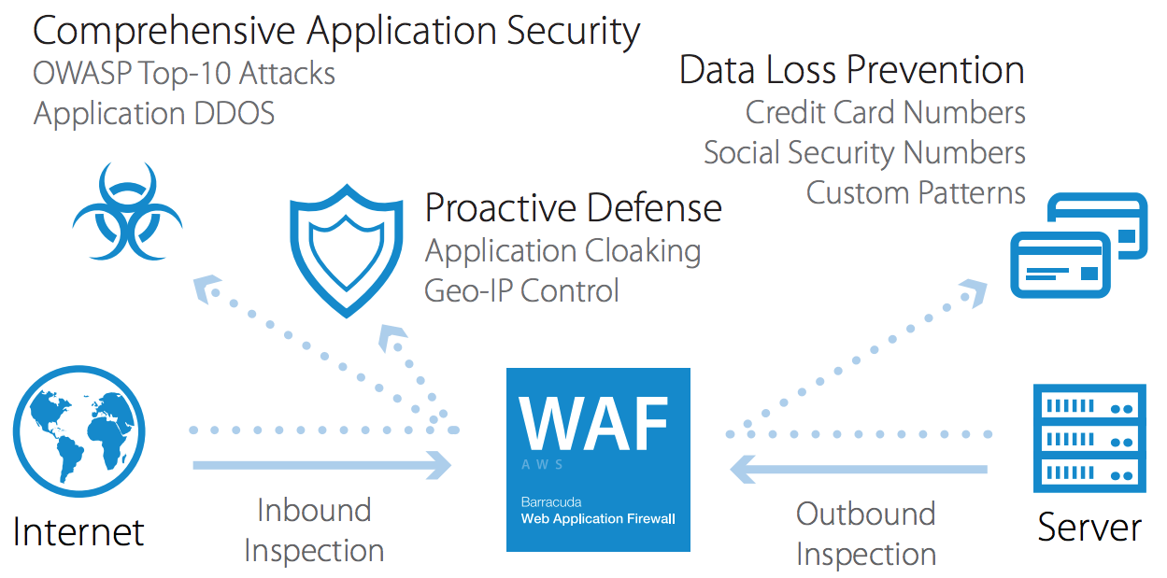
Main task: protect web portals and web application

Slide 7
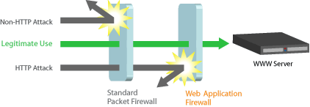
Different from IPS/IDS: Absolutely, yes!

Slide 8
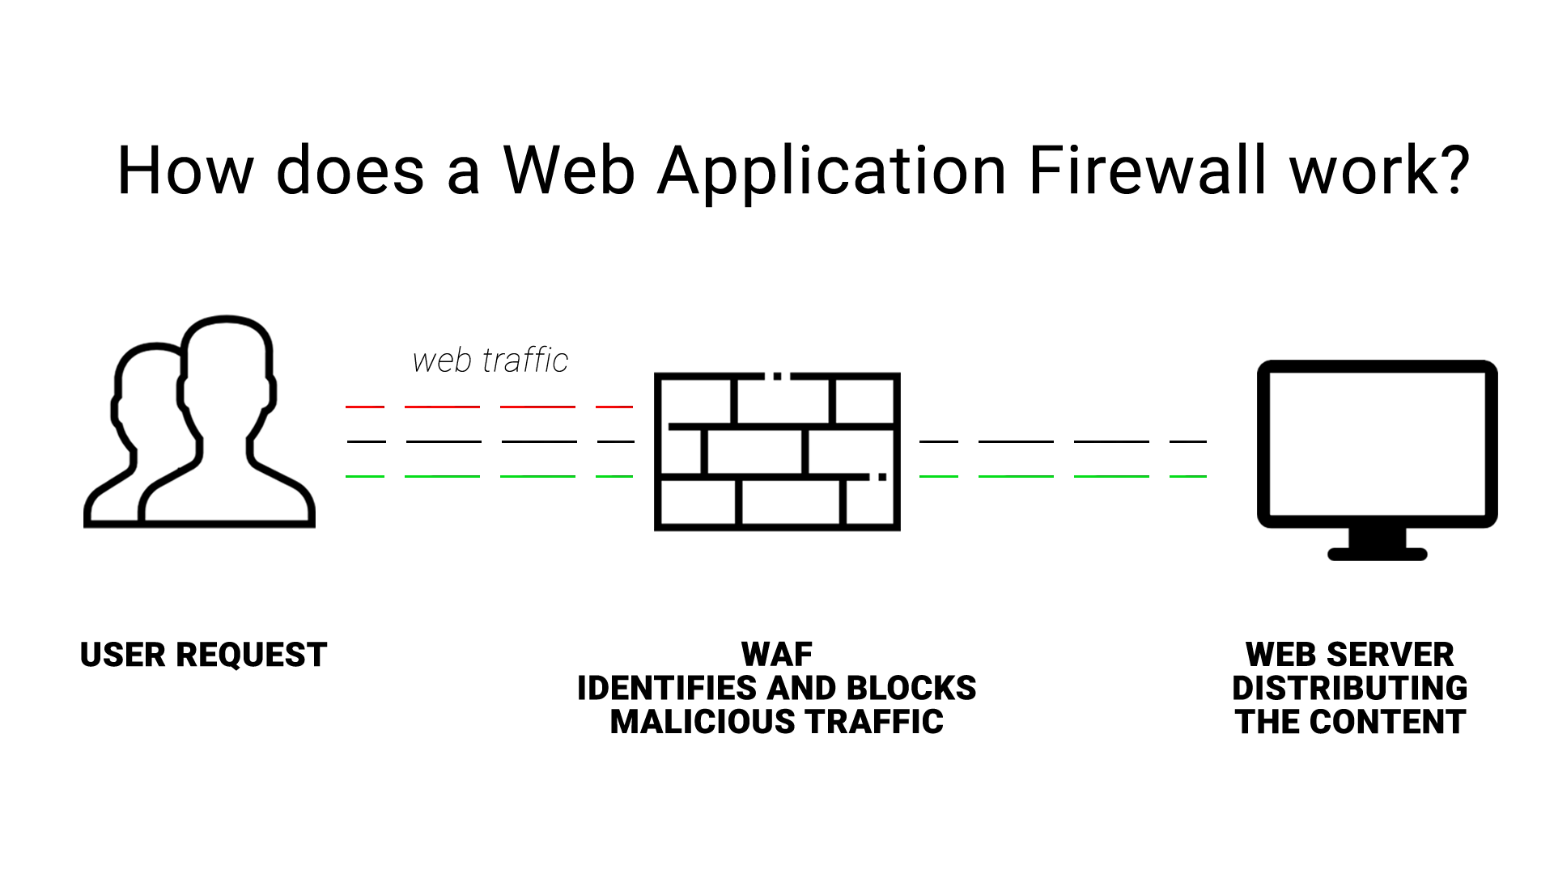
How: inspecting the XML/SOAP semantics of the flowing traffic and also inspecting HTTP/HTTPS for typical attacks at layer 7

Slide 9
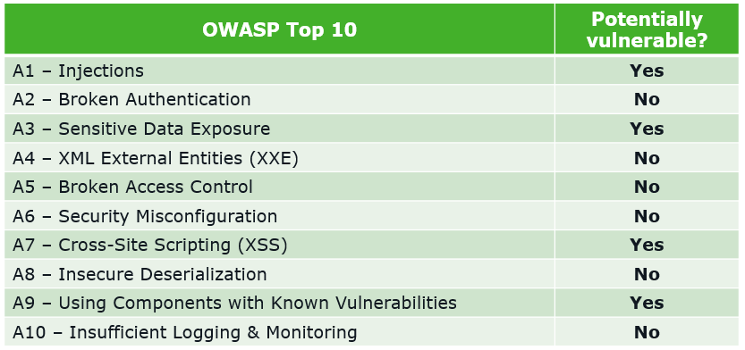

Slide 10
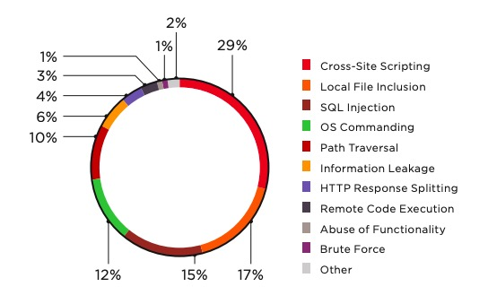

Slide 11
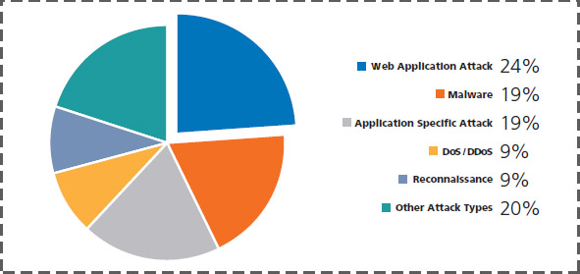

Slide 12
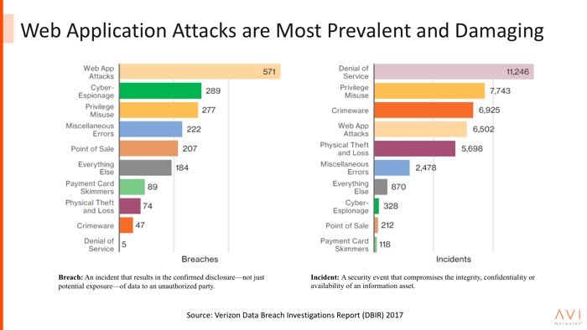

Slide 13
Development Requirements
Hardware:
Management devices (Computers)
Straight-through cable
Cross-Over cable
Software:
Windows/Linux/macOS
Firefox/Chrome/IE
Web server (Cloud or hardware based)
Tools like Nmap, Burp Suite, etc. or Pentesting OS like Kali or Parrot.

Slide 14
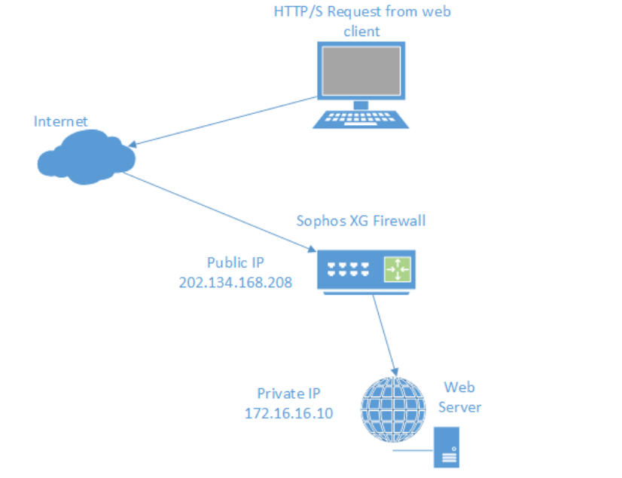
Configuration

Slide 15
References
https://www.cloudflare.com/learning/ddos/glossary/web-application-firewall-waf/
https://www.techopedia.com/definition/29828/web-application-firewall-waf
https://www.youtube.com/playlist?list=PLga6uzcZiv0VibiLSutva451K_hlP8-Ki
https://www.youtube.com/playlist?list=PL9Puyn_9KBpjGvTyUtx2QImGESm6UrkW1

Slide 16
Thank You!

