Slide 1
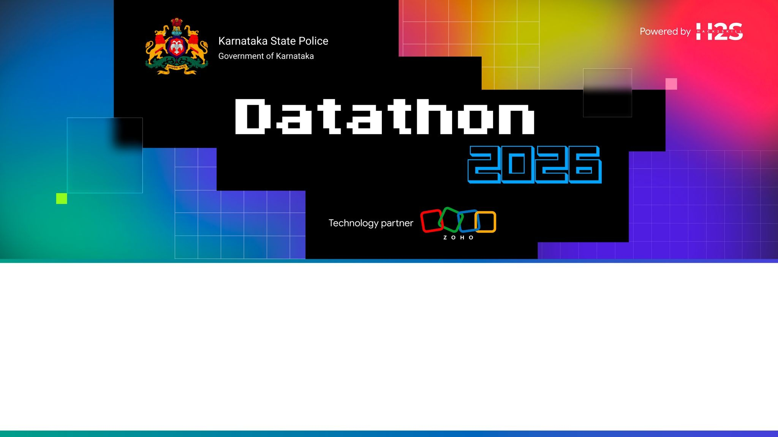
Team Details
PRAHARI
a. Team name:
Fault Line
AI-Driven Crime Intelligence &
Decision Support Platform
b. Team leader name:
Katir
c. Team size:
5
16,74,732
37
1,074
FIRS
DISTRICTS
STATIONS
d. Problem Statement:
Challenge 02 — AI-Driven Crime Analytics
Deployed on Zoho Catalyst · Bilingual English / ಕನ್ನಡ
Members: Nikethan · Hari Nair · Katir · Dhikshitha · Nihan

Slide 2
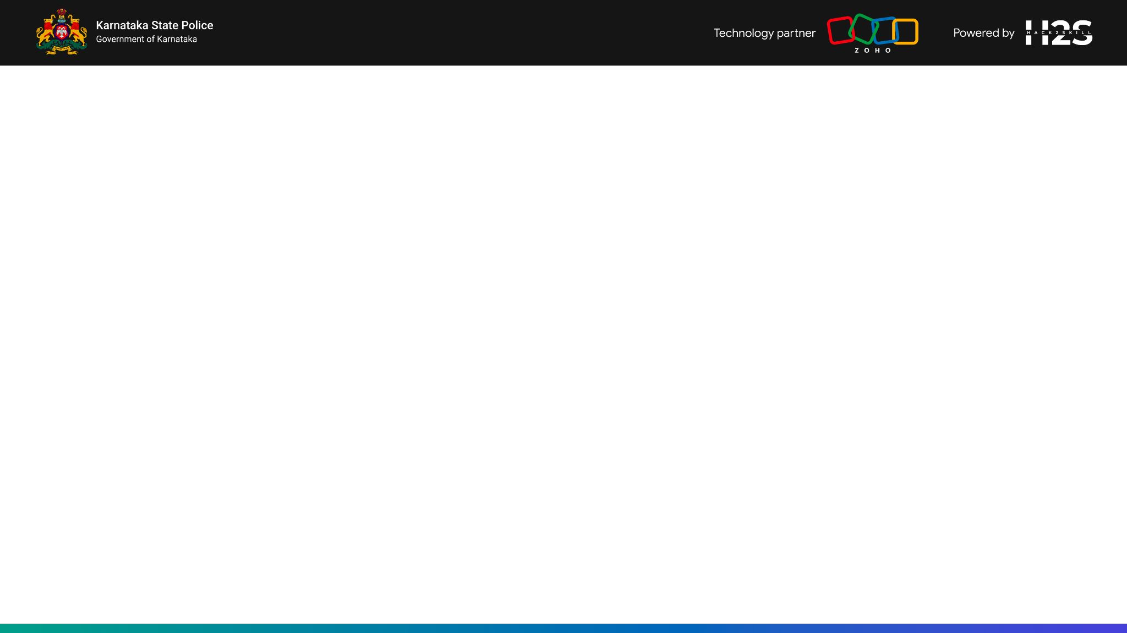
Brief about the solution
PRAHARI turns 16.7 lakh Karnataka FIR records into one operational decision loop, and now takes reports from the public at the other end of it.
01 COMMAND
State-wide picture: live alerts, STL intelligence headline, top districts
02 INVESTIGATE
Person dossier from record: timeline, co-accused, offence pattern
03 CONNECT
Co-offending network — 342k persons, 35,333 detected communities
04 FORECAST
Gi* hotspots (p<0.05), emerging lifecycle, LightGBM week-ahead risk
05 ACT
ILP-optimised patrol deployment with printable briefing sheets
06 REPLAY
Week-by-week backtest on held-out 2024 data — 43.3% mean hit rate
07 TRUST
Calibration, SHAP attribution, fairness audit, stated limitations
08 REPORTS
NEW — triage queue for citizen reports filed through the public portal
The public portal sits on the marketing site; everything above is the officer console.

Slide 3
Opportunities
How different is it from other existing ideas?
Significance, not blur. Every cell is tested with Getis-Ord Gi* at p < 0.05, so a hot cell is statistically real — not a kernel-density smear where busy and dangerous look identical.
The loop closes at both ends. The public files a report; an officer triages it; a verified one becomes an FIR. Other dashboards stop at a map.
It shows its worst week. REPLAY exposes the weakest result deliberately rather than reporting a flattering average.
How will it be able to solve the problem?
Eight CCTNS tables are normalised into one queryable model, removing the cross-referencing that costs officer hours.
Anomalies surface before the fact: STL flags departures with an 80% prediction interval, not a guessed confidence score.
Deployment becomes measurable: 11.67% risk coverage against a 9.87% volume-driven status quo — +18.2% at identical cost.
USP of the proposed solution
Every claim is auditable inside the product — calibration curve, SHAP, fairness audit and a written limitations page ship in the TRUST tab.
Citizen reports are structurally quarantined from the analytics, so accepting public input costs nothing in statistical credibility.
Fully bilingual English / Kannada across all eight tabs and the public portal.

Slide 4
List of features offered by the solution (1 / 3)
FR-1
Statistical hotspot mapping
Getis-Ord Gi* significance at p < 0.05 across 16,650 grid cells; 722 confirmed hot cells. Hot and cold spots at three confidence bands each, filterable by 20 crime categories.
FR-2
Emerging-pattern lifecycle
Classifies every cell as New (192), Intensifying (943), Persistent or Cooling (96) by comparing recent activity against its own 24-month history with a Mann-Kendall trend test.
FR-3
Week-ahead risk forecasting
LightGBM over near-repeat, temporal-lag and spatial-context features. Identifies 53.1% of next-week crime inside 5% of the map (PAI 10.63) on 405,476 held-out predictions.
FR-4
Anomaly detection & alerting
STL decomposition per district-crime series. Departures reported as an excess count with an 80% prediction interval derived from residual dispersion.
FR-5
Patrol deployment optimiser
Integer Linear Programming places N units on the highest-risk reachable clusters at a 2 km beat radius. 11.67% coverage vs a 9.87% volume-driven baseline.
FR-6
Printable patrol briefing
Per-unit sheet with GPS position, 30-day incident count, cells covered, crime-type breakdown and heinous-case count. Black-on-white print layout for shift handover.

Slide 5
List of features offered by the solution (2 / 3)
FR-7
Co-offending network analysis
Louvain community detection over 341,803 offender nodes and 509,633 co-accusation links; modularity 0.978. Networks ranked by size and operational priority.
FR-8
Offender dossier search
Fuzzy name lookup assembling linked FIRs, co-accused with shared-FIR counts, district spread, arrest markers and offence-pattern breakdown from existing record.
FR-9
Backtesting replay
Replays held-out 2024 data week by week: forecast drawn, real FIRs plotted, week scored. 43.3% mean hit rate over 11 weeks with Best and Worst week controls.
FR-10
Explainability & fairness
Isotonic-calibrated probabilities (0.3% calibration error), SHAP attributions in plain language, and a reporting-bias-adjusted fairness audit (Gini 0.183).
FR-11
Bilingual interface
Complete English / Kannada i18n across all eight tabs and the public portal — UI labels, district names, crime categories, tooltips and generated narratives.
FR-12
Cross-tab operational routing
Alerts, district cards and network nodes are actionable: each carries the officer to the matching Forecast, Deployment or Dossier view with context preserved.

Slide 6
List of features offered by the solution (3 / 3)
New this round — the public reporting portal and its officer-side triage.
FR-13
Public reporting portal
Three-step form on the public site. Email OTP verification, 20 crime categories shared with the pipeline, district or GPS location, and a consent gate.
FR-14
Emergency and legal gating
Selecting "happening right now" stops the form and shows 112. Sexual Offences, Crimes Against Children and Kidnapping are refused outright and directed to a station.
FR-15
Reference-number tracking
Every report returns a PR- reference. The reporter can return, see status, answer a request for more information, or withdraw within 24 hours.
FR-16
Officer triage queue
Eighth console tab. Filterable queue, duplicate flagging, spam scoring, full lifecycle enforcement, and a redacted-vs-internal view split.
FR-17
Duplicate and spam defence
Spatial-temporal-textual duplicate detection on grapheme trigrams (works in Kannada). Additive spam scoring sinks junk to the bottom without hiding it.
FR-18
Sealed export gate
A supervisor seals verified reports into a batch with a SHA-256 manifest. Sealing freezes the row. Nothing reaches the pipeline automatically.

Slide 7
Process flow diagram
Nightly batch pipeline produces static artefacts; the console reads them with zero per-query compute.
INGEST
>
NORMALISE
>
ANALYSE
>
MODEL
>
OPTIMISE
>
SERVE
CCTNS export
8 raw tables
Clean schema
16.7L FIRs
Gi* / LISA
STL · Louvain
LightGBM risk
SHAP + calib.
ILP patrol
assignment
GeoJSON + JSON
artefacts
artefacts published to Catalyst Hosting / Stratus
PRAHARI CONSOLE · eight operational tabs, no backend call at read time
COMMAND
INVESTIGATE
CONNECT
FORECAST
ACT
REPLAY
TRUST
REPORTS
Officer decision → patrol deployed → feedback logged → feeds the next retraining cycle
Pipeline recompute ≈ 22 min · scheduled nightly via Catalyst Cron · the console footer shows the last-run timestamp
Batch, not on-demand
Every stage is testable
Feedback re-enters at ingest
Nothing in the analysis runs while an officer waits. A slow model can never become a slow page.
Each step writes a file the next step reads, so a wrong number traces to the stage that produced it.
Accept / reject signals are captured at the console and rejoin at the next recompute.

Slide 8
Process flow — a citizen report, end to end
A separate path with a human gate in the middle. Nothing on this diagram reaches the analytics automatically.
1
FILE
2
SCREEN
3
TRIAGE
4
VERIFY
5
SEAL
6
CARRY
Public portal.
Email OTP, category,
location, consent.
Duplicate + spam
checks at submit.
Neither auto-rejects.
Officer reviews in
the REPORTS tab.
Lifecycle enforced.
Becomes an FIR with
a real FIR number.
A case decision.
Supervisor seals a
batch. SHA-256
manifest. Row frozen.
A PERSON moves the
file to the pipeline
inbox. No automation.
THE AIR GAP IS A PERSON WITH A FILE
There is no network path from the report store to the analytics pipeline. No cron writes into the repository, and no pipeline process reaches into the database. A supervisor downloads a sealed batch and places the file in an inbox directory. Even then, main.py only reads it behind an explicit --include-citizen-firs flag, which is off by default — so a plain pipeline run still reproduces the published numbers byte for byte.
WHAT THE PIPELINE RECEIVES — AND WHAT IT NEVER SEES
Exported: reference, FIR number, district, crime type, incident date, coordinates, who verified it, when, and the batch id.
Never exported: the description, the reporter's email or name, attachments, spam score, officer notes, or the case history. The pipeline receives no free text and no personal data — which is what makes the export legally exportable at all.

Slide 9
Wireframes / Mock diagrams of the proposed solution
One shell across every console tab: masthead, live alert ticker, working canvas, and a rail carrying the evidence for what the canvas shows.
PRAHARI · situation · search · 01–08 tabs · ಕ · ?
Canvas left, evidence right
LIVE TICKER · 20 alerts cycling
The map holds a full-height column so Karnataka fits the container instead of being cropped by a panel band underneath it.
MAP / GRAPH CANVAS
auto-fitted to container
INTELLIGENCE
The rail is actionable
ACTIVE ALERTS
Every alert, district row and person card is a control — clicking flies the map, opens a dossier, or jumps to the matching forecast.
METRICS
Same skeleton, different payload
TOP DISTRICTS
FORECAST swaps the canvas for three lenses, ACT for the deployment map, REPORTS for the triage queue. The officer never relearns the layout.
16,74,732 FIRs · 2016–2024 · 37 districts · analytics computed
Density is designed, not accidental
Console shell — common to all eight tabs
Method notes sit behind a disclosure rather than on screen permanently, so the working surface stays readable at a glance.
Public surface
Landing → Report an issue (3-step form) → reference number → Check status. Same design system, no console chrome, no login.

Slide 10
Architecture diagram of the proposed solution
PRESENTATION TIER
React 19 · TypeScript · Vite 8 · Tailwind CSS v4
MapLibre GL + deck.gl (GeoJSON, Scatterplot, Column layers)
Hash routing · lazy-loaded views · 288 kB initial JS
i18n provider — English / Kannada across console and public portal
ANALYTICS TIER
pandas normalisation over eight CCTNS tables
libpysal + esda — Getis-Ord Gi* and LISA significance testing
LightGBM risk model · STL anomaly decomposition · SHAP attribution
networkx + Louvain community detection · OR-Tools / PuLP ILP optimiser
REPORTS TIER · separate by design
Repository interface with two adapters — local (no credentials) and Catalyst
Lifecycle table pinned to a shared JSON fixture by a parity test
Duplicate detection on the same 1 km lattice the pipeline uses (grid_params.json)
Reads over HTTP, never through the artefact cache — two visibly different transports
Data flows downward at build time (nightly batch); the console reads pre-computed artefacts upward at request time — no analytics run on the request path.

Slide 11
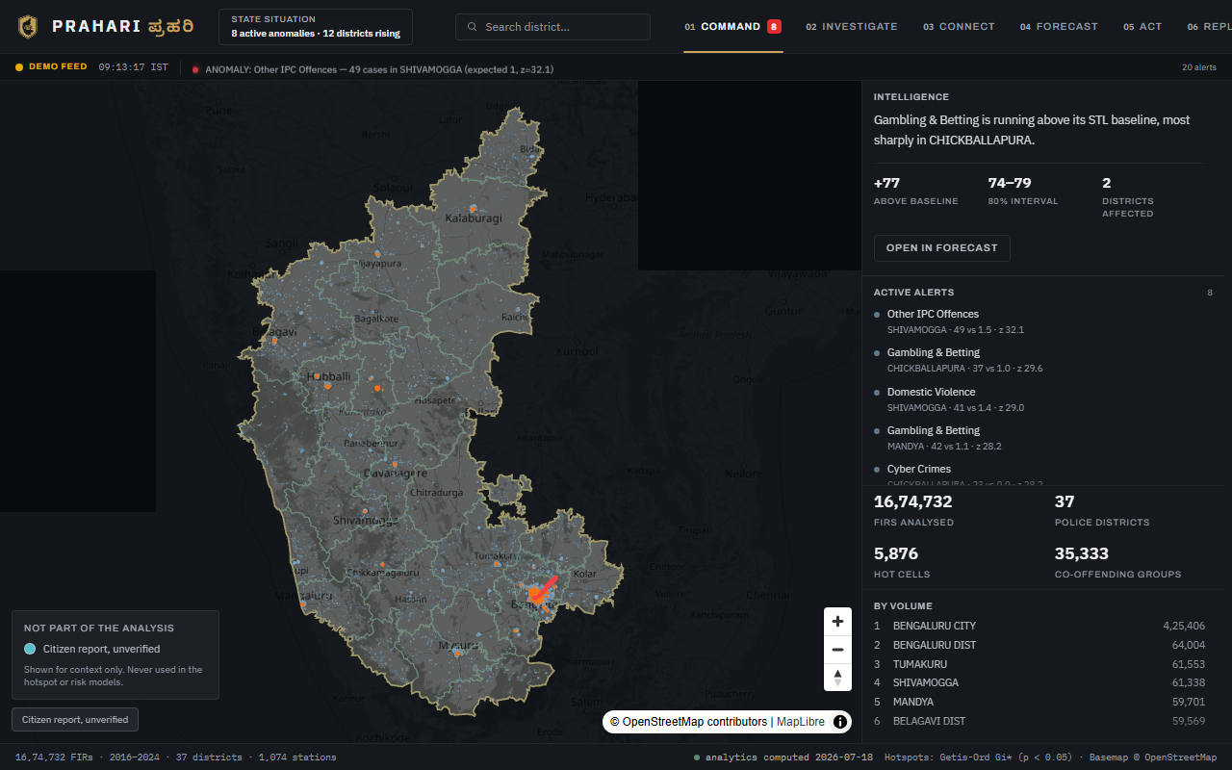
Architecture — why citizen reports are quarantined
The single most important design decision in this round.
THE PROBLEM WITH MIXING THEM
HOW THE SEPARATION IS ENFORCED
FIRs are verified legal records. Citizen reports are unverified, duplicate-prone, spam-prone, and carry a completely different selection bias — who owns a phone, who has signal, who trusts the police.
Feeding them into the Gi* test or the LightGBM model would invalidate the significance results and the calibration that the TRUST tab defends in public.
Separate store, separate module, separate transport. Reports never enter copy_data.py's publish allowlist — the physical boundary between report data and published analytics.
On the map they render as their own layer, in a colour neither palette uses, at a FIXED radius: a hotspot scales with its count because that count is a statistic; a report does not have that weight.
THE TEST WE HOLD OURSELVES TO
Toggling the citizen layer must not move a single number anywhere on screen — not a hot-cell count, not an alert count, not a district total.
If any figure responds to that toggle, the separation is a lie and the TRUST tab's claims become false. This is verified in the browser by capturing every figure on the panel, flipping the layer, and comparing — not assumed.
Labelled "Not part of the analysis", off by default.

Slide 12
Technologies to be used in the solution
Frontend
Analytics & ML
Optimisation
Platform & Tooling
React 19
TypeScript 5
Vite 8
Tailwind CSS v4
MapLibre GL JS
deck.gl
Recharts
vitest
Python 3
pandas / NumPy
libpysal + esda
LightGBM
statsmodels (STL)
SHAP
scikit-learn
networkx + Louvain
OR-Tools
PuLP (ILP)
Greedy heuristic
Coverage verification
GeoPandas
Shapely
Grid indexing
GeoJSON tooling
Zoho Catalyst
Catalyst CLI
Brevo (email OTP)
Git
oxlint
tsc project refs
npm
OpenStreetMap tiles
Why these choices
Significance over density
Pre-compute, then serve
Exact answer, fast path
libpysal / esda give a published, citable Gi* implementation, so a hot cell survives a methodology question rather than resting on a smoothing parameter.
Heavy analysis runs nightly in Python; the console ships static artefacts. No model runs on the request path, so cost and latency stay flat as usage grows.
PuLP solves the deployment ILP exactly and a greedy heuristic serves the UI. Both numbers are shown, so the fast path is verifiable rather than assumed.
Verification gates on every change: tsc project build, production Vite build, 83 passing tests, and zero new oxlint warnings.

Slide 13
Catalyst Services being used in the solution
SERVICE
HOW PRAHARI USES IT
STATUS
Catalyst Hosting
Serves the React console, the public site and every pre-computed analytics artefact as static files
DEPLOYED
Catalyst Functions
Advanced I/O function for the report API — OTP, submit, triage, export and seal endpoints
DESIGNED
Catalyst Data Store
Seven tables: reporters, OTP challenges, reports, events, attachments, audit log, officers
DESIGNED
Catalyst Stratus
Object storage for hotspot GeoJSON surfaces (~84 MB) and citizen report attachments
DESIGNED
Catalyst Cron
Nightly recompute of hotspots, risk surface, anomaly feed and patrol assignments (~22 min)
DESIGNED
Catalyst Auth
Officer and supervisor identity for the triage queue and the sealed-export gate
DESIGNED
Only Catalyst Hosting is live and verifiable by a judge in ten seconds. The report backend is fully specified — table schemas, endpoint contracts, rate limits and the transition validator — and the frontend already runs against that interface through a local adapter, so activating it is an adapter swap rather than a rewrite. We would rather state that plainly than claim a service the deployment does not yet touch.

Slide 14
Estimated implementation cost
Prototype (current)
Catalyst free tier covers hosting, static artefact delivery and every active feature. Analytics run offline. No per-query compute cost.
Rs 0 / month
Nightly Cron execution
One Catalyst Cron job triggers the pipeline recompute (~22 min) each night, at Catalyst standard Cron pricing.
Rs ~500 / month
Data Store storage
Normalised CCTNS tables plus citizen reports and audit rows — roughly 2 GB for the full Karnataka dataset.
Rs ~800 / month
Stratus object storage
GeoJSON hotspot surfaces and model artefacts (~84 MB), plus report attachments capped at 5 MB each.
Rs ~200 / month
Email OTP (Brevo)
Free tier covers 300 transactional emails a day — far more than a district pilot needs for verification codes.
Rs 0 / month
Total at production scale ≈ Rs 1,500 / month
Analytics are pre-computed, so there is no per-officer-request compute charge. Cost stays effectively flat as the number of officers using the console grows.

Slide 15
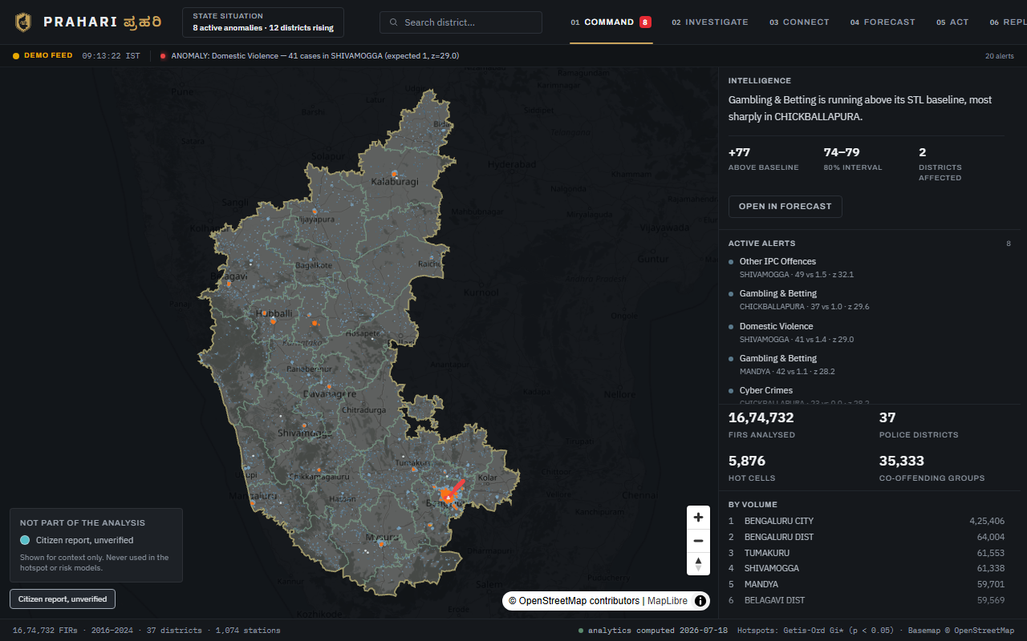
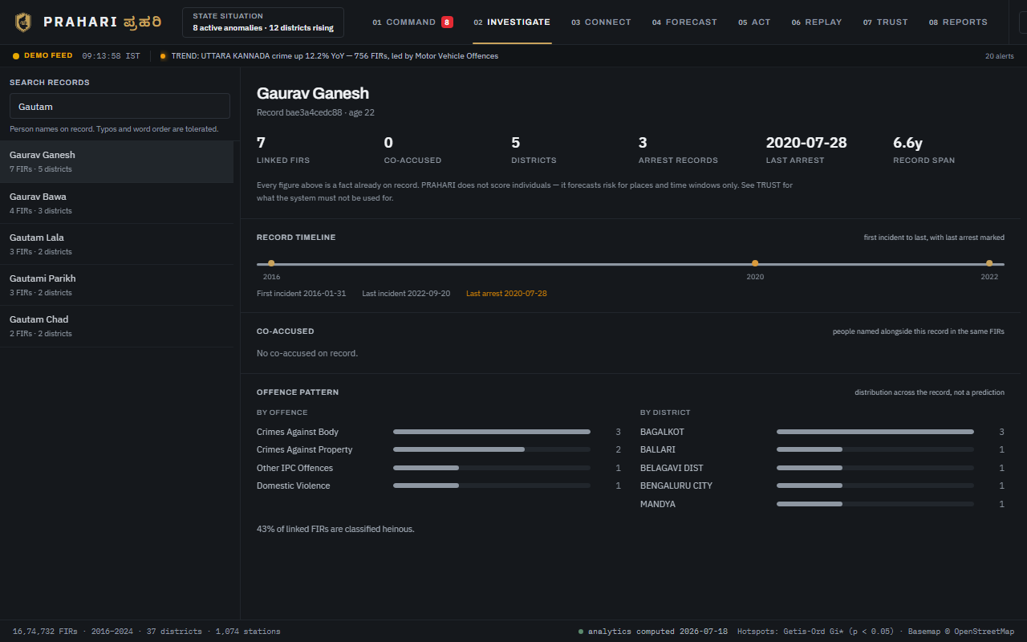
Snapshots of the prototype (1 / 6)
Captured at 1280 x 800 from the running console.
COMMAND — STATE-WIDE OPERATIONAL PICTURE
INVESTIGATE — OFFENDER DOSSIER
Karnataka auto-fitted to a full-height column. The rail carries the STL intelligence headline, eight active alerts, live metrics and the top districts. The headline states the finding; the figures sit beneath it so the claim is checkable.
Fuzzy name search over persons on record. The dossier assembles linked FIRs, arrest records, a first-to-last timeline, co-accused, and the offence pattern by crime type and district — all from existing record.

Slide 16
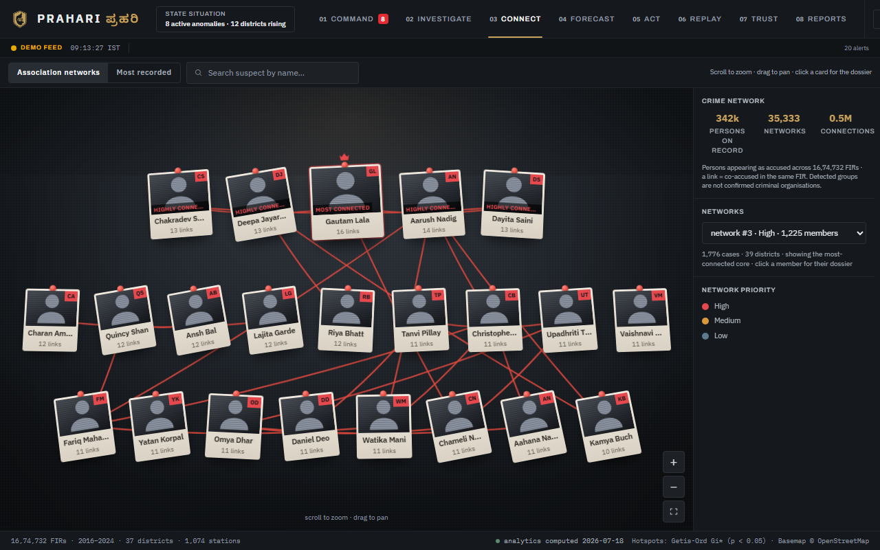
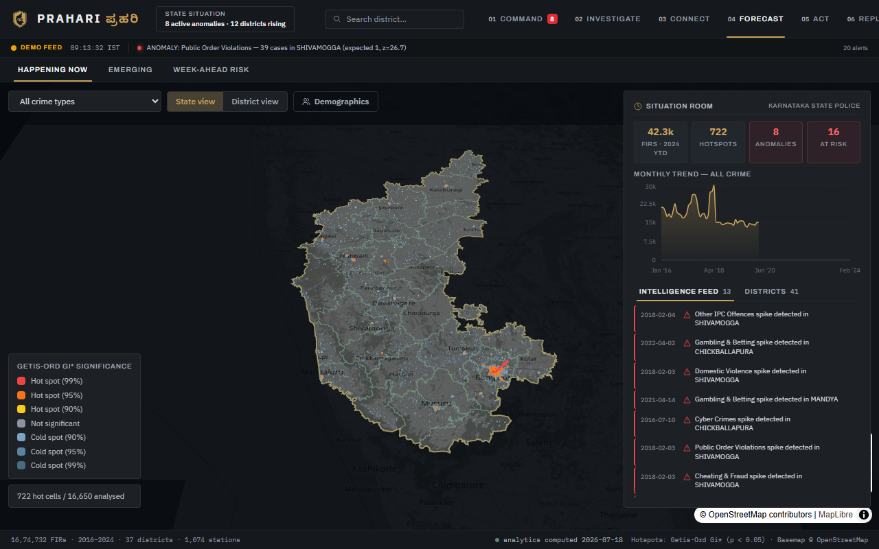
Snapshots of the prototype (2 / 6)
CONNECT — CO-OFFENDING NETWORK
FORECAST — GETIS-ORD GI* HOTSPOTS
341,803 offender nodes and 509,633 co-accusation links, clustered by Louvain into 35,333 communities at modularity 0.978. The most-connected member carries a crown badge; any card opens that person's dossier.
Significance, not density: 722 hot cells out of 16,650 tested at p < 0.05, with three confidence bands each side. Situation room and dated intelligence feed sit alongside the map.

Slide 17
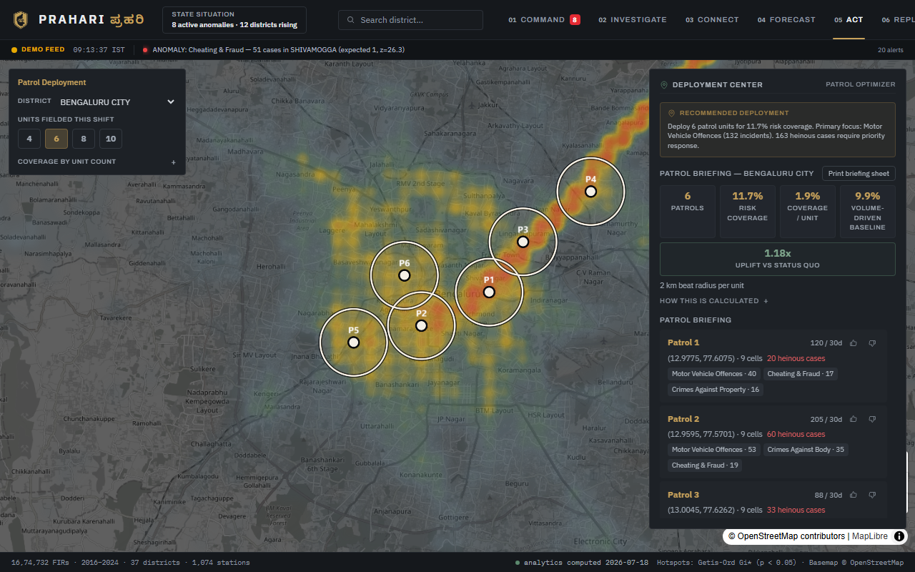
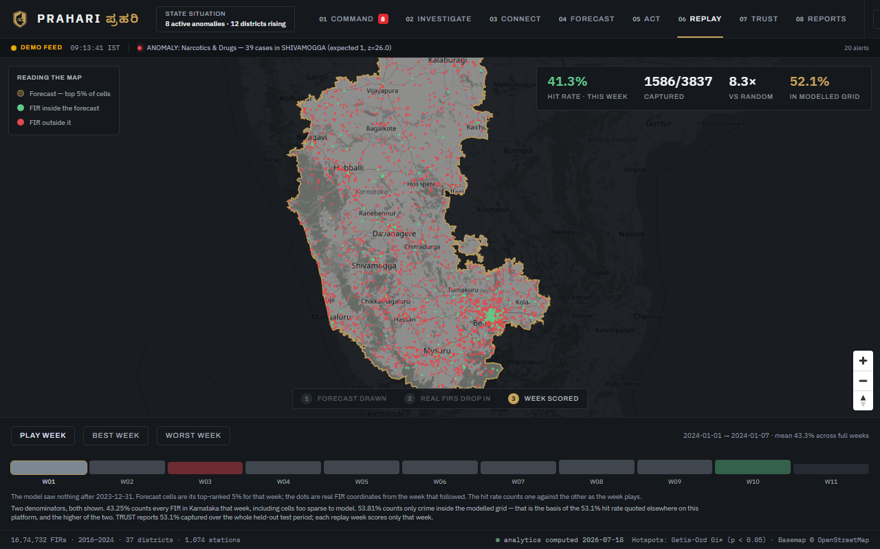
Snapshots of the prototype (3 / 6)
ACT — ILP PATROL DEPLOYMENT
REPLAY — HELD-OUT BACKTEST
Six units placed on the highest-risk reachable clusters at a 2 km beat radius: 11.7% risk coverage against a 9.9% volume-driven baseline. Controls are now one panel; the coverage curve and method note open on demand.
Trained on 2016–2023 only, replayed against 2024 week by week: forecast drawn, real FIRs plotted, week scored. 43.3% mean hit rate over eleven weeks, with the worst week exposed deliberately.

Slide 18
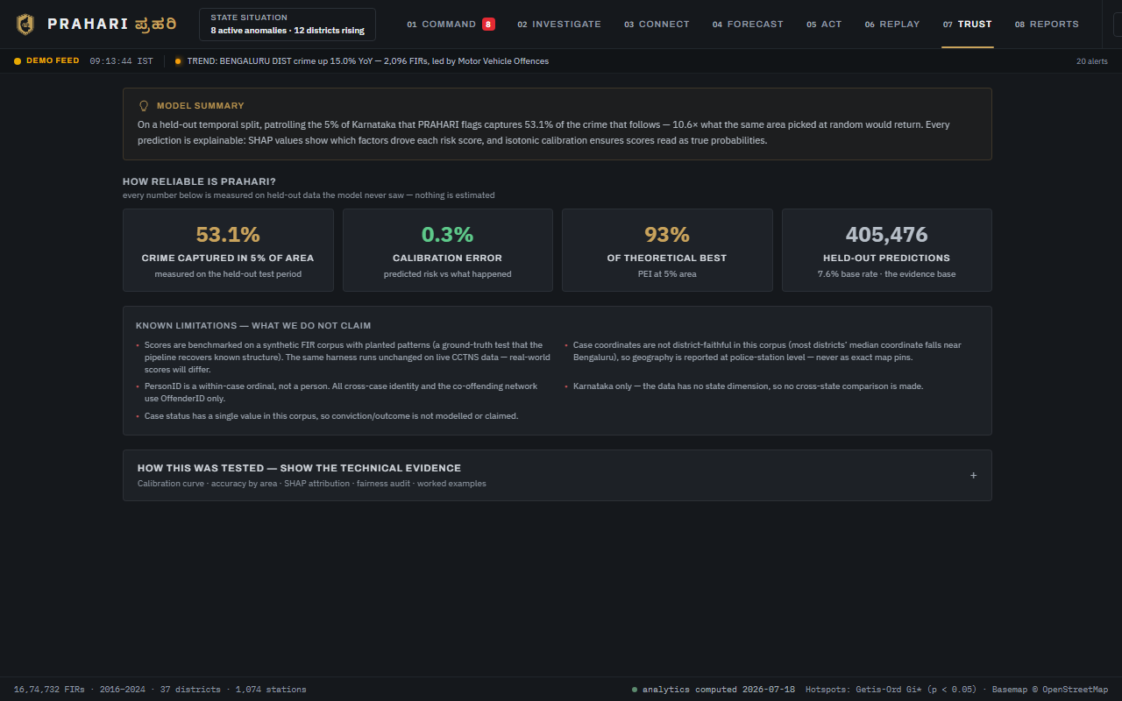
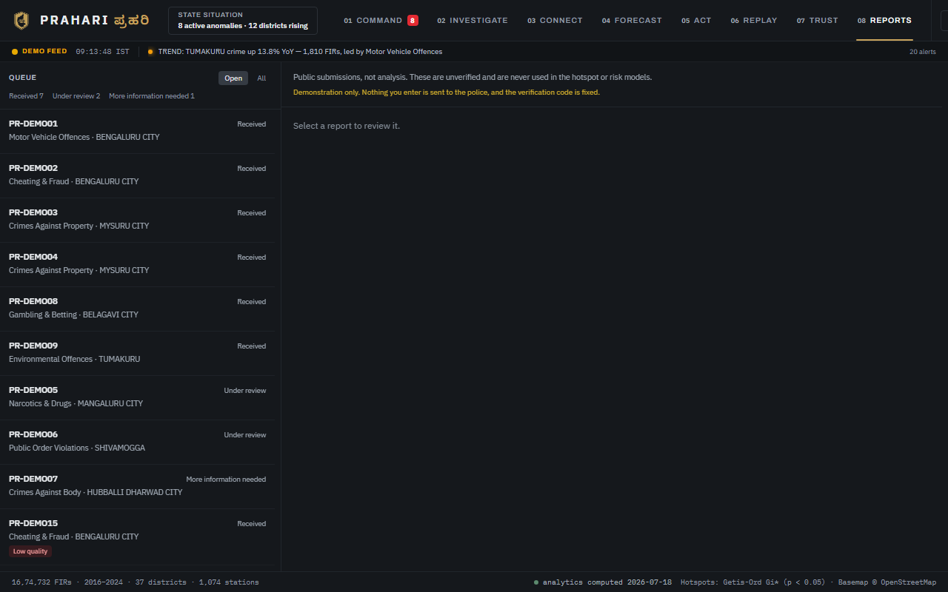
Snapshots of the prototype (4 / 6)
TRUST — TRANSPARENCY AND FAIRNESS
REPORTS — THE OFFICER TRIAGE QUEUE
Isotonic-calibrated reliability curve (0.3% calibration error), SHAP attributions in plain language, a reporting-bias-adjusted fairness audit at Gini 0.183, and a written limitations page.
Citizen submissions with live status counts. Likely duplicates and low-quality reports are flagged and sorted to the bottom — visible, never hidden. The header states plainly that none of this feeds the models.

Slide 19
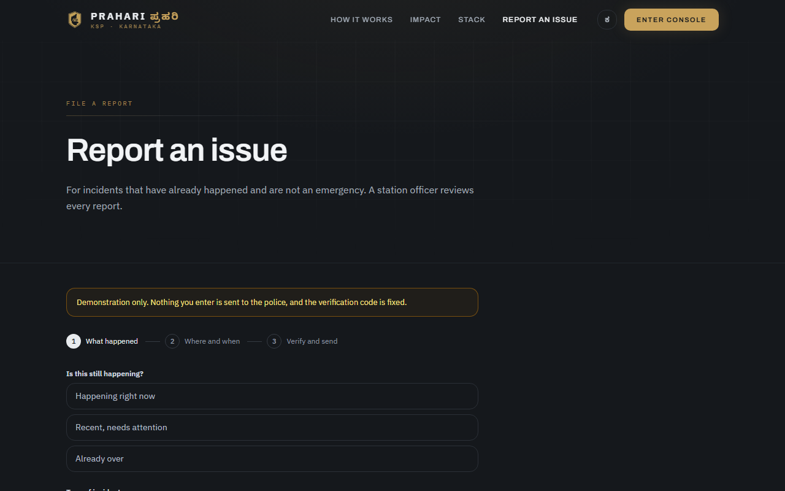
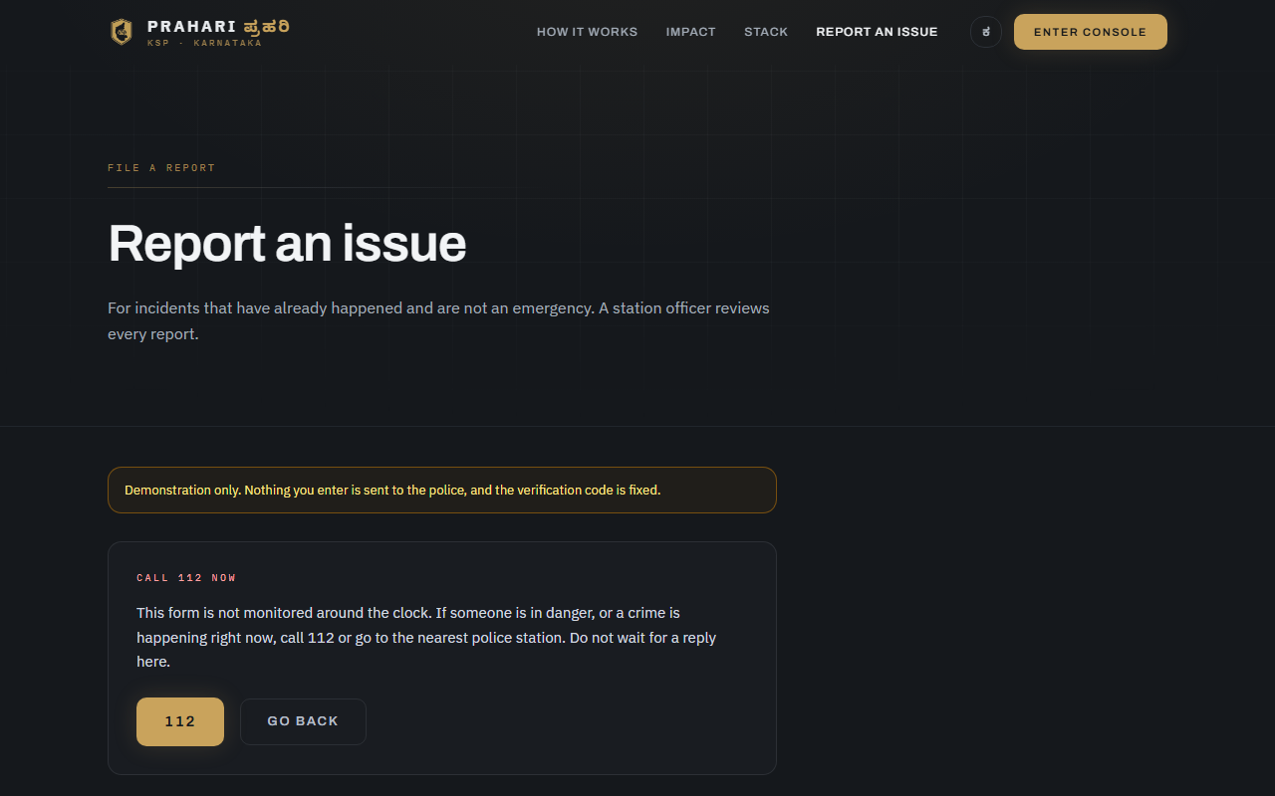
Snapshots of the prototype (5 / 6)
PUBLIC PORTAL — FILING A REPORT
PUBLIC PORTAL — THE EMERGENCY STOP
Three steps in the order a person thinks: what happened, where and when, then who is filing. Verification comes last on purpose — asking for an address before someone has said anything loses reports.
Selecting "happening right now" ends the form and shows 112. A web form nobody is watching at 3 AM must never look like an alternative to calling. The same hard stop applies to legally protected offence categories.

Slide 20
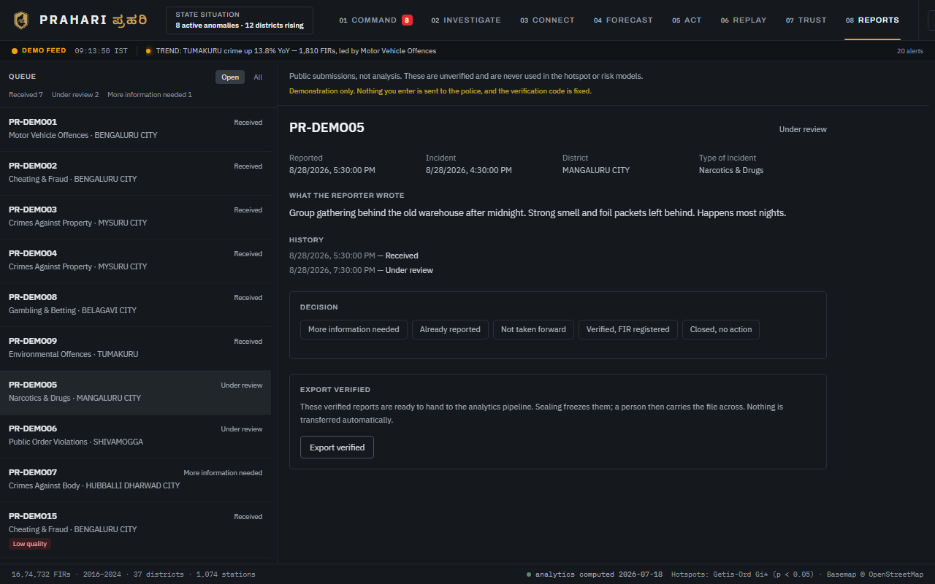
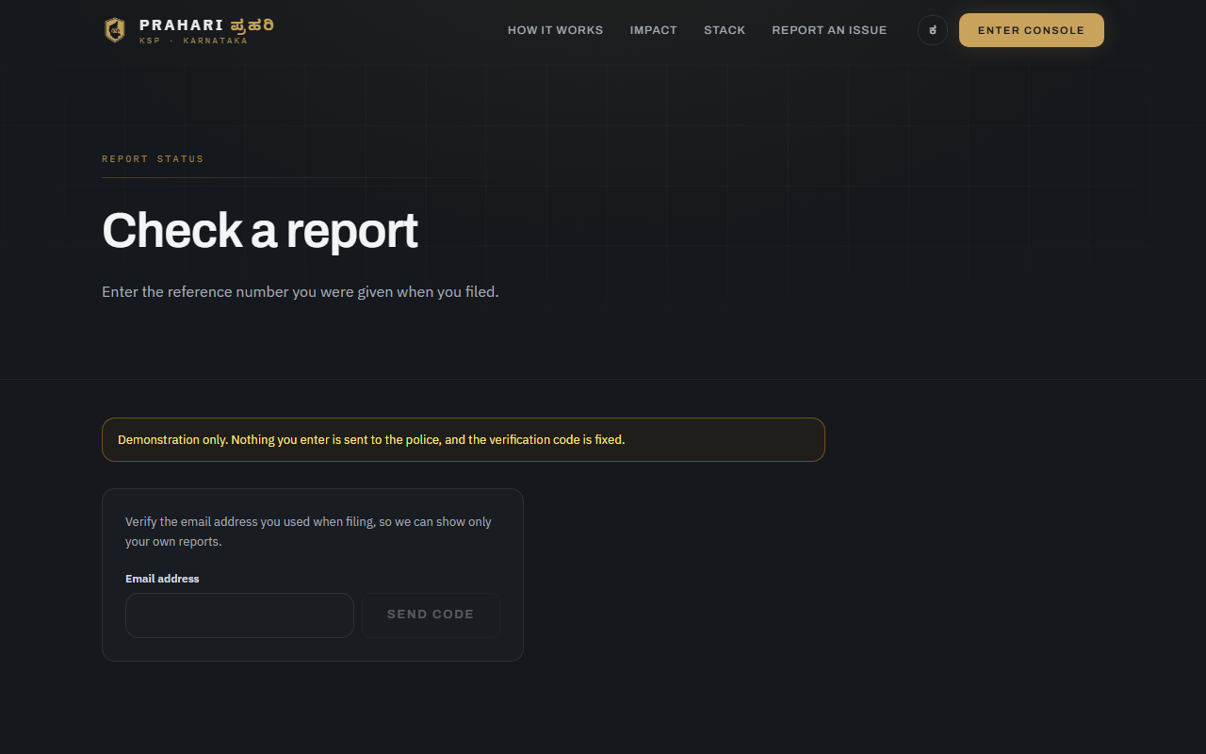
Snapshots of the prototype (6 / 6)
REPORTS — A DECISION, WITH THE LIFECYCLE ENFORCED
PUBLIC PORTAL — TRACKING A REPORT
The panel offers exactly the transitions legal from this state, drawn from one adjacency table that the server validator and a parity test both hold to. Verifying requires a real FIR number.
The reference number returns status, a redacted history, and the ability to answer a request for more information or withdraw within 24 hours. Officer identity and internal notes are never shown.

Slide 21
Prototype performance report / Benchmarking
Every figure below is measured on data held out of training. Nothing is estimated.
10.63
PAI @ top 5%
1.27x
RRI @ top 5%
53.1% of all crime falls inside 5% of the map area
vs a 41.94% status-quo baseline ranked on pre-2024 data only
11.67%
Patrol coverage
+18.2%
Coverage uplift
ILP-optimised against a 9.87% volume-driven status quo
Same unit count, same shift, zero additional cost
11.72%
ILP verification
43.3%
Replay hit rate
Greedy heuristic within 0.05 pts of the exact optimum
Mean across eleven held-out weeks of 2024 data
0.3%
Calibration error
0.183
Fairness Gini
Isotonic calibration over 405,476 held-out predictions
Low disparity; 11 districts flagged for reporting-bias review
Coverage uplift is stated against the volume-driven status quo — patrols at the highest-volume stations — never against random placement. The random comparison flatters and does not survive a follow-up question.

Slide 22
Operational impact — what +18.2% actually means
Same six patrol units. Same shift. Same fuel budget.
STATUS QUO
PRAHARI
9.87%
11.67%
VS
of predicted crime inside a patrolled radius
units placed at the highest-volume stations
of predicted crime inside a patrolled radius
units placed by ILP risk optimisation
+18.2% coverage uplift · ILP-verified at 11.72% · greedy within 0.05 pts · zero additional spend
Scaled across 37 districts with nightly recomputation, that is a materially different deployment posture for no new spending.

Slide 23
The report lifecycle — one table, enforced everywhere
The triage buttons, the server validator and a parity test all read the same adjacency table. They cannot drift.
SUBMITTED
Filed by the public. Awaiting first look.
TRIAGE
An officer has taken it on.
NEEDS_INFO
Sent back for detail. Auto-rejects after 7 days of silence.
DUPLICATE
Same incident as an existing report. Supervisor-only to reopen.
REJECTED
Not taken forward, with a stated reason code.
VERIFIED_FIR
Confirmed and registered with a real FIR number.
CLOSED_NO_ACTION
Genuine but not a police matter.
WITHDRAWN
Retracted by the reporter within 24 hours. Terminal.
Once a verified report is sealed into an export batch it cannot be walked back — the pipeline may already have consumed it. That single rule is what keeps the published statistics reproducible.

Slide 24
Abuse, duplicates and moderation
Proportionate to a prototype, and deliberately advisory: the machine proposes, a human disposes.
DUPLICATE DETECTION
SPAM SCORING
Candidates limited to the same 1 km cell or one of its eight neighbours — pure arithmetic on the lattice, no geo query
Incident time within 48 hours, same crime category
Text similarity by Jaccard over grapheme trigrams, not word tokens: a whitespace tokeniser looks fine in English and silently fails in Kannada
Never auto-merges. It flags a likely duplicate for the officer to confirm
Additive signals: burst from a new account, very short text, long runs of one character, no letters in either script, poor prior history, location outside Karnataka, links, multiple phone numbers
A flagged report sorts to the bottom of the queue and is labelled — it is never hidden or deleted
An officer can always disagree with the score
RATE LIMITS
Per contact: one code a minute, five an hour. Per reporter: three reports an hour, five a day. Per IP: twenty codes an hour, thirty submissions. Per officer: three hundred transitions an hour, which is a work queue, not a limit.
WHAT WE DO NOT DO — STATED RATHER THAN HOPED NOBODY ASKS
No malware scanning on attachments, no image-content moderation, no CSAM detection. Attachments are images only, capped at 5 MB and three per report, visible to officers through short-lived links and never through a public URL. EXIF location is stripped before any officer view, because a photo's embedded GPS can contradict the pinned location and expose where the reporter actually stood.

Slide 25
Provide links to your:
GitHub Public Repository
Full source: Python analytics pipeline, React console and public portal, and the BRD / PRD architecture documents.
github.com/Nikethan10/KSP_datathon
Demo Video Link (3 minutes)
Walkthrough of the eight console tabs and the citizen reporting portal.
[ unlisted link — to be added ]
Deployed Link
Live prototype on Zoho Catalyst Hosting. No login required — the console opens straight into COMMAND.
https://prahari-60076064719.development.catalystserverless.in/app/
Catalyst Stack Page
Service-by-service table that verifies the Catalyst integration claims made on this deck.
https://prahari-60076064719.development.catalystserverless.in/app/#/stack

Slide 26
Additional details — what changed since Round 1
The console went from four tabs to eight, gained a public front door, and every number a judge can see now has a stated statistical basis.
COMMAND tab
New. State-wide picture with a live intelligence feed, an STL-driven headline and clickable district cards.
INVESTIGATE tab
New. Offender dossier search with fuzzy matching, record timeline, co-accused links and offence-pattern breakdown.
CONNECT tab
New. Co-offending network over 342k persons with priority ranking and click-through to dossiers.
REPLAY tab
New. Week-by-week backtesting against held-out 2024 data, with the worst week shown deliberately.
REPORTS tab + portal
New. A public reporting portal and its officer triage queue, with the analytics boundary enforced structurally.
Bilingual Kannada
Completed. All eight tabs and the public portal translate — including generated narratives, not just static labels.
Honest uncertainty
Invented confidence percentages removed. Departures now carry a real 80% prediction interval from STL residual dispersion.
Density pass
Landing page no longer renders the Impact and Stack pages inline; method notes moved behind disclosure across the console.

Slide 27
Future development
INT-01
Activate the Catalyst report backend
Stand up the Advanced I/O function, Data Store tables and Stratus bucket, then swap the frontend adapter. The interface, schema and endpoint contracts are already written; this is configuration and deployment, not design.
FR-19
Ask Prahari — natural-language querying
Officers query the analytics in plain Kannada or English. An LLM layer reads cached artefacts only — no raw case data is exposed to the model.
ING-01
Live CCTNS ingestion
Replace the static FIR export with a live pull from the CCTNS API, triggering incremental hotspot and risk recomputes as cases are registered.
RET-01
Officer feedback retraining loop
Patrol briefing feedback — already logged from the thumbs control — feeds model retraining, closing the human-in-the-loop cycle specified in the BRD.
OPT-01
Multi-shift scheduling
Extend the ILP to multiple shifts and heterogeneous unit types (motorcycle, vehicle, foot patrol) with different coverage radii.
SEC-01
Access control and audit
Role-based access for the dossier surfaces, an audit entry on every identity reveal, and a retention policy for rejected and withdrawn reports.

Slide 28
Responsible AI and known limitations
Responsible by design
What we do not claim
EXPLAINABILITY
GEOGRAPHY
SHAP attributions on every prediction and a calibration diagram showing whether a 70% score means 70%.
Case coordinates are station-level, not exact — the most granular level this data honestly supports.
REPORTING BIAS
IDENTITY
More FIRs can mean more crime or more policing. The audit corrects for known differences before flagging a district.
PersonID is a within-case ordinal, not a cross-case identity. All offender linkage uses OffenderID.
PRIVACY
TIMESTAMPS
Identifiers hashed at ingest. No personal data leaves the report store for the analytics pipeline.
The registration date carries no time component, so sub-daily temporal patterns cannot be modelled.
HUMAN OVERSIGHT
BENCHMARKS
Every deployment and every triage decision is a proposal an officer can accept, edit or reject. The algorithm advises.
Scores are measured on a synthetic FIR corpus with planted patterns. The same harness runs unchanged on live CCTNS data; real-world scores will differ.
THE LINE WE DO NOT CROSS
PRAHARI forecasts risk for areas and time windows, and analyses networks of people already on record. It does not predict crime for named individuals. There is no pre-crime score for a person anywhere in this system. Sexual offences, crimes against children and kidnapping cannot be filed through the public portal at all — those carry statutory identity protections and belong in a station, not a queue.

Slide 29
Team contribution
Katir
BRD and PRD architecture documents. The ACT patrol optimiser and the TRUST layer (SHAP plus fairness audit). Zoho Catalyst deployment and the stack verification page.
TEAM LEAD & SYSTEM DESIGN
Nikethan
Frontend architecture in React 19, TypeScript and Vite 8. All eight tab interfaces, the public reporting portal, MapLibre GL and deck.gl integration, and the bilingual i18n system.
FULL-STACK DEVELOPMENT LEAD
Hari Nair
LightGBM risk model and feature engineering (near-repeat windows, temporal lags). STL anomaly detection, model evaluation and the benchmark harness.
ANALYTICS PIPELINE
Dhikshitha
Co-offending network construction, Louvain community detection, gang-disruption simulation and networkx integration. Socio-economic overlay.
NETWORK ANALYSIS
Nihan
CCTNS schema normalisation across eight tables, libpysal and esda Gi* spatial analysis, GeoJSON optimisation pipeline and district boundary processing.
DATA ENGINEERING
Development ran largely on a shared machine, so git history shows a single committer for much of the codebase. Every commit lists the whole team as co-authors, and the breakdown above reflects actual ownership of each layer.

Slide 30
Judge guide — try it in 90 seconds
Open the deployed link. No login, no setup, no seed data required.
01
COMMAND
Read the intelligence headline and the eight active alerts, then click any district for its detail card.
02
INVESTIGATE
Search a name such as "Gautam" and open any result for a full dossier assembled from record.
03
CONNECT
Browse the co-offending network; click any card to jump to that person's dossier.
04
FORECAST
View the Gi* hotspots, then switch to the Emerging and Week-ahead Risk lenses.
05
ACT
Change the district and unit count, open "How this is calculated", then hit Print.
06
REPLAY
Play week W01, then use Best Week and Worst Week to see both ends of the range.
07
TRUST
Expand the technical evidence: calibration curve, SHAP attributions, fairness audit.
08
REPORT
On the public site, file a report. Try "happening right now" to see the emergency stop.
09
REPORTS
Back in the console, triage what you filed. Verify it, then seal the export batch.
10
ಕ
Toggle the language button for a full Kannada interface, on every surface above.
https://prahari-60076064719.development.catalystserverless.in/app/

Slide 31
The separation, on screen
The strongest claim in this system is that citizen reports never touch the analytics. Here is what that looks like.
Its own layer
A separate deck.gl layer in a hue neither the significance nor the lifecycle palette uses. It reads as an annotation, not a measurement.
Fixed radius
Hotspots scale by log of their count, because that count is a statistic. Scaling reports the same way would lend them a weight they do not have.
No statistic in the tooltip
A hotspot tooltip ends with Gi* z and p. This one begins with "Unverified citizen report" and carries no significance value at all.
Off by default
The officer opts in, and opting in changes only what is drawn.
The test we hold ourselves to: toggling this layer must not move a single number on the screen. Hot-cell count, alert count, district totals — all unchanged. Verified.

Slide 32
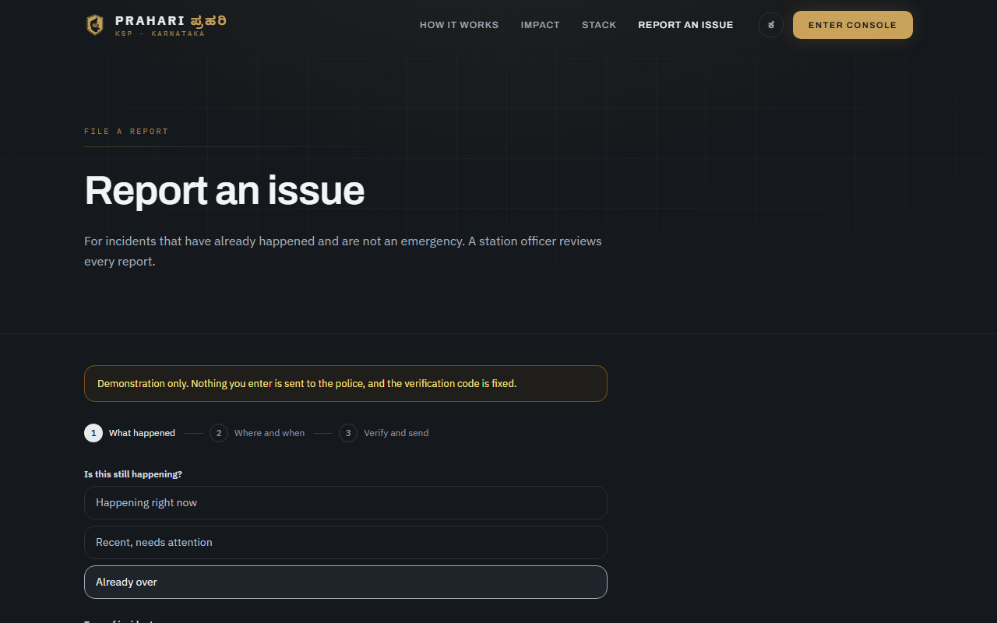
The citizen portal, step by step
Three steps in the order a person actually thinks: what happened, where and when, then who is filing it.
STEP 1 — WHAT HAPPENED
SEVERITY CHOSEN — THE FLOW CONTINUES
Urgency first, because that is the question that can end the flow. Then the category, drawn from the same twenty the pipeline uses, so a verified report becomes an FIR with no mapping table in between.
Choosing anything other than "happening right now" lets the form proceed. Verification is asked for last: requiring an email address before someone has said anything is how you lose the report you most wanted.

Slide 33
The API, as built
One Advanced I/O function on Catalyst. Basic I/O cannot read headers, which makes bearer tokens impossible — so Advanced I/O, versioned under /v1 from the first commit.
Citizen
otp/request · otp/verify · POST reports · reports/mine · reports/{ref} · reply · withdraw
Officer
queue (paginated) · reports/{ref} · transition · stats — every read of a citizen description writes an audit row
Supervisor
export/verified (read-only, mutates nothing) · export/seal (stamps exported_at and freezes the row)
Shared
public/reports/layer — aggregated to the 1 km cell, no free text, no reporter, officer-only by default
300
20
0
/v1
ZCQL ROW CAP
ZCQL COLUMN CAP
TRANSACTIONS AVAILABLE
VERSIONED FROM DAY ONE
ZCQL truncates silently at 300, so every list endpoint paginates; with no transactions, every write is idempotent on a natural key.

Slide 34
What is deliberately switched off
Where the honest answer is "not yet verified", the deployment is closed rather than open.
ALLOW_UNAUTH_OFFICER
Defaults to false. Whether Catalyst Auth reaches an Advanced I/O function is unverified, so an unconfigured deployment refuses officer traffic rather than trusting a header.
PUBLIC_REPORT_LAYER
Defaults to false. A public map of unverified allegations is a reputational and legal hazard even aggregated; the aggregation makes it defensible, not wise.
OTP_DEMO_MODE
With no Brevo key the OTP degrades to a visible fixed code — never to a silent send-nothing that looks like success.
Stratus attachments
Designed, not built. The endpoints return an error rather than pretending to succeed, because a silent no-op would look like a working upload and lose evidence.
Email OTP rather than SMS: India’s DLT regime requires entity registration and template approval before a transactional SMS delivers, and Catalyst has no SMS service. contact_type keeps the channel swappable.

Slide 35


