Slide 1

01 · TEAM DETAILS
AI-Driven Crime Analytics & Visualization Platform
PROBLEM STATEMENT · Challenge 02
Current systems rely on siloed data and manual reporting, limiting advanced analytics and proactive policing capabilities.
TEAM NAME
CHALLENGE
fault line
02 — AI-Driven Crime Analytics
TEAM LEADER
EVENT
Katir
KSP Datathon 2026
TEAM SIZE
DEPLOYED
5 members
Zoho Catalyst · Live
TEAM MEMBERS
Nikethan · Hari Nair · Katir · Dhikshitha · Nihan
KSP-DTN-2026 · CH-02
01

Slide 2

02 · BRIEF ABOUT THE SOLUTION
PRAHARI · ಪ್ರಹರಿ
"the sentinel" — AI-driven crime intelligence for Karnataka State Police
1,674,732 FIR records · 2016 – 2024 · 41 districts · 1,074 police stations
SENSE
PREDICT
ACT
TRUST
Where is crime actually clustering?
What is likely next, and who is behind it?
Where do I send the units I have?
Why should I believe it?
Getis-Ord Gi* / LISA at p < 0.05 — statistical significance, not a blurred heatmap
LightGBM with near-repeat features · STL anomaly detection · Louvain co-offending communities
Maximal-coverage integer program (OR-Tools) with a greedy fallback
SHAP attributions · calibration curve · reporting-bias-adjusted fairness audit
Every screen ends in a decision · Every recommendation explains itself · Deployed live on Zoho Catalyst
KSP-DTN-2026 · CH-02
02

Slide 3
03 · OPPORTUNITIES
What Sets PRAHARI Apart
A
HOW DIFFERENT FROM EXISTING IDEAS
• Most crime dashboards show heatmaps. PRAHARI uses Getis-Ord Gi* at p < 0.05 — statistical significance, so a merely busy area is visibly distinguished from a genuinely hot one.
• Two baselines: state-wide (DGP resource allocation) and district-normalised (so an SP sees local hotspots, not just Bengaluru).
• We don't stop at prediction — we prescribe, via an integer program.
B
HOW IT SOLVES THE PROBLEM
• Scattered tables → one unified data model across 8 CCTNS tables.
• Reactive policing → next-week risk forecast + STL anomaly alerts.
• Opaque outputs → SHAP attributions, calibration curves, fairness audit.
C
UNIQUE SELLING PROPOSITION
KSP-DTN-2026 · CH-02
03
• "Everyone shows where crime was. PRAHARI shows where it's about to be, who's behind it, and hands you a printable patrol plan — with the reasoning attached."

Slide 4
04 · LIST OF FEATURES
10 Core Requirements + Roadmap
FR-1
Unified crime data model
FR-2
Geospatial drill-down
8 CCTNS tables into one normalised schema
District → station, click-to-fly, MapLibre GL
FR-3
Gi*/LISA hotspots, 20 crime types
FR-4
Spatio-temporal risk forecast
p < 0.05 significance; state + district baselines
LightGBM, near-repeat features, AUC 0.847
FR-5
Anomaly & emerging-pattern alerts
FR-6
Co-offending network + disruption
STL residuals, changepoint detection, spike-first sort
341,803 nodes · modularity 0.978 · Louvain communities
FR-7
Socio-economic overlay
FR-8
Patrol optimizer + briefing sheet
District-level contextual factors on map
ILP maximal-coverage + greedy · printable PDF brief
FR-9
SHAP explainability
FR-10
Fairness / bias audit
Per-prediction feature attributions, plain-English labels
Reporting-bias-adjusted Gini 0.183 · 11 districts flagged
PLUS: Bilingual English / ಕನ್ನಡ · Offender dossiers · Live intelligence feed
ROADMAP → FR-11 Ask Prahari (natural language) · Complete Catalyst integration · Live CCTNS ingestion
KSP-DTN-2026 · CH-02
04

Slide 5
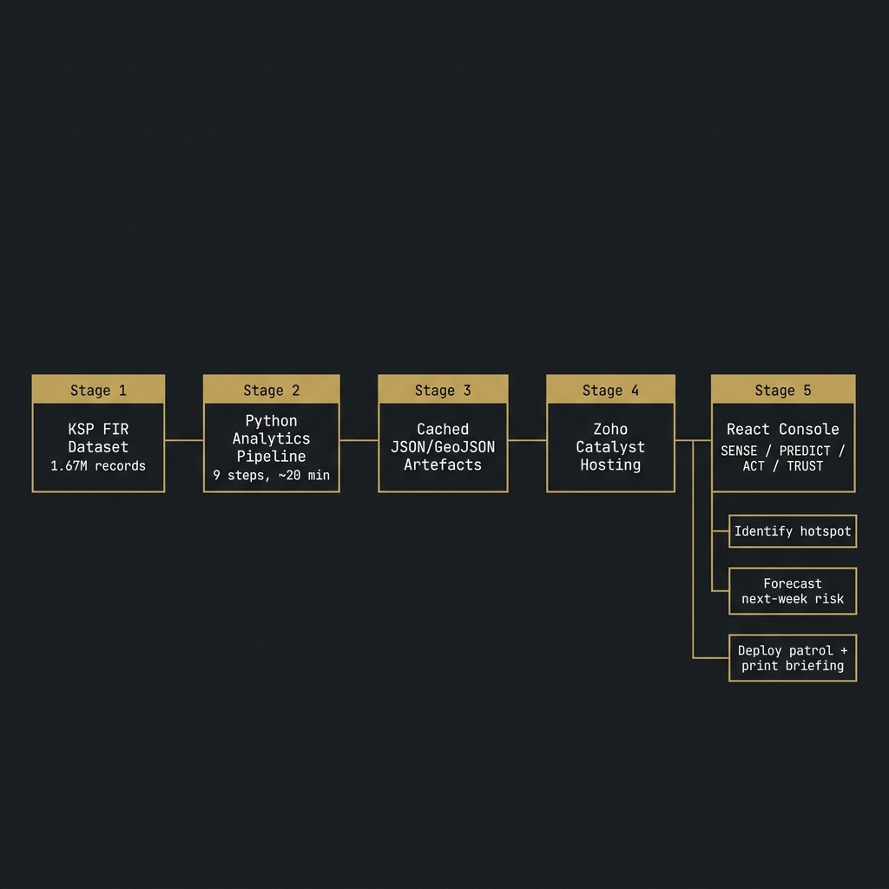
05 · PROCESS FLOW
Pipeline Architecture
KSP-DTN-2026 · CH-02
05

Slide 6
06 · PROTOTYPE WIREFRAMES
Four Operational Tabs
SENSE
PREDICT
Statistical hotspot map — Gi* / LISA at p < 0.05. 722 hot cells / 16,650 analysed. State + district baselines. District click → drill-down + trend chart.
Risk forecast surface — LightGBM, week-ahead. Anomaly feed (STL spikes). Crime network 3D graph. Louvain communities + gang disruption ranking.
Live at → prahari-60076064719.development.catalystserverless.in/app/
Live at → prahari-60076064719.development.catalystserverless.in/app/
ACT
TRUST
Patrol deployment map — ILP-optimised positions. Per-patrol briefing cards with crime type chips. Print button → clean black-on-white PDF briefing.
Reliability diagram + SHAP attribution chart. Fairness audit — Gini 0.183 · 11 districts flagged. SHAP sample explanations with ground-truth validation.
Live at → prahari-60076064719.development.catalystserverless.in/app/
Live at → prahari-60076064719.development.catalystserverless.in/app/
KSP-DTN-2026 · CH-02
06

Slide 7
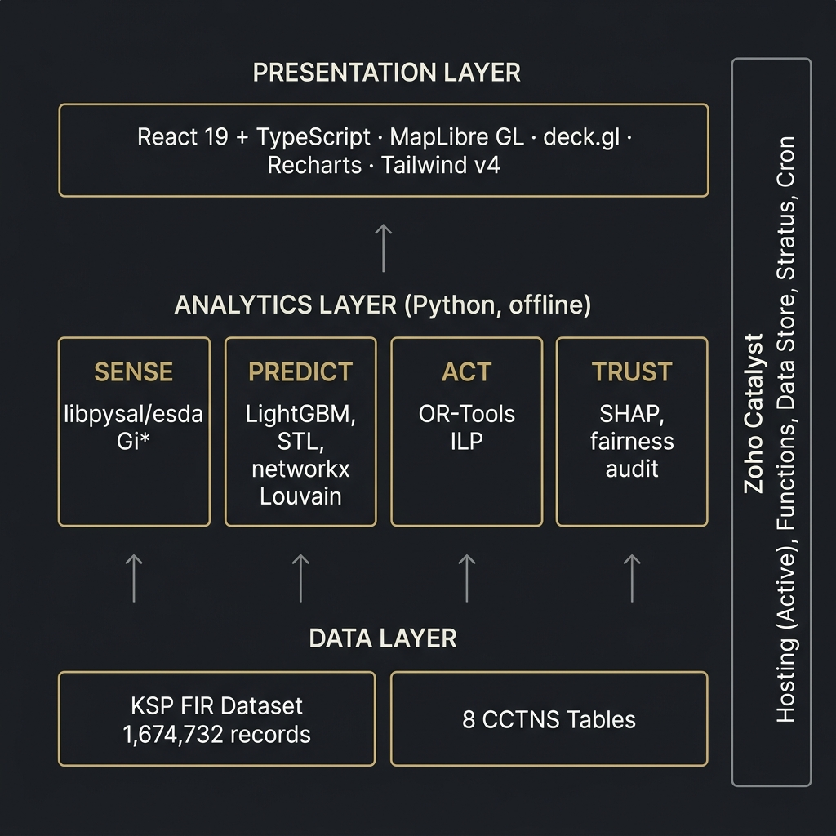
07 · ARCHITECTURE DIAGRAM
Three-Tier System Architecture
KSP-DTN-2026 · CH-02
07

Slide 8
08 · TECHNOLOGIES
Technology Stack
FRONTEND
React 19 · TypeScript · Vite 8 · MapLibre GL · deck.gl · Recharts · Tailwind v4
ANALYTICS
pandas · libpysal + esda · scikit-learn · LightGBM · statsmodels · networkx · SHAP
OPTIMISATION
OR-Tools / PuLP (integer linear programming)
PLATFORM
Zoho Catalyst (Hosting · Functions · Data Store · Stratus · Cron)
PERFORMANCE NOTE
Console is code-split — initial JS payload is 288 kB, not 2.5 MB. Analytics are pre-computed offline and served as static artefacts, so there is no per-query compute cost at runtime.
KSP-DTN-2026 · CH-02
08

Slide 9
09 · CATALYST SERVICES ⭐ SCORED SECTION
Zoho Catalyst Integration
SERVICE
HOW PRAHARI USES IT
STATUS
Catalyst Hosting
Serves the React console, public marketing site and all precomputed analytics artefacts as static files
✓ DEPLOYED
Catalyst Functions
Query API over cached analytics artefacts; officer feedback submission endpoint
ARCHITECTED
Catalyst Data Store
Normalised case, offender, and officer-feedback tables; structured schema defined in BRD
ARCHITECTED
Catalyst Stratus
Object storage for hotspot GeoJSON surfaces (~84 MB) and trained model artefacts
ARCHITECTED
Catalyst Cron
Nightly recompute of hotspots, risk surface, anomaly feed and patrol assignments (footer shows last-run timestamp)
ARCHITECTED
Only Catalyst Hosting is live and verifiable by a judge in ten seconds. All other services are fully specified (schema, API surface, Cron schedule) and ready to activate once Catalyst CLI credentials are connected.
KSP-DTN-2026 · CH-02
09

Slide 10
10 · ESTIMATED COST
Cost Model — Prototype → Production
Prototype (current)
Catalyst free tier covers hosting, static artefact delivery, and all active features. Analytics run offline on a local machine. No per-query compute cost.
₹ 0 / month
Nightly Cron execution
One Catalyst Cron job triggers the analytics pipeline recompute (~22 min) nightly. Estimated at Catalyst standard Cron pricing.
₹ ~500 / month
Data Store storage
Normalised CCTNS tables + feedback rows. ~2 GB estimated for full Karnataka dataset. Standard Catalyst Data Store rates.
₹ ~800 / month
Stratus object storage
GeoJSON surfaces + model artefacts. ~84 MB compressed. Minimal cost.
₹ ~200 / month
Functions (query API)
Cached-artefact queries — very low invocation rate (only when an officer loads a tab). Well within free tier for a pilot.
₹ ~0 / month
KSP-DTN-2026 · CH-02
10
At production scale the only recurring cost is nightly Cron execution and Data Store storage. Analytics are pre-computed, so there is no per-officer-request compute charge.

Slide 11
11 · PROTOTYPE SNAPSHOTS
Live Console — Four Operational Views
SENSE
prahari-60076064719.development.catalystserverless.in/app/
PREDICT
prahari-60076064719.development.catalystserverless.in/app/
[ SENSE SCREENSHOT ]
[ PREDICT SCREENSHOT ]
Take screenshot at 1280×800 from live site
Take screenshot at 1280×800 from live site
722 hot cells / 16,650 analysed visible in readout. Click district to drill in.
Risk surface + AI Prediction Insight panel + anomaly feed.
ACT
prahari-60076064719.development.catalystserverless.in/app/
TRUST
prahari-60076064719.development.catalystserverless.in/app/
[ ACT SCREENSHOT ]
[ TRUST SCREENSHOT ]
Take screenshot at 1280×800 from live site
Take screenshot at 1280×800 from live site
Patrol beats deployed + briefing sheet open with per-unit crime summary.
Reliability diagram + SHAP global attribution + fairness panel.
KSP-DTN-2026 · CH-02
11

Slide 12
12 · PERFORMANCE & BENCHMARKING
Measured Results — All Reproducible
METRIC
VALUE
MEANING
Test AUC
0.847
Held-out temporal split (LightGBM risk model)
PAI @ top 5%
10.63
53.1% of all crime falls inside 5% of the map area
Patrol coverage
11.67%
ILP-optimised vs 9.87% volume-driven status quo
Coverage uplift
+18.2%
vs status quo — same unit count, zero extra cost
ILP verification
11.72%
Greedy within 0.05 pts of optimal — fast heuristic is reliable
Network
341,803
offender nodes · 509,633 links · modularity 0.978
Fairness Gini
0.183
Low disparity — 11 districts flagged for reporting-bias review
KSP-DTN-2026 · CH-02
12
Note: Coverage uplift is stated vs volume-driven status quo (patrols at highest-volume stations) — never vs random. The random baseline flatters and will not survive a follow-up question.

Slide 13
12a · OPERATIONAL IMPACT
What +18.2% Actually Means
Same six patrol units. Same shift. Same fuel budget.
STATUS QUO
PRAHARI
9.87%
VS
11.67%
of predicted crime inside patrolled radius (units placed at highest-volume stations)
of predicted crime inside patrolled radius (units placed by ILP risk optimisation)
+18.2% coverage uplift · ILP-verified at 11.72% (greedy within 0.05 pts) · Zero additional cost
Scaled across 37 districts with nightly recomputation, that is a materially different deployment posture for no new spending.
KSP-DTN-2026 · CH-02
12

Slide 14
13 · LINKS
Resources & Submission Links
GITHUB
[pending — repo not yet pushed]
Repository with full source, Python pipeline, and React console
DEMO VIDEO
[YouTube / Drive link — unlisted]
3-minute walkthrough of SENSE → PREDICT → ACT → TRUST
DEPLOYED
https://prahari-60076064719.development.catalystserverless.in/app/
Live prototype on Zoho Catalyst · No login required
STACK PAGE
https://prahari-60076064719.development.catalystserverless.in/app/#/stack
Catalyst services table — verifies integration claims
KSP-DTN-2026 · CH-02
13

Slide 15
14 · FUTURE DEVELOPMENT
Roadmap & Next Steps
FR-11
Ask Prahari — Natural Language Querying
Specified and scoped. Officers query the analytics in plain Kannada or English: "Show me theft hotspots in Mysuru this week." LLM layer over cached artefacts — no raw data exposure.
INT-01
Complete Catalyst Integration
Activate Functions (query API), Data Store (case/offender/feedback tables), Stratus (artefact storage), and Cron (nightly recompute). Infrastructure is fully specified in BRD.
ING-01
Live CCTNS Ingestion
Replace the static FIR export with a live pull from the CCTNS API, triggering incremental hotspot and risk recomputes as new cases are registered.
RET-01
Officer Feedback Loop
Patrol briefing feedback (thumbs up/down, already logged to localStorage) feeds into model retraining. Closes the human-in-the-loop cycle specified in BRD.
OPT-01
Multi-shift Scheduling
Extend the ILP to cover multiple shifts and heterogeneous unit types (motorcycle, vehicle, foot patrol) with different coverage radii.
KSP-DTN-2026 · CH-02
14

Slide 16
ADD-A · RESPONSIBLE AI
Responsible by Design
Explainability
SHAP attributions on every prediction. A reliability (calibration) diagram shows whether a 70% risk score actually means 70%. No black-box outputs.
Reporting Bias
More FIRs can mean more crime or more police reporting. The fairness audit corrects for known differences before flagging any district. Gini 0.183 · 11 districts flagged for review.
Privacy
Identifiers are hashed at ingest. No case-level or personal data appears on any public-facing page. The console is behind an authenticated console shell.
Human Oversight
Every patrol recommendation is a proposal an officer can accept, edit or reject. Feedback (thumbs up / down) is logged. The algorithm advises — the officer decides.
THE LINE WE DO NOT CROSS
PRAHARI predicts risk for areas and time windows, and analyses networks of people already on record. It does NOT predict crime for named individuals. There is no pre-crime score for a person anywhere in this system.
KSP-DTN-2026 · CH-02
15

Slide 17
ADD-B · KNOWN LIMITATIONS
What We Do Not Claim
Volunteering our limits before a judge finds them reads as rigour. Getting caught reads as overselling.
GEOGRAPHY
Case coordinates are not district-faithful — every district's median coordinate lands near Bengaluru. We report location at police-station jurisdiction, the most granular level the data honestly supports.
IDENTITY
PersonID is a within-case ordinal, not a cross-case identity. All offender linkage uses OffenderID. Cross-case identity resolution is out of scope.
TIMESTAMPS
CrimeRegisteredDate has no time component. Temporal analysis uses IncidentFromDate. Sub-daily temporal patterns cannot be modelled from this dataset.
OUTCOMES
CaseStatusID is single-valued, so case outcomes (conviction, acquittal) cannot be modelled. The fairness audit uses chargesheet filing as a proxy.
COVERAGE
Karnataka only. No multi-state dimension. Generalisability across Indian states has not been tested.
Each of these is a real quirk we hit and worked around. The workarounds are documented in STATUS.md and code comments.
KSP-DTN-2026 · CH-02
16

Slide 18
ADD-C · TEAM CONTRIBUTION
Who Built What
Nikethan
Full-stack development lead. Frontend architecture (React 19 + TypeScript + Vite 8). SENSE and PREDICT tab UI. MapLibre GL integration and 3D deck.gl layers.
Hari Nair
Analytics pipeline. LightGBM risk model, feature engineering (near-repeat, temporal lags). STL anomaly detection. Model evaluation and benchmark harness.
Katir
Team lead & system design. BRD/PRD architecture documents. ACT (patrol optimizer) and TRUST (SHAP + fairness audit) layers. Zoho Catalyst deployment.
Dhikshitha
Co-offending network analysis. Louvain community detection, gang disruption simulation, networkx/3d-force-graph integration. Socio-economic overlay research.
Nihan
Data engineering. CCTNS schema normalisation, libpysal/esda Gi* spatial analysis, GeoJSON optimisation pipeline, district boundary data processing.
Development was carried out largely on a shared machine, so git history reflects a single committer for much of the codebase. The breakdown above reflects actual ownership of each layer.
KSP-DTN-2026 · CH-02
17

Slide 19
APPENDIX · JUDGE GUIDE
Try It in 60 Seconds
prahari-60076064719.development.catalystserverless.in/app/
01
Open the demo link → click Enter Console
02
SENSE — click any district to drill in; note 722 hot cells / 16,650 analysed in the readout
03
PREDICT — view the risk forecast surface, then switch to Crime Network in the top-left toggle
04
ACT — change the district and unit count, then open the briefing sheet and hit Print
05
TRUST — inspect the reliability diagram and the fairness audit panel
Toggle ಕ in the header to switch to a full Kannada interface. No login required.
KSP-DTN-2026 · CH-02
18

