Slide 1
Working Title: Cyber Aztecs
Made by
Emilia Nilges
Niklas Weber
Daniel Bosselmann
Niklas Burrichter

Slide 2
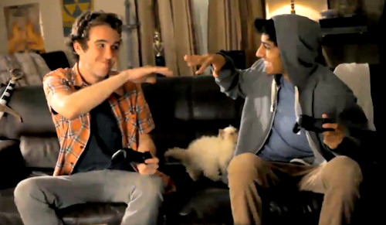
Project vision I
Cooperative gameplay
Solving problems together

Slide 3
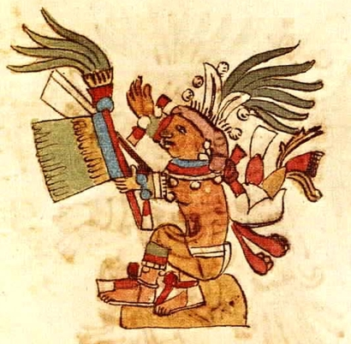
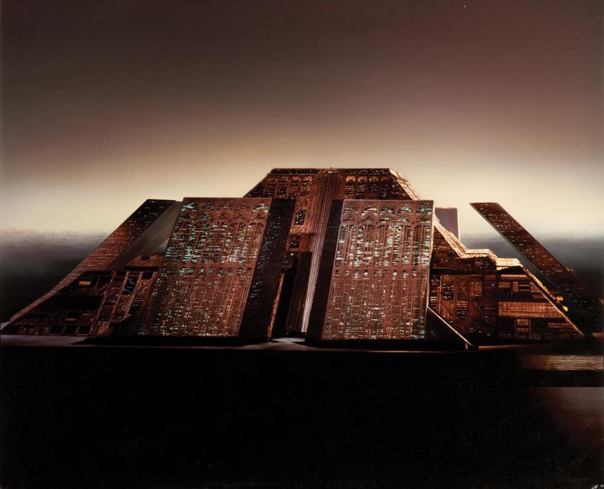
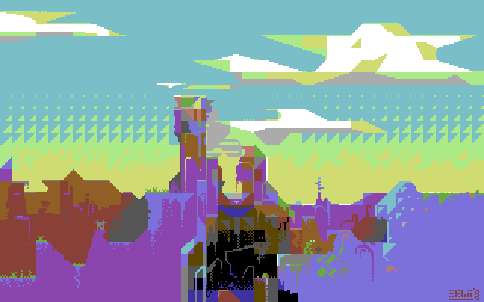
Project vision II
Creating unique game world
Mixing Sci – Fi and Aztecs elements

Slide 4
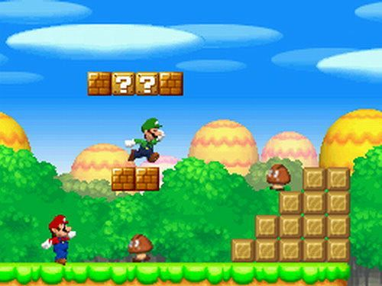
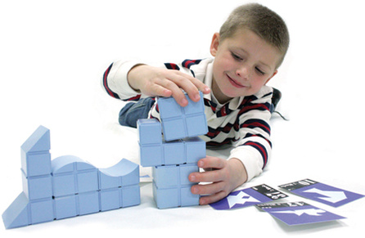
Gameplay concept
Core gamplay:
Key features

Slide 5




Technical Stuff
Genre: 2 Player Jump´n´Run
Platform:
Target Audience: 12+ and Casual gamer

Slide 6
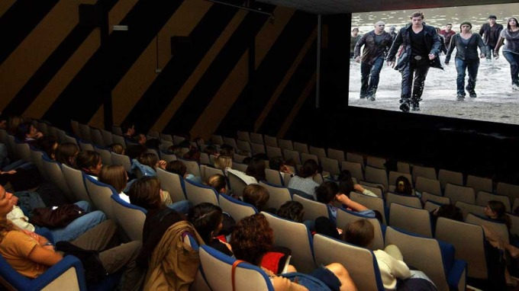
Gameplay loop & Video

Slide 7
Backstory & Setting
In a dystopian alternate future of Aztec mythology created by the Cyber Gods, the civilizations live dominated under a dome. But a mysterious Robot and a drone break through the outer shell of the dome and bring danger to this society. Their destination: To take down the last of the Cyber Gods.

Slide 8
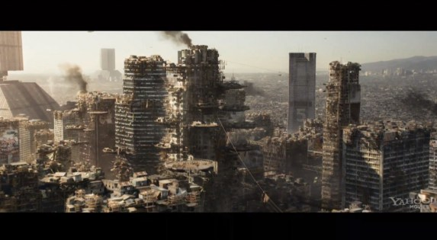
Backstory & Setting

Slide 9
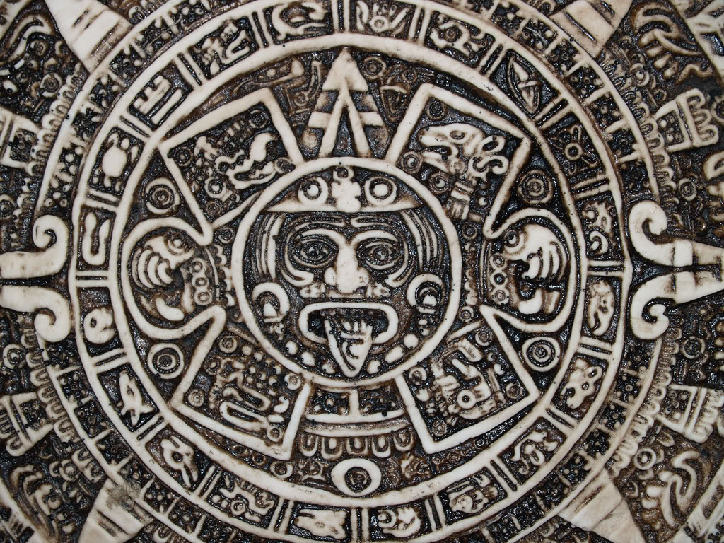
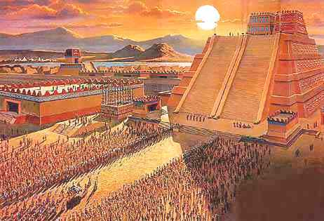
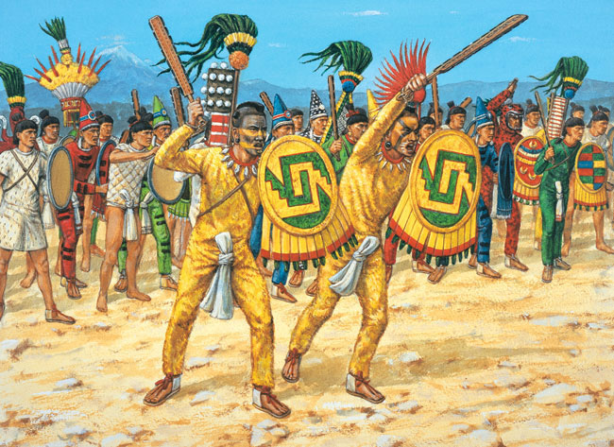

Slide 10
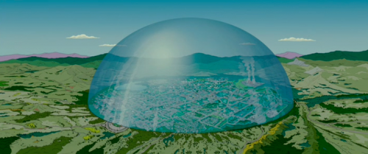

Slide 11

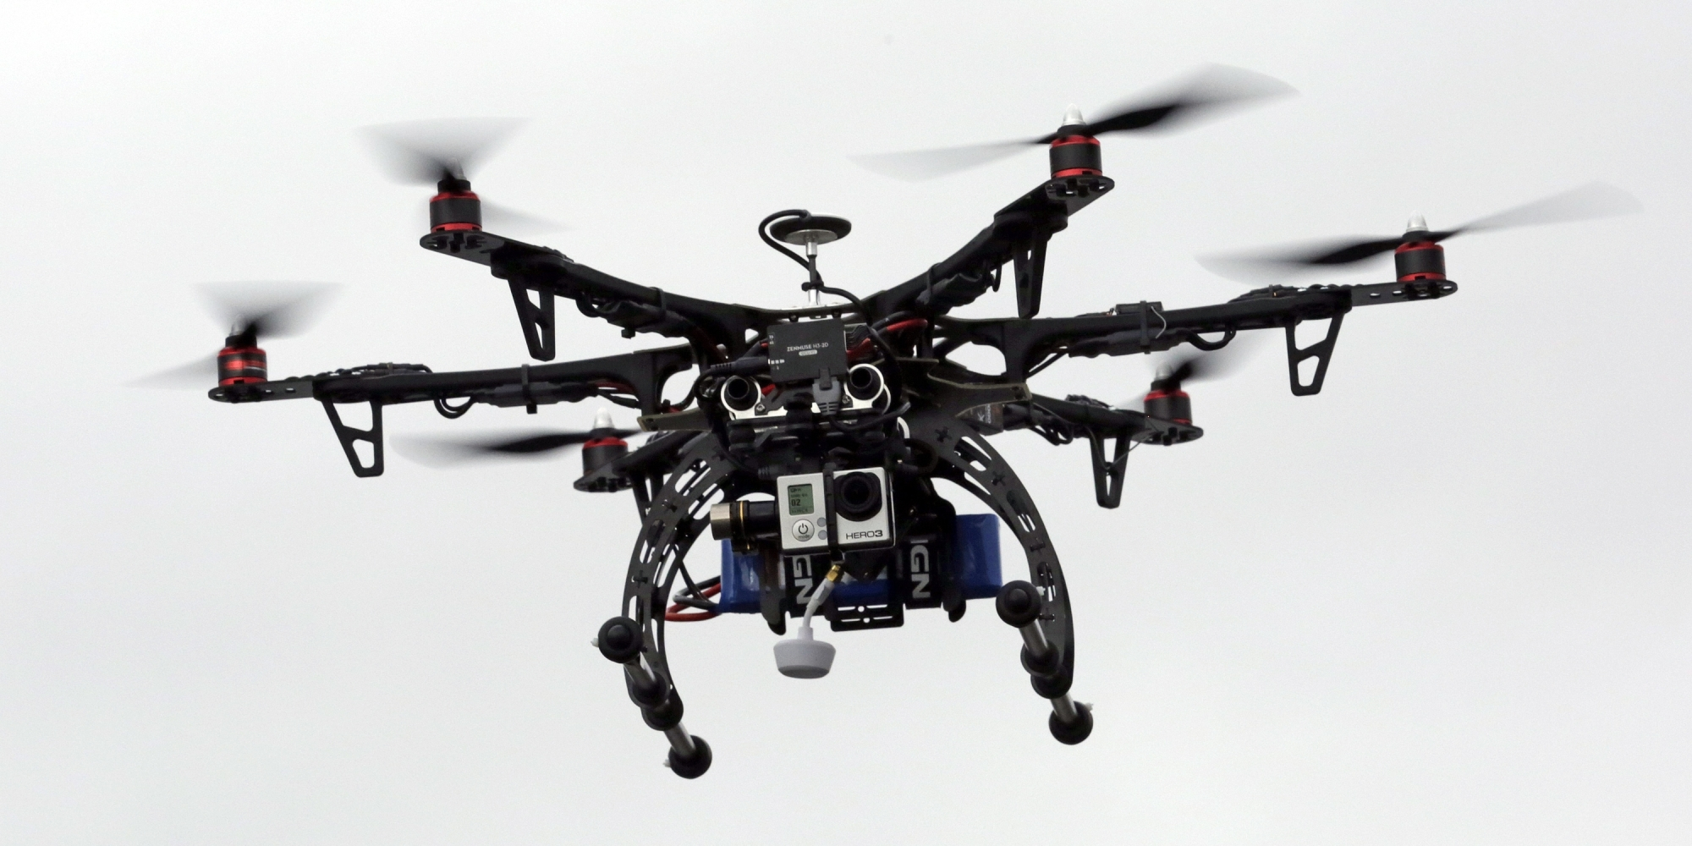

Slide 12
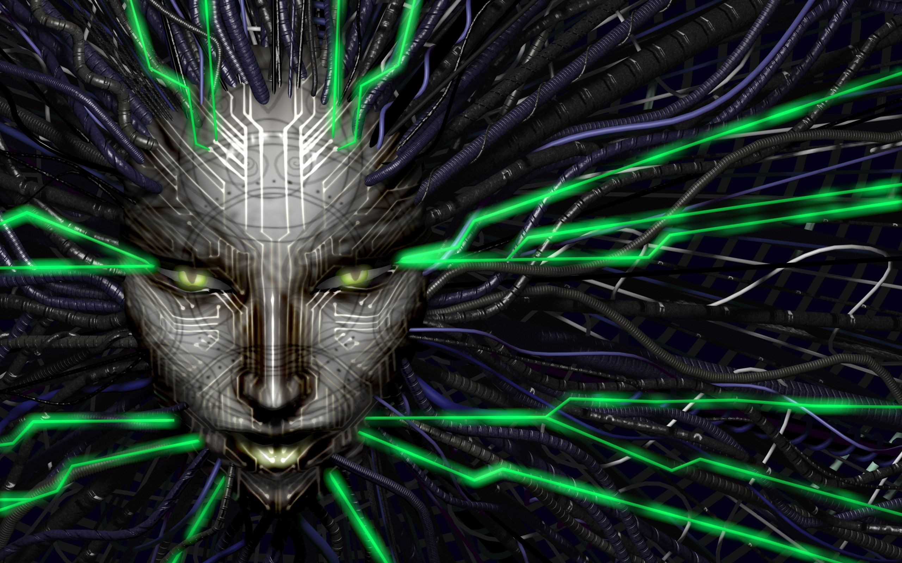

Slide 13


4 – 2 – 1
4 Walls: City under Dome
2 Players: Robot & Disc
1 Problem: To free mankind

Slide 14
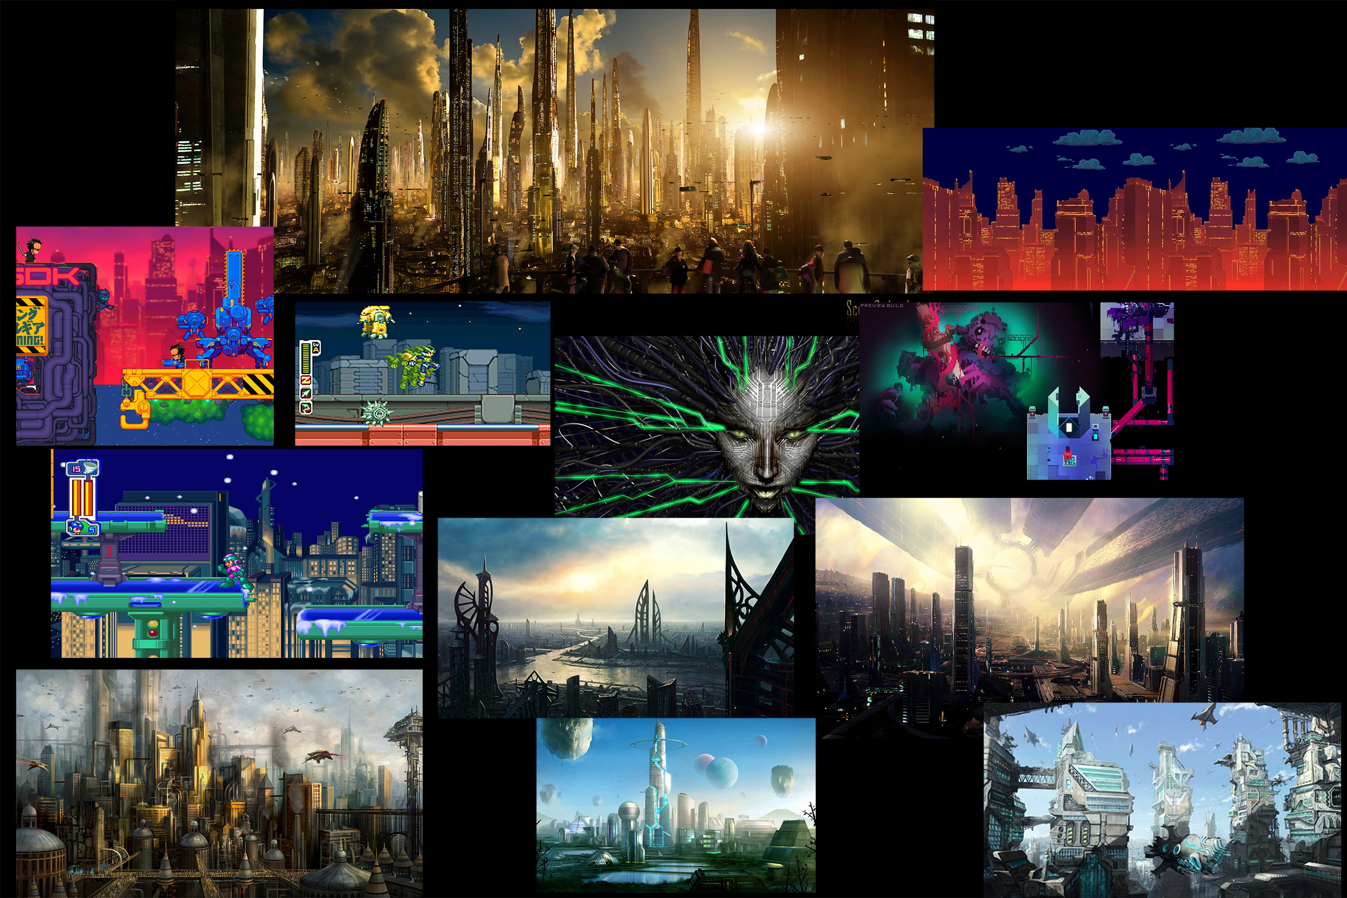

Slide 15
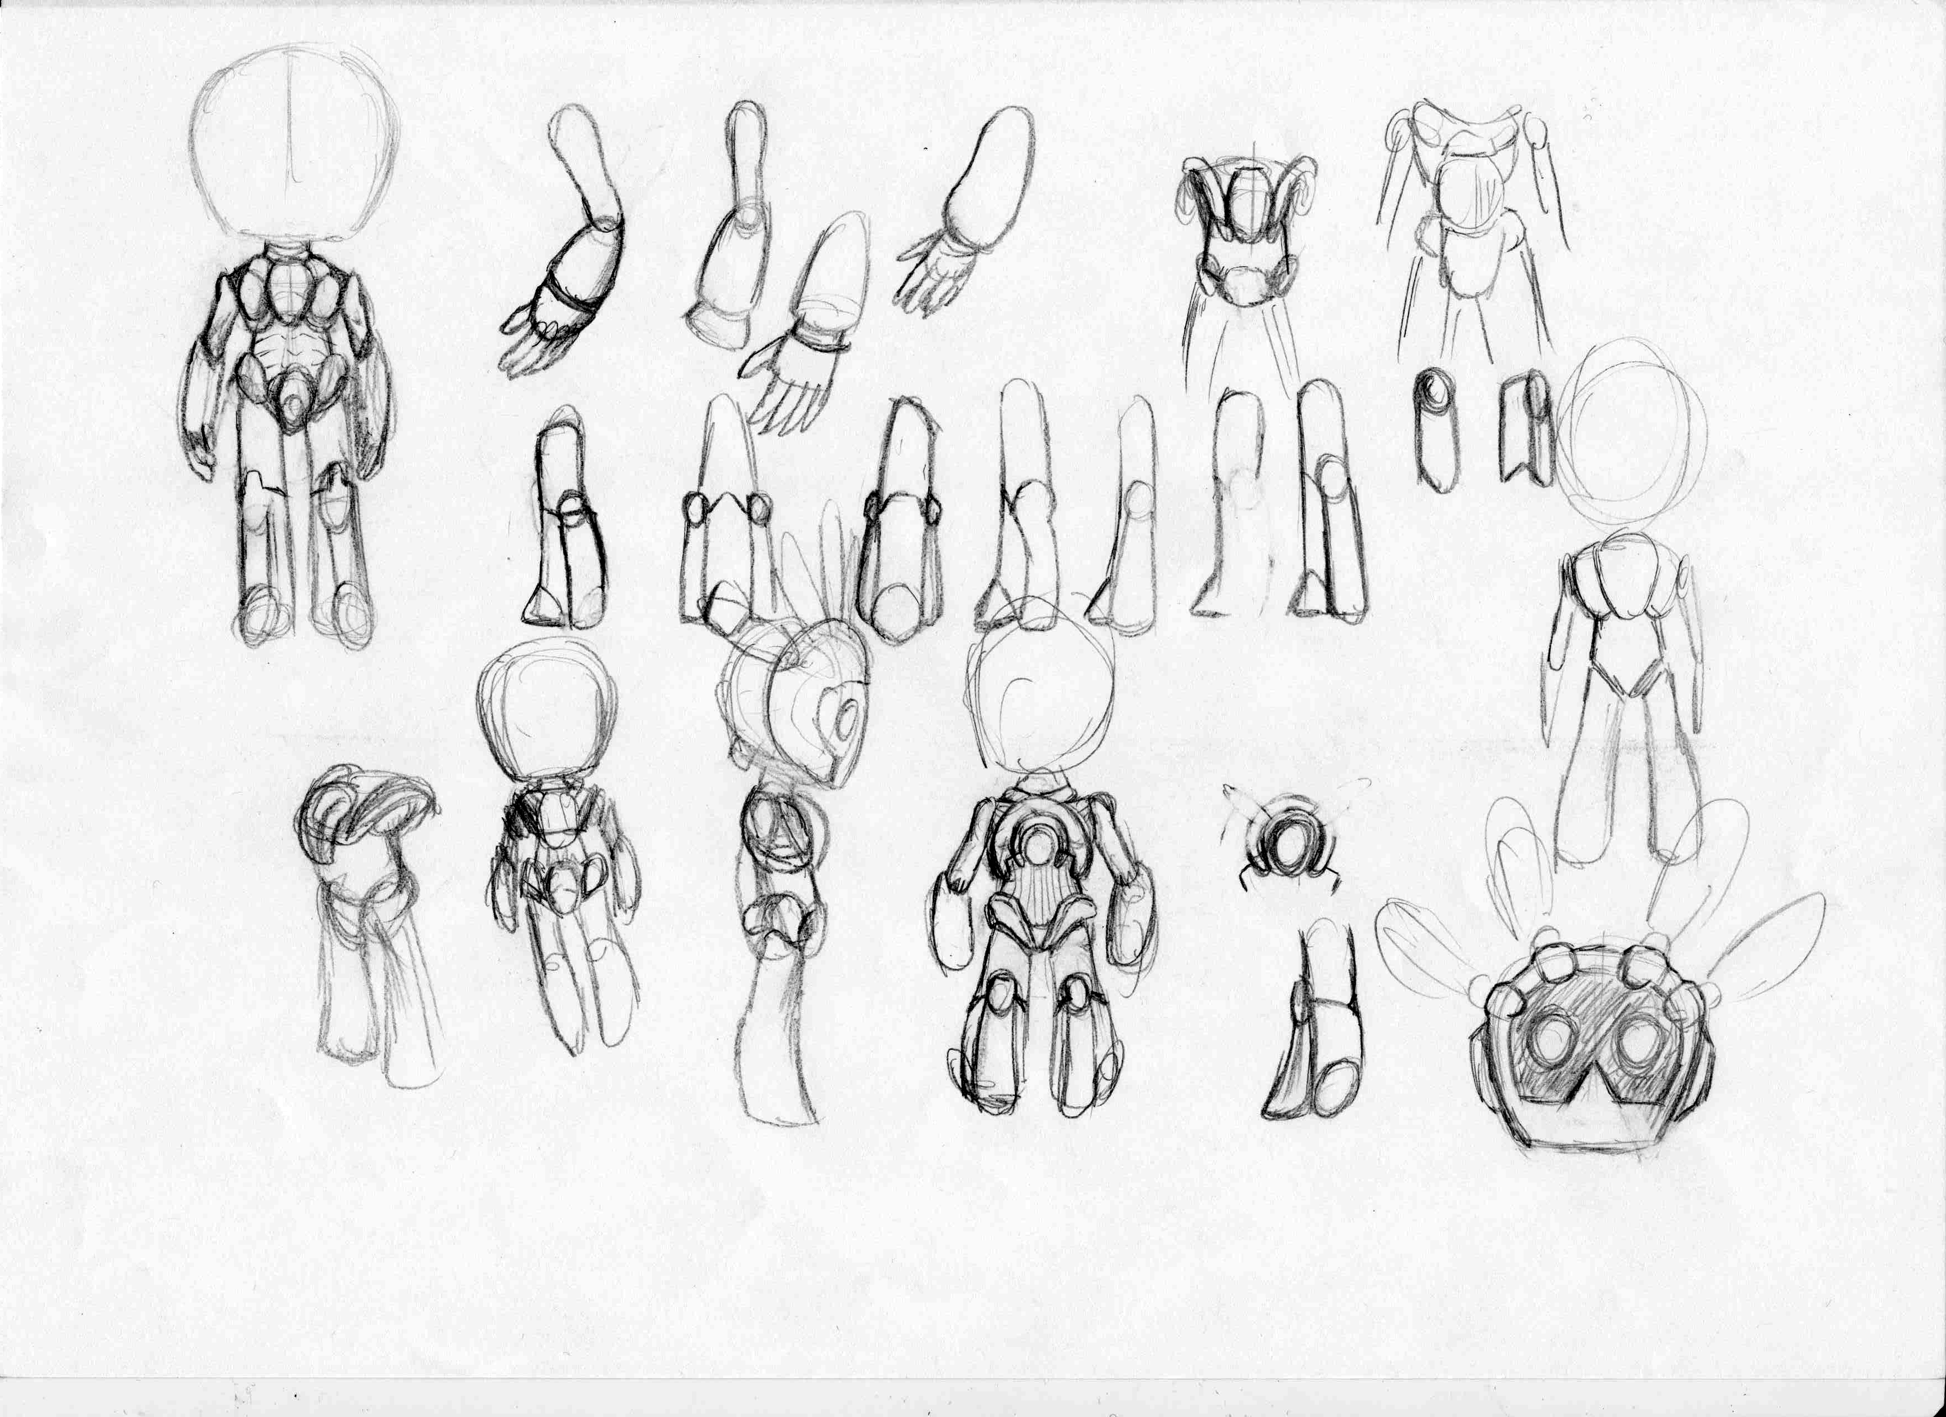
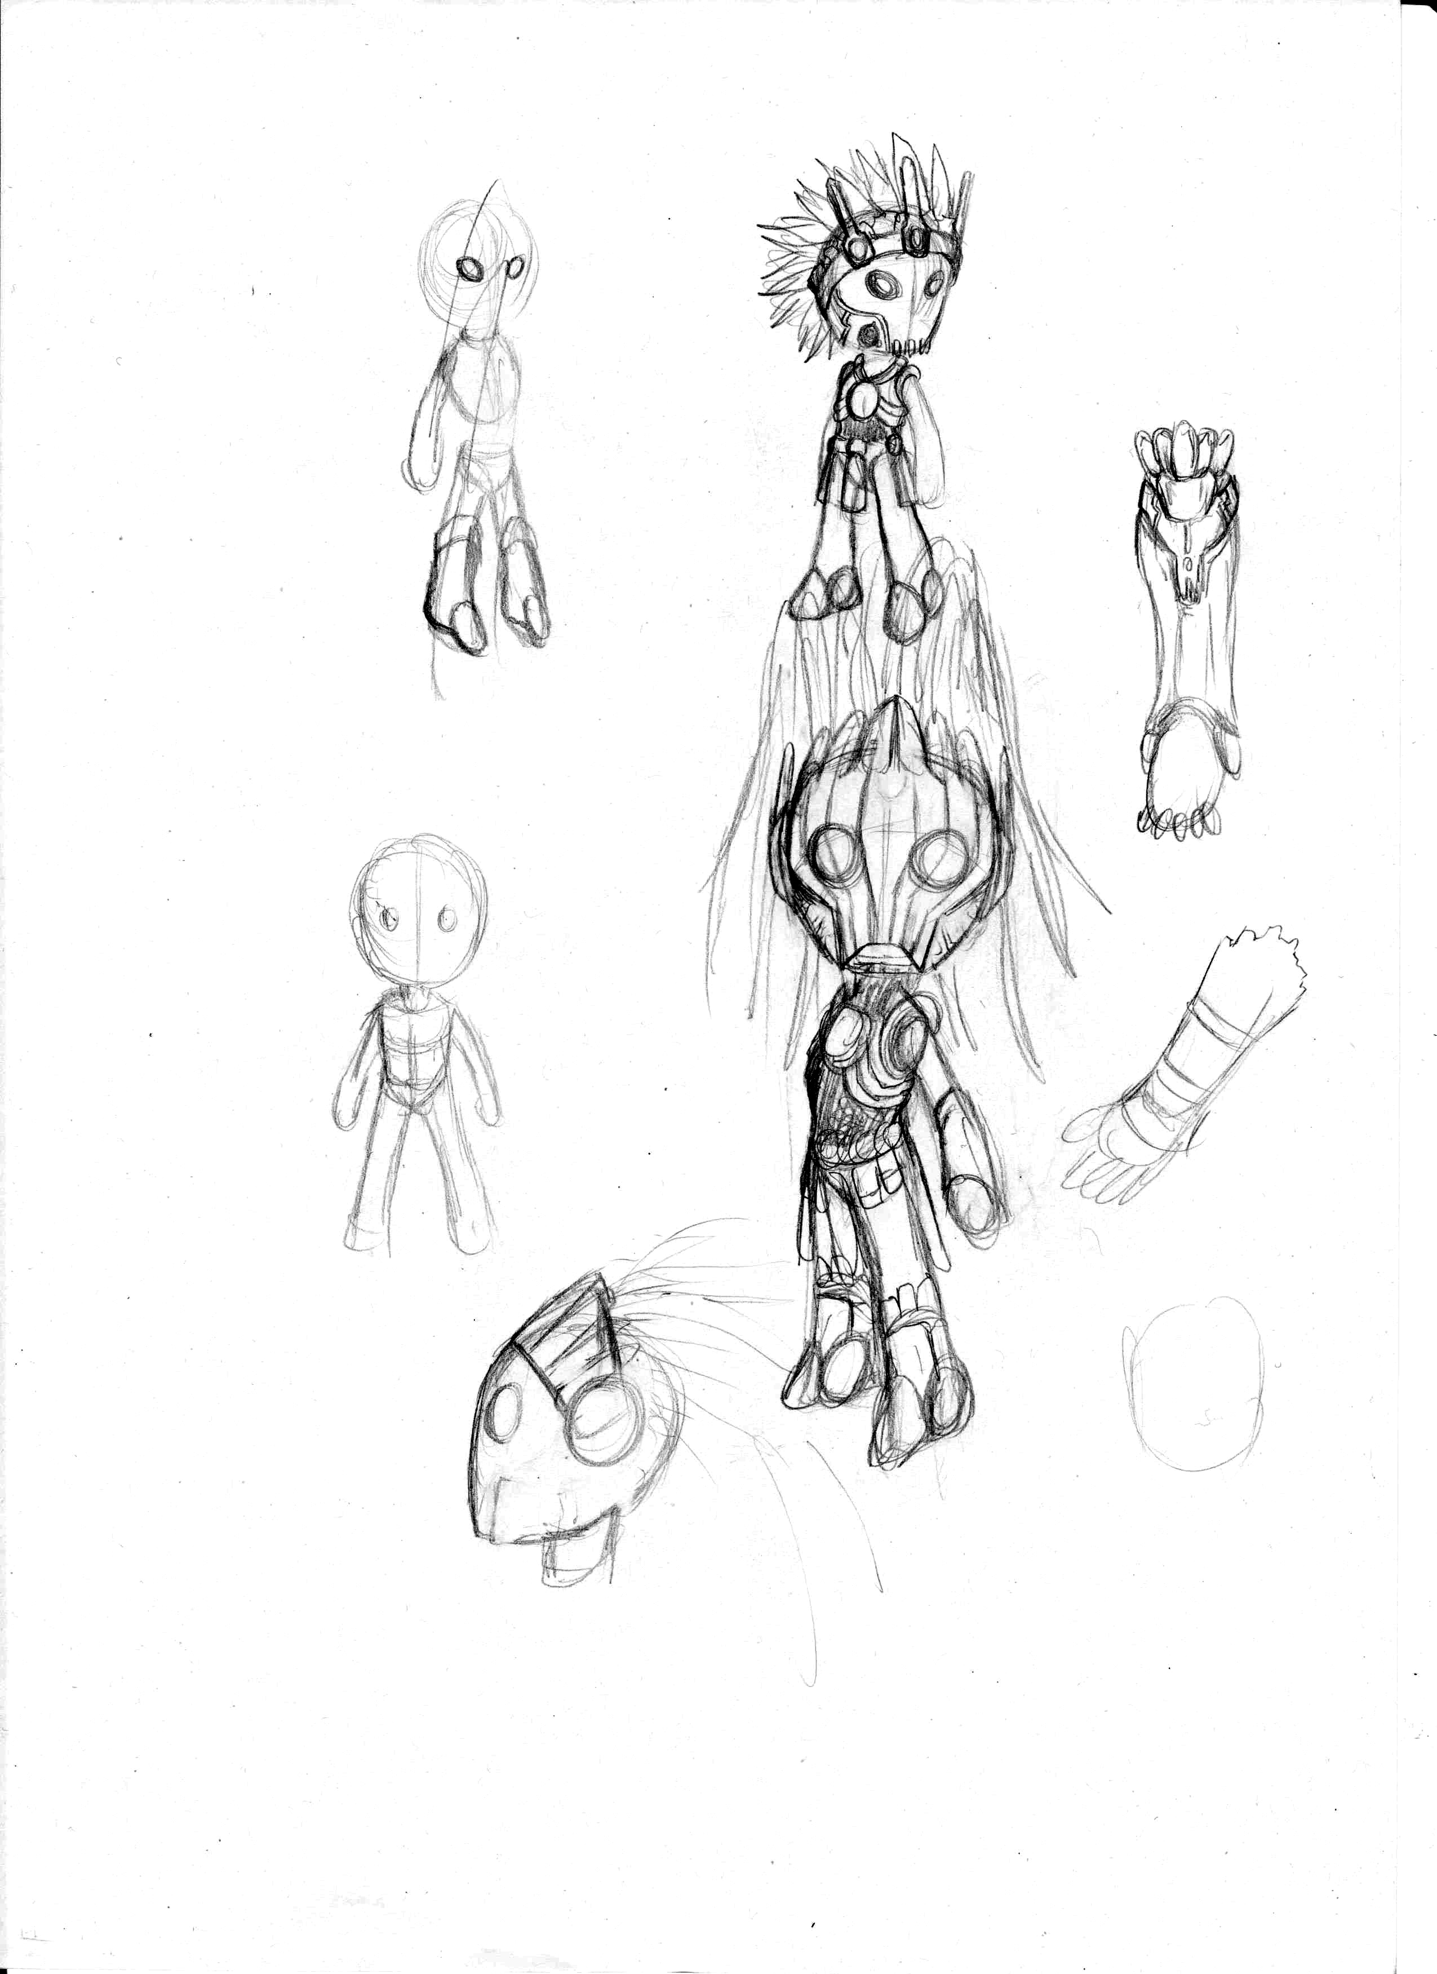
Character design

Slide 16
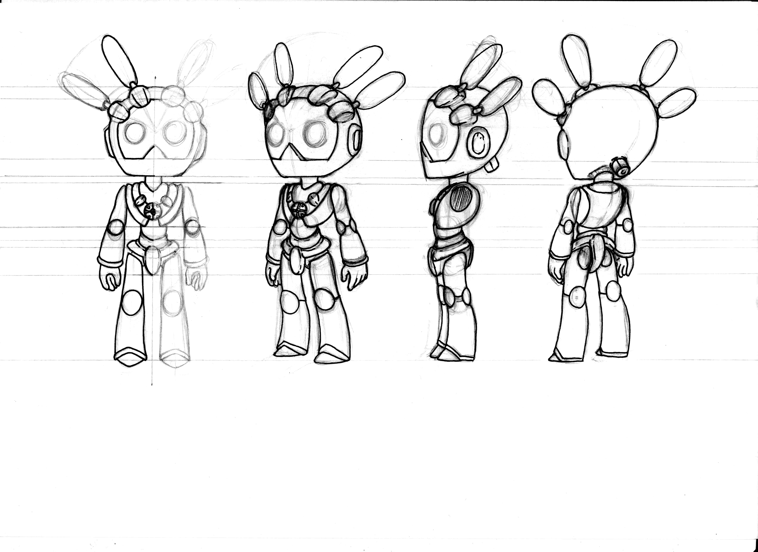
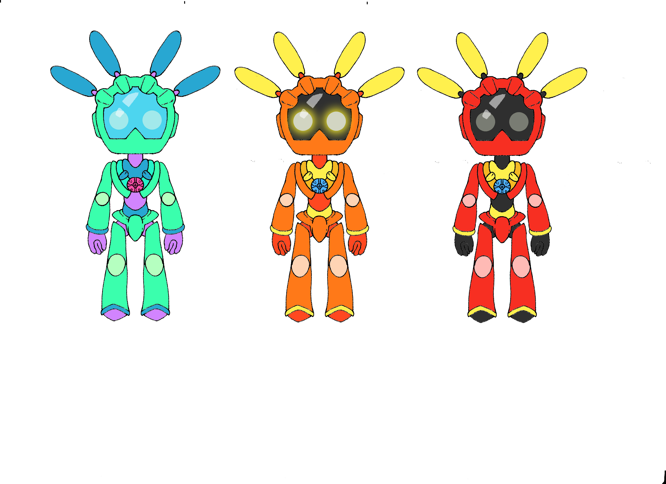

Slide 17
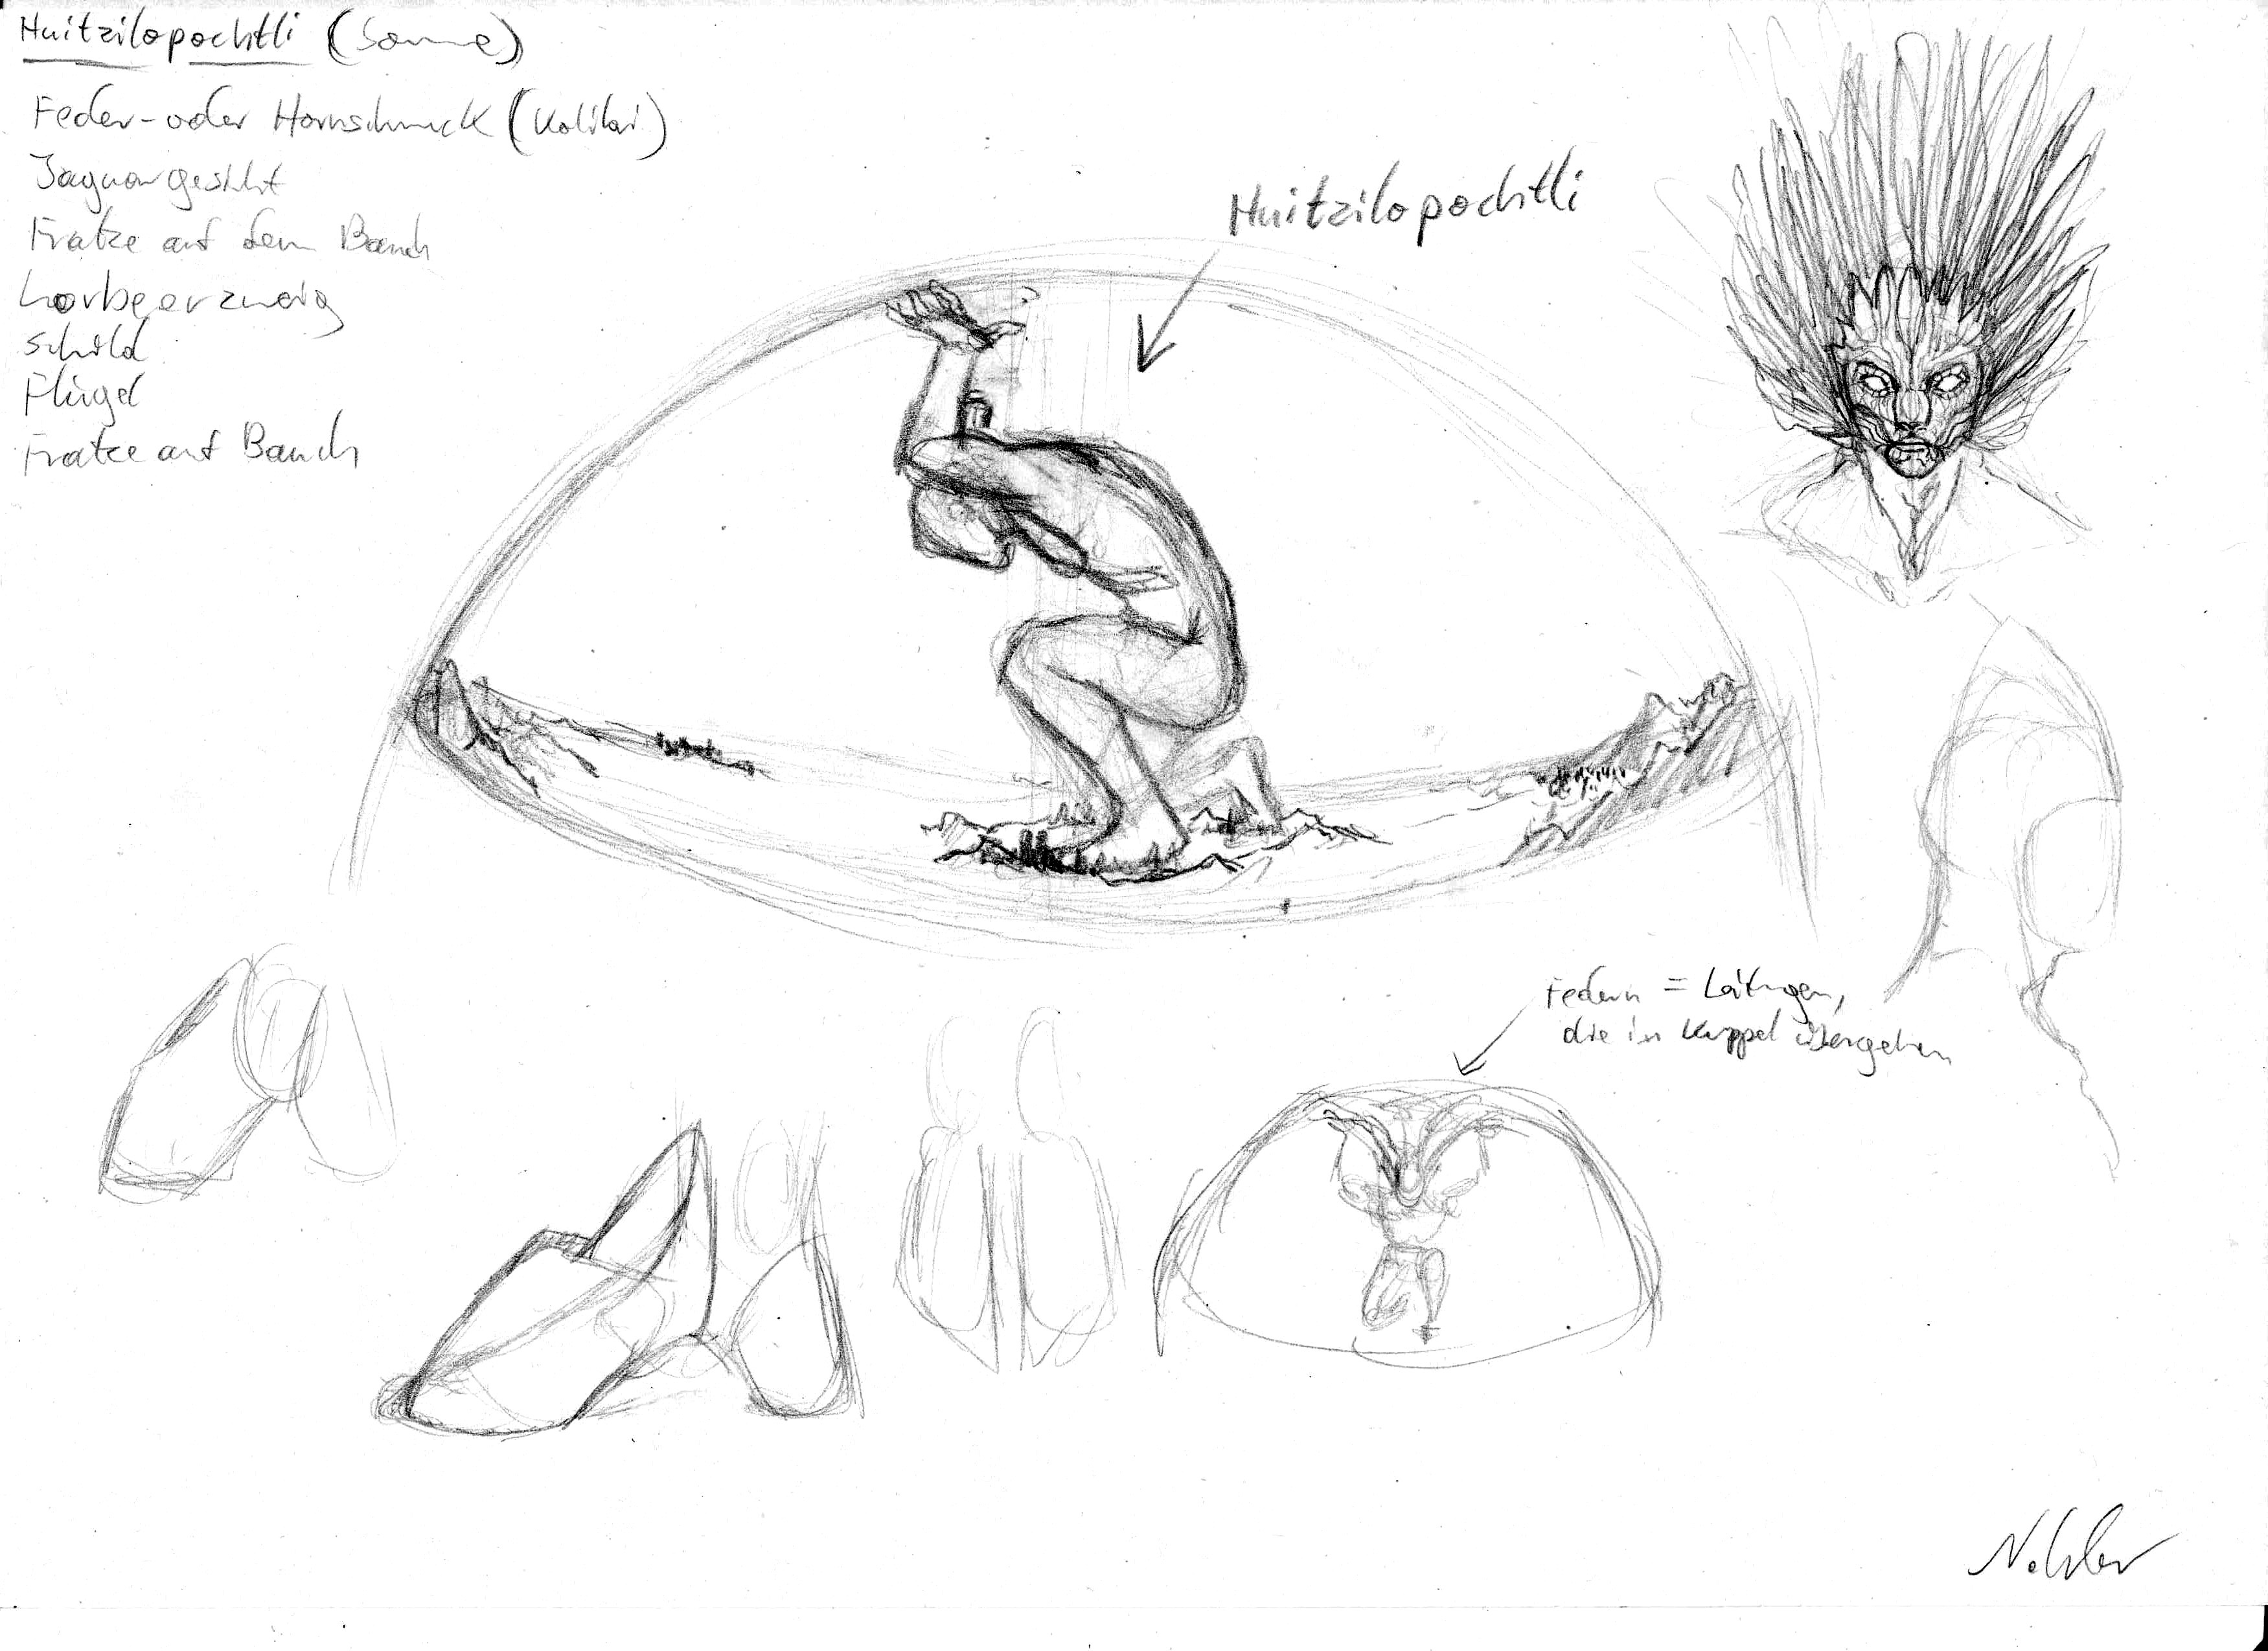
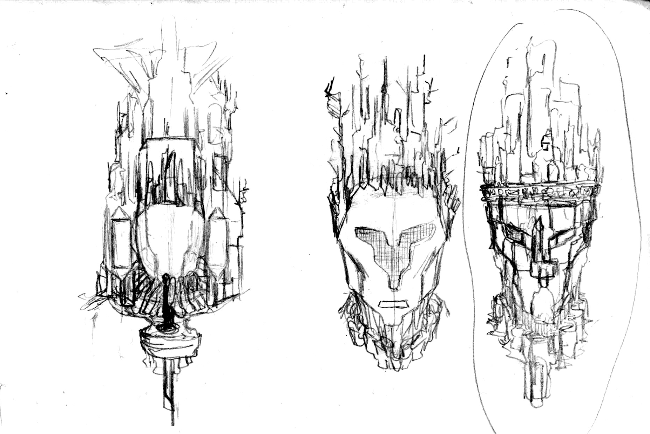
Envoirenment Concepts

Slide 18
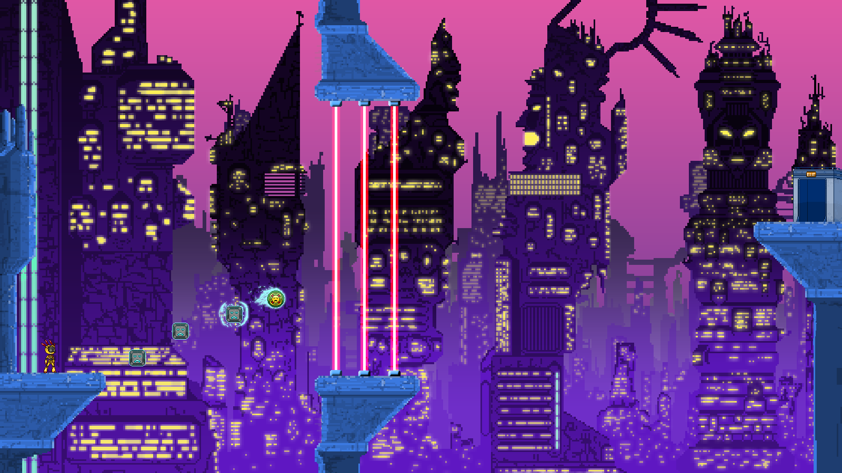
Mockup

Slide 19
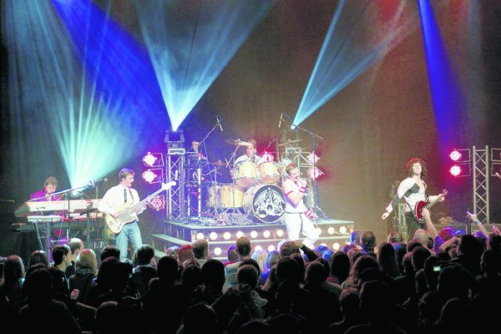
Sound Concepts

Slide 20
Team Roles & Responsibilities

Slide 21
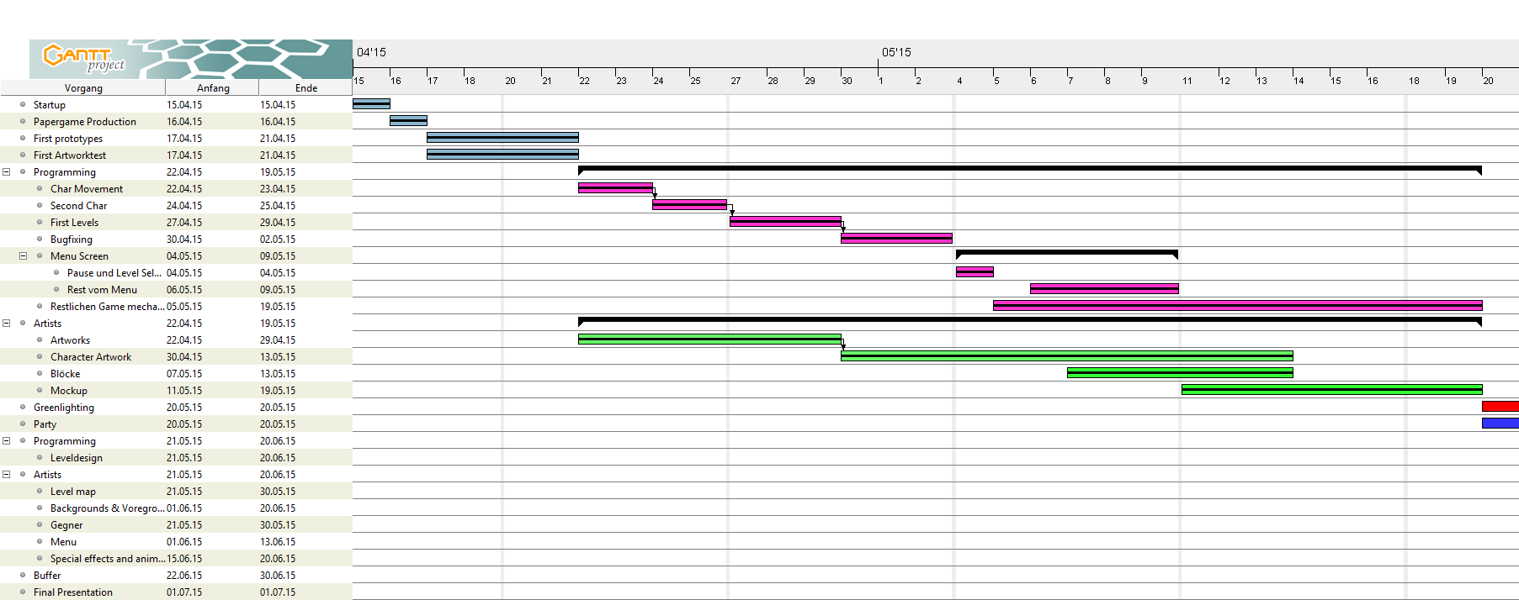
Production Schedule before Greenlight

Slide 22
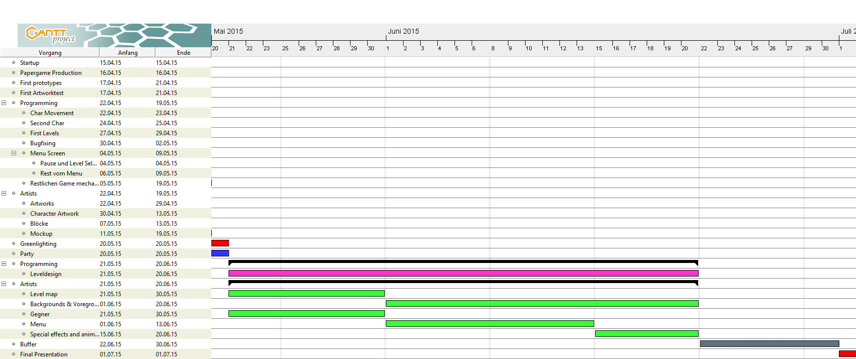
After Greenlight

Slide 23





Technical game document

Slide 24
Thanks for your time

