Slide 1

Manufacturing Downtime
& Yield Analytics
Manufacturing BI Engineering Project
TABLEAU • MICROSOFT POWER BI • QLIK SENSE
TEAM MEMBERS
Hemanth V
Naina Karn
Nikhat Ansar
Vrinda Rajput
Abhinav Yadav
Notes:
Introduce the project title and all five team members. Explain that the project transforms manufacturing production and downtime data into trusted analysis across Tableau, Power BI and Qlik Sense.
Likely SME question: Ask how the metric or transformation is validated; explain the rule and show the related dashboard or data-quality flag.

Slide 2
MANUFACTURING ANALYTICS
Project overview
Manufacturing downtime
Why monitoring matters
Time when a machine is stopped, unavailable or not producing as planned.
Shows production efficiency, scrap loss, downtime impact and assets needing attention.
Production yield
Problem addressed
Percentage of total production that becomes acceptable good output.
Raw records contained duplicates, inconsistent values, missing references and injected quality issues.
Project outcome
Cleaned data, shared dimensional model and interactive analysis in Tableau, Power BI and Qlik Sense.
Production + Quality + Downtime → trusted operational decisions
Internal, Client Confidential
Notes:
Define downtime and yield first. Then explain that the project improves trust in manufacturing reporting by cleaning the source files, validating records and connecting production and downtime through shared dimensions.
Likely SME question: Ask how the metric or transformation is validated; explain the rule and show the related dashboard or data-quality flag.

Slide 3
MANUFACTURING ANALYTICS
Project objectives
1
Production
2
Quality
3
Downtime
4
Comparison
Analyse output and trends
Calculate yield and scrap %
Measure events, hours and reasons
Compare plant, line and machine
5
Root cause
6
Dashboards
7
Decisions
Identify major contributors
Build in three BI platforms
Support operational reviews
Internal, Client Confidential
Notes:
Walk through the objectives from measurement to decision support. Emphasise that the dashboards provide visibility and analysis, not a claim that downtime or scrap has already been reduced.
Likely SME question: Ask how the metric or transformation is validated; explain the rule and show the related dashboard or data-quality flag.

Slide 4
MANUFACTURING ANALYTICS
Dataset overview
Dataset | Purpose | Documented raw | Verified analytical view
production_batches | Batch output, good and scrap quantities | 10,200 | 10,000
machine_downtime | Machine stoppage events and reasons | 18,180 | 18,000
machines | Machine master and type | 250 | 251
plants | Plant master and location | 25 | 26
shift_calendar | Shift and operational schedule | 720 | 721
calendar | Date analysis layer | 120 | 122
data_quality_injections | Injected quality test records | 5 | Removed / not retained
Dataset
Purpose
Documented raw
Verified analytical view
Cleaned dimensions include UNKNOWN rows where required. Injected test records were removed where appropriate.
Internal, Client Confidential
Notes:
Explain the seven source areas. Clearly compare raw and cleaned counts. Production and downtime decrease after deduplication and invalid-record handling. Machine, plant, shift and calendar dimensions increase because controlled UNKNOWN or supporting rows were added.
Likely SME question: Ask how the metric or transformation is validated; explain the rule and show the related dashboard or data-quality flag.

Slide 5
MANUFACTURING ANALYTICS
ETL process and data preparation
1
2
3
4
5
Raw data
Data cleaning
Validation
Data modelling
BI dashboards
Load source CSVs as-is
Standardise and deduplicate
Apply quality and time rules
Build shared dimensions
Tableau, Power BI, Qlik
BI-native workflow only
Power Query for Power BI transformations
Tableau Prep for Tableau preparation
Qlik Load Script for Qlik Sense
Internal, Client Confidential
Notes:
Describe the five-stage flow. Stress that the implementation remained inside the BI ecosystem: Power Query, Tableau Prep and Qlik Load Script. The raw layer was preserved before cleansing.
Likely SME question: Ask how the metric or transformation is validated; explain the rule and show the related dashboard or data-quality flag.

Slide 6
MANUFACTURING ANALYTICS
Data cleaning and validation
Duplicate removal
Standardisation & missing values
Production validation
Downtime validation
Latest batch_id / downtime_id by created_ts
Retain latest complete record
Preserve flags for traceability
Normalise dates and quantities
Map DL, GJ and BR to full state names
Use UNKNOWN members instead of deleting
Check missing or negative quantities
Check scrap ≤ total
Reconcile total = good + scrap
Assign PASS or REVIEW
Check start/end sequence
Derive duration where possible
Compare source vs derived duration
Flag unusual values for review
Outcome: auditable records, explicit exceptions and safer KPI aggregation
Internal, Client Confidential
Notes:
Explain that data was not simply deleted when imperfect. The process retained usable records, mapped missing references to UNKNOWN and separated PASS records from REVIEW records. State mapping supported Tableau geographic recognition.
Likely SME question: Ask how the metric or transformation is validated; explain the rule and show the related dashboard or data-quality flag.

Slide 7
MANUFACTURING ANALYTICS
Data model: Galaxy Schema
DimPlant
FactProductionBatches
DimDate
DimMachine
FactMachineDowntime
DimShift
DimDowntime
Reason
Shared: Plant, Machine, Shift and Date | Downtime Reason: downtime fact only
Two fact tables remain separate because production batches and downtime events have different grains.
LTM
Internal, Client Confidential
Notes:
Explain that there are exactly two fact tables. Machines, Plants, Shift Calendar and Calendar are conformed shared dimensions, and each dimension connects to both facts. The facts remain separate because production batches and downtime events have different grains.
Likely SME question: Ask how the metric or transformation is validated; explain the rule and show the related dashboard or data-quality flag.

Slide 8
MANUFACTURING ANALYTICS
KPIs and analytical approach
7.29M
7.01M
287.85K
96.05%
10.95K
Total Production
Good Quantity
Scrap Quantity
Overall Yield
Downtime Hours
Core formulas
Additional analysis
Yield % = Good Quantity ÷ Total Production × 100
Scrap % = Scrap Quantity ÷ Total Production × 100
Downtime Hours = Valid Downtime Minutes ÷ 60
Average Downtime = Valid Downtime Minutes ÷ Valid Events
Uptime % = Available Time less Downtime ÷ Available Time × 100
Total downtime events
Plant yield ranking
Planned vs unplanned downtime
Machine and shift comparisons
PASS records for trusted production KPIs
Validate logic across all three BI platforms
Internal, Client Confidential
Notes:
Explain the KPI formulas in business language. The displayed executive values align between Power BI and Qlik Sense. Tableau shows a smaller PASS-only analytical view, which highlights why inclusion rules must be explicit.
Likely SME question: Ask how the metric or transformation is validated; explain the rule and show the related dashboard or data-quality flag.

Slide 9
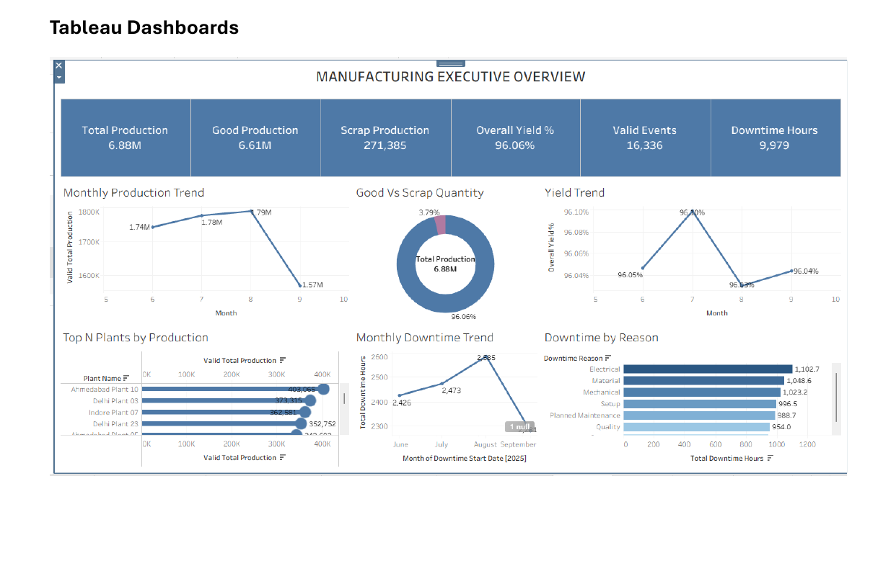
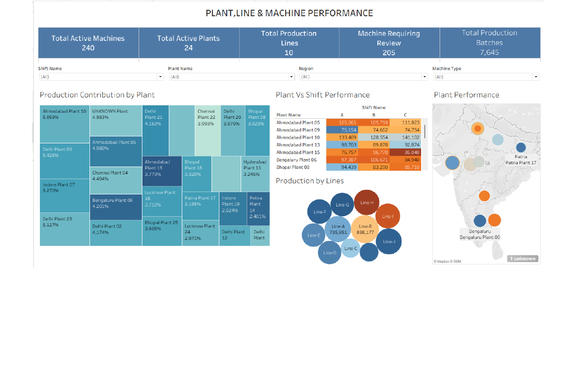
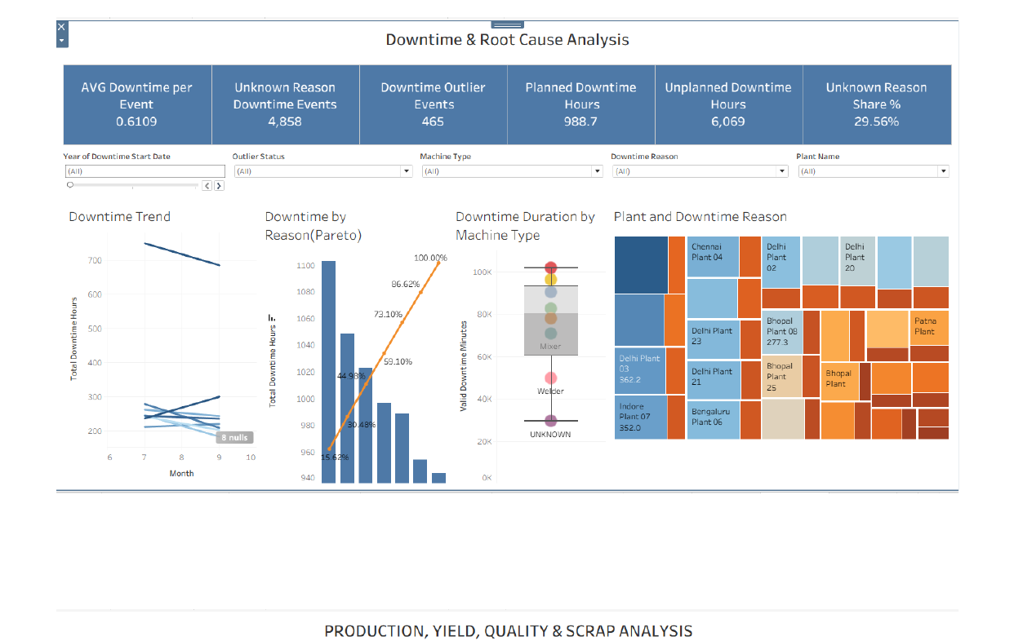
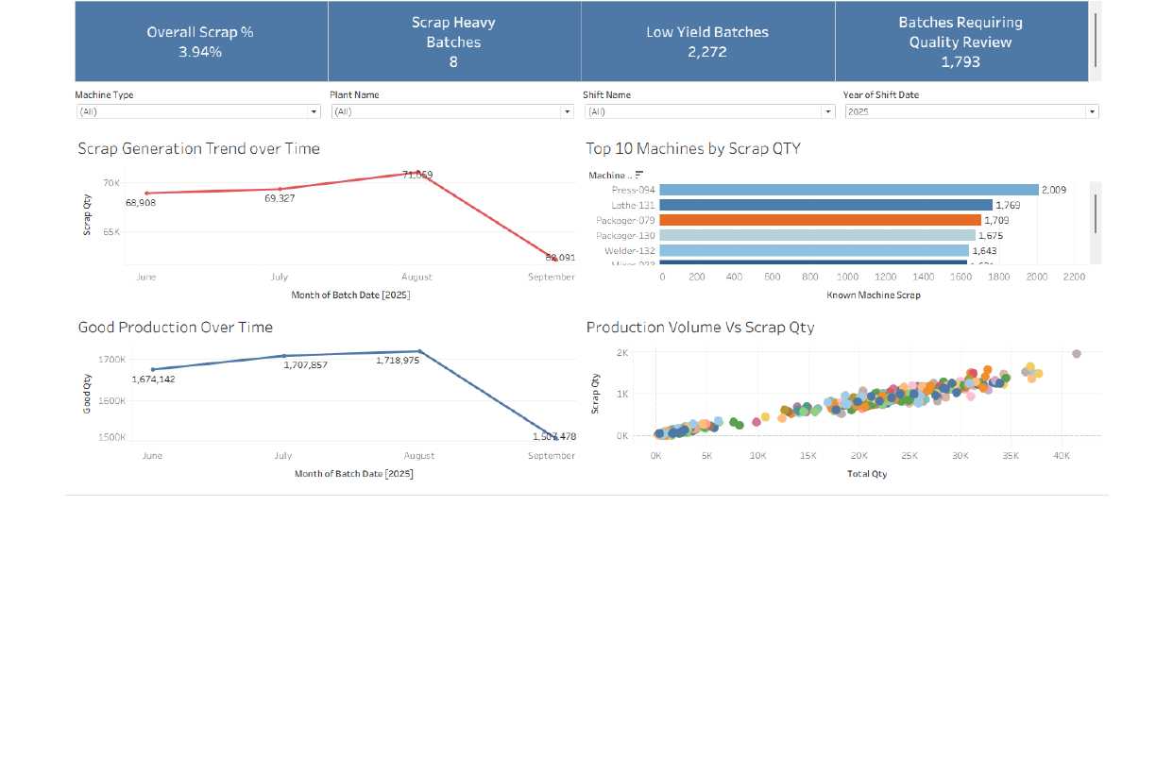
MANUFACTURING ANALYTICS
Tableau dashboards
Manufacturing Executive Overview
Plant, Line & Machine Performance
Downtime & Root Cause Analysis
Production Yield & Scrap Analysis
Internal, Client Confidential
Notes:
Show that the four Tableau dashboards cover executive KPIs, operational hierarchy, downtime root causes, and yield and scrap. Point out that Tableau’s view applies stricter valid or PASS filters in several KPIs.
Likely SME question: Ask how the metric or transformation is validated; explain the rule and show the related dashboard or data-quality flag.

Slide 10
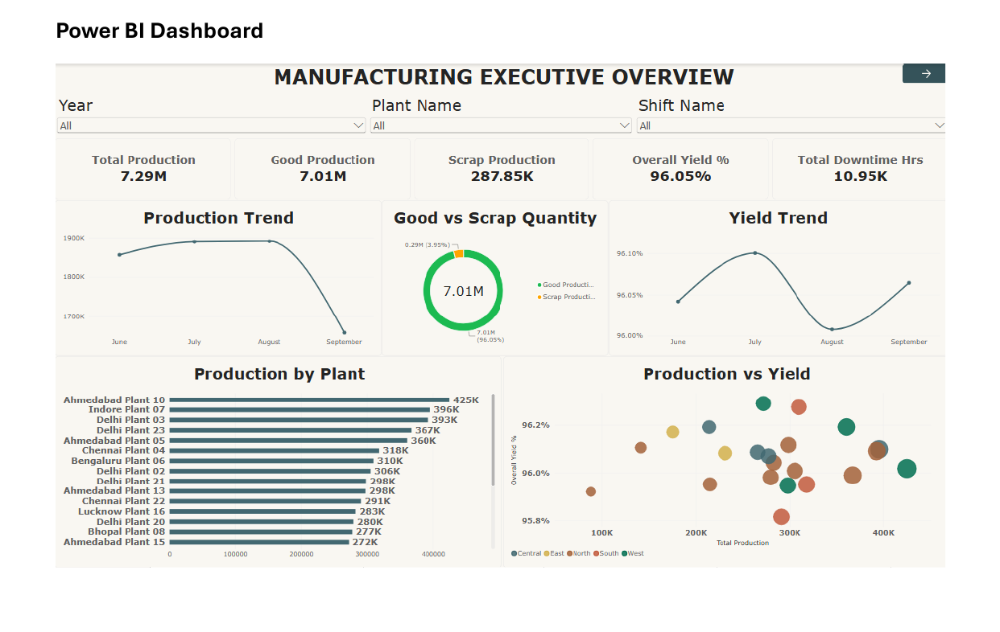
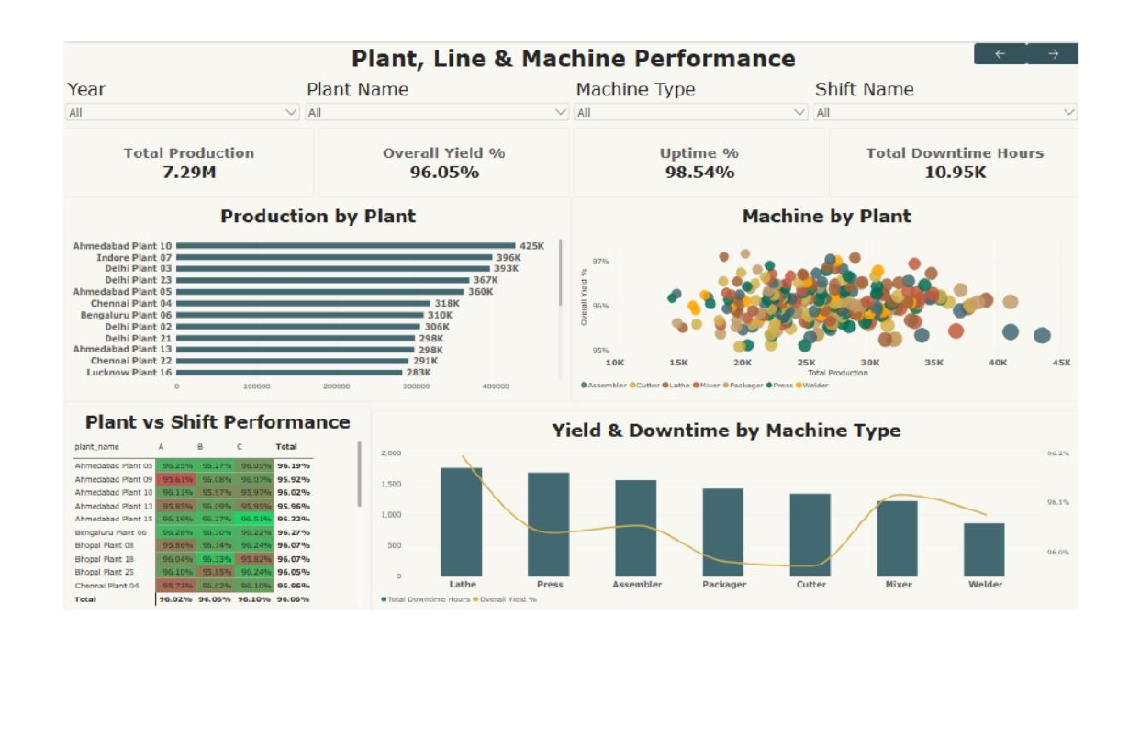
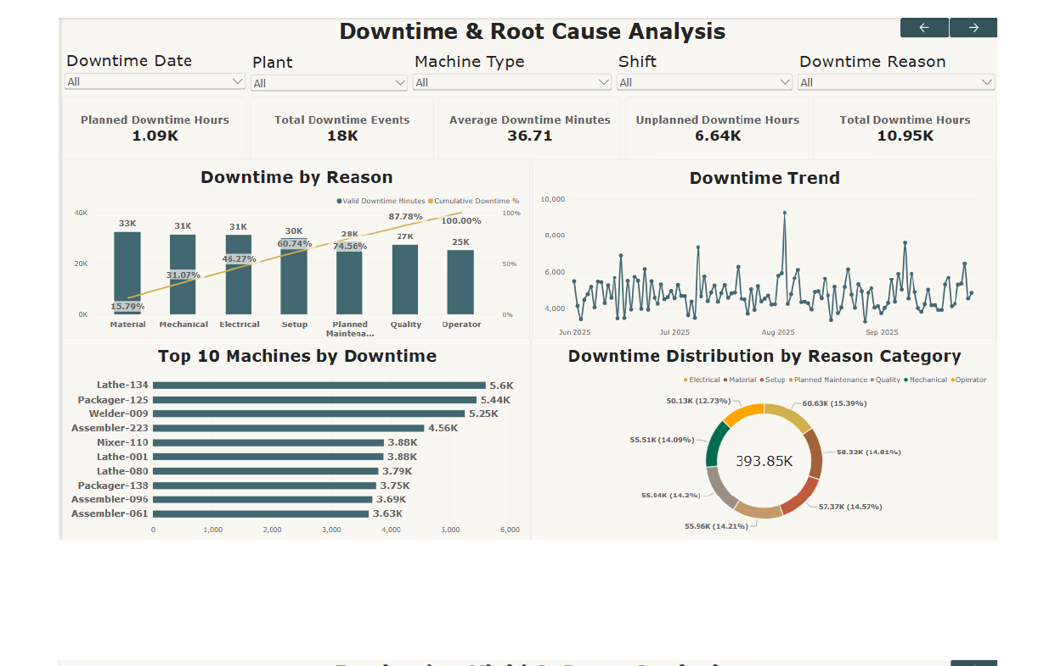
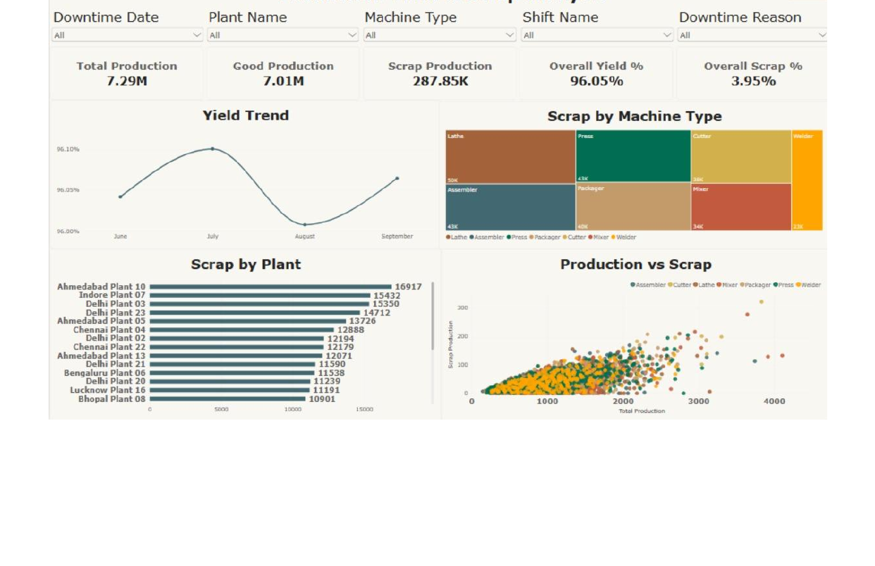
MANUFACTURING ANALYTICS
Microsoft Power BI dashboards
Manufacturing Executive Overview
Plant, Line & Machine Performance
Downtime & Root Cause Analysis
Production Yield & Scrap Analysis
Internal, Client Confidential
Notes:
Use this slide to demonstrate Power BI’s consistent executive summary, plant and machine comparison, Pareto-style downtime analysis, and production quality views.
Likely SME question: Ask how the metric or transformation is validated; explain the rule and show the related dashboard or data-quality flag.

Slide 11
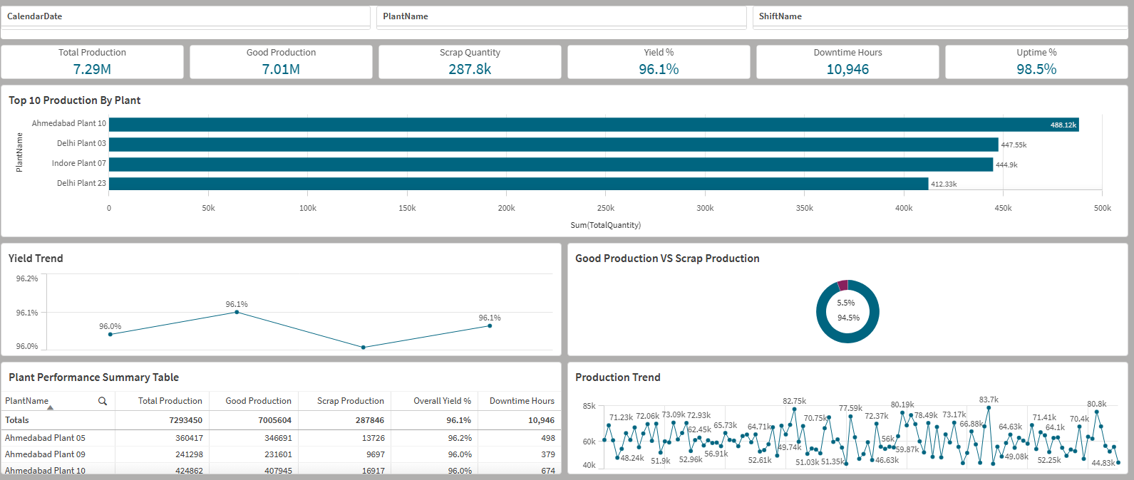
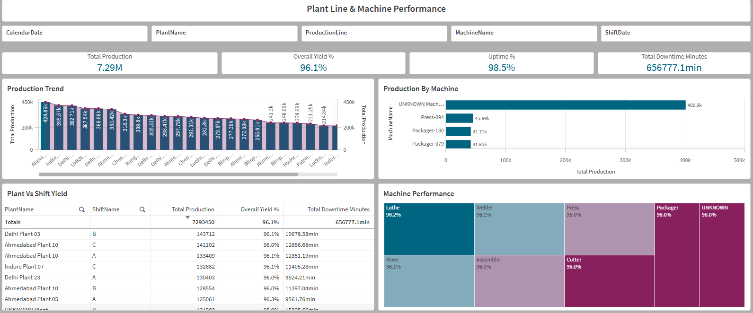
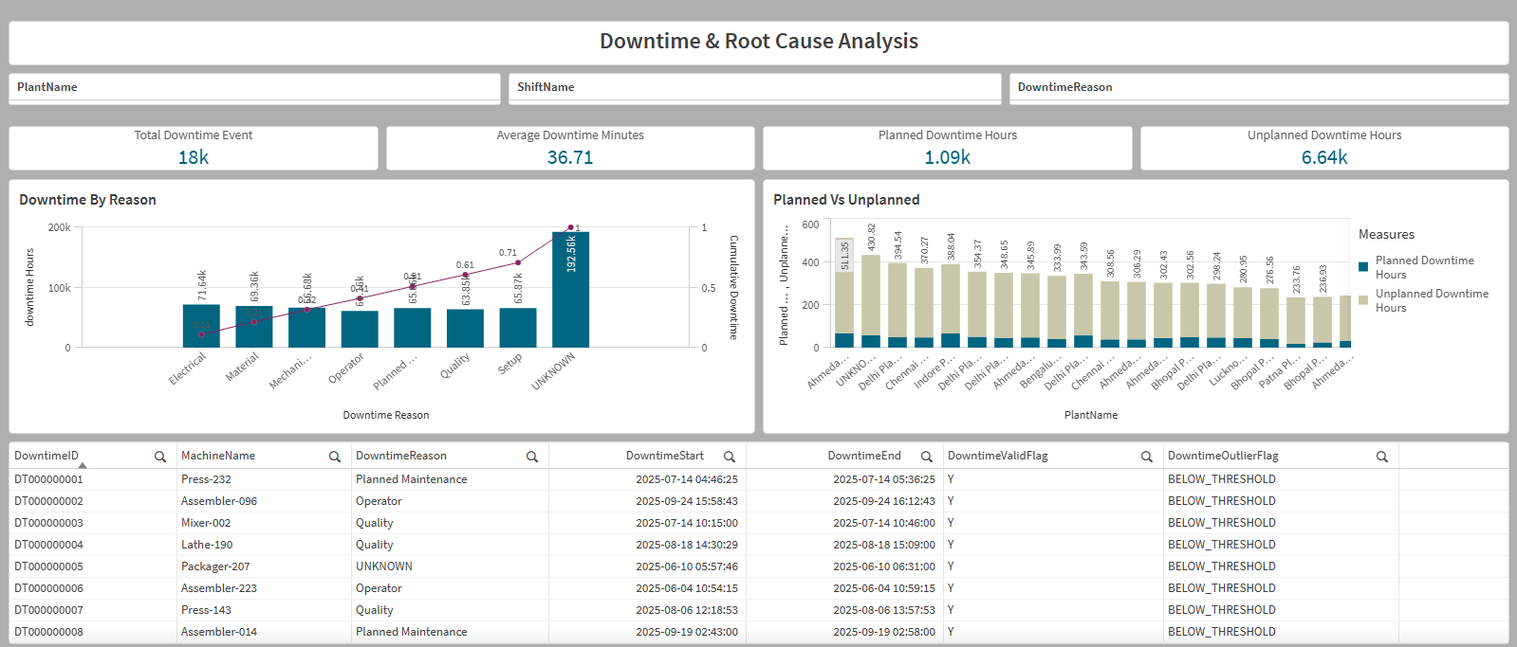
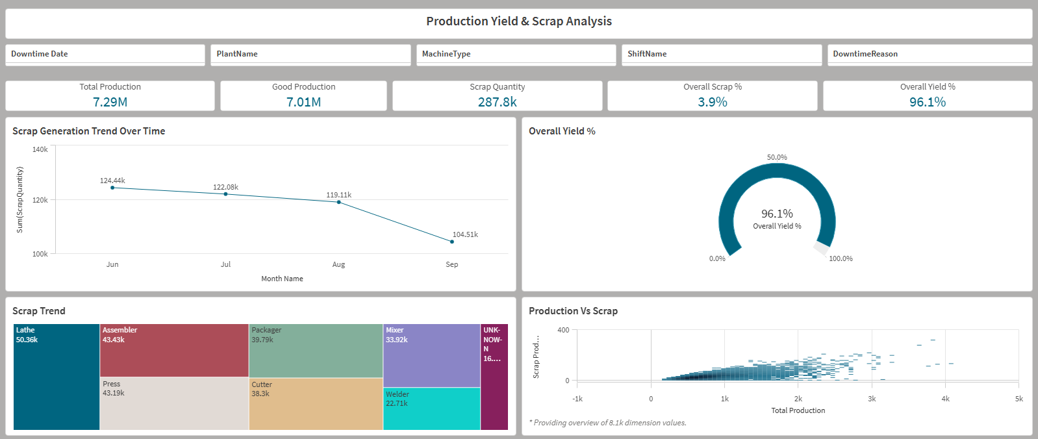
MANUFACTURING ANALYTICS
Qlik Sense dashboards
Manufacturing Executive Overview
Plant, Line & Machine Performance
Downtime & Root Cause Analysis
Production Yield & Scrap Analysis
Internal, Client Confidential
Notes:
Explain that Qlik Sense provides associative filtering across the same four business questions. The KPI totals align closely with the Power BI dashboard view.
Likely SME question: Ask how the metric or transformation is validated; explain the rule and show the related dashboard or data-quality flag.

Slide 12
MANUFACTURING ANALYTICS
Key insights and findings
7.29M
96.05%
287.85K
10.95K hrs
98.54%
Total production
Overall yield
Scrap
Downtime
Uptime
Performance
Good output is 7.01M; scrap represents 3.95% of production.
Downtime
18K events average 36.71 minutes; unplanned hours (6.64K) materially exceed planned hours (1.09K).
Priority assets
Lathe-134 leads displayed machine downtime at 5.6K minutes; Ahmedabad Plant 10 leads production at about 425K.
Data quality
Tableau PASS-filtered scope shows 6.88M production, 16,336 valid events and 29.56% unknown-reason share.
Internal, Client Confidential
Notes:
Separate manufacturing performance from data-quality findings. The consistent Power BI and Qlik executive values are used for performance. Tableau’s smaller PASS-filtered values show the impact of stricter inclusion rules, not necessarily a contradiction.
Likely SME question: Ask how the metric or transformation is validated; explain the rule and show the related dashboard or data-quality flag.

Slide 13
MANUFACTURING ANALYTICS
Business recommendations
1
Prioritise chronic downtime
2
Focus on unplanned loss
3
Improve reason-code capture
Review Lathe-134 and other top machines; validate maintenance history and recurring reasons.
Use Pareto views to target Electrical, Material, Mechanical and Setup contributors.
Reduce UNKNOWN reasons with mandatory codes, controlled lists and supervisor checks.
4
Control scrap-heavy batches
5
Operationalise reviews
6
Keep cross-tool reconciliation
Track high-scrap machines and batches; compare shift, line and product context.
Use weekly plant and machine scorecards with PASS/REVIEW data-quality visibility.
Maintain one KPI definition sheet and test totals after every refresh.
Internal, Client Confidential
Notes:
Frame these as practical next actions enabled by the dashboards. Avoid claiming benefits already achieved. Recommend ownership, recurring reviews and reason-code governance so insights convert into action.
Likely SME question: Ask how the metric or transformation is validated; explain the rule and show the related dashboard or data-quality flag.

Slide 14
MANUFACTURING ANALYTICS
Limitations and future scope
Current limitations
Future scope
Analysis is limited to the provided files
No real-time machine monitoring
Some records require data-quality review
Uptime uses a simplified available-time calculation
Predictive maintenance is not implemented
Automated and scheduled data refresh
Live manufacturing data integration
Better downtime reason-code completeness
Alerts for high downtime or scrap
Predictive maintenance after sufficient history
More robust OEE with planned production time
Internal, Client Confidential
Notes:
Be transparent about what is current and what is proposed. The project is a BI analytics solution based on supplied data, not a live MES platform or predictive-maintenance system.
Likely SME question: Ask how the metric or transformation is validated; explain the rule and show the related dashboard or data-quality flag.

Slide 15

Conclusion
Converted raw manufacturing data into cleaned and validated analytical data
Built a Galaxy Schema with separate production and downtime facts
Analysed yield, scrap, machine downtime and root causes
Delivered four dashboards each in Tableau, Power BI and Qlik Sense
Created trusted visibility to support better operational decisions
Thank You
Hemanth V • Naina Karn • Nikhat Ansar
Vrinda Rajput • Abhinav Yadav
Notes:
Close by summarising the full journey from raw data to validated KPIs, dimensional modelling and cross-platform dashboards. Invite questions on data quality, KPI logic, model grain or dashboard design.
Likely SME question: Ask how the metric or transformation is validated; explain the rule and show the related dashboard or data-quality flag.

