Slide 1
PrepLang
A data-aware compiler for table and image preprocessing
Compiler Design Laboratory (BCSE307P) · Phase 3: Final Implementation and Testing
V.Nikhil · 24BAI0073
Notes:
PrepLang is a language for cleaning data before machine learning, and this is its compiler, written in C++17.

Slide 2
Data-cleaning scripts fail late, or silently
A pandas or OpenCV script only learns that its assumptions are wrong while it runs over the data.
A misspelled column crashes it halfway through.
A word in a number column breaks a type conversion.
Decimal pixels saved as PNG finish without an error and every image is black.
8.5 s
a script runs on 3,000 images, then writes black files
0.26 s
PrepLang reports the mistake at compile time
2
Notes:
Measured on 3,000 JPG images: the hand-written script finishes and writes black images; PrepLang refuses to compile.

Slide 3
The idea: the data is a compile-time input
1
2
3
4
Lexer
LL(1) parser
AST
Semantic analysis
(reads the data)
5
6
7
8
Three address code
Optimizer
Data certificate
pandas + OpenCV code
LOAD reads every CSV cell, a Parquet footer or the header of every image, so the compiler knows types, missing values, value ranges, image sizes and channels before anything runs.
3

Slide 4
Every classic phase, written by hand
Lexical analysis
Syntax analysis
keywords in any case, numbers with exponents, line and column on every token
LL(1) recursive descent, panic-mode recovery, did-you-mean hints
Symbol table
Semantic analysis
one scope; every dataset with the abstract state of its data
type checks and a forward abstract interpretation over intervals
Intermediate code
Optimization
quadruples; wildcards expanded; conditions as temporaries
no-effect and check elimination, liveness-based column pruning, streaming
4

Slide 5
Every EXPECT gets a verdict at compile time
PROVEN
VIOLATED
DEFERRED
The facts imply it, so no run-time check is generated.
The data breaks it: a compile error names the row or file.
Not decidable here: a check is generated, then assumed true.
EXPECT marks BETWEEN 0 AND 100
values are in [35, 95]
EXPECT marks BETWEEN 0 AND 90
row 2 of s.csv has 100
after FILTER marks < 100
checked when the program runs
5

Slide 6
Facts about the data drive the optimizer
5 of 40
922 → 10
exact
columns read after liveness-based pruning
MiB of memory for 1,000 images, streamed
every rewrite keeps the output; RESIZE fusion only with --approx
FILL_NULL on a column with no missing values, a FILTER that is always true, GRAYSCALE on 1-channel images: removed.
Checks of proven contracts: removed.
All image steps up to a save: one loop that handles one image at a time.
6

Slide 7
New: data certificates, compile once and reuse
A proof was valid only for the exact file it was compiled with. Tomorrow's file was refused, even with the same layout.
The compiler analyses the program again with weaker facts and keeps only the facts some proof needs.
py -3 generated.py students=next_week.csv
A refused file is explained: the row, and the proof it would break.
students (data had marks in [35, 95])
name STRING no missing values <- line 6
age INTEGER (any values)
marks INTEGER >= 0 <- line 5
<= 100 <- line 5
UNIQUE, REFERENCES and MATCH_RATE were proven from the values, so their checks stay and run only when an input changes.
7

Slide 8
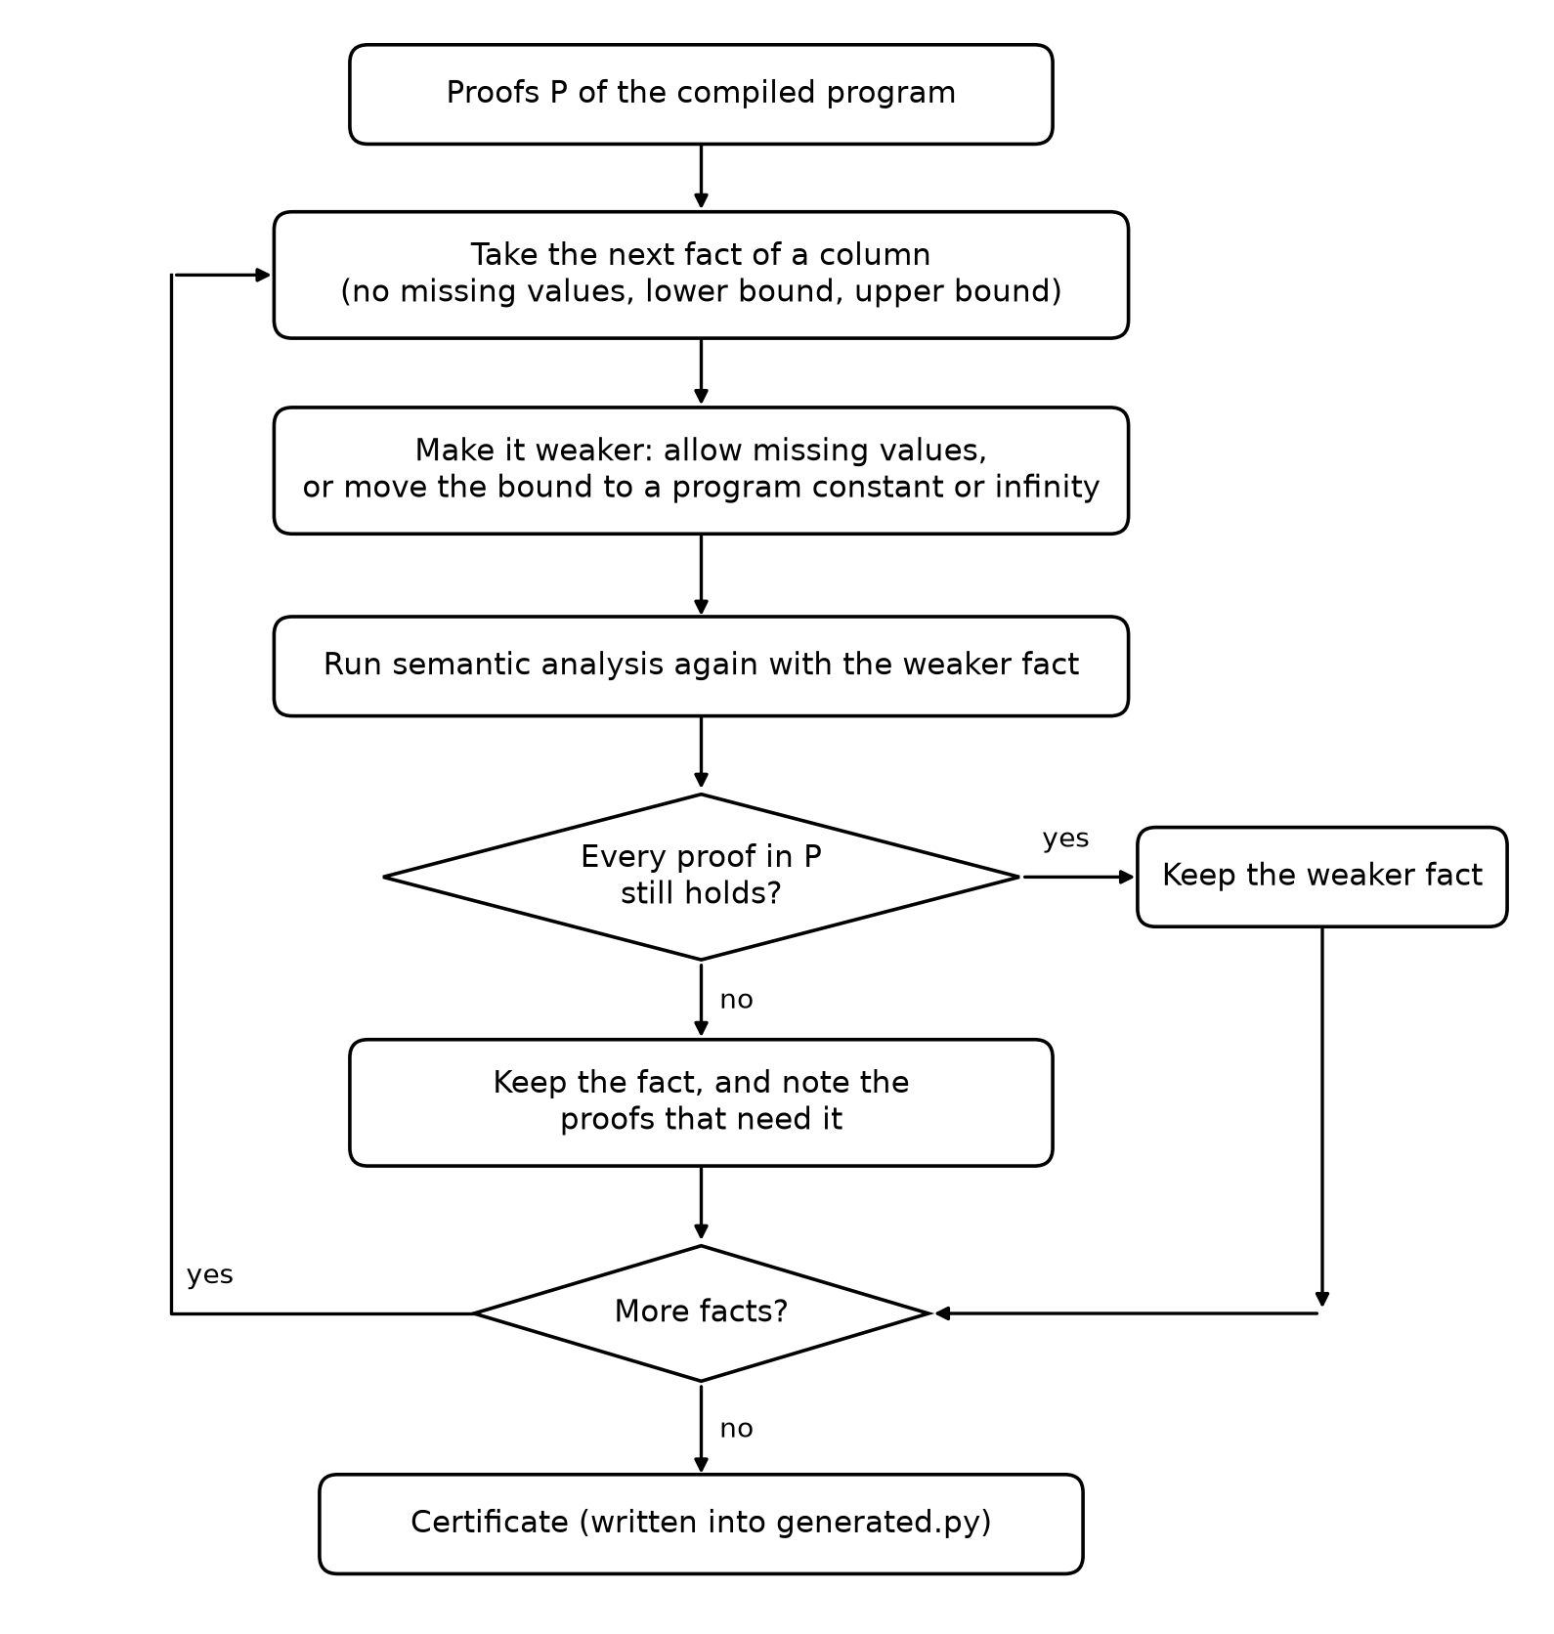
How the certificate is found, and why it is safe
1
Weaken one fact
allow missing values, or move a bound to a program constant or infinity
2
Analyse again
the whole semantic analysis, with no data read (facts replace files)
3
Keep or restore
keep the weaker fact only if every proof and removal survives
4
Sound
monotone transfer functions: an input inside the certificate keeps every proof
8

Slide 9
86% of new batches reused safely
244
new batches for 7 compiled programs, each also compiled fresh
0
admitted runs that differ from a fresh compilation
0
refused batches that a fresh compilation accepts
9

Slide 10
New: checking every cell beats a pandas read
One million CSV rows x 10 columns
One read, one piece per core, cut at line breaks
Cells viewed in place (string_view), no copies
Numbers parsed exactly in one pass (Clinger's fast path)
CRC-32 on its own thread; merge in file order gives the same facts and line numbers
10

Slide 11
Testing and evaluation
181
17
unit tests in 9 programs, all passing
recorded test cases: valid, invalid, boundary, run time
24 / 24
18 / 44
injected mistakes reported before processing
real GitHub failures reported before processing
11

Slide 12
Demonstration
1
Build
Ctrl + Shift + B in VS Code
2
Compile and run
students.prep: every phase, then the cleaned file
3
See the errors
examples/errors: line, caret and hint
4
Certificate
--certificate, then run on a new batch and a bad one
5
Tests
run all tests: 9 programs pass
12

Slide 13
Conclusion
Reading the data at compile time turns data mistakes into compile errors with clear messages.
Contracts are proven, refuted or checked; optimizations stay exact.
Data certificates reuse one compilation on new data: 86% of new batches, with no unsound run.
Next: certificates for image folders, joins and dates, a native backend.
Thank you

