Slide 1

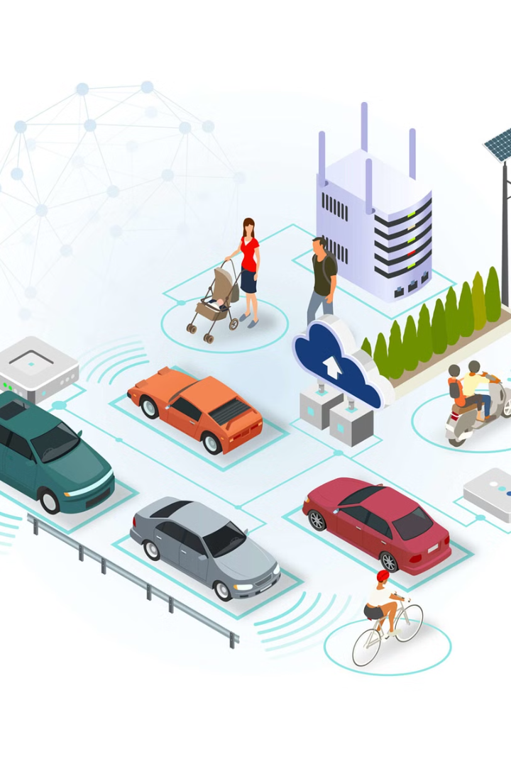
Introduction To IOV Dataset
The Internet of Vehicles (IoV) dataset represents a rich collection of real-time data gathered from connected vehicles, providing insights into traffic patterns, vehicle behavior, and road conditions.

Slide 2
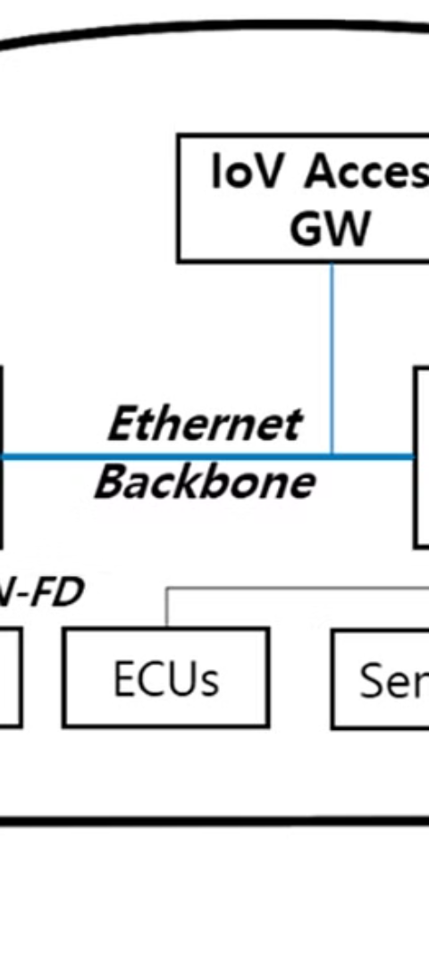
Dataset Overview
Data Sources
Data Volume
The dataset comprises data from various sources, including IoT devices, sensors, and user interactions.
The dataset contains a substantial volume of structured and unstructured data, providing a comprehensive view of IoV interactions.
Data Granularity
It includes granular data points capturing detailed insights into user behavior, vehicle performance, and environmental factors.

Slide 3

Data sources and collection methods
Our IoV dataset is sourced from various connected vehicles, IoT devices, and infrastructure sensors, capturing real-time data on road conditions, traffic patterns, and vehicle performance.
We employ a combination of GPS, vehicle-to-vehicle communication, traffic cameras, and onboard diagnostics to collect diverse, high-quality data.

Slide 4
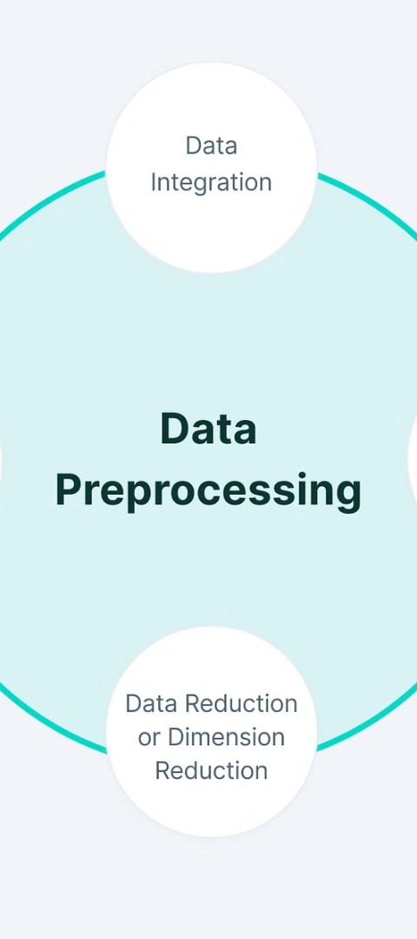
Data preprocessing and cleaning
1
Data Collection
Raw data gathered from multiple sources, including IoT devices and public databases.
2
Data Cleaning
Removing duplicate records, handling missing values, and standardizing data formats.
3
Preprocessing Steps
Normalization, feature scaling, and encoding categorical variables for analysis.

Slide 5
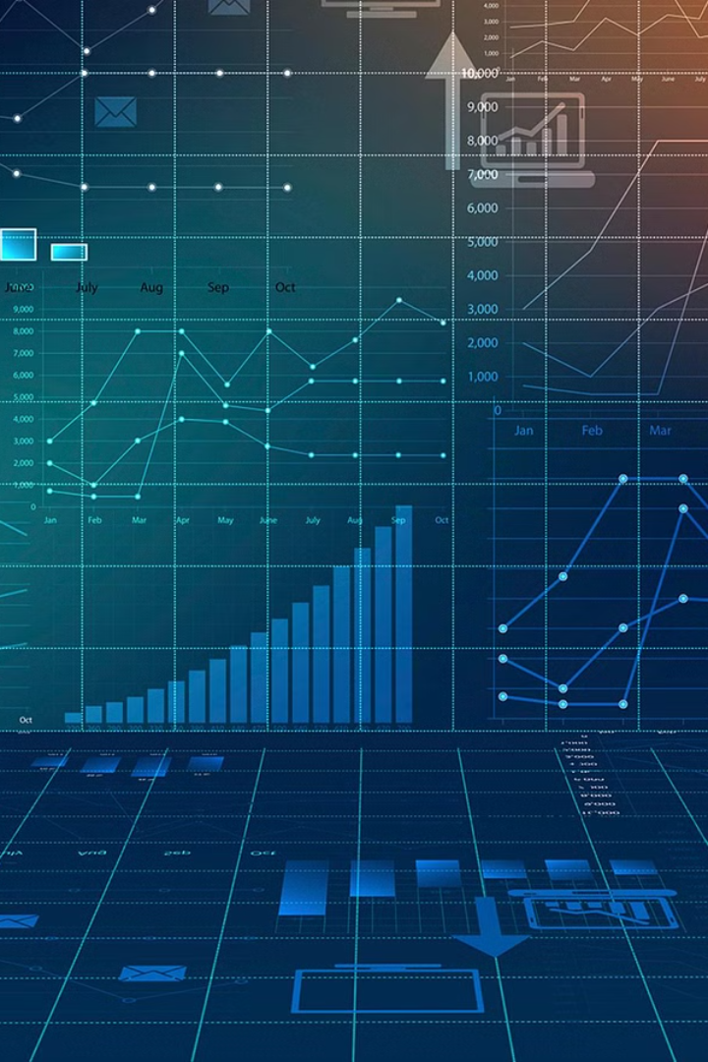
Key Features and Variables
When exploring the IoV dataset, the key features and variables provide crucial insights into the relationships and patterns within the data.
Variables such as user behavior, device interactions, and network performance play a significant role in shaping the outcomes of statistical and machine learning analyses.

Slide 6

Exploratory Data Analysis
Data Distribution: Frequency distributions, central tendency, and dispersion measures
Correlation Analysis: Identify relationships between variables
Missing Values: Examination of missing values and their impact on analysis

Slide 7
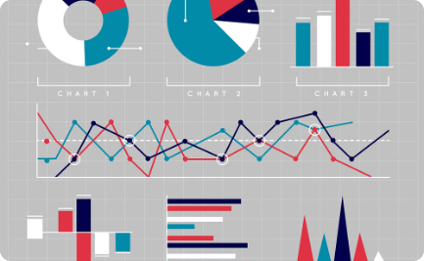
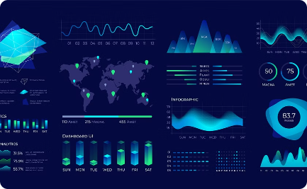

Data Visualization
Informative Charts
Visualizing Big Data
3D Data Visualization
Interactive and visually appealing charts to represent complex data sets.
Visualization techniques for understanding and exploring large-scale datasets.
Advanced 3D visualizations for analyzing multidimensional data.

Slide 8
Statistical Analysis
Data Distribution
Correlation and Regression
Hypothesis Testing
Statistical analysis involves examining the distribution of data to understand central tendencies and deviations.
Evaluating the significance of differences and relationships in the data through hypothesis testing.
Exploring relationships between variables using correlation coefficients and regression analysis.
Methods such as histograms and box plots can visually represent the spread of values.
Common tests include t-tests, ANOVA, and chi-square tests.
Identifying patterns and predicting outcomes based on statistical models.

Slide 9
Machine learning models and predictions
1
Model Selection
2
Hyperparameter Tuning
Choosing the right model depends on the nature of data and the problem at hand.
Fine-tuning parameters for optimal model performance is crucial in prediction accuracy.
3
Evaluation Metrics
4
Future Predictions
Assessing predictive models through various metrics like accuracy, precision, and recall.
Using trained models to make predictions on new data for real-world applications.

Slide 10
Conclusion and Future Work
As we conclude our analysis of the IoV dataset, future work should focus on improving data quality through enhanced sensor technologies and exploring advanced machine learning algorithms to make accurate predictions in real-time IoV applications.
5
ML
Improved Data Quality
Advanced Machine Learning
Focus on enhancing sensor technologies
Explore cutting-edge algorithms for real-time predictions
With a strategic approach to these areas, the IoV dataset can significantly contribute to the advancement of intelligent transportation systems.

