Slide 1
AI · EMERGENCY RESPONSE
AI-Based Emergency Ambulance Route Prediction System
A software prototype for intelligent emergency route planning.
PROPOSED PROTOTYPE
Traffic signals become route decisions.
Notes:
Introduce this as a software prototype for intelligent emergency route planning. The focus is decision support: use available traffic and location information to predict risk and recommend a better route.

Slide 2
THE PROBLEM
Unexpected traffic turns minutes into risk
1
2
3
Disruption
Delay
Risk
Congestion, accidents, roadblocks, construction, and events can disrupt an ambulance route.
Standard navigation may not anticipate future blockages effectively.
More travel time can reduce confidence in the first route choice.
Prototype opportunity: predict likely disruption, then recommend an alternative.
A route that looks clear now may become the slow route before the ambulance arrives.
Notes:
Frame the problem as a prediction gap. The system is not replacing the driver or promising certainty. It is designed to recognize likely disruption earlier and support a route decision.

Slide 3
PROPOSED SYSTEM · ROUTE DECISION
The proposed system turns traffic signals into a route decision
Five steps connect the trip request to a continuously updated recommendation.
01
02
03
04
05
Enter
Analyze
Predict
Compare
Update
Ambulance location and hospital destination.
Available traffic and location information.
Possible congestion or blockage.
Alternative routes and travel times.
Continuously refresh the recommendation.
Proposed prototype behavior · recommendation remains under human control.
Notes:
Walk left to right. The prototype begins with two locations, adds available information, predicts possible disruption, compares alternatives, and keeps the recommendation current.

Slide 4
PROTOTYPE SCOPE
Six objectives define the prototype
01
02
03
Reduce time
Detect blockages
Estimate congestion
Reduce predicted ambulance travel time.
Detect possible traffic blockages.
Use AI/ML to estimate congestion.
04
05
06
Recommend routes
Provide updates
Monitor movement
Recommend alternative routes.
Provide route updates.
Help emergency control centers monitor movement.
Notes:
These six objectives define what the prototype needs to demonstrate: prediction, route choice, updates, and visibility for the emergency control center.

Slide 5
USE CASE
Three users, one coordinated response
Each user sees a different part of the same route decision.
USER 01
SHARED SYSTEM FLOW
USER 03
Ambulance driver
Coordinated response
Hospital staff
Enters trip details and follows the recommended route.
Receives destination and arrival context.
Login
Route selection
Prediction
Monitoring
→
←
Notifications
USER 02
One prototype connects trip input, route choice, risk visibility, and communication.
OUTPUT
Emergency control center
Route notification
Monitors vehicles, traffic risk, and route changes.
Recommendation and changes remain visible to the response team.
Notes:
Explain the system through the users. The driver acts on the route, the control center monitors risk and changes, and hospital staff receives destination and arrival context.

Slide 6
PROTOTYPE WORKFLOW
From location data to a route recommendation
01
Ambulance location + hospital destination
02
Collect traffic and location data
03
Preprocess the data
04
Run AI prediction
05
Detect possible blockages
06
Compare alternative routes
07
Display the best route on the dashboard
08
Monitor traffic continuously
Prototype workflow; real-world data integrations are future implementation work.
Notes:
Follow the data through the system. The workflow ends in a dashboard recommendation, then loops back to continuous monitoring. Real-world data integrations remain future implementation work.

Slide 7
SYSTEM ARCHITECTURE
Three layers keep the system modular
01
PRESENTATION
What users see
Ambulance driver app and emergency control dashboard.
02
APPLICATION
What the system does
Route management, traffic monitoring, AI prediction, route recommendation, and notifications.
03
DATA
What the system stores
User, ambulance, traffic, road/route, and historical traffic data.
Notes:
The architecture separates interface, application behavior, and data. This keeps the prototype easier to explain, test, and extend.

Slide 8
AI BEHAVIOR
The AI component predicts risk, not certainty
The model supports a route decision; it does not guarantee the future.
INPUTS
MODEL
OUTPUTS
Signals from the trip
Suitable ML approach
Decision support
Current speed
Traffic density
Historical patterns
Road incidents
GPS/location information
Selected during implementation based on available data.
Predicted congestion
Estimated travel time
Possible blockage
Recommended route
The prototype explanation stays focused on software behavior rather than mathematical formulas.
Prediction informs the response team; it does not replace human judgment.
Notes:
Keep the AI explanation practical. Inputs describe the road situation, the model is selected during implementation, and outputs become route decision support.

Slide 9
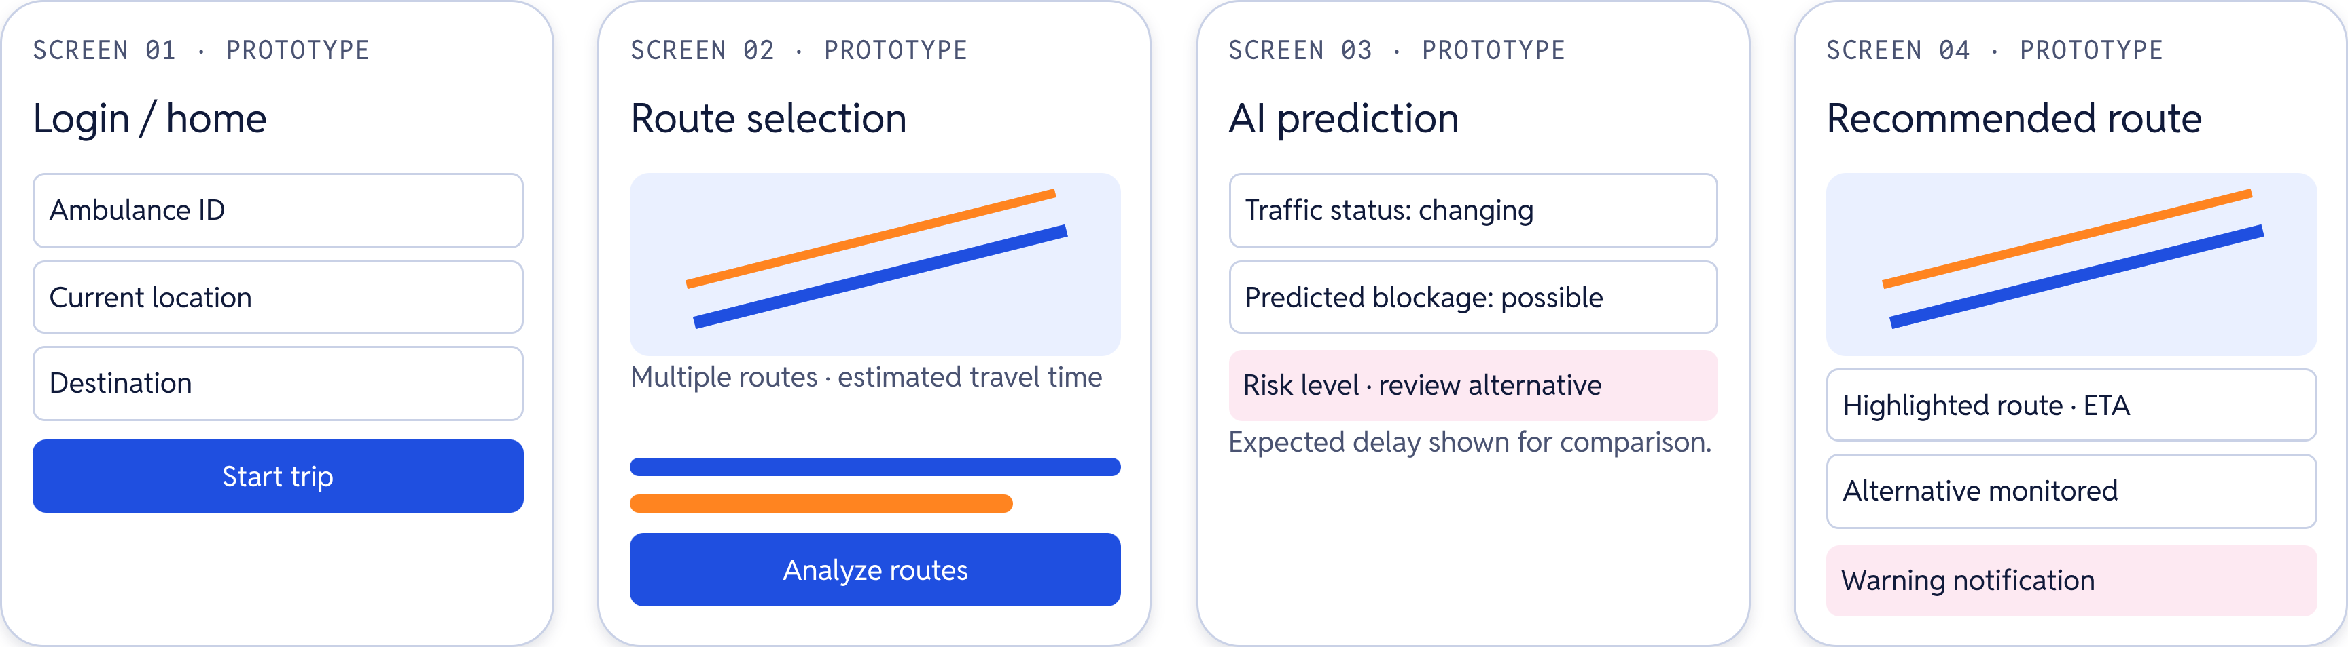
PROTOTYPE UI · EXAMPLE SCREENS
Prototype UI: four screens for one journey
A single trip moves from identity and location to recommendation and warning.
Realistic interface mockups for evaluation · prototype screens, not a deployed live system.
Notes:
Use the four screens to show one journey. Start with trip details, compare routes, inspect predicted risk, then present the highlighted recommendation and warning notification.

Slide 10
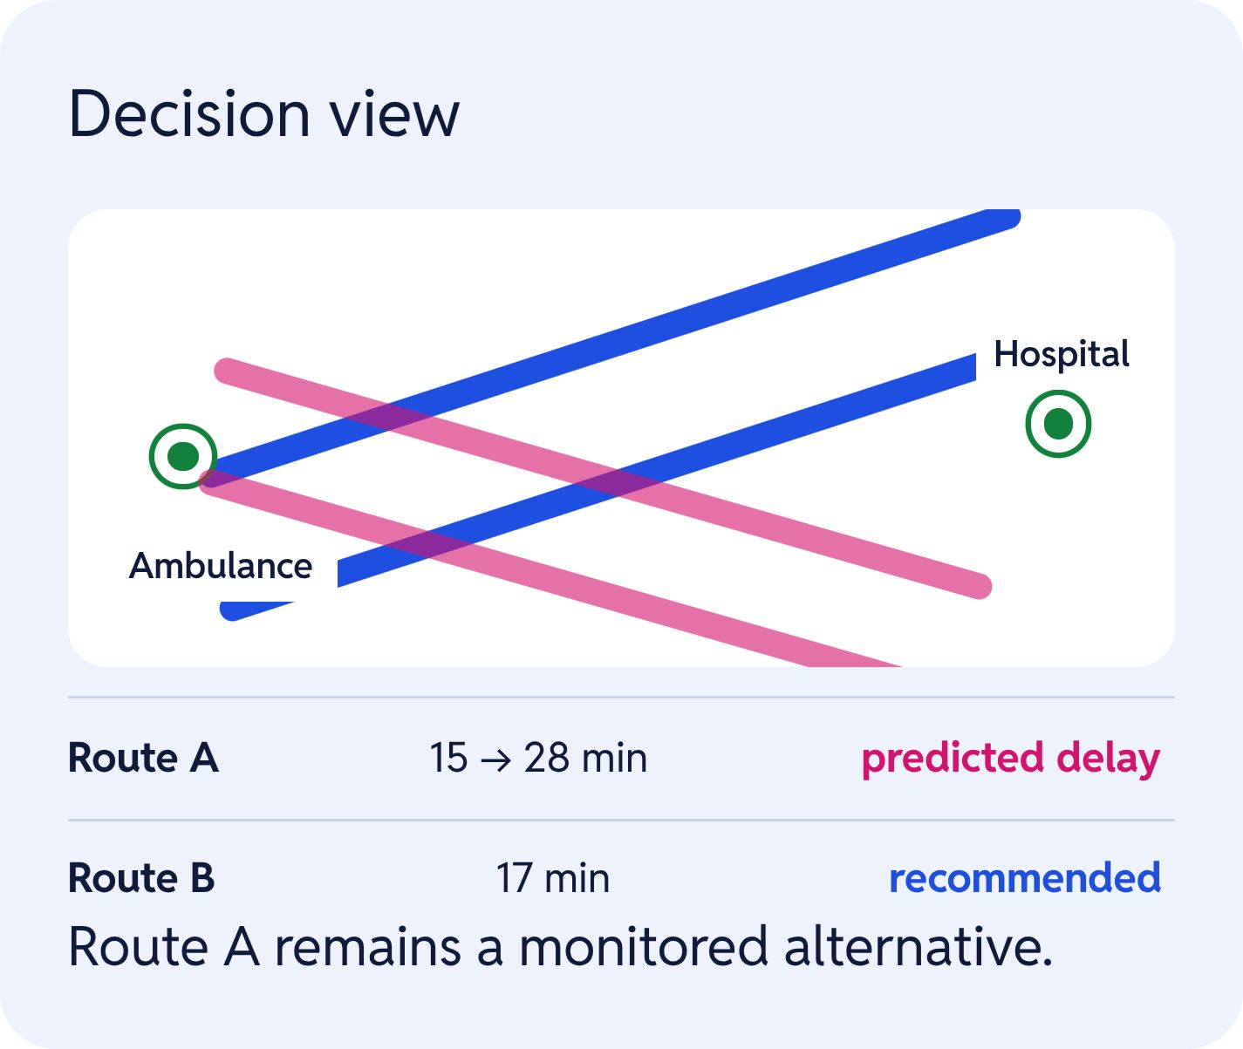
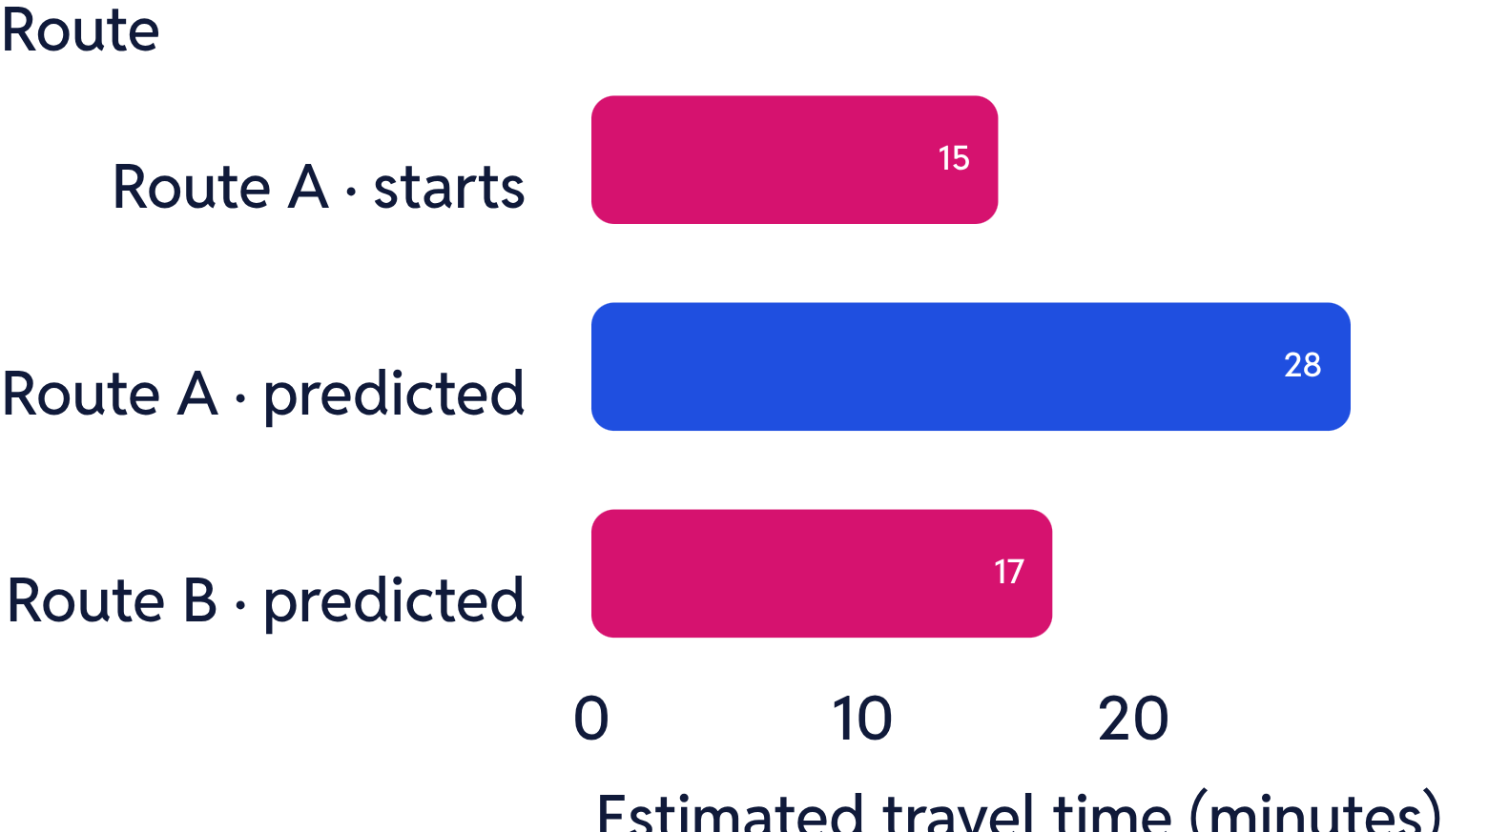
PROTOTYPE SIMULATION · EXAMPLE
Route B avoids the predicted delay
Situation: an ambulance needs to reach a hospital.
Illustrative prototype values · not a live result.
Notes:
Close with the prototype simulation. Route A begins at 15 minutes but rises to a predicted 28 minutes because of accident congestion. Route B is predicted at 17 minutes, so the system recommends Route B and keeps Route A monitored.

