Slide 1
SMART EMERGENCY ROUTING
Every minute matters in an emergency
How AI, traffic intelligence, and route optimization can help an ambulance reach the hospital faster.
Live signals · predictive routing · faster decisions
Notes:
Emergency routing is a moving decision, not a one-time map lookup. This deck follows how live traffic intelligence and AI can help an ambulance reach the hospital faster.

Slide 2
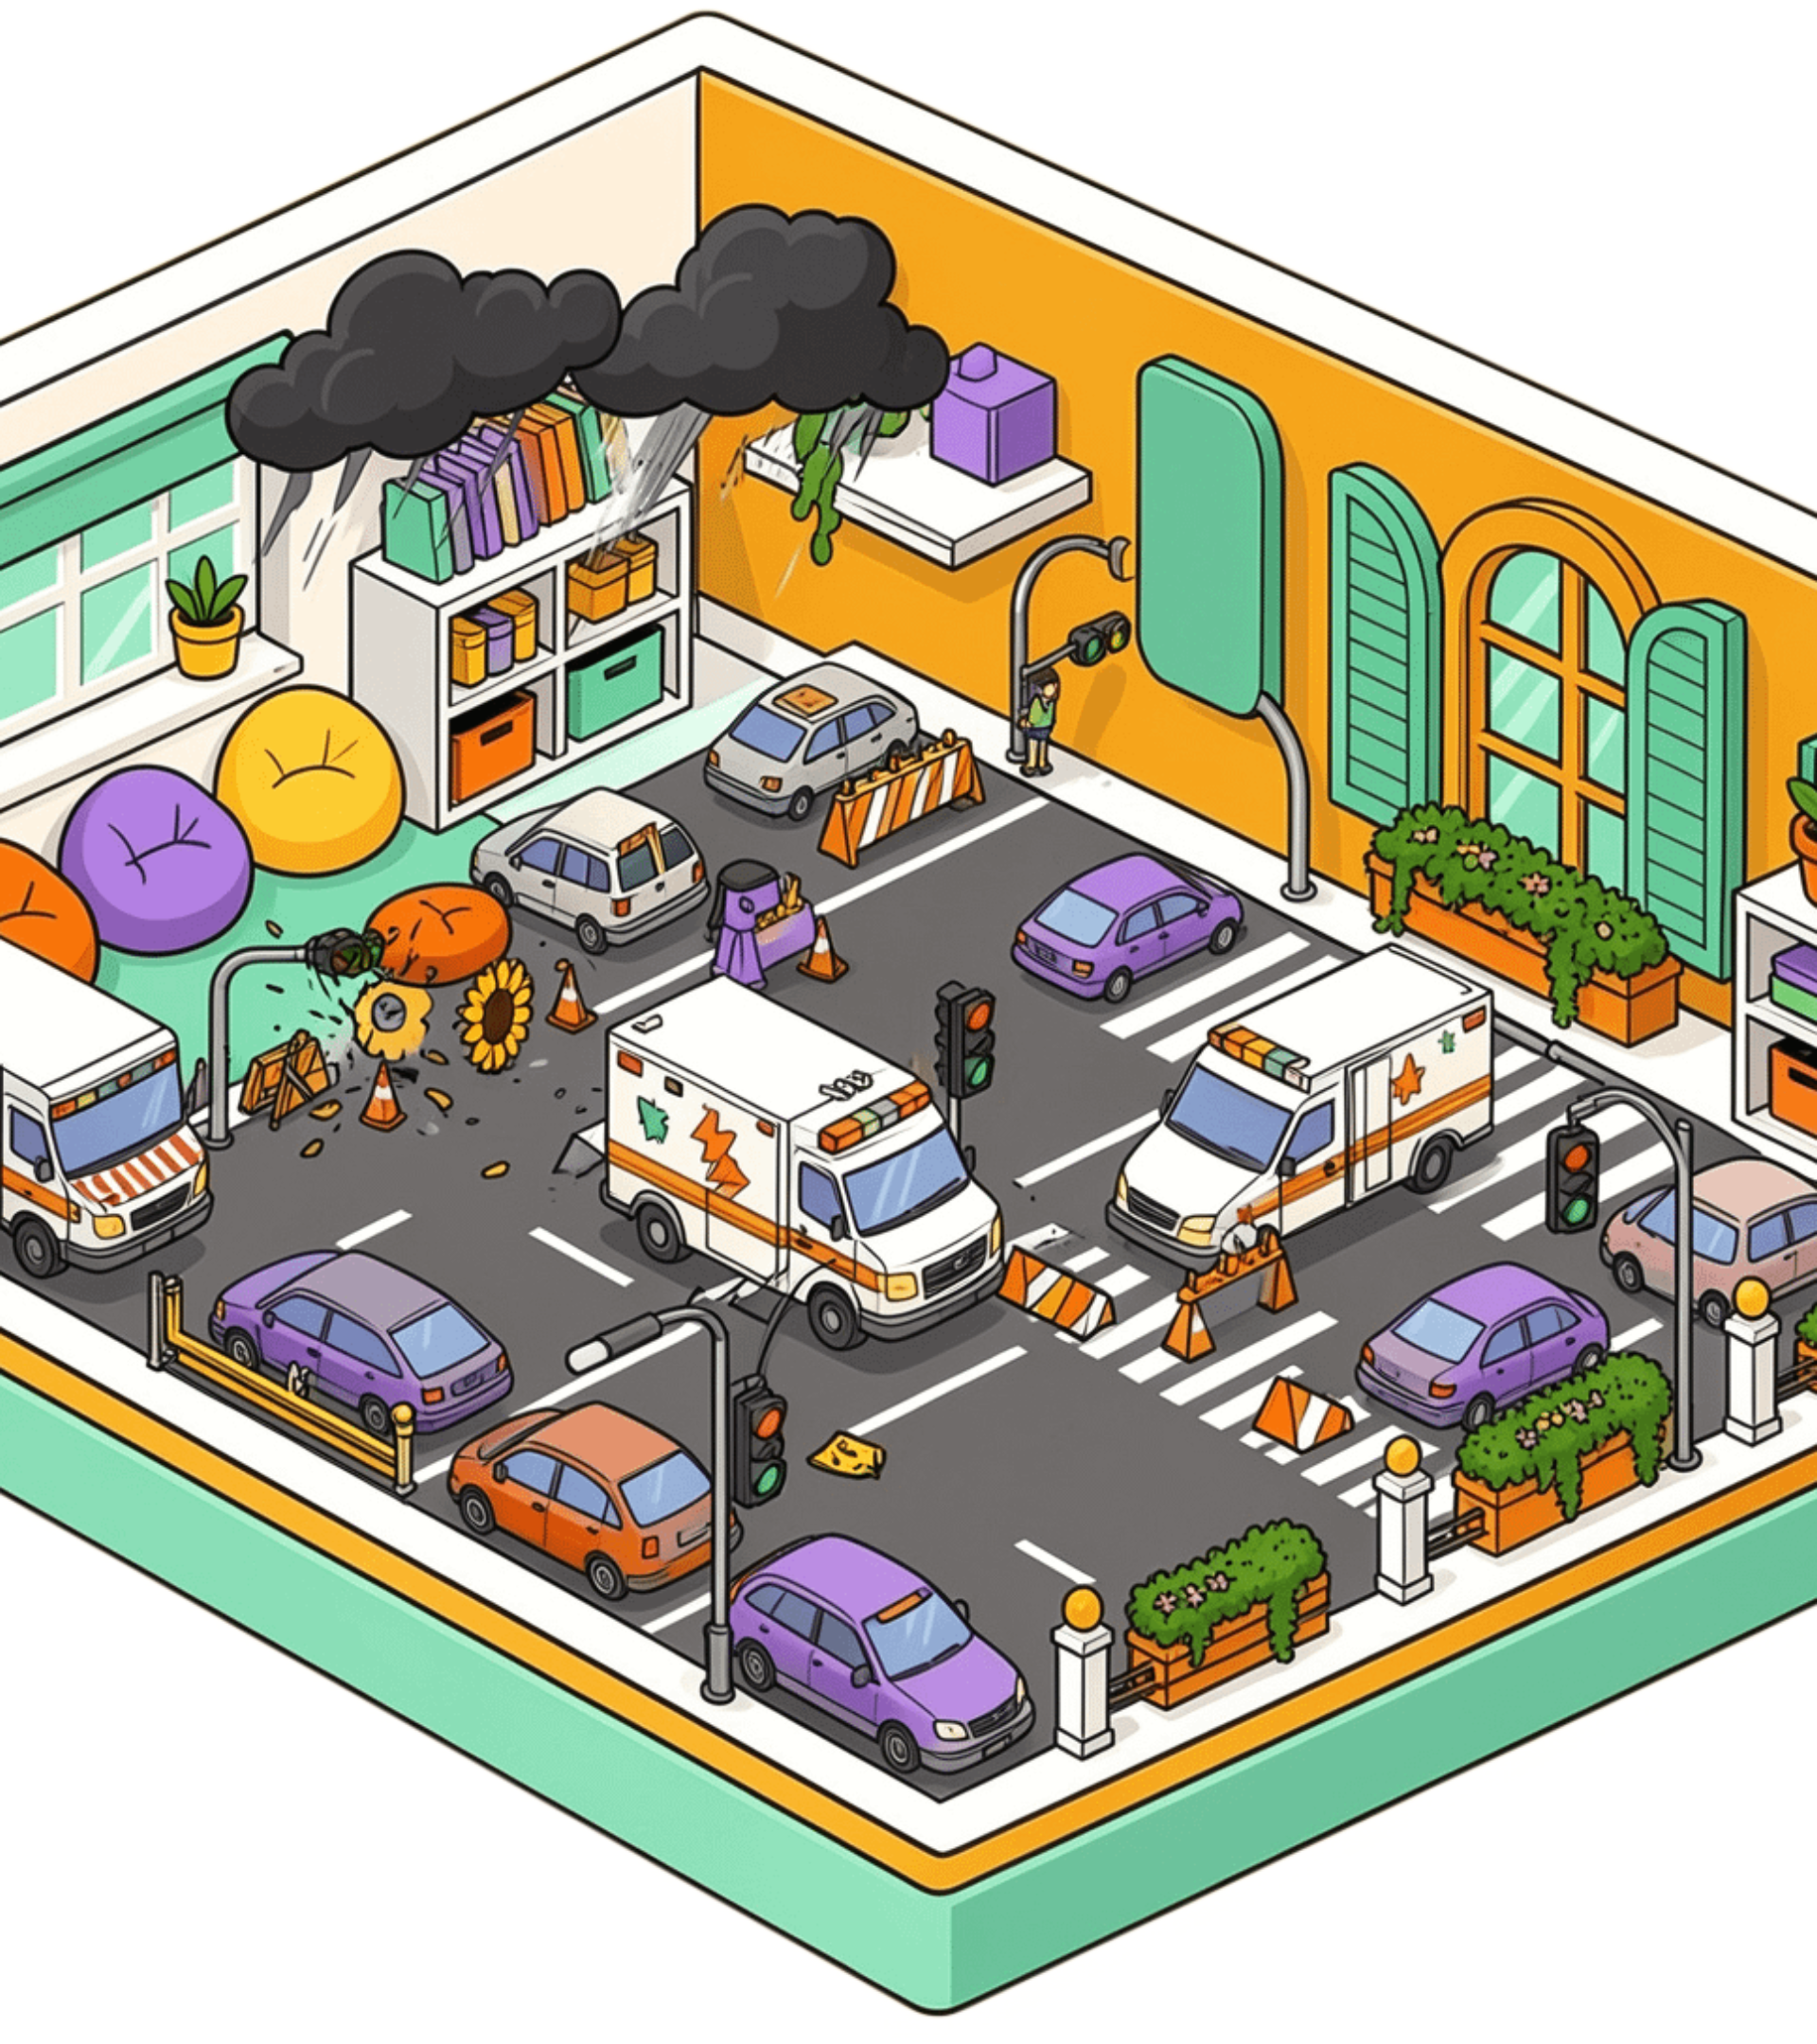
THE ROUTE IS NEVER STATIC
Unexpected traffic turns a route into a risk
Congestion, accidents, roadblocks, construction, events, and weather can make a normal navigation choice inefficient within minutes.
A route that looks clear on a map may already be slowing down.
Notes:
A standard navigation system often starts with what is already known. In an emergency, conditions can change faster than the route can be trusted.

Slide 3
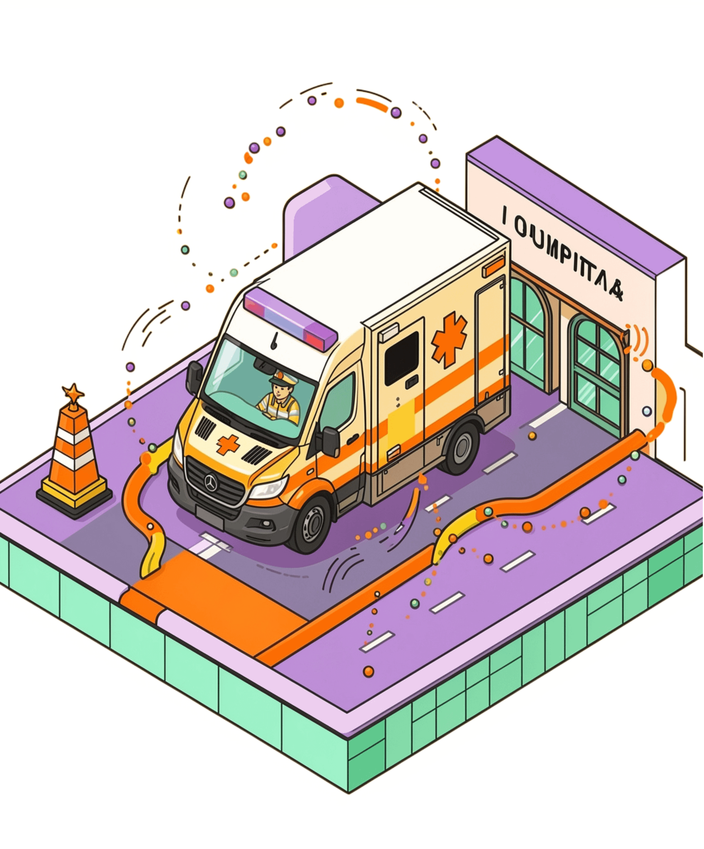
THE CORE IDEA
One AI system keeps the route one step ahead
It gathers live road data, predicts blockages, compares alternatives, and continuously updates the ambulance recommendation.
OBSERVE → PREDICT → RECOMMEND → UPDATE
Notes:
The system does not wait for a driver to discover a blockage. It combines what is happening now with what is likely to happen next, then keeps the recommendation current.

Slide 4
LIVE DECISION LOOP
From raw signals to a live route decision
Every stage turns uncertain road conditions into a recommendation the ambulance can act on.
01
02
03
Collect
Process
Predict
GPS, sensors, maps, historical traffic, incidents, weather, vehicle reports
Clean, align, and combine signals into one road picture
Estimate congestion and travel time ahead
04
05
06
Optimize
Navigate
Update
Compare routes against time and reliability
Send the recommendation to the ambulance
Recalculate whenever conditions change
Notes:
The workflow is continuous. Signals enter the system, become a prediction, shape an optimized route, and return to the vehicle. New signals then restart the loop.

Slide 5




WHY MACHINE LEARNING HELPS
The model learns the patterns humans miss
Past patterns
New signals
What usually happens
What is happening now
Historical traffic data teaches the model how roads behave across conditions and time. As more data arrives, its predictions can improve.
The goal is a better estimate of congestion level or travel time before the delay is obvious.
Feedback
Prediction
What the outcome teaches
What may happen next
Notes:
Humans are good at responding to visible events. A model can also learn recurring relationships: how speed changes before a blockage, how weather shifts travel time, and which routes recover fastest.

Slide 6
ROUTE OPTIMIZATION
Choose the fastest reliable route, not just the shortest
Predicted fastest reliable option
Shorter on the map
Ambulance → reliable route → Hospital
Ambulance → shorter route → Hospital
Locate
Compare
Recalculate
Ambulance + hospital
Generate alternatives; predict each travel time; select the best option.
Update when conditions change.
Notes:
The best route is the one most likely to arrive quickly, not necessarily the one with the fewest road miles. The algorithm keeps comparing alternatives as conditions change.

Slide 7
EARLY WARNING
A blockage becomes visible before it becomes a delay
Several weak signals can become one strong reason to reroute.
Vehicle speeds fall
GPS movement slows
Traffic density rises
Slowing traffic signals a developing blockage.
Vehicle location data confirms the slowdown.
More vehicles add evidence of a delay.
Camera or sensor alert
Incident or construction report
Reroute triggered
Live detection adds another signal.
Weather and incident reports add context before the route visibly stops.
Reports explain what may be blocking the route.
Notes:
No single signal has to be perfect. Falling speeds, GPS movement, cameras, sensors, incident reports, construction, weather, and rising traffic density can reinforce one another until a reroute becomes the safer decision.

Slide 8






SYSTEM ARCHITECTURE
A connected architecture turns data into action
Data sources
Collection
Processing
AI prediction
GPS · sensors · maps · incidents · weather · vehicle reports
Bring signals together in real time.
Clean, align, and prepare the road picture.
Estimate blockage risk and travel time.
Route optimization
Action layer
Choose the fastest reliable alternative.
Dashboard and ambulance navigation keep people aligned.
The same live picture supports the driver and the control center.
Notes:
The value comes from connection. Data sources feed a shared pipeline, prediction informs route optimization, and the result reaches both the ambulance driver and the control center.

Slide 9

SCENARIO
An 18-minute route becomes a 32-minute trap
Before the accident prediction
At 15 minutes
18 min
15 min
Original route appears fastest. The blockage has not yet changed the visible map.
Alternative route recommended before the predicted blockage becomes a 32-minute delay.
Notes:
This is the operational difference. The original route normally takes 18 minutes, but an accident prediction changes its expected travel time to 32 minutes. At 15 minutes, the system recommends an alternative predicted to take 15 minutes.

Slide 10
THE OUTCOME
Better routing creates better emergency outcomes
Faster response. Reduced travel time. Earlier blockage detection. Dynamic updates. Better use of the road network. Quicker hospital access. Stronger control-center support.
Every minute matters in an emergency.
Notes:
Close on the chain of outcomes: better signals support better predictions, better predictions support better routing, and better routing supports emergency teams when the margin for delay is smallest.

