Slide 1

Memory/Cache hierarchy Optimizations for SAT solvers
Group Members
Injarapu Nikhil(210050069)
Dittu Akanksh(210050079)
Divakar Sai(210050143)

Slide 2

Main Motive of this project?
Analysing CPU performance by varying:
Cache inclusion policies
Replacement policies
Cache sizes
Comparing these values with baseline cache hierarchies

Slide 3

Steps to be implemented:

Slide 4

Implementation of different cache inclusion policies
Implementation of different replacement policies
Compute the main parameters like IPC, miss rate for different combination with these policies .

Slide 5
Use different cache sizes and plot some insight graphs.
Analysing the changes in the values and draw conclusions regarding the cause.

Slide 6

What are cache inclusion policies and cache hierarchies?

Slide 7
Cache inclusion policies are the rules by which a data block is stored inside the cache hierarchy.
You will get this when we discuss some inclusion policies.
The cache inclusion policies we will discuss are:
Inclusive
Exclusive
Non Inclusive and Non Exclusive(NINE)

Slide 8
Non inclusion Non exclusion policy(NINE)
NINE may or may not contain the blocks from lower levels.
We will be using Champsim simulator which implements NINE
Policy as baseline.
To implement other policies we need do some small
changes to the given code.
L1
L2

Slide 9
Inclusive policy
An inclusive cache level contain all data blocks from lower levels plus some other blocks.
Let us say a data block X is present in L1, then it must be present in L2.
However, the vice versa of above statement need not
be always true
L2
L1

Slide 10
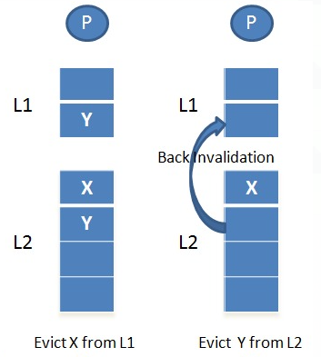
Implementation of inclusive policy(from NINE)
If the block is evicted from L2 or LLC then the block should also be evicted from all the upper level caches to preserve inclusivity. This step is called back-invalidation step.
When implementing back-invalidation the dirty blocks should be taken care of and should be sent to lower level WQ.

Slide 11
Exclusion policy
An exclusive cache does not include any replicated block from the lower level.
Let us say there is a block X in L1 then it
will not be present in L2
In this case the converse is also true.
L1
L2

Slide 12
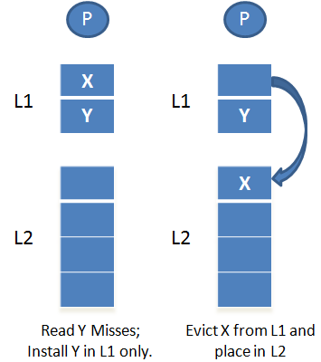
Implementation of Exclusive policy
When a data is extracted from memory, it is placed directly in the L1 cache(not in others).
While writing this block into L1 the victim block should be added to the WQ of lower level.
If there is no space left in lower level and the victim block is dirty, then it cannot be replaced.

Slide 13
 | Inclusive | NINE | Exclusive
Data replication | Always present | May or may not be present | None
Benefits | Simple coherence, no copy back necessary | Simple to implement | Highest effective capacity
Drawbacks | Wastes cache space, back invalidations | Data replication on a miss, complex coherence | More complex on a LLC hit
Trade off between different cache inclusive policies

Slide 14

Cache replacement policies
These are the rules which are used to find the victim for evictions inside the cache. Some of the replacement policies are:
LRU – Least Recently used
LFU – Least frequently used
FIFO – First In First out
RAND – Random
All these replacement policies implementation i.e code part was already done in Lab5 which we will be using here.

Slide 15

Computing the values of interest ( IPC, miss rate) and generating graphs using the above implementations

Slide 16
The following is the result obtained for various inclusion policies and replacement policies with a fixed cache size of 2048 x 16 for a specific trace:
 | LFU | FIFO | RAND | LRU
Inclusive | 0.302844 | 0.303439 | 0.301763 | 0.30403
Exclusive | 0.301042 | 0.304609 | 0.303095 | 0.304812
NINE | 0.305799 | 0.304157 | 0.304898 | 0.304251

Slide 17
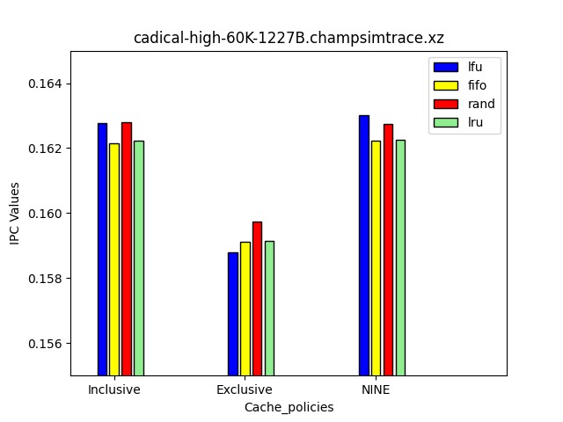
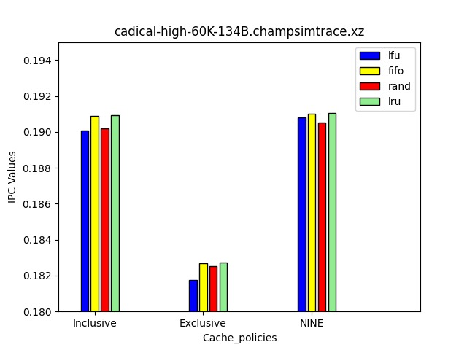
The results obtained by running the code for different traces are:

Slide 18
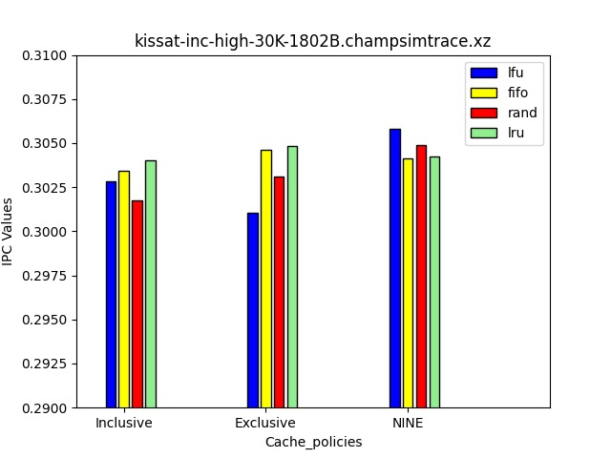

Slide 19
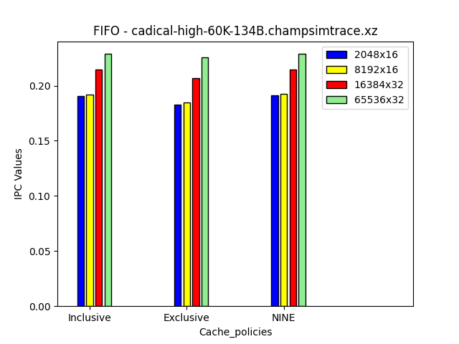
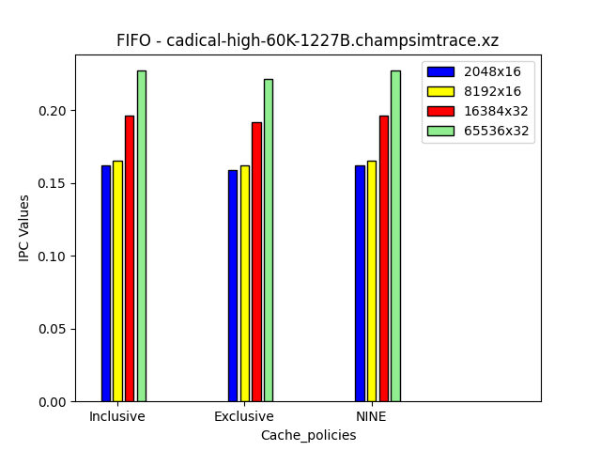
The bar graphs outcomes obtained by changing the cache size and cache inclusion policies while maintaining a specific replacement policy(fifo) are as follows:

Slide 20
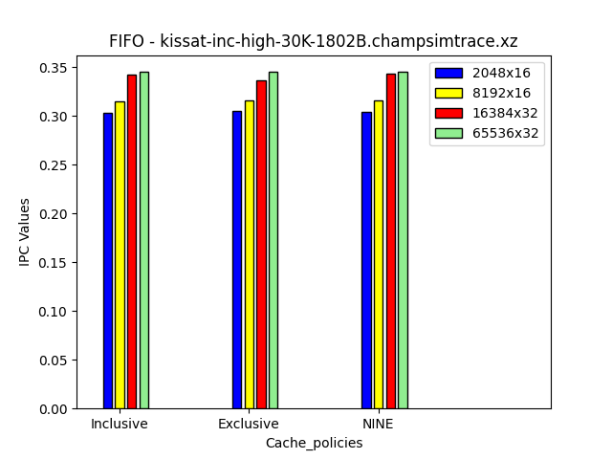

Slide 21

Analyzing the Results obtained

Slide 22
Observations about the CaDiCal SAT solver
Inclusive and NINE policies are more efficient than exclusive.
Cadical sat solver uses a backtracking algorithm to solve SAT problems.
Inclusive and Non inclusive policies refer to the way that the solver handles the learned clauses.

Slide 23
Observations about the CaDiCal SAT solver
In exclusive policy solver immediately removes all the learned clauses that contains a literal that is assigned false.
Inclusive and NINE are more efficient because they allow the solver to keep more learned clauses in cache.This inturn reduces the miss rate.

Slide 24
Observations about KISSAT solver
Exclusive and NINE policies are more efficient than inclusive policy for managing the cache of learned clauses.
Main advantage of exclusive and NINE is that they reduce CACHE pollution.
They also reduce the memory
requirements of the Solver

Slide 25
Observations about KISSAT solver
FIFO policy is more efficient than LRU because of the way the Solver accesess and modifies data structures during its operations.
Due to Random access patterns LRU is not preferred.

Slide 26
Cadical Solver vs KISSat solver
The Cadical solver accesses a greater amount of data than the KISSat solver. As a result, if the cache size is increased, there will be a significant improvement in IPC in the Cadical solver compared to the KISSat solver.
Cadical solver accesses data with a high degree of spatial and temporal locality. Due to this cache memory is more effective.
While KISSat solver accesses data in a more Random way.Due to this large cache size don’t benefit much.

Slide 27
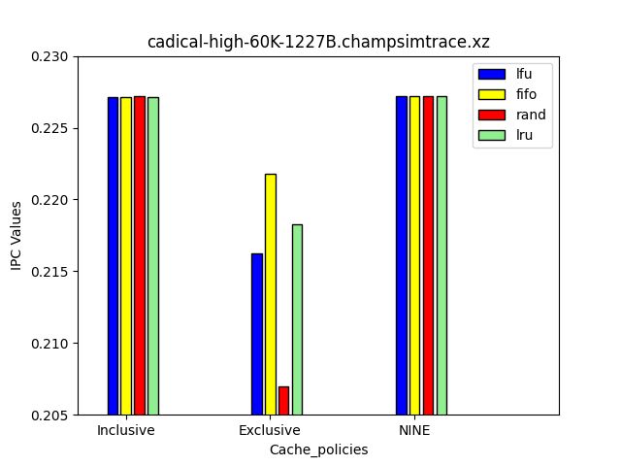
Inference about Cache sizes
When the cache size is increased, the IPC for both inclusive and NINE policies are almost same, regardless of the replacement policy used.
However in the exclusive part the IPC values follow the given order: fifo > lfu > lru > rand

Slide 28
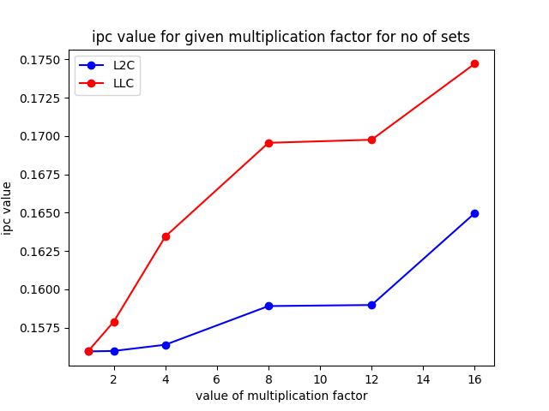
Inference about Cache sizes
Memory Access Patterns: If the application or workload being executed on the processor exhibits a large working set size , increasing the size of the LLC can significantly reduce the number of cache misses and improve performance than that of L2C.

Slide 29

THANK YOU

