Slide 1
E-RAKSHAK HACKATHON 2026 · PROBLEM STATEMENT PS-08
Surat Traffic Intelligence
Data-Driven Traffic Optimization & Adaptive Infrastructure Intelligence
Real-time lane density from CCTV · adaptive signal optimisation · bottleneck detection
— with two signal controllers, each validated on data that can actually support it.
CAMERAS
ZONES
WINDOWS
CHECKS
7
21
2,451
18/18
TEAM
[TEAM NAME]
[Member 1] · [Member 2] · [Member 3] · [Member 4]

Slide 2
PROBLEM STATEMENT
PS-08 — what is being asked
Use the city's existing CCTV network to measure, optimise and predict — without new hardware.
▪ Measure traffic density per lane, from existing CCTV feeds
▪ Optimise signal timing adaptively, from what is actually measured
▪ Detect bottlenecks and identify where they form
▪ Recommend improvements to infrastructure, with evidence
WHAT WE WERE GIVEN
Source
7 Surat CCTV clips
Resolution
1920×1080 @ 20 fps
Duration
≈31.5 min total
Ground truth
none
Camera calibration
none
Signal timing data
none
The constraint that shaped everything
No surveyed reference ships with this data, so no pixel-to-metre scale can be recovered from it. The system separates what it measures from what it estimates, rather than quietly presenting one as the other.
Surat Traffic Intelligence · E-Rakshak Hackathon 2026 · PS-08
2

Slide 3
PROBLEM UNDERSTANDING
What this data can — and cannot — support
Reading the footage before writing the system changed the design twice.
Camera
Scene
Mode
What it can support
GauravPath
Divided arterial, marked lanes
junction
Lane density, signal timing
Rokadiya Hanuman
Divided multi-lane road
junction
Lane density, signal timing
Chauta Bazaar
Dense market street
area
Occupancy, crowding, alerts
Mahidharpura
Near-total gridlock
area
Occupancy, crowding, alerts
Gopi Talav
Pedestrian-dominant gate
area
Occupancy, crowding, alerts
Rly Station
Station forecourt
area
Occupancy, crowding, alerts
Central Bus Depo
Depot platform
area
Occupancy, crowding, alerts
Only 2 of 7 cameras can support the requested measurement
Five cameras watch market streets, a station forecourt and a bus depot — no lane discipline, no signal to optimise. "Lane density" is not a measurable quantity there, so forcing it would mean inventing numbers. Those run in area mode instead.
Surat Traffic Intelligence · E-Rakshak Hackathon 2026 · PS-08
3

Slide 4
PROBLEM UNDERSTANDING · THE KEY DISCOVERY
In the worst gridlock, detection counts fewer vehicles
The failure mode that would have inverted every ranking in the system — silently.
Camera
Detections
Actual condition
▪ Cause. At extreme density a wall of overlapping vehicles stops being separable and the detector's recall collapses.
▪ Risk. A naive "more detections = more congestion" system would rank Surat's worst street among its emptiest — confidently, and backwards. Every number would look plausible.
▪ Fix. A texture-based occupancy index (Canny edge density against absolute cross-camera bounds) which has no notion of an object, so occlusion cannot defeat it.
Rokadiya Hanuman
7,664
flowing arterial
Central Bus Depo
2,905
busy
GauravPath
1,957
free-flowing
Mahidharpura
463
worst gridlock in dataset
Result
Mahidharpura now flags 452 of 453 windows as saturated and ranks correctly as the most congested site. The occupancy index is normalised against absolute bounds measured across all seven cameras, so a value of 0.8 means the same thing on every camera.
Surat Traffic Intelligence · E-Rakshak Hackathon 2026 · PS-08
4

Slide 5
PROPOSED SOLUTION
Two controllers, two datasets, one hard boundary
Surat's junctions run Webster's. Max-pressure is validated on FLUID. Neither borrows from the other.
Webster's
Max-pressure (Varaiya 2013)
Needs to observe
arrival flow per approach
approach queue AND the queue it discharges into
Cameras required
one per approach
one per approach + one per receiving link
Surat CCTV provides
✔ exactly this
✘ no camera watches a receiving link
Runs on
the 7 Surat clips — every operational figure
FLUID: 14 drone recordings, 3 real intersections
On Surat it reports
cycle, splits, delay, saturation
greedy-queue — and refuses to name a phase
Why not just drop the missing term?
Because that does not give a degraded max-pressure — it gives greedy queue control, which Varaiya's §3.1 Example 2 proves fails to stabilise demands max-pressure handles. So rather than fake it, a dataset containing the missing term was obtained, and the controller is validated there.
Surat Traffic Intelligence · E-Rakshak Hackathon 2026 · PS-08
5

Slide 6
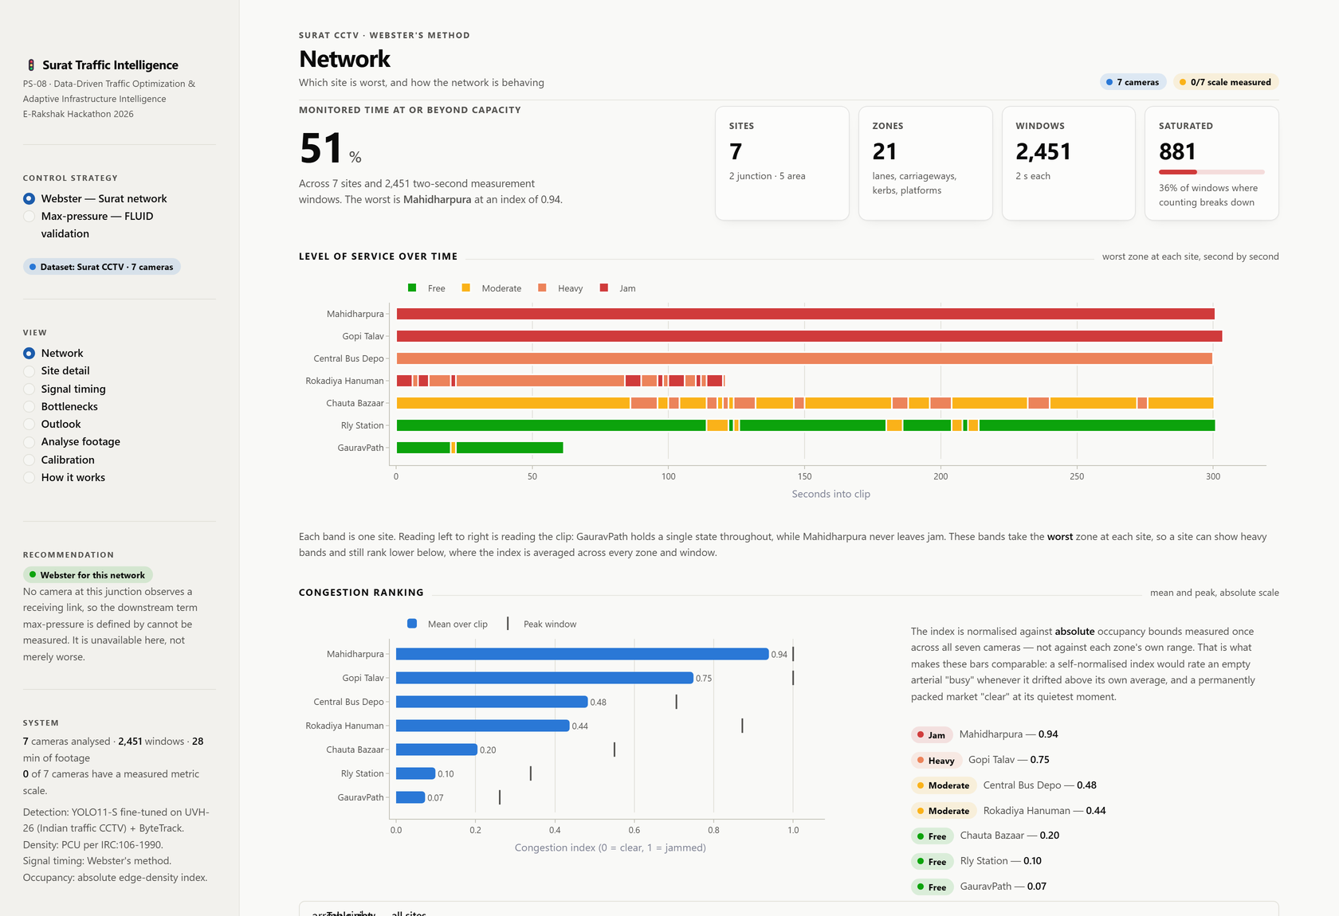
KEY FEATURES
One dashboard, two tracks, thirteen views
TRACK 1 — WEBSTER'S · SURAT CCTV
▪ Network — LOS bands and congestion ranking
▪ Site detail — zones, overlay, heatmap, trends
▪ Signal timing — cycle, splits, delay, saturation
▪ Bottlenecks — every alert with its evidence
▪ Outlook — forecasts with prediction bands
▪ Analyse footage · Calibration · How it works
TRACK 2 — MAX-PRESSURE · FLUID DRONE
▪ Validation — replayed against 3 real signals
▪ Scene — aerial with live queue shading
▪ Phase pressure — every movement's terms
▪ Head-to-head — 3 demand regimes simulated
▪ Method — what the data can and cannot say
Surat Traffic Intelligence · E-Rakshak Hackathon 2026 · PS-08
6

Slide 7
TECHNOLOGY STACK
Chosen for what the data needs
Layer
Choice
Why this one
Detector
YOLO11-S
Better on small, distant, partly occluded vehicles
Weights
UVH-26 fine-tune
Indian CCTV domain; 14 classes incl. auto-rickshaw
Tracker
ByteTrack
Associates low-confidence detections in crowds
Density unit
PCU · IRC:106-1990
The unit Indian capacity standards are defined in
Signal method
Webster's + HCM delay
Needs only what one camera per approach sees
2nd controller
Max-pressure (Varaiya)
Throughput-optimal — gated on observability
Saturation flow
IRC:SP:41-1994, S = 525·W
Width-based; lane count is unrecoverable here
Occupancy
Canny edge density
No object resolution needed — survives saturation
Dashboard
Streamlit + Plotly
Operator view without a JS build step
Language
Python 3.11 · PyTorch 2.5 · OpenCV
GPU-accelerated, standard
Hardware: NVIDIA RTX 3050 6 GB laptop GPU. No cloud training was needed — the UVH-26 weights removed the training step entirely.
Surat Traffic Intelligence · E-Rakshak Hackathon 2026 · PS-08
7

Slide 8
SYSTEM ARCHITECTURE DIAGRAM
From video frame to signal recommendation
1 DETECT + TRACK
detector.py
YOLO11-S · ByteTrack
2 LOCATE
zones.py
lane / zone polygons
3 MEASURE
metrics.py
two parallel paths
DETECTION PATH
PCU density, speed, queue, flow (q = k·v)
OCCUPANCY PATH
texture-based index — survives saturation
4 OPTIMISE
signal_opt.py · maxpressure.py
5 BOTTLENECKS
bottleneck_detect.py — 5 patterns
6 PREDICT
forecast.py — damped trend + band
7 PRESENT dashboard.py — two tracks, 13 views
Standards, not guesses.
IRC:106-1990 (PCU) · IRC:SP:41-1994 (saturation flow) · IRC:103-2012 (pedestrian green)
Surat Traffic Intelligence · E-Rakshak Hackathon 2026 · PS-08
8

Slide 9
WORKFLOW / PROCESS FLOW
End to end, in five steps
One command runs the dashboard; the full pipeline is five steps from raw video.
01
Reference frames
One clean frame per camera, for every overlay drawn later.
02
Calibration
Lane / zone polygons traced, then validated against a movement heatmap.
03
Analyse
Detect → track → assign to zone → measure. Writes one row per zone per 2 s window.
04
Optimise & detect
Webster's cycle and splits; five sustained-pattern bottleneck detectors; damped-trend forecast.
05
Present
Two-track dashboard. Every chart has a table beside it, so no value is reachable only by hovering.
Reproducible without the video
The metrics CSVs are committed, so the entire Webster track — every operational figure in this deck — runs immediately with no video download, no GPU and no model weights.
Surat Traffic Intelligence · E-Rakshak Hackathon 2026 · PS-08
9

Slide 10
AI / ML MODELS
The weights matter more than the architecture
Model
UVH-26-MV-YOLOv11-S
▪ Why this fine-tune. Same domain as our footage, and it carries the auto-rickshaw — a class COCO does not have at all, and which dominates most of these clips.
▪ We did not train it. Used as published. That removed the need to train on an unlabelled dataset.
▪ Density in PCU, not counts. Twelve two-wheelers and twelve buses are not the same amount of traffic. IRC:106-1990 factors.
Source
HuggingFace iisc-aim/UVH-26 @ v1.0
Trained on
26,646 annotated 1080p frames
Domain
Indian Safe-City CCTV
Classes
14 India-specific vehicle types
Tracker
ByteTrack (crowded-scene association)
Throughput
≈12 FPS @ 960px on RTX 3050 6 GB
Flow is never counted from tracker IDs
ByteTrack reissues IDs whenever a track drops briefly — constant in dense mixed traffic — so counting them inflated flow tenfold, to 12,000–23,000 PCU/hr against a real saturation flow near 1,800. Flow comes from the fundamental relation q = k·v instead, on directly measured density and speed.
Surat Traffic Intelligence · E-Rakshak Hackathon 2026 · PS-08
10

Slide 11
RESULTS · SURAT
The operational system — Webster's
Baseline is an untuned fixed timer with equal green splits.
WORST-APPROACH SATURATION
CYCLE LENGTH
MEAN DELAY
EVIDENCE PRODUCED
1.01 → 0.929
135.6 s
−3.8 %
31 alerts
Crosses back under 1.0 — the queue clears within the cycle again
Optimal, against a 120 s fixed baseline
53.5 → 51.4 s/PCU, HCM control delay
plus 21 zone forecasts with prediction intervals
#
Site
Mode
Congestion
Saturated
TWO INDEPENDENT CHECKS
1
Mahidharpura – Diamond Mkt
area
0.939
452 / 453
▪ Cycle sweep. Empirical delay minimum lands at 130 s against Webster's closed form of 135.6 s.
▪ Equal saturation. The optimal plan equalises degree of saturation across approaches (0.929 / 0.929) — the known optimality condition.
2
Gopi Talav Gate
area
0.749
167 / 456
3
Central Bus Depo
area
0.483
213 / 450
4
Rokadiya Hanuman
junction
0.437
0 / 244
5
Chauta Bazaar
area
0.205
4 / 453
Surat Traffic Intelligence · E-Rakshak Hackathon 2026 · PS-08
11

Slide 12
RESULTS · FLUID
Max-pressure, validated on real signals
Replaying max-pressure against what each real fixed-time signal actually did.
Intersection
Cycle
Real signal: green
with nothing to relieve
Max-pressure
SIMULATED COUNTERFACTUAL
FI (4-way, 3-phase)
96 s
41.1%
1.5%
Scenario
Fixed
Max-pr.
Steady, balanced
18.6
20.8
FIDRT (dedicated right turns)
123 s
66.3%
2.3%
Demand swings
24.5
18.5
TI (T-intersection)
71 s
46.6%
16.0%
Downstream blockage
150.0
102.9
The operator's decision rule — narrower than the literature's enthusiasm suggests
Max-pressure earns its place when the split of demand moves between approaches, and above all when something downstream backs up (−31% delay, spillback 289 s → 88 s). On steady demand it is the worse choice — it pays an inter-green for a benefit that is not there. A system offering it as a straight upgrade would be selling the wrong thing.
Deliberately not a delay-reduction claim. Had max-pressure actually run, the queues would have evolved differently — that is an observation about the recorded signals, made from the recorded queues. The counterfactual needs the simulator above.
Surat Traffic Intelligence · E-Rakshak Hackathon 2026 · PS-08
12

Slide 13
INNOVATION AND UNIQUE VALUE PROPOSITION
Four things this system does that a standard pipeline does not
The observability gate
Max-pressure refuses to name a phase when its downstream term is unmeasurable, and returns the weaker answer under its own name — greedy-queue — so a caller cannot present it as max-pressure. The refusal is structural, not a warning label.
Occlusion-proof measurement
A texture-based occupancy index with no notion of an object, so the gridlock that collapses detection cannot invert the ranking. This is the difference between a plausible answer and a correct one.
Separated measurement from estimation
Every figure carrying the uncalibrated pixel scale is marked and banner-flagged; the ranking, level of service and the entire signal comparison are scale-free and unaffected. Every headline result is in the scale-free category.
Documentation that cannot drift
The verification suite recomputes every figure quoted in the README and report, and fails if a number changes in the code but not the docs — or the reverse.
Surat Traffic Intelligence · E-Rakshak Hackathon 2026 · PS-08
13

Slide 14
CHALLENGES FACED
Eleven bugs found and fixed — four worth showing
Each was caught by a check that did not trust the output.
#
Symptom
Root cause
How it was caught
1
Speeds 5× too low
(4–8 km/h on a free arterial)
Isotropic pixel-to-metre scale — vertical and horizontal pixels treated alike
Physical implausibility of the reported speed
2
Flow 10× too high
(12,000–23,000 PCU/hr)
Counting new ByteTrack IDs as arrivals; IDs churn constantly in dense traffic
Compared against real saturation flow ≈1,800
3
"Optimised" plan was worse
(−9.5%, delay increased)
Flow ratio computed per critical lane, saturation per whole approach — mixed units
Swept cycle length; the delay curve had no minimum, which is impossible
4
Max-pressure named a phase
it had no data for
Missing downstream queue silently treated as zero
Audit against Varaiya §3.1 — the result was a different controller
The pattern
Three of these four produced numbers that looked entirely reasonable on screen. What caught them was checking outputs against physical limits and known theory — not testing that the code ran.
Surat Traffic Intelligence · E-Rakshak Hackathon 2026 · PS-08
14

Slide 15
FUTURE SCOPE
What one measurement, and what more data, would unlock
IMMEDIATE — NO NEW HARDWARE
LONGER TERM
▪ One surveyed road width. Promotes every metric figure from estimate to primary. The Calibration view does it in ~2 minutes without a site visit.
▪ Cameras on receiving links. Unlocks true max-pressure on Surat — the controller is already implemented and validated.
▪ Continuous RTSP ingest. Replaces 31 minutes of clips with a live feed; the pipeline is already windowed for it.
▪ Seasonal forecasting. Current model has minutes of history. Weeks of continuous operation would justify a daily/weekly seasonal model.
▪ Coordinated corridors. Green-wave offsets across adjacent junctions — the simulator already models two in series.
▪ Production stack. React + Kafka + PostGIS for city-scale deployment; the measurement core is unchanged.
STATED LIMITATIONS
▪ The metric scale is not calibrated — anything in km/h or PCU/km/lane is an estimate, and is labelled as one.
▪ Lane polygons are traced and heatmap-validated, not surveyed.
▪ The two junction cameras face different corridors, so the combined plan demonstrates the method on real measured demand rather than being deployable at one junction.
▪ FLUID is Chinese traffic — it validates the controller implementation; no claim from it transfers to Surat's fleet.
Surat Traffic Intelligence · E-Rakshak Hackathon 2026 · PS-08
15

