Slide 1

Project 4
EDA - Data science salaries 2020-2023
Nikhil Doye

Slide 2
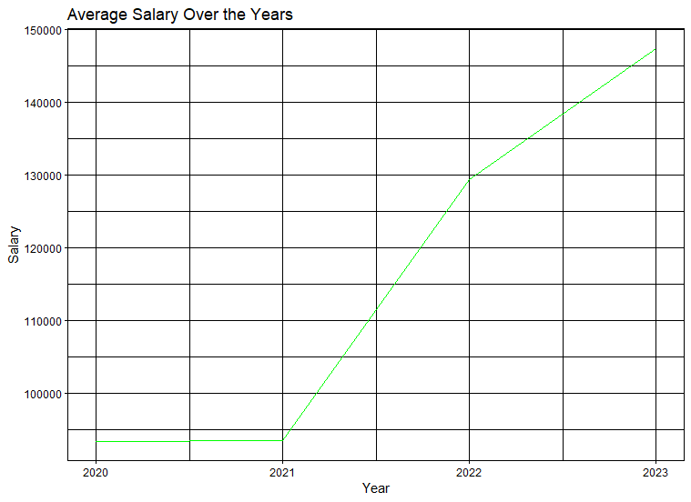
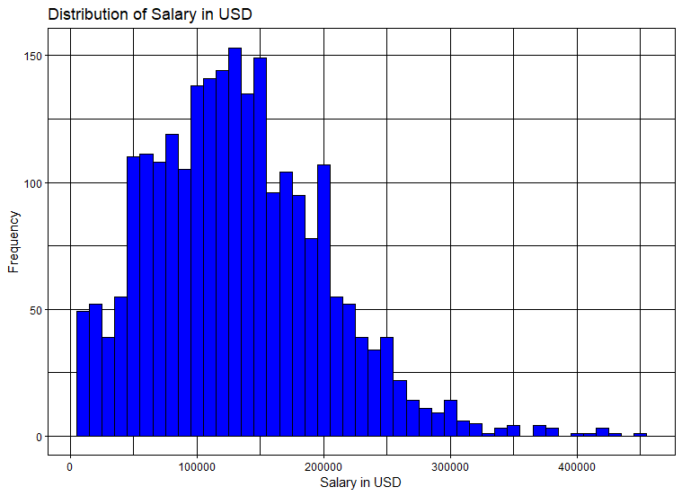
Introduction
Notes:
The dataset contains a CSV file which predominantly consists of various jobs related to data science positions. It contains 3761 observations. It consists of 9 features including salary in USD, company size, employment type, experience level etc.
I will be analysing this dataset to find out the data backed range for negotiating salary for entry level full time positions.
We can conclude few things using the first graph.
- Minimal change in 2020-21
- Continued fluctuations in 2021-23
- Increase in salary post pandemic is obvious from the graph.

Slide 3
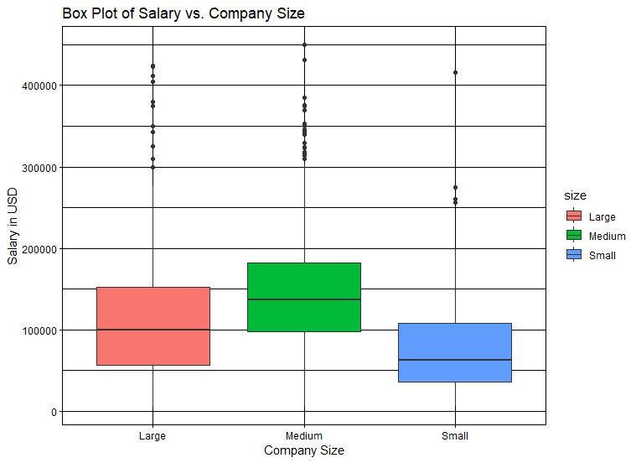
Notes:
Medium companies provide the highest average salary with the most number of outliers above max. It means medium sized companies are willing to pay way more than average salary to secure the individual.

Slide 4
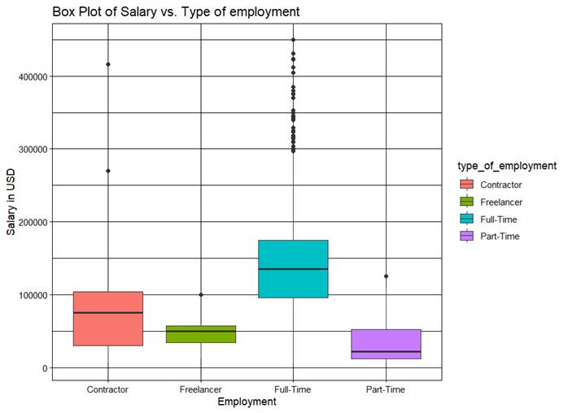
Notes:
As expected full time individuals are getting paid way more than other types of employment.

Slide 5
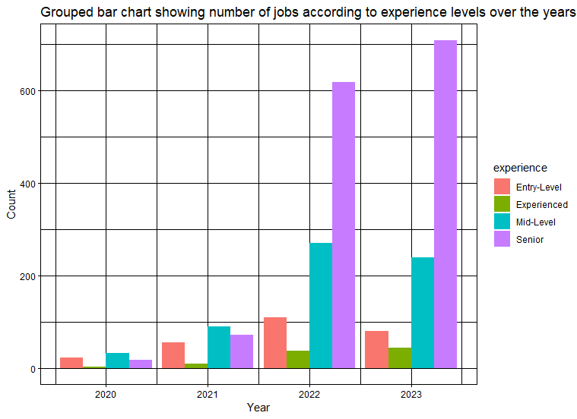
Job split according to experience
Notes:
Market is looking for more senior level people now more than ever.

Slide 6
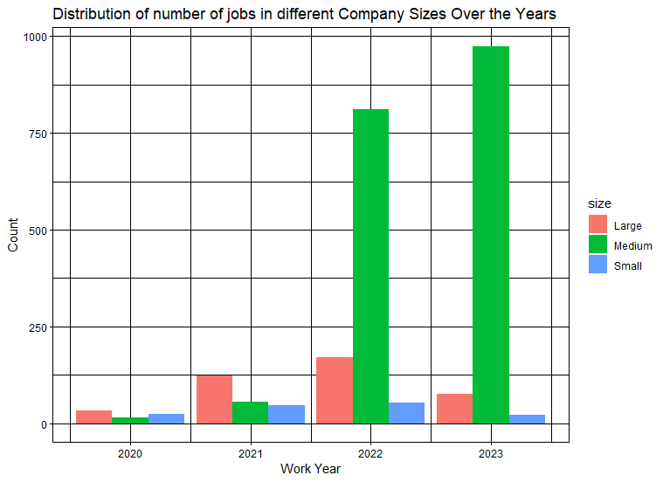
Notes:
There are more number of jobs in medium sized companies in the past few years compared to large sized companies.

Slide 7
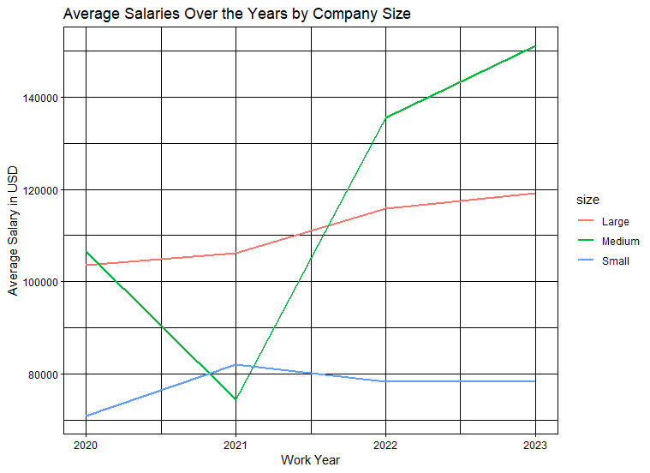
Notes:
Medium size companies see the largest salary growth.
Large companies have stable salaries.

Slide 8
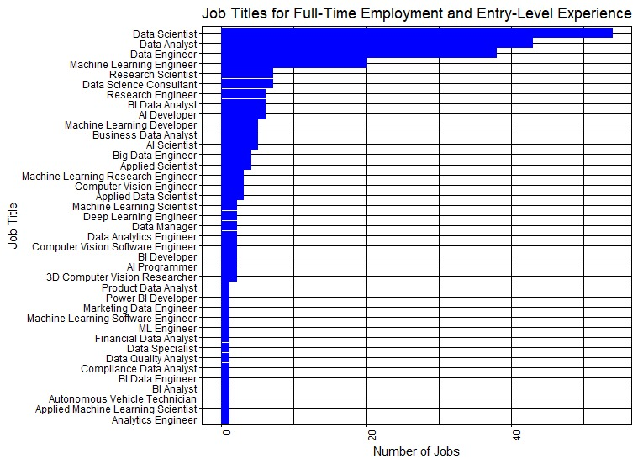
Notes:
I filtered the datasets to find number of jobs for students like me who are targeting full-time employment who have entry level experience.

Slide 9
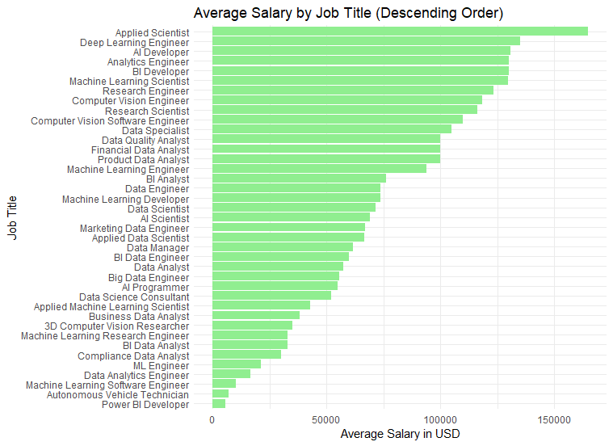
Notes:
The highest paid job for a full-time entry level individual is Applied Scientist who is getting an annual income of $350k.

Slide 10

References - R documentation -

