Slide 1


“UnifyComm AI-Driven Channel Orchestration”
Madan Mohan Malaviya University of Technology,Gorakhpur
Presented By:
Yash Gupta (2023071084)
Ryan Maroof (2023071063)
Nikhil Dubey (2023071047)
Under the guidance of:
Assistant Professor Niharika Singh
(Department of ITCA)

Slide 2
Content
Madan Mohan Malaviya University of Technology, Gorakhpur
Introduction
The Problem: Fragmented Communication
The Solution: Unifycomm
Message Flow Diagram
System Architecture
Intent Classification Model
Sentiment Analysis Model
Technology Stack
Feasibility and Viability
Impacts and Benefits
Production Scope
References

Slide 3
Introduction
Madan Mohan Malaviya University of Technology, Gorakhpur
Overview: UnifyComm is an AI-powered platform designed to unify customer interactions across multiple channels.
The Approach: It replaces isolated communication dashboards with a custom-trained ML intent classifier and a channel orchestration engine.
The Solution: The platform maintains a single, real-time conversation thread per customer, seamlessly integrating Email, SMS, WhatsApp, and calls.
Key Advantage: It utilizes Gen-AI for intelligent response drafting, sentiment detection, and strict compliance enforcement.

Slide 4
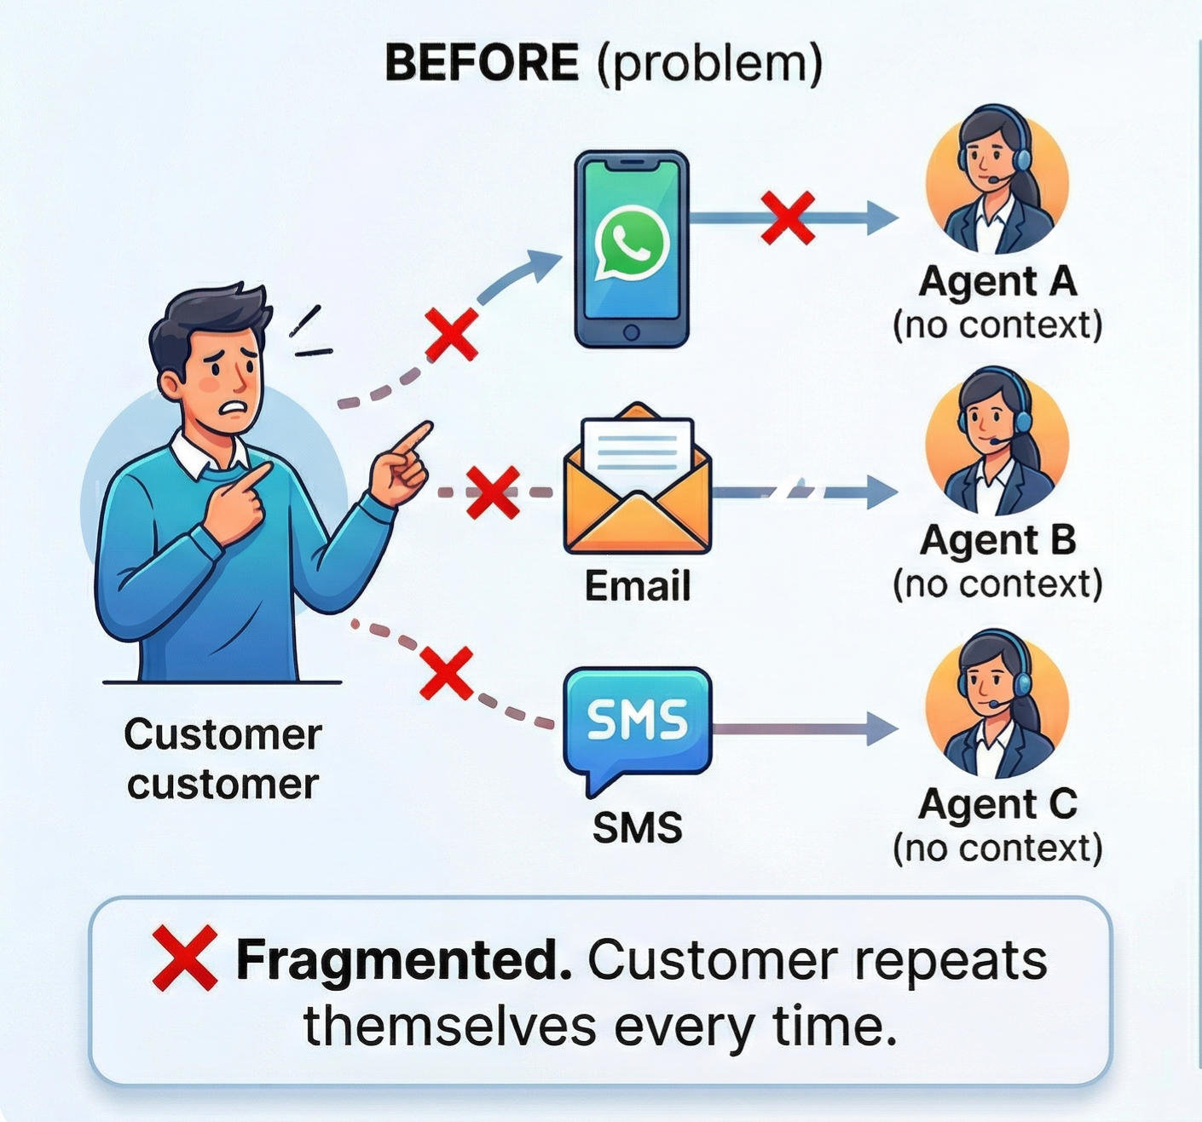
The Problem: Fragmented Communication
Madan Mohan Malaviya University of Technology, Gorakhpur
Fragmented Channels: Customer conversations are scattered across Email, SMS, WhatsApp, and calls.
Context Loss: With zero shared history between channels, customers are forced to repeat their issues to different agents.
Agent Inefficiency: Manual handling of isolated queries leads to high average handling times.
Compliance Vulnerability: Unregulated multi-channel outreach creates high risks of violating TRAI and RBI regulations (e.g., DNC breaches).

Slide 5
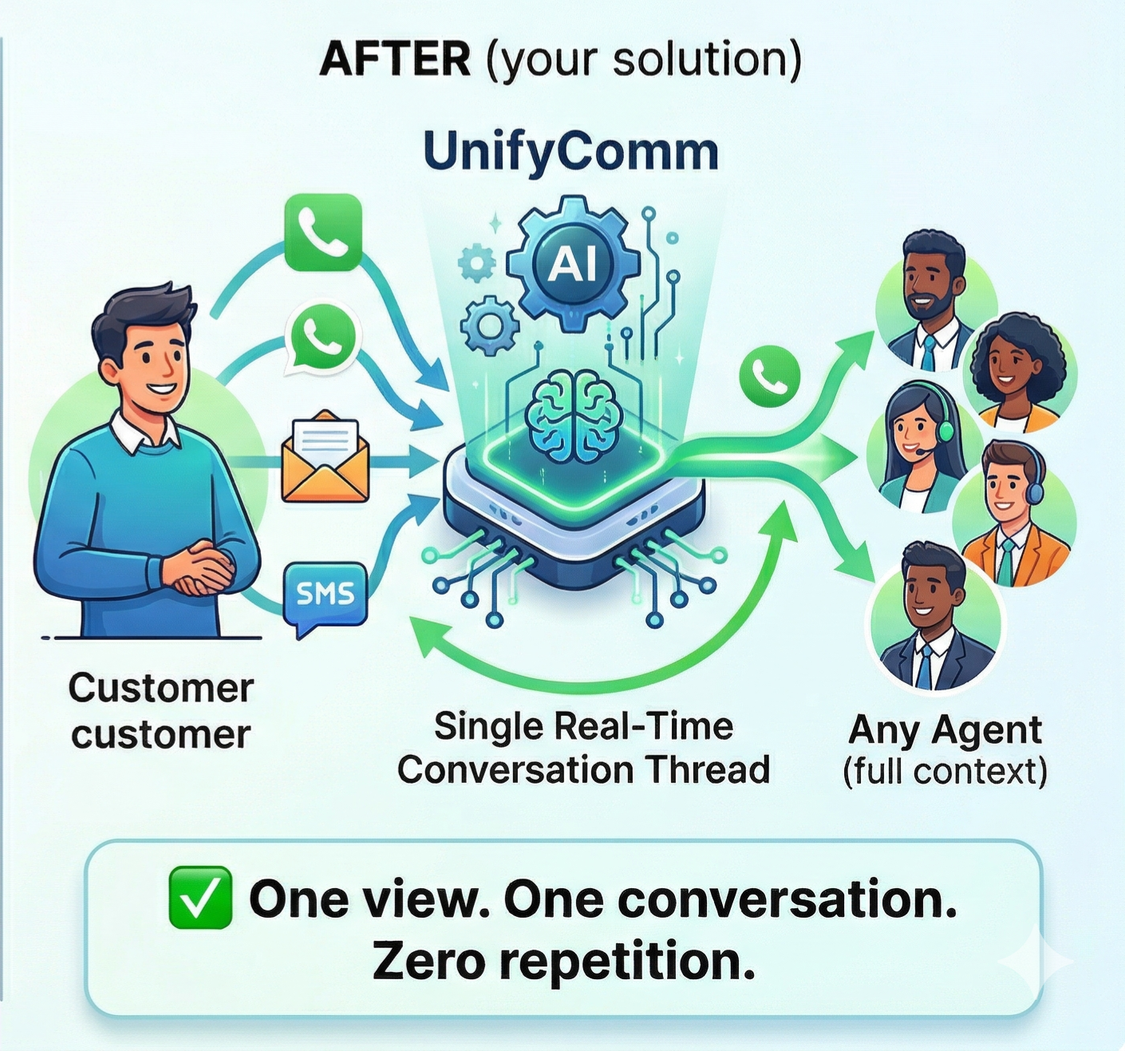
The Solution: Unifycomm
Madan Mohan Malaviya University of Technology, Gorakhpur
Centralized Omni-Channel: Maintains a single, real-time conversation thread per customer, unifying all communication channels.
Persistent Context: Agents can join any conversation mid-thread with full prior history, eliminating context repetition.
AI-Driven Efficiency: Gen-AI powers intelligent response drafting and summarization, designed to reduce average handling time by 40%.
Compliance-First Engine: Features built-in DNC/DND checks and consent validation pipelines prior to every outbound message.

Slide 6
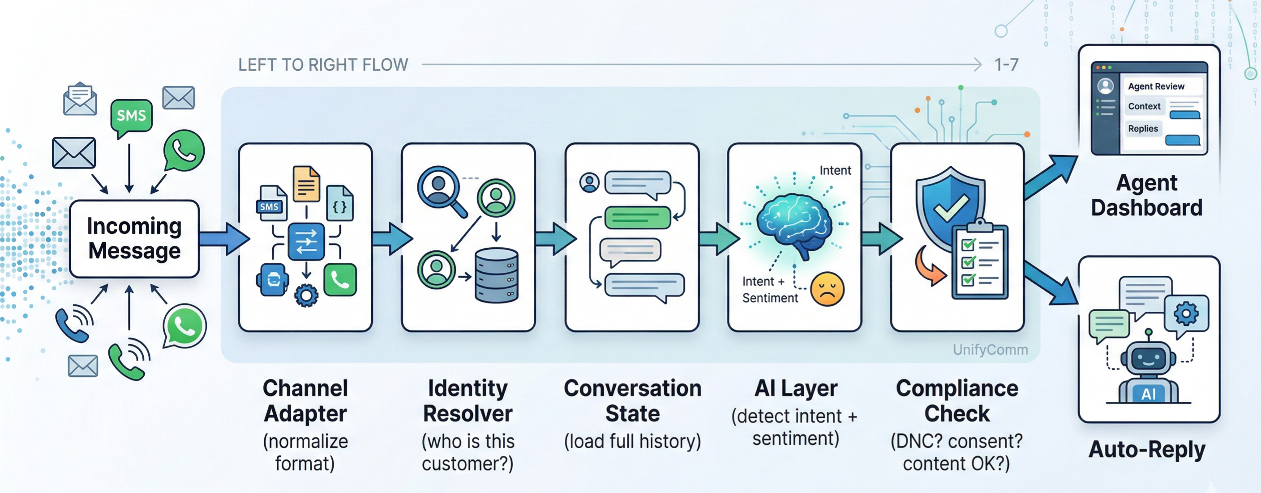
Message Flow Diagram
Madan Mohan Malaviya University of Technology, Gorakhpur

Slide 7
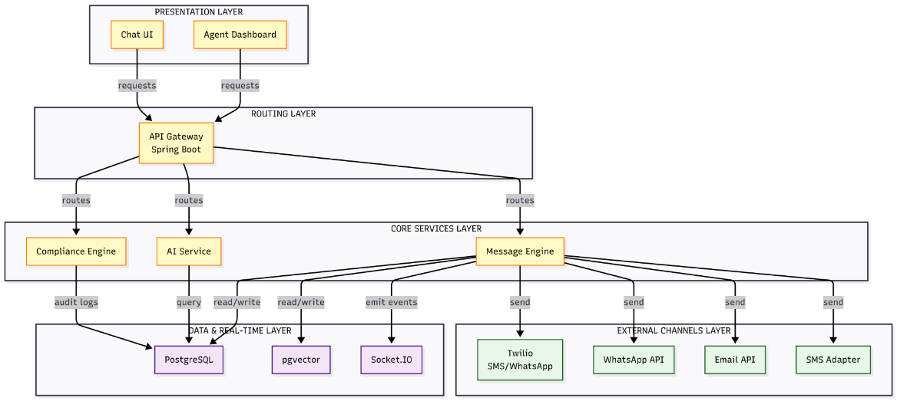
System Architecture
Madan Mohan Malaviya University of Technology, Gorakhpur

Slide 8
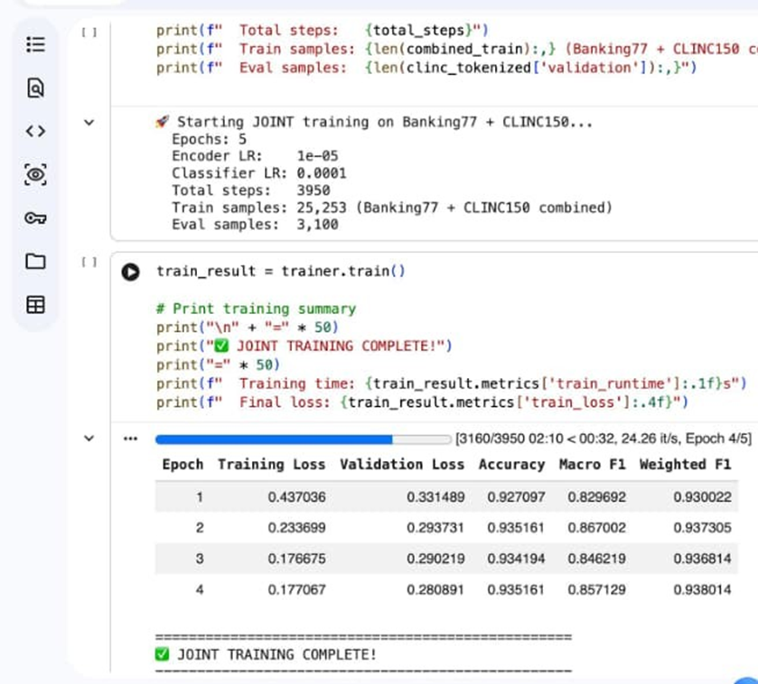
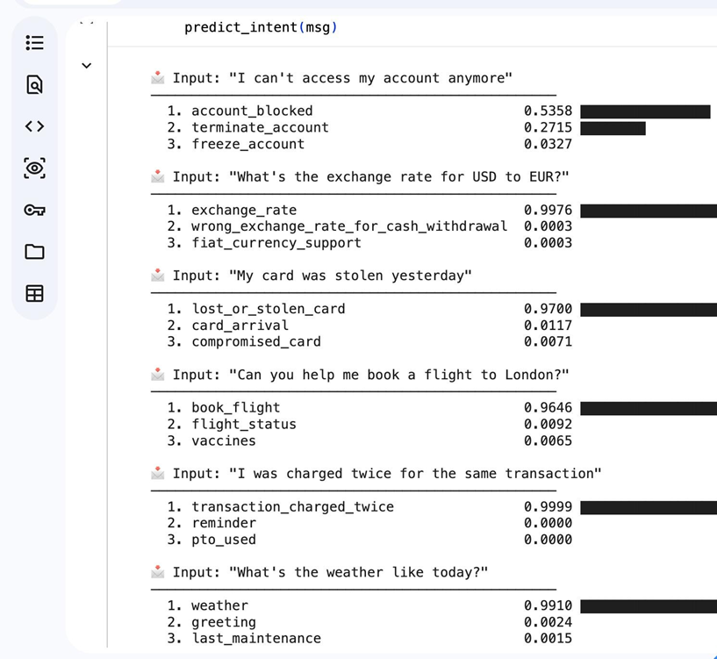
Intent Classification Model
Madan Mohan Malaviya University of Technology, Gorakhpur
Model: MiniLM (Sequentially fine-tuned on Banking77 → combined dataset)
Dataset: Banking77 + CLINC150
Accuracy: ~93.5%

Slide 9
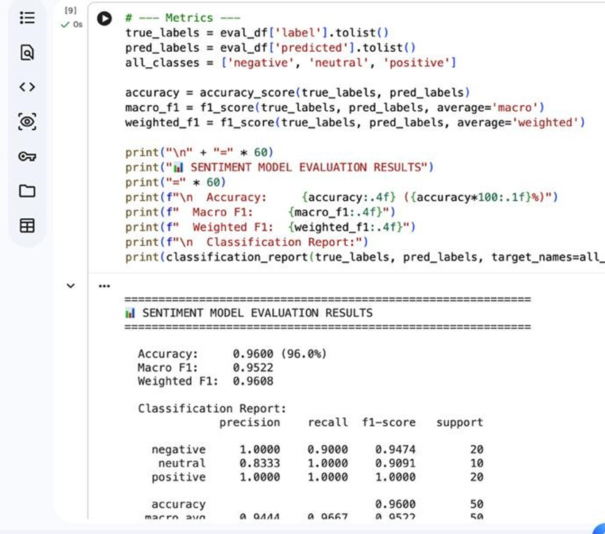
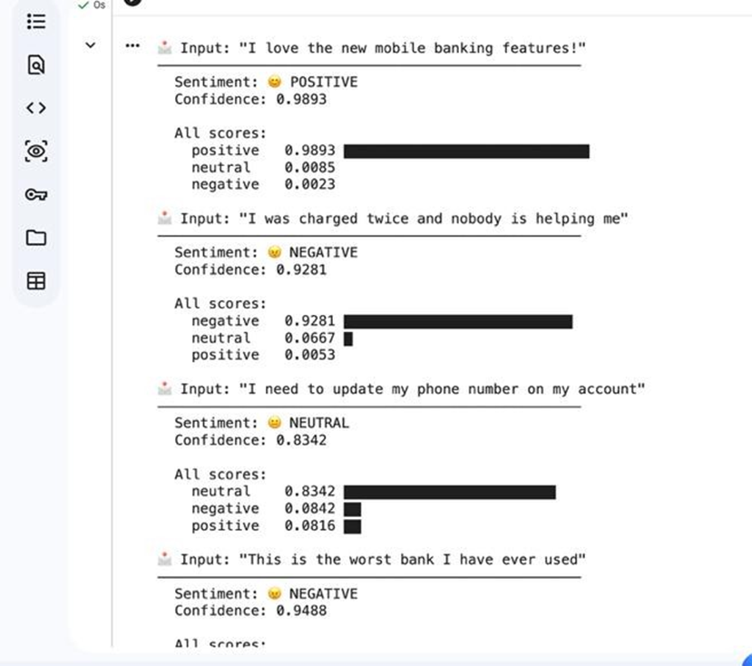
Sentiment Analysis Model
Madan Mohan Malaviya University of Technology, Gorakhpur
Model:Twitter-RoBERTa (cardiffnlp/twitter-roberta-base-sentiment-latest)
Task: Sentiment Classification (Positive / Neutral / Negative)
Usage: Customer sentiment detection

Slide 10
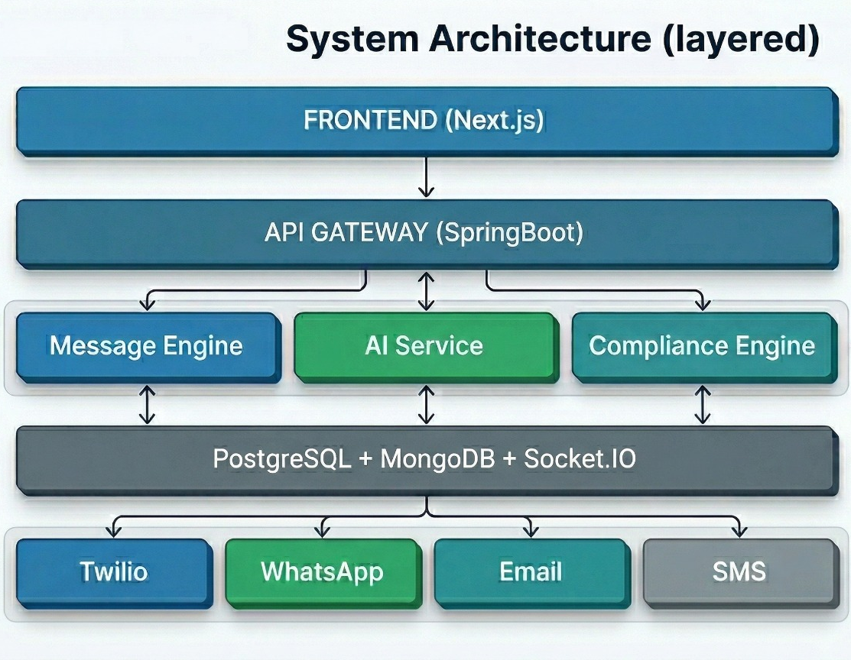
Technology Stack
Madan Mohan Malaviya University of Technology, Gorakhpur
Madan Mohan Malaviya University of Technology, Gorakhpur
Frontend: Next.js + Tailwind CSS (Agent dashboard + chat UI)
Backend: Spring Boot (REST APIs + WebSocket)​
​Database: PostgreSQL (customer profiles, conversation history)​, pgvector, MongoDB.
Real-time: Socket.IO (live conversation updates)​
ML: HuggingFace DistilBERT (intent + sentiment), BART(summarization)​
APIs: Twilio (SMS/WhatsApp), OpenAI (reply drafting fallback)​

Slide 11
Feasibility and Viability
.
Madan Mohan Malaviya University of Technology, Gorakhpur
Feasibility:​
All technologies used are production-grade and open source (HuggingFace, Socket.IO, PostgreSQL)​
Banking77 and CLINC150 are publicly available datasets for training the intent classifier.​
Twilio sandbox allows full SMS/WhatsApp testing without production access​
Fully buildable by a 3-person team in a hackathon window using modular microservices.​
​
Challenges & Mitigation:​
Challenge | Mitigation
Real-time sync across agents | Event-driven architecture with Socket.IO rooms
Identity resolution accuracy | Fuzzy matching + unique identifier priority rules
LLM response latency | Custom ML for structured tasks; LLM only for drafting
Regulatory compliance accuracy | Rule-based DNC engine + ML content classifier

Slide 12
Impacts and Benefits
Madan Mohan Malaviya University of Technology, Gorakhpur
  Target audience: Banks, NBFCs, insurance companies, e-commerce platforms - any enterprise running multi- channel customer support
  Impact points:
  Eliminates context loss — agents never ask customers to repeat their issue.
  Reduces average handling time by 40% through AI-suggested replies and conversation summaries
  Prevents regulatory violations (DNC breaches can result in ₹500+ crore penalties under TRAI regulations).
  Scales to millions of conversations with no increase in agent headcount.
  Broader benefits:
  Social: Better, faster resolution for end customers - especially in banking and healthcare.
  Economic: Reduces support operations cost significantly for enterprises.
  Environmental: Reduces redundant communication - fewer failed message retries = lower API costs and energy use.

Slide 13
Production Scope
.
Madan Mohan Malaviya University of Technology, Gorakhpur
Revenue Model:-​
SaaS subscription - tiered by number of agents, channels, and monthly active conversations​
Tier 1 (Startup) : ₹15,000/month - 5 agents, 3 channels, 10K conversations.​
Tier 2 (Enterprise) : ₹75,000/month - unlimited agents, all channels, compliance module included.​
Target Customers: PSU banks, private banks, NBFCs, large e-commerce players - all of whom are mandated by RBI and TRAI to support communication compliance records​
​
Commercialization Path:​
Hackathon prototype - Pilot with 1 MSME or startup.​
Pursue partnerships - government Digital India Stack.​
Scale via RBI's regulatory sandbox program for Fintech.​
​
Market Size: Indian customer experience market is projected at $1.3B by 2027 and complianceautomation is the fastest growing segment within it.​

Slide 14
References
Madan Mohan Malaviya University of Technology, Gorakhpur
  Twilio: twilio.com/docs
  HuggingFace — DistilBERT Model Card: huggingface.co/distilbert-base-uncased
  Banking77 Intent Classification Dataset: huggingface.co/datasets/banking77
  TRAI Regulations on Unsolicited Commercial Communication (DND): trai.gov.in
  RBI Guidelines on Digital Communication for Banks: rbi.org.in
  Facebook BART Summarization Model: huggingface.co/facebook/bart-large-cnn
  Socket.IO Real-time Documentation: socket.io/docs
  Indian CX Market Report 2027 — Nasscom / KPMG
  Next.js — React Framework Documentation: nextjs.org/docs

Slide 15
Thank You!
Madan Mohan Malaviya University of Technology, Gorakhpur

