Slide 1

Scope detection - negation
Srivasthasva Srinivas, Nikhil, Vinay, Sumanth, Sasank
Hackoverflow, Computer Science, ECE, Amrita School of Engineering Semester 6

Slide 2
1. Problem introduction
Cue Detection: Identification of words that change the polarity of the sentence
Scope Detection: Identification of words that are affected my Cue word
Notes:
<number>

Slide 3
Problem statement, solution and benefit
Challenge
Data PreProcessing
Feature Selection
Our solution
Using Logical approach
Based on research papers
References
1.Negation Scope Detection for Twitter Sentiment Analysis
2. UiO 2 : Sequence-Labeling Negation Using Dependency Features
3. An open-source tool for negation detection: a maximum-margin approach
4. Recursive Deep Models for Semantic Compositionality
Over a Sentiment Treebank
Benefits
Major Breakthrough in sentiment Analysis

Slide 4
2. Evaluation metrics
Notes:
<number>

Slide 5
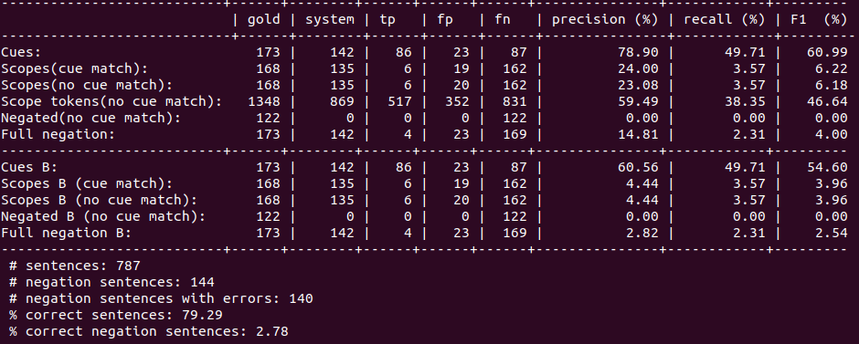
In Cue and scope detection
The matrix is obtained by testing of evaluation set

Slide 6
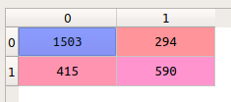
In Scope detection
The matrix is obtained by testing on evaluation set
Notes:
<number>

Slide 7
3. Solution approach
Notes:
<number>

Slide 8
Feature Based approach
For cue detection:
->Existence of word
->Same Parts of Speech tag(90% matches)
->opposite
->Length of affix word
->The way the affix splits the original word

Slide 9
For scope detection:
->Left distance from the nearest cue
->Right Distance from the nearest cue
->Shortest path in parse tree
->Number of commas(‘,’) in the path
Notes:
<number>

Slide 10
4. Challenges faced
Notes:
<number>

Slide 11
Challenges faced
Skewed Data
Too many non negative words
Solution: Proper feature and model selection

Slide 12
5. Your view on this hackathon
->Learned a lot during the process of finding solution to the problem
Notes:
<number>

Slide 13
6. How we could have done it better
->Provide more information
Notes:
<number>

Slide 14
Any queries?
Thank you

