Slide 1
BIG DATA ANALYTICS(22CSE29)
BE(CSE) V-Semester
Prepared
by
J Shiva Sai
Assistant Professor
Department of Computer Science and Engineering
Chaitanya Bharathi Institute of Technology

Slide 2
Course Objectives:
This course aims to:
1. Introduce the importance of Big Data and the role of the Hadoop framework in analyzing large datasets.
2. Gain practical knowledge in working with Hadoop ecosystem tools such as MapReduce, pig, hive, Spark.
3. Provide hands-on experience in using Spark for real-time stream processing.

Slide 3
Course Outcomes:
After the completion of this course, the student will be able to
1. Define and describe the types, characteristics, and challenges of Big Data and the need for its analysis.
2. Analyze the differences between traditional systems and Hadoop and explain the functions of core components like HDFS and YARN.
3. Develop MapReduce programs and analyze different join strategies and pipeline models for big data processing.
4. Design and execute queries using Hive and Pig to extract, transform, and analyze large datasets.
5. Implement scalable data processing applications using Apache Spark and evaluate its performance over traditional frameworks

Slide 4
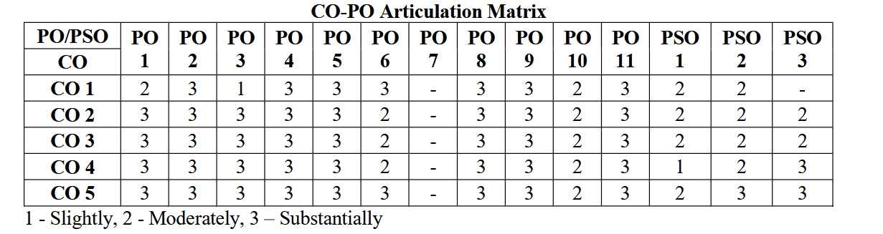
CO PO Articulation Matrix

Slide 5
UNIT-1
Introduction to Big Data: Data and its types: Unstructured, Semi-structured, Structured Sources of data Evolution and Definition of Big Data Characteristics(3Vs/5Vs) and Challenges Need for Big Data, Big data integration process, Applications. Overview of Business Intelligence, Data Science, Analytics Typical analytical architecture Types of Analytics (Descriptive, Predictive, Prescriptive).

Slide 6
Introduction to Big Data
What is Data?
Data refers to raw facts, figures, or information that can be processed and analyzed to extract meaningful insights.
What is Information?
Information means processed data
What is Big Data?
Big Data refers to extremely large, complex datasets that outgrow the processing capacity of traditional database systems

Slide 7
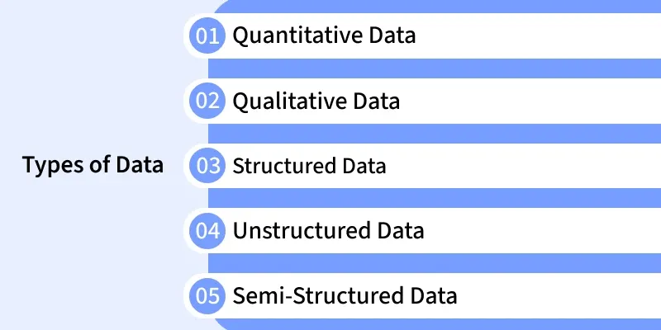

Slide 8
Structured Data
Structured data is organized in rows and columns with a predefined schema.
Characteristics
Fixed format
Easy to store and query
Stored in relational databases
Examples
Student records
Employee database
Banking transactions
Sales records

Slide 9
Semi-Structured Data
Semi-structured data does not follow a strict table structure but contains tags or metadata.
Characteristics
Flexible schema
Easier to process than unstructured data
Commonly stored in XML or JSON formats
Examples
XML files
JSON documents
Emails
HTML files

Slide 10
Unstructured Data
Unstructured data has no predefined format or schema.
Characteristics
Difficult to analyse using traditional databases
Largest portion of Big Data
Requires specialized tools for processing
Examples
Images Videos
Audio recordings
Social media posts
PDF documents
Text documents

Slide 11
Data Sources
Sources:
  Human Generated
  Machine Generated
  Business Data
  Web Data
Examples: E-commerce transactions, Internet of Things (IoT) sensors, social media feeds, server logs, mobile applications, and medical records.

Slide 12
Evolution
Evolution:
Data storage transitioned from flat files and early Mainframe databases in the 1960s to Relational Database Management Systems (RDBMS) in the 1980s.
With the explosion of the internet and mobile devices in the 2000s, data generation surged beyond RDBMS capabilities, resulting in the creation of distributed computing frameworks like Apache Hadoop.

Slide 13
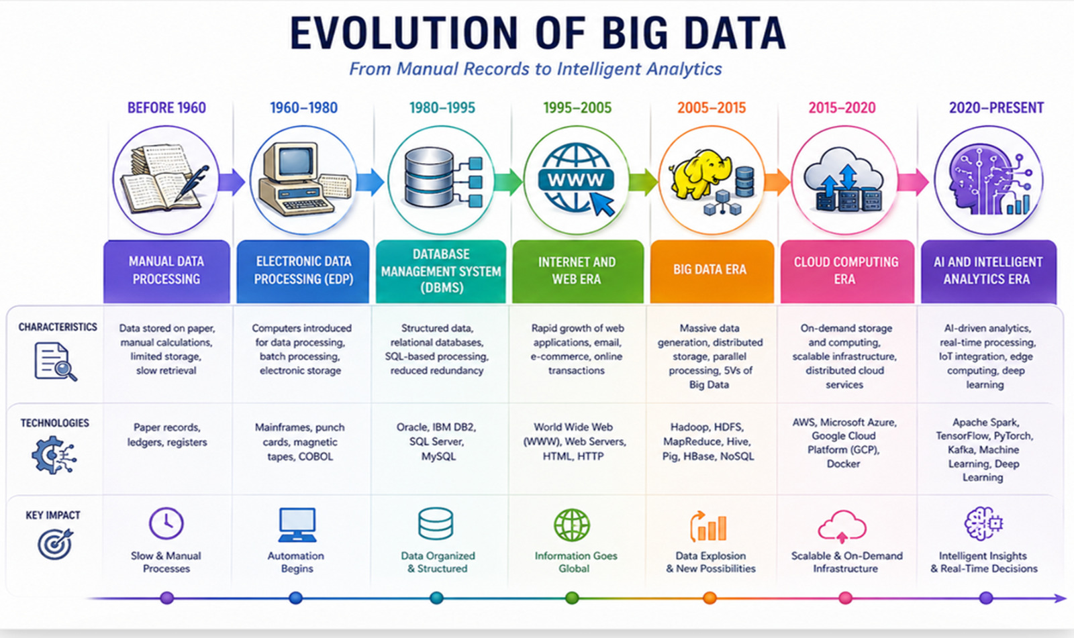

Slide 14
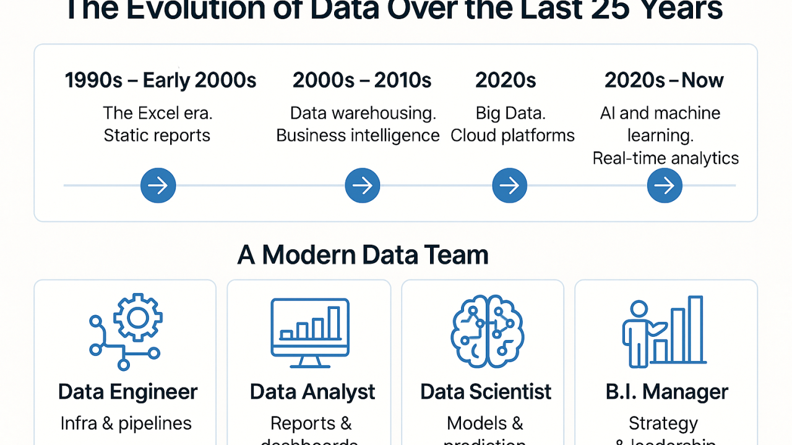
Evolution
File Systems
RDBMS
Data Warehouses
Internet Era
Big Data
AI & Cloud

Slide 15
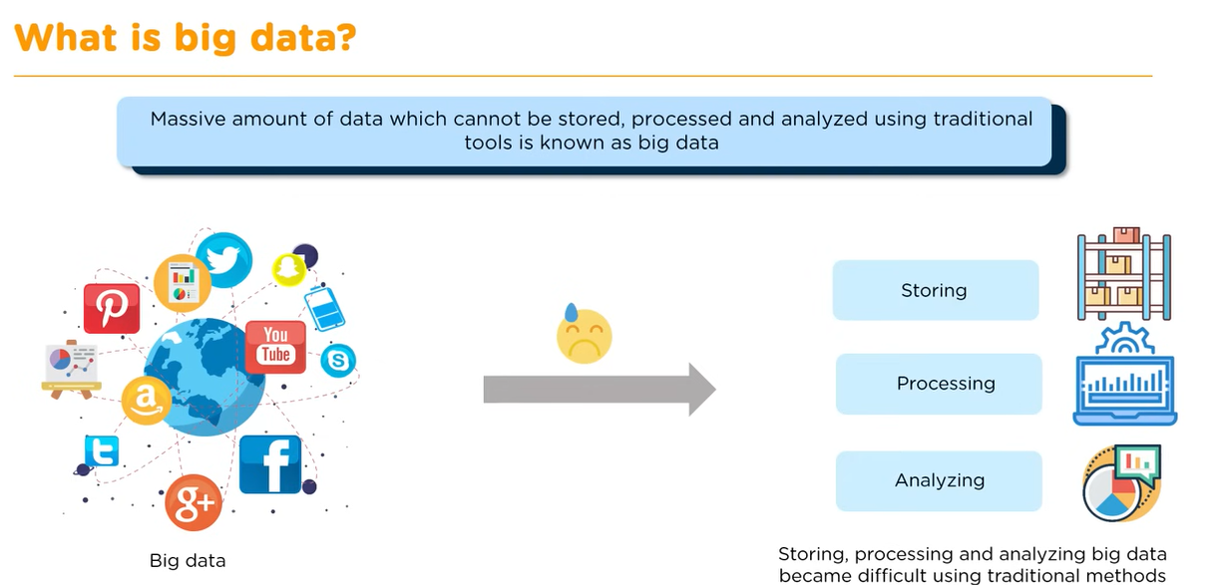
Introduction to Big data

Slide 16
Introduction to Big data
Big Data refers to extremely large and complex datasets that cannot be stored, managed, or processed efficiently using traditional database systems.
Big Data technologies, such as Hadoop and Spark, enable organizations to store, process, and analyze these datasets to gain valuable insights.
Examples
Social media data (Facebook, Twitter, Instagram)
Online shopping transactions
Banking records
Sensor and IoT data
Healthcare records
Video and image files

Slide 17
Importance of Big Data
Better decision-making: Analyze large amounts of data to identify trends and patterns.
Improved customer experience: Understand customer preferences and provide personalized services.
Cost reduction: Optimize operations and reduce waste.
Fraud detection: Detect unusual activities in sectors like banking and insurance.
Innovation: Develop new products and services based on customer needs.

Slide 18
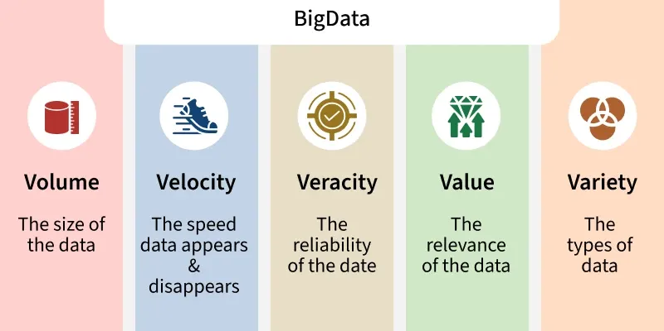

Slide 19
Characteristics of Big Data (3V/5V)
The defining characteristics often called the Vs of Big Data are:
Volume: Massive amounts of data.
Velocity: Speed of generation and processing.
Variety: Different formats: structured, unstructured, semi-structured.
Veracity: Accuracy, trustworthiness of data to deal with noise and errors.
Value: The usefulness of data i.e. having data is not enough, we must extract value from data.

Slide 20
Challenges of Big Data
Storage of massive datasets
Security & Privacy
Data integration from multiple sources
Cost of infrastructure
Real-time Processing requirements
High-speed data processing
Data quality and consistency

Slide 21
Need for Big Data
Traditional systems lack the scalability and processing power to handle the exponential growth of modern, varied data.
Big Data allows organizations to discover complex correlations, reduce operational costs, and improve customer experiences by utilizing massive datasets.
Better decisions
Customer insights
Fraud detection
Real-time analytics
AI/ML support
Competitive advantage

Slide 22
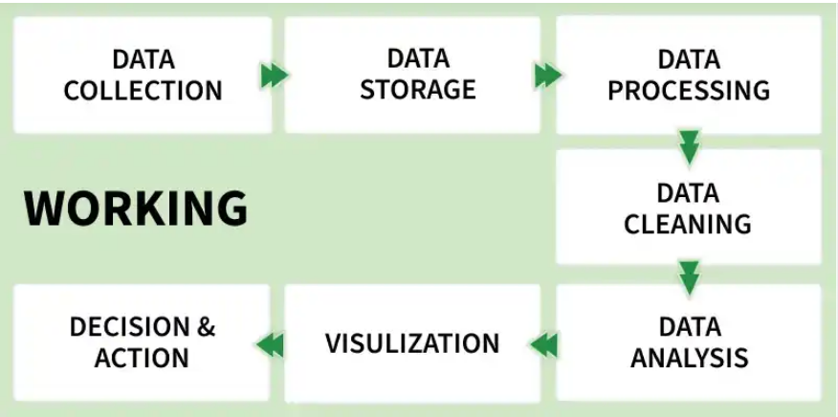
Big Data Integration Process

Slide 23
Big Data Integration Process
Data Collection: Gathering data from various sources.
Data Storage: Using data warehouses, lakes, or distributed storage systems.
Data Cleaning and Preprocessing: Removing inconsistencies and preparing data.
Data Analysis: Applying analytical tools and techniques.
Visualization and Reporting: Presenting insights for decision-makers.

Slide 24
Big Data Integration Process
The pipeline to transform raw data into actionable intelligence involves:
Ingestion: Collecting data from apps, devices, and websites. (Tools: Apache NiFi, Kafka).
Storage: Storing large volumes in distributed file systems or data lakes. (Tools: Hadoop HDFS, Amazon S3).
Processing & Transformation: Cleaning and structuring raw data so it can be queried. (Tools: Apache Spark).

Slide 25
Big Data Integration Process
Depending on architecture, this process relies on different integration methods:
ETL (Extract, Transform, Load): Data is processed and transformed before being loaded into the destination.
ELT (Extract, Load, Transform): Raw data is loaded directly into the target system (like a data lake) and transformed later.
Data Virtualization: Instead of moving the data, this creates a virtual layer that allows you to query multiple sources in real-time.

Slide 26
Applications of Big Data
Healthcare (predictive diagnostics)
Finance (fraud detection)
Retail (customer behavior analysis)
Manufacturing (predictive maintenance)
Social media analytics
Smart cities and IoT applications

Slide 27
Overview of Analytics
Analytics is the process of examining data to discover patterns, trends, and useful information for decision-making.
Importance
  Improves business decisions
  Identifies opportunities
  Reduces risks
  Optimizes operations
  Detects Fraud and Security Threats

Slide 28
Typical Analytical Architecture
Data sources (databases, sensors, social media)
Data ingestion and storage (data lakes, warehouses)
Data processing and transformation (ETL processes)
Data analysis (statistical models, machine learning)
Visualization and reporting tools
Decision-making and action

Slide 29
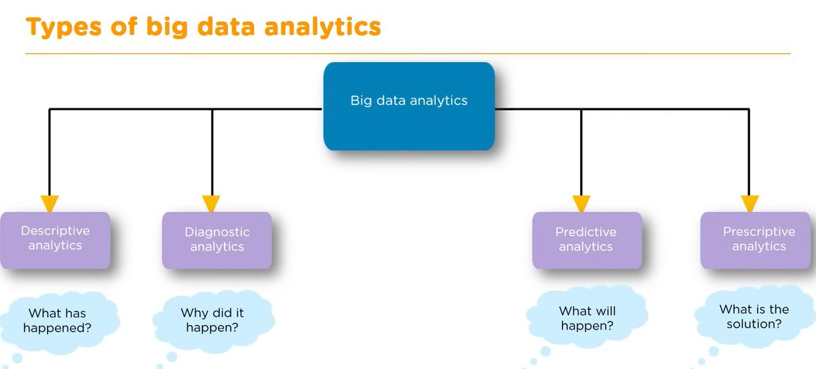

Slide 30
Types of Analytics
Descriptive Analytics
Descriptive analytics answers "What happened?"
Purpose
  Summarizes historical data.
  Generates reports and dashboards.
Examples
  Monthly sales reports
  Attendance reports
  Website traffic statistics

Slide 31
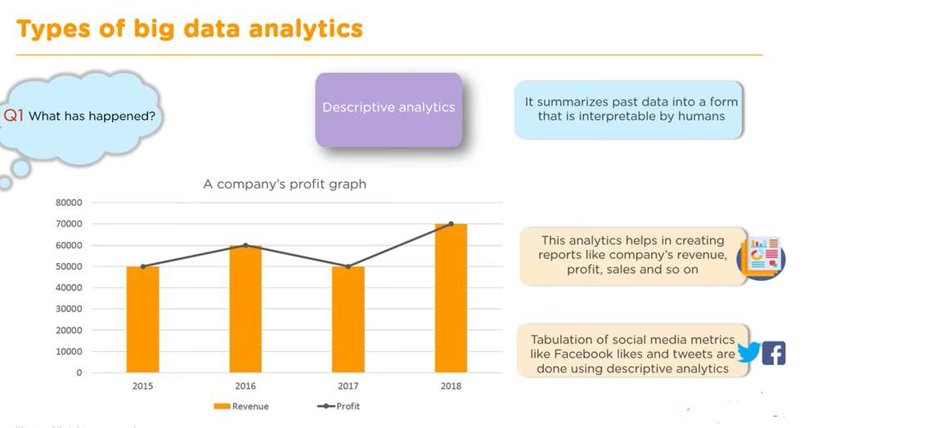

Slide 32
Types of Analytics
Predictive Analytics
  Predictive analytics answers "What is likely to happen?"
Purpose
  Uses historical data and machine learning to forecast future outcomes.
Examples
  Weather forecasting
  Sales prediction
  Credit risk analysis
  Customer churn prediction

Slide 33
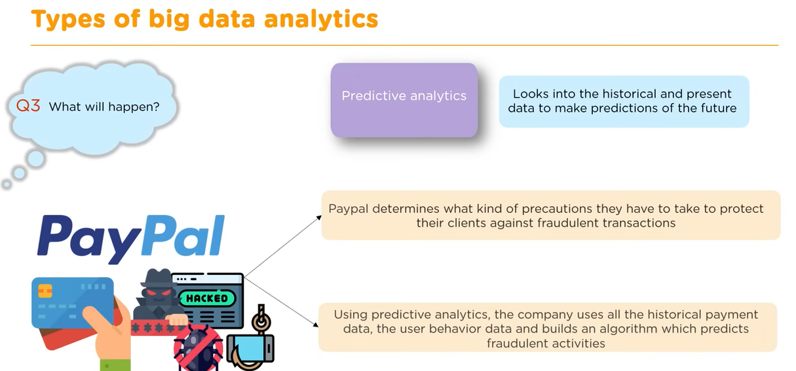

Slide 34
Types of Analytics
Prescriptive Analytics
  Prescriptive analytics answers "What should be done?"
Purpose
  Recommends actions based on predictive results.
  Uses optimization and AI techniques.
Examples
  Route optimization
  Dynamic pricing
  Personalized product recommendations
  Supply chain optimization

Slide 35
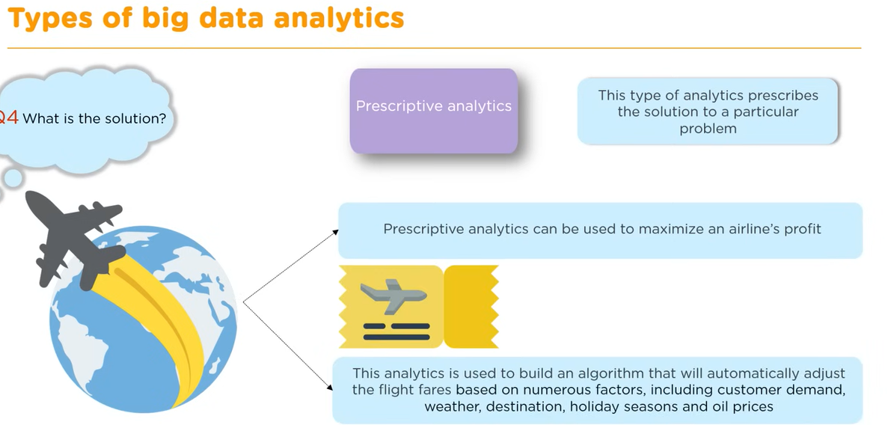

Slide 36
Types of Analytics
Analytics is typically categorized into three distinct types:
Descriptive Analytics: Uses historical data to determine what has happened (e.g., generating a quarterly sales report).
Predictive Analytics: Uses statistical models and machine learning to determine what is likely to happen in the future (e.g., forecasting customer churn).
Prescriptive Analytics: Uses optimization and simulation algorithms to recommend the best course of action to achieve a specific outcome (e.g., dynamic pricing strategies).

Slide 37
Difference b/w Data Analysis and Data Analytics
Data Analysis | Data Analytics
Information | Insights
Subset of Analytics | Uses analysis
Data Investigation, Data Cleaning , Data transformation | Data Collection ,Data inspection
Tools: Google Fusion, Node XL, Rapid Miner | Tools : Python ,SaS, Apache Spark, Excel
Compared with Analytics less better decision | Better Decision

Slide 38
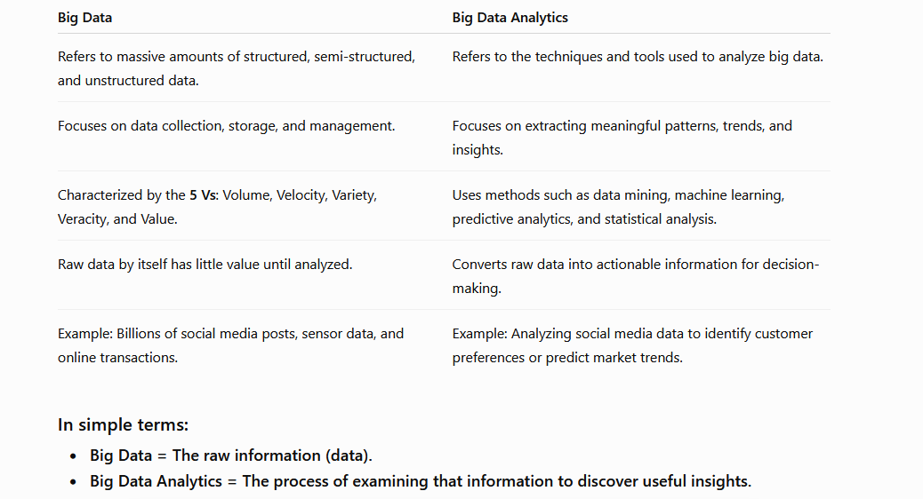
Difference b/w Big Data and Big Data Analytics

Slide 39
Overview of Business Intelligence
Business Intelligence (BI) is a set of technologies, processes, and tools used to collect, analyze, and present business data for informed decision-making.
Objectives
  Improve business performance
  Generate reports and dashboards
  Support strategic planning
  Monitor key performance indicators (KPIs)
BI Tools
  Power BI
  Tableau
  QlikView

Slide 40
How Big Data Analytics Impacts Business Intelligence
Expanding data sizes, handling unstructured information like social media or videos, and shifting tools from looking at past events to predicting future trends.
Bigger data types
Deeper predictions
Real-time Speed

Slide 41
Overview of Data Science
Data Science is an interdisciplinary field that uses statistics, programming, machine learning, and domain knowledge to extract meaningful insights from data.
Components
  Data collection
  Data cleaning
  Data analysis
  Machine learning
  Data visualization
Applications
  Recommendation systems
  Fraud detection
  Image recognition
  Forecasting

Slide 42
How Big Data Analytics Shapes Data Science
Better model Accuracy(reduce overfitting)
Complex feature engineering(predictive patterns)
Scalable Computational Power
Shift to Streaming AI

Slide 43
Overview of Business Intelligence, Data Science, and Analytics
Business Intelligence (BI): Technologies and practices for collecting, integrating, analyzing, and presenting business data to support decision-making.
Data Science: An interdisciplinary field focusing on extracting knowledge and insights from structured and unstructured data using scientific methods, algorithms, and systems.
Analytics: The process of examining data to draw conclusions, often involving statistical analysis and modeling.

