Slide 1
BIG DATA ANALYTICS(22CSE29)
BE(CSE) V-Semester
Prepared
by
J Shiva Sai
Assistant Professor
Department of Computer Science and Engineering
Chaitanya Bharathi Institute of Technology

Slide 2
UNIT-2
Hadoop Ecosystem: Requirement of Hadoop Framework - Design principle of Hadoop Comparison with other system (SQL, RDBMS) - Core components of Hadoop Architecture -Hadoop 1 vs Hadoop 2 HDFS operations, Data ingestion layer, ETL and ELT, Ingestion tools in Hadoop ecosystem, Data ingestion types.

Slide 3
Hadoop Ecosystem
Requirement of Hadoop Framework
Hadoop is an open-source framework designed to store and process massive amounts of data across clusters of computers.
Why Hadoop is Required
Handles Big Data (structured, semi-structured, and unstructured).
Stores data economically using commodity hardware.
Supports distributed storage and parallel processing.
Provides fault tolerance through data replication.
Scales easily by adding more nodes.
Processes petabytes of data efficiently.
Suitable for batch processing and analytics.

Slide 4
Hadoop Ecosystem
Applications
Social media analytics
Search engines
Banking and finance
Healthcare
E-commerce
IoT data processing

Slide 5
Design Principles of Hadoop
Hadoop is designed based on the following principles:
Distributed Storage
Data is stored across multiple machines instead of a single server.
Fault Tolerance
If one node fails, data is recovered from replicated copies.
Scalability
New nodes can be added without changing existing applications.

Slide 6
Design Principles of Hadoop
Data Locality
Processing is moved to where the data resides, reducing network traffic.
High Throughput
Optimized for processing large datasets rather than quick response time.
Cost Effectiveness
Uses inexpensive commodity hardware instead of expensive servers.

Slide 7
Comparison: Hadoop vs SQL/RDBMS
Feature | Apache Hadoop | SQL/ RDBMS
Primary Purpose | Big Data analysis and processing | Online Transaction Processing (OLTP)
Data Types | Structured, semi-structured, and unstructured | Strictly structured data.
Volume | Terabytes to Petabytes | Gigabytes to low Terabytes.
Schema | Validation Schema-on-Read (Applied during data query). | Schema-on-Write (Strictly validated before storing).
Scalability | Horizontal (Add more cheap servers to the cluster). | Vertical (Upgrade the existing server's RAM/CPU).
Hardware | Standard, low-cost commodity hardware. | High-end, expensive proprietary servers.
Data Integrity | Eventual consistency (Low ACID compliance out-of-the-box) | Full ACID compliance (Immediate consistency)
Operation Type | Write once, read many times (Batch processing). | Frequent, rapid reads, writes, and updates.
..

Slide 8
How Does Hadoop Work?
Data is loaded into HDFS, where it's split into blocks and distributed across DataNodes.
MapReduce jobs are submitted to the ResourceManager.
The job is divided into map tasks, each working on a block of data.
Map tasks produce intermediate results, which are shuffled and sorted.
Reduce tasks aggregate results and generate final output.
The results are stored back in HDFS or passed to other applications.

Slide 9
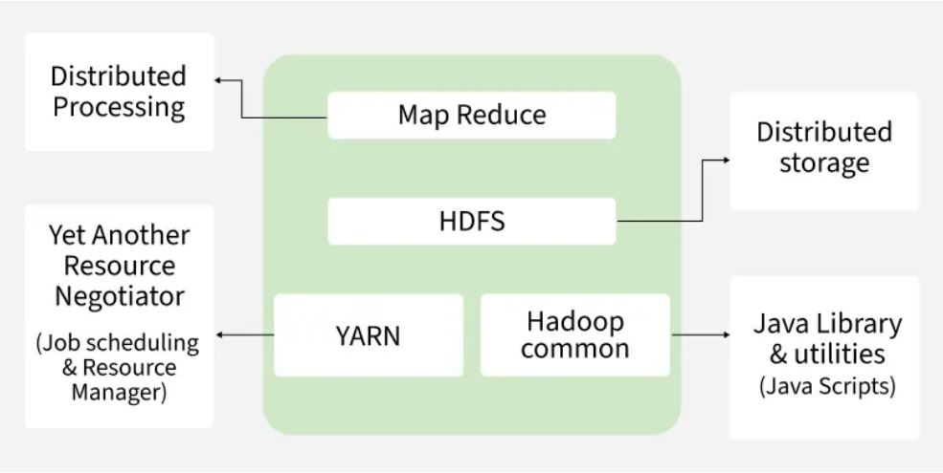
Hadoop Architecture

Slide 10
Components of Hadoop Architecture
Hadoop Architecture Mainly consists of 4 components:
MapReduce
HDFS (Hadoop Distributed File System)
YARN (Yet Another Resource Negotiator)
Common Utilities or Hadoop Common

Slide 11
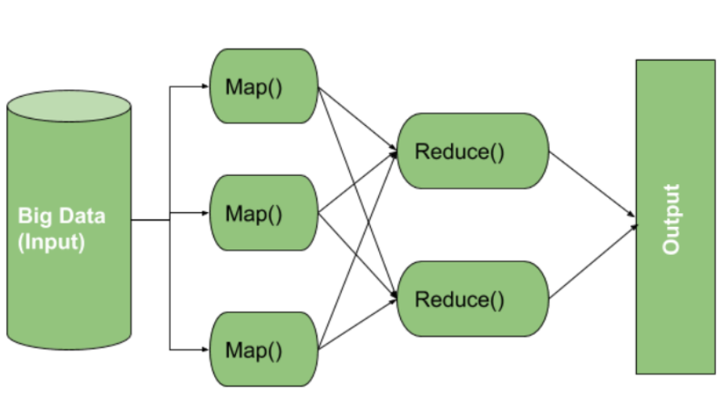
MapReduce
workflow begins when input data is split into key-value pairs by Map() function.
These are then grouped by key and processed by Reduce() function for tasks like sorting or aggregation. The final output is written to HDFS.

Slide 12
Map Task Components
RecordReader: reads input data and converts it into key-value pairs, with keys as location info and values as actual data.
Mapper: processes each pair and outputs zero or more new key-value pairs.
Combiner (optional): acts as a mini-reducer to group Mapper output and reduce data transfer before shuffling.
Partitioner: assigns key-value pairs to Reducers using key.hashCode() % numberOfReducers.

Slide 13
Reduce Task Components
Shuffle and Sort: transfers intermediate key-value pairs from Mappers to Reducers and sorts them by key. Shuffling begins as soon as some Mappers finish.
Reducer: processes grouped key-value pairs, performing tasks like aggregation or filtering based on logic.
OutputFormat: writes final results to HDFS using a RecordWriter, typically storing each record as a key-value line.

Slide 14
Hadoop Distributed File System (HDFS)
HDFS is the primary storage layer.
Runs on inexpensive commodity hardware and stores data in large blocks to optimize performance.
It breaks large files into smaller blocks (usually 128 MB) and stores them across multiple DataNodes.
Each block is replicated (usually 3 times) to ensure fault tolerance so even if a node fails, the data remains available.

Slide 15
HDFS Architecture Components
NameNode (Master Node):
  The master node in HDFS that stores metadata (not actual data)
  manages file operations and directs clients to nearest DataNode for efficient access.
DataNode (Slave Node):
  Stores actual data blocks, serves read/write requests and reports to NameNode.
  Supports replication (default 3) for fault tolerance and scales storage and performance with more nodes.

Slide 16
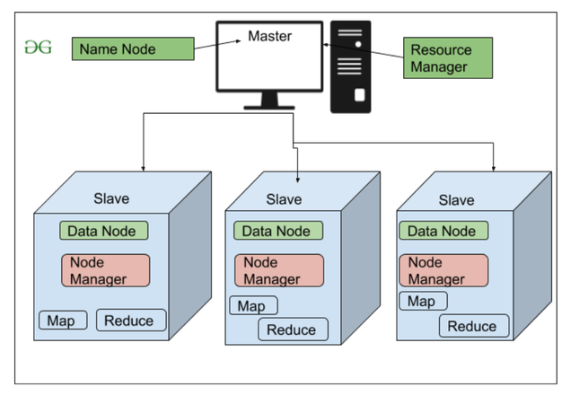
High Level Architecture Of Hadoop

Slide 17
YARN (Yet Another Resource Negotiator)
It handles two core responsibilities:
  Job Scheduling: Splits large tasks into smaller jobs, assigns them to nodes and manages priorities, dependencies and execution.
  Resource Management: Allocates and monitors cluster resources (CPU, memory, etc.) needed for job execution.
Functions:
  Allocates CPU and memory
  Schedules jobs
  Monitors applications
Components:
  Resource Manager
  Node Manager
  Application Master

Slide 18
YARN (Yet Another Resource Negotiator)
Key Features of YARN:
Multi-Tenancy: Supports multiple users and applications.
Scalability: Efficiently scales to handle thousands of nodes and jobs.
Better Cluster Utilization: Maximizes resource usage across the cluster.
Compatibility: Works with MapReduce and other processing models like Spark.

Slide 19
Hadoop Common (Common Utilities)
Includes core Java libraries and scripts required by all components in a Hadoop ecosystem
libraries offer core functionalities such as:
  File system and I/O operations
  Configuration and logging
  Security and authentication
  Network communication
Handles hardware failures automatically and includes tools like Hadoop Archive, native library support and RPC mechanisms.

Slide 20
Hadoop 1 vs Hadoop 2
Hadoop 1 | Hadoop 2
Uses MapReduce only | Supports multiple processing frameworks
No YARN | Includes YARN
Limited Scalability | Highly Scalable
Single NameNode | Supports High Availability
Lower performance | Better performance
No resource sharing | Resource sharing through YARN
Batch processing | Batch + Interactive processing
Less efficient | More efficient

Slide 21
Installation of Hadoop
Install Java
Download Hadoop from official website binary format .tar
  https://www.apache.org/dyn/closer.cgi/hadoop/common/hadoop-3.4.0/hadoop-3.4.0-aarch64.tar.gz
Add and install missing windows Binaries
  Windows needs specific .exe and .dll files to simulate Linux file permissions.
    Go to a trusted repository like the GitHub page for winutils (e.g., cdarlint/winutils).
    Download the winutils.exe and hadoop.dll files that exactly match your Hadoop version.
    Paste these downloaded files directly into your C:\Hadoop\bin directory.

Slide 22
Installation of Hadoop
Configure Windows Environment Variables
  Setting Name: JAVA_HOME Value: \Java\jdk1.8.0 and Name: HADOOP_HOME value: C:\Hadoop Varibales.
  Setting Path in two separate lines
    %HADOOP_HOME%\bin
    %HADOOP_HOME%\sbin

Slide 23
Configuration of Hadoop
Create Data folder named data
Inside of folder data create one more folder named namenode
Inside of folder data create another folder named datanode.
core-site.xml
<configuration>
<property>
<name>fs.defaultFS</name> <value>hdfs://localhost:9000</value>
</property>
</configuration>

Slide 24
Configuration of Hadoop
hdfs-site.xml
<configuration>
<property>
<name>dfs.replication</name>
<value>1</value>
</property>
<property>
<name>dfs.namenode.name.dir</name>
<value>/C:/Hadoop/data/namenode</value>
</property>
<property>
<name>dfs.datanode.data.dir</name>
<value>/C:/Hadoop/data/datanode</value>
</property>
</configuration>

Slide 25
Configuration of Hadoop
mapred-site.xml
<configuration>
<property>
<name>mapreduce.framework.name</name>
<value>yarn</value>
</property>
</configuration>

Slide 26
Configuration of Hadoop
yarn-site.xml
<configuration>
<property>
<name>yarn.nodemanager.aux-services</name> <value>mapreduce_shuffle</value>
</property>
</configuration>

Slide 27
Running of Hadoop
Format and Launch
Right-click the Windows Start Menu and select Terminal (Admin) or Command Prompt (Admin).Initialize the file system by formatting the NameNode (run this command only once):
  Cmd hdfs namenode –format
Verify via Web BrowserOpen your browser and navigate to:
  HDFS Cluster (NameNode): http://localhost:9807
  YARN Resource Manager: http://localhost:8088

Slide 28
HDFS Operations
Common operations performed in HDFS:
File Operations
Create directory
Upload files
Download files
Copy files
Move files
Delete files
Rename files
View files

Slide 29
File Operations
File Operation | Command | Purpose
1. Create Directory | hdfs dfs -mkdir <directory_name> | Creates a new directory in HDFS. Example: hdfs dfs -mkdir /user/data
2. Upload Files | hdfs dfs -put <local_file> <HDFS_path> | Uploads a file from the local system to HDFS. Example: hdfs dfs -put file.txt /user/data
3. Download Files | hdfs dfs -get <HDFS_file> <local_path> | Downloads a file from HDFS to the local system. Example: hdfs dfs -get /user/data/file.txt /home/user
4. Copy Files | hdfs dfs -cp <source> <destination> | Copies files or directories within HDFS. Example: hdfs dfs -cp /user/data/file.txt /backup
5. Move Files | hdfs dfs -mv <source> <destination> | Moves files or directories within HDFS. Example: hdfs dfs -mv /user/data/file.txt /archive
6. Delete Files | hdfs dfs -rm <file> | Deletes a file from HDFS. Example: hdfs dfs -rm /user/data/file.txt
7. Rename Files | hdfs dfs -mv <old_name> <new_name> | Renames a file or directory in HDFS. Example: hdfs dfs -mv file1.txt file2.txt
8. View Files | hdfs dfs -cat <file> | Displays the contents of a file. Example: hdfs dfs -cat /user/data/file.txt

Slide 30
HDFS Operations
Common operations performed in HDFS:
Administrative Operations
Block replication
Check disk usage
Safe mode
Cluster monitoring
Data balancing

Slide 31
Administrative Operations
Administrative Operation | Command | Purpose
1. Block Replication | hdfs dfs -setrep -w <replication_factor> <file_path> | Changes the replication factor of a file. Example: hdfs dfs -setrep -w 3 /user/data/file.txt
2. Check Disk Usage | hdfs dfs -du -h <path> | Displays disk usage of files/directories in human-readable format. Example: hdfs dfs -du -h /user/data
3. Safe Mode | hdfs dfsadmin -safemode enterhdfs dfsadmin -safemode leavehdfs dfsadmin -safemode get | Enters, exits, or checks the status of HDFS Safe Mode.
4. Cluster Monitoring | hdfs dfsadmin -report | Shows cluster information such as capacity, used space, remaining space, and DataNode status.
5. Data Balancing | hdfs balancer | Balances data blocks across DataNodes to distribute storage evenly.

Slide 32
Data Ingestion Layer
Responsible for collecting data from different sources and loading it into Hadoop.
Data Sources
  Databases
  Log files
  Web servers
  Social media
  IoT devices
  Sensors
  Cloud applications
Purpose
  Collect data
  Transform data (optional)
  Load into HDFS, Hive, or HBase

Slide 33
ETL and ELT
ETL (Extract, Transform, Load)
Steps
1. Extract data from source.
2. Transform data into required format.
3. Load into data warehouse.
Advantages
Clean data
Better data quality
Suitable for traditional databases

Slide 34
ETL and ELT
ELT (Extract, Load, Transform)
Steps
1. Extract data.
2. Load into Hadoop/Data Lake.
3. Transform when required.
Advantages
Faster loading
Suitable for Big Data
More scalable
Flexible transformations

Slide 35
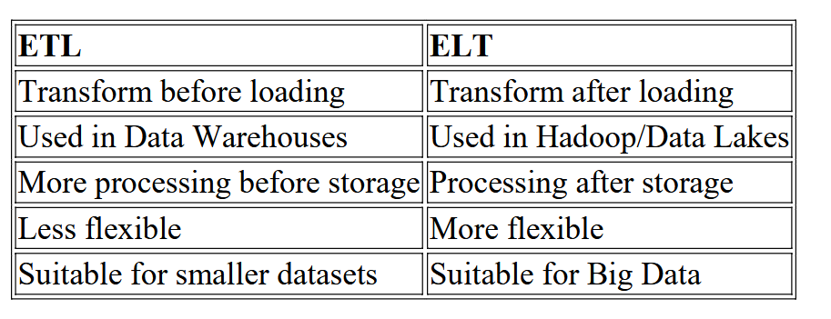
Difference between ETL and ELT

Slide 36
Ingestion Tools in Hadoop Ecosystem
Apache Sqoop
Transfers data between RDBMS and Hadoop.
Imports and exports data.
Use Case: MySQL → HDFS
Apache Flume
Collects streaming log data.
Used for web server logs.
Use Case: Website logs → HDFS

Slide 37
Ingestion Tools in Hadoop Ecosystem
Apache Kafka
Distributed messaging system.
Handles real-time data streams.
Use Case: IoT and live streaming
Apache NiFi
Automates data flow.
Supports drag-and-drop interface.
Real-time ingestion.

Slide 38
Data Ingestion Types
1. Batch Ingestion
  Data loaded at scheduled intervals.
  Suitable for historical data.
Examples
  Daily sales reports
  Monthly payroll
  Weekly backups
Advantages
  Easy to implement
  Cost-effective
  Suitable for large datasets

Slide 39
Data Ingestion Types
2. Real-Time (Streaming) Ingestion
  Data loaded immediately after generation.
  Used where instant processing is required.
Examples
  Stock market
  Online transactions
  Fraud detection
  Sensor data
Advantages
  Immediate insights
  Low latency
  Supports real-time analytics

Slide 40
Data Ingestion Types
3. Lambda Architecture
  Combines batch and real-time processing.
  Provides accurate and fast analytics.
4. Micro-Batch Ingestion
  Processes small batches at short intervals.
  Faster than batch, simpler than pure streaming

Slide 41
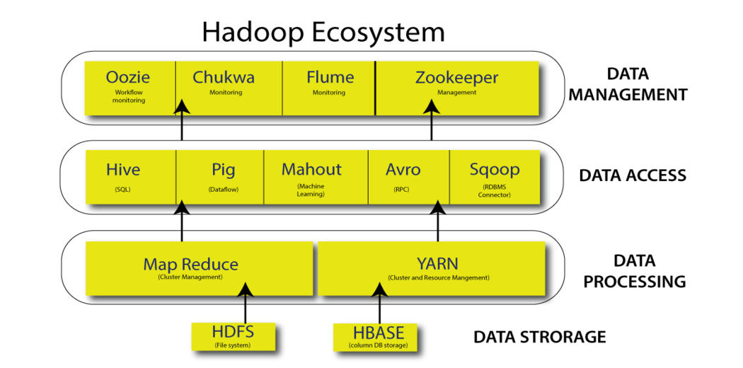
Hadoop Ecosystem Overview

