Slide 1
BIG DATA ANALYTICS(22CSE29)
BE(CSE) V-Semester
Prepared
by
J Shiva Sai
Assistant Professor
Department of Computer Science and Engineering
Chaitanya Bharathi Institute of Technology

Slide 2
UNIT-3
Big Data Frame Works: Hadoop Framework: Introduction to MapReduce, Processing data with Hadoop using MapReduce, Map Reduce Programming: I/O formats, Map side join-Reduce Side Join, Secondary Sorting-Pipelining MapReduce jobs. Introduction to YARN, Architecture, Managing Resources and Applications with Hadoop YARN.

Slide 3
Introduction to Hadoop Framework
Hadoop is an open-source framework developed by Apache for storing and processing Big Data across a cluster of computers.
It enables distributed storage through HDFS (Hadoop Distributed File System) and distributed processing using MapReduce.
YARN (Yet Another Resource Negotiator) manages cluster resources.
Features of Hadoop
  Distributed storage and processing
  Fault tolerance through data replication
  Horizontal scalability
  High availability
  Cost-effective (uses commodity hardware)
  Supports structured, semi-structured, and unstructured data

Slide 4
Introduction to MapReduce
MapReduce is a programming model used to process large datasets in parallel across multiple machines. It divides the work into two main phases: Map and Reduce.
Working of MapReduce
Step 1: Input
  Data is stored in HDFS and divided into input splits.
Step 2: Map Phase
  Each mapper processes an input split and generates intermediate key-value pairs.

Slide 5
Working of MapReduce
Example
Input:
Big Data Big Hadoop
Mapper Output:
(Big,1)
(Data,1)
(Big,1)
(Hadoop,1)

Slide 6
Working of MapReduce
Step 3: Shuffle and Sort
Intermediate data is grouped and sorted by key.
Output:
(Big,[1,1])
(Data,[1])
(Hadoop,[1])

Slide 7
Working of MapReduce
Step 4: Reduce Phase
Reducer aggregates values for each key.
Output:
Big 2
Data 1
Hadoop 1

Slide 8
Example Applications
Word Count
Log Analysis
Weather Data Analysis
Sales Analysis
Recommendation Systems

Slide 9
Word Count – Input Example
Input line 1: Hadoop is scalable
Input line 2: Hadoop is distributed
Input line 3: MapReduce is scalable
Objective: count the occurrence of every word.

Slide 10
Word Count – Grouped Data
Hadoop → [1,1]
is → [1,1,1]
scalable → [1,1]
distributed → [1]
MapReduce → [1]

Slide 11
Word Count – Final output
Hadoop → 2
is → 3
scalable → 2
distributed → 1
MapReduce → 1
The Reducer sums the values for each word.

Slide 12
Advantages
Parallel execution
Automatic fault tolerance
Scalable processing
Efficient for very large datasets

Slide 13
MapReduce Programming – Input and Output Formats
Input and output formats define how data is read from and written to HDFS
A. Input Formats
    TextInputFormat
      Default input format.
      Reads one line at a time.
      Key = byte offset, Value = line of text.
    KeyValueTextInputFormat
      Reads data as key-value pairs separated by a delimiter.
    SequenceFileInputFormat
      Reads Hadoop binary sequence files
    NLineInputFormat
      Reads a fixed number of lines as one input split.

Slide 14
MapReduce Programming – Input and Output Formats
B. Output Formats
    TextOutputFormat
      Default output format.
      Stores output as text.
    SequenceFileOutputFormat
      Writes output in binary format.
    MultipleOutputs
      Generates multiple output files.

Slide 15
Map-Side Join
A Map-Side Join performs the join operation during the map phase, avoiding reducers.
Conditions
  Input datasets must be sorted.
  Data should be partitioned identically.
  Both files should have the same number of partitions.
Advantages
  Faster execution
  No shuffle phase
  Lower network traffic
Disadvantages
  Difficult to prepare datasets
  Suitable mainly for preprocessed data

Slide 16
Reduce-Side Join
A Reduce-Side Join performs the join during the reduce phase.
Working
  1. Mapper tags records from each dataset.
  2. Shuffle groups records with the same key.
  3. Reducer joins matching records.
Advantages
  Works with large datasets
  No requirement for sorted input
  Flexible and widely used
Disadvantages
  Higher network traffic
  Slower because of shuffle and sort

Slide 17
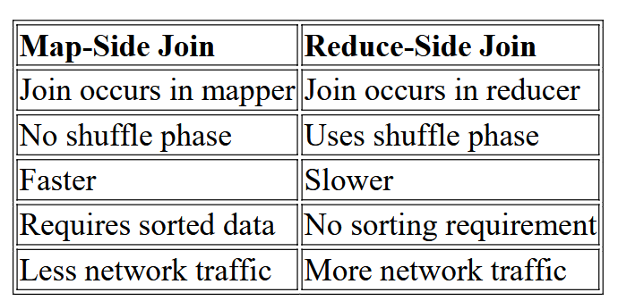
Difference Between Map-Side Join and Reduce-Side Join

Slide 18
HADOOP MAP REDUCE — EXECUTION PIPELINE
Map Reduce is the core component of Hadoop.
Process huge amount of data in parallel by dividing the work into a set of independent tasks.
It works by breaking data processing into two phases: Map phase and Reduce phase.
Map is the first phase of processing, it specify all the complex logic/business rules/costly code.
Reduce is the second phase of processing, it specify light-weight processing like aggregation/summation.

Slide 19
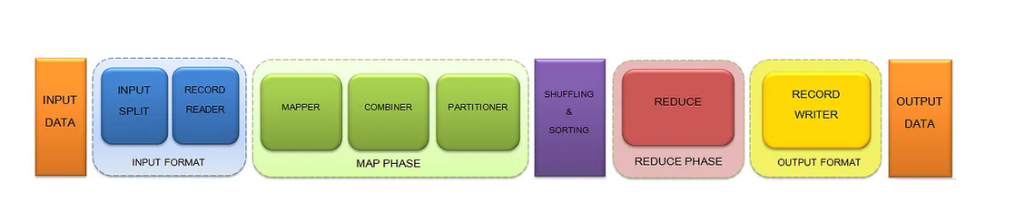
Various Phases of Map Reduce job execution

Slide 20
Various Phases of Map Reduce job execution
Input Files: The data for a Map Reduce task is stored in input files and these input files are generally stored in HDFS.
Input Format: Defines how the input files are split and read. It selects the files or other objects that are used for input. Input Format creates InputSplit.
Java Class: org.apache.hadoop.mapreduce.InputFormat<K,V>
Methods: List<InputSplit>, RecordReader<K,V>

Slide 21
Various Phases of Map Reduce job execution
Input Split: logical representation of data.
It represents the data which is processed by an individual Mapper. When you save any file in Hadoop, the file is broken down into blocks of 128 MB (default configuration).
HDFS is designed to have a Master — Slave configuration
Control the block size by setting mapred.min.split.size parameter in mapred-site.xml.
One map task is created for each Input Split. The split is divided into records and each record will be processed by the mapper.
It is always beneficial to have multiple splits.

Slide 22
Various Phases of Map Reduce job execution
Record Reader:
By default, it uses TextInputFormat for converting data into a key-value pair.
Record Reader communicates with the InputSplit until the file reading is not completed.
It assigns byte offset (unique number) to each line present in the file. Then, these key-value pairs are sent to the mapper for further processing.
Mapper: Mapper processes each input record and generates an intermediate key-value pair. These <key, value> pairs can be completely different from the input pair.
In mapper task, the output is full collection of all these <key, value> pairs.
The intermediate output is stored on the local disk as this is temporary data and writing on HDFS will create unnecessary copies.
In the event of node failure before the map output is consumed by the reduce task, Hadoop reruns the map task on another node and re-creates the map output.
No. of Mapper= {(total data size)/ (input split size)}
Java Class: org.apache.hadoop.mapreduce.Mapper<KEYIN,VALUEIN,KEYOUT,VALUEOUT>

Slide 23
Various Phases of Map Reduce job execution
Combiner:(Mini-Reducer)
Combiner is optional and performs local aggregation on the mappers output, which helps to minimize the data transfer between Mapper and Reducer.
Improving the overall performance of the Reducer. The output of Combiner is then passed to the Partitioner.
Java Class: used in conjunction with different java classes. e.g.- JobConf.getCombinerClass() — usage with JobConf class

Slide 24
Various Phases of Map Reduce job execution
Shuffling and Sorting:
As shuffling can start even before the map phase has finished so this saves some time and completes the tasks in lesser time.
The keys generated by the mapper are automatically sorted by Map Reduce. Values passed to each reducer are not sorted and can be in any order.
Sorting helps reducer to easily distinguish when a new reduce task should start.
This saves time for the Reducer. Reducer starts a new reduce task when the next key in the sorted input data is different than the previous.
Each reduce task takes key-value pairs as input and generates key-value pair as output.
It will not be performed at all in case no Reducers are used. Then, the Map Reduce job stops at the map phase, and the map phase does not include any kind of sorting, thereby producing faster output.
If you want to sort reducer’s values, then the secondary sorting technique is used as it enables us to sort the values in customized order (ascending or descending) passed to each reducer. Once all the mappers are finished and their output is shuffled, then this intermediate output is merged and sorted, which is then provided as input to reduce phase.
Java Parameters: We need to set different parameters in Java for performing shuffling and sorting

Slide 25
Various Phases of Map Reduce job execution
Partitioner:
Hash Partitioner is the default Partitioner in Map Reduce which computes a hash value for the key and assigns the partition based on this result.
The total number of Partitioner that run in Hadoop is equal to the number of reducers which is set by JobConf.setNumReduceTasks() method.
By hash function, key is used to derive the partition.
According to the key-value, each mapper output is partitioned and records having the same key value go into the same partition (within each mapper), and then each partition is sent to a reducer.
This partitioning specifies that all the values for each key are grouped together and make sure that all the values of a single key go to the same reducer, thus ensuring even distribution of the map output over the reducer.
Java Class: org.apache.hadoop.mapreduce.Partitioner<KEY,VALUE>

Slide 26
Various Phases of Map Reduce job execution
Reducer:
It takes the set of intermediate key-value pairs produced by the mappers as the input and then runs a reducer function on each of them to generate the output.
The output of the reducer is the final output, which is stored in HDFS. Reducers run in parallel as they are independent of one another.
The user decides the number of reducers. By default, the number of reducers is 1. Increasing the number of Reducers increases the overhead, increases load balancing and lowers the cost of failures.
Java Class: Reducer<KEYIN,VALUEIN,KEYOUT,VALUEOUT>

Slide 27
Various Phases of Map Reduce job execution
Record Writer: It writes these output key-value pair from the Reducer phase to the output files. The implementation to be used to write the output files of the job is defined by Output Format.
Output Format: The way these output key-value pairs are written in output files by RecordWriter is determined by the Output Format. The final output of reducer is written on HDFS by Output Format. Output Files are stored in a File System.
Java Class: org.apache.hadoop.mapreduce.OutputFormat<K,V>
Method: RecordWriter<K,V>
Output Files: The output is stored in these Output Files and these Output Files are generally stored in HDFS.

Slide 28
Secondary Sorting
Secondary Sorting is used to sort values associated with the same key before they reach the reducer.
Purpose
Sort data on a secondary attribute.
Useful when grouped records need ordered processing.
Example
Input:
(Student,80)
(Student,65)
(Student,90)

Slide 29
Secondary Sorting
Reducer receives:
Student → 65, 80, 90
Applications
Ranking students
Time-series analysis
Sales reports
Log processing

Slide 30
Secondary Sorting
Why it is required?
Normal grouping does not automatically provide desired ordering of values.
Secondary sorting orders values within each primary key.
Useful for timestamps, prices, temperatures and ranking.
Requires appropriate key, partitioning, sorting and grouping logic.

Slide 31
Secondary Sorting Example
Input: A,35; A,28; A,31.
Desired output: A → [28,31,35].
Use a composite key such as (A, temperature).
Partition by A, sort by the complete composite key, group by A.

Slide 32
Secondary Sorting flow
Composite Key
Partitioner
Sort
Grouping
Reducer

Slide 33
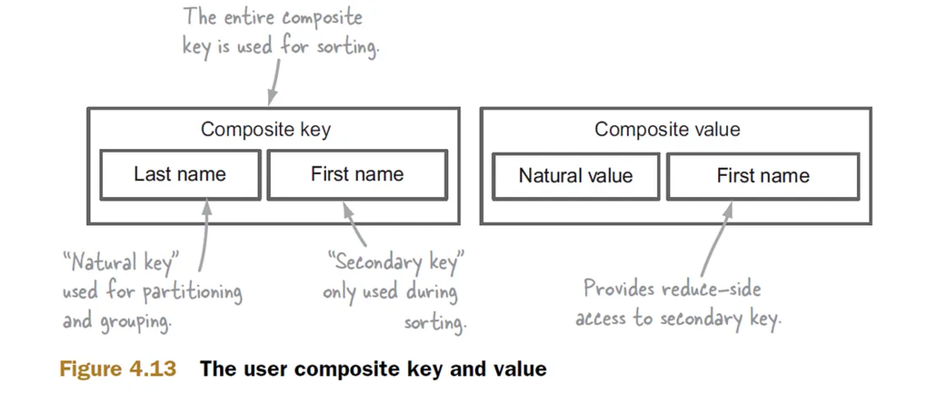
Secondary Sorting
Secondary sort is a technique that allows the MapReduce programmer to control the order that the values show up within a reduce function call.
Lets also assume that our secondary sorting is on a composite key made out of Last Name and First Name.

Slide 34
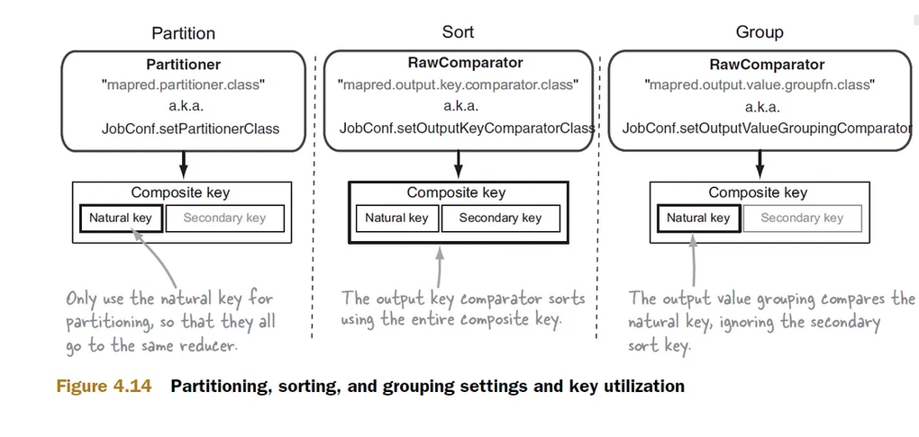
Secondary Sorting
Now lets look at the steps involved in secondary sorting

Slide 35
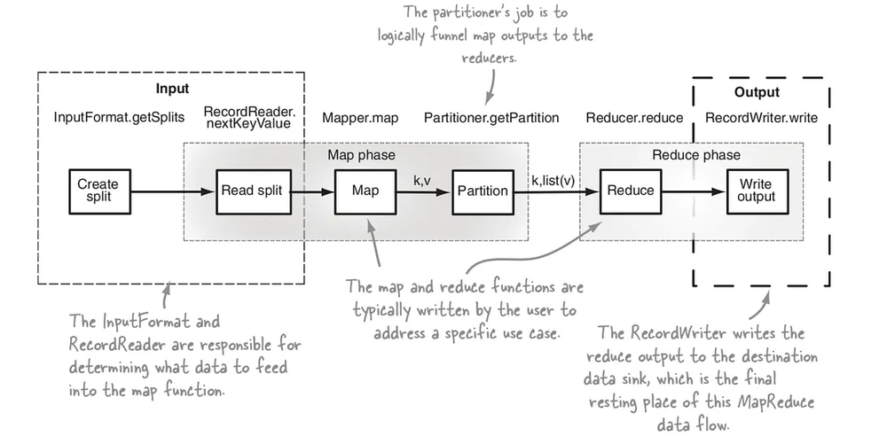
Secondary Sorting

Slide 36
Pipelining MapReduce Jobs
Complex workflows can use multiple MapReduce jobs.
Job 1 output becomes Job 2 input.
Example: clean logs → filter → aggregate → rank.
Each stage can be tested independently.
Intermediate data may introduce additional disk I/O.

Slide 37
MapReduce Pipeline Example
Raw Logs
Job 1: Clean
Job 2: Filter
Job 3: Aggregate
Report

Slide 38
Introduction to YARN
YARN stands for "Yet Another Resource Negotiator".
It was introduced in Hadoop 2.0 to remove the bottleneck on Job Tracker which was present in Hadoop 1.0.
YARN was described as a "Redesigned Resource Manager"
large-scale distributed operating system used for Big Data processing.

Slide 39
Why YARN Hadoop Used?
Hadoop 1.x had some shortcomings like delays in batch processing, scalability issues, and limited support for varied workloads, as it relied solely on MapReduce for processing big datasets.
YARN support a variety of processing approaches—enabling stream processing, interactive querying, and batch jobs to run side by side.
YARN framework can also run non-MapReduce applications, thus overcoming the limitations of Hadoop 1.x.
YARN plays a key role in cloud-native environments by integrating with container orchestration tools like Kubernetes.
It enables scalable and flexible deployment of big data and machine learning workloads on platforms such as AWS EMR, Google Dataproc and Azure HDInsight.

Slide 40
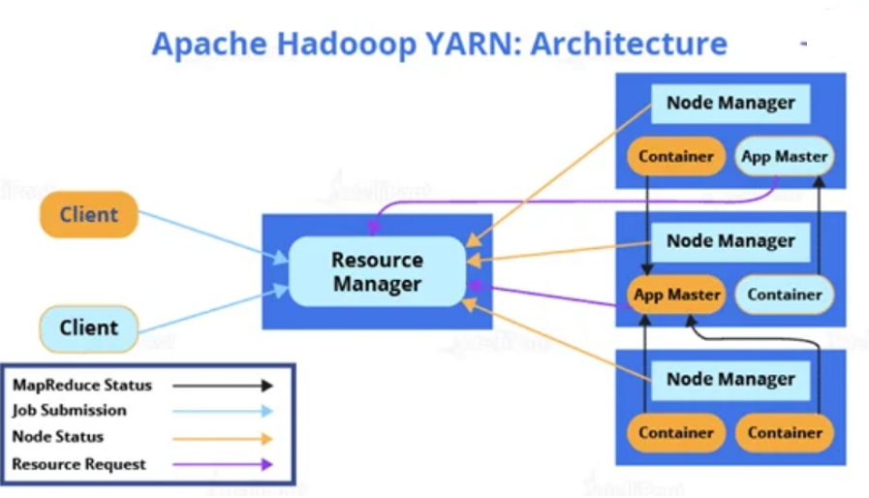

Slide 41
Resource Manager
Responsible for managing several other applications, along with the global assignments of resources such as CPU and memory.
It is used for job scheduling.
Resource Manager has two components:
Scheduler:
  Schedulers’ task is to distribute resources to the running applications.
  It only deals with the scheduling of tasks and hence it performs no tracking and no monitoring of applications.
Application Manager:
  Manages applications running in the cluster.
  Tasks, such as the starting of Application Master or monitoring, are done by the Application Manager.

Slide 42
Node Manager
Node Manager has to monitor the container’s resource usage, along with reporting it to the Resource Manager.
The health of the node on which YARN is running is tracked by the Node Manager.
It takes care of each node in the cluster while managing the workflow, along with user jobs on a particular node.
It keeps the data in the Resource Manager updated
Node Manager can also destroy or kill the container if it gets an order from the Resource Manager to do so.

Slide 43
Application Master
Every job submitted to the framework is an application, and every application has a specific Application Master associated with it. Application Master performs the following tasks:
It coordinates the execution of the application in the cluster, along with managing the faults.
It negotiates resources from the Resource Manager.
It works with the Node Manager for executing and monitoring other components’ tasks.
At regular intervals, heartbeats are sent to the Resource Manager for checking its health, along with updating records according to its resource demands.

Slide 44
Container
A container is a set of physical resources (CPU cores, RAM, disks, etc.) on a single node. The tasks of a container are listed below:
It grants the right to an application to use a specific amount of resources (memory, CPU, etc.) on a specific host.
YARN containers are particularly managed by a Container Launch context which is Container Life Cycle (CLC). This record contains a map of environment variables, dependencies stored in remotely accessible storage, security tokens, the payload for Node Manager services, and the command necessary to create the process.

Slide 45
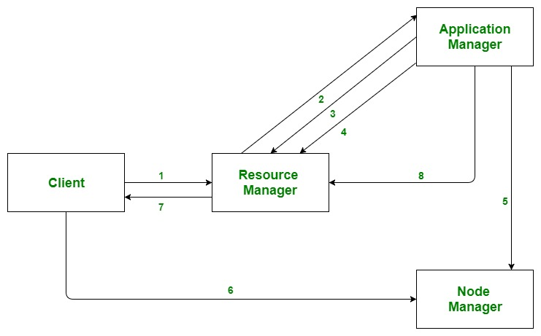
Application workflow in Hadoop YARN

Slide 46
Application workflow in Hadoop YARN
Client submits an application
The Resource Manager allocates a container to start the Application Master
The Application Master registers itself with the Resource Manager
The Application Master negotiates containers from the Resource Manager
The Application Master notifies the Node Manager to launch containers
Application code is executed in the container
Client contacts Resource Manager/Application Master to monitor application’s status
Once the processing is complete, the Application Master un-registers with the Resource Manager

Slide 47
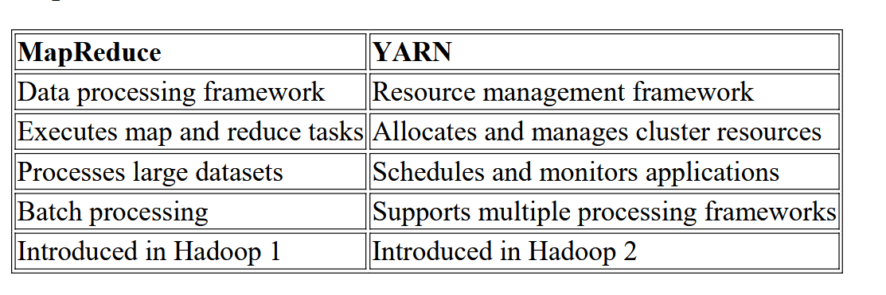
MapReduce Vs YARN

