Slide 1
BIG DATA ANALYTICS(22CSE29)
BE(CSE) V-Semester
Prepared
by
J Shiva Sai
Assistant Professor
Department of Computer Science and Engineering
Chaitanya Bharathi Institute of Technology

Slide 2
UNIT-4
Hive and Pig: Introduction to Hive: What is Hive, Hive Architecture, Hive data types, Hive file formats, Hive Query Language (HQL), RC File implementation, User Defined Function (UDF).
Introduction to Pig: What is Pig, Anatomy of Pig, Pig on Hadoop, Data types in Pig, Running Pig, Execution Modes of Pig, HDFS Commands, Relational Operators, Eval Function, Complex Data Types, Piggy Bank, User Defined Function, Pig Vs Hive.

Slide 3
Introduction to Hive
What is Hive?
Apache Hive is an open-source data warehouse software developed by the Apache Software Foundation.
It is built on top of Apache Hadoop and is used to store, query, and analyze large volumes of data stored in the Hadoop Distributed File System (HDFS).
Hive uses Hive Query Language (HQL), which is similar to SQL, making it easy for users with SQL knowledge to work with big data.

Slide 4
Introduction to Hive
Hive is primarily designed for batch processing and analytics and is not suitable for Online Transactional Processing (OLTP) workloads.
Manages structured data stored in tables, stores schemas in a database, and processes data in HDFS.
Supports optimization and usability functions not easily achievable with raw MapReduce.
It can partition data to improve query performance and is compatible with multiple Hadoop-compatible file formats.

Slide 5
Introduction to Hive
Features
SQL-like language (HQL)
Supports structured data
Suitable for batch processing(data ware housing)
Supports partitioning and bucketing(improving query performance by scanning only relevant subsets of data.)
User-Defined Functions (UDFs)
Multiple File Format Support
Metadata Storage(stores schema and metadata in RDBMS systems such as Derby for single-user setups or MySQL for multi-user setups.)
Optimizations(Hive provides features like predicate pushdown, column pruning, query parallelization and compression algorithms (DEFLATE, Snappy))

Slide 6
Advantages and Disadvantages of Hive
Advantages
Easy for SQL users.
Handles very large datasets.
Integrates with the Hadoop ecosystem.
Supports data warehousing and analytics.
Disadvantages
Not suitable for real-time processing.
Slower than traditional databases for small datasets.
Primarily designed for batch jobs.

Slide 7
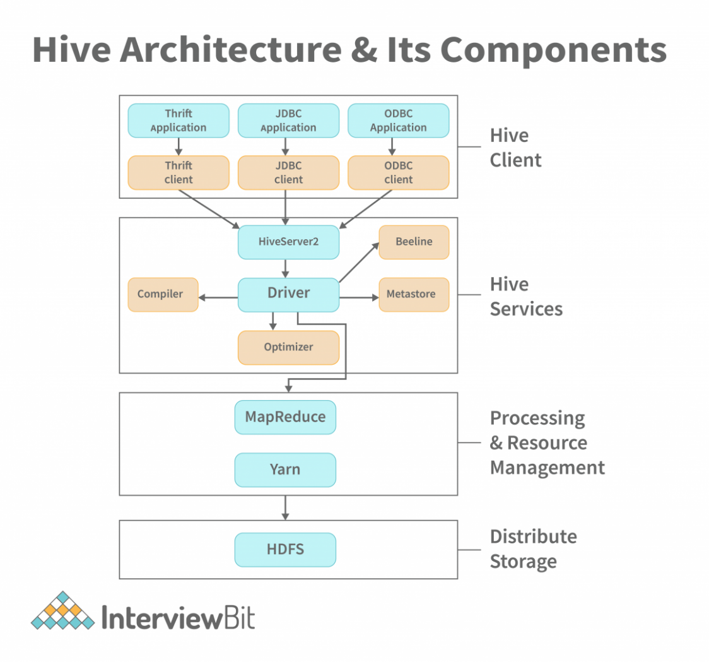
Hive Architecture

Slide 8
Components
1. User Interface (UI)
  Users interact with Hive through: Command Line Interface (CLI), Beeline, DBC, ODBC
2. Driver
  Receives HQL queries.
  Creates execution plans.
  Manages sessions.
3. Compiler
  Parses HQL.
  Performs syntax checking.
  Generates logical execution plans.
4. Optimizer
  Optimizes queries.
  Improves execution speed.
5. Execution Engine
  Executes optimized queries using MapReduce, Tez, or Spark.
6. Metastore
  Stores metadata such as: Database names, Table names, Column names, Data types and Partitions
7. HDFS :Stores the actual data files.

Slide 9
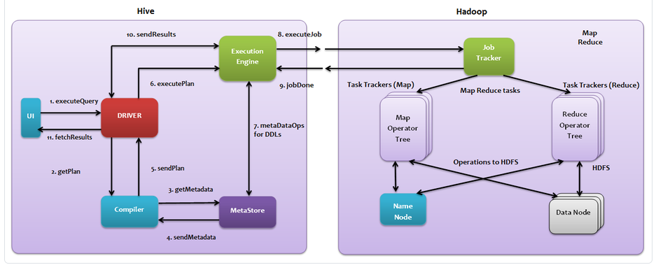
Hive Interaction with Hadoop

Slide 10
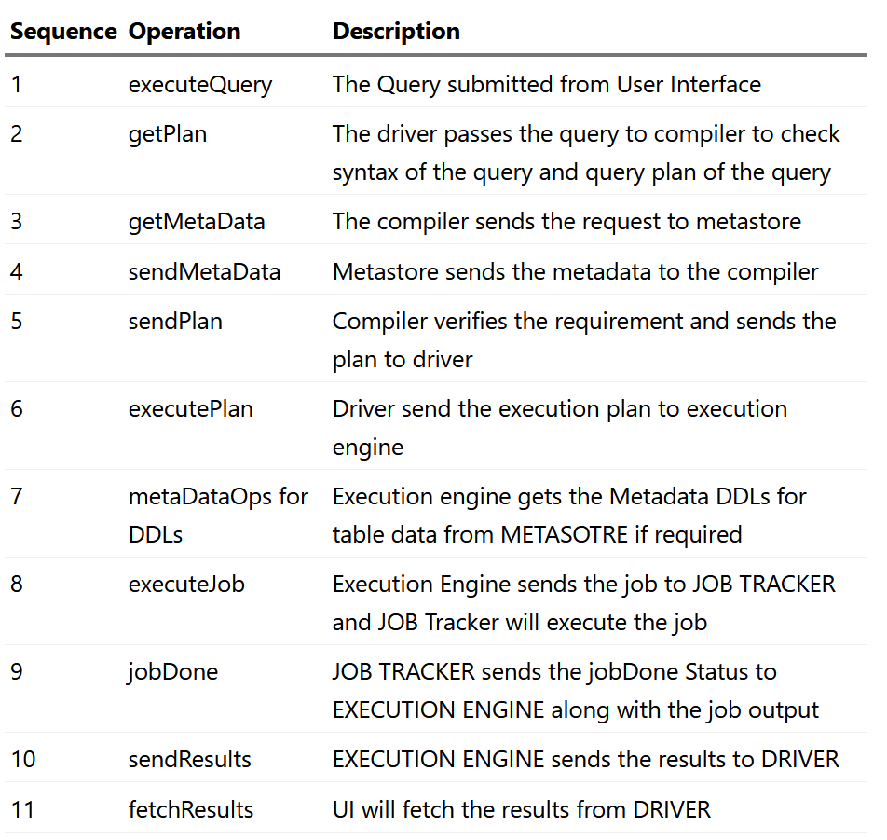

Slide 11
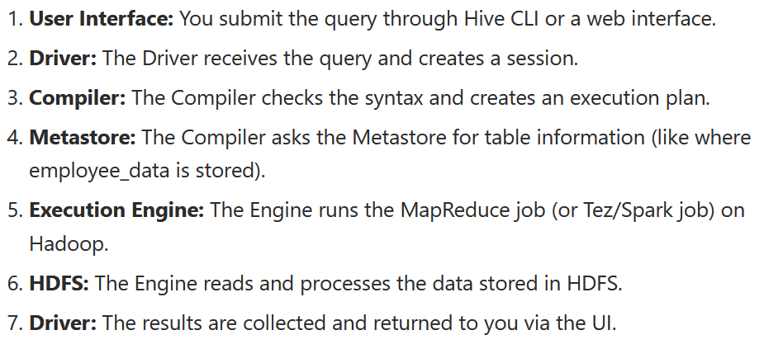
Example
Select dept,Count(*)
From Student
Group by dept;

Slide 12
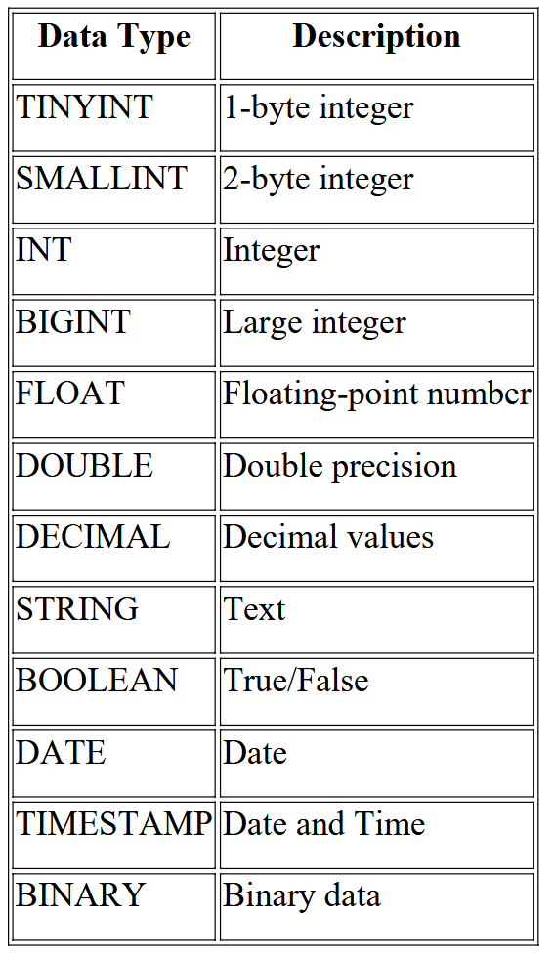
Hive Data Types
Hive supports Primitive and Complex data types.
Primitive Data Type
Example:
CREATE TABLE student(
id INT,
name STRING,
marks FLOAT
);

Slide 13
Complex Data Type
Array
ARRAY<STRING>
Example:
["Java","Python","C"]
Map
MAP<STRING,INT>
Example:
{"Math":95}
Struct
STRUCT<name:STRING,age:INT>
Example:
("Ravi",20)
Union Type
Stores values of different data types in one field.

Slide 14
Hive Query Language (HQL)
HQL is similar to SQL and is used to create databases, tables, and query data.
Create Database
  CREATE DATABASE college;
Use Database
  USE college;
Create Table
  CREATE TABLE employee(
  id INT,
  name STRING,
  salary FLOAT
  );

Slide 15
Hive Query Language (HQL)
Insert Data
  INSERT INTO employee VALUES
  (1,'Ravi',45000);
Retrieve Data
  SELECT * FROM employee;
Filter Data
  SELECT * FROM employee
  WHERE salary>30000;
Group Data
  SELECT department,
  COUNT(*)
  FROM employee
  GROUP BY department;
Order Data
  SELECT *
  FROM employee
  ORDER BY salary DESC;

Slide 16
Hive File Formats
Hive supports several storage formats.
1. Text File
  Default storage format.
  Human-readable.
  create table table_name (schema of the table) row format delimited fields terminated by ',' | stored as TEXTFILE
2. Sequence File
  Binary format.
  Faster than text files.
  Create table table_name (schema of the table) row format delimited fileds terminated by ',' | stored as SEQUENCEFILE;

Slide 17
Hive File Formats
3.RC File (Record Columnar File)
  Stores data column-wise.
  Better compression.
  Faster analytical queries.
4. ORC File (Optimized Row Columnar)
  High compression.
  Faster query execution.
  Optimized for Hive.
5. Parquet File
  Columnar storage format.
  Excellent compression.
  Used in big data analytics.

Slide 18
Hive : RCFile
RCFile (Record Columnar File) is a data placement structure designed for MapReduce-based data warehouse systems.
RCFILE stands of Record Columnar File which is another type of binary file format which offers high compression rate on the top of the rows.
RCFILE is used when we want to perform operations on multiple rows at a time.
RCFile stores table data in a flat file consisting of binary key/value pairs.
It first partitions rows horizontally into row splits, and then it vertically partitions each row split in a columnar way.

Slide 19
Hive : RCFile
RCFile stores the metadata of a row split as the key part of a record, and all the data of a row split as the value part.
RCFile combines the advantages of both row-store and column-store to satisfy the need for fast data loading and query processing, efficient use of storage space, and adaptability to highly dynamic workload patterns.
  As row-store, RCFile guarantees that data in the same row are located in the same node.
  As column-store, RCFile can exploit column-wise data compression and skip unnecessary column reads

Slide 20
create a RCFILE format as follows
Syntax:
create table table_name (schema of the table) row format delimited fields terminated by ',' | stored as RCFILE
Hive has its own RCFILE Input format and RCFILE output format in its default package:
org.apache.hadoop.hive.ql.io.RCFileInputFormat
org.apache.hadoop.hive.ql.io.RCFileOutputFormat

Slide 21
Creating RCFILE
create table olympic_rcfile(
athelete STRING,
age INT,
country STRING,
year STRING,
closing STRING,
sport STRING,
gold INT,
silver INT,
bronze INT,
total INT) row format delimited fields terminated by '\t' stored as rcfile

Slide 22
RC FILE
We cannot load data into RCFILE directly. First we need to load data into another table and then we need to overwrite it into our newly created RCFILE
  INSERT OVERWRITE TABLE olympic_rcfile
  SELECT * FROM olympic;

Slide 23
ORC File Format
ORC stands for Optimized Row Columnar which means it can store data in an optimized way than the other file formats.
ORC reduces the size of the original data up to 75%. As a result the speed of data processing also increases.
ORC shows better performance than Text, Sequence and RC file formats.
An ORC file contains rows data in groups called as Stripes along with a file footer.
ORC format improves the performance when Hive is processing the data.

Slide 24
User Defined Function (UDF)
UDF allows users to create custom functions to perform specialized operations.
UDFs are routines designed to accept parameters, execute a specific action, and return the resulting value.
The return value can either be a single scalar row or a complete result set, depending on the UDF’s code and the implemented interface.
UDFs represent a powerful capability that enhances classical SQL functionality by allowing the integration of custom code, providing Hive users with a versatile toolset.
Apache Hive comes equipped with a variety of built-in UDFs that users can leverage.

Slide 25
User Defined Function (UDF)
Every UDF’s evaluate method is one row at a time. This means if your UDFs has complex code, it could introduce performance issue in execution time.
To gain an understanding of UDFs, let’s begin with an example to comprehend their execution pattern.
UDF’s in action
SELECT length(string_col) FROM table_name;
In this case, the length of the built-in UDF evaluates each row of the string_col values.

Slide 26
User Defined Function (UDF)
Types of UDF
  UDF: One input → One output.
  UDAF: Aggregate functions (e.g., SUM, AVG).
  UDTF: One input → Multiple outputs.
Example:
  SELECT UPPER(name)
  FROM employee;
Advantages
Reusable code.
Extends Hive functionality.
Supports custom business logic.
Source for functions: https://hive.apache.org/docs/latest/language/hive-udfs/

Slide 27
Introduction to Pig
Apache Pig is an open-source platform and abstraction over MapReduce.
Platform used to analyze larger sets of data representing them as data flows.
To write data analysis programs, Pig provides a high-level language known as Pig Latin.
This language provides various operators using which programmers can develop their own functions for reading, writing, and processing data.
Pig is generally used with Hadoop. Perform the data manipulation operations in Hadoop using Apache Pig.
Pig automatically converts Pig Latin scripts into MapReducejobs.

Slide 28
Why Pig is needed?
Using Pig Latin, programmers can perform MapReduce tasks easily without having to type complex codes in Java.
Apache Pig uses multi-query approach, thereby reducing the length of codes.
  Example an operation that would require you to type 200 lines of code (LoC) in Java can be easily done by typing as less as just 10 LoC in Apache Pig. Ultimately, Apache Pig reduces the development time by almost 16 times.
Pig Latin is SQL-like language and it is easy to learn Apache Pig when you are familiar with SQL.
Apache Pig provides many built-in operators to support data operations like joins, filters, ordering, etc. In addition, it also provides nested data types like tuples, bags, and maps that are missing from MapReduce.

Slide 29
Introduction to Pig
Features
  Simple scripting language.
  Automatic optimization.
  Supports structured and semi-structured data.
  Extensible with UDFs.
Applications
  Web logs
  Search Tools
  Sensitive Data Lods
Advantages
  Less coding than MapReduce.
  Easy to learn.
  Suitable for ETL (Extract, Transform, Load).

Slide 30
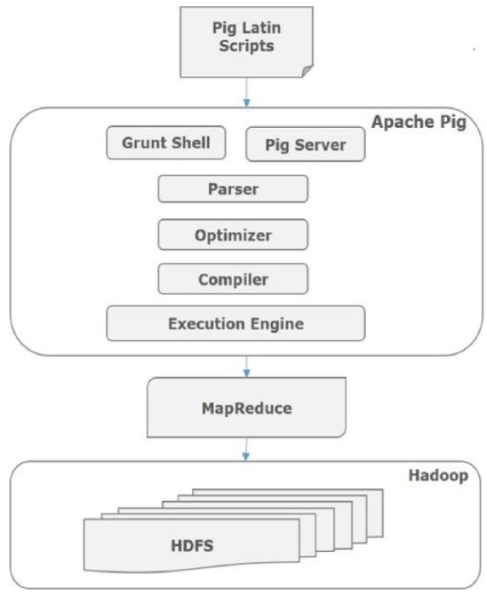
Anatomy of Pig

Slide 31
Pig Components
Parser: Initially the Pig Scripts are handled by the Parser. It checks the syntax of the script, does type checking, and other miscellaneous checks. The output of the parser will be a DAG (directed acyclic graph), which represents the Pig Latin statements and logical operators.
Optimizer: The logical plan (DAG) is passed to the logical optimizer, which carries out the logical optimizations such as projection and pushdown.
Compiler: The compiler compiles the optimized logical plan into a series of MapReduce jobs.
Execution engine: Finally the MapReduce jobs are submitted to Hadoop in a sorted order. Finally, these MapReduce jobs are executed on Hadoop producing the desired results.

Slide 32
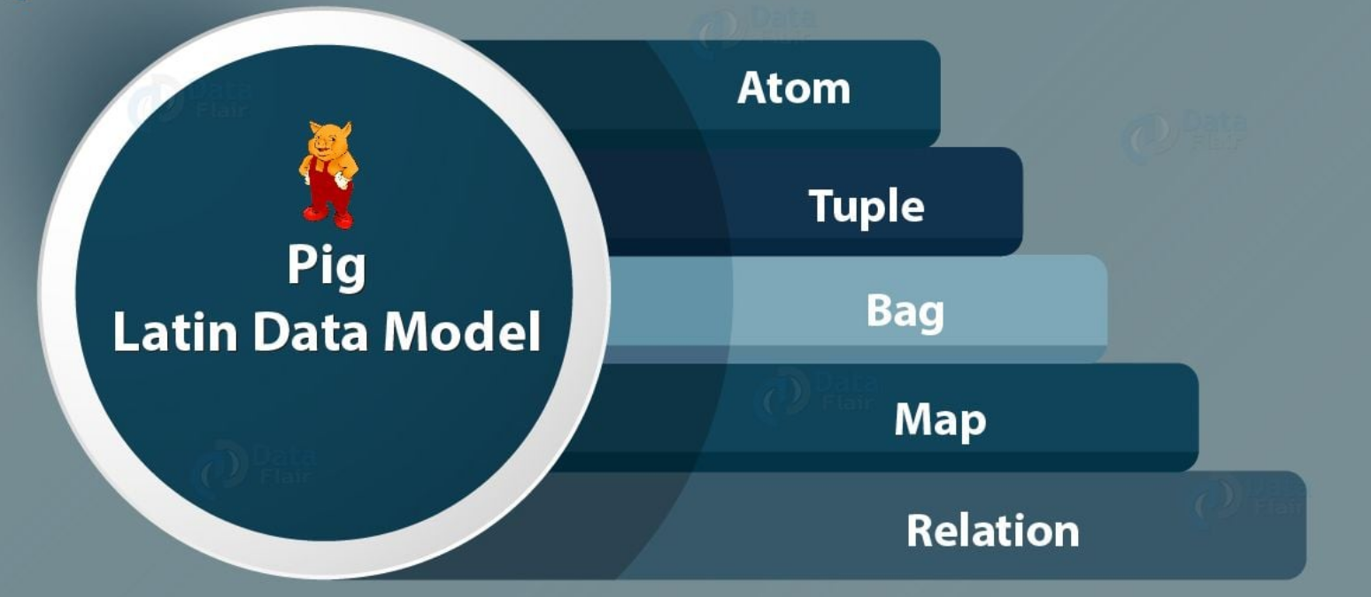

Slide 33
Pig Elements
Atom
– Any single value in Pig Latin, irrespective of their data, type is known as an Atom.
– It is stored as string and can be used as string and number. int, long, float, double, chararray and bytearray are the atomic values of Pig.
– A piece of data or a simple atomic value is known as a field.
– Example: ‘raja’ or ‘30’
Tuple
– A record that is formed by an ordered set of fields is known as a tuple, the fields can be of any type. A tuple is similar to a row in a table of RDBMS.
– Example: (Raja, 30)’

Slide 34
Pig Elements
Bag
– A bag is an unordered set of tuples.
-- collection of tuples (non-unique) is known as a bag.
--Each tuple can have any number of fields (flexible schema).
--A bag is represented by ‘{}’. It is similar to a table in RDBMS, but unlike a table in RDBMS, it is not necessary that every tuple contain the same number of fields or that the fields in th same position (column) have the same type.
Example: {(Raja, 30), (Mohammad, 45)}
– A bag can be a field in a relation; in that context, it is known as inner bag.
– Example: {Raja, 30, {9848022338, raja@gmail.com,}}

Slide 35
Pig Elements
Relation
– A relation is a bag of tuples. The relations in Pig Latin are unordered (there is no guarantee that tuples are processed in any particular order).
Map
– A map (or data map) is a set of key-value pairs. The key needs to be of type chararray and should be unique. The value might be of any type. It is represented by ‘[]’
– Example: [name#Raja, age#30]

Slide 36
Installation of Pig
Step 1: Download the Pig version 0.18.0 tar file from the official Apache pig site. Navigate to the website https://downloads.apache.org/pig/latest//. Download the file 'pig-0.18.0.tar.gz' from the website.
Step 2: Add the path variables of PIG_HOME and PIG_HOME\bin
  After hitting new Add the following values in the fields.
  Variable Name - PIG_HOME
  Variable value - C:\pig-0.18.0
  Path variable C:\pig-0.18.0\bin
Step 3: Correcting the Pig Command File
  set HADOOP_BIN_PATH = %HADOOP_HOME%\bin
  Replace with set HADOOP_BIN_PATH=%HADOOP_HOME%\libexec

Slide 37
Installation of Pig
There are 2 Ways of Invoking the grunt shell:
Local Mode: All the files are installed, accessed, and run in the local machine itself. No need to use HDFS. The command for running Pig in local mode is as follows.
pig -x local
MapReduce Mode: The files are all present on the HDFS . We need to load this data to process it. The command for running Pig in MapReduce/HDFS Mode is as follows.
pig -x mapreduce

Slide 38
Modes of Execution
Pig programs can be run in three methods which work in both local and MapReduce mode. They are
– Script Mode
– Grunt Mode
– Embedded Mode
Embedded Mode
You can embed pig programs in Java, python and ruby and can run from the same.

Slide 39
Script Mode
In script mode, pig runs the commands specified in a script file. The following example shows how to run a pig programs from a script file:
$ vim scriptfile.pig
A = LOAD 'script_file';
DUMP A;
$ pig ­x local scriptfile.pig

Slide 40
Grunt Mode or Interactive Mode
The grunt mode can also be called as interactive mode. Grunt is pig's interactive shell.
It is started when no file is specified for pig to run.
  $ pig ­x local
  grunt> A = LOAD 'grunt_file';
  grunt> DUMP A;
• You can also run pig scripts from grunt using run and exec commands.
  grunt> run scriptfile.pig
  grunt> exec scriptfile.pig

Slide 41
Example
Step 1: Create a Sample Dataset
  Students.csv
  1,Ram,85
  2,Sam,92
  3,Venu,65
  4,Cbit,78
Step 2: Write the Pig Script
-- Load the data from the CSV file
data = LOAD 'C:/pig_demo/students.csv' USING PigStorage(',') AS (id:int, name:chararray, score:int);
-- Filter for students scoring higher than 70
high_scorers = FILTER data BY score > 70;
-- Display the results in the console
DUMP high_scorers;

Slide 42
Example
Step 3: Execute the Script in Windows
Option 1:C:/pig_demo>pig -x local pigexample.pig
Option 2: pig -x local
grunt> exec C:/pig_demo/pigexample.pig
Other example for agriculture dataset
https://www.geeksforgeeks.org/big-data/apache-pig-installation-on-windows-and-case-study/

Slide 43
Example : WordCount
How to find the number of occurrences of the words in a file using the pig script?
You can find the famous word count example written in map reduce programs in apache website. Here we will write a simple pig script for the word count problem.
The pig script given in next slide finds the number of times a word repeated in a file:

Slide 44
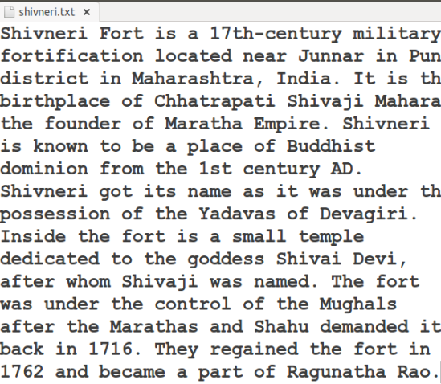
text file- shivneri.txt

Slide 45
Wordcount Program
lines = LOAD 'shivneri.txt' AS
(line:chararray);
words = FOREACH lines GENERATE
FLATTEN(TOKENIZE(line)) as word;
grouped = GROUP words BY word;
w_count = FOREACH grouped GENERATE group,
COUNT(words);
DUMP w_count;

Slide 46
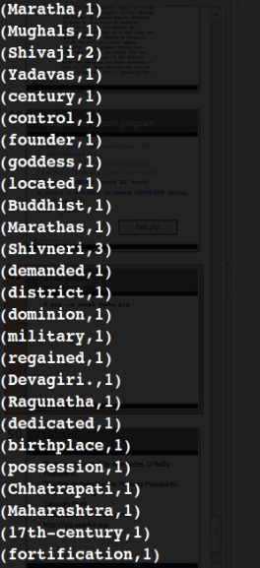
Output
pig -x local forts.pig

Slide 47
HDFS Commands
List Files:hdfs dfs -ls /
Create Directory: hdfs dfs -mkdir /data
Upload File:hdfs dfs -put file.txt /data
Download File:hdfs dfs -get /data/file.txt
Delete File:hdfs dfs -rm /data/file.txt
View File:hdfs dfs -cat /data/file.txt

Slide 48
Relational Operations in Pig
Commands in Pig Latin used to load, process, transform, analyze, and store large datasets.
The important Pig operations are:
  1. LOAD
  2. STORE
  3. DUMP
  4. FILTER
  5. FOREACH
  6. GROUP
  7. COGROUP
  8. JOIN
  9. ORDER BY
  10. DISTINCT
  11. UNION
  12. LIMIT

Slide 49
LOAD Operation
The LOAD operation is used to load data into Pig.
Syntax:
A = LOAD 'student.txt';
Example:
A = LOAD 'student.txt' USING PigStorage(',');
Here:
A → Relation name
LOAD → Loads the data
student.txt → Input file
PigStorage(',') → Indicates comma-separated data

Slide 50
STORE Operation
The STORE operation is used to save the processed data into a file.
Example
STORE B INTO 'output';
Flow chart:
  Input Data → Pig Processing → STORE → Output Data
DUMP Operation
The DUMP operation displays the contents of a relation on the screen.
Example:
DUMP A;

Slide 51
FILTER Operation
The FILTER operation selects records that satisfy a condition.
Suppose the student data is:
101, Lakshmi, 85
102, Sita, 90
103, Ravi, 65
Pig Latin:
A = LOAD 'student.txt' USING PigStorage(',’);
B = FILTER A BY $2 > 75;
DUMP B;
Output:
101, Lakshmi, 85
102, Sita, 90

Slide 52
FOREACH Operation
The FOREACH operation is used to process each record and select required fields.
Example:
A = LOAD 'student.txt' USING PigStorage(',’);
B = FOREACH A GENERATE $0, $1;
DUMP B;
Output:
101, Lakshmi
102, Sita
103, Ravi

Slide 53
GROUP Operation
The GROUP operation groups records having the same value.
Example:
Sales data:
Apple, 100
Mango, 50
Apple, 200
Mango, 100
Pig Latin:
A = LOAD 'sales.txt' USING PigStorage(',’);
B = GROUP A BY $0;
DUMP B;
Result
Apple → (Apple,100), (Apple,200)
Mango → (Mango,50), (Mango,100)

Slide 54
COGROUP Operation
COGROUP is used to group data from two or more relations based on a common key.
Example:
Suppose we have:
Student Data
101, Lakshmi
102, Sita
Marks Data
101, 85
102, 90
Pig Latin:
Students = LOAD 'student.txt' USING PigStorage(',’);
Marks = LOAD 'marks.txt' USING PigStorage(',’);
C = COGROUP Students BY $0, Marks BY $0;

Slide 55
JOIN Operation
The JOIN operation combines two or more datasets using a common field.
Example:
Students = LOAD 'student.txt' USING PigStorage(',’);
Marks = LOAD 'marks.txt' USING PigStorage(',');
Result = JOIN Students BY $0, Marks BY $0;
DUMP Result;
Output:
101, Lakshmi, 101, 85
102, Sita, 102, 90

Slide 56
ORDER BY Operation
The ORDER operation is used to sort data.
Example:
A = LOAD 'student.txt' USING PigStorage(',’);
B = ORDER A BY $2 ASC;
DUMP B;
Here:
$2 → Marks field
ASC → Ascending order

Slide 57
DISTINCT Operation
The DISTINCT operation removes duplicate records.
Example:
A = LOAD 'data.txt’;
B = DISTINCT A;
DUMP B;
UNION Operation
The UNION operation combines two or more relations.
Example
A = LOAD 'student1.txt’;
B = LOAD 'student2.txt’;
C = UNION A, B;
DUMP C;

Slide 58
LIMIT Operation
The LIMIT operation restricts the number of records.
Example:
A = LOAD 'student.txt’;
B = LIMIT A 5;
DUMP B;

Slide 59
Eval Functions
Eval functions perform operations on data and return computed results.
Common functions are:
COUNT()
SUM()
AVG()
MIN()
MAX()
CONCAT()
UPPER()
LOWER()
SIZE()

Slide 60
COUNT() :
Counts the number of records.
COUNT(A)
SUM() :
Calculates the total.
SUM(A.$1)
AVG() :
Calculates the average.
AVG(A.$1)
MIN() :
Finds the minimum value.
MIN(A.$1)
MAX() :
Finds the maximum value.
MAX(A.$1)

Slide 61
Example of Aggregate Functions
Suppose marks are:
80,70,90,60
Pig Latin:
A = LOAD 'marks.txt’;
B = GROUP A ALL;
C = FOREACH B GENERATE
COUNT(A),
SUM(A.$0),
AVG(A.$0),
MIN(A.$0),
MAX(A.$0);

Slide 62
The result provides:
Number of students
Total marks
Average marks
Minimum marks
Maximum marks
String Functions
String functions are used to process character or text data.
Common examples:
UPPER()
LOWER()
CONCAT()
SUBSTRING()
TRIM()

Slide 63
Example:
B = FOREACH A GENERATE UPPER($1);
This converts the selected text into uppercase.
Mathematical Functions
Mathematical functions perform numerical calculations.
Examples include:
ABS()
CEIL()
FLOOR()
ROUND()
SQRT()
Example:
B = FOREACH A GENERATE SQRT($1);
This calculates the square root of a value.

Slide 64
Conversion Functions
Conversion functions are used to convert data from one type to another.
Example:
B = FOREACH A GENERATE (int)$1;
Here the value is converted to an integer.

Slide 65
User Defined Function (UDF) in Pig
It is a custom function written to perform specialized processing.
UDFs can be used for:
Special calculations
Data cleaning
Text processing
Validation
Application-specific processing
Example:
Suppose a company needs a special function to validate customer IDs.
If Pig does not provide the required function, a programmer can create a UDF.

Slide 66
Piggy Bank
Piggy Bank is a collection of reusable User Defined Functions (UDFs) contributed by the Apache Pig community.
These functions extend the capabilities of Pig beyond its built-in functions.
Why Piggy Bank is Used:
  Built-in functions are not sufficient.
  Additional functionality is required.
  Existing community-contributed UDFs can be reused.
  Special data processing is required.

Slide 67
Piggy Bank
Uses
  String processing.
  Date manipulation.
  Mathematical functions.
  XML/JSON processing.
Advantages
  Reusable functions.
  Saves development time.
  Extends Pig functionality.

Slide 68
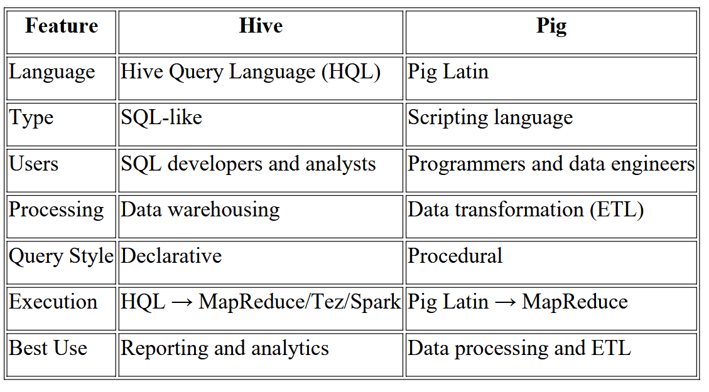
Pig vs HIVE

Slide 69
Main Difference Between Pig and Hive
Pig = Data Flow
Pig Latin describes the processing of data through a sequence of operations.
LOAD
↓
FILTER
↓
GROUP
↓
JOIN
↓
STORE
Hive = SQL-like Query
Hive allows users to query and analyze data using SQL-like statements.
SELECT
↓
FROM
↓
WHERE
↓
GROUP BY
↓
RESULT

Slide 70
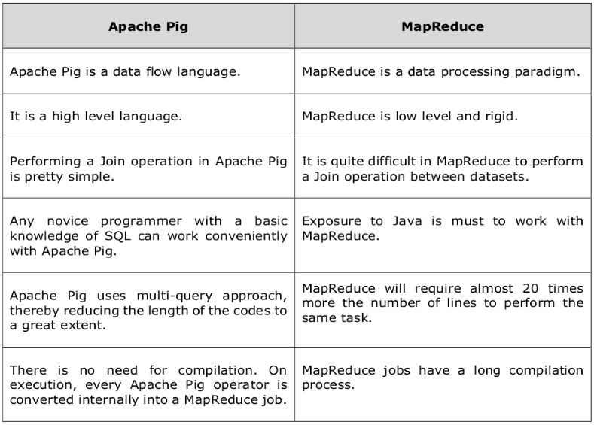
Pig vs MapReduce

