Slide 1
BIG DATA ANALYTICS(22CSE29)
BE(CSE) V-Semester
Prepared
by
J Shiva Sai
Assistant Professor
Department of Computer Science and Engineering
Chaitanya Bharathi Institute of Technology

Slide 2
UNIT-5
Apache Spark Framework: Introduction to Apache spark-Design principles, Advantages and Disadvantages, Layered architecture, Programming with RDDs: Create RDD- Spark operations - transformations, actions-DAG in Apache spark.
Case Study: Analyze student academic data to find trends, subject difficulty levels, and top performers using big data tools.

Slide 3
Introduction to Apache spark
Apache Spark is an open-source, distributed computing framework used for processing and analyzing large-scale datasets.
It was developed at the University of California, Berkeley and is now maintained by the Apache Software Foundation.
Spark is designed to process big data much faster than Hadoop MapReduce by storing intermediate data in memory (RAM) instead of writing it to disk after every operation.

Slide 4
Introduction to Apache spark
Apache Spark is a fast, general-purpose cluster computing framework for large-scale data processing that supports batch processing, streaming, machine learning, graph processing, and SQL analytics.
Features of Apache Spark
High-speed data processing
In-memory computation(Spark’s secret sauce).
Fault tolerance
Distributed processing
Supports multiple programming languages(Polyglot programming)
Easy integration with Hadoop
Supports machine learning and graph processing

Slide 5
Built-in libraries
Apache Spark comes with a rich set of built-in libraries that cater to various data processing needs:
  Spark SQL
  Spark MLlib
  Spark GraphX
  Spark Structured Streaming (and the legacy Spark Streaming)
These libraries are tightly integrated into the Spark ecosystem, which guarantees seamless interoperability and high performance.

Slide 6
Applications of Spark
Big Data Analytics
Machine Learning
Real-time Data Processing
Financial Analysis
Healthcare Analytics
Interactive Data Analysis
Social Media Analytics

Slide 7
Design Principles of Apache Spark
Apache Spark is designed based on the following principles:
1. Speed
  Processes data in memory, making it 10–100 times faster than Hadoop MapReduce.
2. Ease of Use
  Provides APIs in:
    Java
    Scala
    Python (PySpark)
    R

Slide 8
Design Principles of Apache Spark
3. General-Purpose Computing
  Supports:
      Batch processing
      Streaming
      SQL
      Machine Learning
      Graph Processing
4. Fault Tolerance
  Uses RDD lineage to recover lost data automatically.
5. Scalability
  Can process data across hundreds or thousands of computers.

Slide 9
Advantages of Apache Spark
1. High processing speed
2. In-memory computing
3. Easy programming
4. Supports multiple languages
5. Fault tolerant
6. Supports iterative algorithms
7. Suitable for machine learning
8. Supports real-time streaming

Slide 10
Disadvantages of Apache Spark
1. Requires more RAM
2. Higher hardware cost
3. Not suitable for very small datasets
4. Complex cluster management
5. Consumes more memory than Hadoop MapReduce

Slide 11
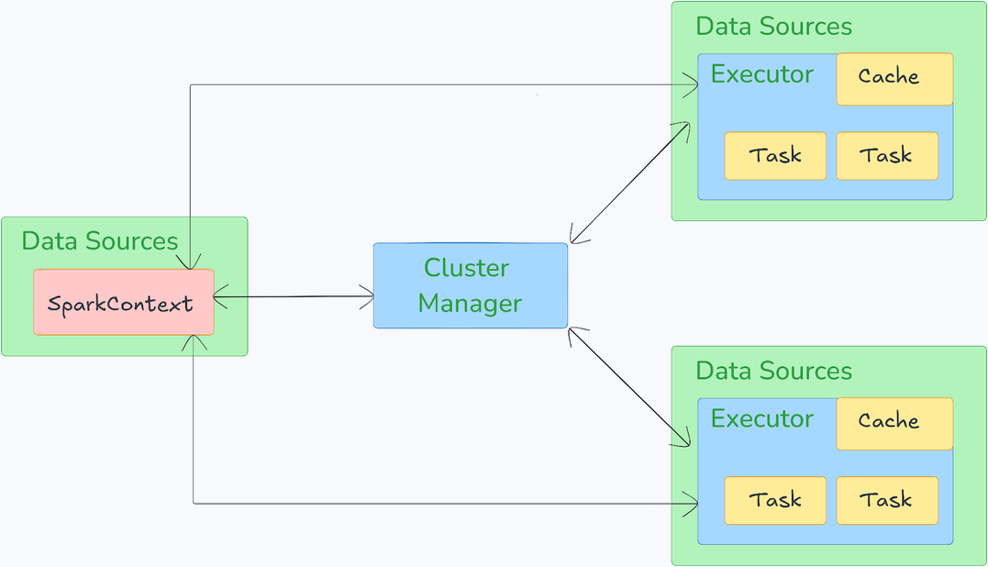
Layered Architecture of Apache Spark

Slide 12
Layered Architecture of Apache Spark
Apache Spark operates on a master-worker architecture, which consists of a driver program that manages the execution of tasks across a cluster of worker nodes.
Apache Spark architecture relies on two main abstractions:
  Resilient Distributed Datasets (RDDs)
  Directed Acyclic Graphs (DAGs)

Slide 13
Layered Architecture of Apache Spark
Resilient Distributed Datasets (RDDs)
RDDs are the fundamental data structure in Spark.
They are immutable collections of objects that are distributed across the cluster.
RDDs can be created from data in storage (such as HDFS or S3) or from existing RDDs through transformations.
RDDs support fault tolerance by tracking lineage information, allowing Spark to recompute lost partitions if necessary.

Slide 14
Layered Architecture of Apache Spark
Directed Acyclic Graph (DAG)
Apache Spark architecture relies on DAG to represent the sequence of transformations applied to RDDs.
When a user submits a Spark application, the system constructs a DAG of stages and tasks.
The DAG scheduler then divides the DAG into stages, each consisting of multiple tasks that can be executed in parallel.
This DAG-based approach allows Spark to optimize the execution plan and improve performance.

Slide 15
Components of Apache Spark
Driver Program
The Driver Program is the central coordinator of a Spark application. It contains the SparkContext, which is the entry point to Spark’s execution environment. The driver program:
Translates your apps logical plan into a physical execution plan, which is then divided into stages and tasks.
Coordinates with the Cluster Manager to schedule tasks across executors.
Monitors and manages the overall execution of your Spark job.

Slide 16
Components of Apache Spark
Cluster Manager
The Cluster Manager is responsible for allocating resources (such as CPU and memory) across the cluster. Spark can run on various cluster managers, including:
  Standalone — Spark’s built-in cluster manager.
  YARN — The resource management layer for Hadoop.
  Apache Mesos — A general-purpose cluster manager.
  Kubernetes — For deploying Spark in containerized environments.
The cluster manager decides which worker nodes your application gets to use.

Slide 17
Components of Apache Spark
Executors
Executors are worker processes that run on worker nodes.
Each executor is responsible for executing the tasks assigned to it by the driver and reporting the results back to the driver.
Executors also store cached data in memory or on disk, depending on the application’s requirements and handle shuffle operations.
Worker Nodes
Worker nodes are the machines in the cluster where executors run.
Each worker node can host multiple executors and the tasks are distributed among these executors for parallel processing.

Slide 18
Programming with RDDs
RDD stands for Resilient Distributed Dataset.
It is the fundamental data structure in Apache Spark.
An RDD is an immutable, fault-tolerant collection of distributed data processed in parallel.
RDD follows Lazy evaluation.

Slide 19
Creating an RDD
RDDs can be created in two ways.
Method 1: From Collection
from pyspark.sql import SparkSession
spark = SparkSession.builder.appName("Example").getOrCreate()
rdd = spark.sparkContext.parallelize([10,20,30,40])
print(rdd.collect())
Output
[10,20,30,40]
Method 2: From HDFS File
rdd = spark.sparkContext.textFile("students.txt")

Slide 20
Spark Operations
Spark operations are of two types:
A. Transformations
Transformations create a new RDD without modifying the original RDD.
Examples:
  map()
    numbers = rdd.map(lambda x:x*2)
  filter()
    even = rdd.filter(lambda x:x%2==0)
  flatMap()
    lines.flatMap(lambda x:x.split(" "))
  distinct()
    rdd.distinct()
  union()
    rdd1.union(rdd2)
  reduceByKey()
    marks.reduceByKey(lambda a,b:a+b)

Slide 21
Spark Operations
B. Actions
Actions execute transformations and return results.
  collect()
    rdd.collect()
  count()
    rdd.count()
  first()
    rdd.first()
  take()
    rdd.take(5)
  reduce()
    rdd.reduce(lambda a,b:a+b)
  saveAsTextFile()
    rdd.saveAsTextFile("output")

Slide 22
DAG (Directed Acyclic Graph) in Apache Spark
A Directed Acyclic Graph (DAG) is a conceptual representation of a series of activities.
DAG in Apache Spark in similar terms is a set of Vertices and Edges, where vertices represent the RDDs and the edges represent the Transformations to be applied on RDD.
There are finite number of vertices and edges in a spark DAG, where each edge directed from one vertex to another.
.

Slide 23
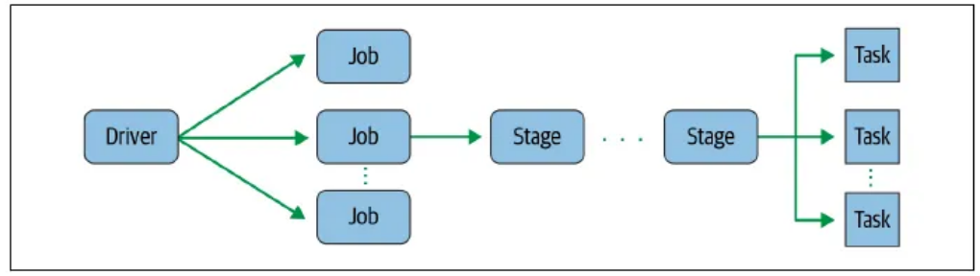
DAG (Directed Acyclic Graph) in Apache Spark
This is how Spark Application model looks like:

Slide 24
DAG (Directed Acyclic Graph) in Apache Spark
A Directed Acyclic Graph (DAG) is the execution plan created by Spark to optimize task execution.
Flow of DAG
Input Data - > map() -> filter() -> reduceByKey() -> collect()
Advantages of DAG
Faster execution
Optimized scheduling
Better fault recovery
Reduces unnecessary computations

Slide 25
Case Study
Analyze Student Academic Data Using Big Data Tools
Problem Statement
A university wants to analyze the academic performance of thousands of students using Apache Spark.
The objectives are to:
  Find overall performance trends.
  Identify difficult subjects.
  Find top-performing students.
  Support better academic planning.

Slide 26
Case Study
Consider any students dataset and perform transformation and actions .
Step 1: Load Data
  from pyspark.sql import SparkSession
  spark = SparkSession.builder.appName("StudentAnalysis").getOrCreate()
  df = spark.read.csv("students.csv", header=True, inferSchema=True)
Step 2: Display Data
  df.show()
Step 3: Find Average Marks by Subject
  df.groupBy("Subject").avg("Marks").show()

Slide 27
Case Study
Step 4: Find Top Performers
  df.orderBy(df.Marks.desc()).show()
Step 5: Count Students by Subject
  df.groupBy("Subject").count().show()
Step 6: Find Students Scoring Above 90
  df.filter(df.Marks > 90).show()
Subject Average Marks
Math 88.5
Physics 77.5
Chemistry 55.0
Top Performers:
Student Marks
Kiran 95
Sita 92

