Slide 1
Carrier Sense Multiple Access
CSMA
From ALOHA → CSMA → CSMA/CD → Collision-Free Access
Listen → Decide → Transmit
Computer Networks • Medium Access Control

Slide 2
Why do we need CSMA?
MOTIVATION
ALOHA sends without checking whether the shared channel is already in use.
ALOHA: the problem
CSMA: the improvement
• A station transmits whenever it has a frame.
• If two stations transmit together, the frames collide.
• Collided frames must be retransmitted → wasted capacity.
• Even Slotted ALOHA has a best-case throughput of only 1/e.
• Sense the shared channel before sending.
• Idle → transmit.
• Busy → wait according to the CSMA rule being used.
• Result: fewer avoidable collisions and better channel use.
1/e ≈ 36.8%
ALOHA asks: “Can I send now?”
CSMA asks: “Is someone already sending?”
02

Slide 3
CSMA: listen before transmitting
CORE IDEA
Carrier Sense Multiple Access lets many stations share one medium.
1
Frame ready
2
Sense channel
3
Idle?
4
Transmit
If BUSY → wait (the waiting rule is what distinguishes the CSMA variants).
shared medium
A
C
B
Important: sensing is not perfect. A signal needs time to propagate, so another station may briefly still sense IDLE.
03

Slide 4
Where the three CSMA variants actually differ
CSMA VARIANTS
They all sense first. The difference is what they do when the channel is busy or becomes idle.
Variant
If channel is BUSY
When it can try
Main effect
1-Persistent
Keep sensing continuously
Transmit immediately when idle
P = 1
Fast access; waiting stations may collide together
Nonpersistent
Wait a random time; stop sensing
Sense again after the random wait
Spreads attempts; fewer collisions, more delay
p-Persistent
Slotted channel: wait to next slot
If slot is idle: transmit with p;
defer with q = 1−p
Probability controls aggressiveness
Memory line: 1-persistent = impatient • nonpersistent = random backoff before re-sensing • p-persistent = probability on idle slots
04

Slide 5
1-Persistent CSMA
VARIANT 1
The station keeps listening and grabs the channel immediately when it becomes idle.
• Frame ready → sense the channel.
• Idle → transmit immediately.
• Busy → continue sensing; do not leave.
• The instant the channel becomes idle → transmit.
• If a collision occurs → wait a random time and restart.
Example: why 1-persistent can still collide
C is transmitting
A
C
B
A and B both find BUSY → both keep listening.
P(transmit | idle) = 1
C finishes → both see IDLE → both send immediately → collision.
Strength: low waiting at light load. Weakness: many waiting stations may all seize the same idle moment.
05

Slide 6
Nonpersistent CSMA
VARIANT 2
If the channel is busy, the station deliberately goes away for a random time before sensing again.
• Frame ready → sense the channel.
• Idle → transmit.
• Busy → do not keep sensing continuously.
• Choose a random waiting time.
• After that wait, sense the channel again and repeat.
Example: random waits spread the attempts
time →
A re-senses
A
C busy
random wait
B re-senses later
B
C busy
different random wait
Because the retry times are spread out, fewer stations hit the same idle instant.
Key difference from 1-persistent: BUSY does not mean “stay at the door”; it means “wait randomly, then come back.”
Trade-off: better channel utilization under contention, but typically longer access delay.
06

Slide 7
p-Persistent CSMA
VARIANT 3
A slotted-channel version: an idle slot does not always trigger immediate transmission.
• Used with a slotted channel.
• Sense the channel at slot boundaries.
• If the channel is idle: transmit with probability p.
• With probability q = 1 − p, defer to the next slot.
• Repeat while slots stay idle; if another station starts, wait randomly and try again.
Example with p = 0.5
Slot 1
Slot 2
Slot 3
Slot 4
Slot 5
defer
defer
send
One possible random sequence
If the channel stays idle: P(defer twice, then send) = q²p = 0.125
q = 1 − p
Smaller p → less aggressive access → fewer simultaneous attempts, but more waiting.
07

Slide 8
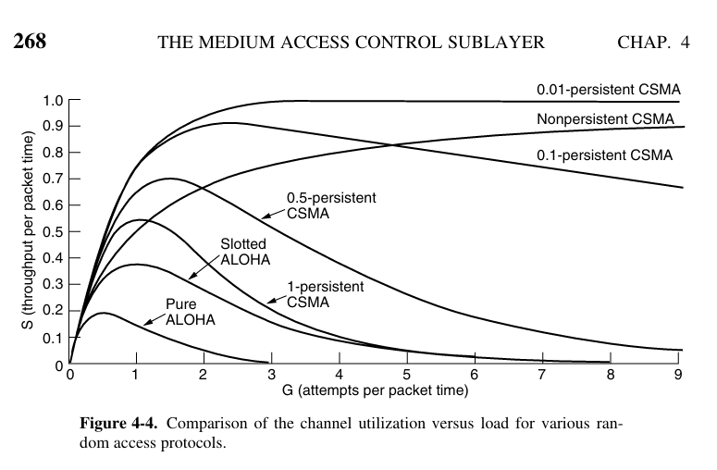
Performance intuition from the textbook curves
PERFORMANCE
Use the graph to understand the trade-off between throughput and aggressiveness.
How to read the graph
• Vertical axis S = successful throughput.
• Horizontal axis G = offered load / transmission attempts.
• ALOHA performs worst because stations do not sense first.
• As load grows, the access rule matters more.
• 1-persistent is aggressive: many waiting stations may transmit together.
• Nonpersistent and smaller-p rules spread attempts, often improving throughput at heavy load.
Remember the trade-off: fewer collisions can require more waiting.
08

Slide 9
Why CSMA can still collide
PROPAGATION DELAY
Carrier sensing is limited by propagation delay.
A starts transmitting
Before A's signal reaches B, B may still sense the channel as IDLE.
A
B
A's signal is still travelling
B starts → the signals overlap → collision.
BDP = Bandwidth × Propagation Delay
Bandwidth-delay product (BDP)
• Small propagation delay → small collision window (typical LAN case).
• Large BDP → more bits can be “in flight” before all stations know a transmission has started.
This is why CSMA reduces collisions but cannot guarantee zero collisions.
09

Slide 10
CSMA/CD: detect a collision and stop early
COLLISION DETECTION
Classic Ethernet improved CSMA by listening while transmitting.
Sense
before
Transmit
if idle
Listen
while sending
Collision?
Abort +
backoff
What collision detection means
Why this is difficult in wireless
• The hardware monitors the shared medium while it transmits.
• If the signal on the medium does not match what it is sending, a collision is occurring.
• The damaged frame is aborted immediately because finishing it would waste time.
• A station's own transmitted signal can be enormously stronger than the signal it receives.
• That makes simultaneous listening-and-detecting much harder.
• So CSMA/CD is not universally applicable.
CS = “Can I transmit?” CD = “Did my transmission collide?”
10

Slide 11
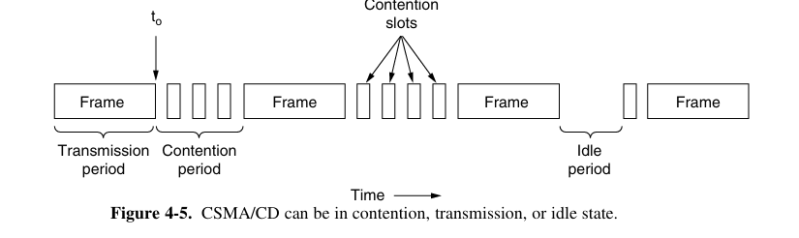
CSMA/CD channel model
CHANNEL STATES
The channel alternates among contention, transmission and idle periods.
Three periods
• Contention: stations compete for the next transmission; collisions can occur here.
• Transmission: one station has captured the channel and sends the rest of its frame.
• Idle: nobody has data to send.
Collision detected during contention → abort → random backoff → sense again.
Once one station has unambiguously captured the channel, other stations hear it and stay silent.
11

Slide 12
Why must CSMA/CD wait 2τ?
2Τ RULE
The worst case is a collision involving the two farthest stations.
t₀
A starts
t₀ + τ − ε
B starts
≈ t₀ + 2τ
A knows
A
B
1st τ: A's signal travels toward B.
B starts just before A's signal arrives → collision.
2nd τ: collision information must travel back to A.
Worst-case collision-detection window ≈ 2τ
Example: 1-km coaxial cable → τ ≈ 5 μs → 2τ ≈ 10 μs.
A station that has transmitted for 2τ with no collision can be sure every other station has heard its transmission.
12

Slide 13
Limitations of CSMA/CD
LIMITS
CSMA/CD reduces the cost of collisions; it does not eliminate contention collisions.
Collisions still occur
Large BDP hurts
Delay becomes variable
During the contention period, two stations can still start within the propagation window.
Longer links or higher bandwidth increase the amount of data in flight; short frames make the contention overhead more significant.
Collision → random backoff → retry. This makes transmission time unpredictable, which is a poor fit for real-time traffic such as VoIP.
contention only
BDP = B × τ
jitter / variable delay
Next idea: instead of detecting and recovering from collisions, decide who gets the channel before sending the data frame.
13

Slide 14
Collision-free access: reserve first
RESERVATION
Reservation protocols announce the desire to transmit before the actual frame.
1
Reserve / announce
2
Everyone learns
who is ready
3
Transmit in
agreed order
4
No data
collision
Assumptions used here
Key question
• Exactly N stations.
• Each station has a unique address 0 to N−1.
• Some stations may be inactive.
• Propagation delay is treated as negligible.
After one successful frame, which station gets the channel next?
Two methods in this deck: Bit-Map and Binary Countdown.
CSMA/CD: compete → collide sometimes → recover | Reservation: announce → agree → transmit
14

Slide 15
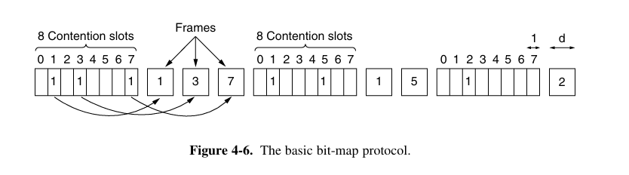
Bit-Map Protocol
BIT-MAP
One contention slot per station; a 1 reserves the right to transmit.
How it works
• A contention period has exactly N slots.
• Station j uses slot j.
• If station j has a frame, it announces 1 in its slot; otherwise 0.
• After all N slots, every station knows the ready set.
• Ready stations then transmit in numerical order.
Example: 1 0 0 1 0 0 0 1 → stations 0, 3 and 7 transmit.
No collisions: everyone agrees on the order before data transmission begins.
If your slot already passed before you became ready, you must wait for the next bitmap cycle.
15

Slide 16
Bit-Map Protocol: efficiency and waiting time
BIT-MAP PERFORMANCE
Let N be the number of stations and d be the frame time measured in contention-bit slots.
Low load
High load
Few stations have data, so one N-bit bitmap may be paid for a single frame.
If all N stations are ready, the N-bit bitmap schedules N frames → only 1 contention bit per frame.
η = d / (d + N)
η = d / (d + 1)
Example: N = 8, d = 100 → low load = 100/108 = 92.6% | high load = 100/101 ≈ 99.0%
Waiting-time intuition
• Low-numbered stations may miss their slot and wait for the next scan: ≈ 1.5N slots on average.
• High-numbered stations usually wait only the remaining part of the current scan: ≈ 0.5N slots.
• Mean across all stations ≈ N slots.
Bit-Map trades reservation overhead and waiting for collision-free, predictable frame order.
16

Slide 17
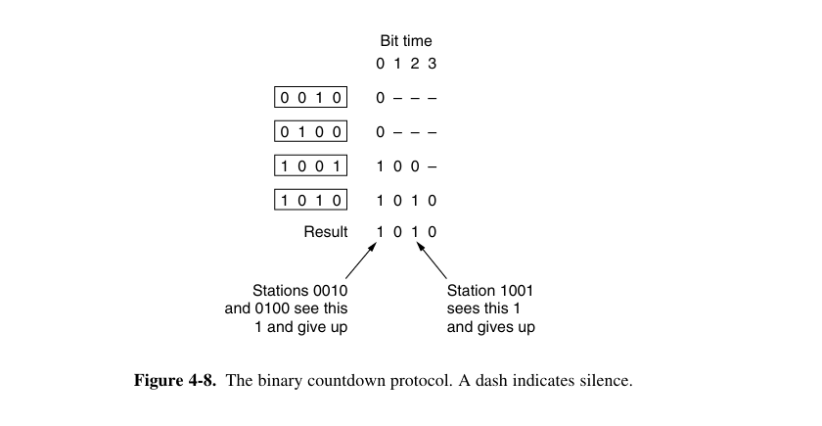
Binary Countdown: how arbitration works
BINARY COUNTDOWN
Stations compete with binary addresses; arbitration assumes propagation delay is negligible.
The rule, step by step
• Every contender has a fixed-length binary address.
• They transmit the address from the most significant bit (leftmost) to the least significant bit.
• At each bit time, simultaneous bits are combined by Boolean OR.
• If I sent 0 but the channel shows 1, another contender has 1 in this more-significant position → my address is lower → I drop out.
• The remaining station with the highest address wins and sends its frame.
0
1
channel = 1
The station that sent 0 loses this round.
OR
→
Why this chooses the highest address: the first bit where two addresses differ is decisive; 1 at that higher-order position means the larger number.
17

Slide 18
Binary Countdown: worked example
WORKED EXAMPLE
Contenders: 0010, 0100, 1001 and 1010.
Bit
Still competing
Bits sent
OR
What happens
MSB b3
0010, 0100,
1001, 1010
0, 0, 1, 1
1
0010 and 0100 sent 0 but saw 1 → both drop
b2
1001, 1010
0, 0
0
Both match the channel → both continue
b1
1001, 1010
0, 1
1
1001 sent 0 but saw 1 → 1001 drops
After b1, only 1010 remains → winner = 1010. It sends its frame; then a new arbitration round starts.
η = d / (d + log₂N)
If the sender address is already the first field of the frame, those log₂N arbitration bits are useful frame bits too → effective efficiency can reach 100%.
ALOHA talks anytime → CSMA listens → CSMA/CD detects collisions → Reservation protocols decide first
18

