Slide 1
Medium Access Control
MAC Sublayer • Channel Allocation • ALOHA
A
B
C
D
Shared channel
R
Who gets to transmit next?
Computer Networks | Medium Access Control 1

Slide 2
Data Link Layer in the Internet
Point-to-point links carry much of WAN traffic; PPP frames the packets.
Point-to-point links
• Direct link between two devices.
• Common in WANs: router-to-router and access links.
• Examples: SONET optical fiber, ADSL, leased lines.
Router R1
PPP
SONET
Optical Fiber
Data Link
Physical / access technology
PPP — Point-to-Point Protocol
Router R2
PPP
ADSL / Cable
Local Loop
• Data-link protocol for point-to-point links.
• Carries IP packets inside frames.
• Provides framing, link setup, and network-layer configuration.
Computer Networks | Medium Access Control 2

Slide 3
PPP: Framing on a Continuous SONET Stream
SONET gives a continuous bitstream; PPP marks where each packet begins and ends.
IP Packet
Why PPP is needed
• SONET sends a fixed-rate stream even when user data is intermittent.
• PPP separates occasional packets from the continuous stream.
• Receiver can identify frame boundaries and check errors.
Flag
Payload
Checksum
Flag
PPP Frame
Key idea: continuous physical transmission needs clear frame boundaries.
SONET
SONET example
• Used in high-speed optical WAN backbones.
• Example: OC-48 ≈ 2.4 Gbps.
• Data arrives as recurring byte payloads.
Optical Fiber
Computer Networks | Medium Access Control 3

Slide 4
PPP Main Features: What LCP and NCP Actually Do
PPP is not only a frame format; it also prepares the link before IP packets can flow.
1 Framing
2 LCP — Link Control Protocol
3 NCP — Network Control Protocol
• Creates a PPP frame around the packet.
• Marks start and end using the Flag byte 0x7E.
• Adds checksum for error detection.
• Used first, before data transfer.
• Opens and tests the point-to-point link.
• Negotiates options such as frame size and authentication.
• Closes the link cleanly when finished.
• Used after LCP has prepared the link.
• Configures the network-layer protocol.
• For IP, IPCP assigns/configures IP-related options.
• Makes PPP independent of one network protocol.
LCP
prepare link
NCP
configure IP
PPP Frames
carry packets
Easy order to remember
Why use them? Without LCP/NCP, both routers may not agree on link settings or IP/network options.
Computer Networks | Medium Access Control 4

Slide 5
PPP Frame Format and Byte Stuffing
PPP is byte-oriented: special bytes are protected so they are not confused with frame boundaries.
Flag
Address
Control
Protocol
Payload
Checksum
Flag
1 B
1 B
1 B
1/2 B
Variable
2/4 B
1 B
0x7E
Start
Usually
11111111
Usually
00000011
Payload type
(e.g., IP)
Actual packet
Error detect
0x7E
End
Why the Flag byte matters
Byte stuffing example
• Flag 0x7E marks frame boundaries.
• If 0x7E appears inside payload, receiver may wrongly think the frame ended.
• PPP solves this using byte stuffing.
• Original data contains 0x7E.
• Sender transmits it as: 0x7D 0x5E.
• Receiver removes 0x7D and XORs 0x5E with 0x20 to recover 0x7E.
PPP usually runs in unnumbered mode on the Internet: connectionless and unacknowledged service.
Computer Networks | Medium Access Control 5

Slide 6
PPP Link: From Setup to Data Transfer
LCP and NCP prepare the link before normal network traffic begins.
ESTABLISH
AUTHENTICATE
NETWORK
OPEN
DEAD
LCP starts & negotiates
Optional login/check
NCP configures IP
Data transfer
TERMINATE
No active link
Close link
Step-by-step
1. LCP
2. NCP
3. OPEN
• Establishes link and agrees basic options.
• Configures the network layer, usually IP.
• PPP frames now carry normal user data.
Think of it like a call: connect → agree settings → verify → configure network → talk → hang up.
Computer Networks | Medium Access Control 6

Slide 7
From Point-to-Point to Shared Channels
When many devices share one medium, deciding who may transmit becomes the problem.
Point-to-point
Broadcast / multiaccess
• Only two devices share the link.
• No competition with other stations on that medium.
• Example: router-to-router PPP link.
• Many devices share one medium.
• Any station may want to send at the same time.
• Overlapping transmissions can cause collisions.
MAC Sublayer
• MAC = Medium Access Control.
• Bottom part of the Data Link Layer.
• Decides who can use the shared channel and when.
A
B
C
D
A
B
two devices
shared medium
Computer Networks | Medium Access Control 7

Slide 8
Channel Allocation Problem
How should one shared channel be divided among competing users?
A
B
C
D
E
Collision
• Two or more simultaneous transmissions overlap.
• The receiver gets a corrupted signal.
• The frame must be retried later.
ONE SHARED CHANNEL
R
Two allocation approaches
• Static allocation: divide the channel permanently, such as FDM/TDM.
• Dynamic allocation: stations compete only when they have data.
Main question: Who gets to transmit next?
Computer Networks | Medium Access Control 8

Slide 9
Static Allocation: Fixed Parts of One Channel
A simple idea: divide the channel once and reserve one part for each user.
Meaning
40 MHz total channel
• The shared channel is split into fixed subchannels.
• Each user receives a permanent portion.
• Because each user has a private portion, interference is avoided.
User A
10 MHz
User B
10 MHz
User C
10 MHz
User D
10 MHz
Real-world analogy: FM radio
FDM example
91.1 MHz
94.3 MHz
98.7 MHz
102.5 MHz
• FDM = Frequency Division Multiplexing.
• Divide by frequency: each user gets a frequency band.
• Works well for steady traffic, such as FM radio stations.
Each station uses a different frequency, so all can transmit at the same time.
Computer Networks | Medium Access Control 9

Slide 10
Why Static Allocation Fails for Bursty Computer Traffic
Fixed bands are wasted when users are idle, and cannot be borrowed by active users.
Same 40 MHz channel
Problem
A
ACTIVE
B
IDLE
C
IDLE
D
ACTIVE
• Computer traffic is bursty: users send data in short bursts, then become idle.
• Idle users keep their assigned bandwidth.
• Active users may still wait even when unused capacity exists.
Bandwidth for B and C is unused, but A and D cannot borrow it.
Queueing idea
• When demand approaches service capacity, waiting time increases quickly.
• T = 1 / (μC − λ)
• Example: 100 Mbps, 10,000-bit frames, 5,000 frames/s → T = 200 μs.
Conclusion: static allocation is simple, but a poor fit for bursty networks.
Computer Networks | Medium Access Control 10

Slide 11
Dynamic Channel Allocation: The Basic Model
These assumptions are used to study random-access MAC protocols.
1 Independent Traffic
4 Time
• Stations generate frames independently; λ = average arrival rate.
• Continuous: transmit anytime. Slotted: transmit only at slot boundaries.
2 Single Channel
5 Carrier Sense
• All stations transmit and receive through one shared channel.
• Station may listen first; if busy, it waits. Without sensing, it transmits directly.
3 Observable Collisions
• Simultaneous frames overlap and are detected as collisions.
Goal: share the channel efficiently while reducing collisions and waiting time
Computer Networks | Medium Access Control 11

Slide 12
Multiple Access Protocols: Roadmap
Different methods solve the same shared-channel problem in different ways.
MULTIPLE ACCESS
Channel Division
Random Access
Controlled / Wireless
FDM
WDM
TDM
Pure ALOHA
Slotted ALOHA
CSMA
Bit map
Binary countdown
MACA / MACAW
Computer Networks | Medium Access Control 12

Slide 13
ALOHA: The Simple Random-Access Idea
Transmit first; if collision occurs, wait randomly and try again.
Step-by-step
• 1. A station gets a frame.
• 2. It transmits immediately.
• 3. If frames overlap, collision occurs.
• 4. Sender waits a random time.
• 5. The frame is retransmitted.
A
B
C
D
Shared radio channel
H
central computer
Why random waiting?
• If both senders retry at the same fixed time, they may collide again.
• Random backoff reduces repeated collisions.
Computer Networks | Medium Access Control 13

Slide 14
Pure ALOHA: Vulnerable Period
A frame is vulnerable whenever another frame overlaps with it.
Earlier frame can overlap start
Later frame can overlap end
Test frame
t₀ − T
t₀
t₀ + T
t₀ + 2T
Vulnerable period = 2T
Meaning
Example
• Vulnerable period is the time interval in which another transmission can destroy the test frame.
• In Pure ALOHA, stations transmit at any instant, so overlap can happen before or after the test frame begins.
• Even a tiny overlap makes the whole frame bad.
• If one frame takes T = 1 ms to send, the vulnerable period is 2T = 2 ms.
• Any other frame starting in this interval can cause collision.
Computer Networks | Medium Access Control 14

Slide 15
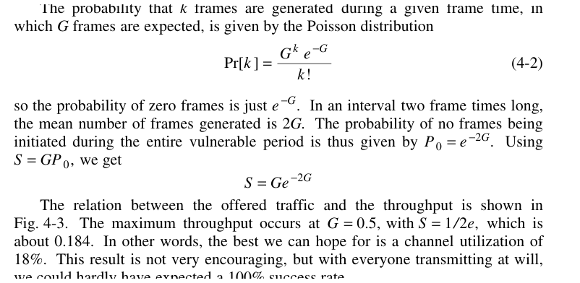
Pure ALOHA: Throughput and Why We Use It
Throughput measures how much useful data is successfully delivered.
What is throughput?
Pure ALOHA formula
Step-by-step
• Throughput (S) = successful frames per frame time.
• It is not the same as offered load.
• Offered load (G) counts all attempts, including retransmissions.
P₀ = e⁻²ᴳ
• 1. A test frame is successful only if no other frame starts in 2T.
• 2. Probability of no competing frame: P₀ = e⁻²ᴳ.
• 3. Successful throughput: S = offered attempts × success probability.
• 4. Maximum S = 1/(2e) ≈ 0.184 = 18.4%.
S = G × P₀ = G e⁻²ᴳ
Why calculate it?
• To know how efficiently the shared channel is being used.
• To compare Pure ALOHA and Slotted ALOHA fairly.
• To see when more traffic starts causing more collisions instead of more success.
example: if a channel can carry 1000 frames/s ideally, Pure ALOHA gives about 184 successful frames/s at best.
Computer Networks | Medium Access Control 15

Slide 16
Slotted ALOHA: Reduce the Vulnerable Period
Stations may transmit only at the beginning of a synchronized slot.
How it works
Slot 1
Slot 2
Slot 3
Slot 4
Slot 5
• Time is divided into equal slots.
• Each slot equals one frame time.
• A station must wait for the next slot boundary before transmitting.
• Collision happens only when two or more stations choose the same slot.
Slot 6
Test frame
Vulnerable period = T
Result
S = G e⁻ᴳ Smax = 1/e ≈ 36.8%
• Pure ALOHA vulnerable period = 2T.
• Slotted ALOHA vulnerable period = T.
• Maximum throughput improves from 18.4% to 36.8%.
Requirement: all stations must agree on slot boundaries.
Computer Networks | Medium Access Control 16

Slide 17
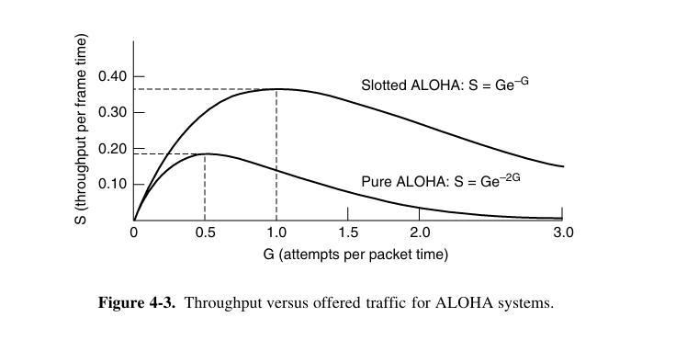
Pure ALOHA vs Slotted ALOHA
The core improvement is controlling when a transmission may begin.
Feature
Pure ALOHA
Slotted ALOHA
Time
Continuous
Discrete slots
Transmission
Any instant
Slot boundary only
Synchronization
Not required
Required
Vulnerable period
2T
T
Max throughput
18.4%
36.8%
Where the idea reappears
Pure → Slotted roughly doubles maximum throughput
• Cable Internet: shared upstream access among users.
• RFID: many tags share one reader.
• Old protocols may become useful again when the same problem returns.
Next idea: listen before transmitting → CSMA
Computer Networks | Medium Access Control 17

