Slide 1
NETWORK LAYER
Services • Datagram & Virtual Circuit • Routing
How packets move from source to destination
B
A
D
E
H1
C
H2
End-to-end packet delivery
Concise classroom presentation

Slide 2
1. What Does the Network Layer Do?
2
End-to-end delivery
Path selection
Across networks
Moves packets from the source host to the destination host, possibly through many routers.
Chooses a suitable route through the network and forwards each packet toward its destination.
Works even when source and destination are on different LANs or WANs.
“Which path should the packet take?”
The key question:
Data Link Layer
Network Layer
Transport Layer
one link / hop-to-hop
source → destination
end-to-end data service
Internet example: IP is the main network-layer protocol.
Network Layer

Slide 3
2. Network Layer Design Issues
3
Five ideas explain most of the chapter:
Store-and-forward packet switching
Receive → store → check → forward
Service to the Transport Layer
What should be visible above the Network Layer?
Connectionless service
Datagram network; packets handled independently
Connection-oriented service
Virtual circuit; path established first
Datagram vs Virtual Circuit
Trade-offs in setup, routing, QoS, failures and congestion
Key design choice: How should packets be carried through the network?
Network Layer

Slide 4
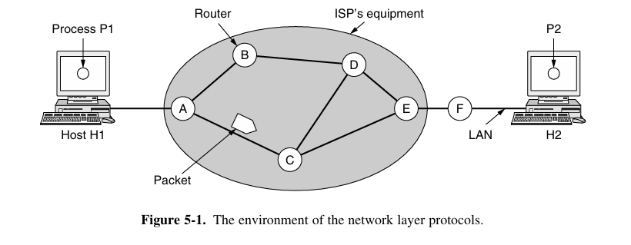
3. Network Layer Environment & Store-and-Forward
4
Example path
H1 → A → B → D → E → F → H2
At every router
1
2
3
4
Receive
Store
Check
Forward
The router waits for the complete packet, checks it, then sends it on the next link.
Packet
Frame
Continues end-to-end through the Network Layer.
Used only on one link; a new frame is created at each hop.
Network Layer

Slide 5
4. Services Provided to the Transport Layer
5
The Network Layer should hide the internal complexity of the network.
1. Independent of router technology
2. Hide network complexity
3. Uniform addressing
Transport should not depend on the internal technology of routers.
Transport should not worry about the number, type or topology of routers.
Use a common numbering plan across LANs and WANs.
Transport Layer
Network Layer
Routers & links
“Deliver my data.”
Handles how
Hidden details
From this interface, designers can choose connectionless or connection-oriented service.
Network Layer

Slide 6
5. Two Service Models
6
Connectionless — Datagram Network
Connection-Oriented — Virtual Circuit
• No setup before sending
• Each packet is routed independently
• Each packet carries destination information
• Routes may change during transmission
• Internet approach: IP
• Connection is established first
• A route is chosen during setup
• Routers keep VC state
• Packets carry a VC identifier
• Resource reservation / QoS is easier
SEND → ROUTE EACH PACKET
SETUP → TRANSFER → RELEASE
Datagram = packet-by-packet decisions
VC = connection-by-connection decision
Network Layer

Slide 7
6. Implementing Connectionless Service
7
Suppose Process P1 on H1 sends a long message to Process P2 on H2.
Process P1
Application creates message
If the message is larger than the maximum packet size:
Transport Layer
Adds transport header
Packet 1
Packet 2
Network Layer
Adds network header
Packet 3
Datagram Network
Routers forward packets
Packet 4
Host H2 / P2
Message delivered upward
Each datagram carries destination information and is forwarded independently.
Encapsulation: each layer adds its own header
Network Layer

Slide 8
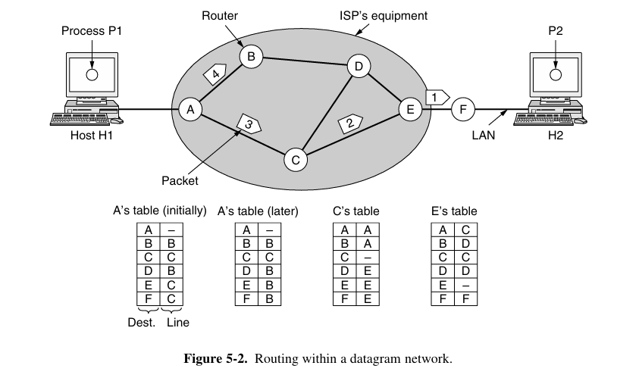
7. Routing in a Datagram Network
8
Router A: destination → next hop
Initially
F → C
Packets 1, 2, 3: A → C → E → F
Later
F → B
Packet 4: A → B → D → E → F
Why can it change?
A routing algorithm can update the table when network conditions change, for example congestion.
Same destination — different packet paths are possible
Network Layer

Slide 9
8. Connection-Oriented Service — Virtual Circuit
10
A Virtual Circuit (VC) establishes a logical path before data transfer.
1. SETUP
2. DATA TRANSFER
3. RELEASE
Choose a route and create VC entries in routers.
Packets carry a VC identifier and follow the established path.
Terminate the VC and remove its table entries.
Example established path
A
C
E
F
H1
H2
All packets in this VC use the established logical route
VC = logical path, not a dedicated physical wire.
Network Layer

Slide 10
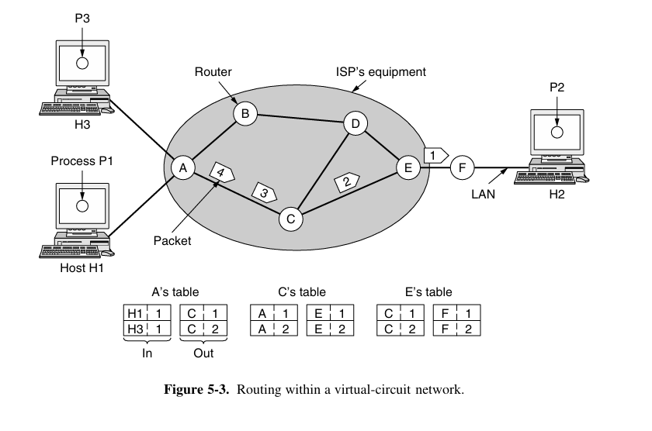
9. How Virtual-Circuit Forwarding Works
11
VC table mapping
(Incoming line, VC ID)
→
(Outgoing line, VC ID)
At A
(H1, VC 1) → (C, VC 1)
At C
(A, VC 1) → (E, VC 1)
At E
(C, VC 1) → (F, VC 1)
VC numbers are local to a link, so the identifier can change from one link to the next.
Network Layer

Slide 11
10. Datagram vs Virtual-Circuit Networks
12
Issue
Datagram Network
Virtual-Circuit Network
Setup
Not required
Required
Addressing
Full destination address
Short VC identifier
Routing
Each packet independently
Route chosen during setup
Router state
No connection-specific state
State stored for each VC
Router failure
Later packets can reroute
VCs through failed router break
QoS
More difficult
Easier with reserved resources
Congestion
More difficult
Easier with advance allocation
Datagram = flexible
Virtual Circuit = established path / easier control
Network Layer

Slide 12
11. Main Trade-offs
13
Setup time vs packet lookup
Addressing overhead
VC spends time on setup first, but forwarding later is simple. Datagram starts immediately, but each packet needs a destination lookup.
Datagrams carry a full destination address. VC packets can use a shorter circuit identifier after setup.
Failures & flexibility
QoS & congestion
A failed router or link can break VCs using it. Datagram traffic can often use another route for later packets.
VCs can reserve bandwidth, buffers and processing in advance, making predictable service easier.
Conceptual timing
VC ≈ setup + data transfer + release
Datagram ≈ send immediately
The best choice depends on traffic duration and service requirements.
Network Layer

Slide 13
12. Which One Fits the Situation?
14
Short transaction → Datagram
Long-running traffic → Virtual Circuit
Example: a store checks a credit-card purchase.
The request and reply are small. VC setup and release can take more effort than the data exchange itself.
Example: persistent traffic between two corporate offices.
A long-lived or permanent VC can justify the setup cost because the connection remains useful for a long time.
Store
Bank
Office A
Office B
Request → approval / decline
Long-lived logical connection
No setup overhead is attractive.
Setup cost is spread over a long session.
Datagrams are also more flexible when routes need to change after congestion or failure.
Network Layer

Slide 14
13. What Is a Routing Algorithm?
Routing algorithm = the method used to decide and update routes in routers.
Know destinations
Choose next hop
Adapt
Forward
Routing information is stored in the router.
Select an outgoing line toward the destination.
Routes can change when network conditions change.
Packet is sent to the next router.
Example: A can send a packet only to directly connected B or C.
It does not need the entire route in one table entry; it needs the next step.
9

Slide 15
14. Routing Algorithm vs Forwarding
9
These two terms are related, but they are not the same.
Routing
Forwarding
Decides and updates the routes used by routers.
It reacts to network conditions and builds the forwarding information.
Uses the current table to send one packet to the next hop.
The router only needs to know the next step, not the whole path.
Routing table form
Destination → outgoing line / next hop
Example
At A, a packet can leave only via directly connected B or C.
Memory line: Routing chooses the road; forwarding puts the packet on that road.
Network Layer

Slide 16
Quick Recap
15
Network Layer
Store-and-forward
End-to-end packet delivery across multiple networks.
Receive → store → check → forward.
Datagram
Virtual Circuit
No setup; packets routed independently.
Setup first; packets follow an established logical path.
Routing table
Main trade-off
Destination → next hop / outgoing line.
Datagram = flexibility. VC = established path and easier control/QoS.
Quick check
1
Which service needs setup first?
2
Can datagrams take different paths?
3
What does Destination → Next Hop mean?
Remember: Datagram = independent packets | VC = established logical path
Network Layer

