Slide 1
ROUTING ALGORITHMS
Choosing the best path from source to destination
COMPUTER NETWORKS
Source → Routers → Destination

Slide 2
1. Routing and Forwarding
INTRO
DEFINITION
“The routing algorithm is that part of the network layer software responsible for deciding which output line an incoming packet should be transmitted on.”
Routing
Forwarding
Decides which route to use
Sends the arriving packet to the next hop
• Builds and updates routing tables
• Chooses the next path based on the routing algorithm
• Looks up the routing table
• Uses the selected output interface / next hop
Easy memory: Routing = plan the path | Forwarding = move the packet
Computer Networks | Routing Algorithms
2

Slide 3
2. When Is the Route Decided?
INTRO
DATAGRAM NETWORK
VIRTUAL CIRCUIT
“This decision must be made anew for every arriving data packet.”
“Routing decisions are made only when a new virtual circuit is being set up.”
• The route can change between packets
• Useful when the best path changes
• Following packets use the established route
• Also called session routing
EXAMPLE
Packet 1: A → R1 → R2 → B
Packet 2: A → R1 → R3 → B
EXAMPLE
Setup: A → R1 → R2 → B
Session packets follow the same path
Computer Networks | Routing Algorithms
3

Slide 4
3. What Makes a Good Routing Algorithm?
CORE
Correctness
Simplicity
Robustness
Valid route
Easy to implement
Handles failures
Stability
Fairness
Efficiency
Converges and stays stable
Reasonable resource sharing
Uses resources well
Fairness vs Efficiency
Maximum total network flow may disadvantage an individual connection, so routing needs a compromise.
What can be optimized?
Hop count
Distance
Delay
Throughput
Bandwidth / cost
Note: maximum throughput can increase queueing delay near capacity.
Computer Networks | Routing Algorithms
4

Slide 5
4. Nonadaptive vs Adaptive Routing
CORE
NONADAPTIVE / STATIC
ADAPTIVE / DYNAMIC
“Nonadaptive algorithms do not base their routing decisions on any measurements or estimates of the current topology and traffic.”
“Adaptive algorithms change their routing decisions to reflect changes in the topology, and sometimes changes in the traffic as well.”
Static routing
Adaptive routing can differ by…
• Routes are computed in advance
• Simple and predictable
• Does not automatically respond to failures
• Where information comes from: local / neighbors / all routers
• When routes change: topology event / periodically
• Metric: distance / hops / estimated transit time
Dynamic routing reacts to network change
Computer Networks | Routing Algorithms
5

Slide 6
5. Optimality Principle and Sink Tree
CORE
TEXTBOOK DEFINITION
Sink Tree
“If router J is on the optimal path from router I to router K, then the optimal path from J to K also falls along the same route.”
“The set of optimal routes from all sources to a given destination form a tree rooted at the destination.”
D
I
J
K
B
C
Best path contains best subpaths
A
E
F
Equal-cost alternatives may form a DAG.
No loops → finite number of hops
Computer Networks | Routing Algorithms
6

Slide 7
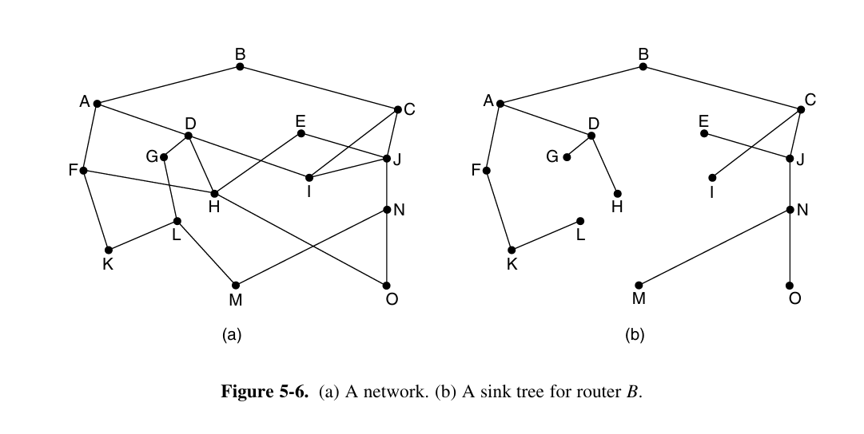
5A. Optimality Principle and Sink Tree — Using the Figure
CORE
How optimality appears in the tree
Pick an optimal path to root B. Every remaining part of that path must also be optimal.
PATH 1
H → D → A → B
If H→B is optimal, then D→A→B and A→B are also optimal subpaths.
PATH 2
O → N → J → C → B
All routers choose their best next hop toward B; these optimal routes combine into one sink tree.
Root = B • branches merge • no loops
Computer Networks | Routing Algorithms
7

Slide 8
6. Shortest Path Routing
CORE
DEFINITION
Method used here
“To choose a route between a given pair of routers, the algorithm just finds the shortest path between them on the graph.”
We use Dijkstra’s algorithm to compute the shortest path.
B
Graph representation
2
4
• Node = router
• Edge = communication link
• Weight = cost of using the link
D
A
1
5
1
2
C
E
Path cost: C(P) = Σ w(e)
5
Possible metrics: hops • distance • delay • bandwidth/cost
Computer Networks | Routing Algorithms
8

Slide 9
7. Dijkstra’s Algorithm — Complete Procedure
DIJKSTRA
DEFINITION
Before you start
Source = 0 | all others = ∞ | edge weights ≥ 0
“Dijkstra’s algorithm finds the shortest paths between a source and all destinations in the network.”
Read the textbook figure:
Permanent
Tentative
→ working node
B(2,A) = distance 2, via A
1
Choose working node
Start with A; later choose the smallest tentative node.
Relaxation formula
2
Check a neighbour v
Candidate = d(u) + w(u,v).
d(v) = min { d(v), d(u) + w(u,v) }
3
Relax / update
If candidate < d(v), update distance and predecessor.
Example: d(G)=6, d(E)=4, w(E,G)=1
new G = min(6, 4+1) = 5
4
Make smallest permanent
The smallest tentative label is now final.
5
Repeat
Stop when destination becomes permanent.
Computer Networks | Routing Algorithms
9

Slide 10
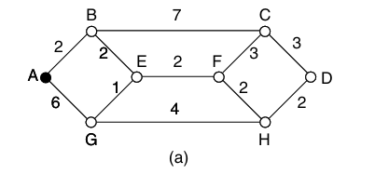
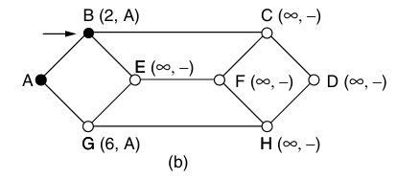
8. Textbook Example — Start and First Working Node
DIJKSTRA
Source = A | Destination = D
FIGURE (a)
FIGURE (b)
Step 0 — Initialize
Step 1 — Working node A
d(A)=0; all other nodes = ∞.
A is the first permanent / working node.
B = min(∞, 0+2) = 2 → B(2,A)
G = min(∞, 0+6) = 6 → G(6,A)
Next: probe A’s neighbours B and G.
Smallest tentative = B(2,A) → make B permanent.
Computer Networks | Routing Algorithms
10

Slide 11
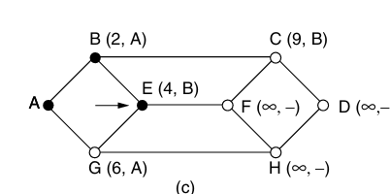
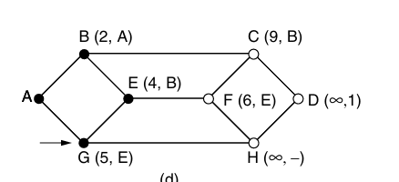
9. Textbook Example — Update Through B and E
DIJKSTRA
FIGURE (c)
FIGURE (d)
Step 2 — Working node B
Step 3 — Working node E
E = min(∞, 2+2) = 4 → E(4,B)
C = min(∞, 2+7) = 9 → C(9,B)
G = min(6, 4+1) = 5 → G(5,E)
F = min(∞, 4+2) = 6 → F(6,E)
Smallest tentative = E(4,B) → E becomes permanent.
Smallest tentative = G(5,E) → G becomes permanent.
Computer Networks | Routing Algorithms
11

Slide 12
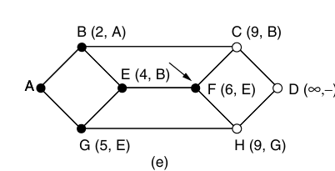
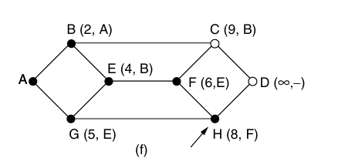
10. Textbook Example — Update Through G and F
DIJKSTRA
FIGURE (e)
FIGURE (f)
Step 4 — Working node G
Step 5 — Working node F
H = min(∞, 5+4) = 9 → H(9,G)
Tentatives: F=6, C=9, H=9
H = min(9, 6+2) = 8 → H(8,F)
C = min(9, 6+3) = 9 → unchanged
Smallest tentative = F(6,E) → F becomes permanent.
Smallest tentative = H(8,F) → H becomes permanent.
Computer Networks | Routing Algorithms
12

Slide 13
11. Textbook Example — Complete the Path to D
DIJKSTRA
Continue after Figure (f)
Final result
Working H (8)
D = min(∞, 8+2) = 10 → D(10,H)
C(9,B) is smaller, so C goes next
Backtrack predecessors
D ← H ← F ← E ← B ← A
Working C (9)
D via C = 9+3 = 12
Keep D(10,H)
Reverse the order:
A → B → E → F → H → D
Working D (10)
D becomes permanent
STOP
Cost = 2+2+2+2+2 = 10
Shortest distance A → D = 10
At C, D would cost 9+3=12, so the existing cost 10 remains better.
Computer Networks | Routing Algorithms
13

Slide 14
12. Flooding — Basic Rule
FLOODING
DEFINITION
Why it works
The packet explores all possible paths. If a path exists, a copy can reach the destination.
“Every incoming packet is sent out on every outgoing line except the one it arrived on.”
R2
Problem: duplicates
S
R1
R3
D
Every router may create more copies.
Without control, packets can loop and grow rapidly.
R4
Simple
Robust
High bandwidth use
Computer Networks | Routing Algorithms
14

Slide 15
13. Flooding — Worked Example
FLOODING
Example packet: P17 | source S | destination D
1
S sends P17 to R1.
R2
P17
2
R1 floods copies to R2 and R3; it does not send back to S.
P17
S
P17
R1
D
3
R2 and R3 both forward toward D. D may receive two copies.
P17
P17
R3
4
R2 and R3 can also send copies to each other → duplicate traffic.
Flooding reaches D, but creates duplicates.
Computer Networks | Routing Algorithms
15

Slide 16
14. Controlled Flooding — Stop the Duplicates
FLOODING
1. HOP COUNT / TTL
2. SEQUENCE NUMBER
Each hop reduces the counter.
Each packet has an identifier.
TTLnext = TTL − 1
Packet ID = Source + Sequence No.
TTL = 0 → discard
Seen P17? YES → discard
NO → record & flood
This prevents a packet from circulating forever.
So R2/R3 do not flood the same P17 again.
Useful for broadcasting, some wireless networks and highly damaged networks — but normal data delivery usually uses more efficient routing.
Computer Networks | Routing Algorithms
16

Slide 17
15. Routing Delivery Models
CORE
Unicast
Broadcast
Multicast
Anycast
One → One
One → All
One → Group
One → One of many
S
S
S
S
A
C
A
C
A
C
A
C
B
B
B
B
Routing is not limited to one source and one destination; the delivery model depends on the application.
Computer Networks | Routing Algorithms
17

Slide 18
16. Quick Recap
SUMMARY
Routing
Good routing
Static vs Dynamic
Selects the path; forwarding moves the packet to the next hop.
Correct, simple, robust, stable, fair and efficient.
Static is precomputed; dynamic adapts to network changes.
Optimality
Dijkstra
Flooding
An optimal route contains optimal subroutes; routes form a sink tree.
Repeatedly makes the smallest tentative distance permanent.
Sends copies along all paths; control with TTL and sequence numbers.
Routing chooses the route | Dijkstra finds a minimum-cost route | Flooding explores all routes
The best routing approach depends on the metric, topology knowledge and how often the network changes.
Computer Networks | Routing Algorithms
18

