Slide 1

Fundamentals of Data Science(22CSC59)
BE- CSE-V-Semester
Presented by
S Durga Devi
Assistant Professor
Department of Computer Science and Engineering
Chaitanya Bharathi Institute of Technology
Hyderabad
9/9/2026- presentees: 141,143,44,45,47,50,51,53,56,57,58,160,61,62,63,65,66,68,69,70,71,74,75,77,180,82,83,86,90,93,96,98,363,366,367,368,369,370,371
S. Durga Devi , Dept of CSE, CBIT, Hyderabad

Slide 2

Unit-III
Creating pandas Data Frames
understanding pandas Series
Reading and querying the Quandl data
describing pandas Data Frames
Grouping and joining pandas Data Frame
working with missing values
creating pivot tables, dealing with dates.
S. Durga Devi , Dept of CSE, CBIT, Hyderabad
S. Dura Devi ,CSE,CBIT

Slide 3
Creating pandas Data Frames
pandas is another popular python library used for data analysis and data manipulations.
Works with tabular data such as excel sheets, .csv files and databases.
Fast, efficient, and productive tool for manipulating and analyzing strings, numeric, date time, and time series data.
Data structures such as DataFrames and Series.
Pandas dataframes are in tabular and two dimensional labelled and indexed data structures with grid of rows and columns.
Columns are heterogeneous types.
pandas handles missing values, grouping data, merge datasets and calculate mean, maximum and minimum.
S. Durga Devi , Dept of CSE, CBIT, Hyderabad
S. Dura Devi ,CSE,CBIT

Slide 4
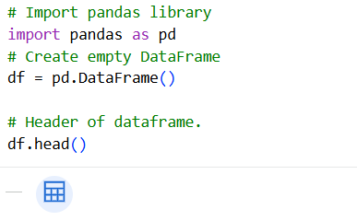
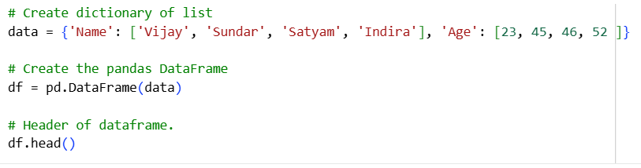
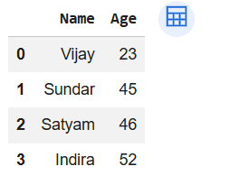
Creating pandas Data Frames
S. Durga Devi , Dept of CSE, CBIT, Hyderabad
S. Dura Devi ,CSE,CBIT

Slide 5
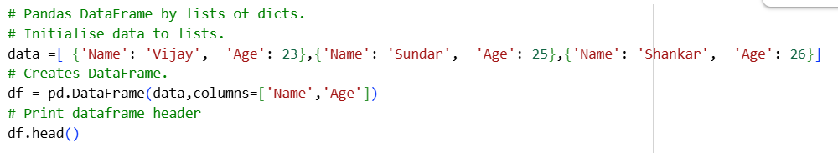
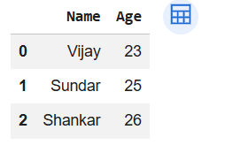
Creating pandas Data Frames
S. Durga Devi , Dept of CSE, CBIT, Hyderabad
S. Dura Devi ,CSE,CBIT

Slide 6
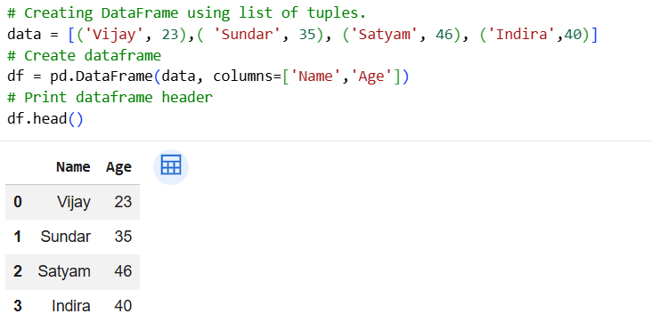
S. Durga Devi , Dept of CSE, CBIT, Hyderabad
S. Dura Devi ,CSE,CBIT

Slide 7
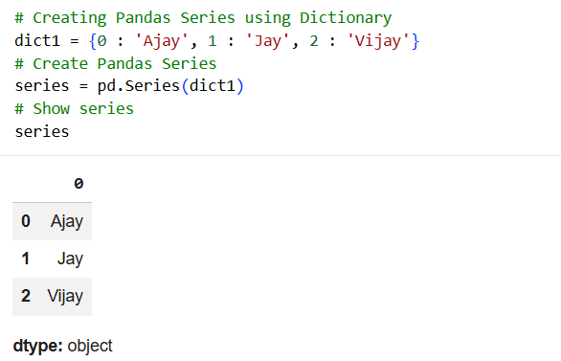
Understanding pandas Series
Series is one dimensional array. Like a single column in spread sheet.
Handles any time of data such as string, numeric, dictionaries, python list and datetime.
Two values – index and values.
Series created by dictionary, Numpy arrays, and scalar value.
1. Create series using python dictionary:
S. Durga Devi , Dept of CSE, CBIT, Hyderabad
S. Dura Devi ,CSE,CBIT

Slide 8
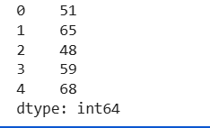
2. Using Numpy arrays: create Numpy object and pass it to series object.
# load Pandas and NumPy
import pandas as pd
import numpy as np
# Create NumPy array
arr = np.array([51,65,48,59, 68])
# Create Pandas Series
series = pd.Series(arr)
print(series)
S. Durga Devi , Dept of CSE, CBIT, Hyderabad
S. Dura Devi ,CSE,CBIT

Slide 9
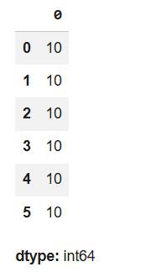
3. Using scalar value: create pandas Series using scalar value. Pass scalar value and list of indexes to Series object.
# load Pandas and NumPy
import pandas as pd
import numpy as np
# Create Pandas Series
series = pd.Series(10, index=[0, 1, 2, 3, 4, 5])
series
using index is optional
S. Durga Devi , Dept of CSE, CBIT, Hyderabad
S. Dura Devi ,CSE,CBIT

Slide 10
Create a series by selecting a column from the dataset(.csv file) and show the type of the object currently local scope.
# Import pandas
import pandas as pd
# Load data using read_csv()
df = pd.read_csv("WHO_first9cols.csv")
# Show initial 5 records
df.head()
Download WHO_first9cols.csv file
https://github.com/PacktPublishing/Python-Data-Analysis-Third-Edition/blob/master/Chapter02/WHO_first9cols.csv
S. Durga Devi , Dept of CSE, CBIT, Hyderabad
S. Dura Devi ,CSE,CBIT

Slide 11
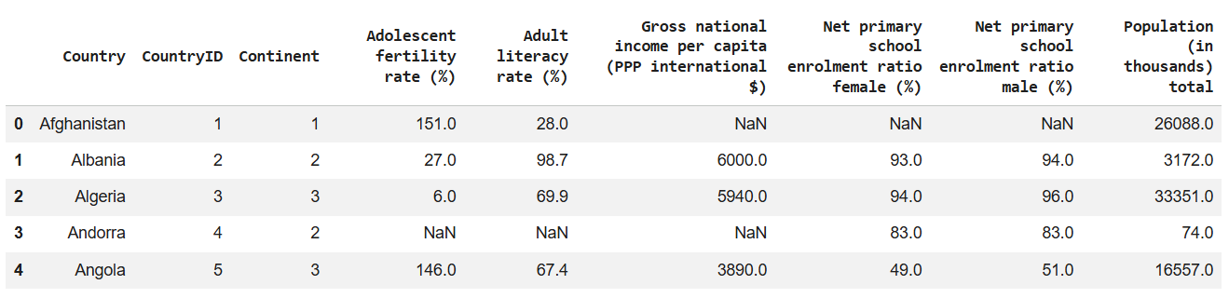
S. Durga Devi , Dept of CSE, CBIT, Hyderabad
S. Dura Devi ,CSE,CBIT

Slide 12

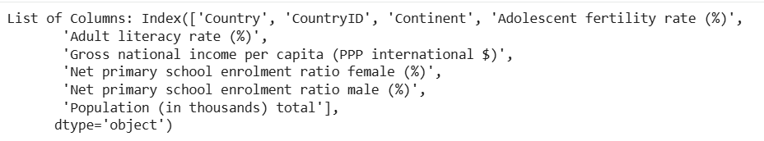
Series data structure shares some of attributes of DataFrames.
# Show the shape of DataFrame
print("Shape:", df.shape)
# Check the column list of DataFrame
print("List of Columns:", df.columns)
S. Durga Devi , Dept of CSE, CBIT, Hyderabad
S. Dura Devi ,CSE,CBIT

Slide 13
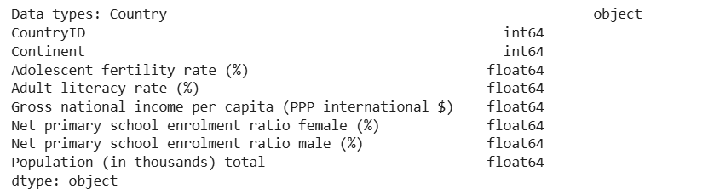
# Show the datatypes of columns
print("Data types:", df.dtypes)
S. Durga Devi , Dept of CSE, CBIT, Hyderabad
S. Dura Devi ,CSE,CBIT

Slide 14
# Select a series
country_series=df['Country']
# check datatype of series
type(country_series)
Output: pandas.core.series.Series
S. Durga Devi , Dept of CSE, CBIT, Hyderabad
S. Dura Devi ,CSE,CBIT

Slide 15
Working pandas series on database
Quandl is one of the platform that provides financial, economic and commercial data sets for data analyst.
Absentees-25-8-2026- 143,152,53,55,70,72,84,94,96,365,66,
S. Durga Devi , Dept of CSE, CBIT, Hyderabad
S. Dura Devi ,CSE,CBIT

Slide 16
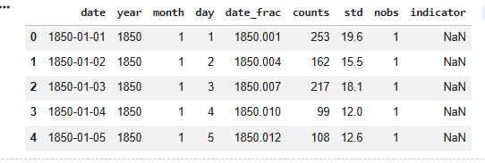
Reading and querying data
Use this dataset named as daily_sunspots_time_series_1850-01_2026-04.csv
import pandas as pd
sunspots = pd.read_csv("daily_sunspots_time_series_1850-01_2026-04.csv")
sunspots.head()
S. Durga Devi , Dept of CSE, CBIT, Hyderabad
S. Dura Devi ,CSE,CBIT

Slide 17
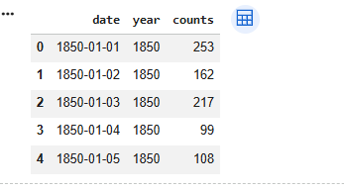
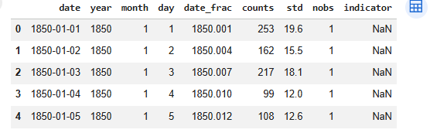
Filter columns from the dataset
import pandas as pd
sunspots = pd.read_csv("daily_sunspots_time_series_1850-01_2026-04.csv")
filtered_columns=sunspots[["date", "year", "counts"]]
filtered.columns.head()
Filter rows from the dataset
filtered_rows=sunspots[sunspots["year"] == 1850]
filtered_rows.head()
S. Durga Devi , Dept of CSE, CBIT, Hyderabad
S. Dura Devi ,CSE,CBIT

Slide 18
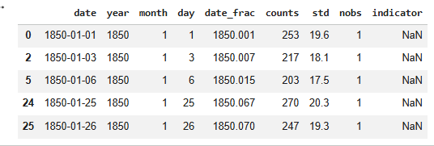
#boolean filtering
temp_count=sunspots[sunspots["counts"] > 200]
temp_count.head()
S. Durga Devi , Dept of CSE, CBIT, Hyderabad
S. Dura Devi ,CSE,CBIT

Slide 19
Describing pandas Data Frames
pandas DataFrame provides several statistical methods.
Pandas Method | Purpose
describe() | Gives a statistical summary of numerical data
count() | Returns the number of non-null values
sum() | Calculates the sum of values
mean() | Calculates the average value
median() | Finds the middle value
mode() | Finds the most frequently occurring value
min() | Finds the minimum value
max() | Finds the maximum value
std() | Calculates standard deviation
var() | Calculates variance
quantile() | Finds a specified percentile or quantile
skew | skewness of the data- distribution symmetry
kurt | kurtosis of the data- distribution shape
S. Durga Devi , Dept of CSE, CBIT, Hyderabad
S. Dura Devi ,CSE,CBIT

Slide 20
Create a series by selecting a column from the dataset(.csv file) and show the type of the object currently local scope.
# Import pandas
import pandas as pd
# Load data using read_csv()
df = pd.read_csv("WHO_first9cols.csv")
# Show initial 5 records
df.head()
Download WHO_first9cols.csv file
https://github.com/PacktPublishing/Python-Data-Analysis-Third-Edition/blob/master/Chapter02/WHO_first9cols.csv
S. Durga Devi , Dept of CSE, CBIT, Hyderabad
S. Dura Devi ,CSE,CBIT

Slide 21
S. Durga Devi , Dept of CSE, CBIT, Hyderabad
S. Dura Devi ,CSE,CBIT

Slide 22
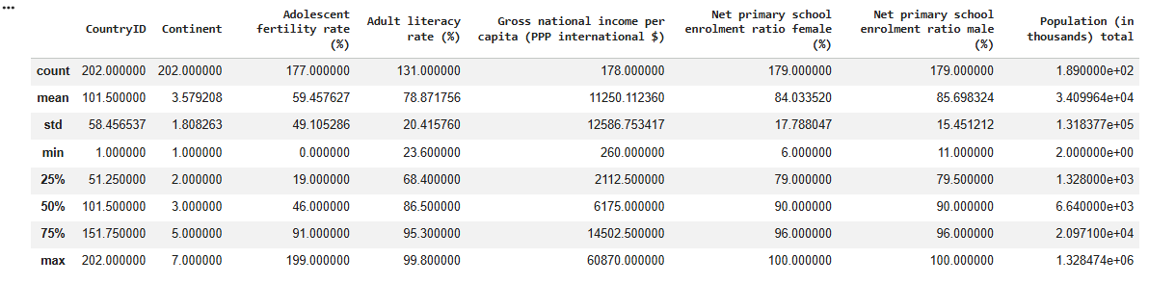
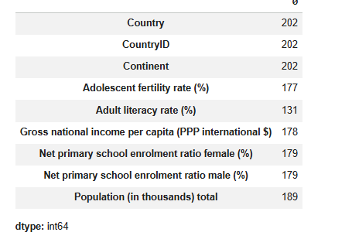
# describe dataset- df.describe()
# count number of observations- df.count()- no of observations in each column.
Helps to find missing
values in the dataset
column wise.
S. Durga Devi , Dept of CSE, CBIT, Hyderabad
S. Dura Devi ,CSE,CBIT

Slide 23
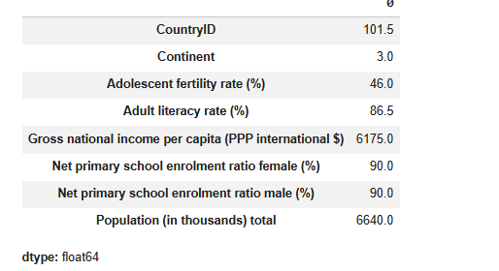
# compute median
df.median(numeric_only=True)
#computer standard deviation
df.std(numeric_only=True)
S. Durga Devi , Dept of CSE, CBIT, Hyderabad
S. Dura Devi ,CSE,CBIT

Slide 24
Grouping and joining pandas Data Frame
Grouping is a data aggregation operation used to organize similar values into groups.
Pandas allows us to apply aggregate functions to each group, such as:
  mean() – average
  min() – minimum
  max() – maximum
  count() – number of values
  sum() – total
Grouping operation follows Split-Apply-Combine
  Split the data into groups.
  Apply an aggregation function to each group.
  Combine the results into a new DataFrame/Series.
S. Durga Devi , Dept of CSE, CBIT, Hyderabad
S. Dura Devi ,CSE,CBIT

Slide 25

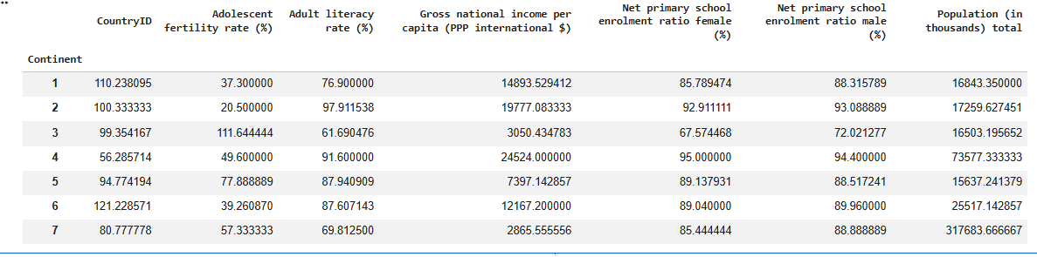
Example
S. Durga Devi , Dept of CSE, CBIT, Hyderabad
S. Dura Devi ,CSE,CBIT

Slide 26
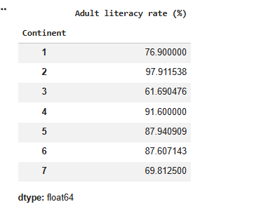
Group by dataframes on the basis of continent and select adult literacy rate(%).
df.groupby('Continent').mean(numeric_only=True)['Adult literacy rate (%)']
S. Durga Devi , Dept of CSE, CBIT, Hyderabad
S. Dura Devi ,CSE,CBIT

Slide 27
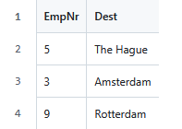
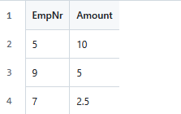
Join operation
Join operation is taken from the relational database.
Data analysts needs to join data from multiple sources.
merge() used to join multiple dataframes.
Use case: Taxi company
Two files- dest.csv and tips.csv.
https://github.com/PacktPublishing/Python-Data-Analysis-Third-Edition/blob/master/Chapter02/dest.csv
https://github.com/PacktPublishing/Python-Data-Analysis-Third-Edition/blob/master/Chapter02/tips.csv
S. Durga Devi , Dept of CSE, CBIT, Hyderabad
S. Dura Devi ,CSE,CBIT

Slide 28
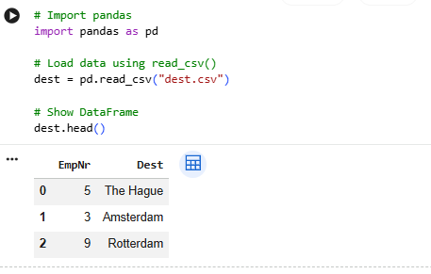
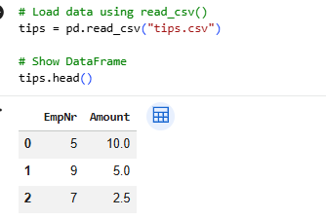
Read dest.csv and tips.csv
S. Durga Devi , Dept of CSE, CBIT, Hyderabad
S. Dura Devi ,CSE,CBIT

Slide 29

Inner join operation
Inner join operation is equivalent to intersection operation of set.
Selects only common records in both the dataframes.
Use merge() method.
merge () uses two parameters
on=provides common attribute based on the join will be performed.
how= defines the type of the join.
# Join DataFrames using Inner Join
df_inner= pd.merge(dest, tips, on='EmpNr', how='inner')
df_inner.head()
S. Durga Devi , Dept of CSE, CBIT, Hyderabad
S. Dura Devi ,CSE,CBIT

Slide 30
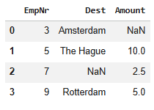
Full outer join
Full Outer join is equivalent to a union operation.
Returns all the records from both data frames and fills NaNs where match will not be found.
# Join DataFrames using Outer Join
df_outer= pd.merge(dest, tips, on='EmpNr', how='outer')
df_outer.head()
S. Durga Devi , Dept of CSE, CBIT, Hyderabad
S. Dura Devi ,CSE,CBIT

Slide 31
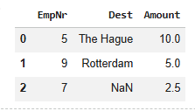
Right outer join
All the records from the right side of the dataframe will be selected.
If the matched record not found in left Data frame then fill with NaNs.
# Join DataFrames using Right Outer Join
df_right= pd.merge(dest, tips, on='EmpNr', how='right')
df_right
S. Durga Devi , Dept of CSE, CBIT, Hyderabad
S. Dura Devi ,CSE,CBIT

Slide 32
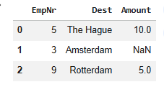
left outer join
All the records from the left side of the Dataframe will be selected.
If the matched record not found in right Data frame then fill with NaNs.
# Join DataFrames using Left Outer Join
df_left= pd.merge(dest, tips, on='EmpNr', how='left')
df_left
S. Durga Devi , Dept of CSE, CBIT, Hyderabad
S. Dura Devi ,CSE,CBIT

Slide 33
Working with missing values
Real world datasets are messy and noisy. Due to this lot of values are either faulty or missing.
Pandas provides built in functions to handle missing data values.
Checking missing values in a DataFrames
isnull() used to check null values in dataset and returns True or False.
True for null values and False for non null values.
sum() function used to sum all the null values and returns the count of missing values.
8/9/2026- presentees: 147,160,163,165,169,171,176,177,178,180,182,183,185,186,187,193,96,200,202,363,368,366,367,371.
S. Durga Devi , Dept of CSE, CBIT, Hyderabad
S. Dura Devi ,CSE,CBIT

Slide 34
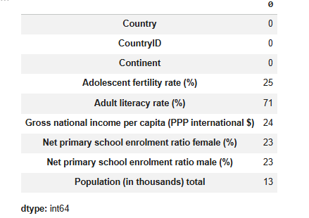
Checking missing values
# Import pandas
import pandas as pd
# Load data using read_csv()
df = pd.read_csv("WHO_first9cols.csv")
# Count missing values in DataFrame
pd.isnull(df).sum()
# alternative method
df.isnull().sum()
S. Durga Devi , Dept of CSE, CBIT, Hyderabad
S. Dura Devi ,CSE,CBIT

Slide 35
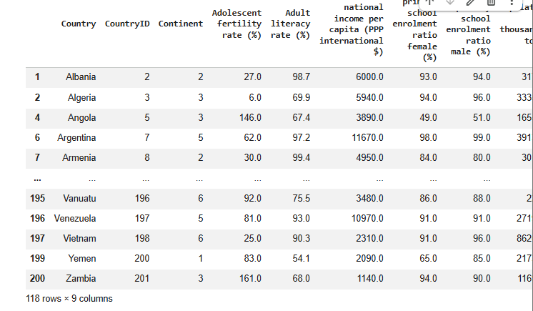
Dropping missing values
Missing values can be dropped for analysis.
Pandas has dropna() function to drop or delete such observations from the Data frame.
inplace=True attribute makes changes in the original DataFrame.
# Drop all the missing values
df.dropna(inplace=True)
df
S. Durga Devi , Dept of CSE, CBIT, Hyderabad
S. Dura Devi ,CSE,CBIT

Slide 36
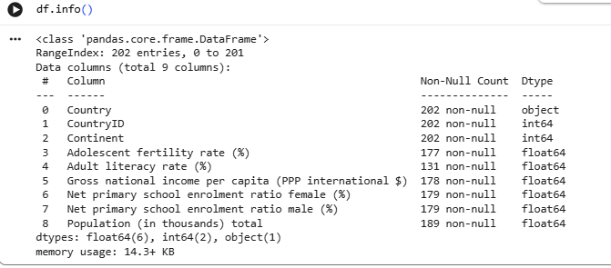
Fill missing values
We can fill the missing values using with zero, mean, median or constant values.
# Import pandas
import pandas as pd
# Load data using read_csv()
df = pd.read_csv("WHO_first9cols.csv")
# Show initial 5 records
df.head()
df.info()
S. Durga Devi , Dept of CSE, CBIT, Hyderabad
S. Dura Devi ,CSE,CBIT

Slide 37
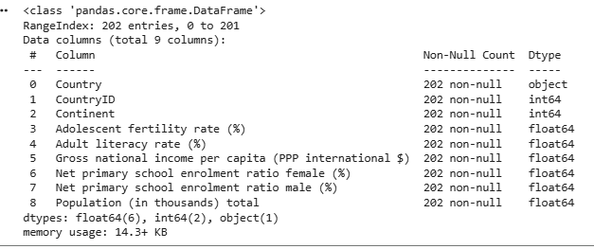
Fill missing values
# Fill missing values with 0
df.fillna(0,inplace=True)
df.info()
S. Durga Devi , Dept of CSE, CBIT, Hyderabad
S. Dura Devi ,CSE,CBIT

Slide 38
Creating pivot tables
Pivot table is summary table.
Summarize and analyze data by grouping values based on one or more columns.
Pandas provides the pivot_table() to summarize the dataframes.
Parameters for the pivot_table()
values: column to aggregate
index: Column(s) to use as row labels
columns:Column(s) to use as column labels
aggfun: how to combine values: ‘sum’,’mean’,’count’ etc.
S. Durga Devi , Dept of CSE, CBIT, Hyderabad
S. Dura Devi ,CSE,CBIT

Slide 39
import pandas as pd
data = {
'Student': ['A', 'B', 'C', 'D', 'E', 'F'],
'Department': ['CSE', 'CSE', 'ECE', 'ECE', 'CSE', 'ECE'],
'Gender': ['Male', 'Female', 'Male', 'Female', 'Female', 'Male'],
'Marks': [80, 90, 75, 85, 95, 70]
}
df = pd.DataFrame(data)
print(df)
Student Department Gender Marks
0 A CSE Male 80
1 B CSE Female 90
2 C ECE Male 75
3 D ECE Female 85
4 E CSE Female 95
5 F ECE Male 70
S. Durga Devi , Dept of CSE, CBIT, Hyderabad
S. Dura Devi ,CSE,CBIT

Slide 40
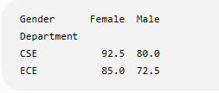
Create pivot table
pivot = pd.pivot_table( df, values='Marks', index='Department',
columns='Gender', aggfunc='mean')
print(pivot)
S. Durga Devi , Dept of CSE, CBIT, Hyderabad
S. Dura Devi ,CSE,CBIT

Slide 41
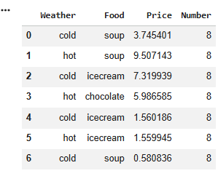
# Import pandas
import pandas as pd
# Load data using read_csv()
purchase = pd.read_csv("purchase.csv")
# Show initial 10 records
purchase.head(10)
S. Durga Devi , Dept of CSE, CBIT, Hyderabad
S. Dura Devi ,CSE,CBIT

Slide 42
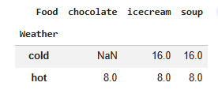
# Summarise dataframe using pivot table
pd.pivot_table(purchase,values='Number', index=['Weather',],
columns=['Food'], aggfunc=sum)
S. Durga Devi , Dept of CSE, CBIT, Hyderabad
S. Dura Devi ,CSE,CBIT

Slide 43
Dealing with dates
Using pandas we can create sequence or range of dates.
pd.date_range() used to generate the list of dates automatically
parameters to date_range()
Starting date
periods: no of dates to create
freq: how often new date is generated.
S. Durga Devi , Dept of CSE, CBIT, Hyderabad
S. Dura Devi ,CSE,CBIT

Slide 44
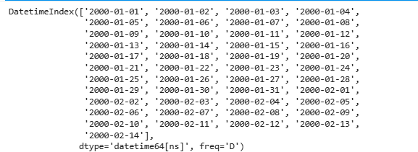
# Date range function
pd.date_range('01-01-2000', periods=45, freq='D’)
# D is generate one date everyday
S. Durga Devi , Dept of CSE, CBIT, Hyderabad
S. Dura Devi ,CSE,CBIT

Slide 45
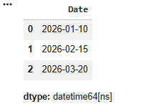
Date is usually stored as string object that should be converted into date object using pandas.
import pandas as pd
data = {
'Name': ['A', 'B', 'C'],
'Date': ['2026-01-10', '2026-02-15', '2026-03-20']
}
df = pd.DataFrame(data)
print(df)
# Convert argument to datetime
pd.to_datetime(df['Date'])
S. Durga Devi , Dept of CSE, CBIT, Hyderabad
S. Dura Devi ,CSE,CBIT

Slide 46
# Convert argument to datetime in specified format
pd.to_datetime(['20260101', '20260102'], format='%Y%m%d’)
# handling with unknown format string
pd.to_datetime(['20200101', 'not a date’])# gives Valueerror
# handle value error
pd.to_datetime(['20200101', 'not a date'], errors='coerce')
S. Durga Devi , Dept of CSE, CBIT, Hyderabad
S. Dura Devi ,CSE,CBIT

Slide 47
References
https://github.com/PacktPublishing/Python-Data-Analysis-Third-Edition/blob/master/Chapter02/.ipynb_checkpoints/ch2-checkpoint.ipynb.
https://github.com/PacktPublishing/Python-Data-Analysis-Third-Edition/blob/master/Chapter02/WHO_first9cols.csv.
https://github.com/PacktPublishing/Python-Data-Analysis-Third-Edition/blob/master/Chapter02/purchase.csv
S. Durga Devi , Dept of CSE, CBIT, Hyderabad
S. Dura Devi ,CSE,CBIT

