Slide 1

Fundamentals of Data Science(22CSC59)
BE- CSE-V-Semester
Presented by
S Durga Devi
Assistant Professor
Department of Computer Science and Engineering
Chaitanya Bharathi Institute of Technology
Hyderabad
S. Durga Devi , Dept of CSE, CBIT, Hyderabad

Slide 2

Unit-V
Topics to be covered
Supervised Learning - Regression Analysis, Linear regression, Multiple linear regression, understanding multi collinearity, removing multi collinearity, Dummy variables, developing a linear regression model, Evaluating regression model performance, R-squared, MSE, MAE, RMSE, fitting polynomial regression, Regression models for classification, Logistic regression, Characteristics of the logistic regression model, Types of logistic regression algorithms, Advantages and disadvantages of logistic regression, implementing logistic regression using scikit-learn.
Unsupervised Learning clustering - PCA and Clustering: Unsupervised learning, reducing the dimensionality of data, PCA, Performing PCA. Finding the number of clusters, the elbow method, the silhouette method, Partitioning data using k-means clustering, Hierarchical clustering, DBSCAN clustering, Spectral Clustering: clustering, Evaluating clustering performance, Internal performance evaluation, The Davies-Bouldin index, The silhouette coefficient, External performance evaluation, The Rand score, The Jaccard score, F-Measure or F1-score, The Fowlkes-Mallows score.
Textbook: Avinash Navlani, Armando Fandango, and Ivan Idris, “Python Data Analysis: Perform Data Collection, Data Processing, Wrangling, Visualization, and Model Building Using Python”, 3rd ed. Packt Publishing, 2021.
S. Durga Devi , Dept of CSE, CBIT, Hyderabad
S. Dura Devi ,CSE,CBIT

Slide 3
Study Hours | Attendance | Assignment Marks | Final Marks
2 | 60 | 40 | 45
4 | 70 | 55 | 58
6 | 80 | 70 | 72
8 | 90 | 85 | 88
Can we predict final marks of a students whose study hours are equal to 7?
S. Durga Devi , Dept of CSE, CBIT, Hyderabad
S. Dura Devi ,CSE,CBIT

Slide 4
Introduction to Machine Learning
Along with the data science we can use machine learning to predict the output or discover the hidden patterns based on the past data.
One of the criticism of AI was, a machine is not intelligent if it is not learning.
Learning means doing the similar task efficiently next time.
Machine learning is the science of getting computers to act without being explicitly programmed.
Learning programs are adaptive.
requires data.
S. Durga Devi , Dept of CSE, CBIT, Hyderabad
S. Dura Devi ,CSE,CBIT

Slide 5
Why machine learning
Learning Vs memorization
Lots of data available
Can handle large amount of data and complex data to give accurate results.
Identify the patterns and make predictions about future events and provides more informed.
S. Durga Devi , Dept of CSE, CBIT, Hyderabad
S. Dura Devi ,CSE,CBIT

Slide 6
Few applications of ML
Friends suggestion on social media platforms
Product/video recommendation
Automatic spam filtering in emails.
Fraud detection
Face recognition and medical image analysis.
Health care: predict diseases.
Speech recognition: converts speech to text – siri, google assist, voice typing
S. Durga Devi , Dept of CSE, CBIT, Hyderabad
S. Dura Devi ,CSE,CBIT

Slide 7
Types of learning
Supervised
Unsupervised
Reinforced
Semi- supervised.
S. Durga Devi , Dept of CSE, CBIT, Hyderabad
S. Dura Devi ,CSE,CBIT

Slide 8
Supervised learning
Supervised learning algorithms are trained using the dataset that contains inputs and paired with the correct output.
Uses labelled data.
In supervised learning machine learns the relationship between independent variable(input ) and output variable.
Similar to a student learning under supervision of a teacher
A teacher provides questions with answers.
Ex: Class room teaching
Algorithm learns from trained data and predict the correct response for the unseen data.
S. Durga Devi , Dept of CSE, CBIT, Hyderabad
S. Dura Devi ,CSE,CBIT

Slide 9
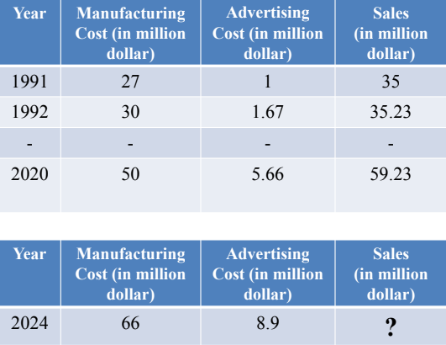
Supervised learning
2026
S. Durga Devi , Dept of CSE, CBIT, Hyderabad
S. Dura Devi ,CSE,CBIT

Slide 10

Supervised learning
S. Durga Devi , Dept of CSE, CBIT, Hyderabad
S. Dura Devi ,CSE,CBIT

Slide 11
How supervised learning works?
Trained process.
Different algorithms use different approaches for learning.
Supervised learning algorithms are divided into two types:
  regression and classification
Algorithms:
Linear regression
Multi linear regression
Polynomial regression
Logistic regression
Decision trees
Artificial neural networks(ANN)(regression and classification)
S. Durga Devi , Dept of CSE, CBIT, Hyderabad
S. Dura Devi ,CSE,CBIT

Slide 12
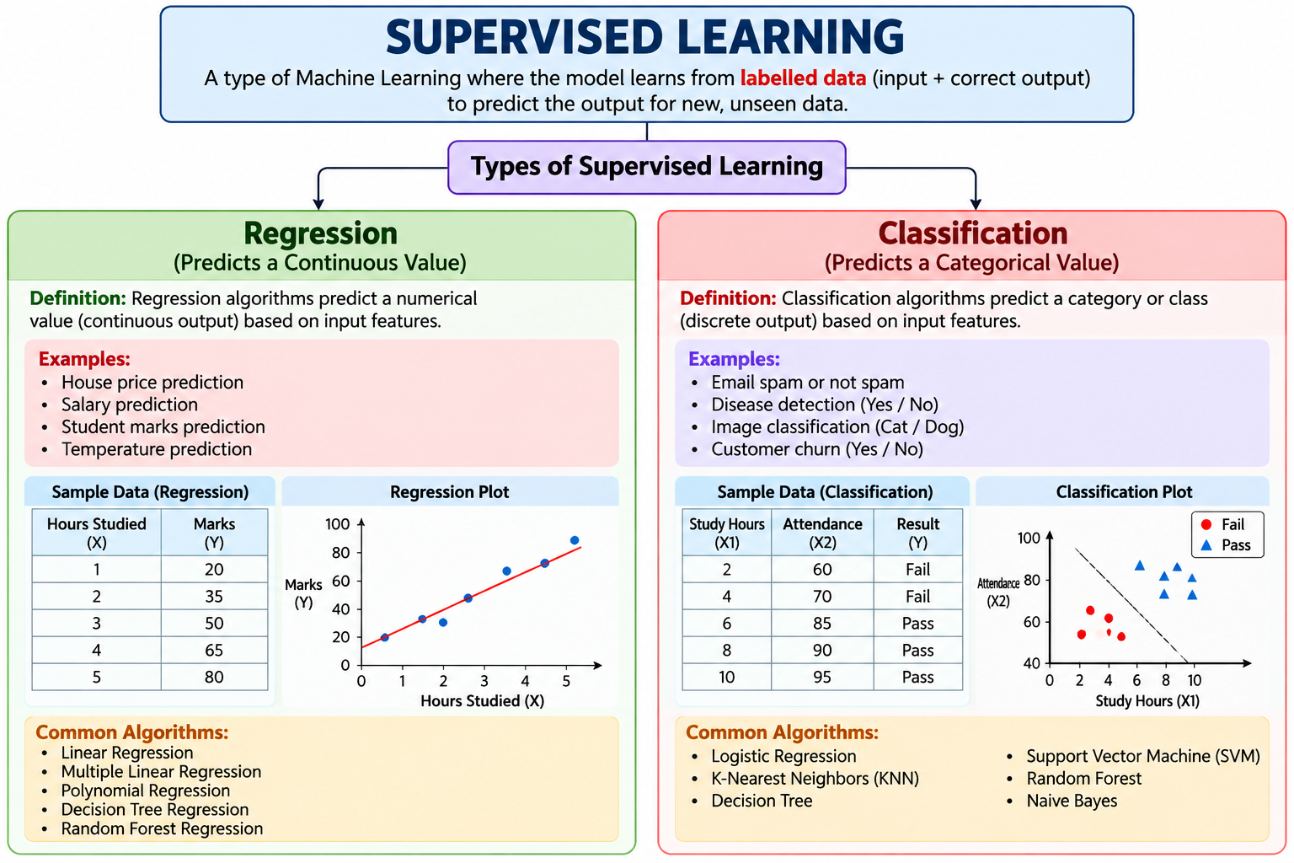
Created by AI
S. Durga Devi , Dept of CSE, CBIT, Hyderabad
S. Dura Devi ,CSE,CBIT

Slide 13
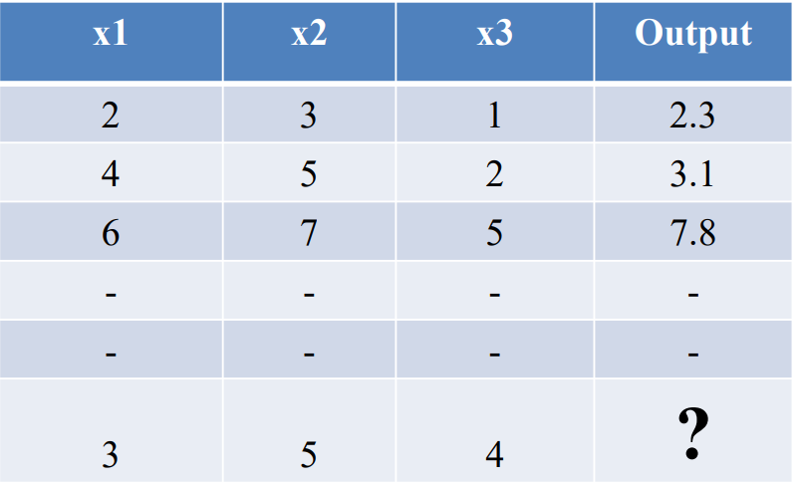
Regression Analysis
Regression is one of the most popular algorithm in statistics and machine learning.
used to predict the continues variables output.
x1,x2,x3 are independent values and output is continues variable(dependent)
S. Durga Devi , Dept of CSE, CBIT, Hyderabad
S. Dura Devi ,CSE,CBIT

Slide 14
Regression
Regression applications
Predicting house price
Temperature prediction
Stock price
Rainfall prediction
Salary prediction
S. Durga Devi , Dept of CSE, CBIT, Hyderabad
S. Dura Devi ,CSE,CBIT

Slide 15
Multiple linear regression
Multicollinearity
Detect mulitcollinearity
Splitting datasets
Develop linear regression model
S. Durga Devi , Dept of CSE, CBIT, Hyderabad
S. Dura Devi ,CSE,CBIT

Slide 16
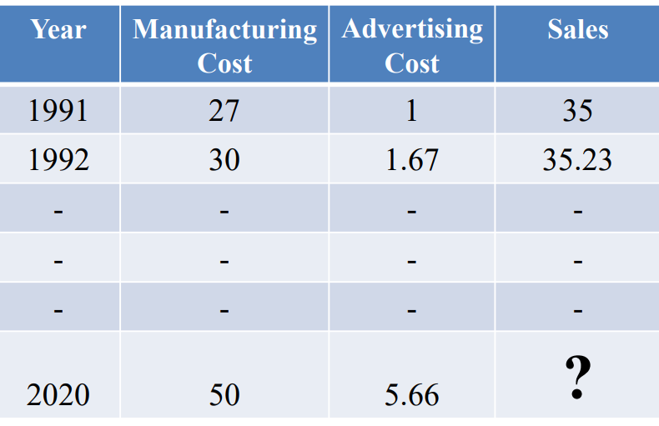
Regression
What is the sale given advertising cost and manufacturing cost?
2026
S. Durga Devi , Dept of CSE, CBIT, Hyderabad
S. Dura Devi ,CSE,CBIT

Slide 17
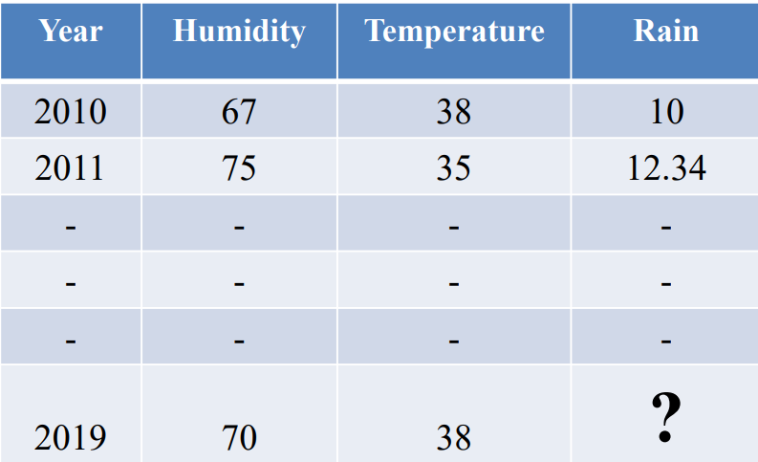
Regression
Example
How much rain will fall in August this year in Hyderabad?
2026
S. Durga Devi , Dept of CSE, CBIT, Hyderabad
S. Dura Devi ,CSE,CBIT

Slide 18
Regression algorithms
Types of regression algorithms
Linear regression
Multiple linear regression
Polynomial regression
Decision tree
Random forest regression
S. Durga Devi , Dept of CSE, CBIT, Hyderabad
S. Dura Devi ,CSE,CBIT

Slide 19
1. Linear regression
Linear regression
  Assumptions: Linear relationship between independent variable (x) and dependent variable (y).
  The relationship is deterministic. Predicts the dependent variable with some amount of error.
  Formula
  y = β₀ +β₁ x+ϵ
  Linear regression tries to find the best-fitting straight line.
Where
Β₀ :means intercept expected value of y when x is zero.
β₁ : slope/ regression coefficient – how much value of y changes when value of x increased by one unit.
ϵ: some error.
Note: parameters of linear regression estimated using OLS method( Ordinary Least Square)
S. Durga Devi , Dept of CSE, CBIT, Hyderabad
S. Dura Devi ,CSE,CBIT

Slide 20
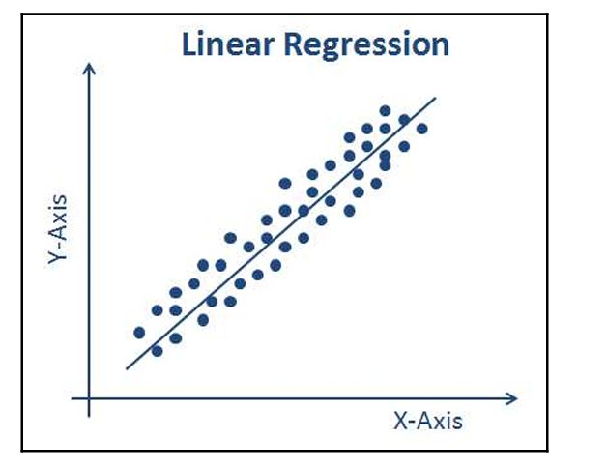
Linear regression
Linear regression data points are fit into a curve that is called as curve fitting.
X- axis represents the independent variable.
Y- axis is dependent variable( outcome)
Example : predict house price based on the area.
S. Durga Devi , Dept of CSE, CBIT, Hyderabad
S. Dura Devi ,CSE,CBIT

Slide 21
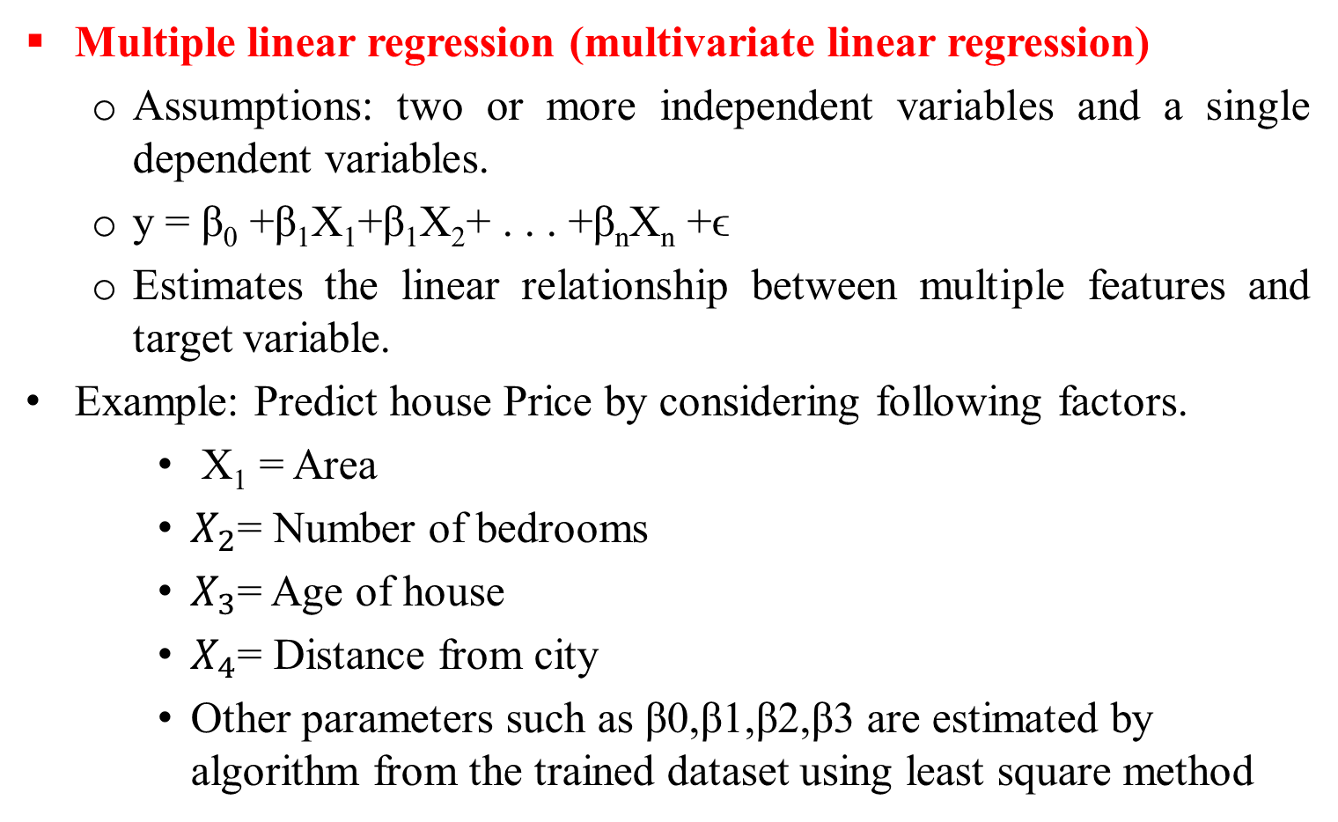
2. Multiple linear regression
Multiple linear regression (multivariate linear regression)
  Assumptions: two or more independent variables and a single dependent variables.
  y = β₀ +β₁X₁+β₁X₂+ . . . +β_{n}X_{n} +ϵ
  Estimates the linear relationship between multiple features and target variable.
Example: Predict house Price by considering following factors.
    X₁​ = Area
    $X_{2}$= Number of bedrooms
    $X_{3}$= Age of house
    $X_{4}$= Distance from city
    Other parameters such as β0​,β1​,β2​,β3​ are estimated by algorithm from the trained dataset using least square method
S. Durga Devi , Dept of CSE, CBIT, Hyderabad
S. Dura Devi ,CSE,CBIT

Slide 22
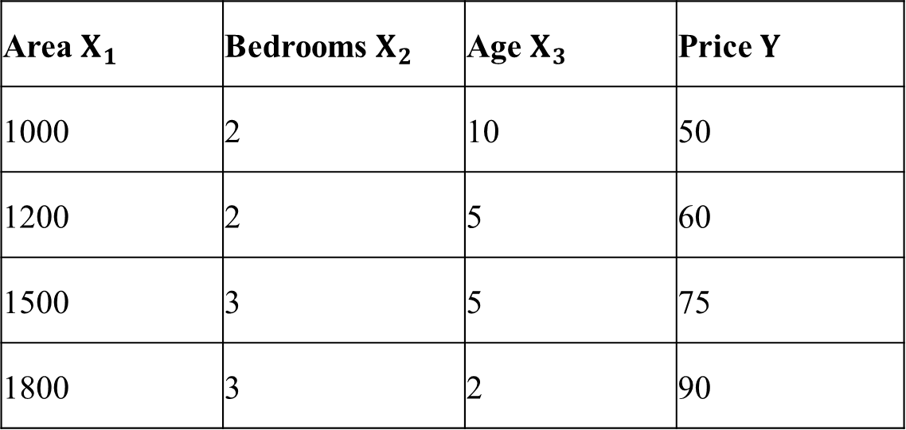
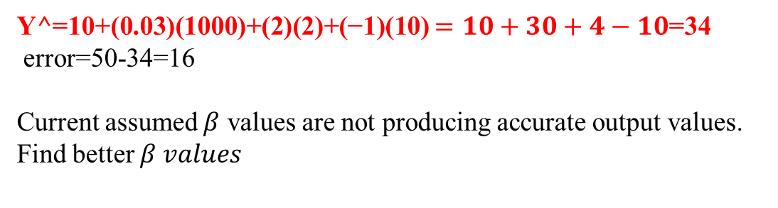
Area $X_{1}$ | Bedrooms $X_{2}$ | Age $X_{3}$ | Price $Y$
1000 | 2 | 10 | 50
1200 | 2 | 5 | 60
1500 | 3 | 5 | 75
1800 | 3 | 2 | 90
Y^=β₀​+β​₁X_{1​}+β₂​X₂​+β₃​X₃​
β0​=10 $β_{1}=0.03$ $β_{2}=2$β3​=−1
Y^=10+(0.03)(1000)+(2)(2)+(−1)(10) $=10+30+4−10$=34
error=50-34=16
Current assumed $β$ values are not producing accurate output values. Find better $β values$
S. Durga Devi , Dept of CSE, CBIT, Hyderabad
S. Dura Devi ,CSE,CBIT

Slide 23
Understanding multicollinearity
In multi linear regression, several independent variable are considered to predict one dependent variable.
Multicollinearity occurs when two or more independent variables are highly correlated with each other.
Multicollinearity causes:
  Larger standard errors
  Unstable regression coefficients and difficult to interpret.
  Difficult to know which variable is more important because independent variables provide similar information.
S. Durga Devi , Dept of CSE, CBIT, Hyderabad
S. Dura Devi ,CSE,CBIT

Slide 24
Causes of multicollinearity
Due to incorrect usage of dummy variables.
Using similar or repeated variables: area in square ft, area in meters.
Creating new variables from other variables: Income=salary+bonus
High correlation among variables. Age and experience highly correlated
S. Durga Devi , Dept of CSE, CBIT, Hyderabad
S. Dura Devi ,CSE,CBIT

Slide 25
Removing multicollinearity
Ways to detect multicollinearity
  Correlation matrix
  Variance inflation Factor(VIF)
  Eigen values
S. Durga Devi , Dept of CSE, CBIT, Hyderabad
S. Dura Devi ,CSE,CBIT

Slide 26
1. Correlation matrix
Correlation coefficient between independent variables.
Calculate the correlation between the independent variables.
Identify highly correlation between independent variables.
S. Durga Devi , Dept of CSE, CBIT, Hyderabad
S. Dura Devi ,CSE,CBIT

Slide 27
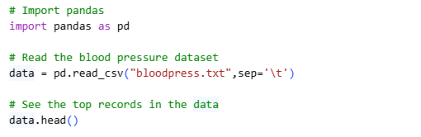
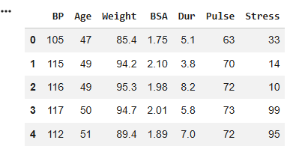
Example
S. Durga Devi , Dept of CSE, CBIT, Hyderabad
S. Dura Devi ,CSE,CBIT

Slide 28
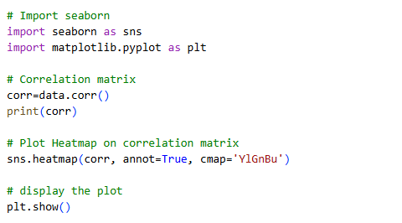
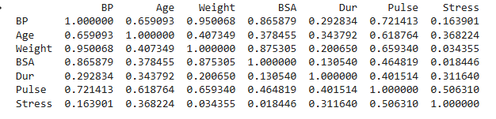
Use correlation matrix
- corr() function in pandas library
S. Durga Devi , Dept of CSE, CBIT, Hyderabad
S. Dura Devi ,CSE,CBIT

Slide 29
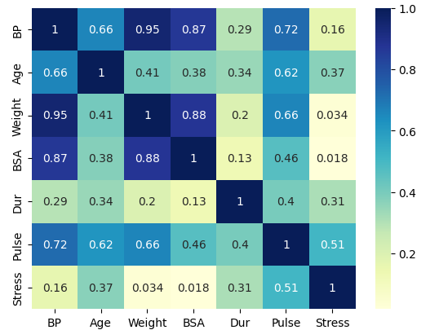
heatmap
Weight and BSA independent variables highly correlated . Either weight or BSA
can be removed
S. Durga Devi , Dept of CSE, CBIT, Hyderabad
S. Dura Devi ,CSE,CBIT

Slide 30
Dummy variables
Sometimes regression analysis to be applied on categorical values.
Example : predict salary of a person
  Experience- numerical data
  Gender- categorical values
Categorical values converted into binary format 0 and 1.
Categorical values into 0 and 1 are called dummy variables.
Dummy values generated by get_dummies() function from pandas library.
S. Durga Devi , Dept of CSE, CBIT, Hyderabad
S. Dura Devi ,CSE,CBIT

Slide 31
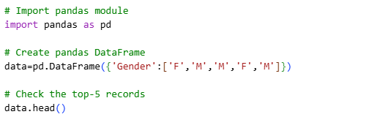
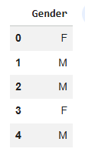
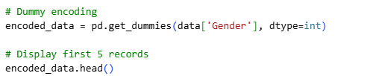

Example on dummy values
S. Durga Devi , Dept of CSE, CBIT, Hyderabad
S. Dura Devi ,CSE,CBIT

Slide 32
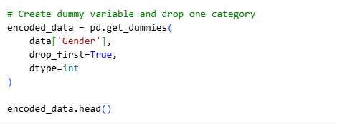

Example on dummy values
Remove one column for collinearity using drop_first=True
drop_first=True remove the first column
S. Durga Devi , Dept of CSE, CBIT, Hyderabad
S. Dura Devi ,CSE,CBIT

Slide 33
Develop linear regression model
Evaluate performance of the model
Polynomial regression
Classification and types

Slide 34

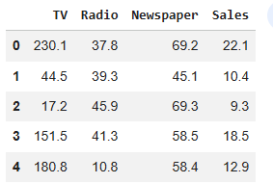
Developing linear regression model
Consider a dataset Advertising.csv
How to mount dataset from google drive?
from google.colab import drive
drive.mount('/content/drive')
Mounted at /content/drive
S. Durga Devi , Dept of CSE, CBIT, Hyderabad
S. Dura Devi ,CSE,CBIT

Slide 35
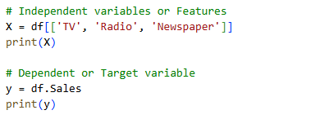
Split the data into two parts:
1. Dependent or target variable
2. Independent variables or features
S. Durga Devi , Dept of CSE, CBIT, Hyderabad
S. Dura Devi ,CSE,CBIT

Slide 36
Split dataset into training data and test data in a ratio 75:25.
Training data is 75% and testing data 25%
use train_test_split() function from sklearn library
test_size: specifies size of the testing dataset.
random_state=0: specifies a seed value for reproducing the same data split each time.
if random_state=None: every run different random split will be generated.
S. Durga Devi , Dept of CSE, CBIT, Hyderabad
S. Dura Devi ,CSE,CBIT

Slide 37
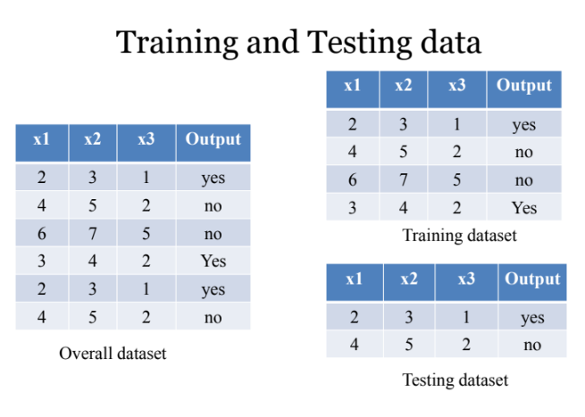
S. Durga Devi , Dept of CSE, CBIT, Hyderabad
S. Dura Devi ,CSE,CBIT

Slide 38
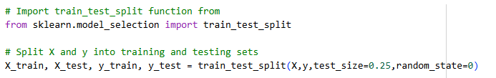
Split the dataset(training and testing)
S. Durga Devi , Dept of CSE, CBIT, Hyderabad
S. Dura Devi ,CSE,CBIT

Slide 39
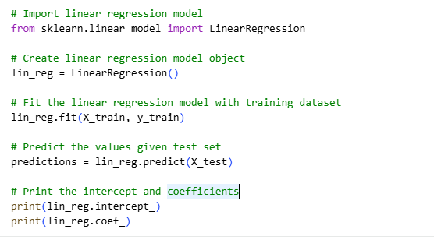

Use linear regression
Learns the regression coefficients
S. Durga Devi , Dept of CSE, CBIT, Hyderabad
S. Dura Devi ,CSE,CBIT

Slide 40
Evaluate regression model performance
How well our model predict the actual values?
Predicted values are not exactly same as actual values. We need to measure performance of our model when it put into production.
Evaluation metrics are used to evaluate performance of regression models.
S. Durga Devi , Dept of CSE, CBIT, Hyderabad
S. Dura Devi ,CSE,CBIT

Slide 41
Evaluation metrics
R- Squared
MSE: Mean Squared Error
MAE: Mean Absolute Error
RMSE — Root Mean Squared Error
S. Durga Devi , Dept of CSE, CBIT, Hyderabad
S. Dura Devi ,CSE,CBIT

Slide 42
R- squared
Assess the goodness of a regression model.
Represents proportion of variance in the dependent variable that is predictable from the independent variables.
R² tells us how much of the variation in dependent variable can be explained by the regression model.
Explains the model performance compared to base model.
R- Square values ranges from 0 to 1.
Near to 0: poor model
Near to 1:perfect model
-negative: worst model.
High value of R² indicates a good fit between the predicted value and the actual value.
S. Durga Devi , Dept of CSE, CBIT, Hyderabad
S. Dura Devi ,CSE,CBIT

Slide 43
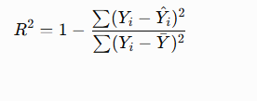
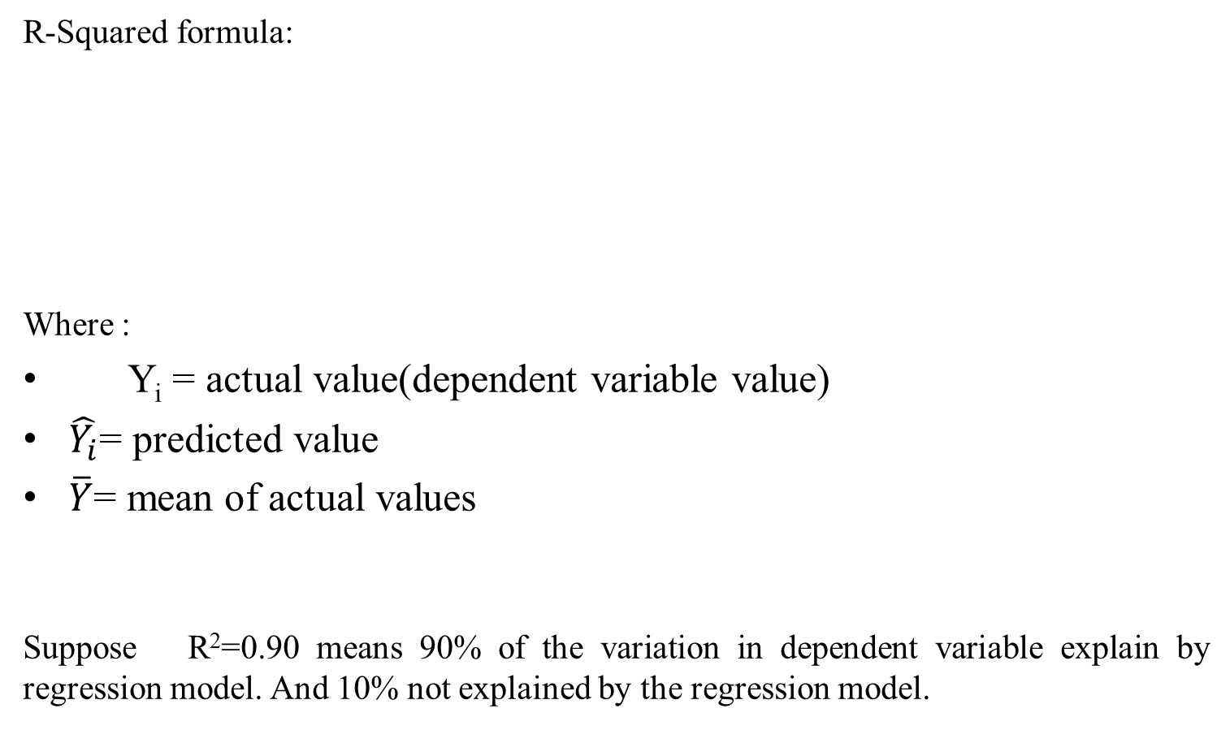
R-Squared formula:
Where :
Y_{i}​ = actual value(dependent variable value)
$\hat{Y_{i}}$= predicted value
$\overline{Y}$= mean of actual values
Suppose R²=0.90 means 90% of the variation in dependent variable explain by regression model. And 10% not explained by the regression model.
S. Durga Devi , Dept of CSE, CBIT, Hyderabad
S. Dura Devi ,CSE,CBIT

Slide 44
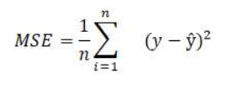
2. MSE(Mean Square Error)
MSE: square of the difference between actual value and predicted values and average of all the values.
Actual | Predicted | Error | Squared Error
50 | 48 | 2 | 4
60 | 63 | -3 | 9
75 | 72 | 3 | 9
MSE=(4+9+9​ )/3
MSE=7.33
S. Durga Devi , Dept of CSE, CBIT, Hyderabad
S. Dura Devi ,CSE,CBIT

Slide 45


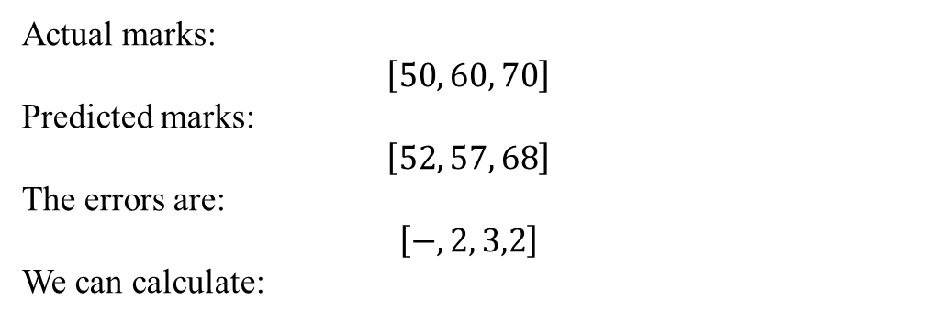
3. MAE(Mean absolute Error)
Absolute change between actual value and predicted value and average between them for all the values.
Actual marks:
$$\left[50 , 60 , 70\right]$$
Predicted marks:
$$\left[52 , 57 , 68\right]$$
The errors are:
$$\left[− , 2 , 3,2\right]$$
We can calculate:
S. Durga Devi , Dept of CSE, CBIT, Hyderabad
S. Dura Devi ,CSE,CBIT

Slide 46

4. RMSE(Root Mean square error)
S. Durga Devi , Dept of CSE, CBIT, Hyderabad
S. Dura Devi ,CSE,CBIT

Slide 47
# Import the required libraries
import numpy as np
from sklearn.metrics import mean_absolute_error
from sklearn.metrics import mean_squared_error
from sklearn.metrics import r2_score
# Evaluate mean absolute error
print('Mean Absolute Error(MAE):', mean_absolute_error(y_test,predictions))
# Evaluate mean squared error
print("Mean Squared Error(MSE):", mean_squared_error(y_test, predictions))
# Evaluate root mean squared error
print("Root Mean Squared Error(RMSE):", np.sqrt(mean_squared_error(y_test, predictions)))
# Evaluate R2-square
print("R2-Square:",r2_score(y_test, predictions))
S. Durga Devi , Dept of CSE, CBIT, Hyderabad
S. Dura Devi ,CSE,CBIT

Slide 48
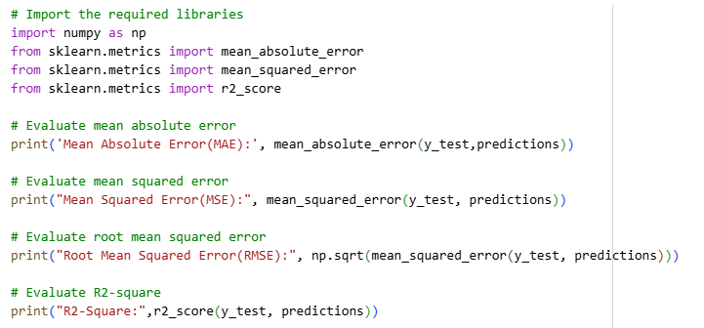

Now evaluate model performance on testing dataset.
Model explains the 85%
variability of data
S. Durga Devi , Dept of CSE, CBIT, Hyderabad
S. Dura Devi ,CSE,CBIT

Slide 49

Fitting polynomial regression
Polynomial regression:
- used to adapt when relationship between independent variables(X) and dependent variable (Y) is non- linear/curve.
Independent variables are modelled as nth polynomial degree.
Formula
S. Durga Devi , Dept of CSE, CBIT, Hyderabad
S. Dura Devi ,CSE,CBIT

Slide 50
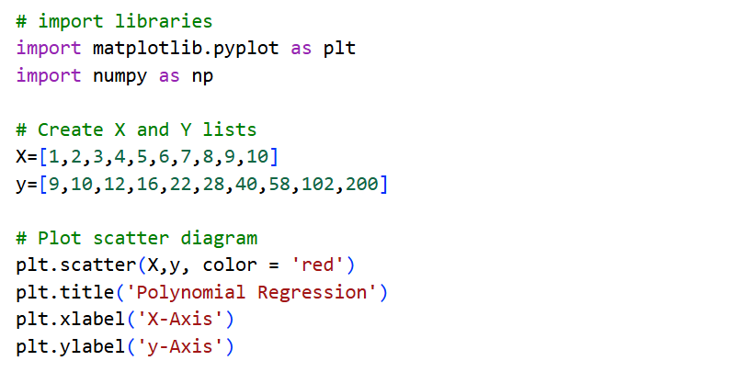
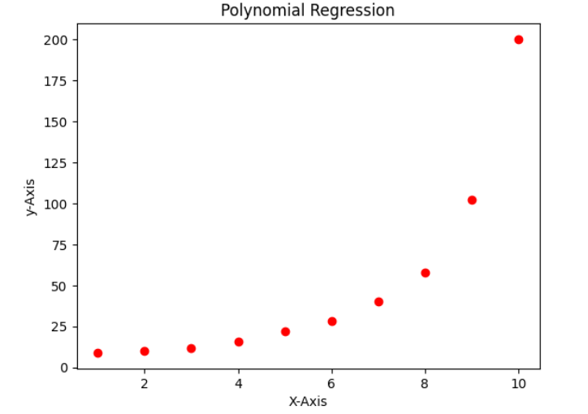
Example
Dataset has a polynomial relationship
S. Durga Devi , Dept of CSE, CBIT, Hyderabad
S. Dura Devi ,CSE,CBIT

Slide 51
import libraries
import pandas as pd
from sklearn.preprocessing import PolynomialFeatures
from sklearn.linear_model import LinearRegression
# Preprare dataset
data = pd.DataFrame({"X":[1,2,3,4,5,6,7,8,9,10],
"y":[9,10,12,16,22,28,40,58,102,200]})
X = data[['X']]
y = data[['y']]
# Apply Polynomial Features
polynomial_reg = PolynomialFeatures(degree = 6)# create polynomial features upto6
X_polynomial = polynomial_reg.fit_transform(X)# original X values to polynomial features
# Apply Linear Regression Model
linear_reg = LinearRegression()
linear_reg.fit(X_polynomial, y)# regression model learns coefficients
predictions=linear_reg.predict(X_polynomial)# train the model and predict y value
# plot the results
plt.scatter(X,y, color = 'red')
plt.plot(X, predictions, color = 'blue')
plt.title('Polynomial Regression')
plt.xlabel('X-Axis')
plt.ylabel('y-Axis')
S. Durga Devi , Dept of CSE, CBIT, Hyderabad
S. Dura Devi ,CSE,CBIT

Slide 52
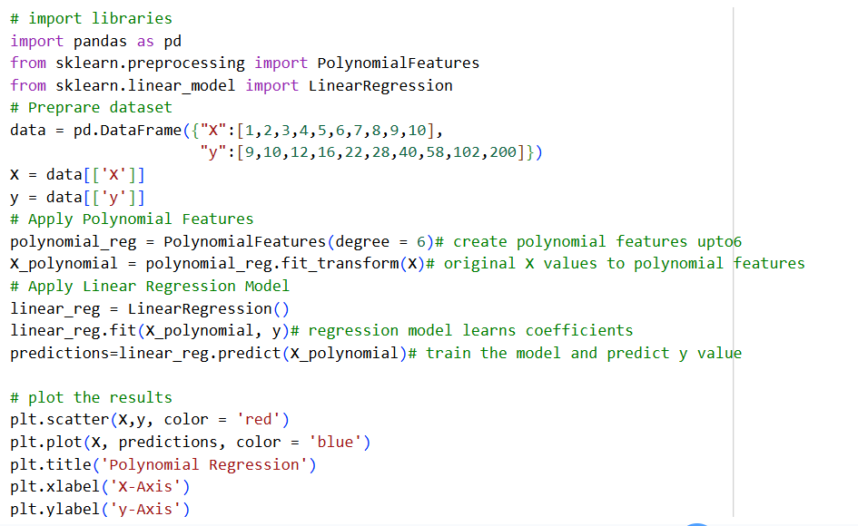
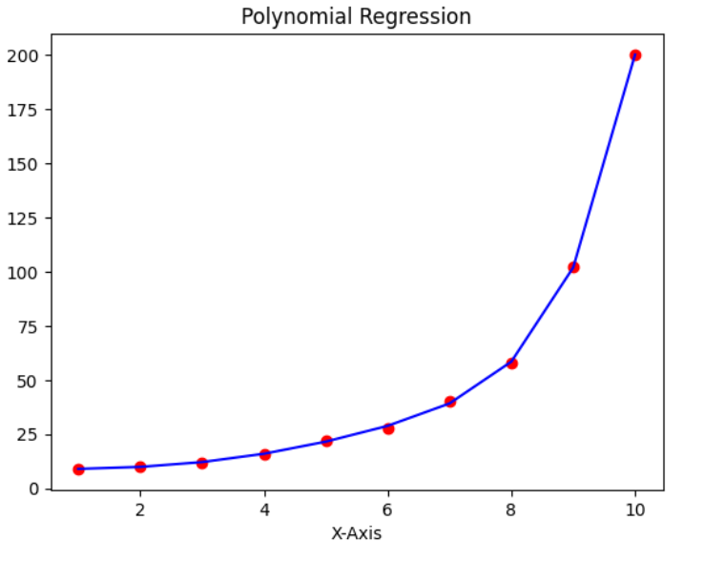
S. Durga Devi , Dept of CSE, CBIT, Hyderabad
S. Dura Devi ,CSE,CBIT

Slide 53
Regression models for classification
Classification is supervised learning algorithm where output variable is categorical value.
Classification used to solve classification problems such as detecting spam emails, analysing financial risks, exam results(pass/fail), disease detection, fraud detection.
Classification
Binary
Multi class
S. Durga Devi , Dept of CSE, CBIT, Hyderabad
S. Dura Devi ,CSE,CBIT

Slide 54
Binary classification
  The target variable have only two values -0/1
  Example: student in exam pass/fail, spam detection, disease prediction
2. Multi-class classification
  More than two classes
  Example: new article – politics, sports, business and many more.
  Fruits: banana, apple, orange etc.
S. Durga Devi , Dept of CSE, CBIT, Hyderabad
S. Dura Devi ,CSE,CBIT

Slide 55
Classification methods
Logistic regression
2. K- nearest neighbours(KNN)
3. Decision Trees
4. Random forest
5. Support Vector Machine(SVM)
6. Naive Bayes
S. Durga Devi , Dept of CSE, CBIT, Hyderabad
S. Dura Devi ,CSE,CBIT

Slide 56
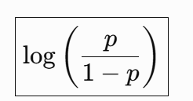
Logistic regression
Logistic regression forecast the binary outcome.
Dependent variable with classes of values: 0/ 1.
    Y€ {0,1}
Logistic regression computes the log of odd ratio of target variable.
Represents probability of occurrences of an event.
Linear regression calculates the probability of the positive class.
Example probability of student pass in the exam.
Note: logistic regression extended to do multi class also.
S. Durga Devi , Dept of CSE, CBIT, Hyderabad
S. Dura Devi ,CSE,CBIT

Slide 57
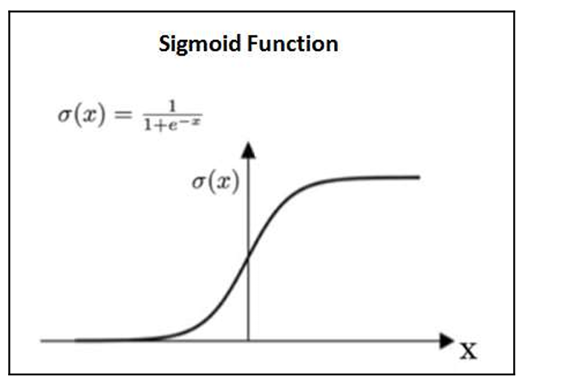
Logistic regression
Logistic regression is a kind of linear regression where the dependent or target variable is categorical.
Logistic regression uses sigmoid function on the prediction results of linear regression.
Sigmoid function converts the models output into a probability value between 0 and 1.
This function takes any real value and maps between 0 and 1. forms the “S” shaped curve.
S. Durga Devi , Dept of CSE, CBIT, Hyderabad
S. Dura Devi ,CSE,CBIT

Slide 58
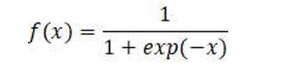
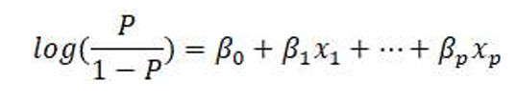
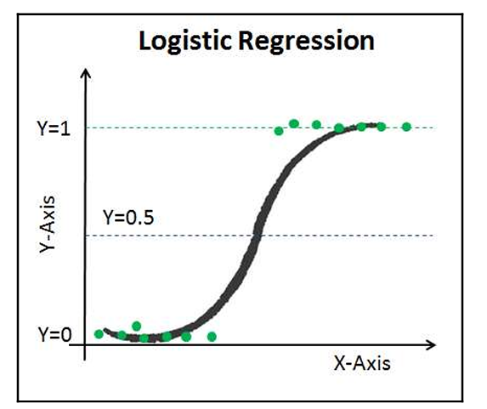
Sigmoid function
Sigmoid function formula:
Logistic regression equation:
Log() function is called odds ratio or “odds”.
Odds ratio: ratio of probability of the occurrence of an event to the probability of not occurrence of an event.
S. Durga Devi , Dept of CSE, CBIT, Hyderabad
S. Dura Devi ,CSE,CBIT

Slide 59
Characteristics of logistic regression
The dependent or target variable must be binary in nature.
No multicollinearity in between independent variables.
Coefficients are estimated using maximum likelihood estimation method
Logistic regression uses threshold value to convert into class.
example threshold value=0.5
if P>=0.5- class1
P<0.5 – class0
Model evaluated using concordance and KS (Kolmogorov–Smirnov) statistics. Particularly used in banking, insurance models.
S. Durga Devi , Dept of CSE, CBIT, Hyderabad
S. Dura Devi ,CSE,CBIT

Slide 60
Types of logistic regression algorithms
Binary logistic regression model
Multinomial logistic regression model
Ordinal logistic regression model
S. Durga Devi , Dept of CSE, CBIT, Hyderabad
S. Dura Devi ,CSE,CBIT

Slide 61
Types of logistic regression algorithms
  Binary logistic regression model:
    Dependent variable has only two classes
    Example : predict whether student pass or fail.
    Email classification: spam or not spam.
  2. Multinomial logistic regression model
    Dependent variable has more than two classes.
    Classes need not be in order
    Example : news article: politics, sports, health, business
  Ordinal logistic regression model:
    dependent variable has more than two classes with meaningful order
    Student performance: poor<average<good<excellent.
S. Durga Devi , Dept of CSE, CBIT, Hyderabad
S. Dura Devi ,CSE,CBIT

Slide 62
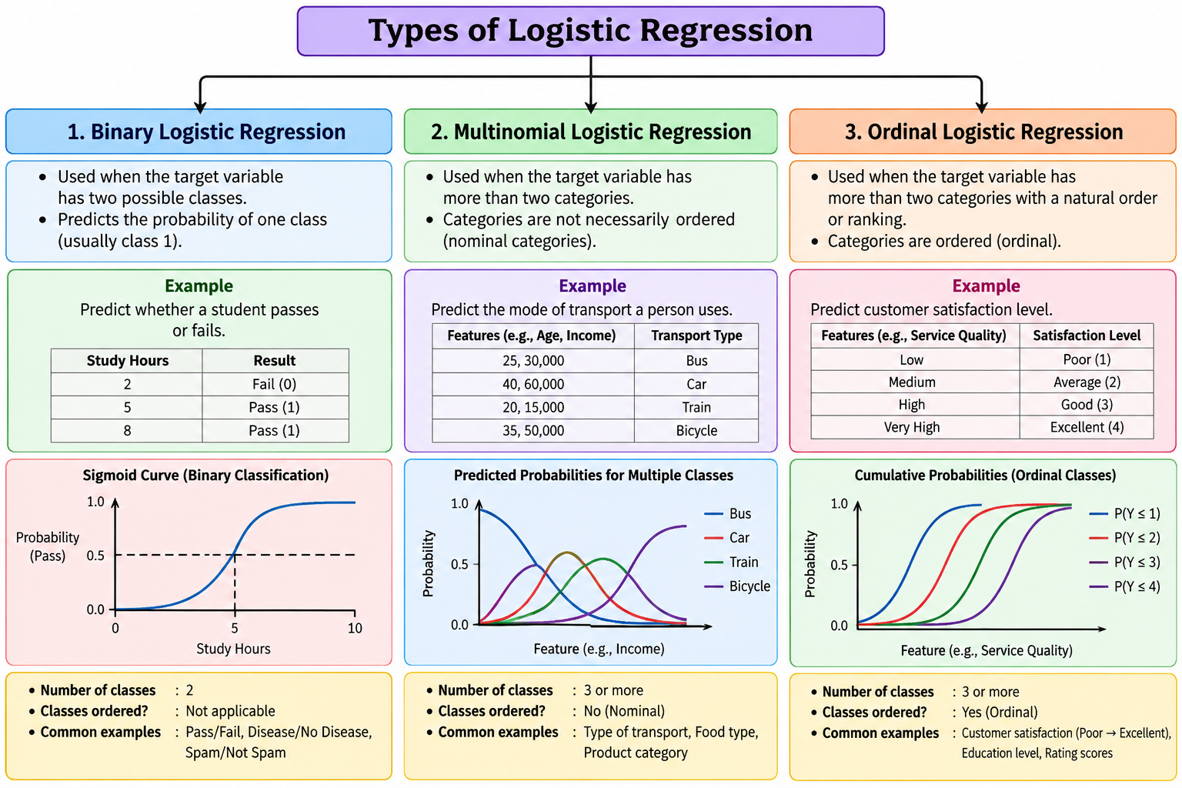
Created by AI
S. Durga Devi , Dept of CSE, CBIT, Hyderabad
S. Dura Devi ,CSE,CBIT

Slide 63
Advantages and disadvantages of logistic regression
Advantages
  Easy to understand, interpretable and implement.
  Provides probability outcome for each observation
  Understands confidence of a prediction- how model is calibrated.
Disadvantages
  Not perform well for highly correlated independent variables
  Cannot work for non linear relationship
  Too many independent variables, algorithm learns about noise that leads to overfitting.
S. Durga Devi , Dept of CSE, CBIT, Hyderabad
S. Dura Devi ,CSE,CBIT

Slide 64
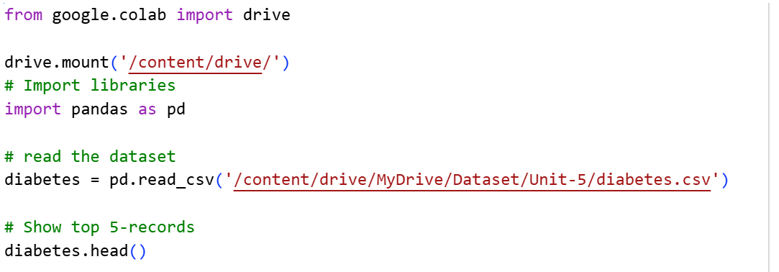
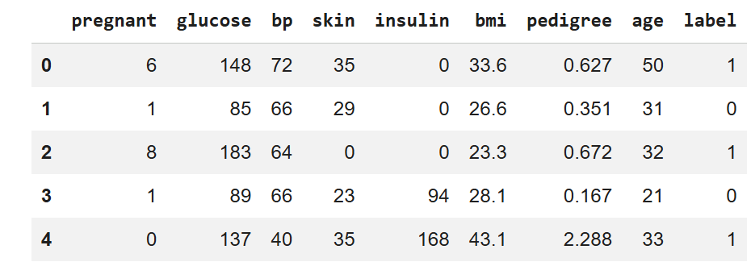
Implementing logistic regression using scikit-learn
S. Durga Devi , Dept of CSE, CBIT, Hyderabad
S. Dura Devi ,CSE,CBIT

Slide 65
Splitting dataset
#split the dataset in two parts: feature set and target label
feature_set = ['pregnant', 'insulin', 'bmi', 'age','glucose','bp','pedigree']
features = diabetes[feature_set]
target = diabetes.label
# partition data into training and testing set
from sklearn.model_selection import train_test_split
feature_train, feature_test, target_train, target_test = train_test_split(features, target, test_size=0.3, random_state=1)
S. Durga Devi , Dept of CSE, CBIT, Hyderabad
S. Dura Devi ,CSE,CBIT

Slide 66
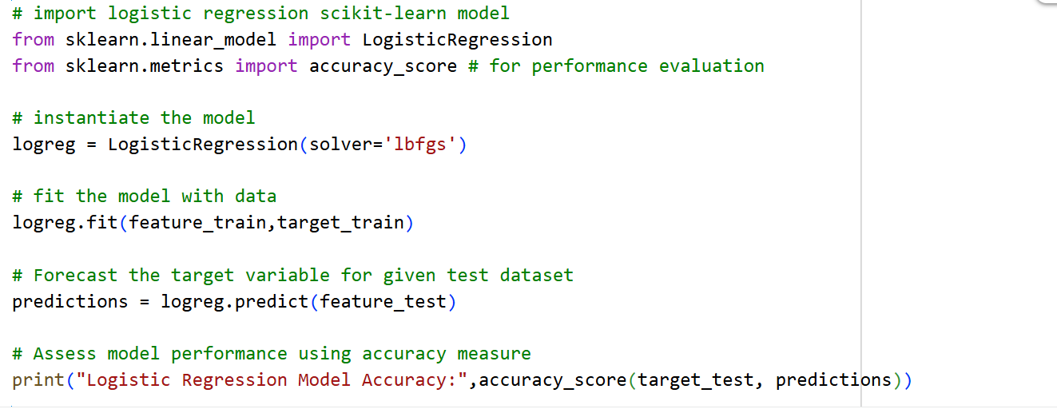
Develop logistic regression model
solver: is optimization method used to
find models coefficients during training.
‘lbfgs’: Limited-memory Broyden–Fletcher–
Goldfarb–Shanno
S. Durga Devi , Dept of CSE, CBIT, Hyderabad
S. Dura Devi ,CSE,CBIT

Slide 67
references
Case studies from textbook-1
Page nos 321
https://github.com/PacktPublishing/Python-Data-Analysis-Third-Edition/tree/master/Chapter09
S. Durga Devi , Dept of CSE, CBIT, Hyderabad
S. Dura Devi ,CSE,CBIT

