Slide 1

Fundamentals of Data Science(22CSC59)
BE- CSE-V-Semester
Presented by
S Durga Devi
Assistant Professor
Department of Computer Science and Engineering
Chaitanya Bharathi Institute of Technology
Hyderabad
S. Durga Devi , Dept of CSE, CBIT, Hyderabad

Slide 2

Unit-V
Topics to be covered
Unsupervised Learning clustering - PCA and Clustering: Unsupervised learning, reducing the dimensionality of data, PCA, Performing PCA. Finding the number of clusters, the elbow method, the silhouette method, Partitioning data using k-means clustering, Hierarchical clustering, DBSCAN clustering, Spectral Clustering: clustering, Evaluating clustering performance, Internal performance evaluation, The Davies-Bouldin index, The silhouette coefficient, External performance evaluation, The Rand score, The Jaccard score, F-Measure or F1-score, The Fowlkes-Mallows score.
Textbook: Avinash Navlani, Armando Fandango, and Ivan Idris, “Python Data Analysis: Perform Data Collection, Data Processing, Wrangling, Visualization, and Model Building Using Python”, 3rd ed. Packt Publishing, 2021.
S. Durga Devi , Dept of CSE, CBIT, Hyderabad
S. Dura Devi ,CSE,CBIT

Slide 3
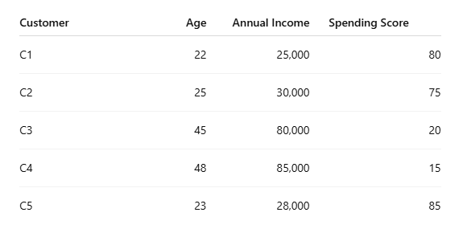
Unsupervised learning
Unsupervised learning is a machine learning algorithm where model works without labelled data.
Learns patterns on its own by grouping similar data points or finding hidden structures without supervision.
We have labelled independent variable but no predefined target/dependent variable labelled.
cluster1- young, low income,
and high spending
Cluster-2- older, high income,
low spending.
S. Durga Devi , Dept of CSE, CBIT, Hyderabad
S. Dura Devi ,CSE,CBIT

Slide 4
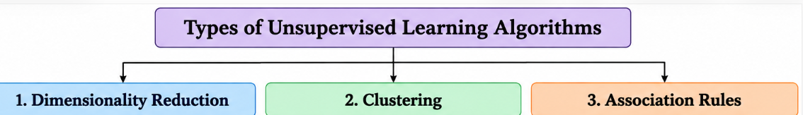
Type of Unsupervised learning
Dimensionality Reduction
Clustering
Association Rules
S. Durga Devi , Dept of CSE, CBIT, Hyderabad
S. Dura Devi ,CSE,CBIT

Slide 5
1. Reducing the dimensionality of data
Reducing dimensionality(Dimensionality Reduction)
- Decreasing the number of features in dataset while retaining the original information.
Objective is to select the best relevant features for classification, regression and other unsupervised learning algorithms.
Why dimensionality reduction?
Complex dataset easily analyse and visualize.
Improves model performance by reducing noise and computational cost
Reduces space for features
Uses most relevant features for analysis
Reduces the overfitting.
S. Durga Devi , Dept of CSE, CBIT, Hyderabad
S. Dura Devi ,CSE,CBIT

Slide 6
Dimensionality reduction techniques
PCA: Principal Component Analysis
Non negative matrix factorization(NMF)
Locally linear embeddings
Isomap
S. Durga Devi , Dept of CSE, CBIT, Hyderabad
S. Dura Devi ,CSE,CBIT

Slide 7
PCA: Principal Component Analysis
In larger dataset there is a curse of dimensionality, when large number of dimensions are present , ML algorithms become less effective and features space can increase substantially.
Increases the complexity for the prediction model due to large number of attributes.
PCA: Principal Component Analysis: is one of the method for the dimensionality reduction.
Principal Component Analysis
- Identifies patterns in the dataset and correlation between the variables in original dataset an transfers into lower dimensions without affecting the significant information.
- highly correlated variables contributes same information, they will be treated as redundant attributes.
Note: PCA does not remove redundant attributes , it creates new variables called principal component
S. Durga Devi , Dept of CSE, CBIT, Hyderabad
S. Dura Devi ,CSE,CBIT

Slide 8
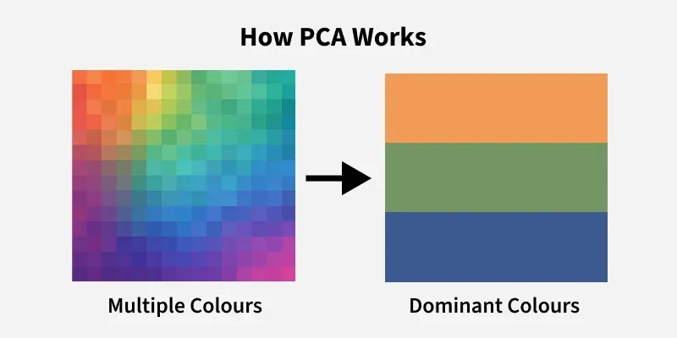
PCA captures the directions or components which has maximum variance or maximum
information.
https://www.geeksforgeeks.org/data-analysis/principal-component-analysis-pca/
S. Durga Devi , Dept of CSE, CBIT, Hyderabad
S. Dura Devi ,CSE,CBIT

Slide 9

PCA: Principal Component Analysis
PCA equation
X₁,X₂…. Xp are attributes in original dataset.
Wij: coefficient of variable when forming a PCA
S. Durga Devi , Dept of CSE, CBIT, Hyderabad
S. Dura Devi ,CSE,CBIT

Slide 10
Performing PCA
To perform PCA follow below given steps
Compute correlation or covariance matrix for the dataset.
Find eigenvalues and eigenvectors of correlation or covariance matrix.
Sort eigenvalues and their corresponding eigenvectors.
Multiply eigenvector matrix with original dataset then PCA matrix will be generated.
PCA finds new directions (principal components) that capture maximum variance in the data.
S. Durga Devi , Dept of CSE, CBIT, Hyderabad
S. Dura Devi ,CSE,CBIT

Slide 11
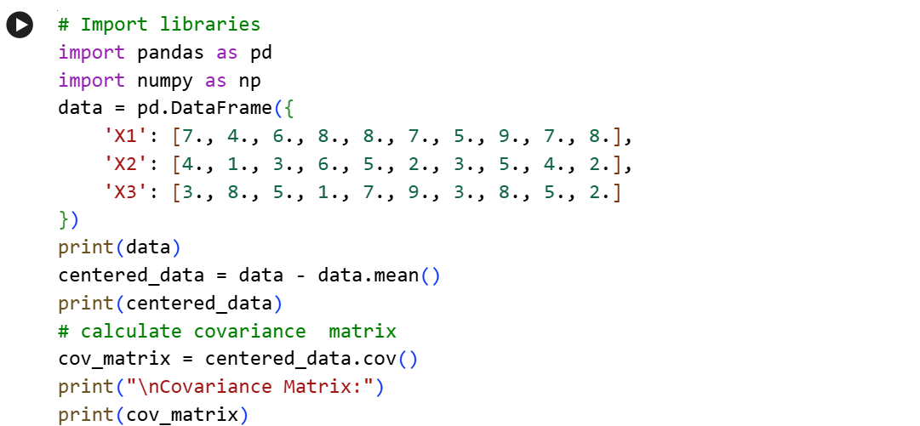
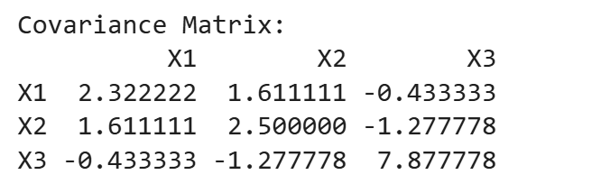
PCA Example
Subtract mean of the data from each data values
S. Durga Devi , Dept of CSE, CBIT, Hyderabad
S. Dura Devi ,CSE,CBIT

Slide 12
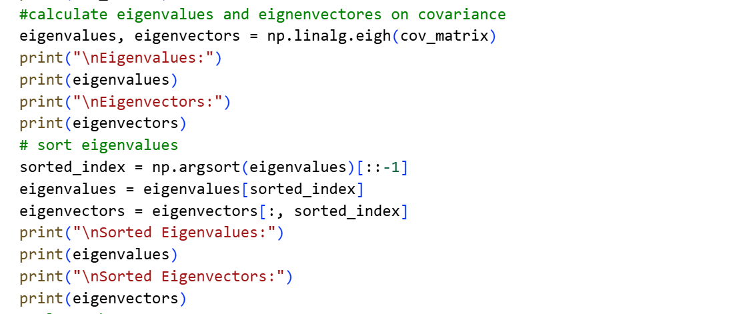
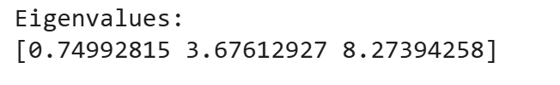
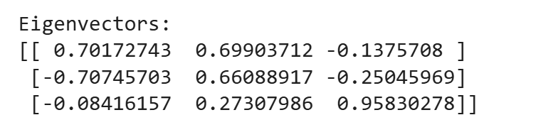

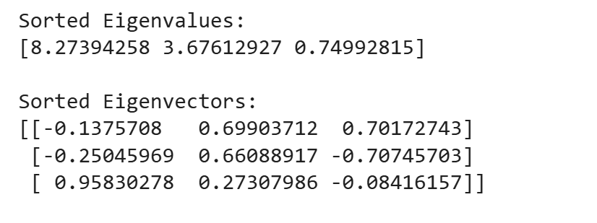
PCA Example
S. Durga Devi , Dept of CSE, CBIT, Hyderabad
S. Dura Devi ,CSE,CBIT

Slide 13
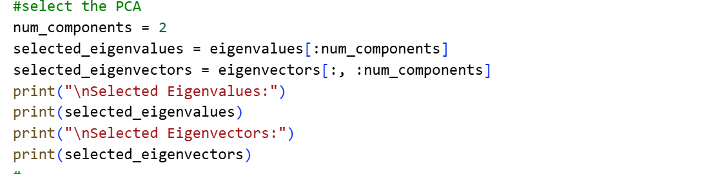
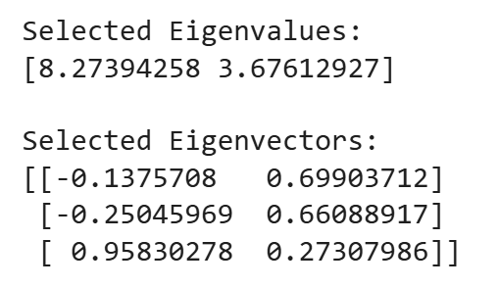
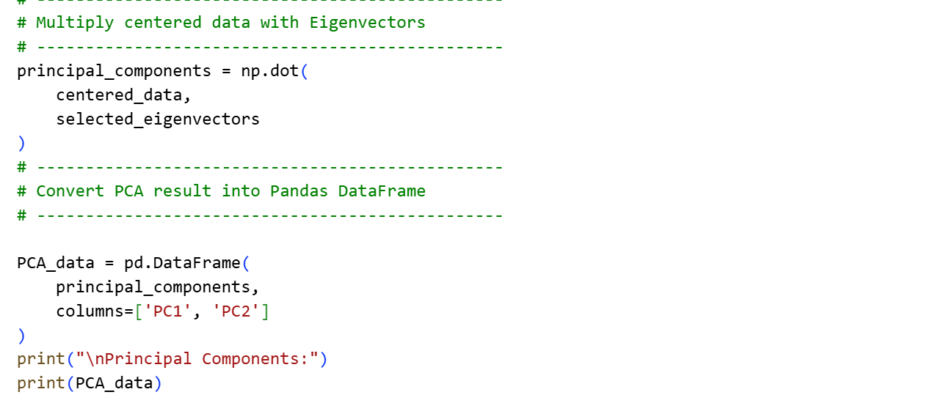
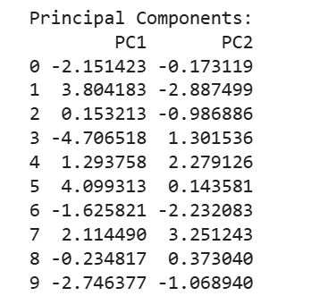
Take all the rows but first two columns
S. Durga Devi , Dept of CSE, CBIT, Hyderabad
S. Dura Devi ,CSE,CBIT

Slide 14
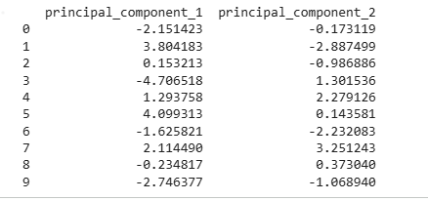
PCA using scikit-learn in python
# Import pandas and PCA
import pandas as pd
# Import principal component analysis
from sklearn.decomposition import PCA
# Create dataset
data=np.array([[7., 4., 3.],
[4., 1., 8.],
[6., 3., 5.],
[8., 6., 1.],
[8., 5., 7.],
[7., 2., 9.],
[5., 3., 3.],
[9., 5., 8.],
[7., 4., 5.],
[8., 2., 2.]])
# Create PCA object and fit PCA Model
pca_model = PCA(n_components=2)
components = pca_model.fit_transform(data)
components_df = pd.DataFrame(data = components,
columns = ['principal_component_1', 'principal_component_2'])
print(components_df)
S. Durga Devi , Dept of CSE, CBIT, Hyderabad
S. Dura Devi ,CSE,CBIT

Slide 15
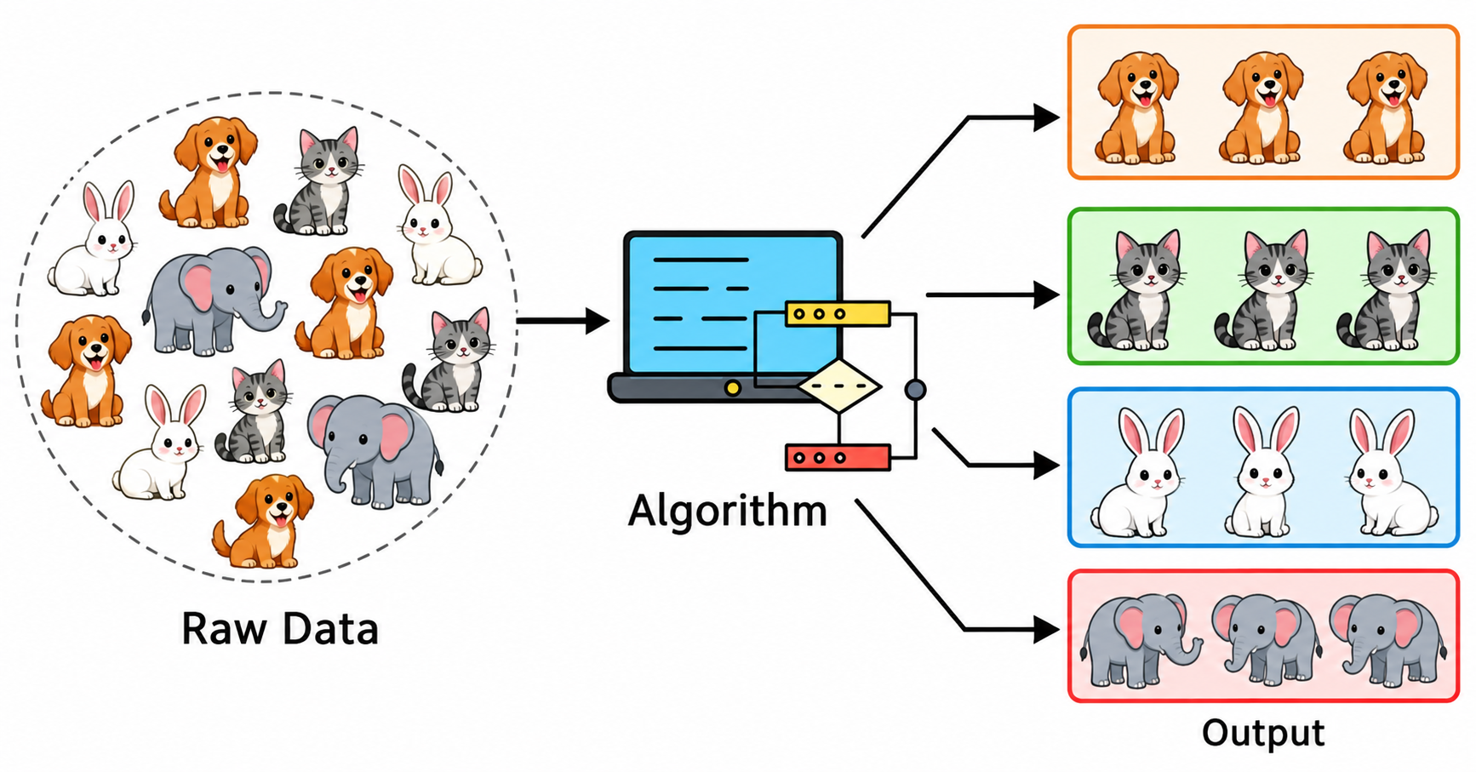
2. Clustering
Clustering is an unsupervised learning algorithm that groups similar data points together.
Works on unlabelled data and algorithm itself discovers the groups.
Clustering is the task of grouping a set of objects in such a way that objects in the same group (called a cluster) are more similar to each other than to those in other groups (clusters).
Example: Grouping similar products, similar customers
Created by AI
S. Durga Devi , Dept of CSE, CBIT, Hyderabad
S. Dura Devi ,CSE,CBIT

Slide 16
Where do you use clustering?
Netflix: recommend movies and web series to its users as per their watch history and preferences.
Amazon: recommends products to the customers based on their search history.
Image segmentation: separates sky, people, objects
Healthcare: patients with similar characteristics
Social network analysis: communities with similar interactions.
Anomaly detection: detecting outliers
S. Durga Devi , Dept of CSE, CBIT, Hyderabad
S. Dura Devi ,CSE,CBIT

Slide 17
Measuring similarity between data points
Why do we need similarity measures?
In clustering similar data points are grouped into same cluster
To identify similar or dissimilar data points, measure distance between.
Smaller distances- more similar
Larger distances- more dissimilar
Type of distance measures
1. Euclidean Distance – Straight-line distance
2. Manhattan Distance – Distance along horizontal/vertical paths
3. Minkowski Distance – Generalized distance measure
S. Durga Devi , Dept of CSE, CBIT, Hyderabad
S. Dura Devi ,CSE,CBIT

Slide 18
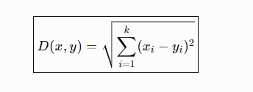

Distance measures
1. Euclidean Distance
Where x,y are data points
x_{i} is ith feature of data point x
Y_{i} is ith feature of data point y
K= total number of features in dataset
S. Durga Devi , Dept of CSE, CBIT, Hyderabad
S. Dura Devi ,CSE,CBIT

Slide 19
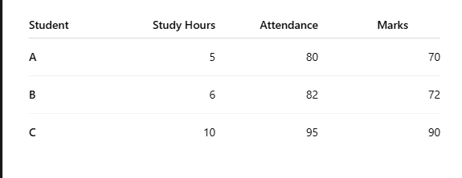
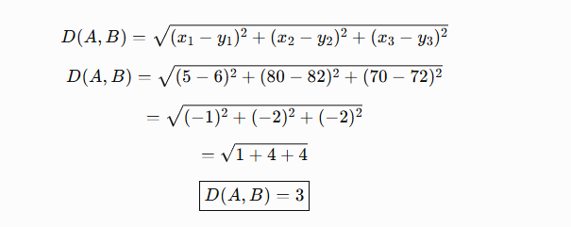
Example on Euclidean distance
Pair | Euclidean Distance | Similarity
A – B | 3.00 | Very similar
A – C | 25.50 | Less similar
B – C | 22.56 | Less similar
S. Durga Devi , Dept of CSE, CBIT, Hyderabad
S. Dura Devi ,CSE,CBIT

Slide 20

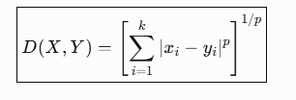
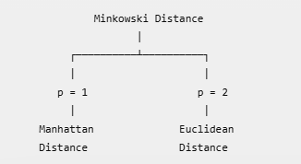
2. Manhattan Distance
Manhattan distance calculates the distance by adding the absolute differences of each feature.
3. Minkowski Distance
Where p is parameter that determines the type of distance
S. Durga Devi , Dept of CSE, CBIT, Hyderabad
S. Dura Devi ,CSE,CBIT

Slide 21
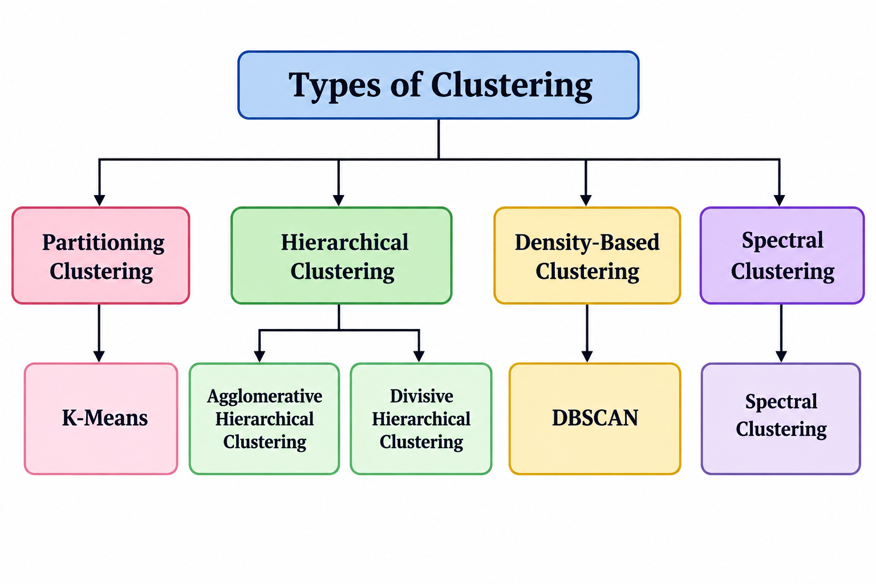
Types of clustering algorithms
Partitioning clustering: K- means
Hierarchical clustering: Agglomerative, Divisive
Density based clustering- DBSCAN
Spectral clustering: spectral clustering
S. Durga Devi , Dept of CSE, CBIT, Hyderabad
S. Dura Devi ,CSE,CBIT

Slide 22
Finding number of clusters
Challenge with clustering is how many clusters should we create from the given dataset or data points?
Number of clusters not known in advance.
Some algorithms requires to specify number of clusters in advance
How do you select best number of clusters?
Use following methods
1. Elbow method
2. Silhouette Method
S. Durga Devi , Dept of CSE, CBIT, Hyderabad
S. Dura Devi ,CSE,CBIT

Slide 23
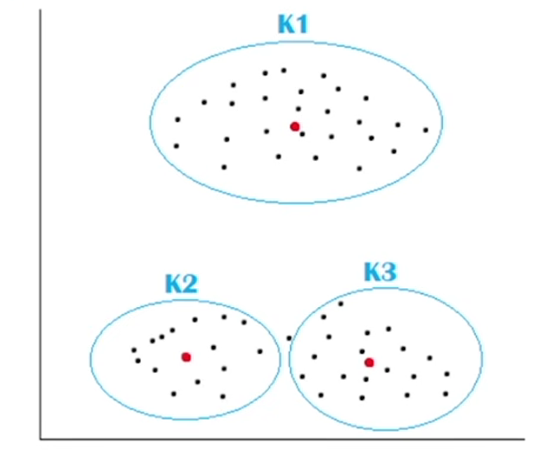
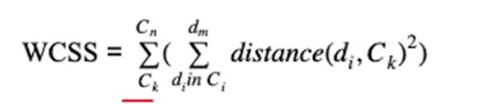
1. Elbow method
Elbow method is used to find the optimal no of clusters in K- means algorithm by analysing how performance of clustering changes with different values of k.
Working of Elbow method
Select range of k values say(1 to 10)
For each k cluster calculate WCSS(within cluster sum of squares) means how each data point close to its centroid in a cluster.
Where c is the cluster centroid and d_{i} is data point in each cluster.
for each cluster c_{k} – calculate the distance from centroid to each data point and square it and sum of all.
3. Plot the values of WCSS according to number of clusters.
4. Identify the point where the curve flatten significantly . That point is the optimal number of clusters.
S. Durga Devi , Dept of CSE, CBIT, Hyderabad
S. Dura Devi ,CSE,CBIT

Slide 24
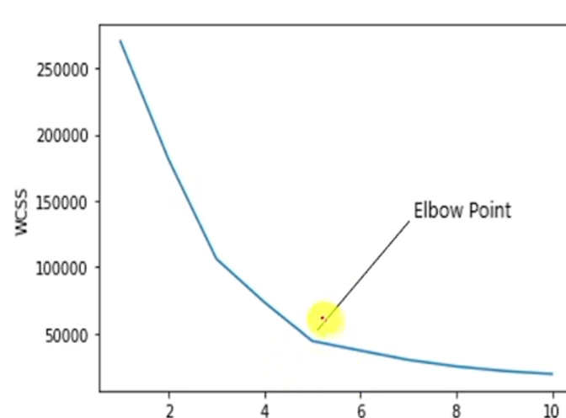
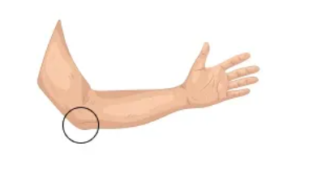
Optimal number of clusters are 5.
S. Durga Devi , Dept of CSE, CBIT, Hyderabad
S. Dura Devi ,CSE,CBIT

Slide 25
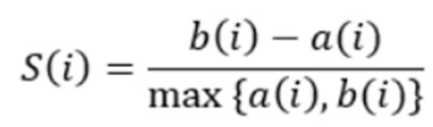
The silhouette method
Silhouette method used to find optimal number of cluster for an algorithm.
Calculate silhouette coefficient of silhouette score which measures how similar a data point is within cluster ( cohesion) compared to other cluster.
Where
S(i) is the silhouette coefficient of the data point i.
• a(i) is the average distance between i and all the other data points in the cluster to which i belongs.
• b(i) is the average distance from i to all clusters to which i does not belong.
Plot the values of silhouette scores
Silhouette coefficient ranges from -1 to 1.
S. Durga Devi , Dept of CSE, CBIT, Hyderabad
S. Dura Devi ,CSE,CBIT

Slide 26
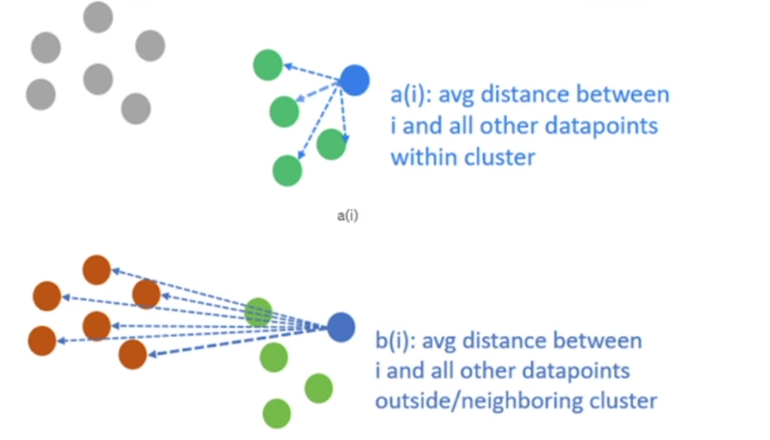
Understanding of a_{i} and b_{i}
S. Durga Devi , Dept of CSE, CBIT, Hyderabad
S. Dura Devi ,CSE,CBIT

Slide 27
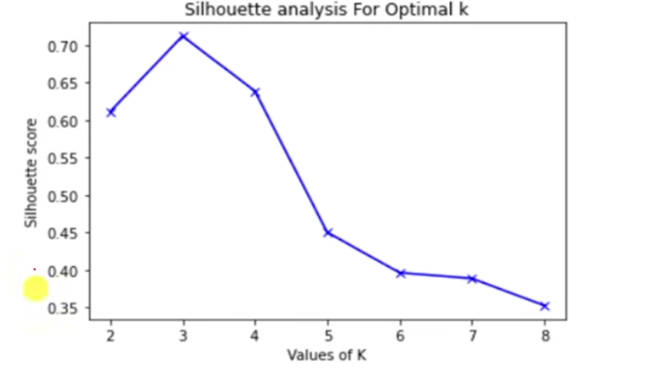
Plot between k and silhouette score
Optimal number of cluster in the above diagram- 3 where silhouette
show high value.
S. Durga Devi , Dept of CSE, CBIT, Hyderabad
S. Dura Devi ,CSE,CBIT

Slide 28
references
Case studies from textbook-1
Page nos 321
https://github.com/PacktPublishing/Python-Data-Analysis-Third-Edition/tree/master/Chapter11
https://data-flair.training/blogs/clustering-in-machine-learning/
https://techvidvan.com/machine-learning-courses/?campaign=btah&ref=1
https://data-flair.training/blogs/types-of-machine-learning-algorithms/
https://data-flair.training/blogs/r-data-science-project-customer-segmentation/ - case study
https://data-flair.training/blogs/data-science-r-movie-recommendation-system/ - case study
S. Durga Devi , Dept of CSE, CBIT, Hyderabad
S. Dura Devi ,CSE,CBIT

