Slide 1

BE-CSE-V SEM
SOFTWARE ENGINEERING
(22CSC21N )
Presented by : D.MEENAKSHI (Assistant Professor)
DEPARTMENT OF COMPUTER SCIENCE AND ENGINEERING

Slide 2
What is Agile Software Development?
Agile: Easily moved, light, nimble, active software processes
How agility achieved?
  Fitting the process to the project
  Avoidance of things that waste time

Slide 3
Agile Model
To overcome the shortcomings of the waterfall model of development.
  Proposed in mid-1990s
The agile model was primarily designed:
  To help projects to adapt to change requests
In the agile model:
  The requirements are decomposed into many small incremental parts
that can be developed over one to four weeks each.

Slide 4
*An Agile Development-Agility
The Manifesto for
Agile Software Development
“We are uncovering better ways of developing software by doing it and helping others do it. Through this work we have come to value:
  Individuals and interactions over processes and tools
  Working software over comprehensive documentation
  Customer collaboration over contract negotiation
  Responding to change over following a plan
That is, while there is value in the items on the right, we value the items on the left more.”
Kent Beck et al

Slide 5
What is “Agility”?
Effective (rapid and adaptive) response to change (team members, new technology, requirements)
Effective communication in structure and attitudes among all team members, technological and business people, software engineers and managers.
Drawing the customer into the team. Eliminate “us and them” attitude. Planning in an uncertain world has its limits and plan must be flexible.
Organizing a team so that it is in control of the work performed.
Eliminate all but the most essential work products and keep them lean.
Emphasize an incremental delivery strategy as opposed to intermediate products that gets working software to the customer as rapidly as feasible.

Slide 6
What is “Agility”?
Yielding …
Rapid, incremental delivery of software
The development guidelines stresses on delivery over analysis and design although these activates are not discouraged, and active and continuous communication between developers and customers.

Slide 7
Why and What Steps are“Agility” important?
Why? The modern business environment is fast-paced and ever-changing. It represents a reasonable alternative to conventional software engineering for certain classes of software projects. It has been demonstrated to deliver successful systems quickly.
What? May be termed as “software engineering lite” The basic activities- communication, planning, modeling, construction and deployment remain. But they morph into a minimal task set that push the team toward construction and delivery sooner.
The only really important work product is an operational “software increment” that is delivered.

Slide 8
-Agility and the Cost of Change
Conventional wisdom is that the cost of change increases nonlinearly as a project progresses. It is relatively easy to accommodate a change when a team is gathering requirements early in a project. If there are any changes, the costs of doing this work are minimal. But if the middle of validation testing, a stakeholder is requesting a major functional change. Then the change requires a modification to the architectural design, construction of new components, changes to other existing components, new testing and so on. Costs escalate quickly.
A well-designed agile process may “flatten” the cost of change curve by coupling incremental delivery with agile practices such as continuous unit testing and pair programming. Thus team can accommodate changes late in the software project without dramatic cost and time impact.

Slide 9
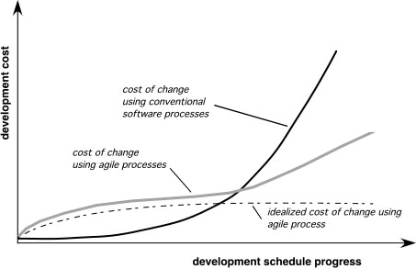
Agility and the Cost of Change

Slide 10
*An Agile Process
Is driven by customer descriptions of what is required (scenarios). Some assumptions:
  Recognizes that plans are short-lived (some requirements will persist, some will change. Customer priorities will change)
  Develops software iteratively with a heavy emphasis on construction activities (design and construction are interleaved, hard to say how much design is necessary before construction. Design models are proven as they are created. )
  Analysis, design, construction and testing are not predictable.
Thus has to Adapt as changes occur due to unpredictability
Delivers multiple ‘software increments’, deliver an operational prototype or portion of an OS to collect customer feedback for adaption.

Slide 11
-Agility Principles - I
1. Our highest priority is to satisfy the customer through early and continuous delivery of valuable software.
2. Welcome changing requirements, even late in development. Agile processes harness change for the customer's competitive advantage.
3. Deliver working software frequently, from a couple of weeks to a couple of months, with a preference to the shorter timescale.
4. Business people and developers must work together daily throughout the project.
5. Build projects around motivated individuals. Give them the environment and support they need, and trust them to get the job done.
6. The most efficient and effective method of conveying information to and within a development team is face–to–face conversation.

Slide 12
Agility Principles - II
7. Working software is the primary measure of progress.
8. Agile processes promote sustainable development. The sponsors, developers, and users should be able to maintain a constant pace indefinitely.
9. Continuous attention to technical excellence and good design enhances agility.
10. Simplicity – the art of maximizing the amount of work not done – is essential.
11. The best architectures, requirements, and designs emerge from self–organizing teams.
12. At regular intervals, the team reflects on how to become more effective, then tunes and adjusts its behavior accordingly.

Slide 13
-Human Factors
The agile process molds to the needs of the people and team, not the other way around
Key traits must exist among the people on an agile team and the team itself:
  Competence. ( talent, skills, knowledge)
  Common focus. ( deliver a working software increment )
  Collaboration. ( peers and stakeholders)
  Decision-making ability. ( freedom to control its own destiny)
  Fuzzy problem-solving ability. (ambiguity and constant changes, today’s problem may not be tomorrow’s problem)
  Mutual trust and respect.
  Self-organization. ( themselves for the work done, process for its local environment, the work schedule)
Notes:
The problem you solve today may not be needed tomorrow. This is kept in mind.

Slide 14
Agile Methodologies
XP
Scrum
Unified process
Crystal
DSDM
Lean

Slide 15
Agile Model: Principal Techniques
User stories:
– Simpler than use cases.( Format: As a <user>, I want <feature> so that <benefit>).
Metaphors:
  Based on user stories, developers propose a common vision of what is required. (Developers and customers use a familiar real-world example to describe the software.)
Spike:
  Simple program to explore potential solutions. (If developers are unsure how to implement a feature, they first build a small prototype to learn or experiment)
Refactor:
– Restructure code without affecting behavior, improve efficiency, structure, etc.

Slide 16
At a time, only one increment is planned, developed, deployed at the customer site.
– No long-term plans are made.
An iteration may not add significant functionality,
  But still a new release is invariably made at the end of each iteration
  Delivered to the customer for regular use.
7

Slide 17
Methodology
Face-to-face communication favoured over written documents.
To facilitate face-to-face communication,
  Development team to share a single office space.
  Team size is deliberately kept small (5-9 people)
  This makes the agile model most suited to the development of small projects.

Slide 18
Face-to-face at whiteboard
Effectiveness of Communication Modes
Face-to-face conversation
Communication Effectiveness
Video conversation
Phone conversation
Modeling Options
Videotape Email
conversation
Audiotape
Documentation Options
Paper
Cold
Richness of Communication Channel
Copyright 2002-2005 Scott W. Ambler Original Diagram Copyright 2002 Alistair Cockburn
Hot

Slide 19
Agile Model: Principles
The primary measure of progress:
  Incremental release of working software
Important principles behind agile model:
  Frequent delivery of versions --- once every few weeks.
  Requirements change requests are easily accommodated.
  Close cooperation between customers and developers.
  Face-to-face communication among team members.
10

Slide 20
Agile Documentation
Travel light:
– You need far less documentation than you think.
Agile documents:
  Are concise
  Describe information that is less likely to change
  Describe “good things to know”
  Are sufficiently accurate, consistent, and detailed
Valid reasons to document:
  Project stakeholders require it
  To define a contract model
  To support communication with an external group
  To think something through
11

Slide 21
Agile Software Requirements Management
High Priority
Each iteration implement the highest- priority requirements
{
Each new requirement is prioritized and added to the stack
Requirements may be reprioritized at any time
Requirements may be removed at any time
Low Priority
Requirements
Copyright 2004 Scott W. Ambler

Slide 22
Adoption Detractors(factors or challenges that make it difficult for an organization to adopt Agile methodology).
Sketchy definitions, make it possible to have
  Inconsistent and diverse definitions
High quality people skills required
Short iterations inhibit long-term perspective
Higher risks due to feature creep(adding new features):
  Harder to manage feature creep and customer expectations
  Difficult to quantify cost, time, quality.

Slide 23
Agile Model Shortcomings
Derives agility through developing tacit knowledge within the team, rather than any formal document:
  Can be misinterpreted…
  External review difficult to get…
  When project is complete, and team disperses, maintenance becomes difficult…

Slide 24
Agile Model versus Iterative Waterfall Model
The waterfall model steps through in a planned sequence:
  Requirements-capture, analysis, design, coding, and testing .
Progress is measured in terms of delivered artefacts:
  Requirement specifications, design documents, test plans, code reviews, etc.
In contrast agile model sequences:
  Delivery of working versions of a product in several increments.

Slide 25
Agile Model versus Iterative Waterfall Model
As regards to similarity:
– We can say that Agile teams use the waterfall model on a small scale.

Slide 26
Extreme Programming (XP)
7/18/2020

Slide 27
*Agile process models:Extreme Programming (XP)
The most widely used agile process, originally proposed by Kent Beck in 2004.
It uses an object-oriented approach.
Planning
Design
Coding
Test

Slide 28
Extreme Programming Model
Extreme programming (XP) was proposed by Kent Beck in 1999.
The methodology got its name from the fact that:
  Recommends taking the best practices to extreme levels.
  If something is good, why not do it all the time.

Slide 29
If code review is good:
– Always review --- pair programming
If testing is good:
Taking Good Practices to Extreme
– Continually write and execute test cases --- test-driven development
If incremental development is good:
  Come up with new increments every few days
If simplicity is good:
  Create the simplest design that will support only the currently required functionality.

Slide 30
Taking to Extreme
If design is good,
– everybody will design daily (refactoring)
If architecture is important,
  everybody will work at defining and refining the architecture (metaphor)
  If integration testing (Integration Testing is a software testing technique in which two or more individual modules are combined and tested together to verify that they interact and exchange data correctly.
It is performed after Unit Testing and before System Testing). is important,
  build and integrate test several times a day (continuous integration)

Slide 31
4 Values
Communication:
– Enhance communication among team members and with the
customers.
Simplicity:
  Build something simple that will work today rather than something that
takes time and yet never used
  May not pay attention for tomorrow
Feedback:
  System staying out of users is trouble waiting to happen
Courage:
  Don’t hesitate to discard code

Slide 32
Best Practices
Coding:
without code it is not possible to have a working system.
Utmost attention needs to be placed on coding.
Testing:
  Testing is the primary means for developing a fault-free product.
Listening:
  Careful listening to the customers is essential to develop a good quality product.

Slide 33
-XP process
XP Planning
  Begins with the listening, leads to creation of “user stories” that describes required output, features, and functionality. Customer assigns a value (i.e., a priority) to each story.
  Agile team assesses each story and assigns a cost (development weeks. If more than 3 weeks, customer asked to split into smaller stories)
  Working together, stories are grouped for a deliverable increment next release.
  A commitment (stories to be included, delivery date and other project matters) is made. Three ways:
    1. Either all stories will be implemented in a few weeks, 2. high priority stories first, or 3. the riskiest stories will be implemented first.
  After the first increment “project velocity”, namely number of stories implemented during the first release is used to help define subsequent delivery dates for other increments. Customers can add stories, delete existing stories, change values of an existing story, split stories as development work proceeds.

Slide 34
XP Design
Occurs both before and after coding as refactoring is encouraged
  Follows the KIS principle (keep it simple) Nothing more nothing less than the story.
  Encourage the use of CRC (class-responsibility-collaborator) cards in an object-oriented context. The only design work product of XP. They identify and organize the classes that are relevant to the current software increment.
  For difficult design problems, suggests the creation of “spike solutions”—a design prototype for that portion is implemented and evaluated.
  Encourages “refactoring”—an iterative refinement of the internal program design. Does not alter the external behavior yet improve the internal structure. Minimize chances of bugs. More efficient, easy to read.

Slide 35
XP Coding and Testing
XP Coding
  Recommends the construction of a unit test for a story before coding commences. So implementer can focus on what must be implemented to pass the test.
  Encourages “pair programming”. Two people work together at one workstation. Real time problem solving, real time review for quality assurance. Take slightly different roles.
XP Testing
  All unit tests are executed daily and ideally should be automated. Regression tests are conducted to test current and previous components.
  “Acceptance tests” are defined by the customer and executed to assess customer visible functionality
Notes:
Regression tests are to test new changes to the code.

Slide 36
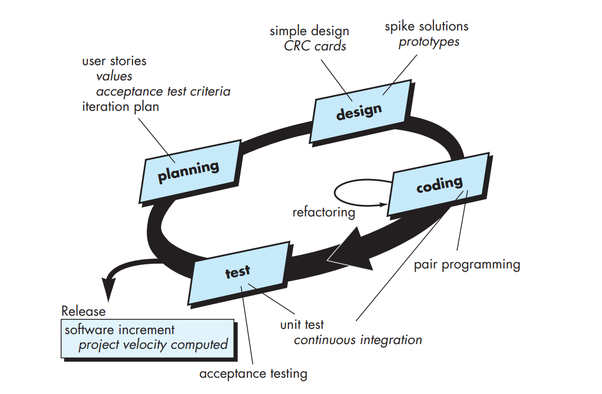
Extreme Programming (XP)

Slide 37
A CRC model is really a collection of standard index cards that represent classes. The cards are divided into three sections. Along the top of the card you write the name of the class. In the body of the card you list the class responsibilities on the left and the collaborators on the right.

Slide 38
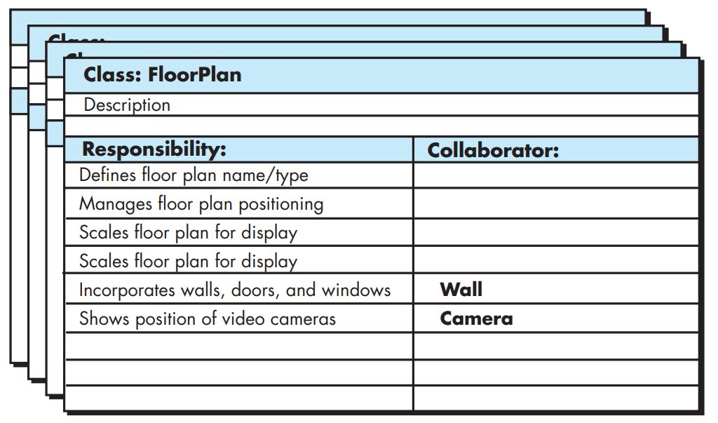
A CRC(class-responsibility-collaborator) model index card

Slide 39
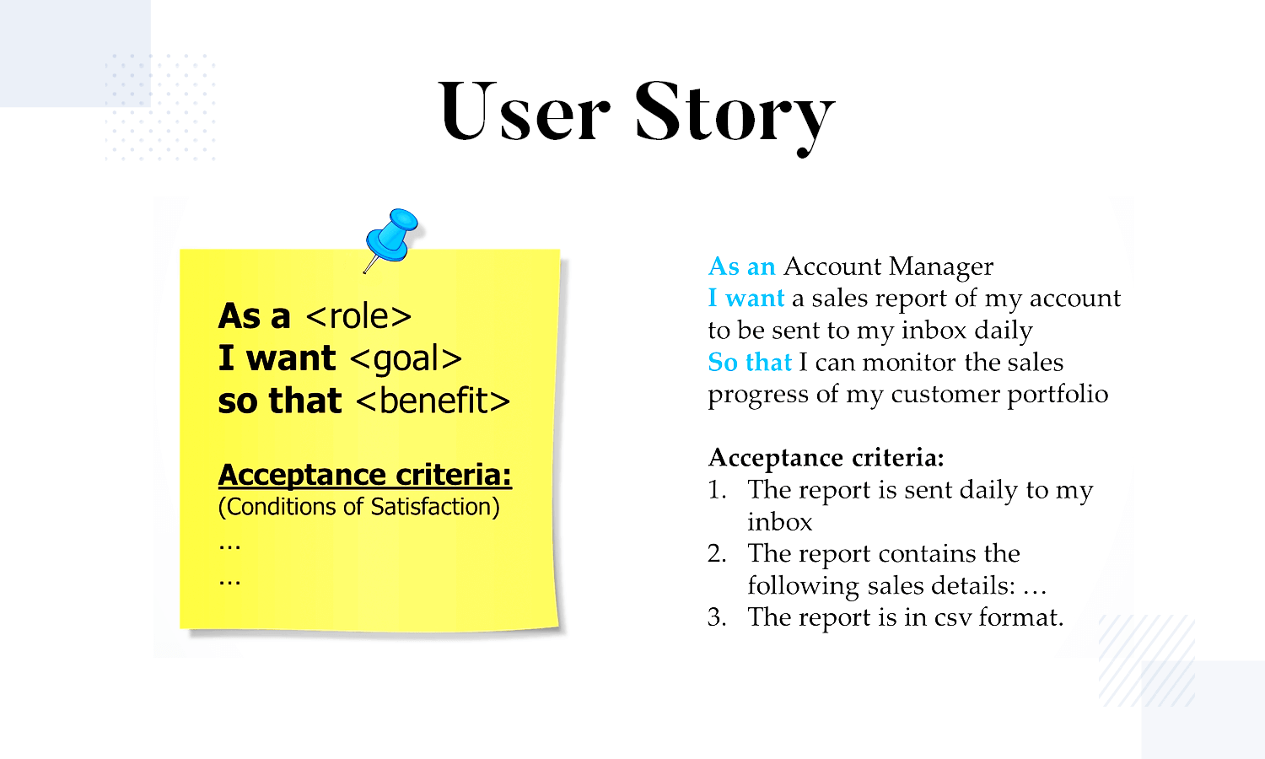

Slide 40
The XP Debate
Requirements volatility: Customer is an active member of XP team, changes to requirements are requested informally and frequently.
Conflicting customer needs: Different customers' needs need to be assimilated. Different vision or beyond their authority.
Requirements are expressed informally: Use stories and acceptance tests are the only explicit manifestation of requirements. Formal models may avoid inconsistencies and errors before the system is built. Proponents said changing nature makes such models obsolete as soon as they are developed.
Lack of formal design: XP deemphasizes the need for architectural design. Complex systems need overall structure to exhibit quality and maintainability. Proponents said incremental nature limits complexity as simplicity is a core value.

Slide 41
Full List of XP Practices
Planning – determine scope of the next release by combining business priorities and
technical estimates
Small releases – put a simple system into production, then release new versions in very
short cycles
Metaphor – all development is guided by a simple shared story of how the whole
system works
Simple design – system is to be designed as simple as possible
Testing – programmers continuously write and execute unit tests

Slide 42
Full List of XP Practices
Refactoring – programmers continuously restructure the system without changing its behavior to remove duplication and simplify
Pair-programming -- all production code is written with two programmers at one machine
Collective ownership – anyone can change any code anywhere in the system at any time.
Continuous integration – integrate and build the system many times a day – every time a task is completed.

Slide 43
Full List of XP Practices
40-hour week – work no more than 40 hours a week as a rule
On-site customer – a user is a part of the team and available full- time to answer questions
Coding standards – programmers write all code in accordance with rules emphasizing communication through the code

Slide 44
Emphasizes Test-Driven Development (TDD)
Based on user story develop test cases
Implement a quick and dirty feature every couple of days:
  Get customer feedback
  Alter if necessary
  Refactor
Take up next feature

Slide 45
Project Characteristics that Suggest Suitability of Extreme Programming
Projects involving new technology or research projects.
  In this case, the requirements change rapidly and unforeseen technical problems need to be resolved.
Small projects:
  These are easily developed using extreme programming.

Slide 46
Suggest Suitable Life Cycle Model
A software for an academic institution to automate its:
  Course registration and grading
  Fee collection
  Staff salary
  Purchase and store inventory
The software would be developed by tailoring a similar software that was developed for another educational institution:
  70% reuse
  10% new code and 20% modification

Slide 47
Other Agile Process Models
Adaptive Software Development(ASD)
Scrum
Dynamic Systems Development Method(DSDM)
Feature Driven Development(FDD)
Agile Modeling
and more…

Slide 48
*Adaptive Software Development (ASD)
Originally proposed by Jim Highsmith (2000) focusing on human collaboration and team self-organization as a technique to build complex software and system.
ASD — distinguishing features
  Mission-driven planning
  Component-based focus
  Uses “time-boxing” (timeline for each component with cost)
  Explicit consideration of risks
  Emphasizes collaboration for requirements gathering
  Emphasizes “learning” throughout the process

Slide 49
Three Phases of ASD
1. Speculation: project is initiated and adaptive cycle planning is conducted. Adaptive cycle planning uses project initiation information- the customer’s mission statement, project constraints (e.g. delivery date), and basic requirements to define the set of release cycles (increments) that will be required for the project. Based on the information obtained at the completion of the first cycle, the plan is reviewed and adjusted so that planned work better fits the reality.

Slide 50
Three Phases of ASD
2. Collaborations are used to multiply their talent and creative output beyond absolute number (1+1>2). It encompasses communication and teamwork, but it also emphasizes individualism, because individual creativity plays an important role in collaborative thinking.
  It is a matter of trust. 1) criticize without animosity, 2) assist without resentments, 3) work as hard as or harder than they do. 4) have the skill set to contribute to the work at hand, 5) communicate problems or concerns in a way that leads to effective action.
3. Learning: As members of ASD team begin to develop the components, the emphasis is on “learning”. Highsmith argues that software developers often overestimate their own understanding of the technology, the process, and the project and that learning will help them to improve their level of real understanding. Three ways: focus groups, technical reviews and project postmortems.

Slide 51
Adaptive Software Development

Slide 52
*Dynamic Systems Development Method(DSDM)
It is an agile software development approach that provides a framework for building and maintaining systems which meet tight time constraints through the use of incremental prototyping in a controlled project environment.
Promoted by the DSDM Consortium (www.dsdm.org)
DSDM—distinguishing features
  Similar in most respects to XP and/or ASD

Slide 53
Dynamic System Development Method is approach to system development which as the name suggests develops the system dynamically.
It an associate degree agile code development approach that provides a framework for building and maintaining systems.
An iterative & incremental approach that emphasizes continuous user/customer involvement.
Goal-to deliver projects on time & on budget while adjusting for changing requirements along the way.

Slide 54
DSDM is a methodology that prioritizes schedule and quality over functionality.
Its Straight forward framework.
Simple & Extendible

Slide 55
Principles of DSDM
Nine guiding principles
  Active user involvement is imperative.
  DSDM teams must be empowered to make decisions.
  The focus is on frequent delivery of products.
  Fitness for business purpose is the essential criterion for acceptance of deliverables.
  Iterative and incremental development is necessary to converge on an accurate business solution.
  All changes during development are reversible.
  Requirements are baselined at a high level
  Testing is integrated throughout the life-cycle.

Slide 56
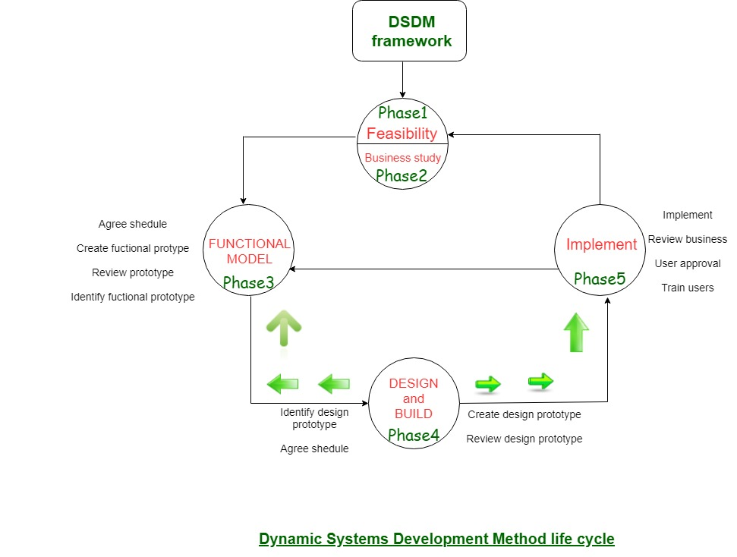

Slide 57
DSDM life cycle:
Feasibility Study:
It establishes the essential business necessities and constraints related to the applying to be designed then assesses whether or not the application could be a viable candidate for the DSDM method.
Business Study:
It establishes the use and knowledge necessities that may permit the applying to supply business value; additionally, it is the essential application design and identifies the maintainability necessities for the applying.

Slide 58
Functional Model Iteration:
It produces a collection of progressive prototypes that demonstrate practicality for the client.
(Note: All DSDM prototypes are supposed to evolve into the deliverable application.) The intent throughout this unvarying cycle is to collect further necessities by eliciting feedback from users as they exercise the paradigm.

Slide 59
Design and Build Iteration:
It revisits prototypes designed throughout useful model iteration to make sure that everyone has been designed during a manner that may alter it to supply operational business price for finish users. In some cases, useful model iteration and style and build iteration occur at the same time.

Slide 60
Implementation:
It places the newest code increment (an “operationalized” prototype) into the operational surroundings. It ought to be noted that:
  (a) the increment might not 100% complete or,
  (b) changes are also requested because the increment is placed into place. In either case, DSDM development work continues by returning to the useful model iteration activity.

Slide 61
Advantages
Users are highly involved in the development.
Basic functionality is delivered within very short time.
Provides easy access for Developers to end-users.
Projects are delivered on time within a specific budget.

Slide 62
Disadvantages
Sometimes its Costly
May not suitable for small Organizations.
Not suitable for one time projects
Users and Developers both need to be trained.

Slide 63
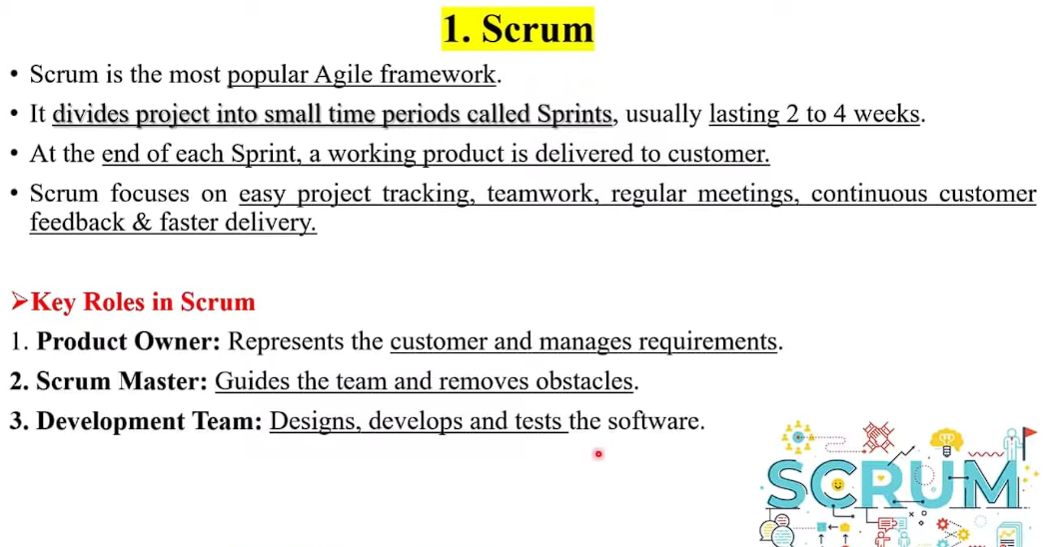

Slide 64
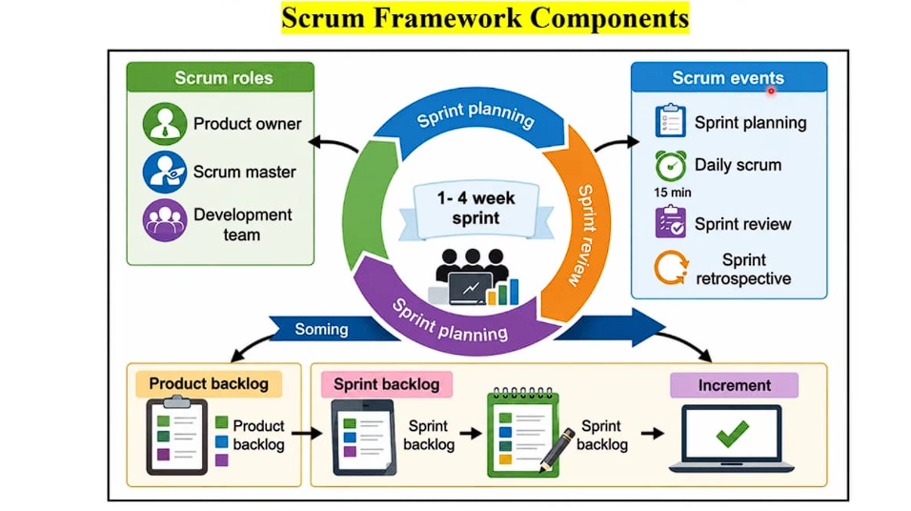

Slide 65
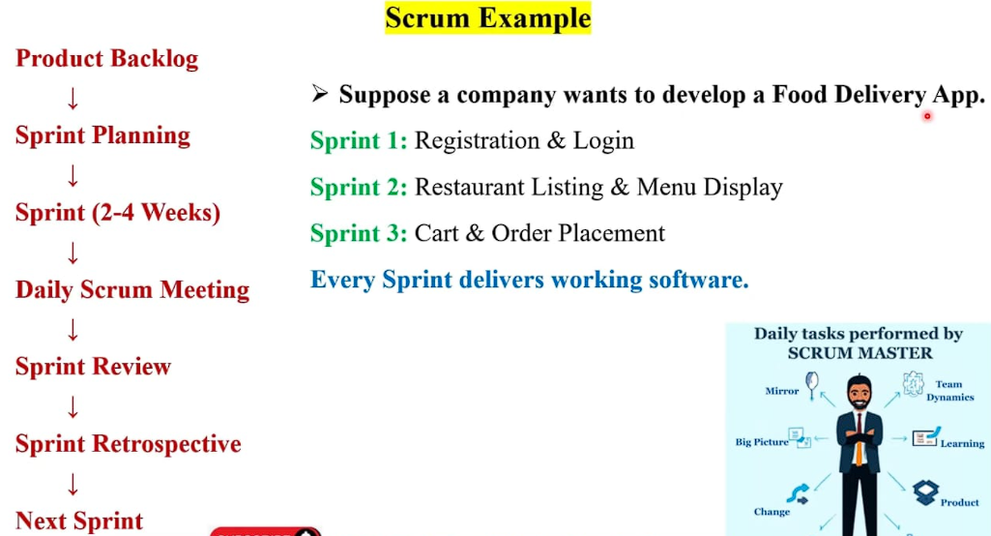

Slide 66
*Scrum
A software development method Originally proposed by Schwaber and Beedle (an activity occurs during a rugby match) in early 1990.
Scrum—distinguishing features
  Development work is partitioned into “packets”
  Testing and documentation are on-going as the product is constructed
  Work units occurs in “sprints” and is derived from a “backlog” of existing changing prioritized requirements
  Changes are not introduced in sprints (short term but stable) but in backlog.
  Meetings are very short (15 minutes daily) and sometimes conducted without chairs ( what did you do since last meeting? What obstacles are you encountering? What do you plan to accomplish by next meeting?)
  “demos” are delivered to the customer with the time-box allocated. May not contain all functionalities. So customers can evaluate and give feedbacks.
Notes:
Backlog is a list of requirements and features
Sprint tackles one of them from the backlog within a time-box unit

Slide 67
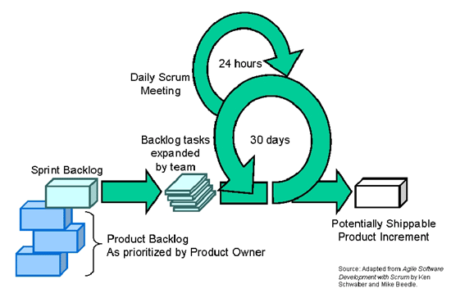
Scrum

Slide 68
Scrum

Slide 69
Scrum: Characteristics
One of the agile processes
Self-organizing teams
Product development progresses in a series of month-long
sprints
Requirements are listed in a product backlog

Slide 70
Daily
Scrum
Sprint
planning
Sprint
review
Scrum
Sprint
backlog
Product backlog
Product
increment

Slide 71
Sprint
Scrum projects progress in a series of “sprints”
  Analogous to XP iterations or time boxes
  Target duration is one month
Software increment is designed, coded, and tested during a sprint
No changes entertained during a sprint

Slide 72
Sprint
Fundamental process flow of Scrum
A month-long iteration, during which an incremental product functionality completed
NO outside influence can interfere with the Scrum team during the Sprint
Each day begins with the Daily Scrum Meeting

Slide 73
Scrum Framework
Roles : Product Owner, ScrumMaster, Team
Ceremonies : Sprint Planning, Sprint Review, Sprint Retrospective, and Daily Scrum Meeting
Artifacts : Product Backlog, Sprint Backlog, and Burndown Chart

Slide 74
Key Roles and Responsibilities in Scrum Process
Product Owner
  Acts on behalf of customers to represent their interests.
Development Team
  Team of five to nine people with cross-functional skill sets.
Scrum Master (aka Project Manager)
  Facilitates scrum process and resolves impediments and acts as a buffer between the team and outside interference.

Slide 75
Product Owner
Defines the features of the product
Decides on release date and content
Prioritizes new features
Adjusts features and priority every iteration, as needed
Accepts or rejects work results.

Slide 76
The Scrum Master
Represents management
Removes impediments(obstacles)
Ensures that the team is fully functional and productive
Shield the team from external interferences

Slide 77
Scrum Team
Typically 5-10 people
Cross-functional
– QA, Programmers, UI Designers, etc.
Teams are self-organizing
Membership can change only between sprints

Slide 78
Ceremonies
Sprint Planning Meeting
Daily Scrum
Sprint Review Meeting

Slide 79
Sprint Planning
Goal is to produce Sprint Backlog
Product owner works with the Team to negotiate what
Backlog Items the Team will work on in order to meet
Release Goals
Scrum Master ensures Team agrees to realistic goals

Slide 80
Daily Scrum
Daily
15-minutes
Stand-up meeting
Not for problem solving
Three questions:
  What did you do yesterday
  What will you do today?
  What obstacles are in your way?

Slide 81
Daily Scrum
Is NOT a problem solving session
Is NOT a way to collect information about WHO is behind the schedule
Is a meeting in which team members make informal commitments to each other and to the Scrum Master
Is a good way for a Scrum Master to track the progress of the Team

Slide 82
Team presents what it accomplished during the sprint
Typically takes the form of a demo of new features
Informal
  2-hour prep time rule
Participants
  Customers
  Management
  Product Owner
  Other teammates
Sprint Review Meeting

Slide 83
Product Backlog
A list of all desired work on the project
  Usually a combination of
    story-based work (“allow user to search and replace”)
    task-based work (“improve exception handling”)
List is prioritized by the Product Owner.

Slide 84
Product Backlog
Requirements for a system, expressed as a prioritized list of Backlog Items
  Managed and owned by Product Owner
  Spreadsheet (typically)

Slide 85
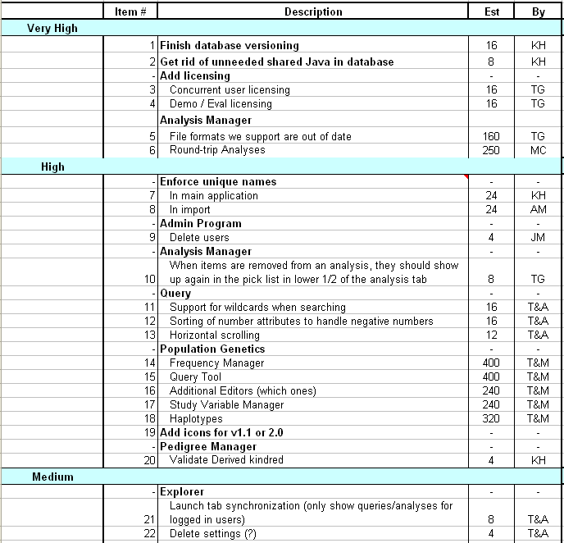
Sample
Product Backlog

Slide 86
Sprint Backlog
A subset of Product Backlog Items, which define the work for a Sprint
  Created by Team members
  Each Item has it’s own status
  Updated daily

Slide 87
Sprint Backlog during the Sprint
Changes occur:
  Team adds new tasks whenever they need to in order to meet the Sprint Goal
  Team can remove unnecessary tasks
  But: Sprint Backlog is only updated by the team
Estimates are updated whenever there’s new information

Slide 88
Burn down Charts
Are used to represent “work done”.
Are remarkably simple but effective Information disseminators
Three Types:
  Sprint Burn down Chart (progress of the Sprint)
  Release Burn down Chart (progress of release)
  Product Burn down chart (progress of the Product)

Slide 89
Sprint Burn down Chart
Depicts the total Sprint Backlog hours remaining per day
Shows the estimated amount of time to complete
Ideally should burn down to zero to the end of the Sprint
Usually is not a straight line

Slide 90
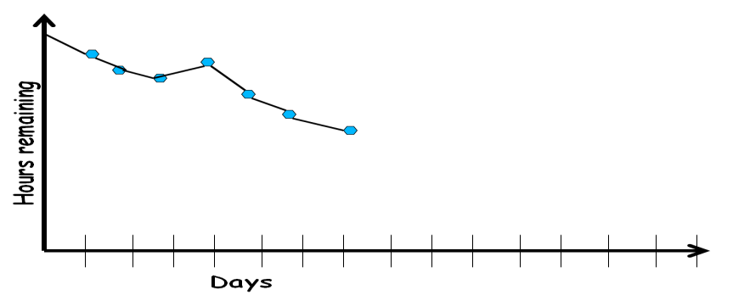
Sprint Burndown Chart

Slide 91
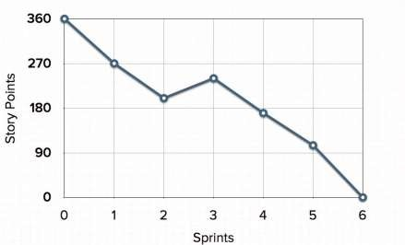
Release Burndown Chart
Will the next release be done on right time?
How many more sprints?
X-axis: sprints
Y-axis: amount of story points remaining

Slide 92
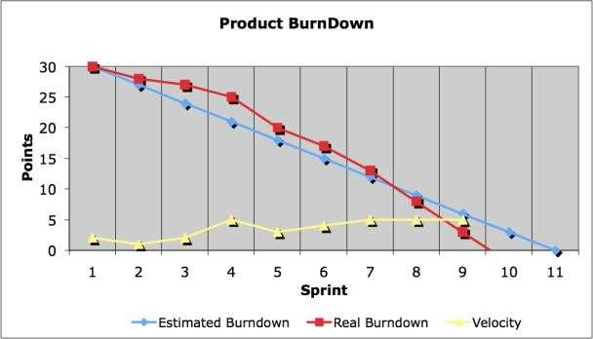
Product Burndown Chart
Is a “big picture” view of project’s progress (all the releases)

Slide 93
Scalability of Scrum
A typical Scrum team is 6-10 people
Jeff Sutherland proposed and experimented with up to over 800 people
"Scrum of Scrums" also called "Meta-Scrum“

Slide 94
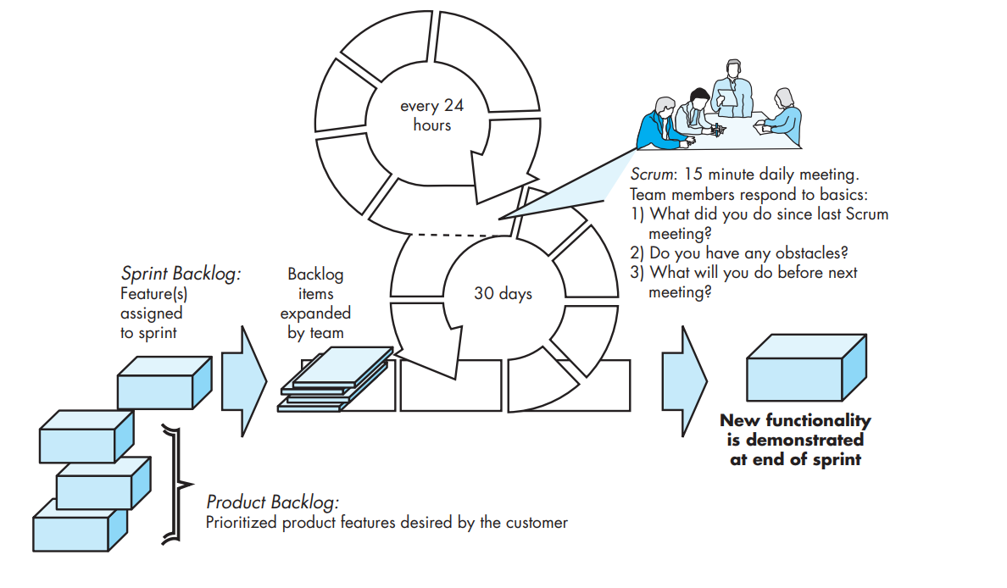

Slide 95
*Feature Driven Development
Originally proposed by Peter Coad et al. as an object-oriented software engineering process model.
FDD—distinguishing features
  Emphasis is on defining “features” which can be organized hierarchically.
    a feature “is a client-valued function that can be implemented in two weeks or less.”
  Uses a feature template
    <action> the <result> <by | for | of | to> a(n) <object>
    E.g. Add the product to shopping cart.
    Display the technical-specifications of the product.
    Store the shipping-information for the customer.
  A features list is created and “plan by feature” is conducted
  Design and construction merge in FDD

Slide 96
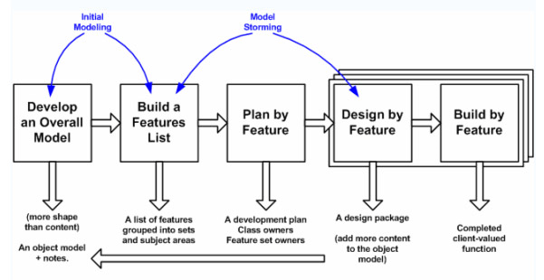
Feature Driven Development

Slide 97
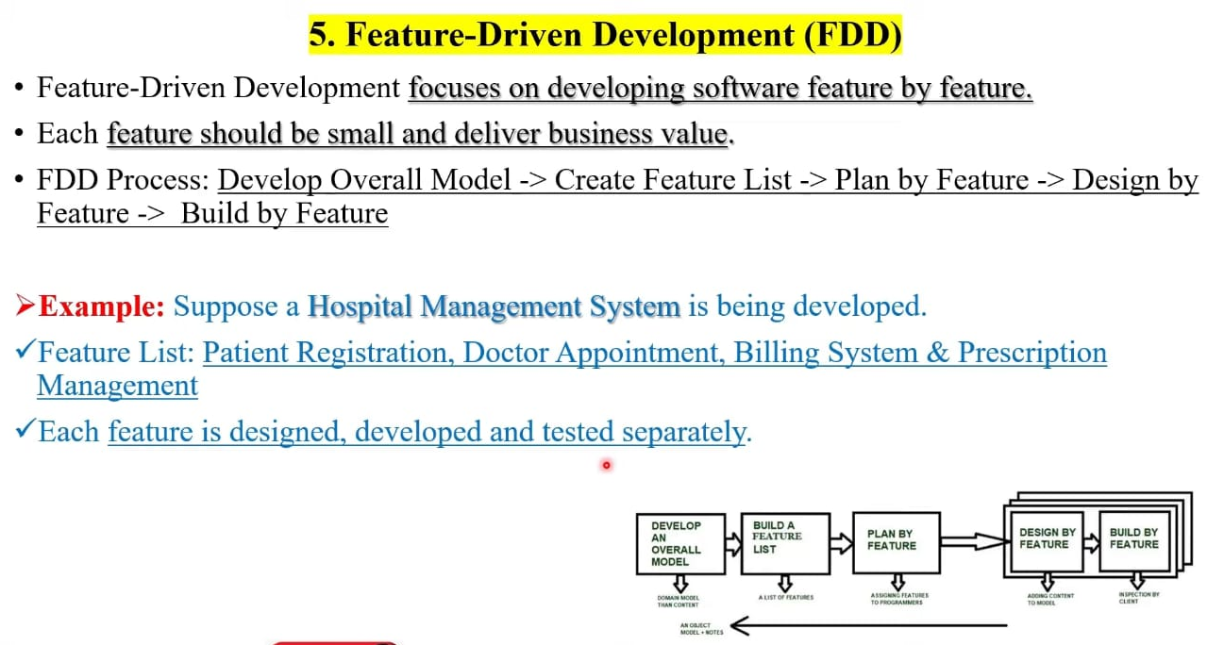

Slide 98
*Agile Modeling (AM) :
Agile Modeling (AM) is a lightweight software modeling methodology that uses simple, purpose-driven models to improve communication, understanding, and agility during software development. Agile Modeling (AM) is a practice-based methodology for effective modeling and documentation of software systems.
Developed by Scott Ambler.
Focuses on lightweight, effective, and practical models rather than perfect documentation.
Agile models are "just good enough" to serve their purpose.
-Need for Agile Modeling
Large and business-critical systems require modeling to:
  Improve understanding of requirements.
  Divide the problem among team members.
  Assess software quality during development.
Traditional modeling can become:
  Complex and difficult to manage.
  Highly formalized.
  Large in size.
  Difficult to maintain when changes occur.
-Agile Modeling Philosophy
Follows the values of the Agile Manifesto.
Encourages:
  Courage to change designs and refactor.
  Humility to accept ideas from customers, business experts, and stakeholders.
Emphasizes collaboration and simplicity.

Slide 99
-Core Principles of Agile Modeling
1. Model with a Purpose
Create a model only when there is a specific goal.
Examples:
  Communicating with customers.
  Understanding a system feature.
  Clarifying design decisions.
Purpose determines:
  Type of model.
  Level of detail required.
2. Use Multiple Models
Different models show different views of the system.
No single model can describe everything.
Use only models that add value.
Each model should address a specific aspect of the software.
3. Travel Light
Keep only models that provide long-term value.
Discard unnecessary documentation.
Less documentation means:
  Easier maintenance.
  Faster development.
  Greater agility.
Key idea: Build only what is needed—no more, no less.

Slide 100
4. Content Is More Important Than Representation
Information conveyed is more important than perfect notation.
A useful model with minor notation errors is better than a perfect model with little value.
Focus on communication and understanding.
5. Know the Models and Tools
Understand:
  Strengths of each modeling technique.
  Weaknesses of each modeling technique.
  Tools used to create models.
Choose the most suitable model for the situation.
6. Adapt Locally
Tailor the modeling approach to the team's needs.
No single process fits every project.
Flexibility is encouraged.
-Relationship with UML and UP
Many organizations use the Unified Modeling Language (UML) for analysis and design modeling.
The Unified Process (UP) provides a framework for applying UML.
Scott Ambler developed a simplified version of UP that integrates Agile Modeling principles.

Slide 101
REQUIREMENTS ENGINEERING (RE)
Definition
Requirements Engineering (RE) is the process of understanding, documenting, validating, and managing software requirements.
It helps software engineers understand:
  What the customer wants.
  What business impact the software will have.
  How end-users will interact with the software.
RE acts as a bridge between communication and software design.
Importance of Requirements Engineering
Developers often start coding before understanding requirements completely.
This may lead to:
  Wrong software being developed.
  Increased cost and effort.
  Project failure.
RE helps understand the problem before attempting to solve it.
It provides a strong foundation for design and construction.
RE as a Bridge to Design and Construction
RE begins during the communication activity and continues into modeling.
It allows the software team to:
  Understand the project context.
  Identify user needs.
  Determine project priorities.
  Analyze information, functions, and behavior required by the system.
RE ensures that design and implementation are based on correct requirements.

Slide 102
*REQUIREMENTS ENGINEERING TASKS
Requirements Engineering consists of seven major tasks:
Inception
Elicitation
Elaboration
Negotiation
Specification
Validation
Requirements Management
1. INCEPTION
Definition
Inception is the starting point of a software project.
It establishes a basic understanding of the problem and the required solution.
Context-Free Questions Asked During Inception
Questions about Stakeholders
Who requested this project?
Who will use the solution?
What economic benefits will be obtained?
Is there any existing solution available?
Questions about the Problem
What problems will the solution address?
What is considered good output?

Slide 103
What is considered good output?
In what business environment will the solution be used?
Are there any performance constraints?
Questions about Communication
Are you the correct person to answer these questions?
Are the answers official?
Can anyone provide additional information?
Should more questions be asked?
Objectives of Inception
Understand the problem.
Identify stakeholders.
Understand the desired solution.
Evaluate communication between customer and developer.
2. ELICITATION
Definition
Elicitation is the process of gathering requirements from customers, users, and stakeholders.
Objectives
Identify system goals.
Understand customer expectations.
Gather user requirements.
Problems in Elicitation
A. Scope Problems
System boundaries are not clearly defined.
Customers provide unnecessary technical details.

Slide 104
B. Understanding Problems
Customers are unsure about their needs.
Lack of domain knowledge.
Communication difficulties.
Ambiguous or conflicting requirements.
C. Volatility Problems
Requirements change over time.
Business needs evolve during development.
Solution
Requirements gathering should be performed in a structured and organized manner.
3. ELABORATION
Definition
Elaboration expands and refines the information gathered during inception and elicitation.
Objectives
Develop a detailed requirements model.
Refine software functions, features, and constraints.
Activities
Create user scenarios.
Identify system functions.
Analyze system behavior.
Define information requirements.
Outcome
Refined technical model of the software system.

Slide 105
4. NEGOTIATION
Definition
Negotiation resolves conflicts among stakeholder requirements.
Why Negotiation is Needed
Customers often request more features than resources allow.
Different stakeholders may have conflicting requirements.
Activities
Estimate development effort.
Assess project cost and schedule impact.
Prioritize requirements.
Eliminate unnecessary requirements.
Modify or combine conflicting requirements.
Outcome
Agreed and prioritized set of requirements.
5. SPECIFICATION
Definition
Specification is the documentation of software requirements.
Forms of Specification
Written documents.
Graphical models.
Mathematical models.
Usage scenarios.
Prototypes.

Slide 106
Purpose
Describe software functions and performance.
Define development constraints.
Provide a common understanding among stakeholders.
Software Requirements Specification (SRS)
Official document describing the system.
Defines what the software should do.
Describes system behavior and performance.
6. VALIDATION
Definition
Validation checks whether requirements are correct and complete.
Objectives
Ensure requirements are unambiguous.
Detect errors and omissions.
Remove inconsistencies.
Verify requirement quality.
Validation Checks
Requirements should be:
Correct
Complete
Consistent
Unambiguous
Realistic

Slide 107
Verifiable
Testable
Main Validation Technique
Technical Review
Participants
Software Engineers
Customers
End Users
Stakeholders
7. REQUIREMENTS MANAGEMENT
Definition
Requirements Management controls and tracks requirements throughout the project lifecycle.
Activities
Identify requirements.
Assign unique identifiers.
Track requirement changes.
Maintain traceability.
Control modifications.
Traceability Tables
Link requirements with:
  System components.
  Design elements.
  Testing activities.
  Environment constraints.
Benefits
Manages changing requirements.
Improves project control.
Ensures consistency throughout development.

Slide 108
*Establishing the Groundwork
Definition
Groundwork is the initial activity in Requirements Engineering.
It helps in understanding software requirements and starting the project successfully.
It establishes communication between stakeholders and software engineers.
1. Identifying Stakeholders
Stakeholder Definition
A stakeholder is anyone who benefits directly or indirectly from the system.
Examples
Business managers
Product managers
Marketing people
Customers
End users
Software engineers
Support and maintenance engineers
Importance
Different stakeholders have different needs and expectations.
At project inception, a list of stakeholders is prepared.
Each stakeholder may suggest additional stakeholders.

Slide 109
2. Recognizing Multiple Viewpoints
Concept
Different stakeholders view the system differently.
Examples
Marketing people focus on attractive features.
Business managers focus on cost and schedule.
End users focus on ease of use.
Software engineers focus on technical infrastructure.
Support engineers focus on maintainability.
Importance
Requirements from different stakeholders may conflict.
Requirements should be categorized and analyzed.
An internally consistent set of requirements should be selected.
3. Working Toward Collaboration
Concept
Stakeholders and software engineers must work together.
Responsibilities of Requirements Engineer
Identify common requirements.
Identify conflicting requirements.
Resolve conflicts through discussion.
Benefits
Better understanding of requirements.
Reduced misunderstandings.
Improved project success.
Note
Final decisions are often made by a project champion or business manager.

Slide 110
4. Asking the First Questions
Purpose
To understand the customer, project goals, and system requirements.
A. Questions about Stakeholders
Who requested this work?
Who will use the solution?
What is the economic benefit?
Is another solution available?
B. Questions about the Problem
What problems will the solution solve?
What is considered good output?
What is the business environment?
Are there performance constraints?
C. Meta Questions
Are you the right person to answer?
Are the answers official?
Am I asking relevant questions?
Can anyone provide additional information?
Importance
Helps break the ice.
Initiates effective communication.

Slide 111
5. Nonfunctional Requirements (NFRs)
Definition
Requirements that specify quality attributes and constraints of a system.
Examples
Performance
Security
Reliability
Usability
Maintainability
Testability
Importance
Software may not be useful without NFRs.
Often listed separately in SRS.
Two-Phase Approach
Establish software engineering guidelines.
Prioritize and select important NFRs
6. Traceability
Definition
Traceability refers to documented links between requirements and other software work products.
Traceability Matrix
Rows represent requirements.
Columns represent design elements, test cases, etc.
Indicates relationships between them.
Benefits
Ensures all requirements are considered.
Tracks requirement changes.
Supports development and testing activities.
Maintains continuity across project phases.

Slide 112
*Requirements Elicitation (Requirements Gathering)
Definition
Requirements elicitation is the process of gathering requirements from stakeholders.
It combines:
  Problem solving
  Elaboration
  Negotiation
  Specification
Stakeholders and software engineers work together to identify requirements.
1. Collaborative Requirements Gathering
Definition
A team-oriented approach where stakeholders and software engineers work together.
Guidelines
Meetings are conducted with stakeholders and software engineers.
Rules for participation are established.
An agenda is prepared.
A facilitator controls the meeting.
Worksheets, charts, forums, or bulletin boards are used for recording ideas.
Goals
Identify the problem.
Propose solutions.
Negotiate different approaches.
Develop preliminary requirements.

Slide 113
Process of Collaborative Gathering
Step 1: Product Request
A product request is prepared during inception.
It contains a brief description of the proposed system.
Step 2: Identify Objects
Participants identify objects related to the system.
Example (SafeHome):
Control panel
Smoke detector
Motion detector
Door sensor
Alarm
Display
Step 3: Identify Services
Participants identify services performed by the system.
Examples:
Configure system
Set alarm
Monitor sensors
Dial phone
Read display
Step 4: Identify Constraints
Examples:
Must be user-friendly ,Must work with standard phone line ,Must detect faulty sensors
Step 5: Identify Performance Criteria
Examples:
Detect event within 1 second ,Fast response time
Accurate detection
Step 6: Develop Consensus
Duplicate entries are removed.
New ideas are added.
Final list is agreed upon by all stakeholders.

Slide 114
Mini-Specifications
Definition
A brief description of an object or service.
Purpose
Provides additional details.
Helps clarify requirements.
Example
Control Panel:
Wall mounted device.
Wireless connectivity.
Keypad for input.
Display for feedback.
Issues List
Definition
A list of unresolved issues identified during discussions.
Purpose
Issues are recorded and addressed later.
Prevents important concerns from being forgotten.
Important Questions During Elicitation
Can the system be built?
Are enough resources available?
Will the system meet customer needs?
Can the product reach the market on time?
Will system performance be adequate?

Slide 115
2. Quality Function Deployment (QFD)
Definition
QFD is a technique that translates customer needs into technical requirements.
Objective
Maximize customer satisfaction.
Types of Requirements
1. Normal Requirements
Explicitly stated by customers.
Customer is satisfied if present.
2. Expected Requirements
Not explicitly stated.
Considered basic requirements.
Absence causes dissatisfaction.
3. Exciting Requirements
Unexpected features.
Exceed customer expectations.
Increase customer satisfaction.
Data Collection Techniques
Customer interviews
Surveys
Observation
Historical records
3. Usage Scenarios (Use Cases)
Definition
Describe how users interact with the system.
Purpose
Understand system functionality.
Understand user behavior.
Help in system design.
Benefits
Clarifies requirements.
Improves communication between users and developers.
4. Elicitation Work Products
The outputs of elicitation are:
Statement of need and feasibility.
Statement of project scope.
List of stakeholders.
Description of technical environment.
List of requirements.
Usage scenarios (Use Cases).
Prototypes (if developed).

Slide 116
5. Agile Requirements Elicitation
Definition
Requirements are captured using User Stories.
User Story
A simple requirement written from the user's perspective.
Advantages
Easy to write.
Easy to manage.
Encourages communication.
Limitation
May ignore business goals.
May overlook security and performance requirements.
6. Service-Oriented Methods
Definition
System is viewed as a collection of services.
Focus
Identify services provided by the application.
Characteristics
Understand customer needs.
Encourage creative thinking.
Develop quick solutions.
Use prototypes and user stories.
Requirement Rule
Every requirement should be traceable to a specific service.

Slide 117
*Negotiating Requirements
Definition
Negotiation is the process of resolving conflicts among stakeholder requirements.
It balances:
  Functionality
  Performance
  Cost
  Time-to-market
The goal is to develop a realistic project plan that satisfies stakeholders and the software team.
Why is Negotiation Needed?
Requirements gathered during inception, elicitation, and elaboration are often incomplete.
Different stakeholders may have conflicting requirements.
Resources such as:Time ,Budget ,Manpower are limited.
Therefore, negotiation becomes necessary.
Objectives of Negotiation
Resolve requirement conflicts.
Prioritize requirements.
Balance customer needs with project constraints.
Develop realistic schedules and budgets.
Achieve agreement among all stakeholders.

Slide 118
Win-Win Negotiation
Concept
The best negotiation aims for a Win-Win Outcome.
Stakeholders Win
Get a system that satisfies most of their needs.
Software Team Wins
Works within realistic budget and deadlines.
Result
Both customer and developer are satisfied.
Boehm's Negotiation Activities
1. Identify Stakeholders
Identify all key stakeholders involved in the project.
2. Determine Win Conditions
Understand what each stakeholder wants from the system.
These desired outcomes are called Win Conditions.
3. Negotiate Win Conditions
Resolve conflicts among stakeholder needs.
Convert individual win conditions into Win-Win Conditions acceptable to everyone.
Outcome
A mutually agreed set of requirements.

Slide 119
Handshaking
Definition
Handshaking is a two-way communication process between customers and the software team.
Process
Software Team
Proposes solutions.
Explains impact of requirements.
Communicates design intentions.
Customer Representatives
Review proposed solutions.
Identify missing features.
Seek clarification on requirements.
Benefits
Improves communication.
Helps identify requirement variations.
Increases customer acceptance.
Promotes Win-Win negotiation.
Advantages of Requirement Negotiation
Resolves requirement conflicts.
Improves stakeholder satisfaction.
Creates realistic project plans.
Reduces project risks.
Improves communication between customers and developers.
Leads to successful software development.

Slide 120
*Validating Requirements
Definition
Requirement Validation is the process of checking whether requirements are correct, complete, and satisfy stakeholder needs.
It ensures that the requirements model provides a strong foundation for design.
During Validation, Requirements are Checked For:
Inconsistency
Omissions (missing requirements)
Ambiguity (unclear requirements)
Requirement Validation Checklist
Is each requirement consistent with system objectives?
Is each requirement specified at the proper level of detail?
Is the requirement really necessary?
Is the requirement clear and unambiguous?
Is the source of the requirement identified?
Does the requirement conflict with any other requirement?
Is the requirement achievable in the given technical environment?
Is the requirement testable after implementation?
Does the model correctly represent system information, functions, and behavior?
Is the model properly partitioned into detailed sections?
Are requirement patterns properly validated and consistent with customer needs?
Outcome of Validation
Accurate requirements model.
Requirements match stakeholder needs.
Errors and conflicts are removed.
Provides a solid foundation for system design.

Slide 121
Software Requirements Specification Document (SRS)

Slide 122
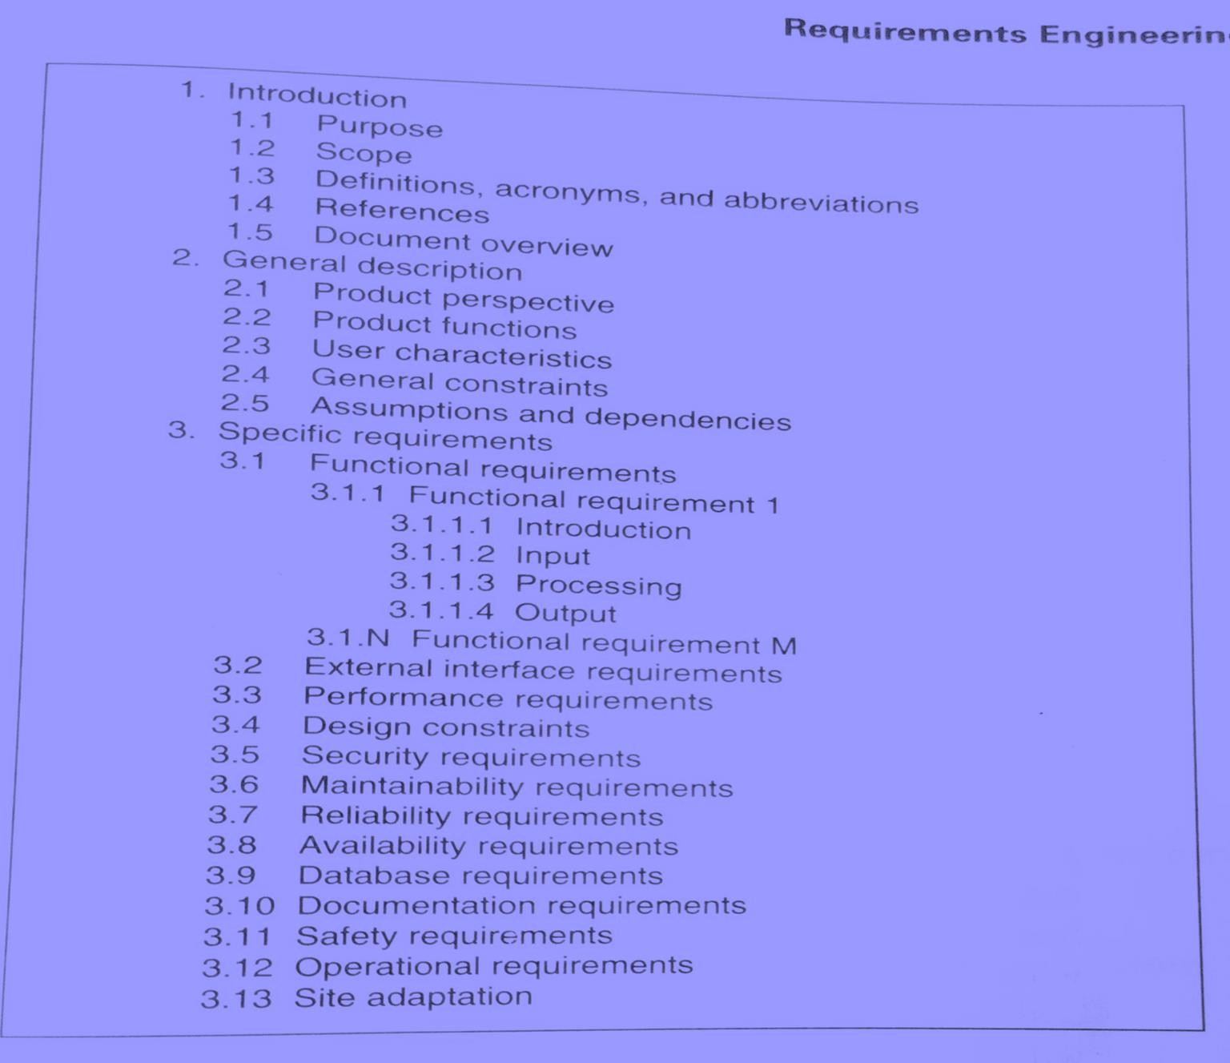
Systems Requirements Specification
SRS is the official statement of what the system developers should implement.
SRS is a complete description of the behavior of the system to be developed.
SRS should include both a definition of user requirements and a specification of the system requirements.
The SRS fully describes what the software will do and how it will be expected to perform.
Table of Contents:
Introduction
General Description
Functional Requirements
Non Functional Requirements

Slide 123
INTRODUCTION
  Purpose
    Describe the purpose of the SRS, not the purpose of the software being developed.
    Intended audience for SRS.
  Scope
    Describe application of software (benefits, objectives).
    Explain what software will (not) do.
Scope
Example (video Rental System)
The owner of a local video store wanted to create a new business plan where everything about renting a video (except the picking up and returning of videos) was done online.
Therefore, the new VRS will allow the following functionality
online:
to search for videos,
to become members,
to rent videos,
to modify membership information,
and to pay overdue fees.
-The store personnel may use the VRS to process the rented or returned videos, to add or remove videos to/from his store’s video inventory and to update video information.
-The VRS is intended to increase the owner’s profit margin by increasing video sales with this unique business approach and by allowing him to reduce the staffing needed in his stores.
Purpose
The purpose of the Software Requirements Specification document is to clearly define the system under development, namely the Video Rental System (VRS). The intended audience of this document includes the owner of the video store, the clerks of the video store, and the end users of the VRS.
*Other intended audience includes the development team such as the requirements team, requirements analyst, design team, and other members of the developing organization.

Slide 124
Definitions/acronyms/abbreviations
  Definitions of terms and abbreviations that are used in the SRS.
E.g.
  User: The person operating and/or using the software system.
References
  A complete list of all documents referenced elsewhere in the SRS.
  Specify the sources from which the references can be obtained.
Overview
  Brief description of rest of SRS.
  How the SRS is organized
General Constraints
Provide a general description of any other items that will limit the developer's options for designing the system.
  In this section, the constraints of the system are listed. They include hardware, network, system software, and software constraints. It also includes user constraints, processing constraints, timing constraints, and control limits.
E.g.
The software system will run under Windows.
All code shall be written in Java.
2.OVERALL DESCRIPTION
Product Perspective
  If the product is independent and totally self-contained, it should be stated here.
  Describe the functions of each component of the larger system or project, and identify interfaces.
Product Functions
  Provide a summary of the functions that the software will perform.
User Characteristics
  Describe those general characteristics of the eventual users of the product that will affect the specific requirements.
Assumptions and Dependencies
List and description of each of the factors that affect the requirements stated in the SRS.

Slide 125
Example
A Product Perspective
The VRS is a web-based system.
The system interfaces with two other systems, the owner’s email system,
the video distributor’s video system, and the browsers used by VRS customers.
The system provides a secure environment for all financial transactions and for the storing and retrieving of confidential member information.
The clerks of the video store use VRS to process the return of rented videos. The owner of the video store uses VRS to add new videos into the system, remove videos from the system, and modify video information.
Product Functions
The VRS allows customers to search the video inventory provided by this video store. To rent videos through the VRS, one must register as a member using the VRS. Upon becoming a member and logging into the VRS, the VRS provides the functionality for renting videos, modifying membership information, and paying overdue fines.
The VRS sends emails to members concerning video rentals. One day before a rented video is due to be returned, VRS emails the member a reminder of the due date for the video(s). For any overdue videos, VRS emails the member every 3rd day with overdue notices. At the 60-day limit for outstanding videos, VRS debits the member’s credit card with the appropriate charge and notifies the member of this charge.

Slide 126
Systems Requirements Specification
User Characteristics
The three main groups of VRS users are customers, members, and store personnel. A customer is anyone who is not a member. The customer can only search through the video inventory. The amount of product training needed for a customer is none since the level of technical expertise and educational background is unknown. The only skill needed by a customer is the ability to browse a website.
Member is someone who has registered with VRS. A member can rent videos and pay fees online. As with a customer, these activities require no product training since the level of technical expertise and educational background of a member is unknown. The only skill needed by a member is the ability to browse a website.
The store personnel are divided into two groups: the clerk-level personnel and owner-level personnel. Their educational level is unknown and both group needs little to no training.

Slide 127
Systems Requirements Specification
General Constraints
This system provides web access for all customer and member functions. The user interface will be intuitive enough so that no training is required by customers, members, or store personnel. All online financial transactions and the storage of confidential member information will be done in a secure environment. Persistent storage for membership, rental, and video inventory information will be maintained.

Slide 128
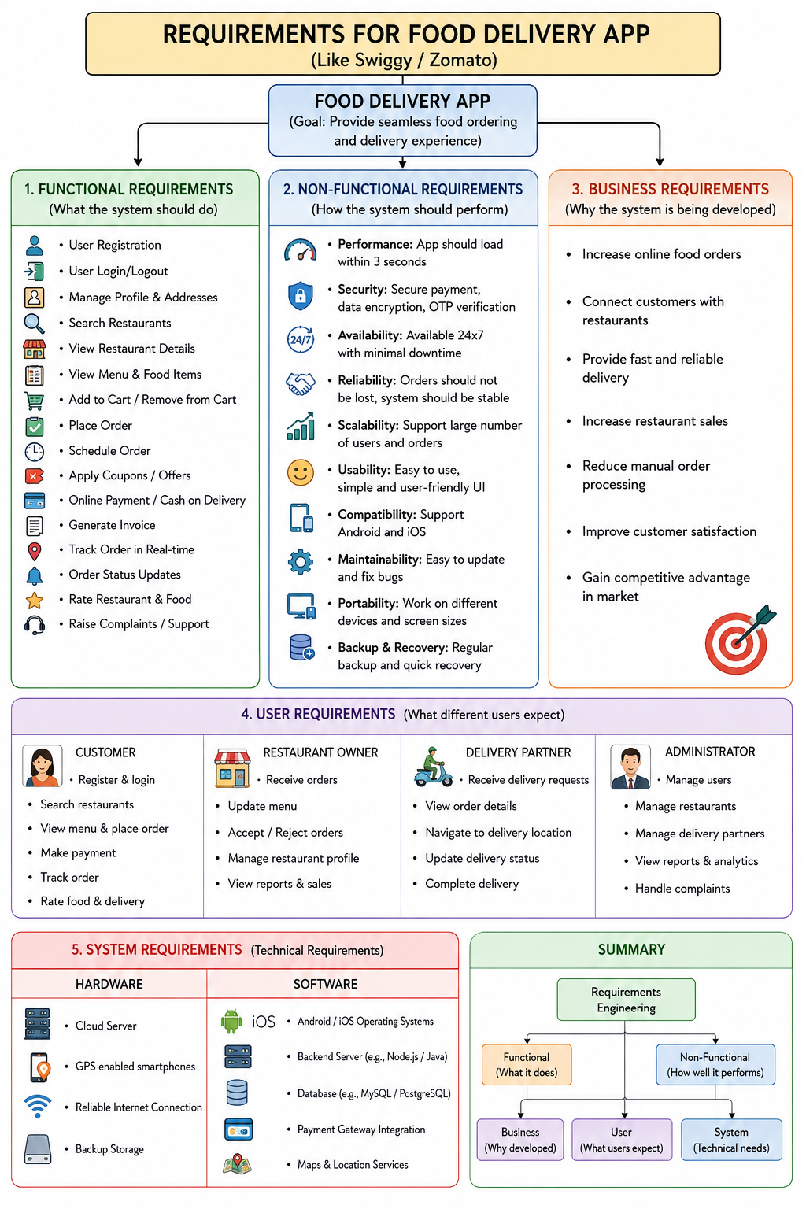

Slide 129
Requirement Analysis
Definition
Requirement Analysis is the process of analyzing stakeholder needs, constraints, assumptions, and qualifications to produce clear and complete software requirements.
Activities in Requirement Analysis
Analyze stakeholder needs
Identify constraints
Identify assumptions
Identify qualifications
Refine requirements
Remove ambiguity
Validate requirements
Advantages
✔ Produces clear requirements
✔ Removes ambiguity
✔ Reduces development errors
✔ Improves communication
✔ Saves development cost
Types of Requirement Analysis
1. Structured Analysis
Function-oriented approach
Uses DFDs and ER Diagrams

Slide 130
2. Data-Oriented Analysis
Focuses on data and relationships
Uses ER Models and Data Dictionaries
3. Object-Oriented Analysis
Focuses on objects and classes
Uses UML diagrams
Uses inheritance and encapsulation
4. Prototyping
Develops a working model before final development
Helps customers validate requirements
Reduces misunderstandings
1. Structured Analysis
Definition
Structured Analysis is a process modeling (data flow modeling) technique used to understand and represent system requirements graphically.
Main Components
Data Flow Diagram (DFD) – Represents system behavior and data movement.
Data Dictionary – Defines all data elements used in the DFD.
Data Dictionary Symbols
Symbol | Meaning
+ | Composition
* | Repetition
| | Selection
[ ] | Optional / Combination of repeated data

Slide 131
Example: Restaurant Bill
Restaurant_bill =Dish_price+ Sales_tax+ Service_charge+ Seat_charge+ Grand_total
Dish_price =[ Dish_name + Quantity + Price ]*
Seat_charge =[ Reserved_table | Common_table ]
Structured Analysis Method
A structured analysis method uses techniques and graphical tools to represent the scenario of the working system in an organization.
Business Need
│
▼
Prepare the Context Diagram
(Level-0 DFD)
│
▼
Construct Logical Level DFD
│
▼
Decomposition of Level-1 DFD
│
▼
Identify Man–Machine Boundary
│
▼
Prepare DFD Process Description Fig: Structured Analysis Approach
│
▼
Requirement Specification

Slide 132
2. Data-Oriented Analysis
1. E-R Modeling (ERM)
Entities
Attributes
Relationships (R/S)
Student → Entity
Name, ID, Phone → Attributes
Enrolls in → Relationship
Types of Relationships
Aggregation → Part-of / Part-whole relationship between entities.
Specialization → IS-A relationship.
Generalization
Data-Oriented Analysis Method
Identification of entities and relationships.
Construct the basic E-R Diagram.
Add key attributes.
Add non-key attributes.
Apply hierarchical relationships.
Perform normalization.
Add integrity rules.
3,4. Student_ID ← Key attribute
Name ← Non-key attribute
Phone ← Non-key attribute
Email ← Non-key attribute
6. reduce duplication and avoid data-related problems.
7.ensure that the data remains correct and valid.
Examples:
Student_ID cannot be NULL.
Student_ID must be unique.
A student cannot enroll in a course that does not exist.
Phone number should have a valid format.
A student's age cannot be negative.

Slide 133
3. Object-Oriented Analysis (OOA)
OOA vs OOP
OOA (Object-Oriented Analysis)
Engages in requirement modeling of the application.
OOP (Object-Oriented Programming)
Translates the analysis into programming constructs to produce a practical software product.
Models Used in Object-Oriented Analysis
Class Diagram
Object Modeling
Dynamic Modeling
  Sequence Diagram
  State Chart Diagram
Functional Modeling

Slide 134
4. Prototyping
Prototyping is divided into two types:
Throwaway Prototyping
Evolutionary Prototyping
1. Throwaway Prototyping
Definition
Throwaway prototyping is a technique where a temporary prototype is built to understand and validate customer requirements. Once the requirements are finalized, the prototype is discarded, and the actual system is developed. Characteristics
Temporary prototype
Used to clarify requirements
Prototype is discarded after requirement analysis
Reduces ambiguity
Improves customer understanding
Advantages
Better understanding of requirements
Early customer feedback
Reduces development risk
Saves time and cost
2. Evolutionary Prototyping
Definition
Evolutionary prototyping is a software development approach in which the prototype is continuously refined and enhanced until it evolves into the final software product.

Slide 135
Characteristics
Prototype is not discarded.
Continuous customer feedback.
Continuous refinement and enhancement.
Final prototype becomes the actual software.
Advantages
Suitable for changing requirements.
High customer involvement.
Early error detection.
Faster product delivery.
Better software quality.
Uses
Used in Rapid Application Development (RAD).
Suitable when requirements are not clearly defined.
Suitable for interactive software systems.

Slide 136
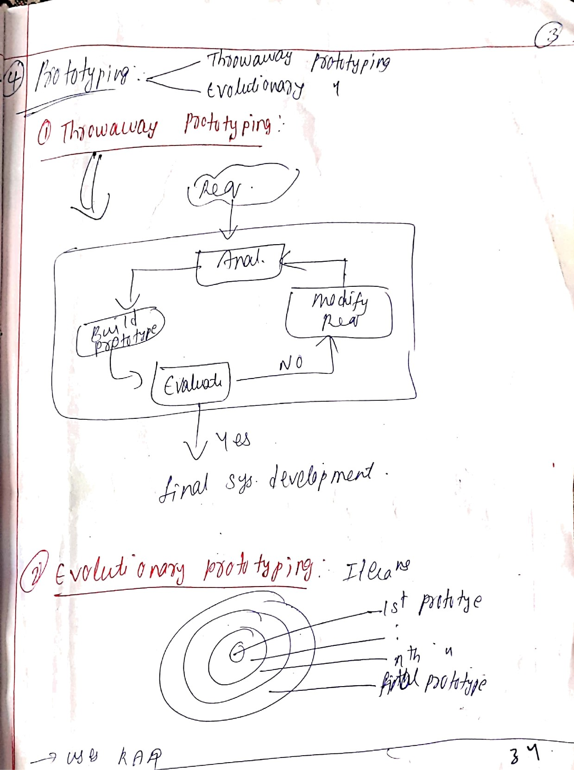
Scanned with CamScanner

Slide 137
Requirements Analysis and Specification
RAJIB MALL
Computer Science and Engineering Department
IIT KHARAGPUR

Slide 138
What are Requirements?
A Requirement is:
–
A capability or condition required from the system.
What is involved in requirements analysis and specification?
  Determine what is expected by the client from the system. (Gather and Analyze)
  Document those in a form that is clear to the client as well as to the
development team members. (Document)

Slide 139
For toy problems: understanding and specifying requirements is rather easy…
For industry-standard problems: Probably the hardest, most problematic and error prone among development tasks…
The task of requirements specification :
  Input: User needs that are hopefully fully understood by the users.
  Output: Precise statement of what the software will do.

Slide 140
Requirements for Products
When a company plans to develop a generic product:
– Who gives the requirements?
The sales personnel! Interact directly with customers. Understand customer needs and market demand. Gather feedback from existing and potential customers. Communicate these requirements to the development team. Example Microsoft Office It is a generic product. There is no single customer who defines all the requirements. Microsoft's sales and marketing teams collect user feedback from millions of users and identify new features such as AI assistance, cloud storage, and collaboration tools.

Slide 141
Requirements Gathering
Activities in Requirements Analysis and Specification
Requirements Analysis
Requirements Specification
SRS Document

Slide 142
Requirements Engineering Process
Feasibility
Study
Requirements
gathering
Requirements
analysis
Feasibility
report
Requirements
specification
Feasibility Study: process of investigating whether a proposed software project is practical and possible to develop.
Feasibility report: document prepared after conducting the feasibility study.
Technical feasibility
→ Do we have the technology, hardware, software, and skills needed?
Economic feasibility
→ Do the benefits justify the cost?
Operational feasibility
→ Will the software work in the organization, and will users be able to use it?
Schedule feasibility
→ Can we complete the project within the required time?
Legal feasibility
→ Can we develop and use it without violating laws, regulations, or licenses?
SRS Document

Slide 143
Requirements Analysis and Specification
Requirements Gathering:
  Fully understand the user requirements.
Requirements Analysis:
  Remove inconsistencies, unexpected conditions, etc. from requirements.
Requirements Specification:
  Document requirements properly in an SRS document.

Slide 144
Good SRS reduces development cost:
– Req. errors are expensive to fix later
Need for SRS…
Req. changes cost a lot (typically 40% of requirements change later)
Good SRS can minimize changes and errors
Substantial savings --- effort spent during req. saves multiple times that effort
An Example:
– Cost of fixing errors in req. , design , coding , acceptance testing and operation increases exponentially
Cost

Slide 145
Establishes the basis for agreement between the
What are the Uses of an SRS Document?
customers and the suppliers
Forms the starting point for development.
Provide a basis for estimating costs and schedules.
Provide a basis for validation and verification.
Provide a basis for user manual preparation.
Serves as a basis for later enhancements.

Slide 146
Forms A Basis for User Manual
The SRS serves as the basis for writing User Manual for the software:
  User Manual: Describes the functionality from the perspective of a user --- An important document for users.
  Typically also describes how to carry out the required tasks with examples.

Slide 147
SRS Document: Stakeholders
SRS intended for a diverse audience:
  Customers and users use it for validation, contract, ...
  Systems (requirements) analysts
  Developers, programmers to implement the system
  Testers use it to check whether requirements have been met
  Project Managers to measure and control the project
Different levels of detail and formality is needed for each audience
Different templates for requirements specifications used by companies:
  Often variations of IEEE 830

Slide 148
Requirement process..
User needs
Specification and review may lead to further gathering and analysis.
Gathering
Analysis
Specification
Review
SRS Document

