Slide 1
Planning a Software Project

Slide 2
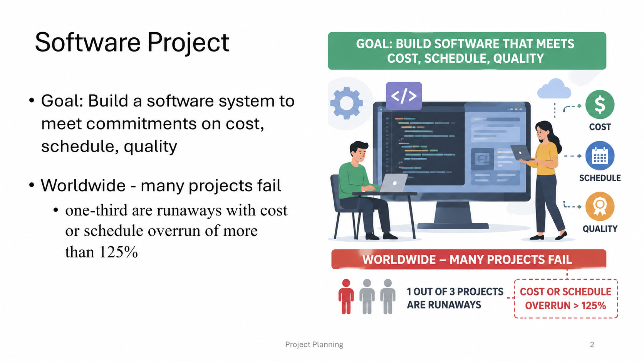

Slide 3
Project Failures
Major reasons for project runaways
  unclear objectives
  bad planning
  no project management methodology
  new technology
  insufficient staff
All of these relate to project management
Effective project management is key to successfully executing a project

Slide 4
Why improve PM?
Better predictability leading to commitments that can be met
Lower cost through reduced rework, better resource mgmt, better planning,..
Improved quality through proper quality planning and control
Better control through change control, CM(Configuration Management) → Keeps track of different versions of software, documents, code, and other project items.
Example: Maintaining Version 1.0, Version 1.1, Version 2.0 of the food delivery app., monitoring etc.

Slide 5
Why improve PM ….
By continuously monitoring the project, we can clearly understand how the project is performing and take corrective action at the right time.
Better handling of risks reducing the chances of failure
All this leads to higher customer satisfaction
And organization improvement

Slide 6
The Project Mgmt Process
Has three phases - planning, monitoring and control, and closure
Planning is done before the much of the engineering process (life cycle, LC) and closure after the process
Monitoring phase is in parallel with LC
We focus on planning; monitoring covered through its planning

Slide 7
Project Planning
Basic objective: To create a plan to meet the commitments of the project, I.e. create a path that, if followed, will lead to a successful project
Planning involves defining the LC process to be followed, estimates, detailed schedule, plan for quality, etc.
Main output - a project management plan and the project schedule

Slide 8
Key Planning Tasks
Estimate effort
Define project milestones and create a schedule
Define quality objectives and a quality plan
Identify risks and make plans to mitigate them
Define measurement plan, project-tracking procedures, training plan, team organization, etc.

Slide 9
Effort Estimation

Slide 10
Effort Estimation
For a project total cost and duration has to be committed in start
Requires effort estimation, often in terms of person-months
Effort estimate is key to planning - schedule, cost, resources depend on it
Many problems in project execution stem from improper estimation

Slide 11
Estimation..
No easy way, no silver bullet
Estimation accuracy can improve with more information about the project
Early estimates are more likely to be inaccurate than later
  More uncertainties in the start
  With more info, estimation becomes easier

Slide 12
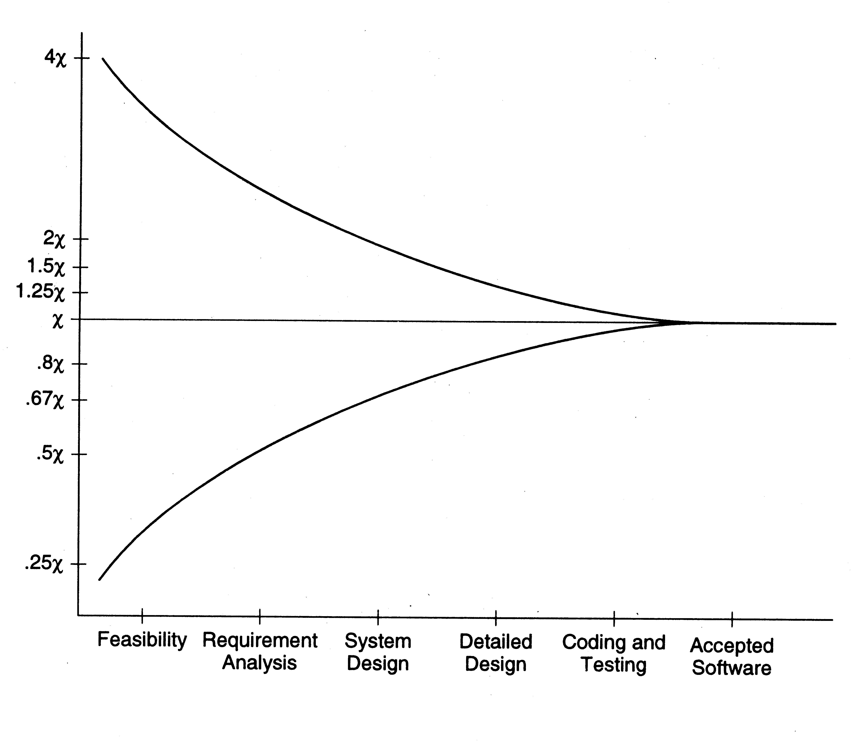
Estimation accuracy

Slide 13
Effort Estimation Models..
A model tries to determine the effort estimate from some parameter values
A model also requires input about the project, and cannot work in vacuum
So to apply a model, we should be able to extract properties about the system
Two types of models - top-down and bottom-up

Slide 14
Effort Estimation Models

Slide 15
Top down estimation
First determines the total effort, then effort for components
Simple approach – estimate effort from size and productivity
  Get the estimate of the total size of the software
  Estimate project productivity using past data and project characteristics
  Obtain the overall effort estimate from productivity and size estimates
Effort distribution data from similar project are used to estimate effort for different phases

Slide 16
Top-down Estimation
A better method is to have effort estimate as a function of size using:
Effort = a * size ^{b}
E is in person-months, size in KLOC
Incorporates the observation that productivity can dip with increased size
Constants a and b determined through regression analysis of past project data

Slide 17
COCOMO Model
Uses size, but adjusts using some factors
Basic procedure
  Obtain initial estimate using size
  Determine a set of 15 multiplying factors from different project attributes
  Adjust the effort estimate by scaling it with the final multiplying factor

Slide 18
COCOMO..
Initial estimate: a * size ^{b} ; some standard values for a, b given for diff project types
There are 15 cost driver attributes like reliability, complexity, application experience, capability, …
Each factor is rated, and for the rating a multiplication factor is given
Final effort adjustment factor is the product of the factors for all 15 attributes

Slide 19
COCOMO – Some cost drivers
Cost Driver | Very low | Low | Nominal | High | Very High
Required reliability Database size Product complexity Execution time constraint Memory constraint Analyst capability Application experience Programmer capability Use of software tools Development schedule | .75 .7 1.46 1.29 1.42 1.24 1.23 | .88 .94 .85 1.19 1.13 1.17 1.10 1.08 | 1.0 1.0 1.0 1.0 1.0 1.0 1.0 1.0 1.0 1.0 | 1.15 1.08 1.15 1.11 1.06 .86 .91 .86 .91 1.04 | 1.4 1.16 1.3 1.3 1.21 .71 .82 .70 .83 1.1

Slide 20
COCOMO – effort distribution
Effort distribution among different phases is given as a percent of effort
Eg. For medium size product it is
  Product design – 16%
  Detailed design – 24%
  Coding and UT – 38%
  Integration and test – 22%

Slide 21
Bottom-up Estimation
An alternate approach to top-down
Effort for components and phases first estimated, then the total
Can use activity based costing - all activities enumerated and then each activity estimated separately
Can group activities into classes - their effort estimate from past data

Slide 22
An Estimation Procedure
Identify programs in the system and classify them as simple, medium, or complex (S/M/C)
Define the average coding effort for S/M/C
Get the total coding effort.
Use the effort distribution in similar projects to estimate effort for other tasks and total
Refine the estimates based on project specific factors

Slide 23
3.3 Effort Estimation
Estimating project costs is one of the crucial aspects of
project planning and management.
Estimating cost has to be done as early as possible during the project life cycle.
Type of costs
  facilities: hardware, space, furniture, telephone, etc.
  software tools: for designing software.
  staff (effort): the biggest component of cost.

Slide 24
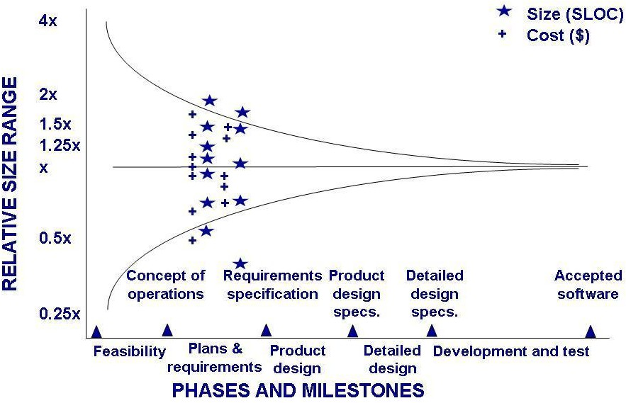
3.3 Effort Estimation
Estimation Should be Done Repeatedly
Uncertainty early in the project can affect the accuracy of cost and size estimations

Slide 25
3.3 Effort Estimation
Sidebar 3.3 Causes of Inaccurate Estimates
Key causes(6)
  Frequent request for change by users.
  Overlooked(missed/unnoticed) tasks.
  User's lack of understanding of the requirements.
  Insufficient analysis when developing estimates.
  Lack of coordination of system development, technical services, operations, data administration, and other functions during development.
  Lack of an adequate method or guidelines for estimating.

Slide 26
3.3 Effort Estimation
Sidebar 3.3 Causes of Inaccurate Estimates
Key influences(10)
  Complexity of the proposed application system.
  Required integration with existing system.
  Complexity of the program in the system.
  Size of the system expressed as number of functions or programs.
  Capabilities of the project team members.
–
Cont...

Slide 27
– Cont...
Project team's experience with the application, the programming language, and hardware.
Capabilities of the project team members.
Database management system.
Number of project team member.
Extent of programming and documentation standards.

