Slide 1

Methodology
Air - bNb case study
By :
NIKHIL KUMAR SINGH

Slide 2
Problem Statement
For the past few months, Airbnb has seen a major decline in revenue.
Now that the restrictions have started lifting and people have started to travel more, Airbnb wants to make sure that it is fully prepared for this change.

Slide 3
Objective
To prepare for the next best steps that Airbnb needs to take as a business, you have been asked to analyze a dataset consisting of various Airbnb listings in New York. Based on this analysis, you need to give two presentations to the following groups.
1. Presentation - I
Data Analysis Managers: These people manage the data analysts directly for processes and their technical expertise is basic.
Lead Data Analyst: The lead data analyst looks after the entire team of data and business analysts and is technically sound.
2. Presentation - II
Head of Acquisitions and Operations, NYC: This head looks after all the property and host acquisitions and operations. Acquisition of the best properties, price negotiation, and negotiating the services the properties offer falls under the purview of this role.
Head of User Experience, NYC: The head of user experience looks after the customer preferences and also handles the properties listed on the website and the Airbnb app. Basically, the head of user experience tries to optimize the order of property listing in certain neighborhoods and cities in order to get every property the optimal amount of traction.

Slide 4
Steps Followed
Data Understanding, Preparation, and Pre-Processing :
Reading Data
Treating Missing values
Treating outlier
Treating some error columns.
Tools Used :
Python Jupyter Notebook :- Mainly to perform Data Wrangling.
Tableau :- To come up with useful insights and business recommendations.

Slide 5
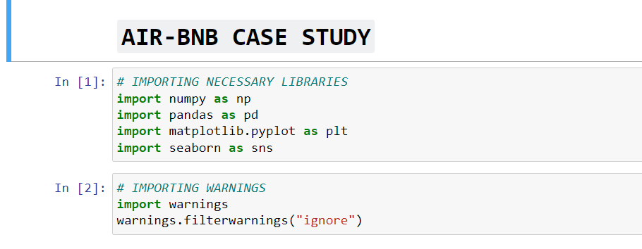
Importing Necessary Libraries

Slide 6
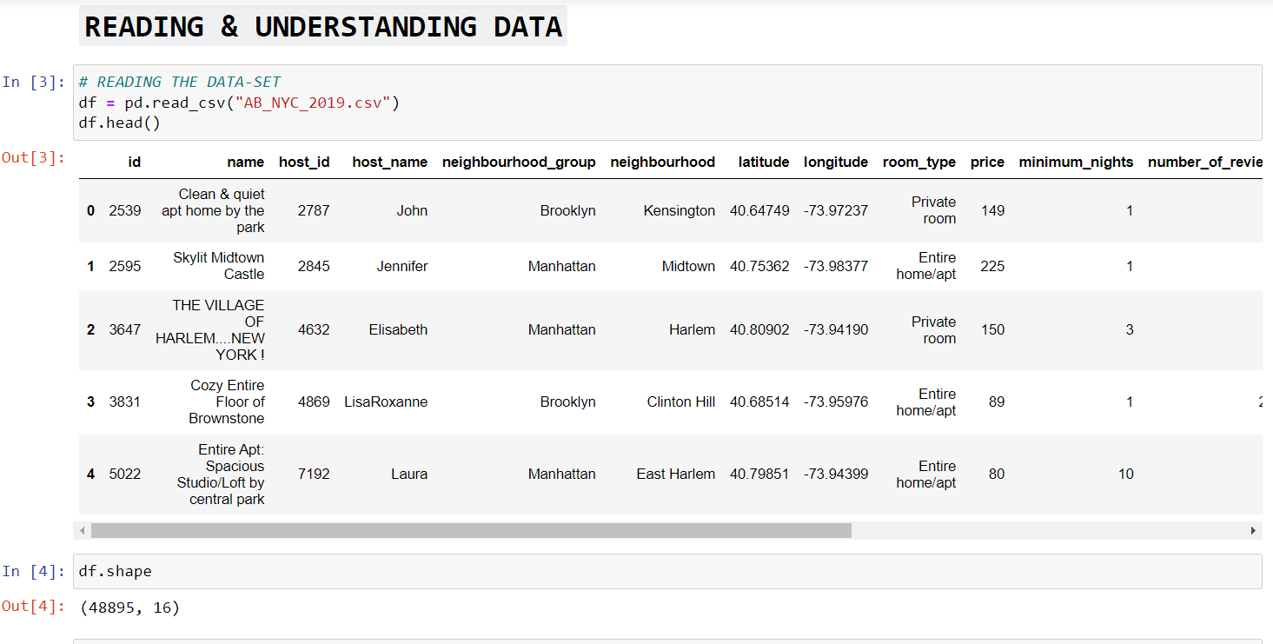
Reading The Data-set
First I read the data-set with help of pandas then look at the first 5 rows for understanding the data.
Then I look at the shape of the data-set which comes out as :-
Total 48895 rows and 16 columns.

Slide 7
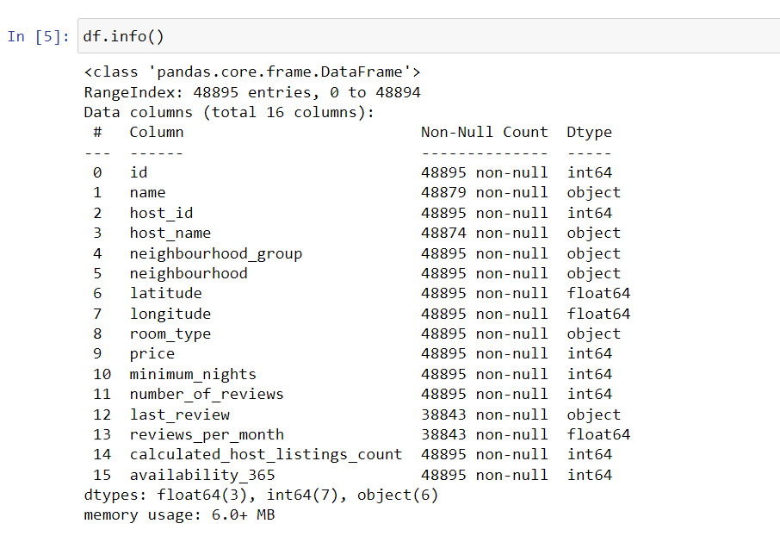
Understanding The data-set
After looking at the shape of the data-set we will look at the overall information of the data-set to get better understanding of data and for that we use .info() function.
By using that function we get to know about how many entries are there, all the columns name with there data-type and count of Non-nulls and overall count of data-type like how many float64, int64 and object are there.

Slide 8
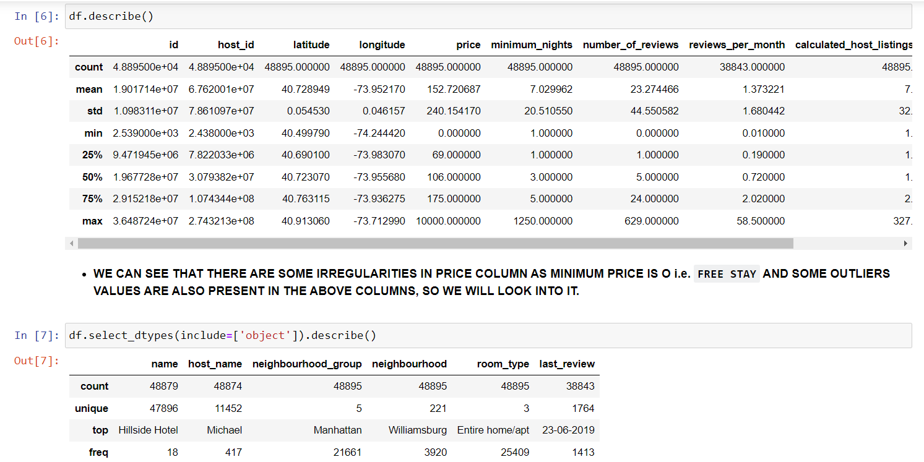
Stastical distribution of data-set
After that we use .describe() function to get the overall stastical distribution of data-set.
Numerical Column :- If we use .describe() function without any other argument we will get the stastical distribution of only numerical column i.e. float and int.
Categorical Column :- In the 2nd command we added some arguments before .describe() function to view the stastical distribution of categorical column i.e. object.
WE CAN SEE THAT THERE ARE SOME IRREGULARITIES IN PRICE COLUMN AS MINIMUM PRICE IS O i.e. FREE STAY AND SOME OUTLIERS VALUES ARE ALSO PRESENT IN THE ABOVE COLUMNS, SO WE WILL LOOK INTO IT.

Slide 9
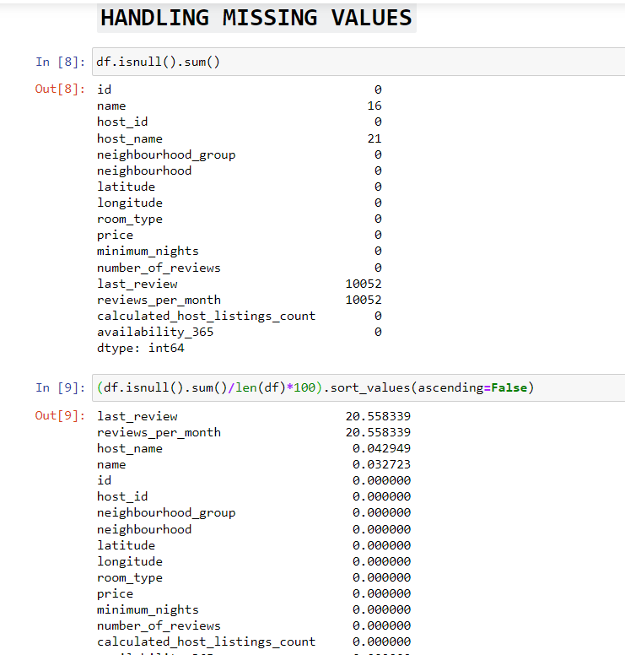
Missing Values
After understanding the data we will look at the missing values in the data-set and treat them accordingly.
By using the .isnull().sum() function we will get the count of missing values i.e. NaN values that are present in each column of the data-set.
In 2nd command we get the percentage of missing values means which column contains how much percentage of missing values and sort it in descending order to get highest missing value column on top.
We can see there are 4 columns that have missing values.

Slide 10
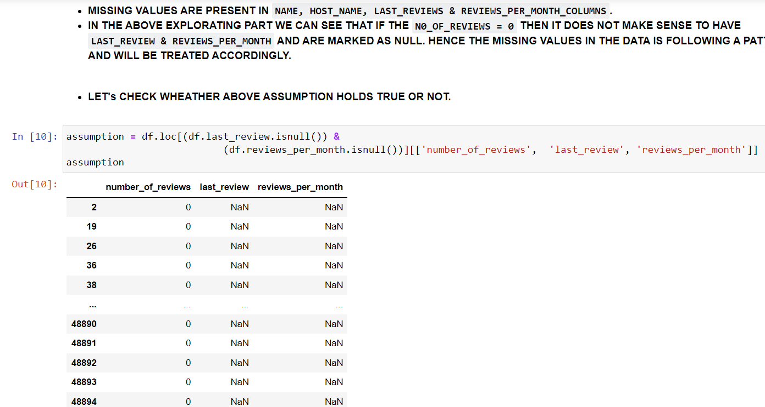
Assumption of missing value
MISSING VALUES ARE PRESENT IN NAME, HOST_NAME, LAST_REVIEWS & REVIEWS_PER_MONTH_COLUMNS.
IN THE ABOVE EXPLORATING PART WE CAN SEE THAT IF THE N0_OF_REVIEWS = 0 THEN IT DOES NOT MAKE SENSE TO HAVE LAST_REVIEW & REVIEWS_PER_MONTH AND ARE MARKED AS NULL. HENCE THE MISSING VALUES IN THE DATA IS FOLLOWING A PATTERN AND WILL BE TREATED ACCORDINGLY.
ABOVE ASSUMPTION HOLDS TRUE.

Slide 11
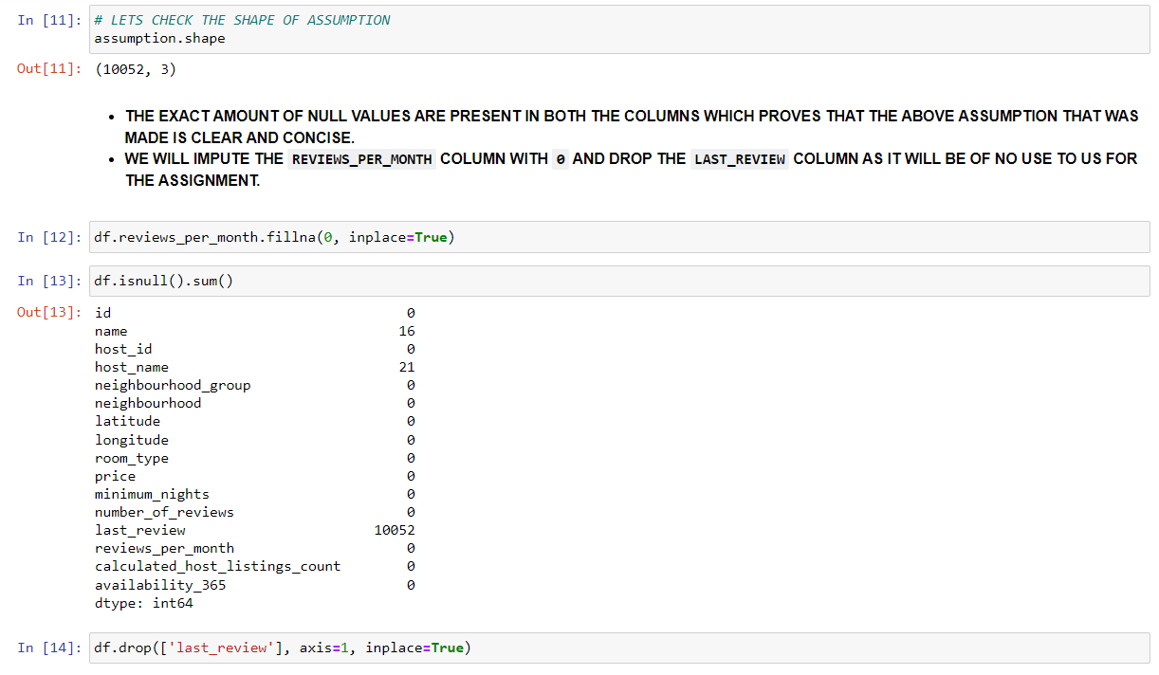
Treating Assumption
First we check the number of rows and columns that are present in the assumption and we found out that the exact amount of null values are present in both the columns.
SO WE WILL IMPUTE THE REVIEWS_PER_MONTH COLUMN WITH 0 AND DROP THE LAST_REVIEW COLUMN AS IT WILL BE OF NO USE TO US FOR THE ASSIGNMENT.
Now only 2 columns are left which have missing values so we will look at it and treat it accordingly.

Slide 12
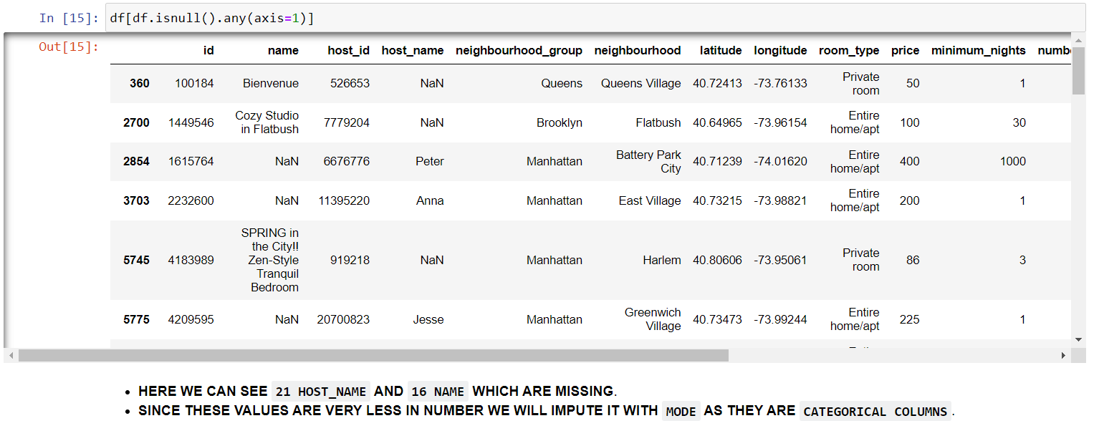
Handling Remaining 2 missing column
After treating assumption accordingly we look at the values of remaining 2 missing column.
HERE WE CAN SEE 21 HOST_NAME AND 16 NAME WHICH ARE MISSING.
SINCE THESE VALUES ARE VERY LESS IN NUMBER WE WILL IMPUTE IT WITH MODE AS THEY ARE CATEGORICAL COLUMNS AND WE USE MODE TO FILL THE NULL VALUES OF CATEGORICAL COLUMN AND MEAN OR MEDIAN TO FILL THE NULL VALUES OF NUMERICAL COLUMNS.

Slide 13
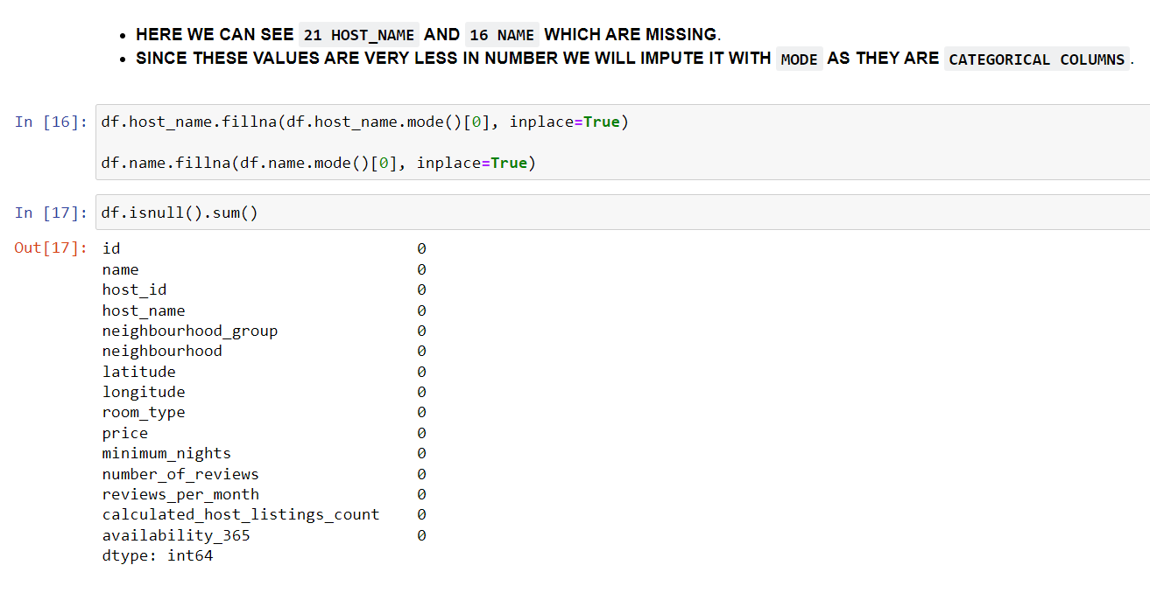
Handling Missing values
Here we imputed the null values of remaining 2 column with mode.
Then at last we again use the .isnull().sum() function to look and cross-check wheather all the null values are gone or some columns still have the null values.
At last we should always cross-check.
Now we have treated the null values so we will move further.

Slide 14
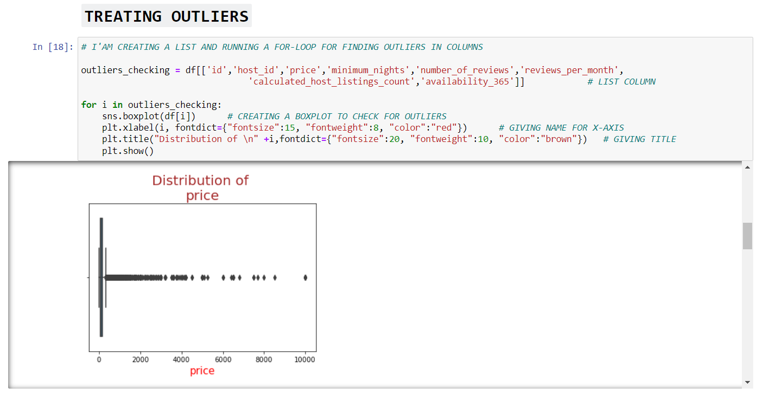
Checking Outliers
After treating null values we will look at the outliers and treat them accordingly.
Here in this code snippet I have created a list of all the Numerical column and running a for loop for finding the outliers in that list.
And we found out that some columns contains outliers.

Slide 15
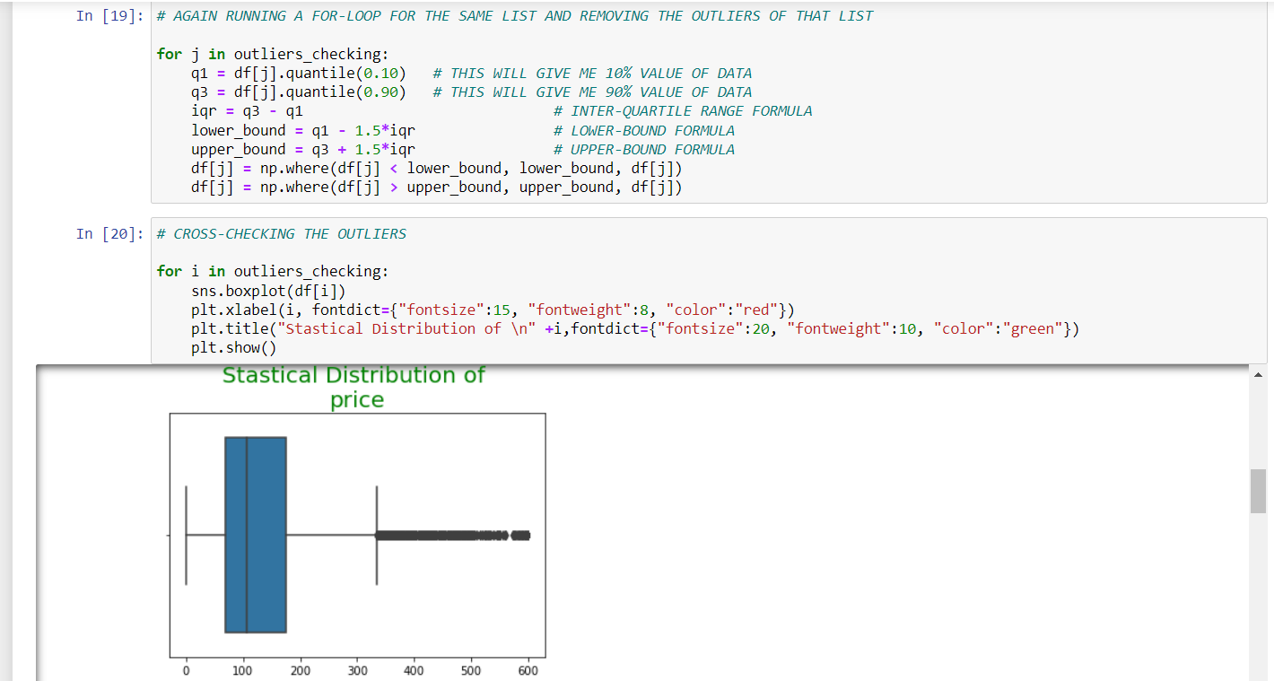
Treating Outliers
Here in the first code snippet I have again running a for-loop for the same list to treat outliers.
Then I have again run a for-loop to cross-check weather outliers have been treated accordingly or not.

Slide 16
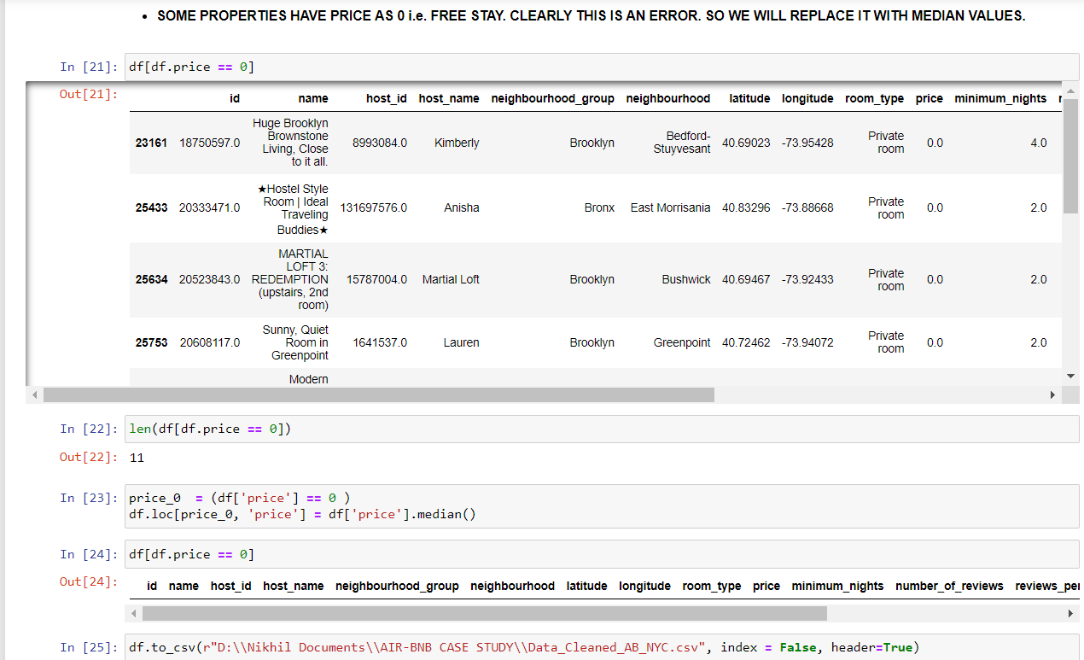
Some properties have price = 0
At first I got all the column which has price as 0.
Then I replaced all the values of price = 0 with the median of price.
Then at last cross-check weather the above code snippet has been worked or not.
At last I saved the data in csv file.
After this step I have loaded the data-set in Tableau Desktop for visualizations and get & recommend insights.

Slide 17
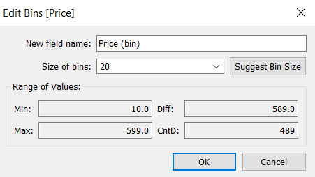
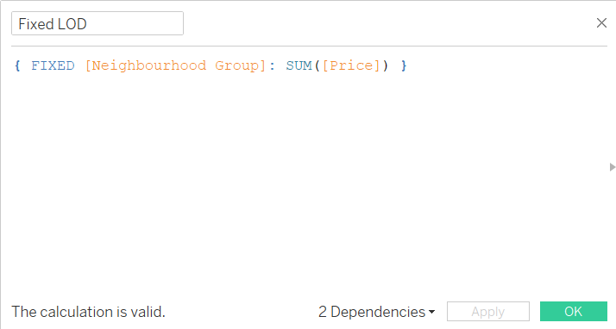
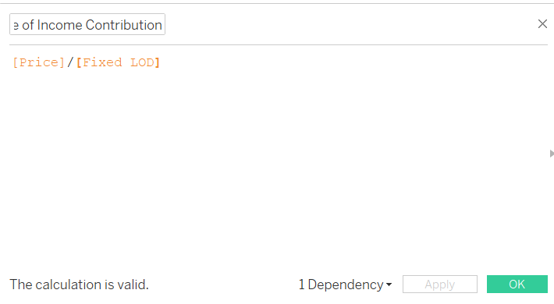
Created Bins & Calculated Field in Tableau
First we have created a bin of Price column.
Then we have created a new calculated field named as Fixed LOD using columns Neighbourhood Group and sum(price).
And again with the help of above Fixed LOD we created a new calculated field named as Percentage of Income Contribution.

Slide 18
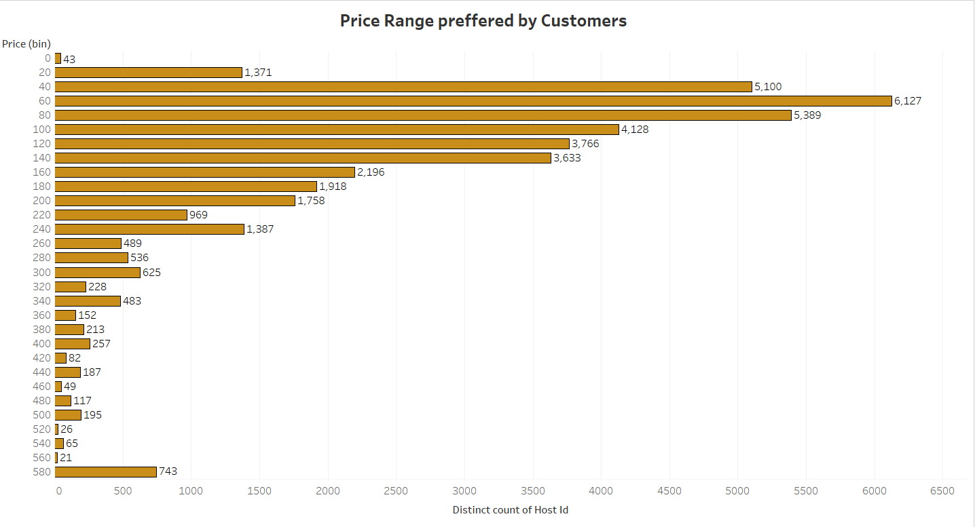
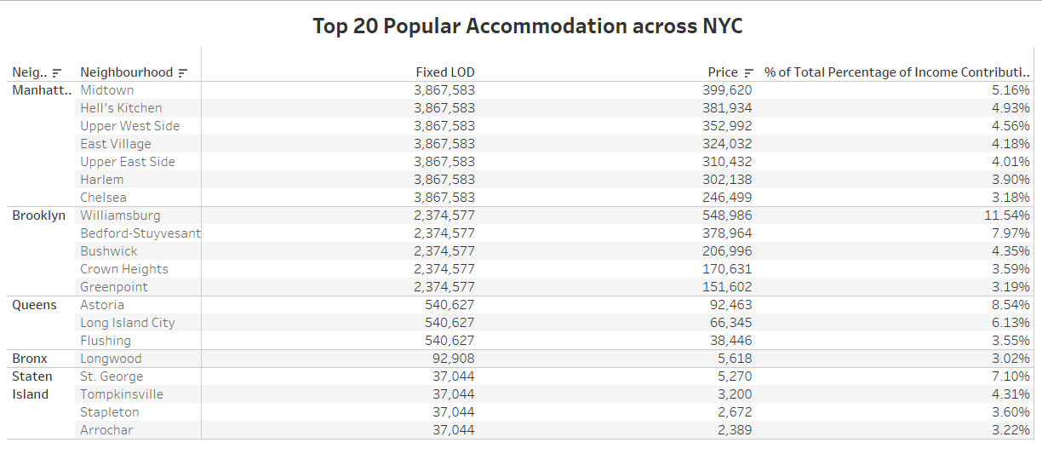
Visualisation
Now here with the help of bins and calculated field that we have created earlier we get the following insights :-
Price range preferred by customers.
Top 20 popular accommodation across NYC.

Slide 19
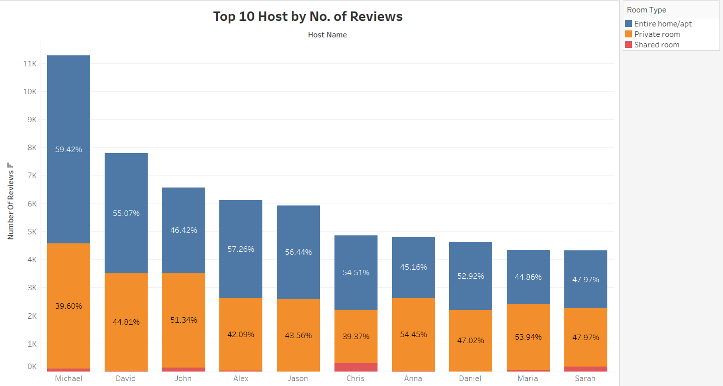
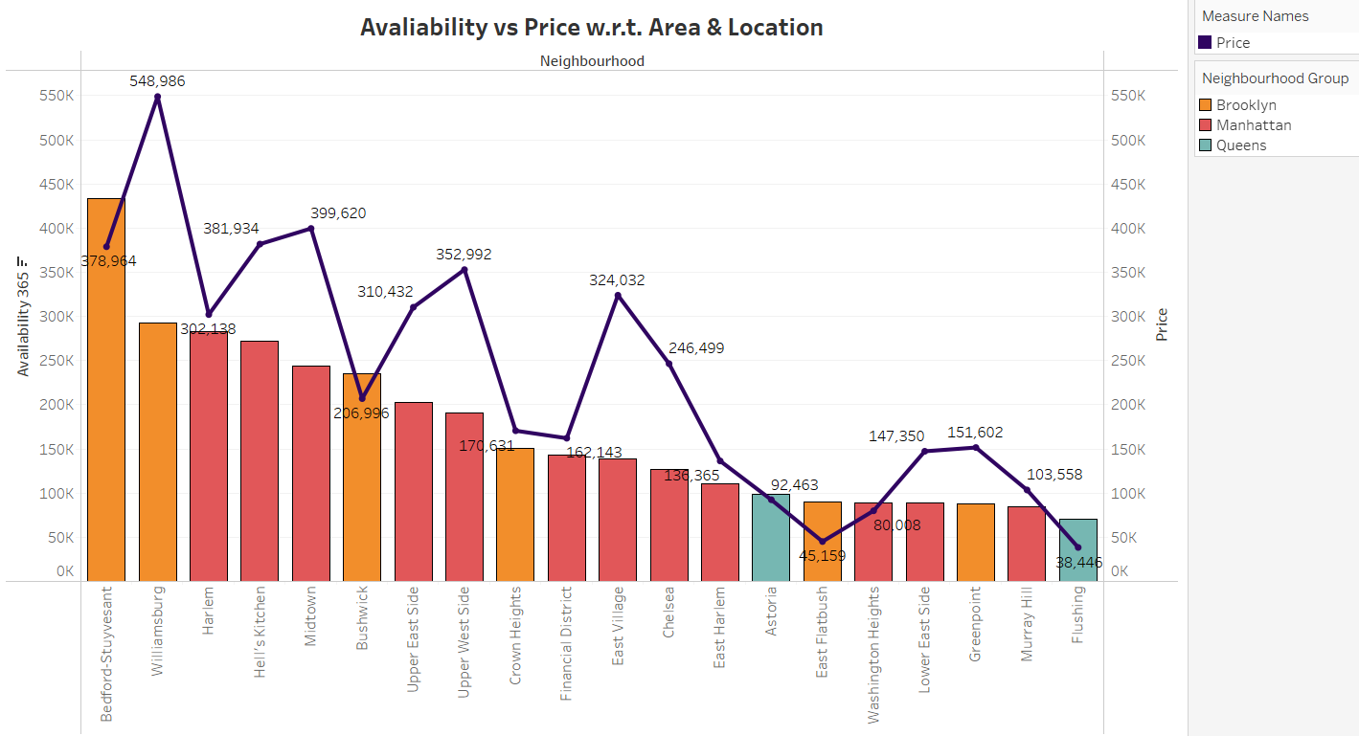
Visualisation
Here we get two insights :-
Top 10 host by Number of Reviews.
Availability vs Price w.r.t Area & Location (Dual Axis Chart).

Slide 20
Recommendation & Presentation
After doing all the analysis in the Data-set we made the presentation using the above given insights and visualization keeping the pyramid principle and the best business practices in mind and we have also given some recommendations on that presentation for the growth of the business.

