Slide 1

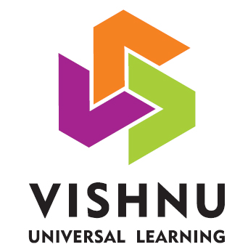
Technical Seminar on Spring Boot REST API
Under the Guidance of
Mr. P. Bhaskar Rao
Assistant Professor
Department of Computer Science and Engineering
BVRIT
Presented by
Student Name
HT No

Slide 2
Abstract
Introduction
Features
Architecture
Dependency Injection
Inversion Of Control
Challenges
Conclusion
References
Abstract
For the development and operating efficiency of
Web applications based on the Model-View-Controller
(MVC) framework, and, according to the actual
business environment and needs in the project
practice, the framework of Web application system is
studied in this paper. Through the research of Spring
MVC framework framework as well as some related
core techniques, combined with JSP.

Slide 3
Abstract
Introduction
Features
Architecture
Dependency Injection
Inversion Of Control
Challenges
Conclusion
References
Introduction
Spring Boot is an open source Java-based framework used to create a micro Service. It is developed by Pivotal Team and is used to build stand-alone and production ready spring applications. This chapter will give you an introduction to Spring Boot and familiarizes you with its basic concepts.
Spring Boot provides a good platform for Java developers to develop a stand-alone and production-grade spring application that you can just run. You can get started with minimum configurations without the need for an entire Spring configuration setup.

Slide 4
Spring Boot
Abstract
Introduction
Features
Architecture
Dependency Injection
Inversion Of Control
Challenges
Conclusion
References
Spring Boot automatically configures your application based on the dependencies you have added to the project by using @EnableAutoConfiguration annotation.
For example, if MySQL database is on your classpath, but you have not configured any database connection, then Spring Boot auto-configures an in-memory database.
The entry point of the spring boot application is the class contains @SpringBootApplication annotation and the main method.
6/10

Slide 5
Spring MVC
Abstract
Introduction
Features
Architecture
Dependency Injection
Inversion Of Control
Challenges
Conclusion
References
Model: A model contains the data of the application. A data can be a single object or a collection of objects.
View: A view represents the provided information in a particular format. Generally, JSP+JSTL is used to create a view page. Although spring also supports other view technologies such as Apache Velocity, Thymeleaf and FreeMarker.
Controller: A controller contains the business logic of an application. Here, the @Controller annotation is used to mark the class as the controller.
6/10

Slide 6
REST
Abstract
Introduction
Features
Architecture
Dependency Injection
Inversion Of Control
Challenges
Conclusion
References
REST, or REpresentational State Transfer, is an architectural style for providing standards between computer systems on the web, making it easier for systems to communicate with each other.
REST-compliant systems, often called RESTful systems, are characterized by how they are stateless and separate the concerns of client and server.
Possible HTTP requests/responses to communicate client with server and vice versa are: GET, POST, PUT, DELETE.
6/10

Slide 7
Features
Abstract
Introduction
Features
Architecture
Dependency Injection
Inversion Of Control
Challenges
Conclusion
References
Web Development
SpringApplication
Application events and listeners
Admin features
Externalized Configuration
Properties Files
YAML Support
Type-safe Configuration
Logging
Security

Slide 8
Dependency Injection
Abstract
Introduction
Features
Architecture
Dependency Injection
Inversion Of Control
Challenges
Conclusion
References
Without DI:
public class ImplementAlgorithm {
BubbleSort newBubbleSort = new BubbleSort();
With DI:
ImplementAlgorithm newAlgo =
new ImplementAlgorithm(new BubbleSort());
public interface SortAlgorithm{
public sortFunc(int[] arr);
}
public class BubbleSort implements SortAlgorithm{

Slide 9
Inversion Of Control (IoC)
Abstract
Introduction
Features
Architecture
Dependency Injection
Inversion Of Control
Challenges
Conclusion
References
Without IoC:
public class ImplementAlgorithm {
BubbleSort newBubbleSort = new BubbleSort();
With IoC:
@Component
public class ImplementAlgorithm {
@Autowired
private SortAlgorithm newSortAlgorithm;
6/10

Slide 10
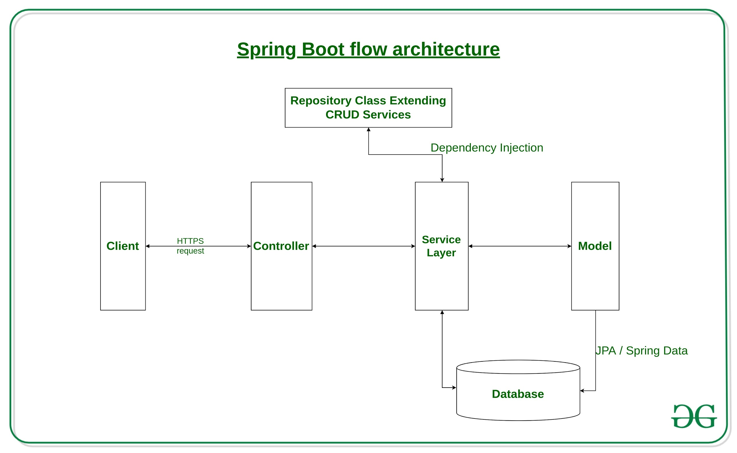
Abstract
Introduction
Features
Dependency Injection
Inversion Of Control
Architecture
Challenges
Conclusion
References
Architecture
6/10

Slide 11
Abstract
Introduction
Features
Architecture
Dependency Injection
Inversion Of Control
Challenges
Conclusion
References
Challenges
Inconsistency and poor error handling.
Improperly Dealing with Multithreading.
Not Employing Annotation-Based Validation.
6/10

Slide 12
Conclusion
Abstract
Introduction
Features
Architecture
Dependency Injection
Inversion Of Control
Challenges
Conclusion
References
The Spring boot software development framework is being widely accepted within the software development community. Spring boot provides multiple benefits over the previously used waterfall framework.
Spring boot attempts to simplify the software planning and estimation process by decomposing large requirements into small individual tasks. Analyzing small tasks allow the software development team to more accurately predict the level of effort required in order to implement the change.

Slide 13
Abstract
Introduction
Literature Reviews (Related Works)
Architecture
Dependency Injection
Inversion Of Control
Challenges
Conclusion
References
References
L. GuangChun, W. Lu, and X. Hanhong, "A novel web application frame developed by MVC, " ACM SIGSOFT Software Engineering Notes, vol. 28, no. 2, p. 7, 2003.
J. LIU and J. DAI, "Research of lightweight Web application based on Spring MVC and iBATIS frameworks [J], " Journal of Computer Applications, vol. 4, p. 26, 2006.
M. Fisher, J. Ellis, and J. Bruce, JDBC API tutorial and reference. Addison-Wesley Professional, 2003.
7/10

Slide 14
Any Questions?

