Slide 1

Movable Road Divider for organizing vehicular traffic
Under the Guidance of
Mr. P. Bhaskar Rao, Assistant Professor
Department of Computer Science & Engineering
B V Raju Institute of Technology, Narsapur
Presented by
K. V. Pavan Kumar, 16211A05C8
L. A. Radhakrishna Das, 16211A05D3
M. Nikhil Pavan Sai, 16211A05D6

Slide 2
Abstract
Abstract
Introduction
Modules
Architecture Model
Software/Hardware Requirements
Screenshots
Conclusion
Future Enhancement
References
Road Divider is generically used for dividing the Road for ongoing and incoming traffic.
This helps keeping the flow of traffic efficient manner.
Generally there is equal number of lanes for both ongoing and incoming traffic.
Based on the traffic density the divider is moved to other lane so that the problem of under-utilization of road is solved and traffic can be controlled in efficient manner.

Slide 3
Abstract
Introduction
Modules
Architecture Model
Software/Hardware Requirements
Screenshots
Conclusion
Future Enhancement
References
Abstract
Introduction
Existing System
Proposed System
Software requirements
Architecture Model
Modules
UML Diagrams/ER Diagrams/Flow Charts
References
Introduction
In any city, there is industrial area or shopping area where the traffic generally flows in one direction in the morning or evening.
The other side of Road divider is mostly either empty or very under utilized.
This is true for peak morning and evening hours. This results in loss of time for the car owners, traffic jams as well as under utilization of available resources.
An Automated road divider can provide a solution to the above mentioned problem effectively. Here Low, Medium and High density of traffic value will be posted on IOT server as a graph.

Slide 4
Abstract
Introduction
Modules
Architecture Model
Software/Hardware Requirements
Screenshots
Conclusion
Future Enhancement
References
Abstract
Introduction
Existing System
Proposed System
Software requirements
Architecture Model
Modules
UML Diagrams/ER Diagrams/Flow Charts
References
Introduction
The domain is Embedded Systems.
The controller used is ATMEGA-328 and the crystal is of 16MHz.
We also used DC motor and Ultra Sonic Sensors in our project.

Slide 5
Modules
Abstract
Introduction
Modules
Architecture Model
Software/Hardware Requirements
Screenshots
Conclusion
Future Enhancement
References
Microcontroller ATmega328
Operating Voltage 5V
Input Voltage (recommended) 7-12V
Input Voltage (limits) 6-20V
Digital I/O Pins 14 (of which 6 provide PWM o/p)
Analog Input Pins 6
DC Current per I/O Pin 40 mA
DC Current for 3.3V Pin 50 mA
Flash Memory 32 KB (ATmega328) of which 0.5 KB used by boot loader
SRAM 2 KB (ATmega328)
EEPROM 1 KB (ATmega328)
Clock Speed 16 MHz

Slide 6
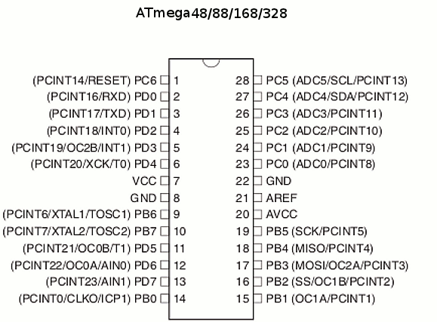
Modules
Abstract
Introduction
Modules
Architecture Model
Software/Hardware Requirements
Screenshots
Conclusion
Future Enhancement
References
PIN Diagram

Slide 7
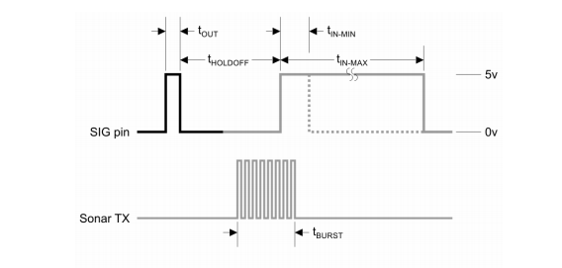
Modules
Abstract
Introduction
Modules
Architecture Model
Software/Hardware Requirements
Screenshots
Conclusion
Future Enhancement
References
Sonar Signal Module

Slide 8
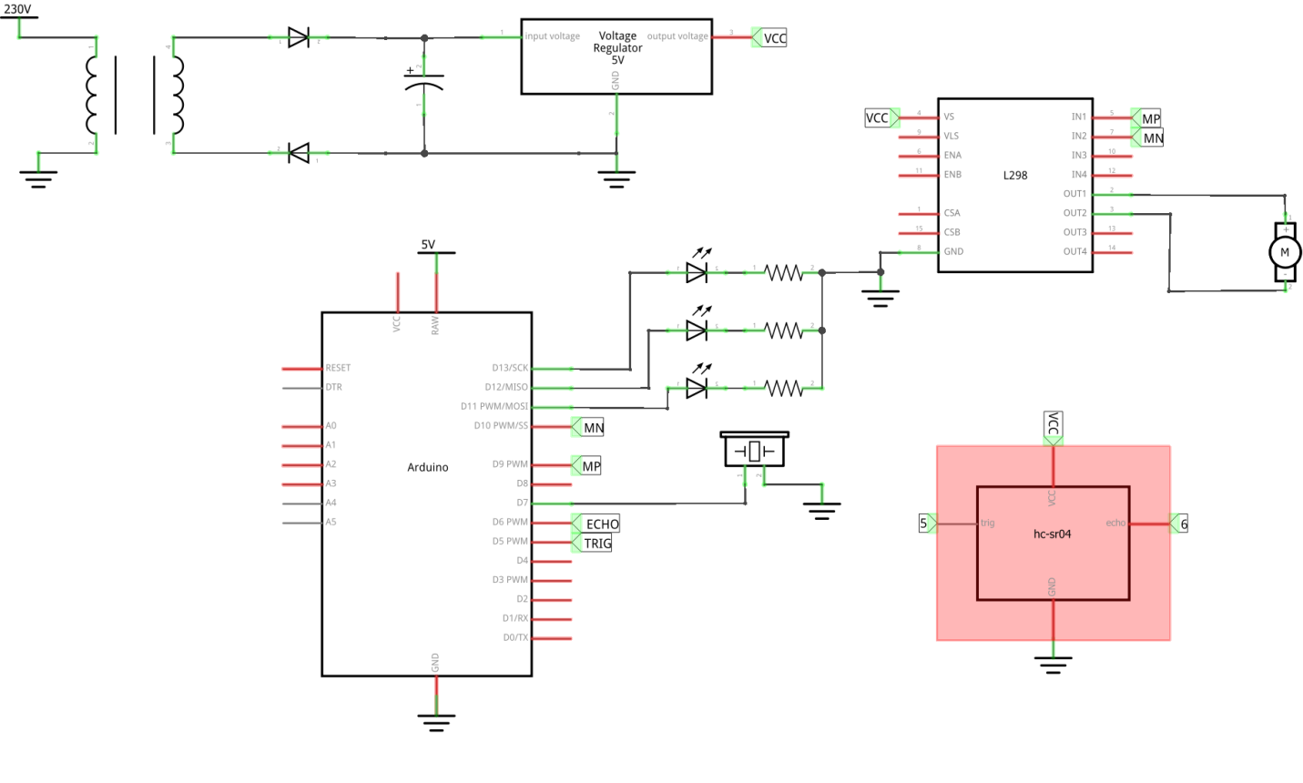
Architectural Model
Abstract
Introduction
Modules
Architecture Model
Software/Hardware Requirements
Screenshots
Conclusion
Future Enhancement
References

Slide 9
Introduction
Existing System
Proposed System
Software Requirements
References
Abstract
Introduction
Modules
Architecture Model
Software/Hardware Requirements
Screenshots
Conclusion
Future Enhancement
References
Software/Hardware Requirements
Arduino IDE
Embedded C
Microcontroller : Arduino Uno
Wifi-module
Driver circuit
DC motor
LEDs
Ultrasonic sensor

Slide 10
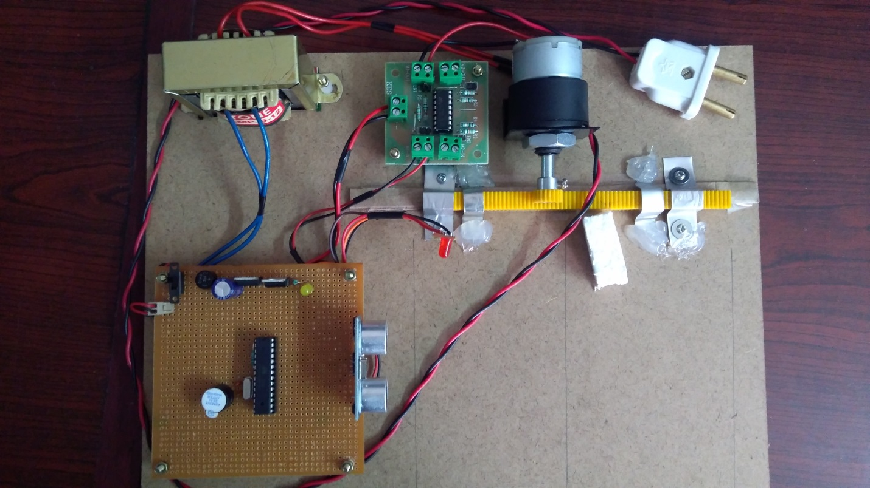
Screenshots
Abstract
Introduction
Modules
Architecture Model
Software/Hardware Requirements
Screenshots
Conclusion
Future Enhancement
References

Slide 11
Conclusion
Abstract
Introduction
Modules
Architecture Model
Software/Hardware Requirements
Screenshots
Conclusion
Future Enhancement
References
In any city, there is industrial area or shopping area where the traffic generally flows in one direction in the morning or evening.
The other side of Road divider is mostly either empty or very under utilized.
This is true for peak morning and evening hours. This results in loss of time for the car owners, traffic jams as well as under utilization of available resources.
An Automated road divider can provide a solution to the above mentioned problem effectively. Here Low, Medium and High density of traffic value will be posted on IOT server as a graph.

Slide 12
Future Enhancement
Abstract
Introduction
Modules
Architecture Model
Software/Hardware Requirements
Screenshots
Conclusion
Future Enhancement
References
The road moving is the solution for a certain period of time, but this is not an ideal solution.
For the better enhancement of controlling the traffic we are planning to make the road as flyovers whenever needed dynamically according to the traffic density (Similar to moving the road left and right, we move the whole road up and down).

Slide 13
Introduction
Existing System
Proposed System
Software requirements
References
Abstract
Introduction
Modules
Architecture Model
Software/Hardware Requirements
Screenshots
Conclusion
Future Enhancement
References
References
K.Vidhya, A.Bazila Banu, Density Based Traffic Signal System", Volume 3, Special Issue 3, March 2014
Priyanka Khanke, Prof. P. S. Kulkarni , "A Technique on Road Tranc Analysis using Image Processing", Vol. 3 Issue 2, February 2014
Rajeshwari Sundar, Santhoshs Hebbar, and Varaprasad Golla, Implementing intelligent Traffic Control System for Congestion Control, Ambulance Clearance, and Stolen Vehicle Detection" IEEE Sensors Journal, Vol. 15, No. 2, February 2015
Ms.Pallavi Choudekar, Ms.Sayanti Banerjee , Prof.M.K.Muju, Real Time Traffic Light Control Using Image Processing" Vol. 2, No. March
2/1

Slide 14
Introduction
Existing System
Proposed System
Software requirements
References
Abstract
Introduction
Modules
Architecture Model
Software/Hardware Requirements
Screenshots
Conclusion
Future Enhancement
References
References
S.Lokesh, “An Adaptive Traffic Control System Using Raspberry PI”, International journal of engineering sciences & research Technology, IEEE conference June 2014, pp 831-83
Shabbir Bhusari, “Traffic control system using Raspberry-pi”, Global Journal of Advanced Engineering Technologies ISSN (Online), Volume 4, Issue 4- 2015, pp 413-415.MARCH 2015
Soufiene Djahel, “Reducing Emergency Services Response Time in Smart Cities: An Advanced Adaptive and Fuzzy Approach”, IEEE 2015, pp 978- 986
George Kiokes, “Development of an Integrated Wireless Communication System for Connecting Electric Vehicles to the Power Grid”, IEEE conf. 2015, pp 296-301
2/1

Slide 15
Q and A?
?

