Slide 1
EDUNET
SRM University , Andhra Pradesh
My Work
Progress
Presentated by Nikhil Pulluri

Slide 2
Student Portfolio

Slide 3



Objectives
To learn and practice HTML, CSS and JavaScript
Showcase Skills and Accomplishments
Provide Evidence of Learning

Slide 4

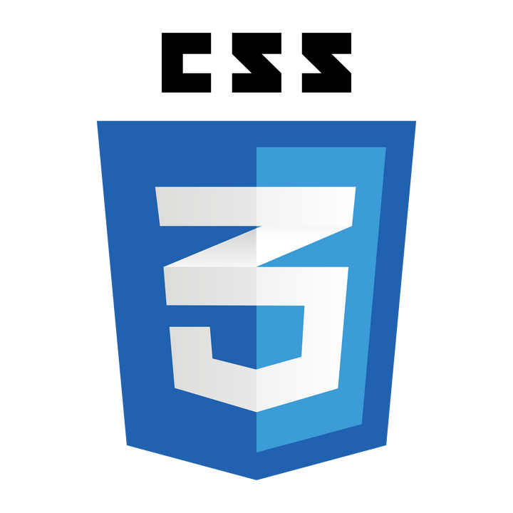



Tech Stack

Slide 5
01
Using different concepts like Navbars, Anchor tags, several other important tags to give proper detailing to the website.
02
Apply styles using Cascading Style Sheet (CSS). Features like Flex, Box shadow and several other to highlight the sections of the website.
Project Strategy
03
Using Media Queries to implement the responsiveness of the webpage.
04
Adding modal using Bootstrap and authentication using FireBase

Slide 6
Additional Features

Slide 7
Introducing Google Firebase

Slide 8

Firebase is a comprehensive app development platform developed by Google that provides a suite of tools and services to help developers build, improve, and grow their applications. Initially started as a real-time database service in 2011, Firebase was acquired by Google in 2014 and has since evolved into a powerful platform with a wide range of features.

Slide 9
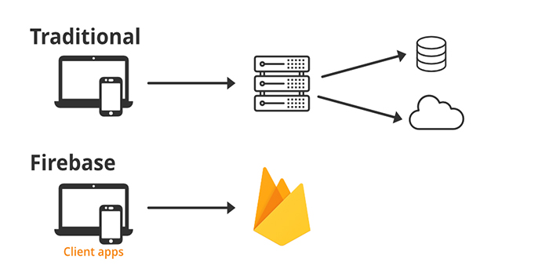
Traditional Backend Vs Firebase

Slide 10
In developing my student portfolio website, I working to integrate Firebase Authentication to manage user authentication securely and efficiently. Firebase, a comprehensive app development platform by Google, offers a robust and easy-to-implement authentication system that enhances the security and functionality of my portfolio.

Slide 11
Firebase Authentication provides a secure and reliable way to manage user identities. It supports various authentication methods, including email and password, phone authentication, and federated identity providers such as Google, Facebook, and Twitter. This versatility makes it an ideal choice for adding authentication to any web application, including my portfolio website.

Slide 12
Introducing
Bootstrap

Slide 13
Bootstrap is a popular open-source front-end framework developed by Twitter. It is designed to help developers create responsive and mobile-first web pages quickly and efficiently. Bootstrap provides a collection of reusable code, built-in components, and powerful JavaScript plugins, all of which make it easier to design modern and responsive websites.

Slide 14
In modern web development, providing a seamless and intuitive user authentication experience is crucial. One effective way to implement this is by using a modal—a dialog box/popup window that is displayed on top of the current page content. Bootstrap, a popular front-end framework, offers an easy-to-use modal component that can be customized to include authentication forms such as login and registration.

Slide 15
Some Highlights of the Project

Slide 16
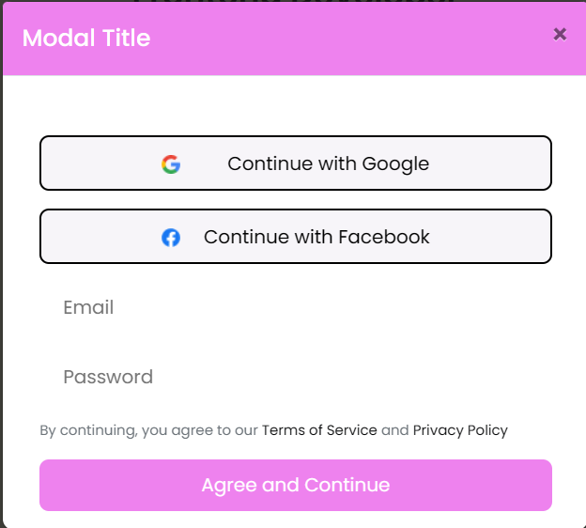
Using Bootsrap Modal
This feature enables to show a pop up before proceeding the website. Authentication is included inside the Modal.

Slide 17
Let’s have a Demo

Slide 18
Thank you
: )

