Slide 1
SPFF
Conv
Bottle Neck
Conv (1X1)
If shortcut=True
Conv2d
MaxPool2d
Conv
BatchNorm2d
MaxPool2d
Conv
MaxPool2d
SiLU
Concat
Conv (1X1)

Slide 2
C2F
C3K2
C3K
Conv
Conv
Conv
Split
C3K (3X3)
BottleNeck
n
n
BottleNeck
C3K (3X3)
BottleNeck
BottleNeck
Concat
Concat
Concat
Conv (1X1)
Conv (1X1)
Conv (1X1)

Slide 3
PSA
C2PSA
Attention
Conv (1X1)
Concat
Split
FFN
PSA
Conv (1X1)
PSA
Conv (1X1)
No activation
Concat
Concat
Conv (1X1)

Slide 4
640 x 640 x 3
Yolo V11 Architecture
Conv
Backbone
Head
Neck
320X320X(min(64,mc)xw)
Conv
C3K2
shortcut=False, n=3xd
80X80X(min(256,mc)xw)
Detect
160X160X(min(128,mc)xw)
C3K2
shortcut=False, n=3xd
80X80X(min(256,mc)xw)
Conv
160X160X(min(128,mc)xw)
80X80X(min(256,mc)xw)
Conv
Concat
80X80X(min(256,mc)xw)
Concat
C3K2
shortcut=False, n=6xd
80X80X(min(256,mc)xw)
C3K2
shortcut=False, n=3xd
Upsample
40X40X(min(512,mc)xw)
40X40X(min(512,mc)xw)
Detect
80X80X(min(256,mc)xw)
80X80X(min(256,mc)xw)
40X40X(min(512,mc)xw)
C3K2
shortcut=False, n=3xd
40X40X(min(512,mc)xw)
Conv
40X40X(min(512,mc)xw)
Conv
C3K2
shortcut=True, n=6xd
Concat
40X40X(min(512,mc)xw)
20X20X(min(1024,mc)xw)
40X40X(min(512,mc)xw)
40X40X(min(512,mc)xw)
Conv
Upsample
20X20X(min(1024,mc)xw)
Concat
SPFF
20X20X(min(1024,mc)xw)
C3K2
shortcut=True, n=3xd
20X20X(min(1024,mc)xw)
20X20X(min(1024,mc)xw)
C3K2
shortcut=False, n=3xd
20X20X(min(1024,mc)xw)
Detect
C2PSA
20X20X(min(1024,mc)xw)

Slide 5
Conv
Bottle Neck
If shortcut=True
Conv2d
Conv
BatchNorm2d
Conv
SiLU

Slide 6
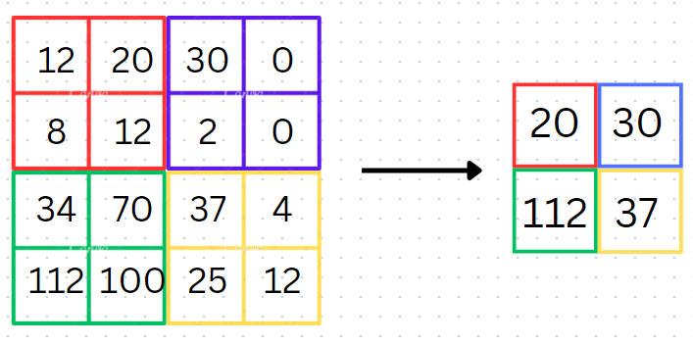
SPFF
Conv (1X1)
MaxPool2d
MaxPool2d
MaxPool2d
Concat
Conv (1X1)

Slide 7
