Slide 1
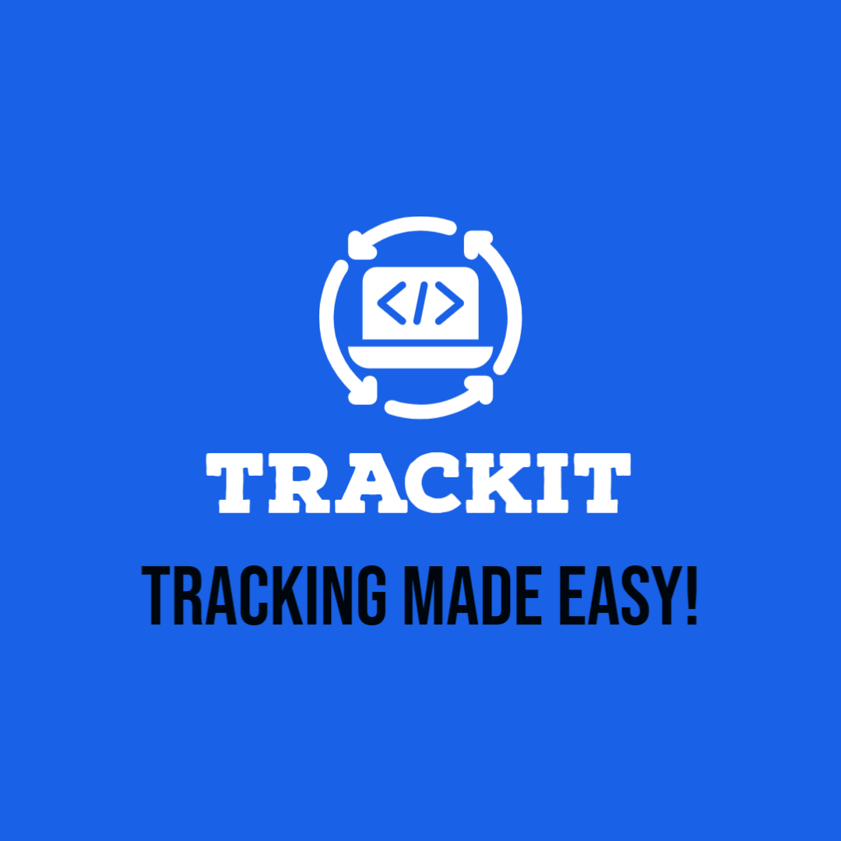
TrackIT
INFO: 6150 Final Project
Project Tracking made Easy
Group Members:
Naga Venkata Nishanth Sayana
Nikhil Reddy Karukonda
Venkatesha Matam
Rahul Chowdary Kalapala

Slide 2

Description
In this rapidly evolving technology era, the number of projects handled by each tech company has been growing continuously, making it difficult for companies to handle the projects effectively.
So TrackIT tool assists companies to manage multiple projects efficiently.
This application contains many use cases such as project spaces, task scheduling, project task analytics, etc. which are vital for project management.

Slide 3

Features
Login and Sign-Up
Authentication
View Project List
CRUD operations on Project (Contains Users, Project metadata and Tasks reference)
View Tasks List Under the Project, Filter by User
CRUD operations on Tasks with-in a Project
View Task Analytics -> Task Status

Slide 4

Tech Stack
ReactJs with Material UI (MUI)
NodeJs (Express -> REST API), MongoDB ​(Mongoose)
Context API for state management
SASS, Moment, Chart.js​ (Doughnut Chart API), dotenv
Node-Mailer (OTP authentication), BcryptJs(Password),
JWT Authentication​
​Axios for HTTP API Calls

Slide 5
Contributions
Naga Venkata Nishanth Sayana →
Nikhil Reddy Karukonda →
Venkatesha Matam →
Rahul Kalapala →
Log-In, Sign-Up & User Profile(UI & Backend), User Context API, JWT Authentication, Node-Mailer and BcryptJs
(UI and Backend) Project Setup
DB schema (Projects, Users, Tasks), Navbar UI
Projects -> UI (Card and Modals, User Context) and APIs (CRUD)
Tasks -> APIs (CRUD), Filter tasks by user
Tasks page -> Task Cards, Task Modals, Task Chips, Analytics Modal
SCSS -> Task cards, Task modals
User Context
Tasks → Task analytics chart, SCSS

Slide 6

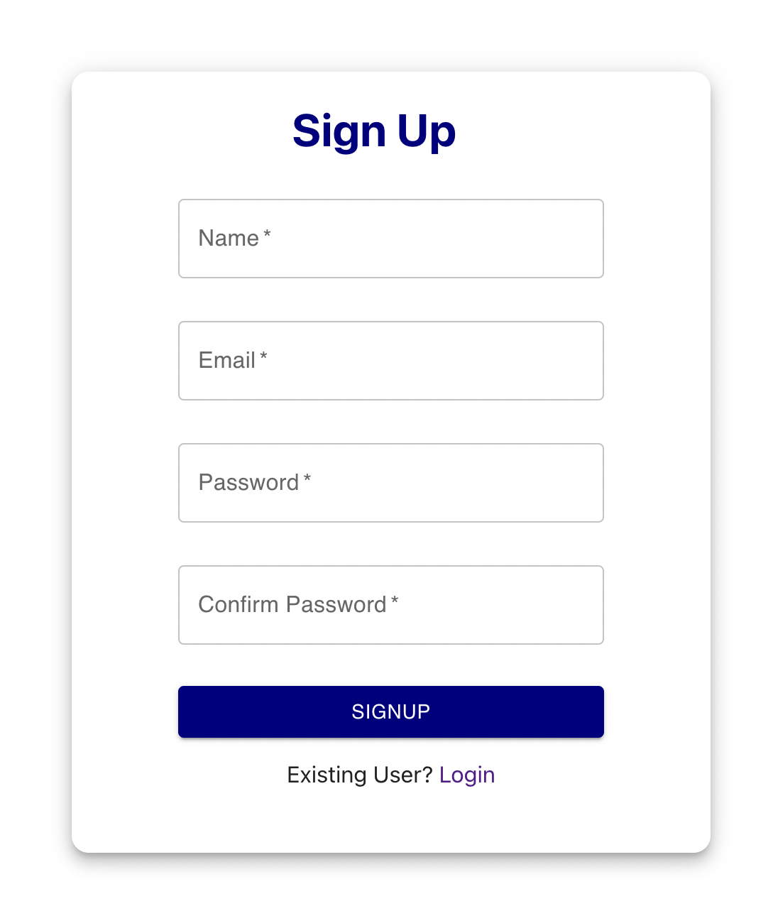
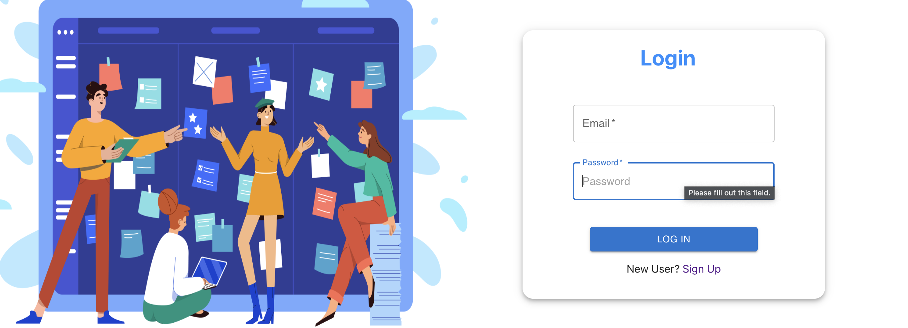
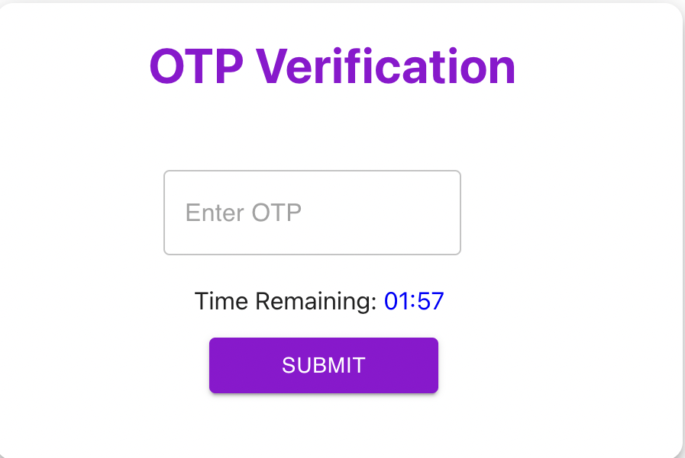
Login, Sign-Up && OTP Verification with Timer

Slide 7

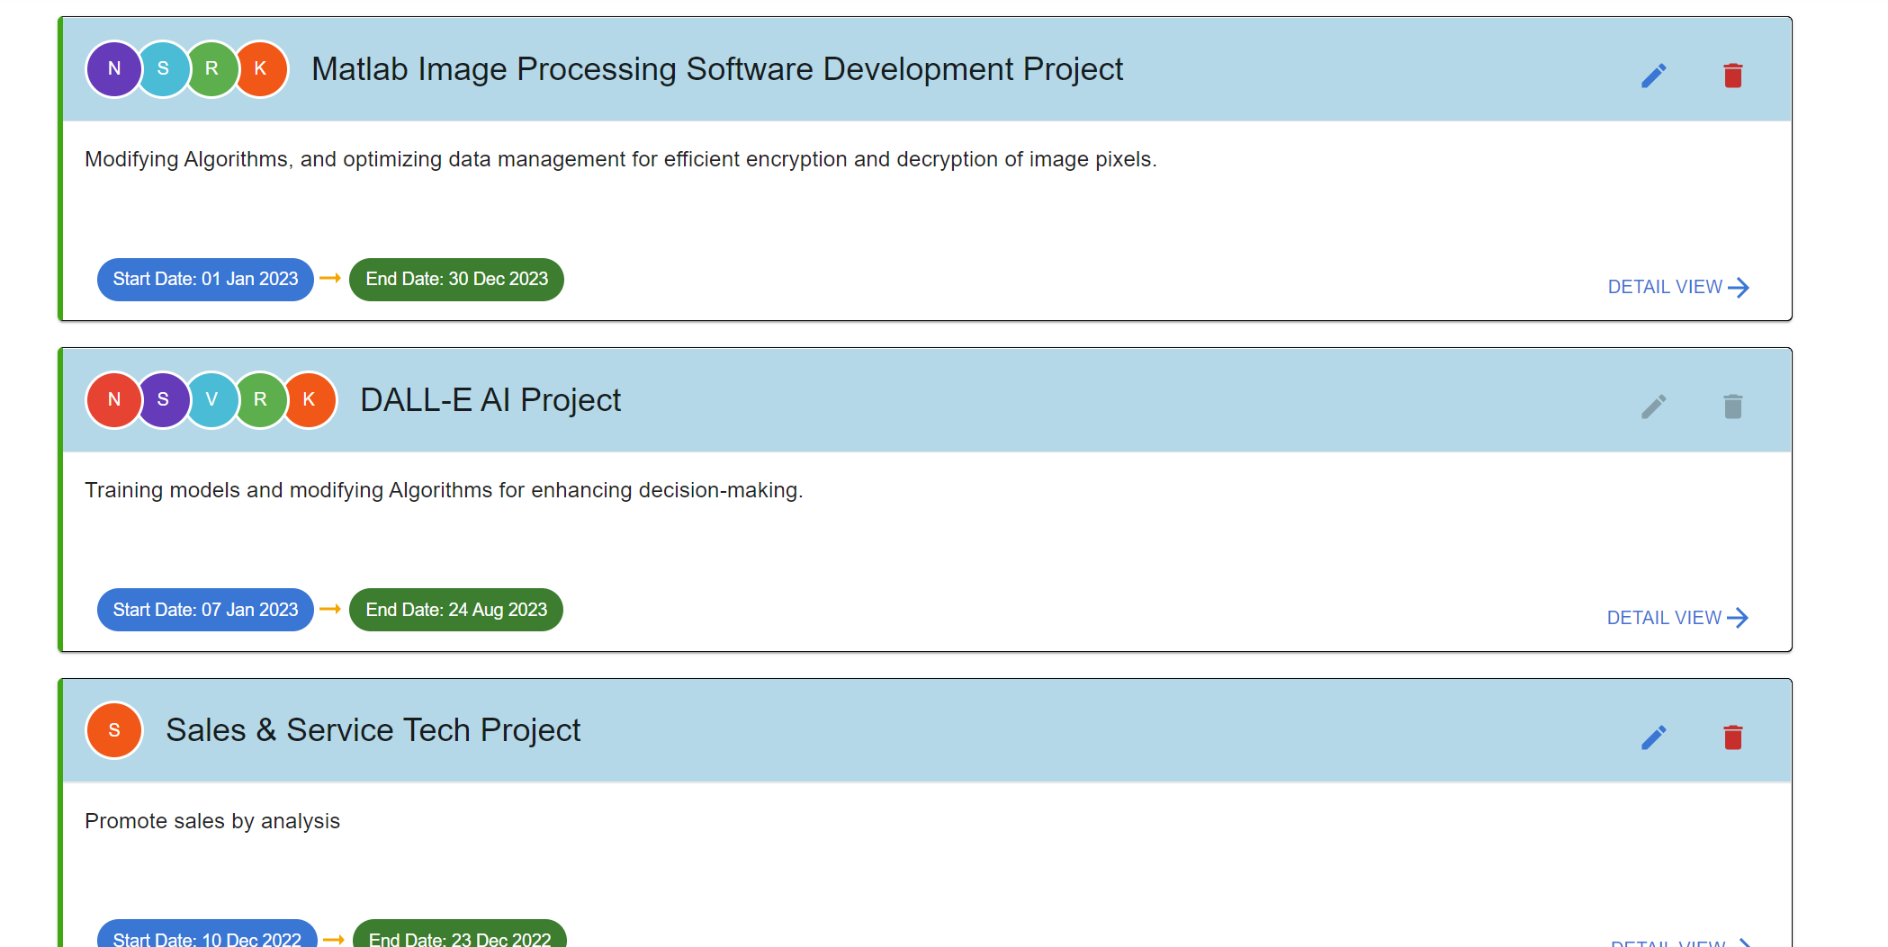
Projects List

Slide 8
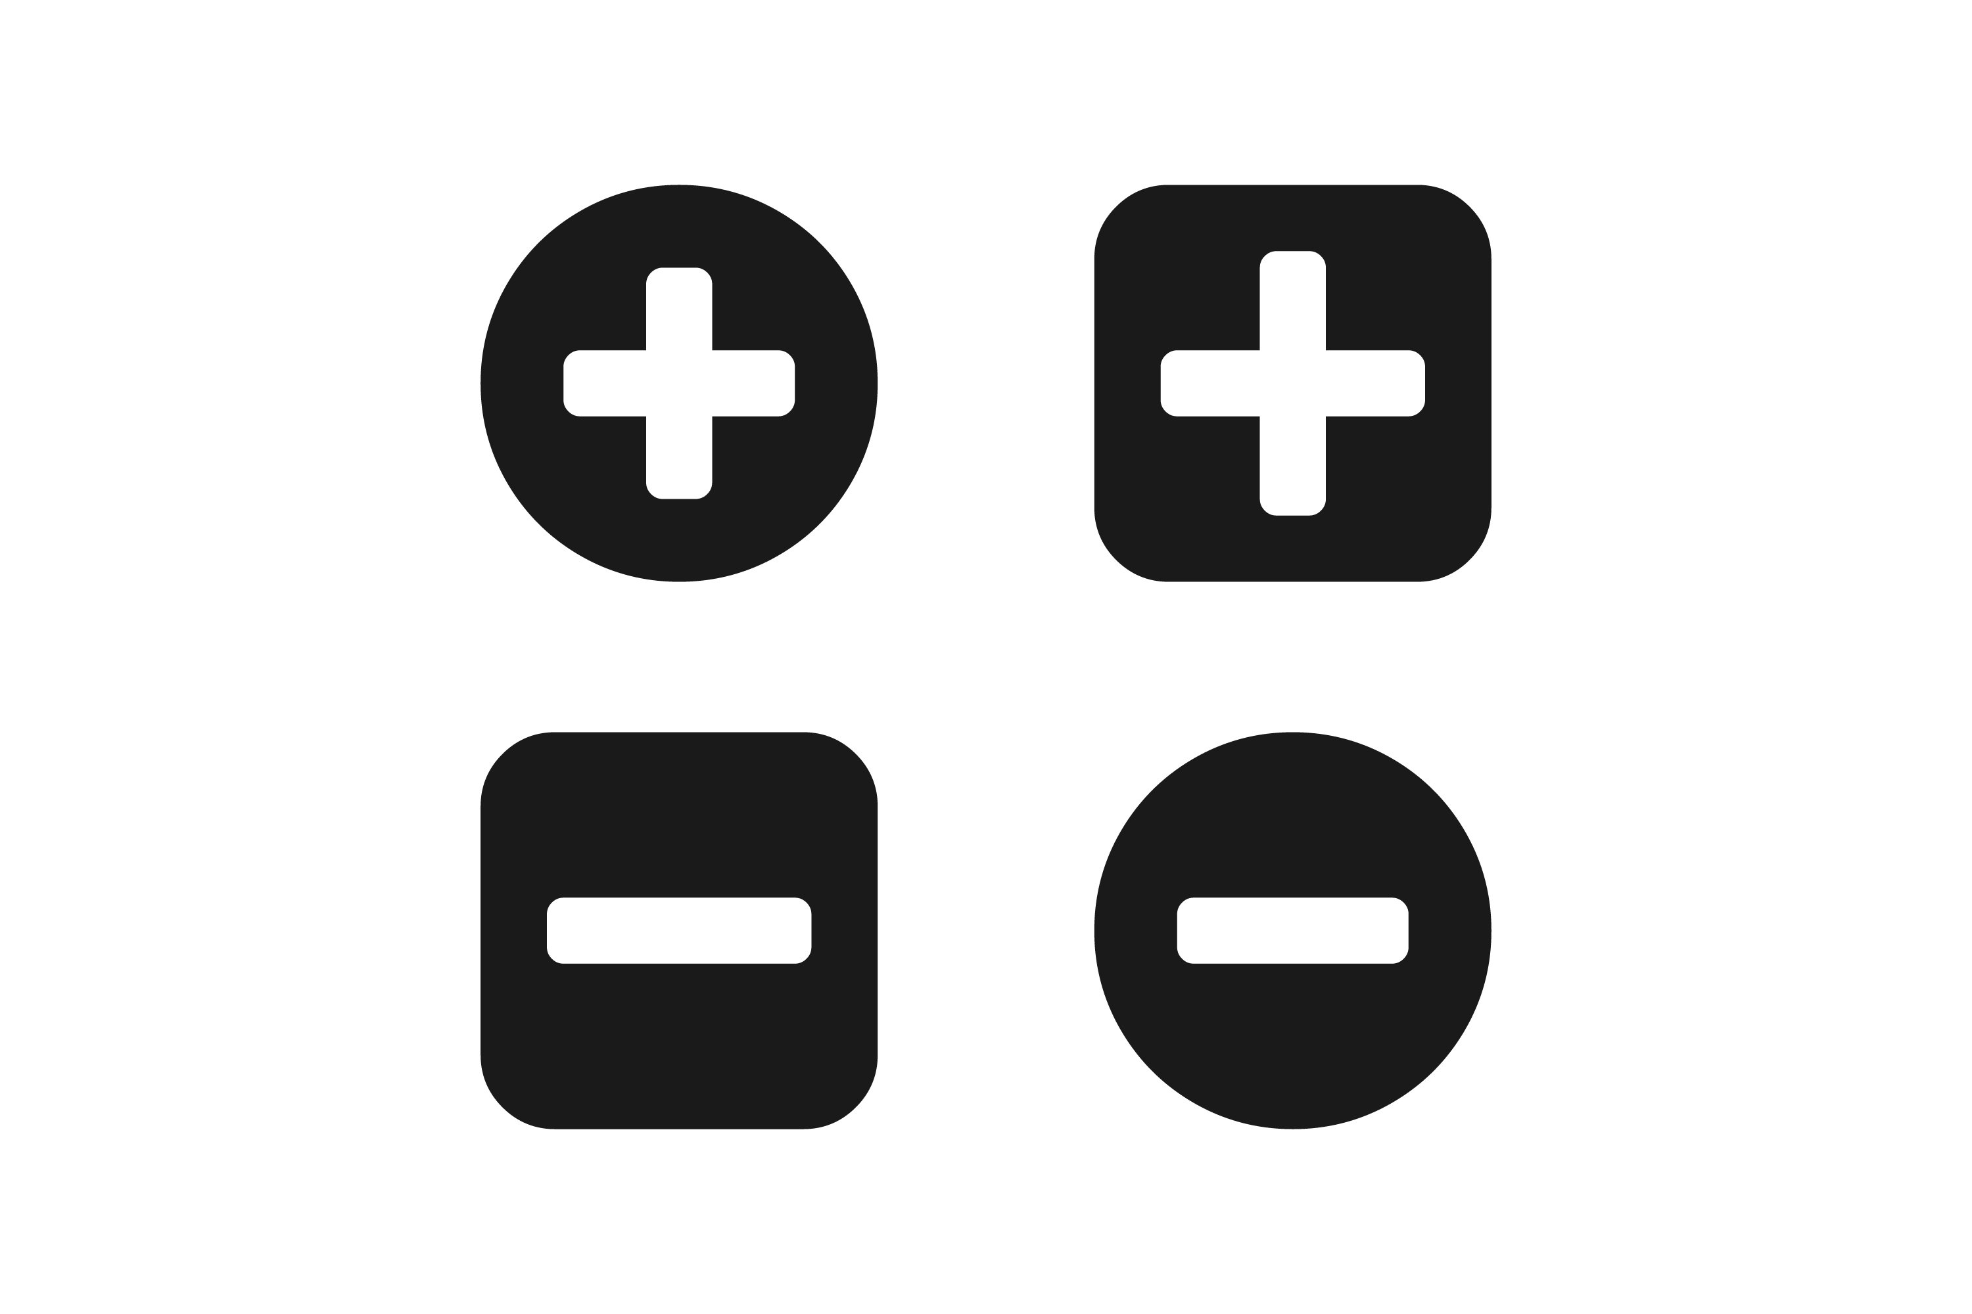
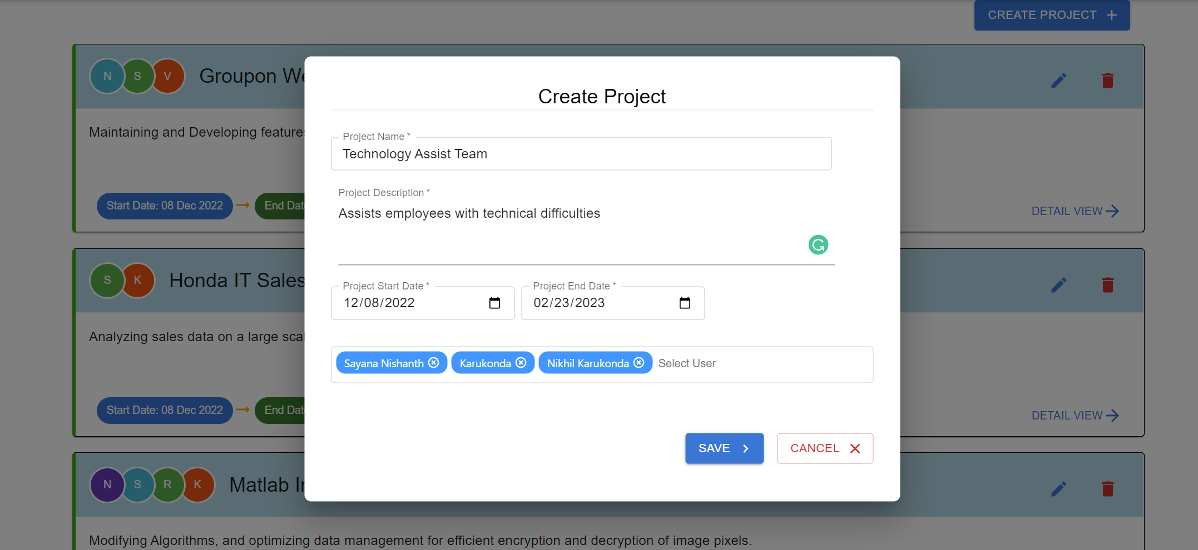
Project Modal (CREATE / EDIT)

Slide 9

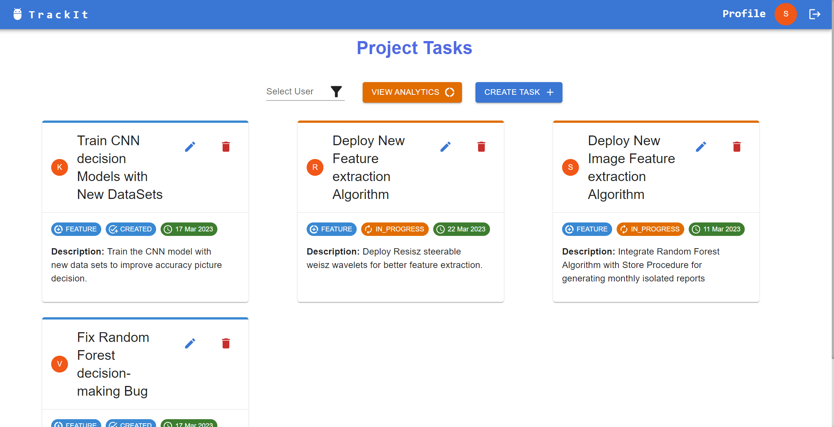
Project - Tasks List

Slide 10

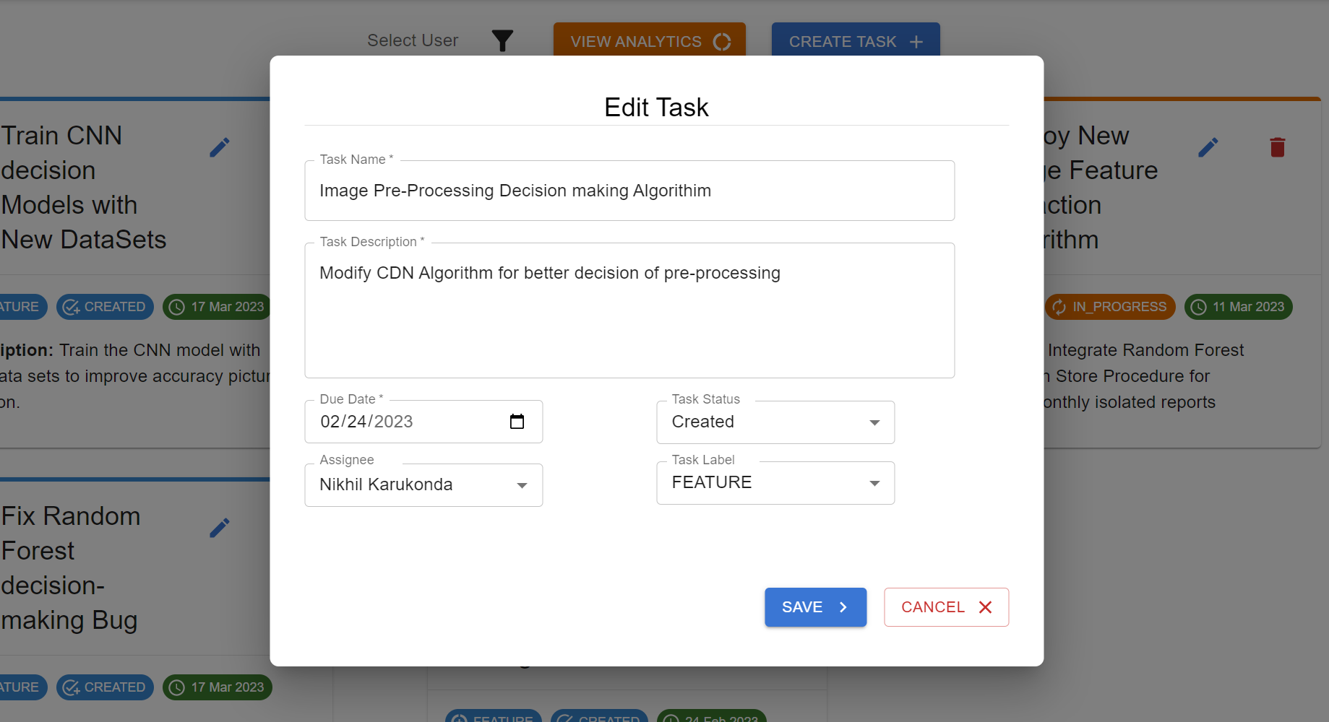
Tasks Modal (CREATE / EDIT)

Slide 11

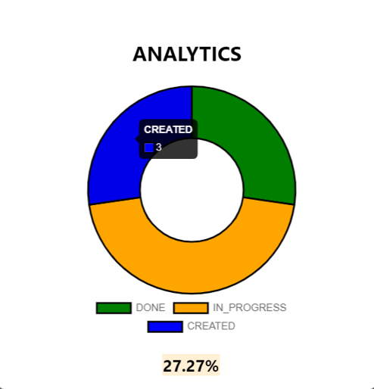
Task Analytics
ChartJs Library is used to render charts
Doughnut Chart is used to display the Task Status (CREATED, IN_PROGRESS, DONE) Counts on Hover.
Tasks can be filtered by Username
Chart Filter

Slide 12
References
https://mui.com/
https://expressjs.com/
https://www.telerik.com/kendo-react-ui/react-hooks-guide/
https://www.chartjs.org/docs/latest/charts/doughnut.html
https://developer.mozilla.org/en-US/docs/Web/JavaScript
https://www.npmjs.com/package/axios
https://www.npmjs.com/package/multiselect-react-dropdown

Slide 13
Thank You

