Slide 1
Hadoop Ecosystem

Slide 2

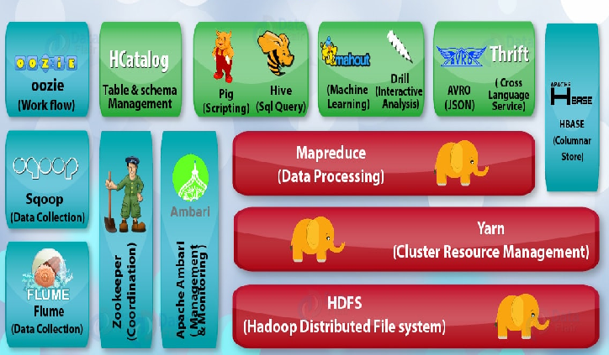

Slide 3
Hadoop ecosystem
Flume is a system used for moving massive quantities of streaming data into HDFS
Sqoop is a tool designed to transfer data between Hadoop and relational database servers.
Oozie is a workflow scheduler system to manage Apache Hadoop jobs
HCatalog is a table and storage management layer for Hadoop that enables users with different data processing tools

Slide 4
Zookeeper
Zookeeper is a coordination service for distributed application that enables synchronization across a cluster. Zookeeper in Hadoop can be viewed as centralized repository where distributed applications can put data and get data out of it.

Slide 5
Hadoop Distributed File System -HDFS
is the primary storage system of Hadoop
is a java based file system
is a distributed filesystem that runs on commodity hardware
Hadoop interact directly with HDFS by shell-like commands

Slide 6
Regular file system vs HDFS
In HDFS block size is fixed
HDFS does not allow editing of files
Access is sequential
Replication of data

Slide 7
HDFS Components
NameNode
DataNode

Slide 8


Slide 9
NameNode
Also known as Master node
Does not store actual data or dataset
Stores Metadata (number of blocks, their location, on which Rack, which Data node the data is store)

Slide 10
Tasks of HDFS NameNode
Manage file system namespace
Regulates client’s access to files
Executes file system execution such as naming, closing, opening files and directories

Slide 11
High Availability of NameNode
Prior to Hadoop 2.0.0, the NameNode was a single point of failure
After Hadoop 2, the HDFS High Availability feature addresses SPOF by running redundant NameNodes – Active and Standby
Active NameNode is responsible for all client operations in the cluster
Standby is simply acting as a slave, maintaining enough state to provide a fast failover if necessary
In order for the Standby nodes to keep their state synchronized with the Active node, the nodes have access to a directory on a shared storage device

Slide 12
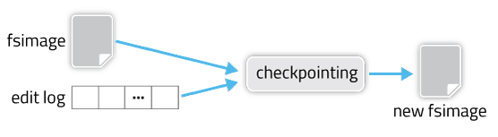
Check Points
Checkpointing is an essential part of maintaining and persisting filesystem metadata in HDFS. It’s crucial for efficient NameNode recovery and restart, and is an important indicator of overall cluster health
Checkpointing is a process that takes an fsimage and edit log and compacts them into a new fsimage

Slide 13
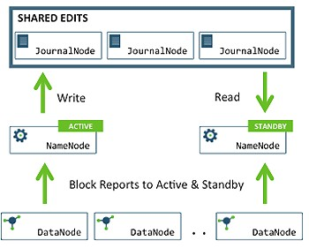

Slide 14
Active NameNode and Standby NameNode

Slide 15
DataNode and its tasks
It is also known as Slave
Responsible for storing actual data in HDFS
Performs read and write operation as per the request of the clients
Also perform block creation, deletion, and replication upon instruction from the NameNode.

Slide 16
DataNode
DataNode is also known as Slave node.
DataNode stores actual data in HDFS.
DataNodes responsible for serving, read and write requests for the clients.
DataNodes can deploy on commodity hardware.
DataNodes sends information to the NameNode about the files and blocks stored in that node and responds to the NameNode for all filesystem operations
When a DataNode starts up it announce itself to the NameNode along with the list of blocks it is responsible for.

Slide 17
Functions of DataNode
The DataNodes perform the low-level read and write requests from the file system’s clients.
Every DataNode sends a heartbeat message to the Name Node and conveys that it is alive.
All Data Nodes are synchronized in the Hadoop cluster in a way that they can communicate with one another and make sure of
Balancing the data in the system
Move data for keeping high replication
Copy Data when required

