Slide 1
MINI PROJECT
Name | Nikhil M Nikhil S G Vinayashree M Shet
Registration Numbers
Branch | Big Data Analytics
Project Title | Speech Enhancement Using Audio Spectrogram Transformer model
Guide
241058020
241058024
241058030
Mr. Raghudathesh G P

Slide 2
CONTENTS
Introduction
Objective
Operational Flow
Functional Requirements
Implementation
References

Slide 3
INTRODUCTION
This project highlights the innovative Audio Spectrogram Transformer (AST), a ground breaking model that revolutionizes audio classification by leveraging a purely attention-based architecture. AST applies a Vision Transformer to audio spectrograms, treating them as images, which allows it to capture long-range dependencies and global context more effectively than traditional convolutional neural networks (CNNs). Developed by Yuan Gong, Yu-An Chung, and James Glass, AST achieves state-of-the-art results on various benchmarks, including Audio Set, ESC-50, and Speech Commands, with remarkable accuracy such as 0.485 mAP on Audio Set and 95.6% accuracy on ESC-50. By eliminating the need for convolutions, AST simplifies the architecture while maintaining superior performance, making it a versatile tool for diverse audio classification tasks.

Slide 4
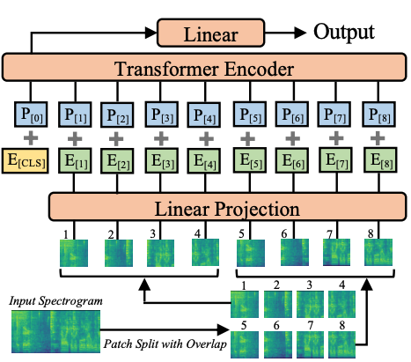
Audio Spectrogram Transformer architecture.

Slide 5
The AST model consists of the following main components:
Patch embedding: converts the input spectrogram into a sequence of patches.
Sinusoidal positional embedding: adds positional information to the patch embeddings.
Multi-head self attention: captures dependencies between patches.
Transformer encoder: encodes the sequence of patches using multiple layers of self-attention and feed-forward networks.
MLP head: maps the encoded patches to the desired output classes.

Slide 6
OBJECTIVE
Data Preparation
Data modelling/Modeling the data
Benchmarking the results with other work

Slide 7
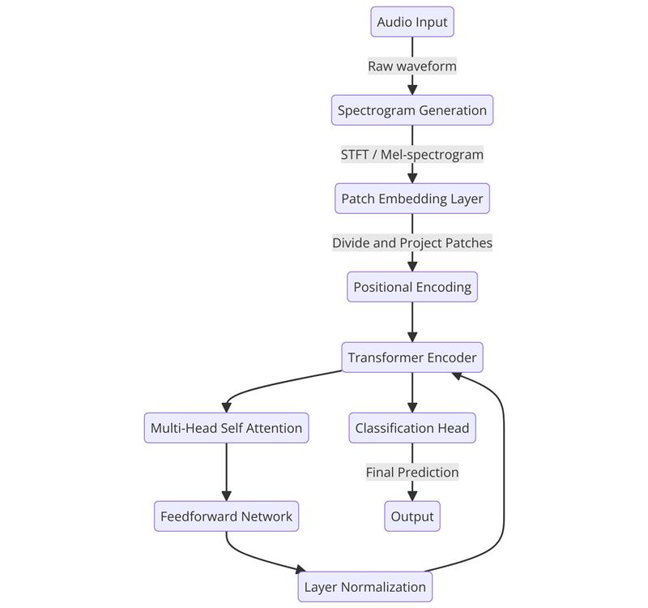
Block Diagram

Slide 8
. Patch Embedding
Splits the input spectrogram into fixed-size patches using 2D convolution.
Each patch is flattened and projected into an embedding space.
Input shape: [B, C, H, W], Output shape: [B, N, D].
Enables spectrograms to be processed like token sequences in transformers.
Sinusoidal Positional Embedding
Adds positional information to each patch embedding using sine and cosine waves.
This helps the transformer model understand the order of patches.
Even indices use sine functions; odd indices use cosine functions.
It is non-learnable and based purely on position and frequency.

Slide 9
Multi-Head Self Attention
Enables the model to attend to multiple parts of the input simultaneously.
Uses multiple attention "heads" for richer feature extraction.
Each head computes scaled dot-product attention independently.
Outputs are concatenated and linearly transformed to capture dependencies.
Transformer Encoder
Each layer contains multi-head self-attention and a feed-forward network.
Includes layer normalization and residual connections for stability.
Stacked layers allow deeper, more abstract representation learning.
Ideal for capturing global relationships across all spectrogram patches

Slide 10
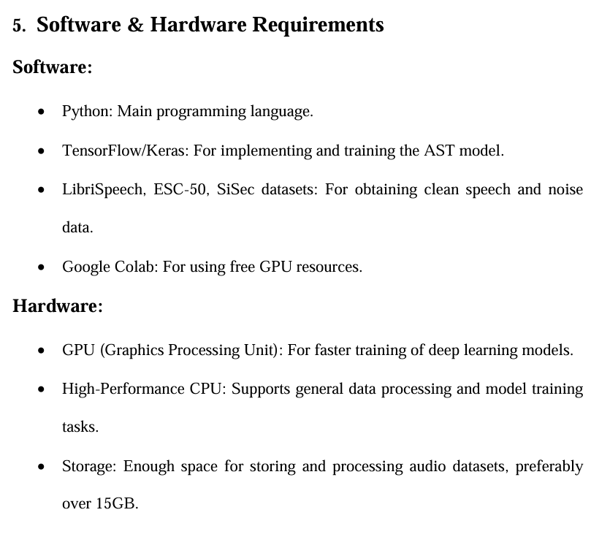
FUNCTIONAL REQUIREMENTS

Slide 11
IMPLEMENTATION
Import Libraries & Modules Import PyTorch, torchaudio, and model components like PatchEmbed, MultiHeadAttention, etc.
Preprocess Dataset Convert audio files into log-mel spectrograms; normalize and reshape them.
Apply Patch Embedding Split spectrogram into fixed-size patches and embed using a 2D convolution.
Add Positional Encoding Use sinusoidal embeddings to inject patch position information.
Transformer Encoder Layers Stack multiple encoder layers with self-attention and feed-forward networks.
Classification with MLP Head Apply global pooling and a fully connected layer to output class scores.
Train the Model Use cross-entropy loss and Adam optimizer to train on labeled spectrograms.
Evaluate Performance Measure accuracy, plot confusion matrix, and visualize model predictions.

Slide 12
RESULTS
The Audio Spectrogram Transformer (AST) effectively adapts transformer models for audio processing by treating spectrograms as sequences of patches, similar to how Vision Transformers handle images. The model begins by embedding non-overlapping spectrogram patches into a latent space, enriched with sinusoidal positional information to maintain temporal context. Multi-head self-attention enables the model to capture global dependencies across patches, which are further refined through stacked transformer encoder layers. The final MLP head projects these learned representations into output classes for tasks such as audio classification. Overall, the AST architecture demonstrates strong performance in capturing the hierarchical and temporal patterns in audio data, making it a powerful tool for tasks like environmental sound recognition, audio tagging, and speech classification.

Slide 13
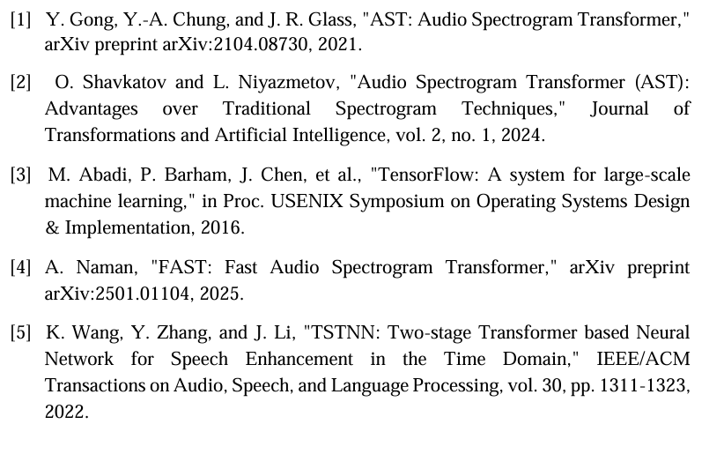
REFERENCES
[1] K. J. Piczak, "ESC: Dataset for Environmental Sound Classification," in Proc. ACM Int. Conf. on Multimedia, Orlando, FL, USA, Nov. 2015, pp. 1015-1018.
[2] O.Ronneberger, P. Fischer, and T. Brox, "U-Net: Convolutional Networks for Biomedical Image Segmentation," in Proc. Int. Conf. on Medical Image Computing and Computer-Assisted Intervention (MICCAI), Munich, Germany, Oct. 2015, pp. 234-241.
[3] Jansson, E. Humphrey, N. Montecchio, R. Bittner, A. Kumar, and T. Weyde, "Singing voice separation with deep U-Net convolutional networks," in Proc. Int. Conf. on Music Information Retrieval (ISMIR), Suzhou, China, Oct. 2017, pp. 745-751.
[4] N. Siddique, S. Paheding, C. P. Elkin, and V. Devabhaktuni, "U-Net and its variants for medical image segmentation: A review of theory and applications," IEEE Access, vol. 9, pp. 82031-82057, 2021.
[5] Y. Deng, Y. Hou, J. Yan, and D. Zeng, "ELU-Net: An efficient and lightweight U-Net for medical image segmentation," IEEE Access, vol. 8, pp. 123045-123053, 2020.

Slide 14
THANK YOU

