Slide 1

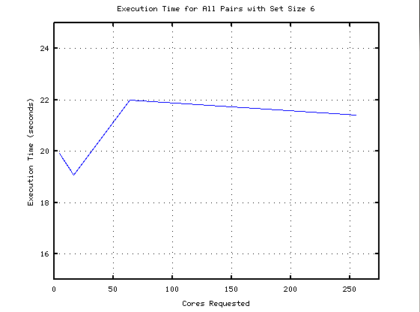
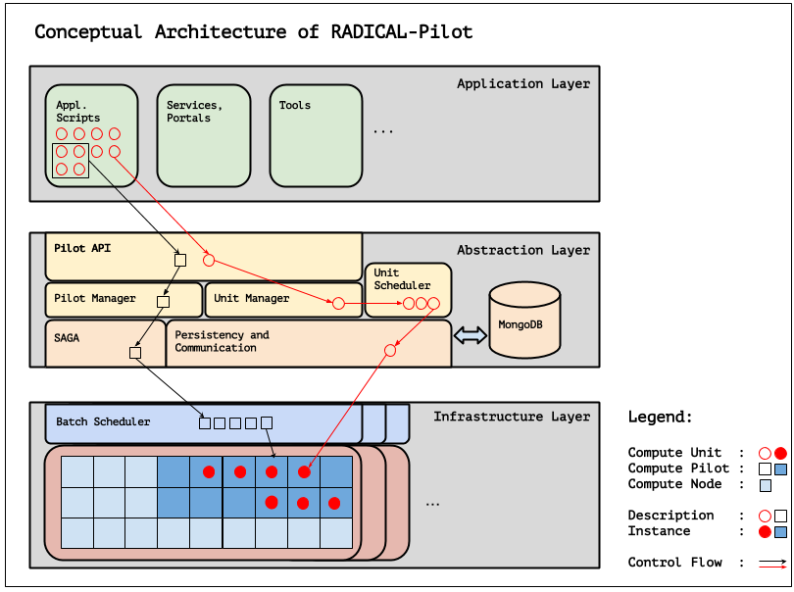
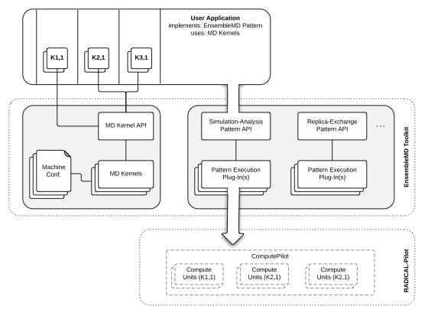
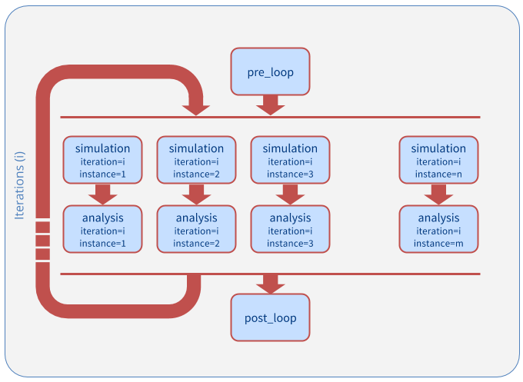
Analyzing Performance of RADICAL-Pilot in Molecular Dynamics Simulations
Nikhil Shenoy
Professor Shantenu Jha, RADICAL Cybtertools Research Group, Rutgers Electrical and Computer Engineering Department
Introduction
Methods
Results/Discussion
Much of today's scientific experiments have become computation driven, and the amount of data that needs to be processed can be very large. For example, biologists run computationally-intensive molecular dynamics simulations to process large data sets on machines called high performance computers. Scheduling simulations and managing the data produced by them has become a major challenge, as well as getting fast return times and efficiently using the resources on each machine. This research seeks to solve these challenges by improving upon a simple interface for molecular biologists to submit domain-specific tasks for processing on high performance computers.
The performance measurements for this project involved four steps:
1) Identify portions of each Ensemble MD pattern that interact with RADICAL-Pilot
2) Wrap each section of the pattern with timing functions to measure execution time
3) Scale the number of requested cores by powers of 2 while holding the workload constant
4) Scale the size of the workload while holding the number of requested cores constant
5) Time the execution of the entire script
6) Repeat each configuration four times
7) Repeat steps 1-5 on another HPC machine, such as Trestles or Gordon
As the size and complexity of the workload increased, the total execution time increased above the expected value.
Trials on Trestles and Gordon (other HPC machines) exhibited similar behavior, but with slight variations.
In several cases, the execution time of a workload did not decrease as the core count increased.
Background
The Ensemble MD (Molecular Dynamics) Toolkit is a Python framework that captures and implements common molecular dynamics patterns for large numbers of simulations. Ensemble MD utilizes RADICAL-Pilot, a Python-based Pilot-Job framework, as a tool to submit user-defined jobs to the computing cluster. The two modules work hand-in-hand to provide simple, easy-to-use abstraction for molecular biologists to submit their tasks. Users of Ensemble MD will directly interact with three modules to perform their high-performance task: the Pattern class, the Application kernel, and the Execution Environment. The Pattern class contains the logic for the user’s task, while the Application Kernel defines the application workload. Finally, the Execution Environment represents the resource on which the task is being computed. These three components interface with RADICAL-Pilot to process HPC jobs.
Figure 4: Plot of Execution time as the number of cores increases. The workload was to run the generic All_Pairs example.
Future Directions
Figure 2: This diagram describes the interaction between RADICAL-Pilot and the underlying HPC machine. Ensemble MD resides in a layer above the Application layer and interacts with the Application layer. The Abstraction Layer displays the different components of RADICAL-Pilot during job submission. The Infrastructure layer shows how Pilots are scheduled onto the hardware.
Develop other client APIs which are designed for specific scientific uses (ex.: DNA Sequencing).
The interactions measured between EnsembleMD and RADICAL-Pilot could also be used to develop a generic scientific interface. With a generic interface, a scientist could still have access to the benefits of RADICAL-Pilot even though there may not be a dedicated API for his area of expertise yet.
Acknowledgements
I would like to thank Professor Shantenu Jha, Matteo Turilli, Vivek Subramanian, Ioannis Paraskevakos, and the rest of the RADICAL team for all their guidance. This project would nothave been done with them.
Figure 1: Flow diagram of Ensemble MD Operation
Figure 3: Ensemble MD Pattern for Simulation Analysis
Notes:
feel free to change background colors & text boxes and use sections for difference purposes!
1

