Slide 1

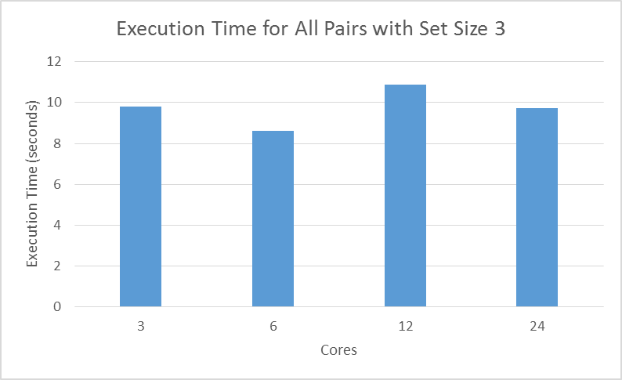
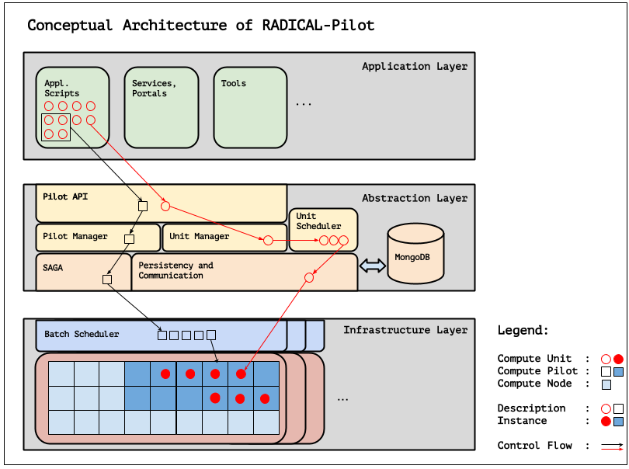
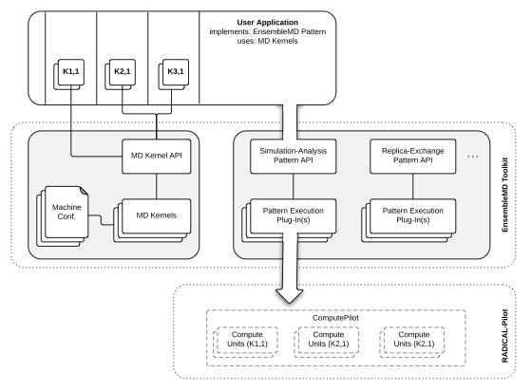
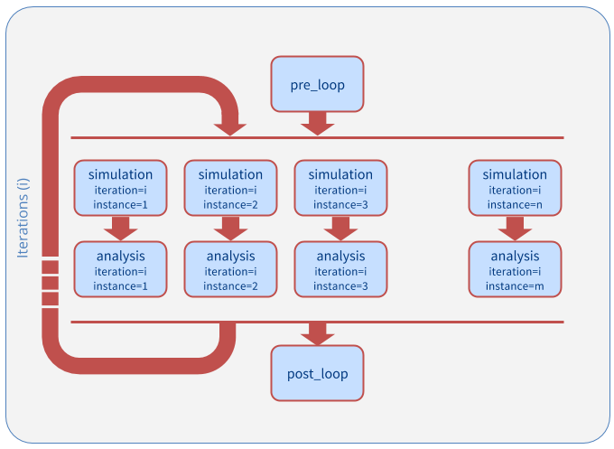
Analyzing Performance of RADICAL-Pilot in Molecular Dynamics Simulations
Nikhil Shenoy
Professor Shantenu Jha, RADICAL Cybtertools Research Group, Rutgers Electrical and Computer Engineering Department
Introduction
Methods
Results/Discussion
Much of today's scientific experiments rely on processing large amounts of data.
Biologists run computationally- and data-intensive simulations on machines called high performance computers.
Major Challenges: Scheduling simulations, managing the data, getting fast return times, efficient utilization of resources.
This research seeks to solve these challenges by improving upon a simple interface for molecular biologists to process high performance tasks.
The performance measurements for this project involved four steps:
1) Identify portions of each Ensemble MD pattern that interact with RADICAL-Pilot
2) Wrap each section of the pattern with timing functions to measure execution time
3) Scale the number of requested cores by powers of 2 while holding the workload constant
4) Scale the size of the workload while holding the number of requested cores constant
5) Time the execution of the entire script
6) Repeat each configuration four times
7) Repeat steps 1-5 on another HPC machine, such as Trestles or Gordon
As the size and complexity of the workload increased, the total execution time increased above the expected value.
Trials on Trestles and Gordon (other HPC machines) exhibited similar behavior, but with slight variations.
In several cases, the execution time of a workload did not decrease as the core count increased.
Background
The Ensemble MD (Molecular Dynamics) Toolkit is a Python framework that captures and implements common molecular dynamics patterns for large numbers of simulations.
Ensemble MD utilizes RADICAL-Pilot, a Python-based framework, as a tool to submit user-defined jobs to the computing cluster.
Ensemble MD consists of components that represent the logic of an application, the workload, and the execution resource.
The two frameworks work hand-in-hand to provide simple, easy-to-use abstraction for molecular biologists to submit their tasks.
Figure 4: Plot of Execution time as the number of cores increases. The workload was to run the generic All_Pairs example.
Future Directions
Figure 2: Ensemble MD resides in a layer above the shown Application layer and interacts with it. The Abstraction Layer then utilizes components of RADICAL-Pilot for job submission. Finally, the Infrastructure layer shows how tasks are scheduled onto the hardware.
Develop other client APIs which are designed for specific scientific uses (ex.: DNA Sequencing).
The interactions measured between EnsembleMD and RADICAL-Pilot could also be used to develop a generic scientific interface. With a generic interface, a scientist could still have access to the benefits of RADICAL-Pilot even though there may not be a dedicated API for his area of expertise yet.
Acknowledgements
I would like to thank Professor Shantenu Jha, Matteo Turilli, Vivek Subramanian, Ioannis Paraskevakos, Antons Treikalis, and the rest of the RADICAL team for all their guidance. This project could not have been done with them.
Figure 1: Flow diagram of Ensemble MD Operation
Figure 3: Ensemble MD Pattern for Simulation Analysis
Notes:
feel free to change background colors & text boxes and use sections for difference purposes!
1

