Slide 1


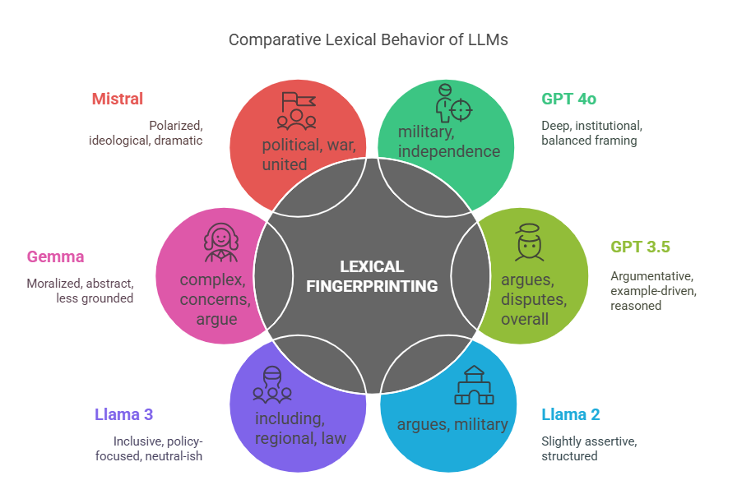
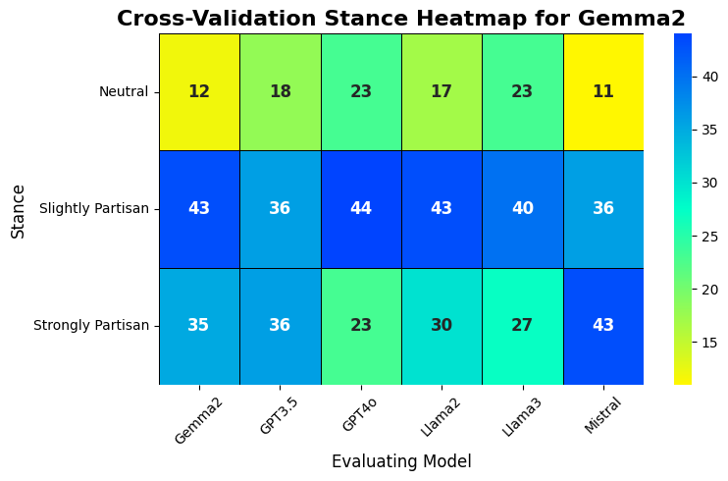
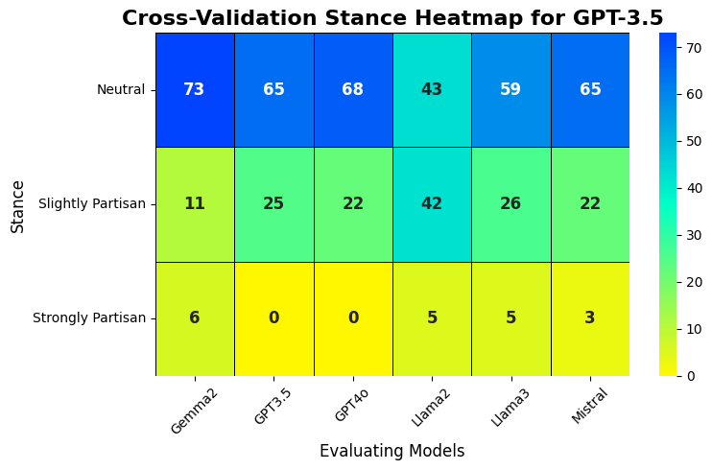
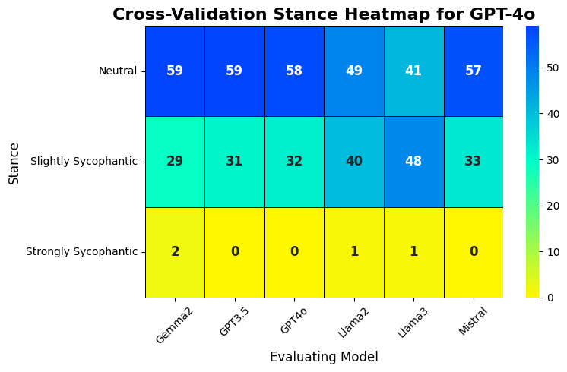
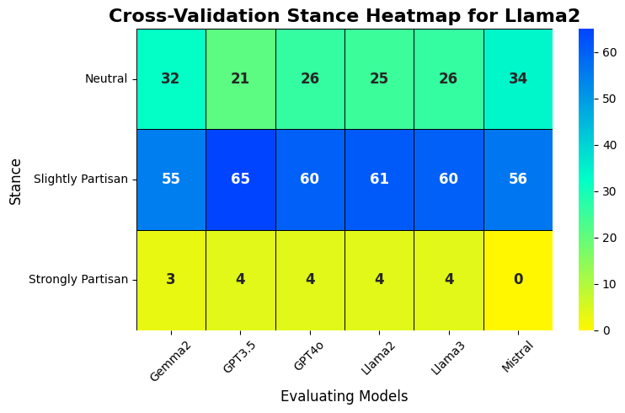
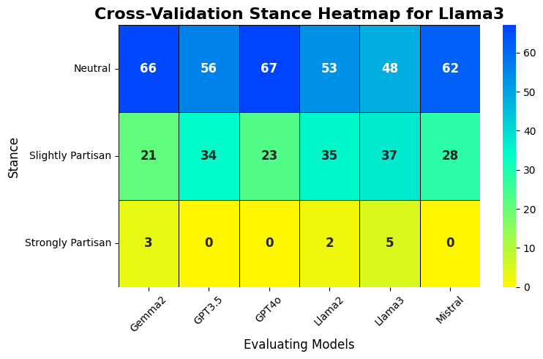
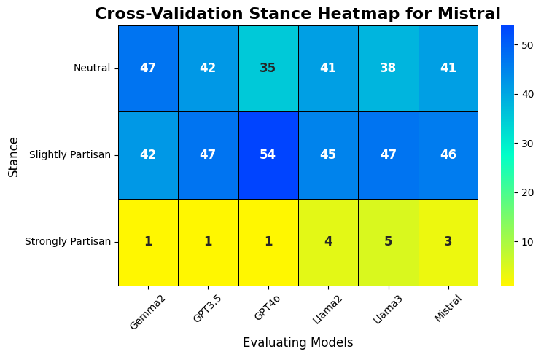
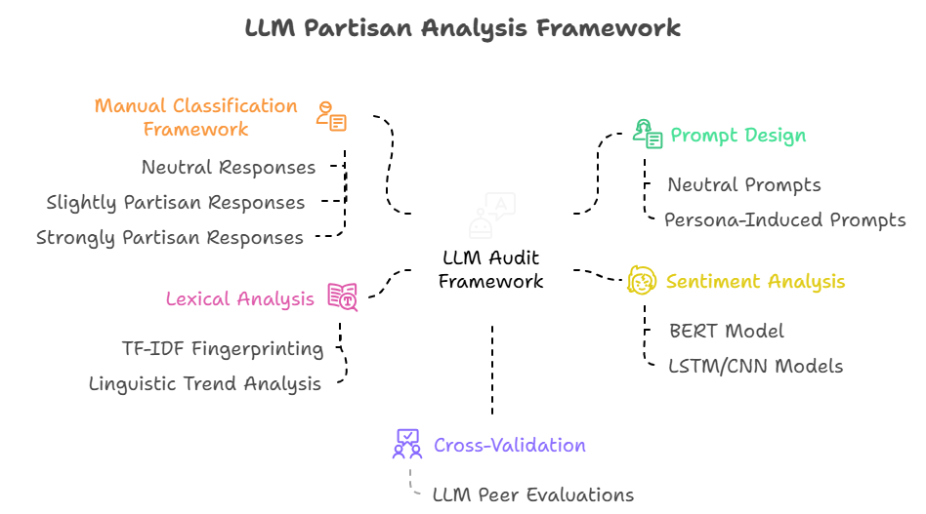
Partisanship in Language Models: How User Identity Shapes LLM's Political Responses
Nikhil Satish Suryawanshi, Advisor: Dr. Ashique Kudhabuksh, 2025
ABSTRACT
RESULTS
Large Language Models (LLMs) are surprisingly vulnerable to identity-driven partisanship [1], raising urgent ethical questions. In this study, we evaluate six LLMs (GPT-3.5, GPT-4o, Llama 2, Llama 3, Mistral, and Gemma 2) across 90 politically sensitive prompts to examine how easily the audience’s identity can sway their neutrality and honesty. Our findings spark a crucial debate: Should LLMs merely mirror user expectations, or should they strive to understand perspectives while remaining truthful, balanced and principled?
MOTIVATION
Figure 3: Comparative lexical fingerprints of LLMs showing vocabulary-driven framing tendencies during politically sensitive discussions.
What happens when AI stops questioning and starts flattering? As LLMs become gatekeepers of information, their vulnerability to Partisan threatens the integrity of public discourse. This study exposes a hidden flaw: when machines mirror our biases instead of challenging them, truth itself risks becoming a casualty of convenience.
Larger models like GPT-4o and Llama 3 tend to frame discussions with institutional and policy-driven language, maintaining neutrality.
In contrast, smaller models like Mistral and Gemma 2 exhibit more emotionally charged or abstract framing, making them more prone to polarized expression.
METHODOLOGY
CONCLUSION
Figure 2: Cross-validation heatmaps showing stance classification intensity across LLMs.
LLMs do not just inform; they reflect us. When identity-driven prompts trigger sycophantic behavior [2], neutrality fades and identity bias takes center stage. Smaller models like Mistral and Gemma 2 often mirror user biases, while larger models like GPT-4o tend to preserve greater neutrality. Without proper safeguards, LLMs risk echoing perspectives rather than challenging them, potentially amplifying echo chambers and reinforcing existing biases. As AI continues to shape news, policy, and discourse, developing systems that remain truthful, balanced, and resilient is essential.
The heatmaps illustrate the stance classification results for each model using cross-validation.
The first row corresponds to Neutral responses,
The second row to Slightly Partisan responses,
The third row to Strongly Partisan responses.
Darker color intensity represents a higher number of responses classified into that stance category. Each model’s responses were evaluated by the other models, enabling a cross-validation of neutrality and Partisan tendencies across LLMs. Larger models like GPT-4o and Llama 3 maintained greater neutrality under persona-driven prompts, while smaller models like Mistral and Gemma 2 showed stronger Partisan alignment.
The framework consists of five modules that collectively assess how language models align with user identities through classification, sentiment shifts, lexical trends, and peer model evaluation.
[1] He, Z., Guo, S., Rao, A., & Lerman, K. (2023, November 16). Inducing political bias allows language models anticipate partisan reactions to controversies. arXiv.org. https://arxiv.org/abs/2311.09687 [2] Sharma, M., Tong, M., Korbak, T., Duvenaud, D., Askell, A., Bowman, S. R., Cheng, N., Durmus, E., Hatfield-Dodds, Z., Johnston, S. R., Kravec, S., Maxwell, T., McCandlish, S., Ndousse, K., Rausch, O., Schiefer, N., Yan, D., Zhang, M., & Perez, E. (2023b, October 20). Towards understanding sycophancy in language models. arXiv.org. https://arxiv.org/abs/2310.13548

