Slide 1


Introduction to Keyloggers
Keyloggers are software programs that covertly record every keystroke made on a computer, including passwords, credit card numbers, and other sensitive information. They can be used for both legitimate and malicious purposes.
BY:
CHAMALLA NIKHIL

Slide 2
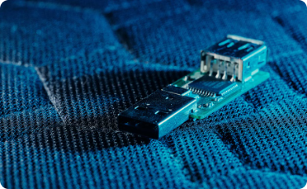
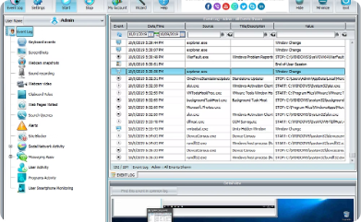
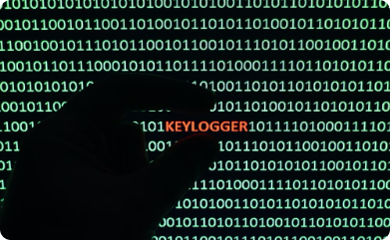
What is a Keylogger?
Definition
Functionality
Origins and Evolution
A keylogger is a software or hardware tool that records every keystroke made on a computer or mobile device. It tracks and logs all user input, including login credentials, messages, and other sensitive information.
Keyloggers can operate in the background, silently capturing data without the user's knowledge. They are often used for monitoring, security purposes, or to compromise a system's privacy and security.
Keyloggers have existed for decades, originally as hardware devices but later evolving into sophisticated software-based solutions. Their capabilities and applications have expanded over time, leading to both legitimate and malicious uses.

Slide 3
Ethical Considerations
Privacy Concerns
Consent and Transparency
Keyloggers raise serious privacy issues, as they can record sensitive personal information without the user's knowledge or consent.
The ethical use of keyloggers requires explicit user consent and transparency about their deployment and purpose.
Legal Implications
Responsible Development
The legality of keyloggers varies by jurisdiction, and their use may be restricted or prohibited in certain contexts.
Keylogger developers have a moral obligation to ensure their tools are used ethically and not abused to cause harm.

Slide 4
Keylogger Development in Python
Planning and Design
Begin by outlining the keylogger's core functionality, considering aspects like keyboard input capture, data storage, and user monitoring.
Implementing the Keylogger
Write the Python script to continuously monitor and log keyboard inputs, handling edge cases and optimizing for performance.
1
2
3
Python Libraries and Modules
Leverage powerful Python libraries such as pynput and PyAutoGUI to gain access to keyboard and mouse events.

Slide 5




Capturing Keyboard Inputs
Hook into the Keyboard
Use a library like pynput to capture keystrokes from the user's keyboard in real-time.
Record Keystrokes
Store the captured keystrokes in a variable or log file for later retrieval and analysis.
Handle Special Keys
Differentiate between regular keys and special keys like Shift, Ctrl, and Alt to provide more context.

Slide 6
Storing and Retrieving Keystrokes
Keylogger Storage
1
Securely store captured keystrokes
Data Retrieval
2
Access and review logged inputs
Encryption
3
Protect sensitive user data
Effectively storing and retrieving keylogger data is crucial for monitoring user activity. The keylogger must securely save all captured keystrokes, allowing the user to access and review the logged inputs. To protect sensitive information, the data should be encrypted before storage. This ensures the privacy and integrity of the collected information.

Slide 7



Monitoring User Activity
Keystroke Logging
1
Capture every character typed
Screenshot Capture
2
Periodically take screenshots
Application Tracking
3
Monitor launched apps and websites
The keylogger can monitor user activity through a variety of techniques. Keystroke logging records every character typed, providing a detailed history of the user's actions. Screenshot capture takes periodic snapshots of the screen, allowing you to visually review the user's workflow. Application tracking monitors the programs and websites accessed, giving you insight into the user's digital habits and productivity.

Slide 8
Encrypting and Securing Keylogger Data
Encryption
1
Secure keystrokes with strong encryption
Access Control
2
Restrict access to logged data
Storage Security
3
Safely store captured keystrokes
To ensure the privacy and security of the captured keystrokes, it is critical to implement robust encryption techniques. This could involve using advanced encryption algorithms like AES or RSA to scramble the data. Additionally, access to the stored logs should be strictly controlled, with authentication and authorization measures in place. The physical and digital storage of the keylogger data must also be secured to prevent unauthorized access or tampering.

Slide 9



Practical Applications of Keyloggers
Security Monitoring
Parental Controls
Troubleshooting
Keyloggers can be used to monitor employee computer usage and detect potential security breaches or unauthorized access.
Parents can use keyloggers to track their children's online activities and ensure their safety on the internet.
IT professionals can leverage keyloggers to diagnose and resolve computer issues by analyzing user input and system interactions.

Slide 10

Conclusion and Future Enhancements
In conclusion, this keylogger project has explored the powerful capabilities of Python in capturing and monitoring user activity. As we look to the future, there are exciting opportunities to enhance this tool further, such as integrating advanced analytics, remote accessibility, and additional security measures.

