Slide 1



STOCK TREND AI
STOCK MARKET
FORECASTING MODEL
Presented by
Nikhil Kumar

Slide 2


Introduction
Stock Trend AI is an advanced machine learning–based forecasting model designed to predict future stock price trends and market movements with high accuracy.
By analyzing historical stock data, technical indicators, and market sentiment, the model identifies hidden patterns and provides short-term and long-term predictions for informed investment decisions.

Slide 3
Ai Components
Machine Learning
Deep Learning
Natural Language Processing
Machine Learning is a branch of Artificial Intelligence that enables systems to analyze data, learn patterns, and make predictions or decisions without being explicitly programmed.
Deep Learning is an advanced form of Machine Learning that uses multi-layered neural networks to simulate human brain processes, excelling in tasks like image recognition, speech, and complex data modeling.
NLP focuses on enabling machines to understand, interpret, and communicate in human language, bridging the gap between human communication and computer understanding.
Computer Vision
Generative AI
Agentic AI
Computer Vision allows computers to perceive and interpret visual information from the world — such as images and videos — to identify objects, detect patterns, and make intelligent visual decisions.
Generative AI refers to models capable of creating new and original content — text, images, audio, or code — by learning from existing data and generating human-like outputs.
Agentic AI represents the next evolution of AI — systems that can autonomously plan, reason, and act to achieve goals, continuously improving through feedback and interaction with their environment.

Slide 4





LSTM Algorithm
Our Stock Trend AI model is built using the Long Short-Term Memory (LSTM) algorithm — a powerful type of Recurrent Neural Network (RNN) designed to analyze sequential and time-series data.
In the stock market, prices change continuously over time, and understanding these temporal dependencies is crucial.
The LSTM model captures long-term relationships and hidden patterns in historical price data such as open, close, high, low, and volume, enabling accurate trend prediction and future price forecasting.

Slide 5
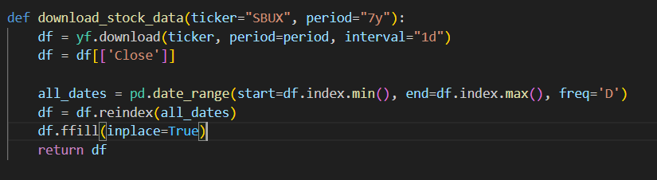
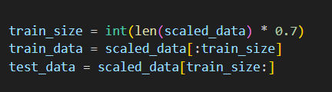
Implementation Steps
1. Preprocessing (Techniques used)
2. Training and Test Data Split
The code downloads historical stock price data using the yfinance API for the ticker "SBUX" (Starbucks) for the past 5 years. Only the ‘Close’ price column is used as input for modeling. After reindexing to ensure daily frequency, missing dates are filled using forward fill (ffill), maintaining data continuity.
After scaling, the dataset is split as:
70% → Training data
30% → Testing data
The split ensures that older data is used for training and newer data for testing — preserving the time-series nature.

Slide 6

Implementation Steps
3. Scaling
4. Training
Model Architecture:
LSTM Layer 1: 50 units, returns sequences (return_sequences=True)
Dropout Layer 1: 20% to prevent overfitting
LSTM Layer 2: 50 units
Dropout Layer 2: 20%
Dense Layer: 7 neurons (for 7-day future predictions)
Loss Function: Mean Squared Error (mse)
Optimizer: Adam with a learning rate of 0.001
Epochs: 100
Batch Size: 32
Validation: Performed on test data
Callbacks: TensorBoard for tracking training metrics visually.
Technique Used: MinMaxScaler from sklearn.preprocessing
Range: Values are scaled between 0 and 1 using
This scaling helps stabilize LSTM training and ensures faster convergence by normalizing different price magnitudes.

Slide 7
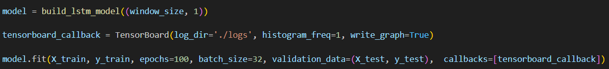
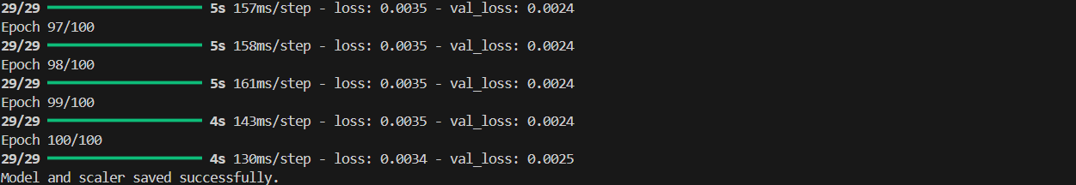
Implementation Steps
4. Training
5. Testing
The test dataset is created using the same create_dataset() logic to evaluate the model’s predictive performance. Validation metrics (loss curves) can be monitored using TensorBoard logs. After training, both the model and scaler are saved in the "saved_models" directory for later inference and prediction.

Slide 8
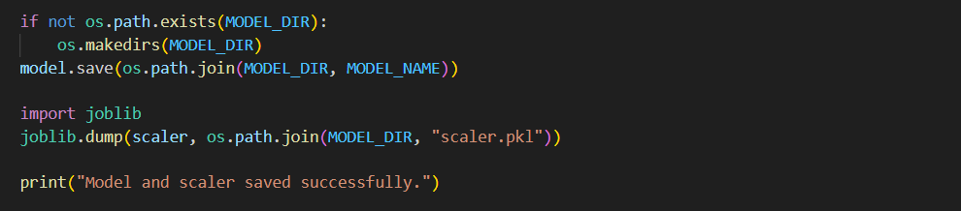
Saving Model
After training, the model and scaler are saved for future predictions and deployment.
Formats Used:
.keras file: TensorFlow’s native format that stores the complete model — architecture, weights, and optimizer state.
.pkl file: Stores the MinMaxScaler object using joblib, ensuring the same data scaling is applied during prediction as in training.
All files are saved in the saved_models directory for easy reuse.

Slide 9
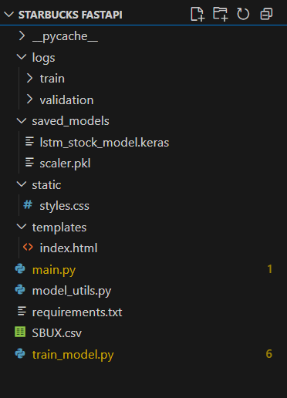
Folder structure of FASTAPI
The FastAPI backend is organized for clarity, scalability, and easy integration of the machine learning model.
Below is the typical structure and explanation of each folder and file.
main.py - The core FastAPI application — handles API routes, loads model, performs predictions, and serves web pages.
model_utils.py - Contains helper functions for loading the trained LSTM model and preprocessing input data for inference.
train_model.py - Used to train the LSTM model, preprocess stock data, and save model files (.keras, .h5, .pkl).
saved_models/ - Stores the trained model (.keras, .h5) and scaler (.pkl) used for predictions.
templates/ - Contains HTML files (like index.html) rendered by Jinja2 for the web interface.
static/ - Stores static frontend resources such as CSS, JavaScript, and image files.
requirements.txt - Lists all Python dependencies required for running the FastAPI backend.
README.md - Provides documentation, setup instructions, and project overview.

Slide 10
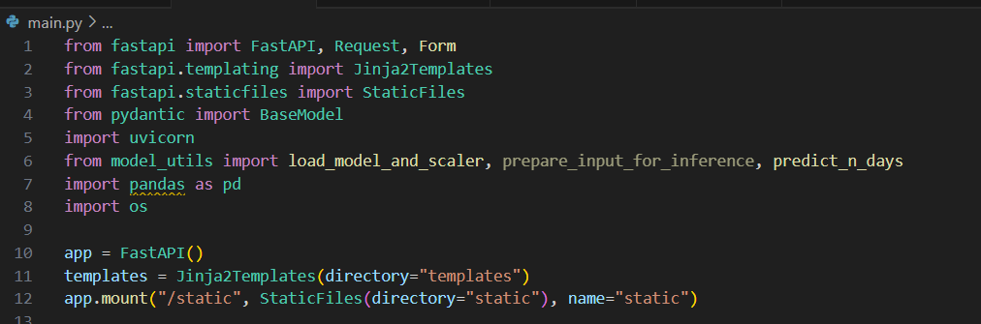
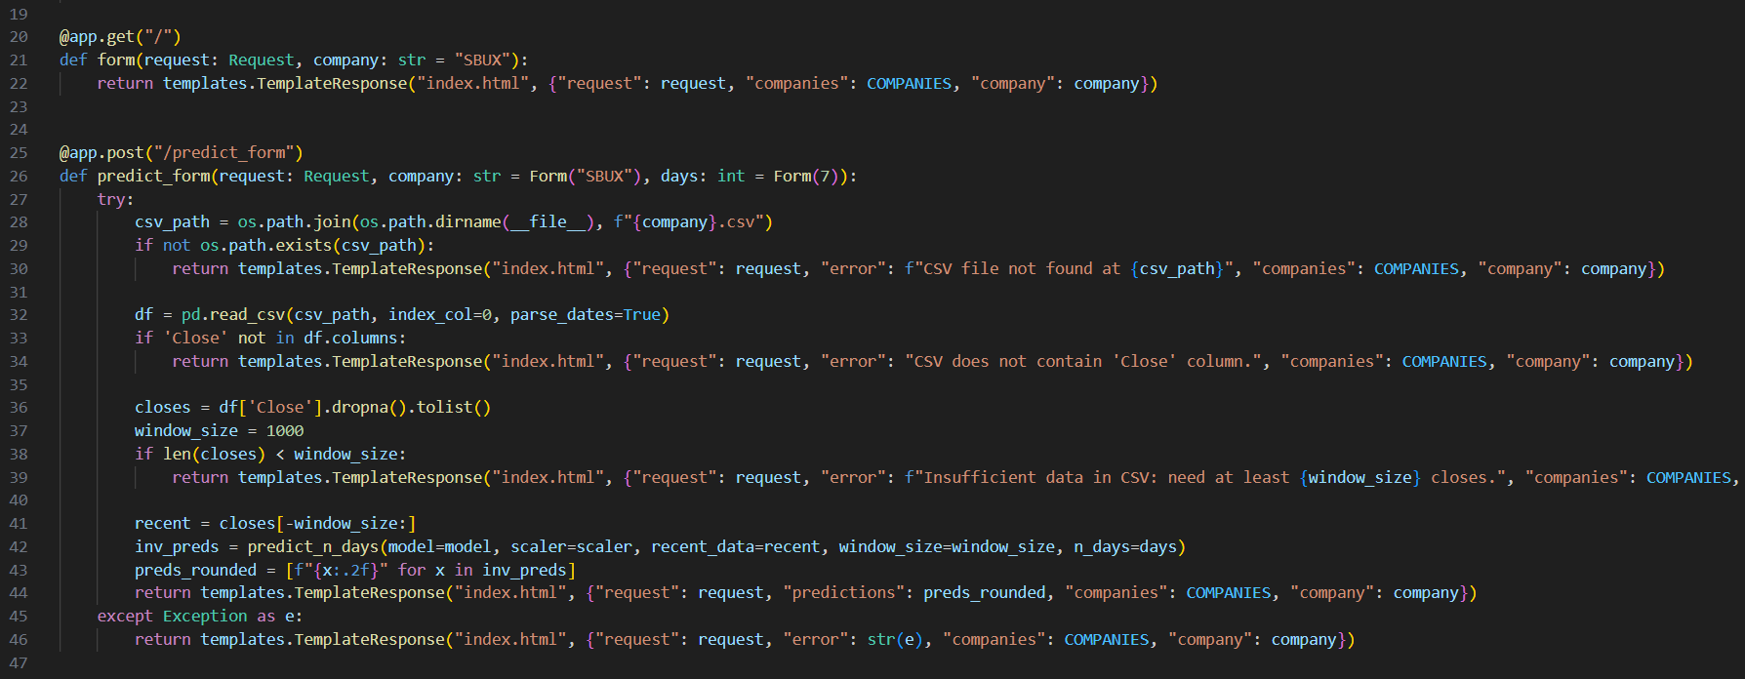
Program Structure of FASTAPI

Slide 11
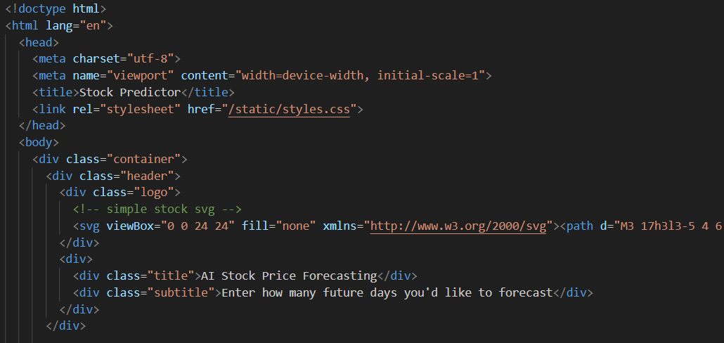
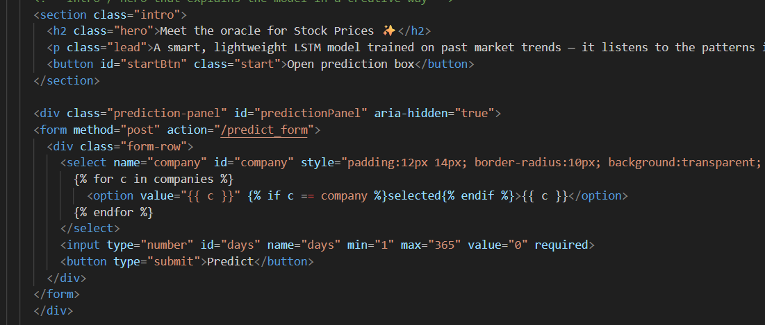
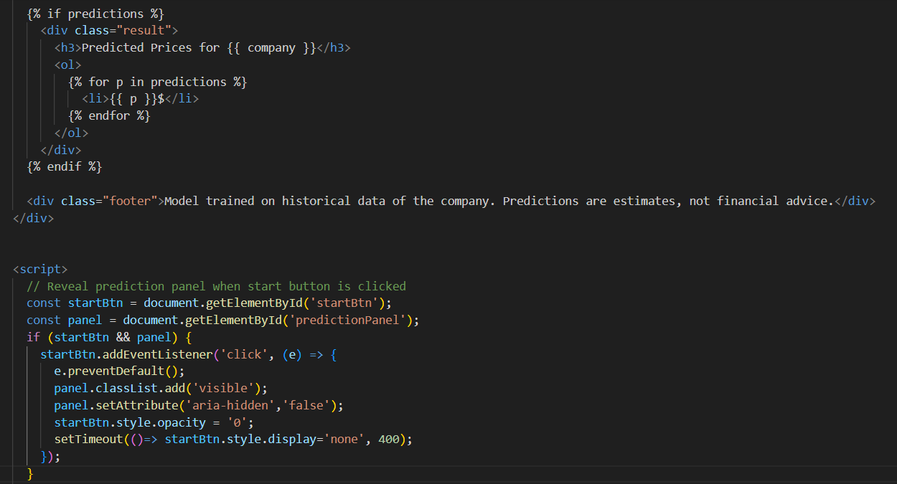
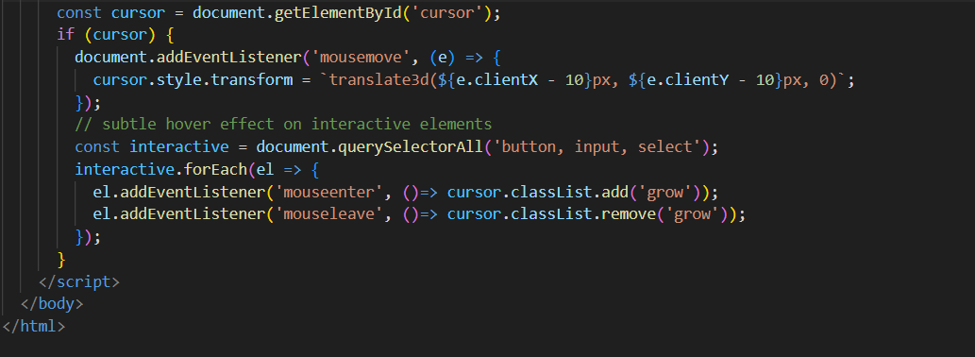
Frontend(HTML)

Slide 12
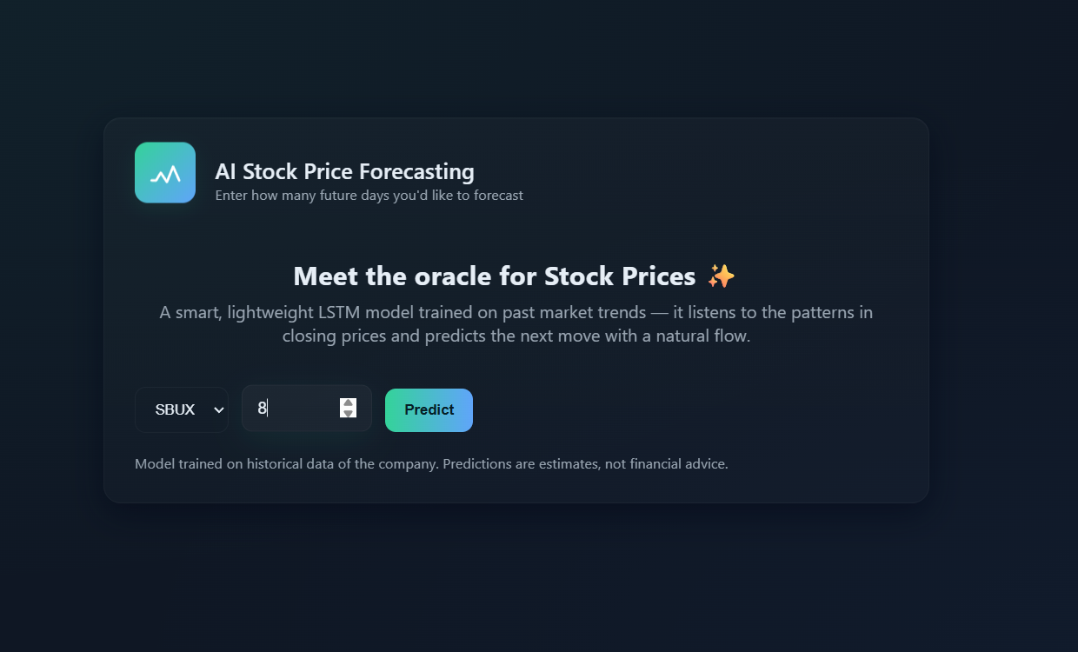
Front End Screen Shot

Slide 13
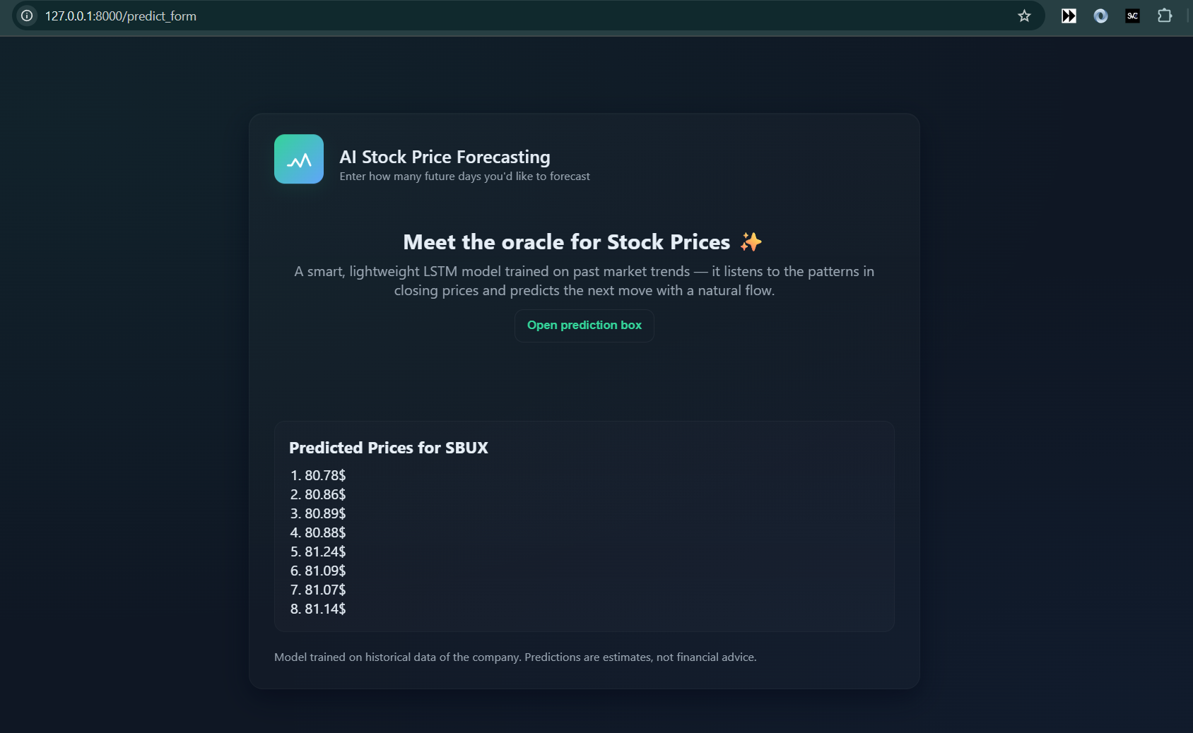
Response of Frontend Screenshot

Slide 14
Conclusion
This project successfully integrates Machine Learning (LSTM) with a FastAPI backend and an HTML frontend to create a complete Stock Price Prediction Web Application.
The final system is a fully functional end-to-end AI-powered web app that:
1. Downloads real-time stock data
2. Trains and saves prediction models
3. Uses FastAPI for deployment
4. Provides instant 7-day price forecasts through a clean web interface

Slide 15
Thank You

