Slide 1



STOCK TREND AI
FORECASTING MODEL
page 01
PRESENTED BY-
AMAN KUMAR
HARSHITH
NIKHIL KUMAR
SAI ALEKHYA KUMARI
SINDHU REDDY
2025

Slide 2



Introduction
page 02
Stock Trend AI is an advanced machine learning–based forecasting model designed to predict future stock price trends and market movements with high accuracy.
By analyzing historical stock data, technical indicators, and market sentiment, the model identifies hidden patterns and provides short-term and long-term predictions for informed investment decisions.

Slide 3
Ai Components
Machine Learning
Machine Learning is a branch of Artificial Intelligence that enables systems to analyze data, learn patterns, and make predictions or decisions without being explicitly programmed.
Deep Learning
Deep Learning is an advanced form of Machine Learning that uses multi-layered neural networks to simulate human brain processes, excelling in tasks like image recognition, speech, and complex data modeling.
page 03
Natural Language
Processing
NLP focuses on enabling machines to understand, interpret, and communicate in human language, bridging the gap between human communication and computer understanding.

Slide 4
Ai Components
Computer Vision
Computer Vision allows computers to perceive and interpret visual information from the world — such as images and videos — to identify objects, detect patterns, and make intelligent visual decisions.
Generative AI
Generative AI refers to models capable of creating new and original content — text, images, audio, or code — by learning from existing data and generating human-like outputs.
page 04
Agentic AI
Agentic AI represents the next evolution of AI — systems that can autonomously plan, reason, and act to achieve goals, continuously improving through feedback and interaction with their environment.

Slide 5

LSTM
Algorithm
Our Stock Trend AI model is built using the Long Short-Term Memory (LSTM) algorithm — a powerful type of Recurrent Neural Network (RNN) designed to analyze sequential and time-series data.
In the stock market, prices change continuously over time, and understanding these temporal dependencies is crucial.
The LSTM model captures long-term relationships and hidden patterns in historical price data such as open, close, high, low, and volume, enabling accurate trend prediction and future price forecasting.
page 05

Slide 6
STUDIO SHODWE
Implementation
Steps
1. Preprocessing (Techniques used)
2. Training and Test Data Split
The stock data for Starbucks (SBUX) is downloaded using yfinance for the last 5–7 years.
Missing dates are added and forward-filled to maintain a continuous daily time series.
A sliding window approach creates input sequences (X) and corresponding output horizons (y).
Quantum feature extraction is applied to reduce each window to a set of quantum-enhanced features.
The scaled stock data is split into training (70%) and testing (30%) sets.
The window_size defines how many past days are used to predict the next horizon days.
Both raw and quantum-processed datasets are prepared for LSTM input.
This ensures the model learns on past patterns while keeping unseen data for evaluation.
page 06

Slide 7
STUDIO SHODWE
Implementation
Steps
3. Scaling
4. Training
The raw stock prices are first normalized using MinMax scaling for stable training.
Each historical window is reduced to match the number of qubits, compressing the data.
Reduced values are scaled to [0, π] and passed through a quantum circuit to generate quantum-enhanced features.
These features capture non-linear correlations and are then fed to the LSTM alongside scaled data.
A hybrid LSTM model is built with quantum features as input.
It has an LSTM layer, dropout, a dense hidden layer, and an output layer for the 7-day horizon.
The model uses Adam optimizer and mean_squared_error as the loss function.
Training runs for 60 epochs with a TensorBoard callback for monitoring.
page 07

Slide 8
STUDIO SHODWE
Implementation
Steps
5.Testing
6.Saving
The trained hybrid quantum-LSTM model is evaluated on unseen test data.
Quantum-preprocessed features of test windows are fed into the model.
The model predicts the next 7 days’ stock prices, and the predictions are compared against actual values.
Validation loss is monitored to check performance and ensure the model generalizes well.
After training, the LSTM model weights are saved in a .keras file for future use.
The MinMaxScaler used for normalization is saved separately as scaler.pkl.
Quantum circuit weights are stored as quantum_weights.npy to reproduce feature transformations.
This allows seamless model deployment and consistent predictions without retraining.
page 08

Slide 9
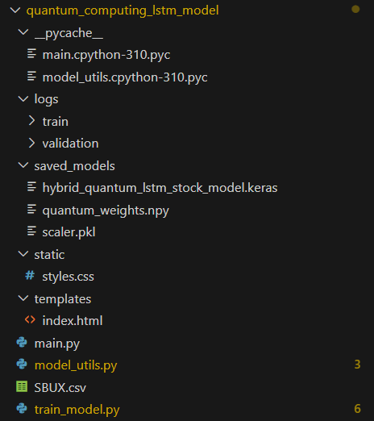
FASTAPI
Folder Structure of
_pycache__/ – Compiled Python bytecode files.
logs/ – Stores training and validation logs.
saved_models/ – Contains saved models, weights, and scalers.
static/ – Static web assets like CSS.
templates/ – HTML templates for rendering UI.
main.py – Entry point for running the application.
model_utils.py – Utility functions for model operations.
SBUX.csv – Stock data file for Starbucks.
train_model.py – Script to train the hybrid quantum-LSTM model.
page 09

Slide 10
Program Structure of
FASTAPI
1. Importing Required Libraries:
Loads all required FastAPI, data handling, and system libraries for web and model operations.
2. App Initialization:
Creates the FastAPI app, configures Jinja2 templates, and mounts static files.
3. Data Model Definition:
page 10
Defines a Pydantic model (StockData) to validate user input data
4. GET Endpoint (/):
Renders the main HTML page with company selection and year display.

Slide 11
Program Structure of
FASTAPI
5. POST Endpoint (/predict_form):
Processes user input, loads the hybrid quantum-LSTM model, and predicts future stock prices.
6. Model Loading & Prediction:
Dynamically loads model, scaler, and weights, reads CSV data, and generates predictions.
7. Error Handling:
page 11
Catches and displays errors related to model loading, data, or CSV files gracefully.
8. Running Application:
Launches the FastAPI server using Uvicorn on localhost (port 8000).

Slide 12

Frontend
Head Section:
Sets up the webpage title, metadata, and links the external stylesheet for design.
HTML
Header:
Displays the site logo, brand name “Starry Stocks,” and a navigation link to the prediction form.
Prediction Form:
Collects user input for company selection and number of days to predict.
page 12
Results Section:
Dynamically shows prediction results or error messages returned from FastAPI.
Footer:
Displays the current year and a disclaimer that predictions are not financial advice.

Slide 13
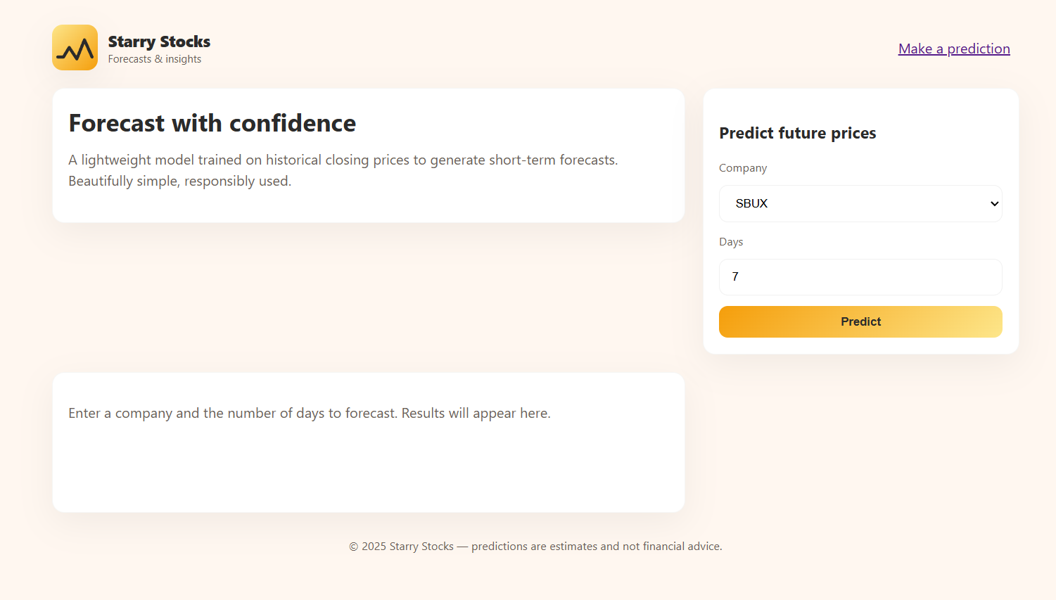
Front End
Screen Shot
page 13

Slide 14
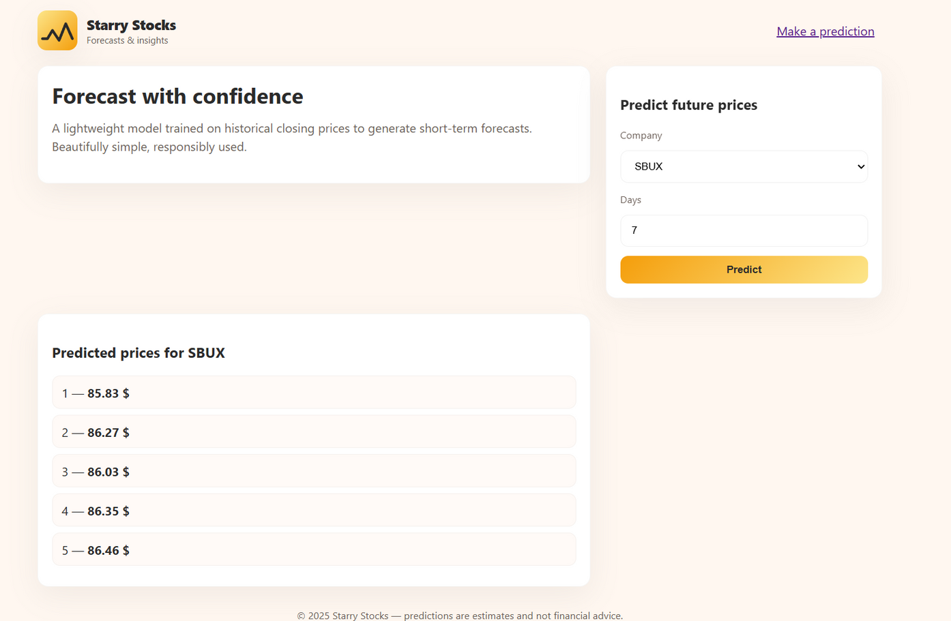
Response of Frontend
Screen Shot
page 14

Slide 15

Conclusion
This project successfully integrates quantum preprocessing with an LSTM-based deep learning model to enhance stock price prediction accuracy. It combines the power of quantum feature extraction and classical sequence modeling, providing short-term forecasts for stock prices. The FastAPI backend efficiently handles prediction requests, while the HTML frontend offers an interactive and user-friendly interface. Overall, it demonstrates a hybrid quantum-classical approach to real-world financial forecasting — bridging advanced AI with emerging quantum computing concepts.
page 15

Slide 16
THANK YOU!
page 16

