Slide 1
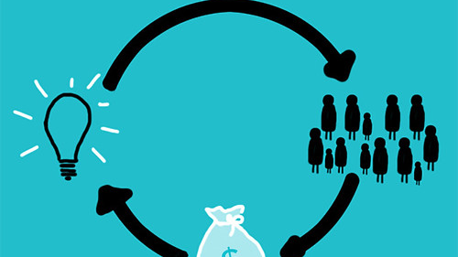
Crowdfunding
Project
This Photo by Unknown author is licensed under CC BY-SA.

Slide 2
Team Members
Richa Jemadevi
Sayali Nawanit
Shivam Patil
Vaishnavi Sharma
Sanket Karane
Nikhil Vaidya

Slide 3
Contents
What Is Crowdfunding ?
How Does Crowdfunding Platform Works ?
Business Objective
Data Model And Transformation
Challenges We Faced
Strategic Guidance for the Company
Understanding Data
Dashboards
Crowdfunding Analysis Overview

Slide 4

What Is Crowdfunding ?
Crowdfunding is the practice of funding a project or venture by raising small amounts of money from a large number of people, typically via the Internet.
Crowdfunding is a form of crowdsourcing and alternative finance.
This Photo by Unknown author is licensed under CC BY-SA-NC.

Slide 5
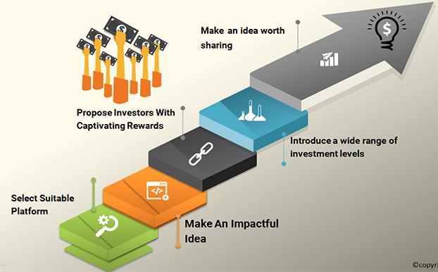
How Crowdfunding Works ?
Crowdfunding works by creators initiating campaigns on online platforms, detailing their projects' goals and funding needs. Individuals, or backers, contribute varying amounts of money to support these projects.
The campaign typically has a set funding goal and timeframe.

Slide 6
How Crowdfunding Works ?
If the goal is met within the timeframe, creators receive the funds to execute their projects, providing backers with promised rewards or incentives in return.
Effective communication and transparency are crucial throughout the process to build trust with backers.

Slide 7
Understanding Data
Project
Location
Category
Creators

Slide 8
Business Objective
High rate of project failure(188,210) compared to successful projects(140,282)
1
Lack of insights into factors contributing to project failure.
2
Need to identify successful project patterns for replication
3

Slide 9
Data Model And Transformation
Epoch Time Conversion:
Converted epoch time to standard date format for improved readability.
Data Cleaning
Addressed null and error values in the "Name" column.
Employed data cleaning techniques for enhanced accuracy.
Goal Amount Column Addition:
Incorporated a new column to represent goal amounts for projects or initiatives.
Provides a key metric for understanding and analyzing project objectives.
Calendar Table Integration:
Integrated a calendar table to facilitate date-based analysis and reporting.
Enables tracking and visualization of data trends over time.

Slide 10
Data Model And Transformation
Power BI Integration:
Utilized Power BI for data modeling and visualization.
Connection Setup:
Established connections between sheets using relevant columns.
Ensured seamless integration for comprehensive analysis.
Column Matching:
Aligned data across sheets by connecting common columns.
Facilitated cohesive data modeling.
Relationship Establishment:
Established relationships among sheets for accurate cross-sheet analysis.

Slide 11

Challenges
Explore reasons behind the high no. Of failed projects.
Understanding the dynamics influencing project outcomes.
Addressing potential risks in crowdfunding campaigns.

Slide 12
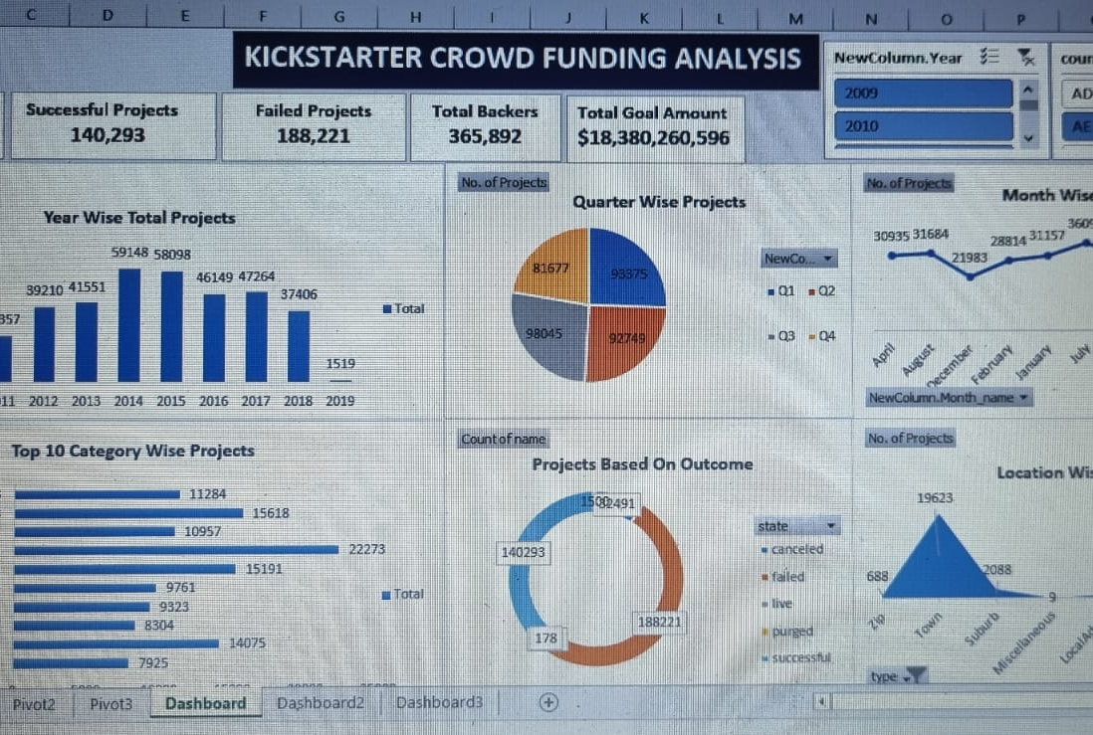
Excel Dashboard
Total project Overview: This Excel sheet presents a high-level Total project overview for Crowdfunding, including a total Projects figure of ₹ 365,846.
Quarter Wise Projects Analysis: Understand how Quarter wise projects performance varies across different quarters, possibly highlighting peak seasons or trends.
Projects Based on Outcome: Gain insights into the annual Projects Based on outcome performance of Crowdfunding.
Top 10 Category Wise Projects: This section provides valuable insights into the company's financial performance and Top 10 Category wise projects.

Slide 13
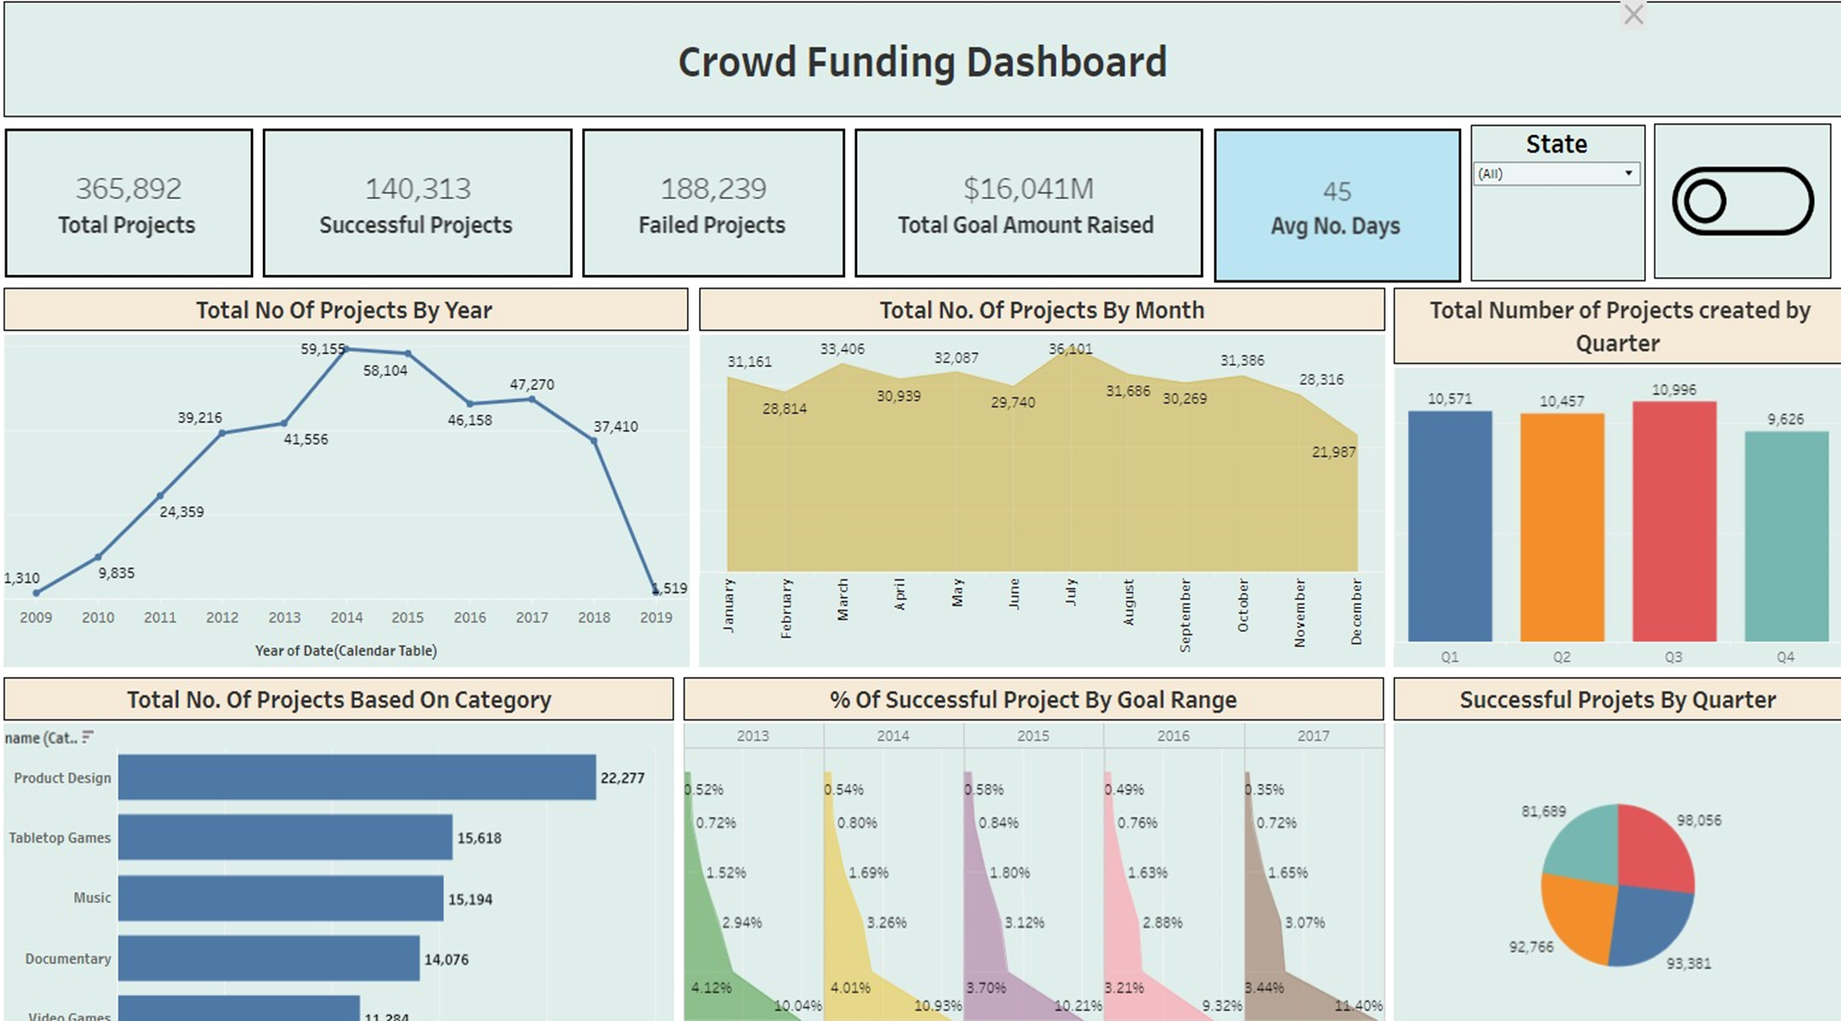
Tableau Dashboard
Total Projects: The total projects 365892, and in 2014 in this year projects it on peak it was 59159
Successful Projects : It shows projects distribution across different years, with the highest successful projects is 140313.
Projects by Quarter: This section displays quarter figures by projects, with highest quarter 3 .

Slide 14
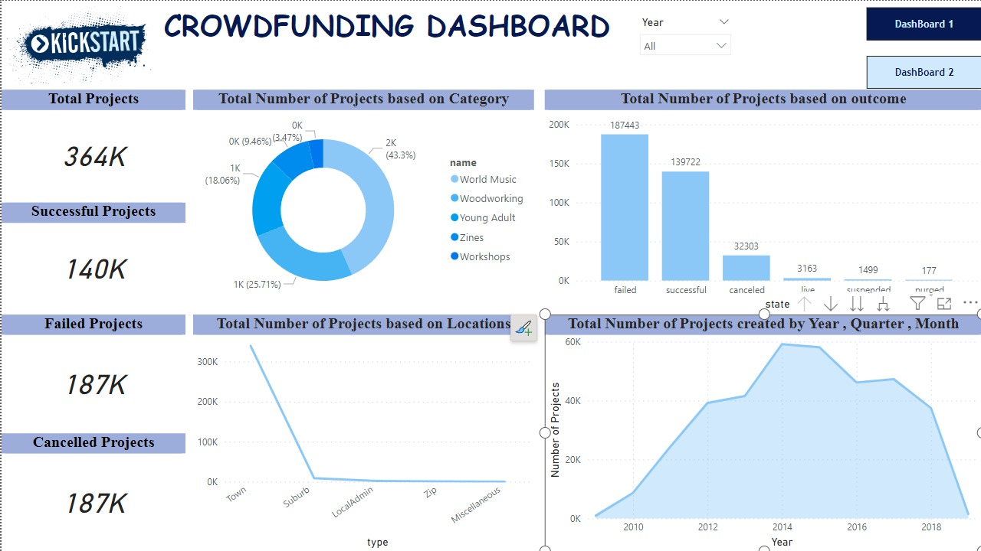
Power BI Dashboard
We can see cards
Total Projects- 364000
Successful Projects- 140000
Failed Projects- 187000
Cancelled Projects-187000.

Slide 15
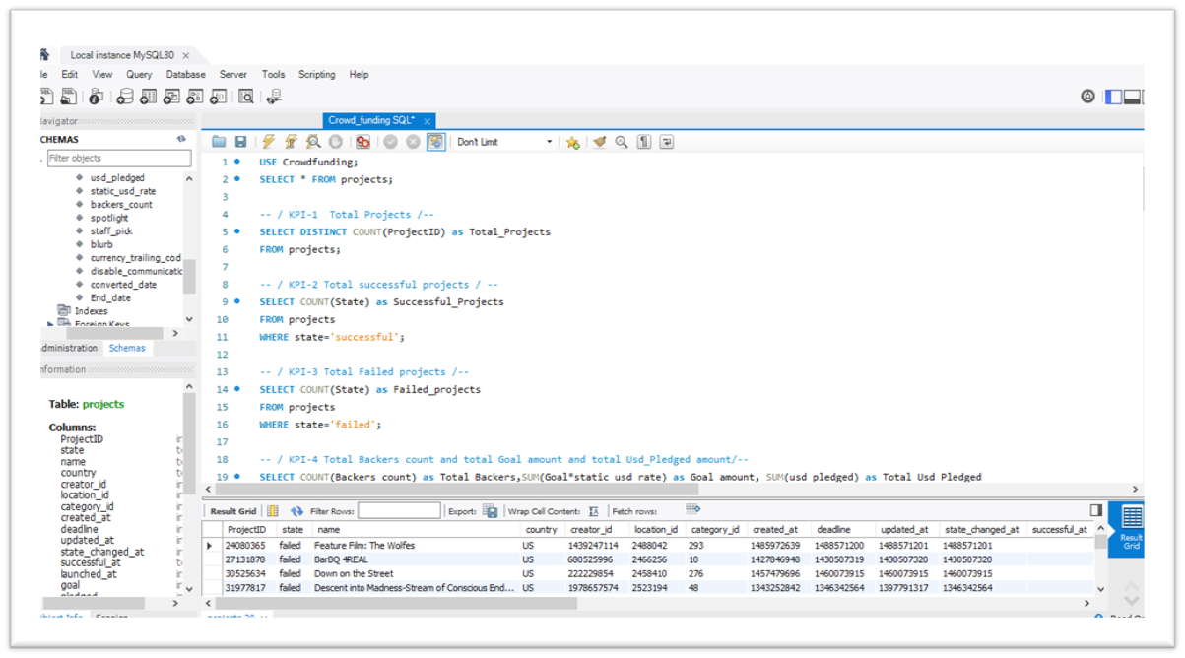
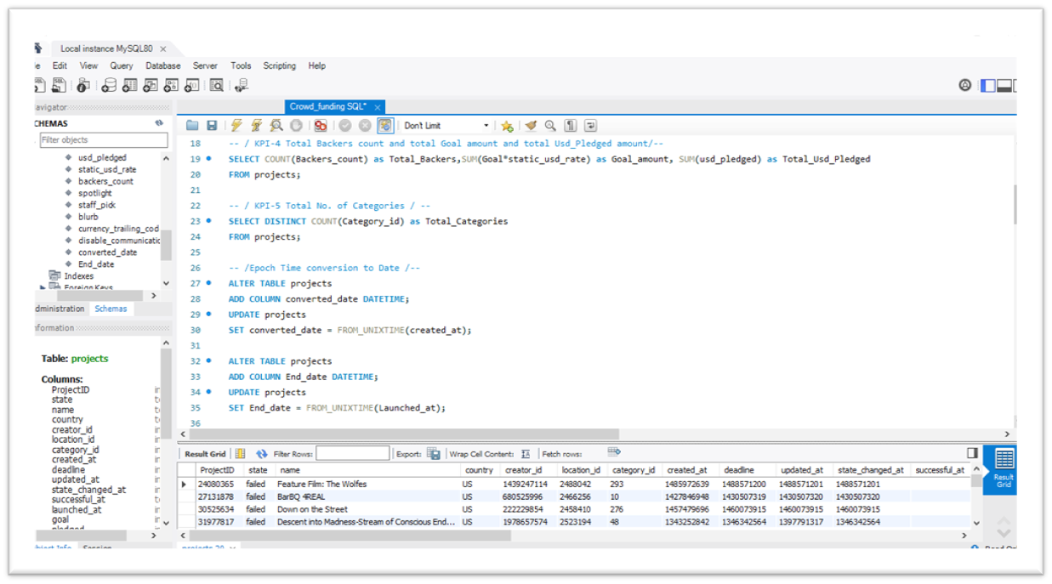
SQL

Slide 16
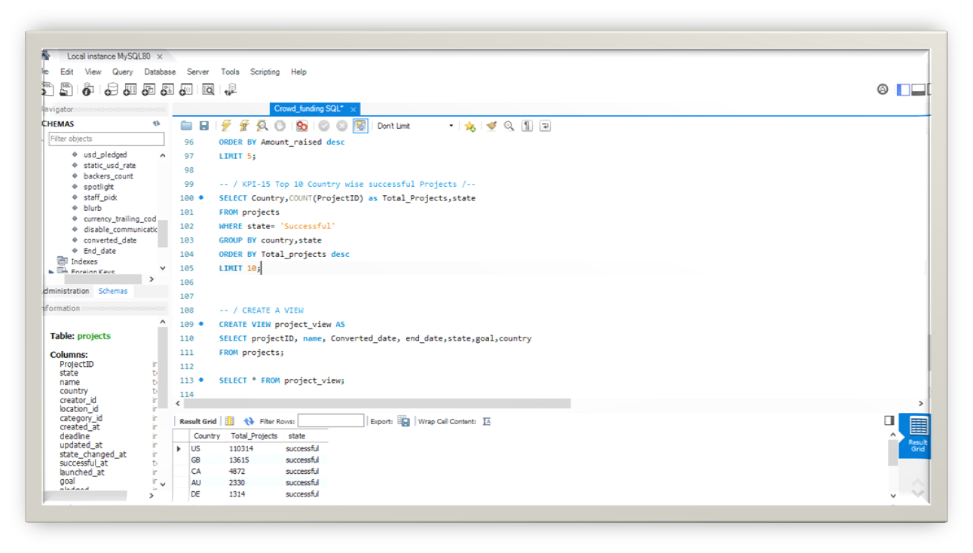
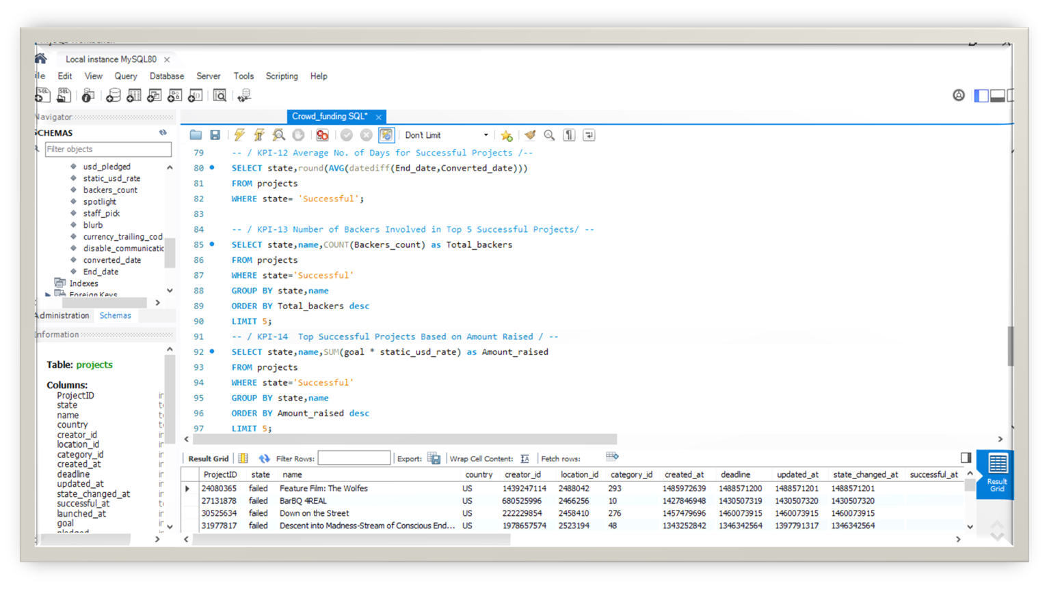
SQL

Slide 17
Strategic Guidance for the Company
1. Company should investigate and address reasons behind project failure to reduce risks.
2.explore opportunities for innovation in crowdfunding strategies.
3.Make strategic adjustments based on yearly project distribution trends.
4. Improve project planning considering average days for successful campaigns.

Slide 18
Crowdfunding Analysis Overview
1. Project Landscape: A total of 365,820 projects have been analyzed, with 140,282 successfully funded and 188,210 facing failure. A substantial 36,582,820 backers participated in these ventures. 2. Financial Impact: A significant goal amount of $16,039,050,147 has been raised, underscoring the economic scale of crowdfunding endeavors. 3. Temporal Trends: Examining yearly trends reveals a peak in 2014 with 59,139 projects, while 2019 experienced a downturn with only 1,308 projects, providing insights into changing dynamics over time. 4. Outcome Disparity: The number of failed projects (188,210) surpasses successful ones (140,282), shedding light on challenges within the crowdfunding landscape.

Slide 19
Crowdfunding Analysis Overview
5. Efficiency Metrics: Successfully funded projects have an average duration of 48 days, showcasing a key metric for project success and efficiency. 6. National Success Stories: The United States leads with 110,314 successful projects, highlighting its dominance in the crowdfunding arena, while Italy (IT) boasts 649 successful projects. 7. Strategic Insights: Unveiling patterns and trends enables strategic decision-making for both project creators and backers, fostering a deeper understanding of project dynamics. 8. Conclusion: This comprehensive analysis empowers stakeholders with actionable insights, fostering informed decision-making in the dynamic world of crowdfunding.

Slide 20

Thank You

