Slide 1


SMART INDIA HACKATHON 2026
TITLE PAGE
Problem Statement ID – SIH26026
Problem Statement Title - Development of Mobile (Quadruped)/Handheld Device/System for Real-Time Detection of Narcotics and Explosives across Indian Railways.
Theme - Blockchain & Cybersecurity
PS Category- Hardware
Team ID- 120731
Team Name (Registered on portal) - Cyber Renegades

Slide 2
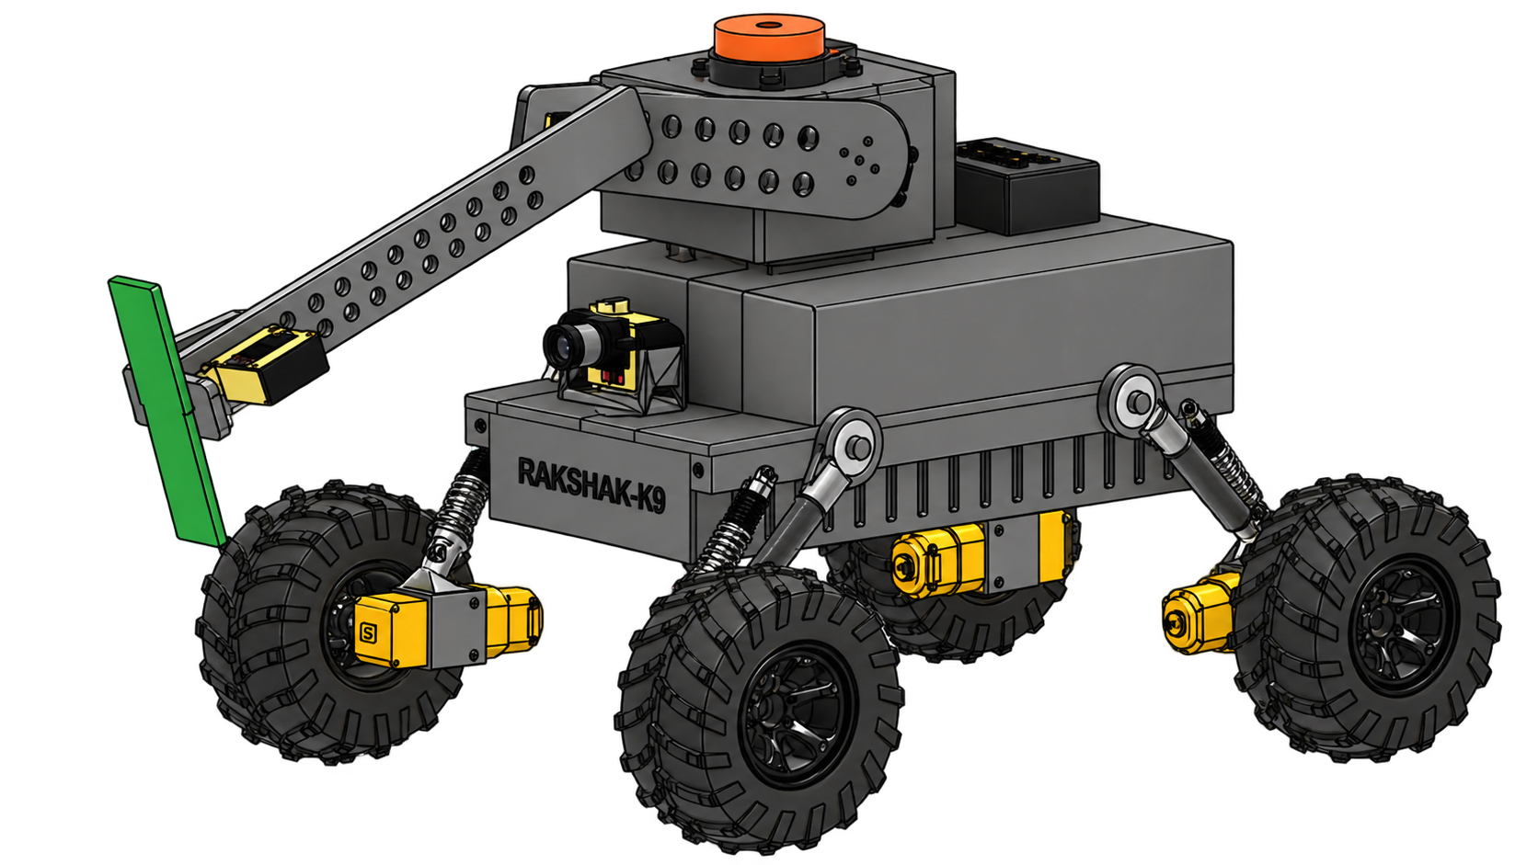
RAKSHAK-K9:Autonomous Multi-Sensor Robotic System for Real-Time Detection of Narcotics and Explosives Across Indian Railways
Cyber Renegades
PROBLEM EXISTING
PROPOSED SOLUTION
No Field Detection Tech: RPF secures 1000s of stations but has zero mobile system for real-time narcotics/explosives screening.
Manual Checks Don't Scale: ₹300 Cr seized in 2025 alone — yet what's caught is a fraction of what moves through.
Evidence Doesn't Hold Up: No verifiable chain of custody means a catch can be challenged in court.
Rakshak-K9
An autonomous AI robot that patrols railway premises, detects narcotics and explosives using multi-sensor fusion, alerts RPF instantly, and stores tamper-proof evidence on blockchain.
Autonomous Patrolling Using LiDAR-IMU
Detachable Handheld Unit
UNIQUENESS/ INNOVATION
Detection → Legal Proof: Alarm → black-box confirmation → blockchain-backed evidence.
Tamper-proof Evidence: IPFS + blockchain protects evidence integrity while keeping originals retrievable.
Offline-First Operation: Logs evidence offline and syncs automatically when connectivity returns.
Detachable Inspection Unit: Detection module unclips for close-range manual RPF inspection.
One Robot, Multiple Environments: Patrols platforms, coaches & tracks with one unit.
On-Board Black-Box Confirmation: Confirms suspected substance on-site—no lab wait.
On-Board Swab Test Kit
(Black Box)
mm Wave
Radar
2
BME688 ( VOC-based detection)
RGB Camera
Fig : Custom Design Robotic System (Rakshak K9)

Slide 3





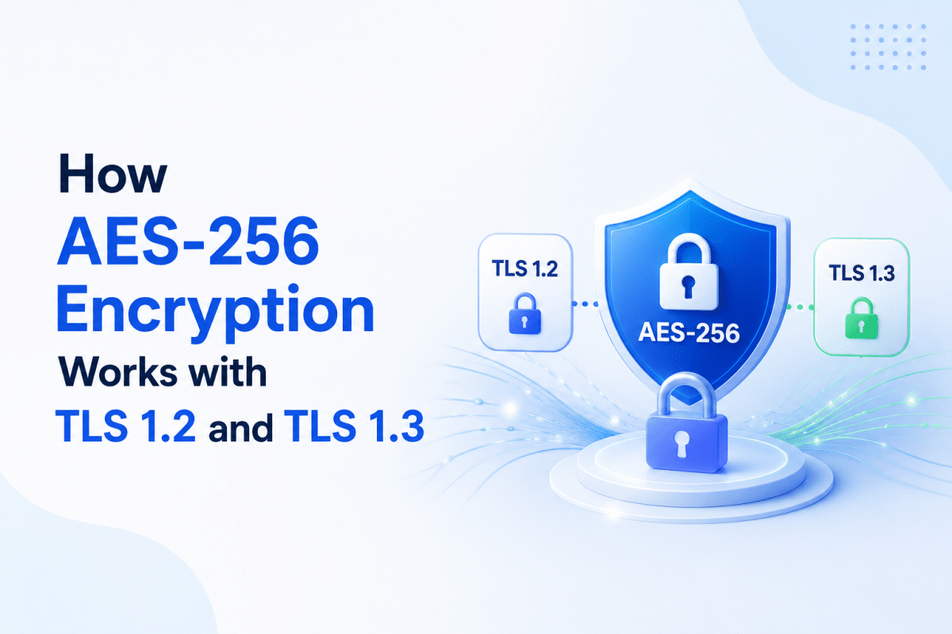
TECHNICAL APPROACH
Cyber Renegades
TECHNICAL FLOW
BLACK BOX WORKING
1
Swab Collection
Wipe suspect surface with silica-gel TLC swab
2
Apply DCM
Spray DCM solution onto swab (glows red-orange, QY = 15%)
YES
3
Seal Chamber
Insert swab into black-box, exclude ambient light
4
Baseline (I_before)
Photosensor records initial DCM glow at 620 nm
5
UV LED ON (254 nm · 1–2 min)
RDX/HMX → NO₂· · PETN → NO₂⁺
6
Quenching
NO₂· / NO₂⁺ + DCM → DCM-NO₂ (glow OFF )
7
Reading (I_after)
Photosensor records post-UV intensity
7
Result
Quenching % = 1 − (I_after / I_before)
→ High: EXPLOSIVE DETECTED
→ Low: CLEAR
TECH STACK
YOLOv8
OpenCV
LiDAR
Blockchain
Pinata
TLS

Slide 4
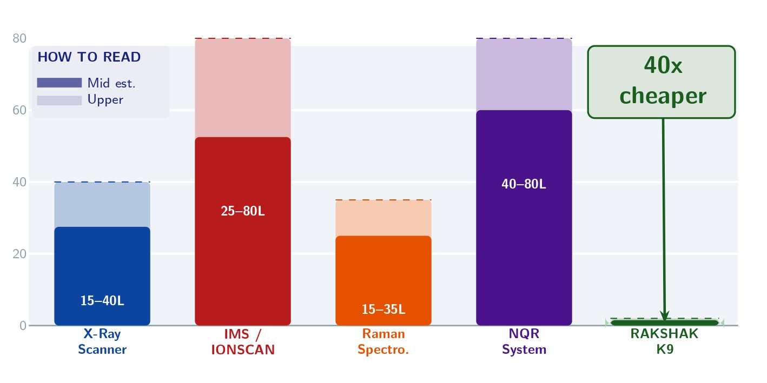
FEASIBILITY AND VIABILITY
Cyber Renegades
Risk Mitigation
TECHNICAL FEASIBILITY
Network failure
Offline storage + automatic sync on reconnection
YOLOv8 + OpenCV → Real-time detection
mmWave Radar → Internal bag inspection
False detections
Multi-sensor fusion + AI analysis
BME688 → VOC-based detection
Black-box confirmation chamber: RPF-collected swab +fluorescence reagent, read via UV emitter + photosensor.
IPFS(Pinata) for tamper-evident storage
GPS Denied Environment
Use camera + LiDAR + Imu + Encoder for Navigation
Blockchain (Solidity): Immutable logging of detection records.
LiDAR-SLAM — Auto + Manual navigation, real-time mapping, obstacle avoidance
Difficult terrain
Custom build robotic system for all Railway environment
Evidence tampering
IPFS hash + blockchain-backed records
Economic Approach --- Cost Comparison (INR Lakhs)
Detection ≠ Confirmation
Black-box testing provides on-site verification.
SPACE FOR GITHUB LINK

Slide 5
IMPACT AND BENEFITS
Cyber Renegades
POTENTIAL IMPACT
ENVIRONMENTAL AND OPERATIONAL
Fewer false alarms mean less disruption to trains.
One design works across coaches, platforms, and tracks.
Minimal infrastructure compared to fixed systems.
Portable Yet Powerful
Offers Portable non-invasive inspection using mm-Wave Radar+ vision in a compact system that can be easily moved where needed.
Supports RPF Officers
Detects suspicious objects and instantly alerts RPF officers, helping them respond faster and make informed decisions.
MULTIDIMENSIONAL ADVANTAGES
Enhanced Railway Security
Faster identification of suspicious substances and objects.
Faster & Targeted Inspection
AI-based detection activates relevant sensors only when required.
ECONOMIC
SOCIAL
Affordable multi-sensor setup instead of costly single systems.
Easy to deploy across multiple stations.
Lower recurring costs than manual or canine screening.
Helps curb smuggling and reduce economic losses.
Safer and more secure train travel for everyone.
Reduces workload for RPF personnel.
Builds public trust through transparent and verifiable records.
Scalable & Easy Deployment
Modular and portable architecture enables quick deployment across multiple railway stations, while additional units can be added easily as security requirements grow.

Slide 6
RESEARCH AND REFERENCES
Cyber Renegades
Key References
Texas Instruments IWR6843AOP (60 GHz mmWave FMCW Radar Module
  https://www.ti.com/product/IWR6843AOP
  https://www.ti.com/tool/IWR6843AOPEVM
Bosch Sensortec BME688 Nano
  https://www.bosch-sensortec.com/en/products/environmental-sensors/gas-sensors/bme688
Core IPFS Paper — Primary Reference
  https://arxiv.org/abs/1407.3561
Detection Principle: DCM Fluorescence Quenching
Wang et al., Scientific Reports 6:25015 (2016)DOI: 10.1038/srep25015
Anthropic Claude — AI Assistant
  https://www.anthropic.com/claude
Research Area | Relevance to Our Solution
mmWave Radar | Mm-Wave radar enables 3D spatial sensing for object detection.
AI-Based Autonomous Screening | AI fuses camera, mm-Wave 3D, and BME688 data for autonomous screening and targeted sensor activation.
IPFS + Blockchain | Links the physical detection event → digital evidence → verified chain of custody.
GPS-Denied Localization | Uses LiDAR/vision/IMU-based localization where GPS is unreliable or unavailable.
Adaptive / Event-Driven Sensing | Camera/AI can activate specific sensors only when required.
Human–Robot Collaboration | Robot performs screening while security personnel make the final decision.

