Slide 1
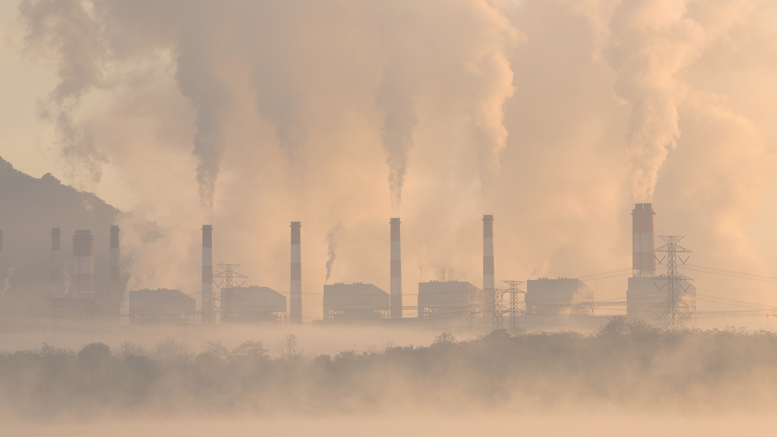



EXL Excellence Quotient 2023
PM2.5 Forecast model
Team DUNIKHI
participants-
Nikhil Ranjan murmu
Durga Prasad Pradhan
NIT ROURKELA

Slide 2
1
Problem statement
Develop a real-time prediction tool to forecast PM2.5 concentration across 34 Indian cities for the first 3 days of January 2023.
Study the data of PM2.5 for 34 different cities.
Developing Time-Series model .
Checking for any drastic increase or decrease in trend .
Forecasting raises awareness about air pollution issues, fostering collective action and promoting sustainable practices for a healthier and more habitable society.
Feature
engineering
dataset
Studying the data
modelling
Checking the trend

Slide 3
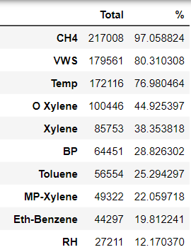
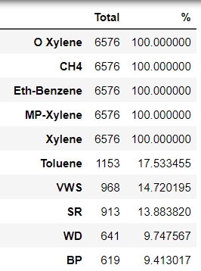
2
Key Findings / Patterns In The Data
Missing values
Only 2.9% of the data from the dataset contains for a single city. So, deleting rows from the dataset will be critical.
And the distribution of null value in the whole data set don’t follow any pattern. But for the individual cities either it has no values, or it has values around 80%. Hence using imputers will be not create much difference .
Top 10 Null values in %
Whole data frame
For Delhi only
(a)
(b)
Different variables
Variables
Meteorological variable
Demographic variable & Vehicular variable
Date &Time
The data are having large variation according to different cities.( Ex- NO,NO2 and NOx are highly correlated for some cities but not for all cities. Which creates difficulty for feature engineering.)
These values are provided with very saturated values which gets easy replicate in some other variables.
Equal interval of time stamp are provided which gets very easy to get a time index or getting values like year , month and day of week.

Slide 4


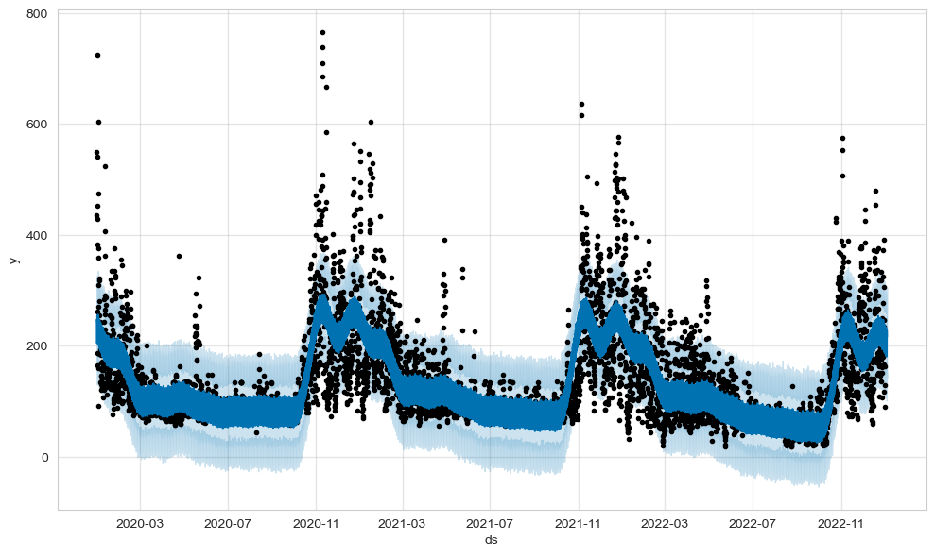
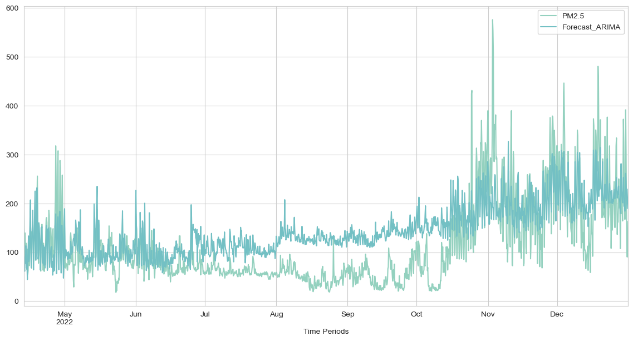
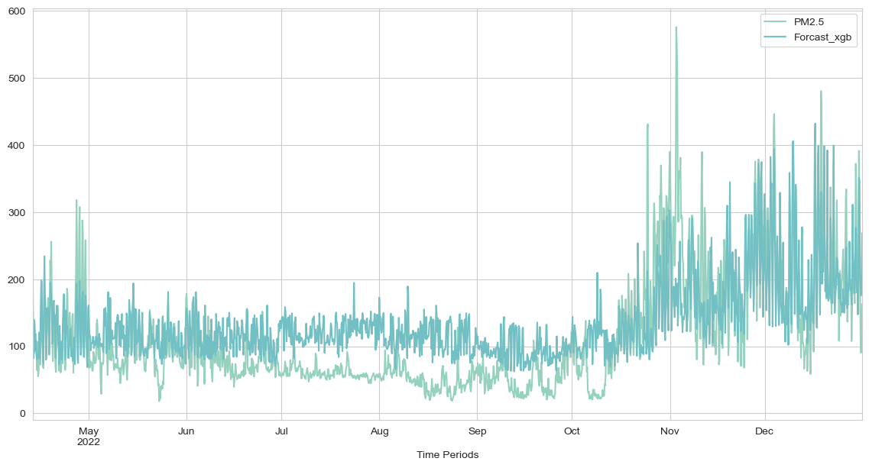
3
Selection of model
Ideal Model
Given to predict PM2.5 values for the next 3 days with 4 hrs gape which indicates to predict using time-series model.
On dataset of Delhi applied different model .(One of the highest PM2.5 emission city)
Without using tuning of hyper-parameters selected the model using mean absolute error value and the trend followed by the predicted values.
ARIMA Model
MAE = 64
XGBoost Model
MAE = 50
fbProphet Model
MAE = 39

Slide 5
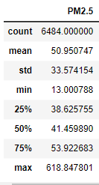
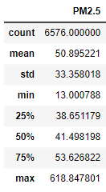
4
Solution Design
Flow chart –
Important steps to model improvisation
Visualization
Visualizing the data using pairplot, countplot, scatterplot heatmap, and boxplots to study large dataset.
Model selection
Tring different time series models for a single city to deploy on the others too. Models tried are ARIMA , XGBoost and Prophet models
Trying model improvement
The best parameters are changepoint_prior_scale equals 0.01
Feature Engineering
Dividing the data according to cities.
Dealing with missing values using imputation by value distribution and by dropping columns (by high correlation).
Finalization
Using univariate model .
Combing all cities data and defining a function of for loop to run 34 cities by a model at a time.
Key(Distribution) :
before
after
Checking distribution after imputation

Slide 6
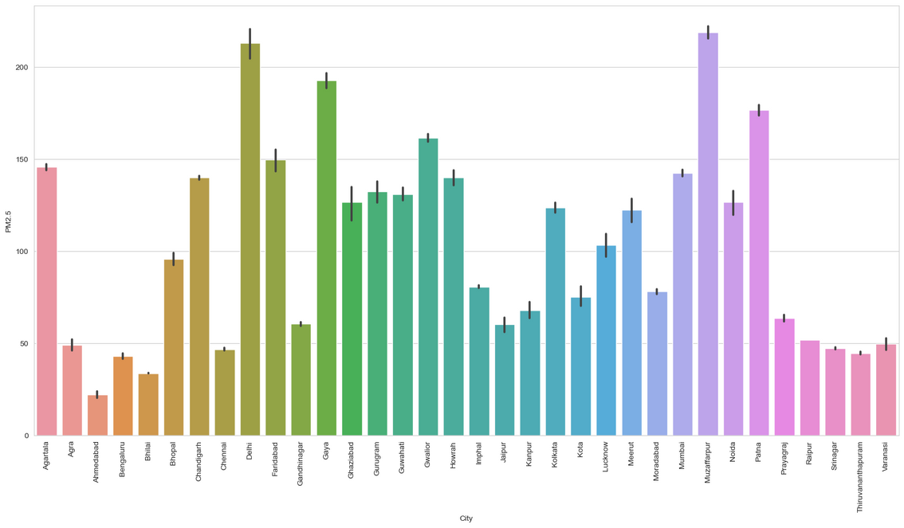
5
Predictions & Possible Recommendations
Permissible PM 2.5 is 60 μg/m3
Model Predictions :
Accuracy is 83%
Top 5 polluted cities are Delhi ,Muzaffarpur, Gaya, Patna, Gwalior having over 150 μg/m3.
24 Out of 34 cities are above PM2.5 permissible limit.
Possible Recommendations:
Predicted PM2.5 values by cities
Measure PM 2.5 concentration are coming from road dust, vehicular emission .
To Decrease this, we have reduce most fuel driven vehicles and Promote EV specifically top polluted Cities.

Slide 7
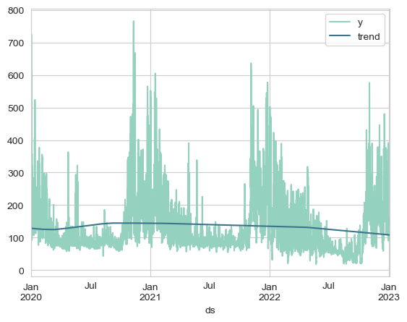
6
Evaluation Of The Model & Framework
Strength
Able to predict the future trend with seasonality .
It consider all the important functions like growth, seasonality ,holiday and error which is very helpful for a time-series model.
Model trained for all cities separately and able to run in loop.
Trend
Weakness
Basic
Model
Should have tried normalization of data for imputation.
Prediction are not able to predict exceptionally high values like 800 or 500 means predicted data are concentrated.
Don’t have enough flexibility on the part of hyper parameter tuning (like learning rate or no. of trees or epochs.)
Not included day of week which is an important fata for time-series model on an hourly basis.

