Slide 1
GUJARAT POLICE INNOVATION CHALLENGE 2026
SENTINEL COMMAND
A GIS camera registry and unified ANPR command layer
on the official Sentinel sandbox — Hybrid Model 1 + 2
Category 1
Model
Sandbox
Submit by
Student / solo
Hybrid 1 + 2
30 official cameras
15 Sep 2026
Nikhil · Working prototype, not a mock-up · Consume official RTSP / HLS — do not replace departmental VMS
Notes:
Open with the one-line pitch: we do not rip out cameras. We map them, watch them, read plates, and hunt a number.

Slide 2
THE PROBLEM · WHY A COMMAND LAYER
26 departments
No shared map
Independent CCTV estates. Analog and IP. Cloud and local NVR. 7-day vs 15-day retention.
Police cannot see where cameras sit, who owns them, or which feeds are live.
Many viewers
Databases exist
Command centres jump between vendor players. No single hunt for a vehicle number.
VAHAN, SARTHI, eGujCop, AFIS already hold stolen/wanted records — CCTV is not wired to them yet.
Sentinel Command | Gujarat Police Innovation Challenge 2026 | Category 1 solo
02
Notes:
Official problem: heterogeneous infrastructure, 1000 km spread, analytics, scale to 80k. We solve the officer job today: map + watch + plate + hunt.

Slide 3
CHOSEN APPROACH · HYBRID MODEL 1 + 2
Model 1 is mandatory as the GIS foundation. We combine it with Model 2 so the registry is not a dead inventory — officers can watch, detect, and hunt.
Model 1 — Registry
Model 2 — Viewing + ANPR
Not running (roadmap)
Leaflet GIS pins, bulk CSV + API import from official cameras.json, department labels, gap report, registry CSV export.
HLS player in one UI, RTSP TCP capture for AI, YOLOv8n vehicles, RapidOCR plates, events index, watchlist alerts, hunt trail.
Model 3 vendor adapters / Kafka. Model 4 central VMS, face, live VAHAN. Named as Phase 2 adapters — not faked in this prototype.
Sentinel Command | Gujarat Police Innovation Challenge 2026 | Category 1 solo
03
Notes:
Justification: solo Category 1. Official page allows hybrid. Existing VMS stay independent — we consume RTSP/HLS only.

Slide 4






WHAT THE OFFICER GETS · WORKING TODAY
GIS registry
Unified watch
ANPR metadata
30 official cameras + own-feed clips on one Leaflet map. Filter, CSV import, coverage gap.
HLS in-app player via session cookie proxy. Same catalogue as cctv.corp8.cloud.
YOLOv8n finds vehicles. RapidOCR reads close plates. Events stored with time and snapshot.
Watchlist alerts
Cross-camera hunt
Integrator-safe
Representative stolen/wanted list. Match fires a red banner and a beep. Allowed by the brief.
Type a registration. Trail on the map. Timestamped hits. Export CSV for the file.
RTSP over TCP, PTS timing, backoff, consume-only. We never publish into their gateway.
Sentinel Command | Gujarat Police Innovation Challenge 2026 | Category 1 solo
04

Slide 5
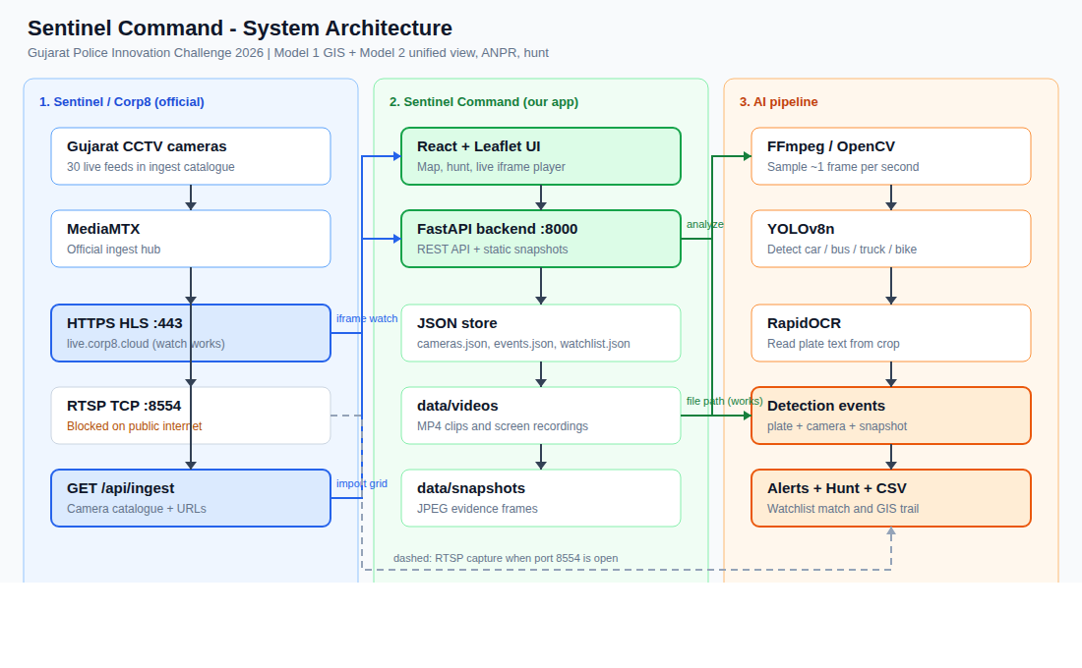
ARCHITECTURE · THEIR GRID + OUR COMMAND LAYER
Split of duties
Their side
Cameras, MediaMTX-style hub, password portal, RTSP + HLS.
Our side
React UI, FastAPI, JSON registry, YOLO, OCR, hunt CSV.
Rule
We do not store 24-hour video. Short JPEG evidence only. Departmental NVRs stay.
Labels in the PNG: catalogue is now cameras.json; RTSP 103.250.160.189:8554 is open from this network; watch is HLS proxy, not iframe.
Sentinel Command | Gujarat Police Innovation Challenge 2026 | Category 1 solo
05
Notes:
Point at three lanes: official grid, our app, AI pipeline. HLS for watch, RTSP for AI.

Slide 6
LIVE INTEGRATION · OFFICIAL INTEGRATOR CONTRACT
1
Sign in
POST /auth/login on cctv.corp8.cloud. Session cookie stays in the backend CookieJar.
2
Catalogue
GET /cameras.json — 30 rows (cam01…cam30). Never hard-code ids.
3
Build URLs
HLS https://cctv.corp8.cloud/cam04/index.m3u8
RTSP rtsp://103.250.160.189:8554/stream/cam04
4
Watch vs AI
Officer: HLS + hls.js via our proxy.
ANPR: OpenCV RTSP TCP, PTS timestamps, backoff 2s–30s.
Sentinel Command | Gujarat Police Innovation Challenge 2026 | Category 1 solo
06

Slide 7
AI ANALYTICS · DETECT → CROP → READ → STORE
1 Capture
2 YOLO v8n
3 RapidOCR
4 Evidence
FFmpeg / OpenCV samples ~1 JPEG/s. IST stamp. PTS-based time, not wall-clock per packet.
Nano weights on CPU. Classes: car, motorcycle, bus, truck. Box + confidence.
Crop lower ~45% of the vehicle box. ONNX OCR. Normalize GJ-01-AB-1234 → GJ01AB1234.
Annotated JPEG + events.json. Raw frames can be deleted. Not a 24-hour DVR.
Honest analytics note for judges
Own-feed boom-barrier clips yield readable plates (GJ01AB1234). Wide Paldi live junction (cam04) yielded 61 vehicles and 0 OCR plates — letters are too few pixels. We show both: vehicles on government feed, plates on close-up feed. Same pipeline.
Sentinel Command | Gujarat Police Innovation Challenge 2026 | Category 1 solo
07

Slide 8
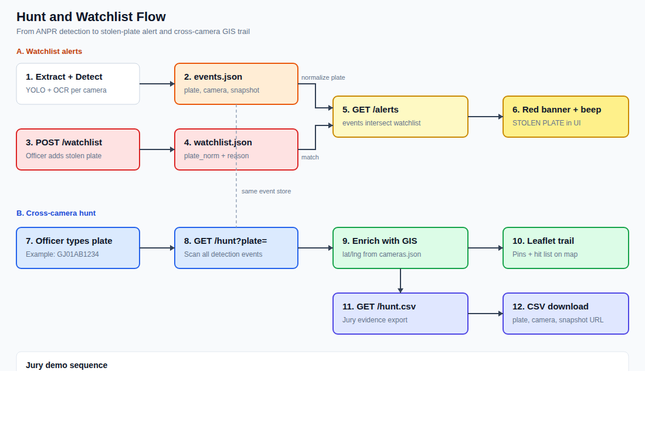
JURY TEST · WATCHLIST + HUNT A REGISTRATION
When they give a number
1. Add it to Watchlist (optional).
2. Hunt box → Find trail.
3. Map polyline + hit list.
4. Export CSV for the file.
If empty: Capture 4 / 5 / 12, Detect, Hunt again. That is the product, not a failure.
Demo seed: GJ01AB1234 — 13 hits, Gate + Paldi own-feed.
Sentinel Command | Gujarat Police Innovation Challenge 2026 | Category 1 solo
08

Slide 9
STACK · OPEN, VENDOR-NEUTRAL, MATCHES THEIR SUGGESTED TOOLS
Layer | Choice | Why
UI | React 19 + Vite 6 | Official suggested React.js
Map | Leaflet + OSM | Official Model 1 GIS suggestion
API | Python FastAPI | Official suggested Python / FastAPI
Store now | JSON files | Solo speed. Postgres + PostGIS on the scale slide
Watch | HLS + hls.js proxy | HTTPS 443, cookie, AES-128 playlists
AI ingest | OpenCV RTSP TCP | Integrator guide: tcp, PTS, backoff
Detect | YOLOv8n (nano) | CPU-capable vehicle boxes
OCR | RapidOCR ONNX | Plate text from crop
Sentinel Command | Gujarat Police Innovation Challenge 2026 | Category 1 solo
09

Slide 10
MEASURED ON THIS PROTOTYPE · NOT A CONCEPT VIDEO
33
30
61
13
cameras in registry
from cameras.json
live Paldi vehicles
GJ01AB1234 hits
30 official + 3 own-feed
Ahmedabad to Gandhidham
cam04 RTSP TCP sample
Gate + Paldi own-feed hunt
Two-system proof (Model 2 deliverable)
System A — official Sentinel grid (HLS watch + RTSP AI). System B — local MP4s treated as cameras. Same Extract / Detect / Hunt code path. Existing departmental storage is untouched.
Sandbox publishes ~30 cameras, not 50. We onboard every id in cameras.json. Statewide 80k is a scale plan, not this laptop.
Sentinel Command | Gujarat Police Innovation Challenge 2026 | Category 1 solo
10

Slide 11
SCALE TO ~80,000 · SAME APIS, MORE MACHINES
Now
JSON store, one node, 30–40 cameras, file + official catalogue, CPU YOLO.
Phase 2
PostgreSQL + PostGIS, Redis watchlist, object storage for snapshots, simple RBAC.
Phase 3
Zone RTSP workers, queue (Kafka/RabbitMQ), horizontal API, GPU batching, HLS edge cache.
Phase 4
VAHAN / SARTHI / eGujCop adapters, optional face, HA + DR, regional PoPs.
Sentinel Command | Gujarat Police Innovation Challenge 2026 | Category 1 solo
11
Notes:
Cost sketch if asked: analytics GPUs at zone, not 80k central transcodes. Keep video at source. Metadata is cheap.

Slide 12
SECURITY, INTEROP, AND HONEST LIMITS
Built in
Not this laptop
Consume-only. Never publish to the gateway.
Grid password in .env — not in git.
RTSP TCP, PTS timing, join warnings not fatal.
Open protocols: RTSP, HLS, REST JSON.
No 24h central archive — evidence JPEGs only.
No live VAHAN. No face. No Kafka. No department SSO. ANPR on distant junctions is vehicle-first. Continuous 30-camera workers are a scale step, not the demo. We say this so the jury can trust the rest.
Sentinel Command | Gujarat Police Innovation Challenge 2026 | Category 1 solo
12

Slide 13
8-MINUTE LIVE DEMO
UI already running at localhost:5174
0:00
Map + pitch
Hybrid 1+2. Registry first. Existing VMS stay.
0:40
Fetch grid
cameras.json → 30 pins. Export registry CSV.
1:20
Live watch
Camera 4 / 12 HLS player.
2:10
Own-feed ANPR
Gate → Extract → Detect. Readable plate.
3:20
Watchlist
GJ01AB1234 → red STOLEN PLATE banner.
4:00
Hunt + CSV
Trail on map. This is the scoring test.
5:00
Gov feed AI
Paldi Capture → Detect vehicles + times.
6:20
Scale slide
Postgres, zone workers, VAHAN adapter later.
7:20
Their number
Paste designated registration into Hunt.
Notes:
If Hunt is empty for their plate: Capture 4, 5, 12 then Detect, then Hunt. Do not freeze.

