Slide 1


HACKATHON PITCH DECK
KaushalSetu
Verified skills. Trusted workers. Faster hiring.
A three-sided recruitment platform for job seekers, employers, and admins.
Connecting skills with opportunities
Notes:
Hello everyone. We are presenting KaushalSetu, a platform that connects job seekers with employers and makes hiring simpler, more transparent, and more trustworthy.

Slide 2
KAUSHALSETU
Hiring breaks when skill proof is scattered
Blue-collar workers often have real capability, but employers struggle to verify it quickly and fairly.
Workers
Employers
Admins
Skills live in memories, certificates, WhatsApp chats, and past employer references instead of one credible profile.
Hiring teams screen manually, repeat calls, and still lack confidence that a candidate is the right fit.
Verification work is separated from the hiring flow, so trust signals arrive late or stay invisible.
The gap is not job availability alone. It is verified trust, discoverability, and workflow visibility.
02
Notes:
Set the context: workers need credible profiles, employers need confidence, and admins need tools to verify information.

Slide 3
KAUSHALSETU
KaushalSetu turns skills into a trusted hiring loop
Every role gets a focused workflow, but all three share the same verified data layer.
Worker
KaushalSetu
Employer
>
>
Build profile
Add skills and certificates
Apply and message
Trust score
Matching
Application tracking
Post jobs
Discover candidates
Move hiring stages
Admin verification approves profiles and certificates, then those credentials strengthen worker trust and employer matching.
03
Notes:
Explain that KaushalSetu is not just a job board. It is a complete loop where verified worker data improves matching and hiring decisions.

Slide 4
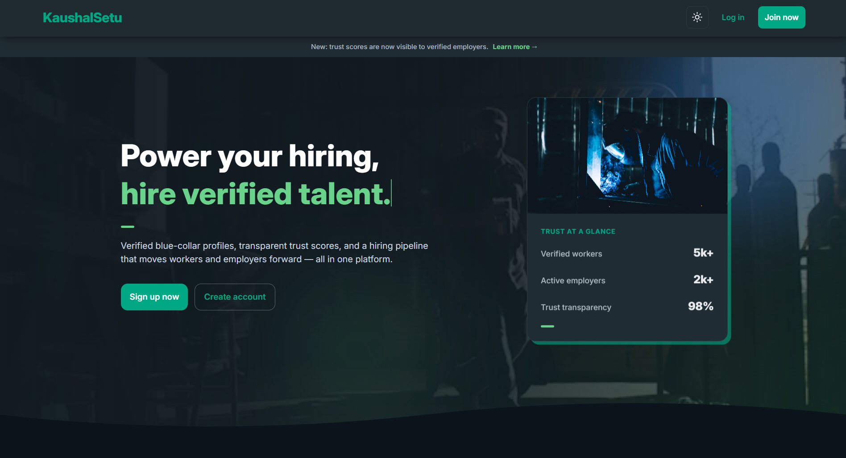
KAUSHALSETU
The landing page sets expectations before login
Light/dark themes, demo accounts, testimonials, and server wake feedback make the first experience clear.
Theme toggle
Instant light and dark mode switching.
Swiper testimonials
Social proof in a compact carousel.
Landing page screenshot
Demo roles
Use the home page showing hero, theme toggle, and testimonials.
Worker, Employer, and Admin accounts are ready for judges.
Render wake toast
Users see a clear message if the backend is waking up.
04
Notes:
Walk through the home page: theme support, Swiper testimonials, demo accounts for all three roles, and the small toast for Render server wake-up.

Slide 5
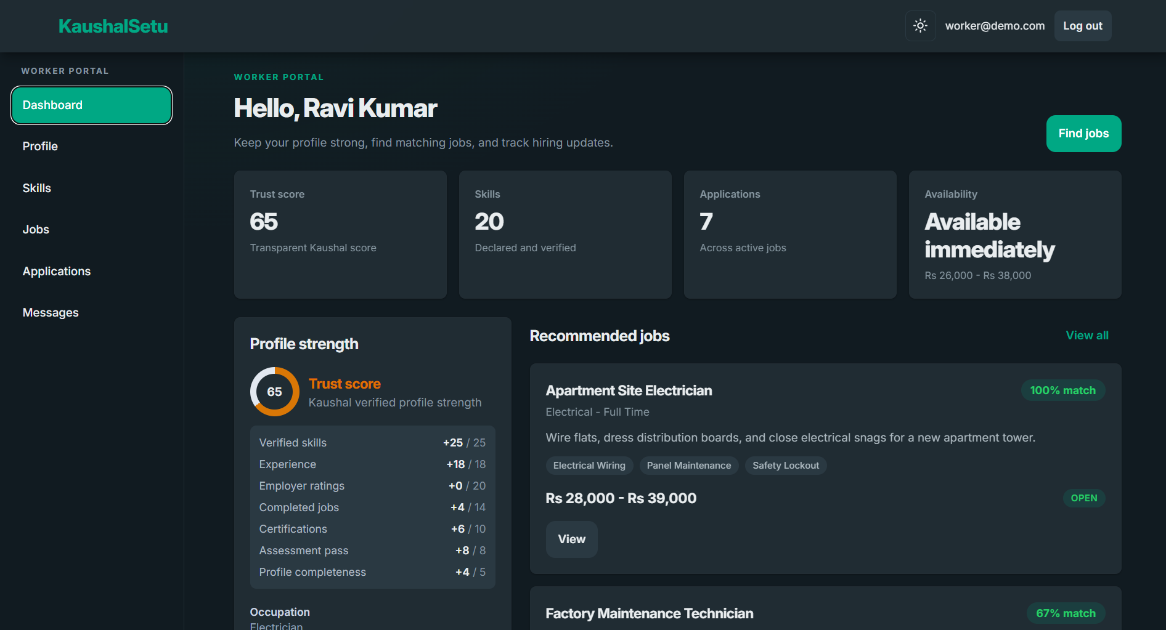
KAUSHALSETU
Workers build a profile employers can trust
A worker can keep skills, qualifications, experience, certificates, and Trust Score in one professional identity.
- Skills, qualifications, experience, and languages live together.
- New certificates enter an admin verification queue.
- Approved credentials strengthen the profile and trust score.
- Workers can update their profile as they learn and gain experience.
82
Worker dashboard / profile
Kaushal Trust Score
Replace with Trust Score and profile preview screen.
Transparent profile strength, updated as credentials improve.
05
Notes:
Describe the worker dashboard and profile. Emphasize Trust Score as a visible, explainable indicator of profile strength.

Slide 6
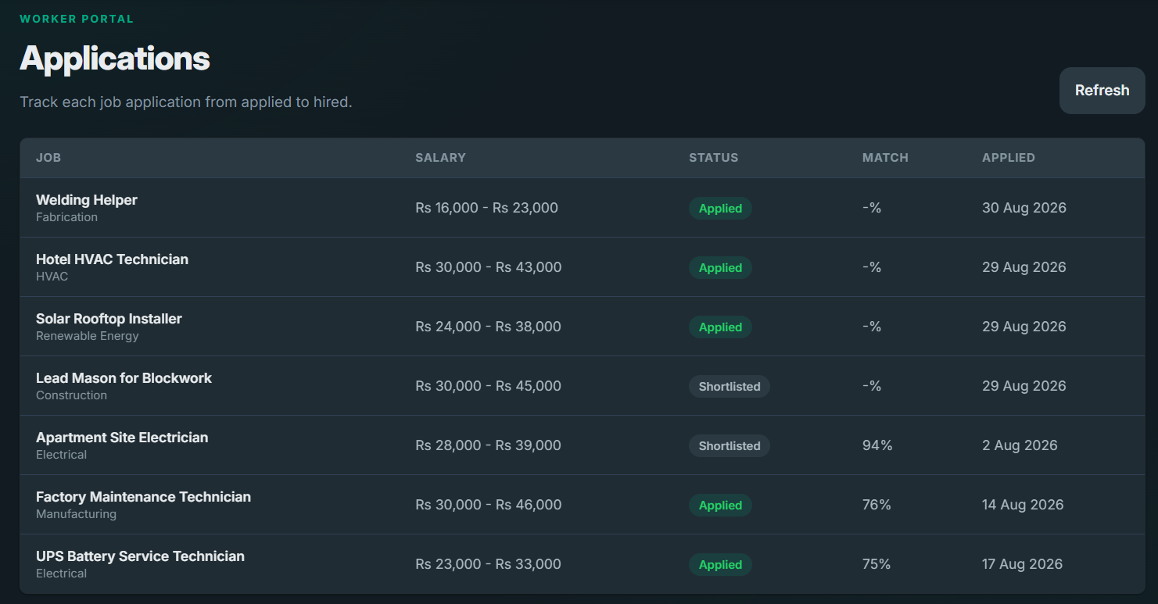
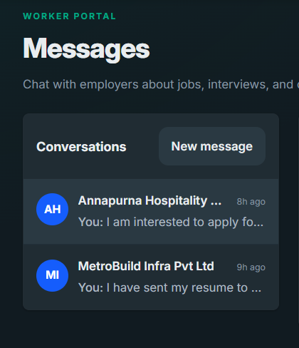
KAUSHALSETU
Workers move from discovery to conversation without leaving the app
The job journey stays traceable from recommendation to application status to real-time chat.
Worker flow
Browse matched jobs
Jobs and applications
Messages
Apply with one click
Show available jobs, one-click apply, and status tracking.
Show Socket.IO real-time chat.
Track every application
Message employers
06
Notes:
Cover jobs, applications, and messaging. Mention WebSockets and Socket.IO for real-time delivery.

Slide 7
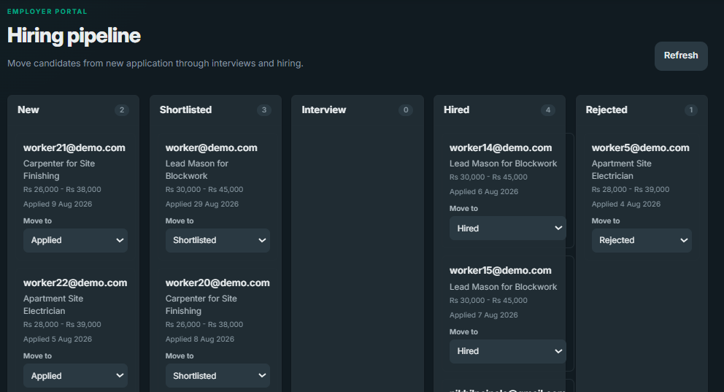
KAUSHALSETU
Employers manage the hiring workflow end to end
Companies can publish openings, search workers, shortlist candidates, and move applicants through a pipeline.
1
Create job openings
2
Browse available workers
Employer pipeline screenshot
3
Shortlist by skills and experience
Use pipeline with New, Shortlisted, Interview, Hired, and Rejected stages.
4
Move candidates across stages
5
Review analytics centrally
07
Notes:
Switch to the employer side: update company profile, create and close jobs, browse candidates, shortlist, use pipeline, message workers, and view analytics.

Slide 8
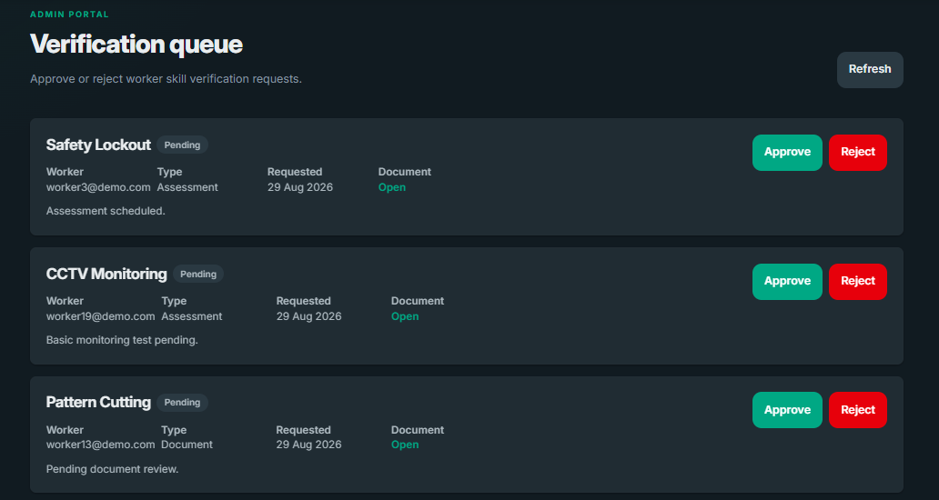
KAUSHALSETU
Admins keep verified trust visible
The admin role turns submitted claims into reviewed credentials that workers and employers can rely on.
Review profiles
Verify or unverify worker profiles.
Approve certificates
Submitted credentials enter a queue before affecting profiles.
Admin verification queue
Show certificate approval, rejection, and platform statistics.
Monitor statistics
Worker, job, and platform activity stay centralized.
08
Notes:
Move to admin: profile verification, certificate queue, approve and reject actions, and platform statistics.

Slide 9
KAUSHALSETU
The innovation is transparent trust, not another black box
KaushalSetu makes the reason behind hiring recommendations visible to workers, employers, and admins.
0-100
Match %
Live
Queue
Trust Score
Explainable Fit
Messaging
Verification
Calculated from verified skills, ratings, experience, completions, certificates, assessments, and profile completeness.
Employers see why a worker matches a role across skills, location, availability, salary, and trust.
Socket.IO keeps worker-employer conversations inside the hiring workflow.
Admin approvals turn documents and certificates into visible trust signals.
Trust signals are not hidden. They become the product experience.
09
Notes:
Emphasize what makes the project stand out: transparent Trust Score, explainable matching, verification, and real-time communication.

Slide 10
KAUSHALSETU
Built as a production-ready MERN app
The demo runs on a deployed frontend and backend, with real-time messaging layered into the hiring flow.
Frontend
React 19, Vite, Tailwind CSS
Light/dark theme, Swiper, role portals
Architecture
Backend
React UI
Node.js, Express, JWT auth
Routes, controllers, services, middleware
REST API
Data
MongoDB with Mongoose
Users, profiles, jobs, applications, messages
Express API
Mongoose
Realtime + Deploy
Socket.IO and WebSockets
Frontend on Netlify, backend on Render
MongoDB
10
Notes:
Summarize the stack: MongoDB, Express, React, Node, Socket.IO/WebSockets, Netlify frontend, Render backend.

Slide 11
IMPACT
KaushalSetu connects skills with opportunities
Workers
Employers
Admins
Build trusted profiles, discover jobs, apply, track status, and talk to employers.
Find credible candidates, shortlist faster, and manage the full hiring pipeline.
Protect platform trust through profile, skill, and certificate verification.
A single platform for trusted profiles, smarter hiring, and verified opportunity.
Thank you
Notes:
Close with the summary: workers, employers, and admins each have a clear job to do, and KaushalSetu brings them together.

