Slide 1
Cochlear’s Manufacturing Insights Dashboard

Slide 2
Project Overview
Project objective: To present key findings from the manufacturing data and provide valuable insights to manufacturing service team and manufacturing managers.
Focus areas : Cash flow analysis and improving quality, efficiency and improvements.
Dashboard components:
a)Key metrics – Total revenue, Total cost, total hours worked, Defect rate etc.,.
b)Visuals – Bar chart, Pie chart, Cards.
c) Interactivity - slicers for filtering data by fiscal week.

Slide 3
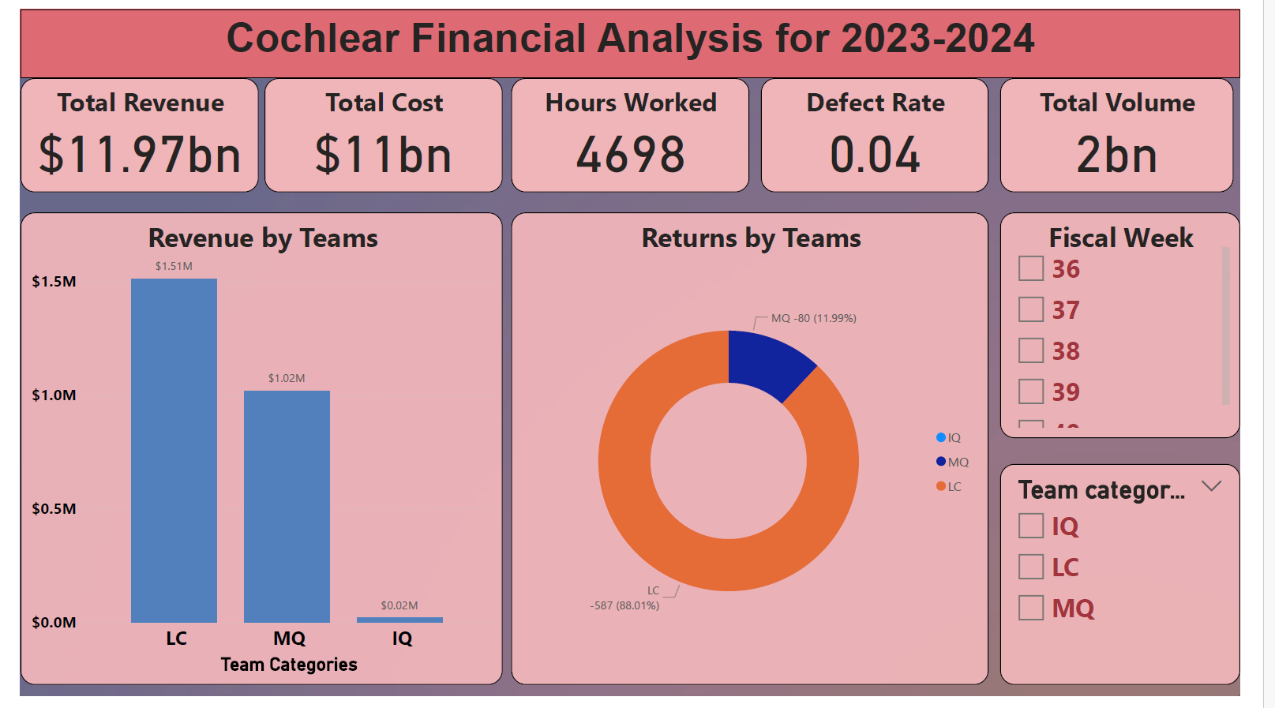
Dashboard Overview
Assumptions
1.Revenue per unit - $ 4.5
2. Cost per hour - $ 30

Slide 4
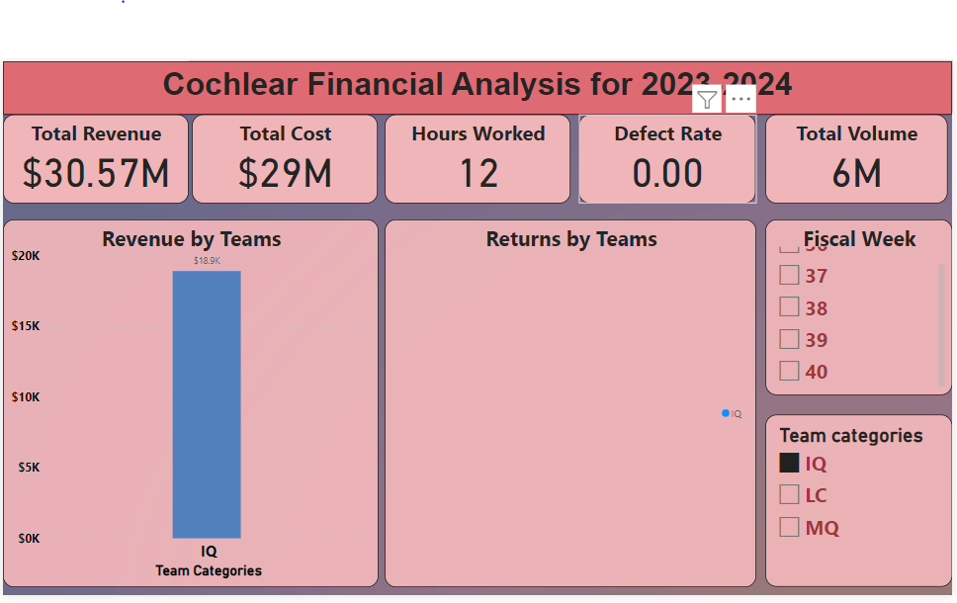
1.Team IQ Analysis
The cashflow is least when compared to other team categories.
The total hours worked is 12.
The highest revenue generated was in fiscal week 37 and week 40.
The least revenue was generated in week 39.
The Team IQ has the least defect rate which is 0.

Slide 5
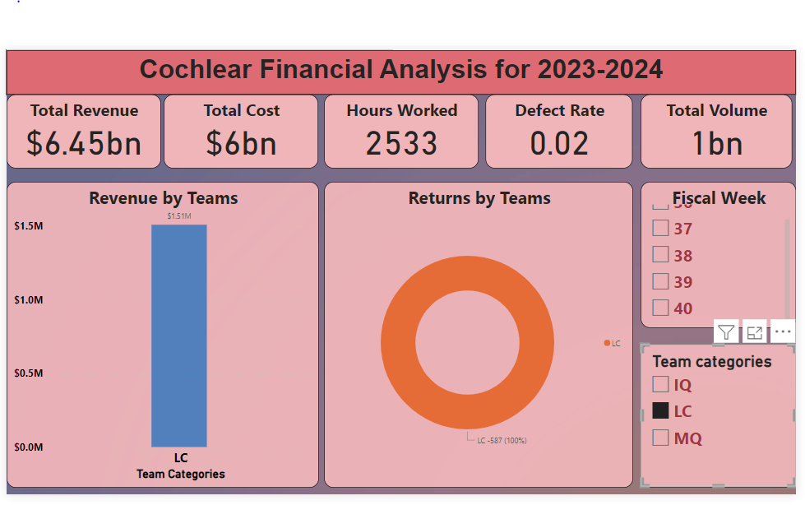
2. Team LC Analysis
The revenue generated by Team LC is 6.45Bn but the cash flow is 0.45Bn.
The total hours worked is 2533.
The highest revenue generated was in fiscal week 36 and week 37.
The least revenue was generated in week 39.
The Team LC has the defect rate which is 0.02, this is 2%.

Slide 6
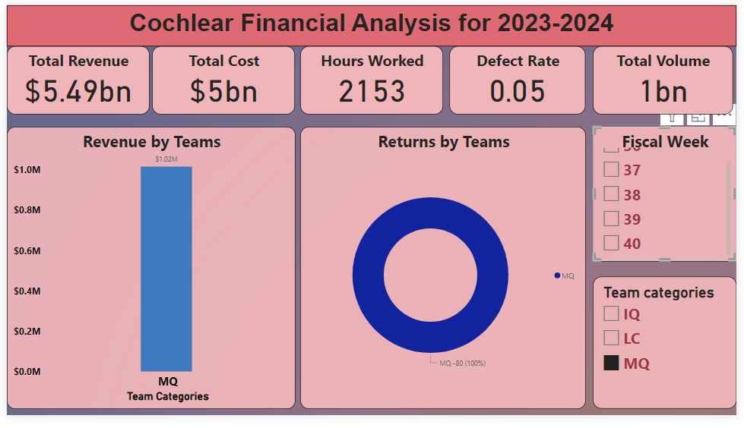
3. Team MQ Analysis
The revenue generated by Team MQ is 5.49Bn with highest cashflow compared to other team categories.
The total hours worked is 2153.
The highest revenue generated was in the fiscal week 38.
The least revenue was generated in week 36.
The Team MQ has the highest defect rate which is 0.05, this is 5% of the total volume produced

Slide 7
Findings
The total revenue generated is greater than the cost. This indicates positive cashflow for the company.
The highest performance teams are LC and MQ.
More revenue can be generated by increasing “Per unit cost of the product” or reducing the defect rate(implementing advance machineries, Regular staff training etc.,).
The current defect rate as per the analysis is 4%, this can be further reduced by implementing various technologies.
The current hours worked are 4695 (195 days). The production time can be reduced by implementing machineries or increasing additional shifts/man power.
Team of LC category has more returns compared to IQ and MQ.
Team LC category has generated the higher revenue for Cochlear.

Slide 8
Thank You

