Slide 1

HEALTHCARE ANALYSIS

Slide 2
PROJECT SUMMARY
Line Chart In MS Excel- The chart shows the trends in bad debts and charity care for California hospitals from 2016 to 2020. Both bad debts and charity care increased from 2016 to 2019, followed by a significant decline in 2020.
Pie Chart In Tableau - The pie chart displays the yearly distribution of a specific metric from 2016 to 2020. The data shows a peak in 2017 with 401,977 units, followed closely by 2018 and 2019 with slightly lower values. There is a significant drop in 2020 to 177,790 units, likely influenced by global disruptions such as the COVID-19 pandemic, which had widespread impacts on various sectors.
Available Beds By Cities (Top 5) In Powerbi- The bar chart shows the availability of hospital beds in the top 5 cities. Los Angeles leads with 103,000 available beds, followed by Oakland with 70,000, Pasadena with 60,000, San Diego with 57,000, and San Francisco with 56,000. The differences in bed availability highlight the varying capacities of healthcare infrastructure across these cities, which is crucial for managing healthcare demands, especially during events like pandemics or natural disasters.

Slide 3
KPI’S COVERED
State Wise Revenue
Top 5 City By Revenue
Type Of Ownership By Revenue
Top 5 County With Highest Count Of Hospital
Total Net Patient Revenue By Year
Available Beds Over The Year
Number Of California Hospital Discharges By Payer Source
Year Wise Expenses
Percentage Of California Hospital Patient Days By Payer Source
Change In The Number Of California Hospital Discharges By Payer Source
California Hospital Net Patient Revenue By Payer
Trends In California Hospital Bad Debts And Charity
Total Patients
Total Hospitals
Total Patient Stays
Total Discharges
Net Patient Revenue
Total Bad Debt
Bad Debt By Year
Total Revenue By City
Revenue Trend By Year
Revenue By Type Of Hospital
Total Expenses
Margin By City

Slide 4
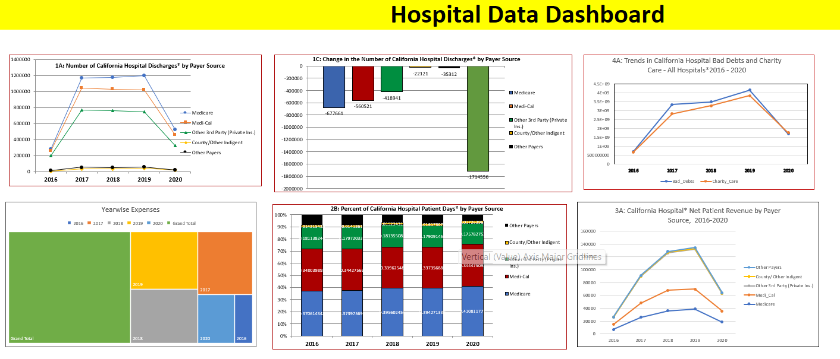
EXCEL DASHBOARD
Hospital Data Dashboard

Slide 5
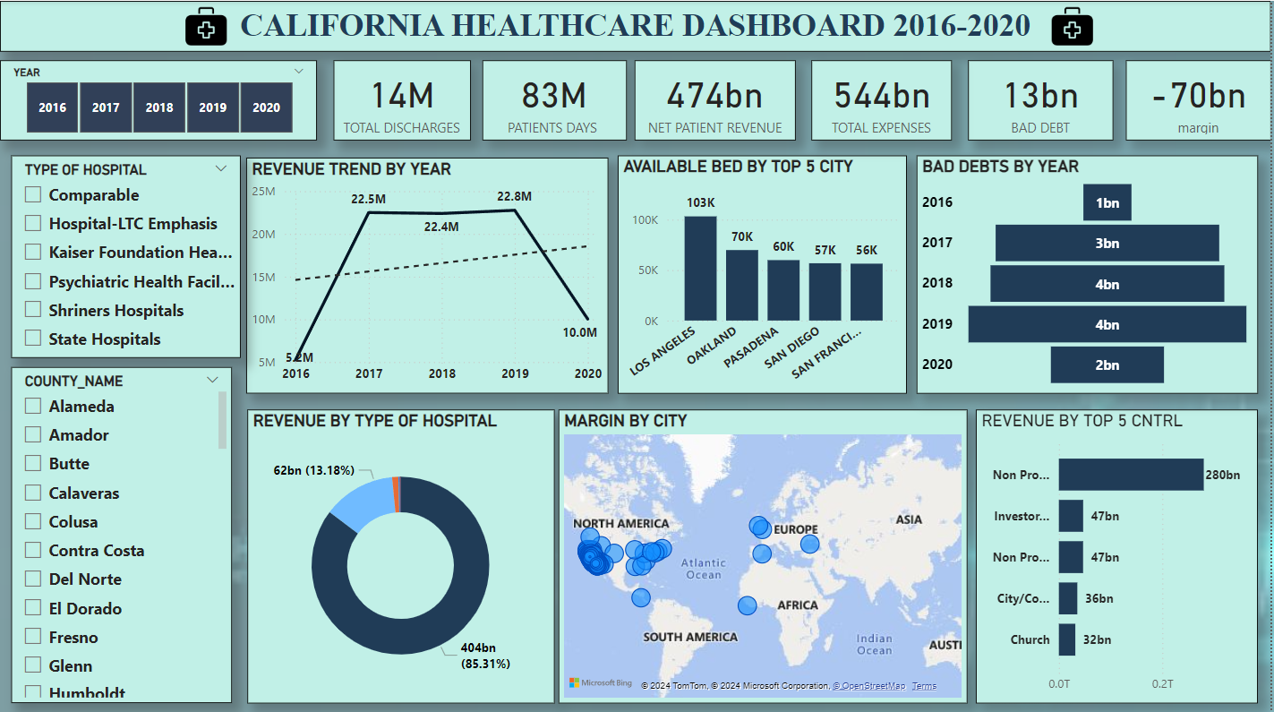
POWER BI DASHBOARD

Slide 6
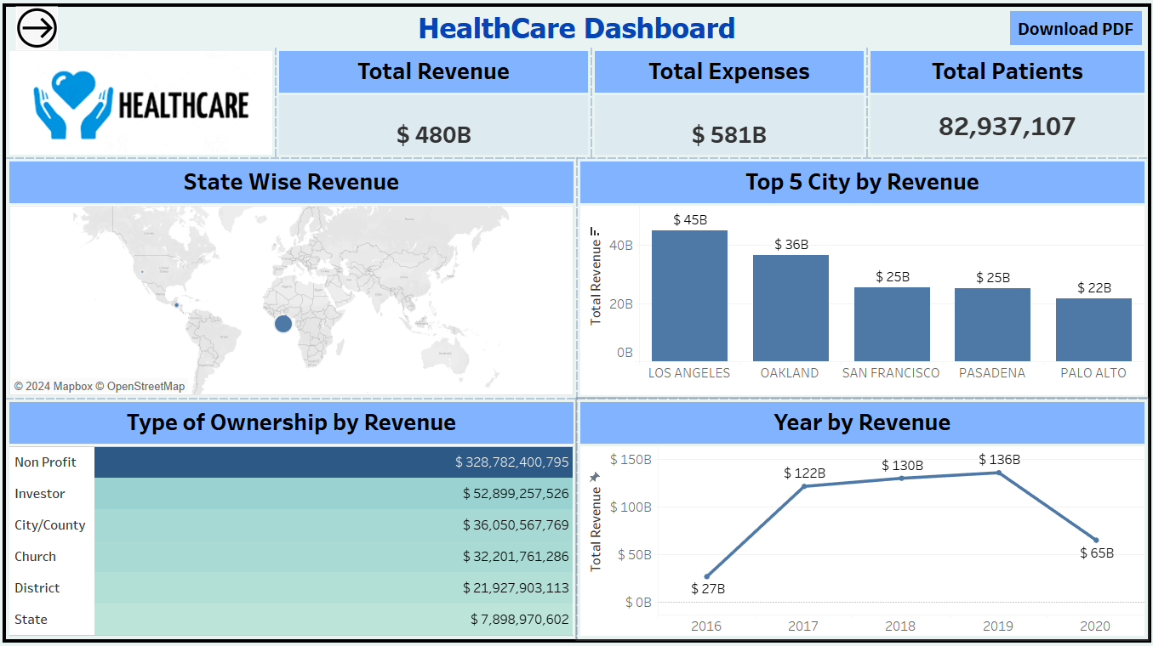
TABLEAU DASHBOARD

Slide 7
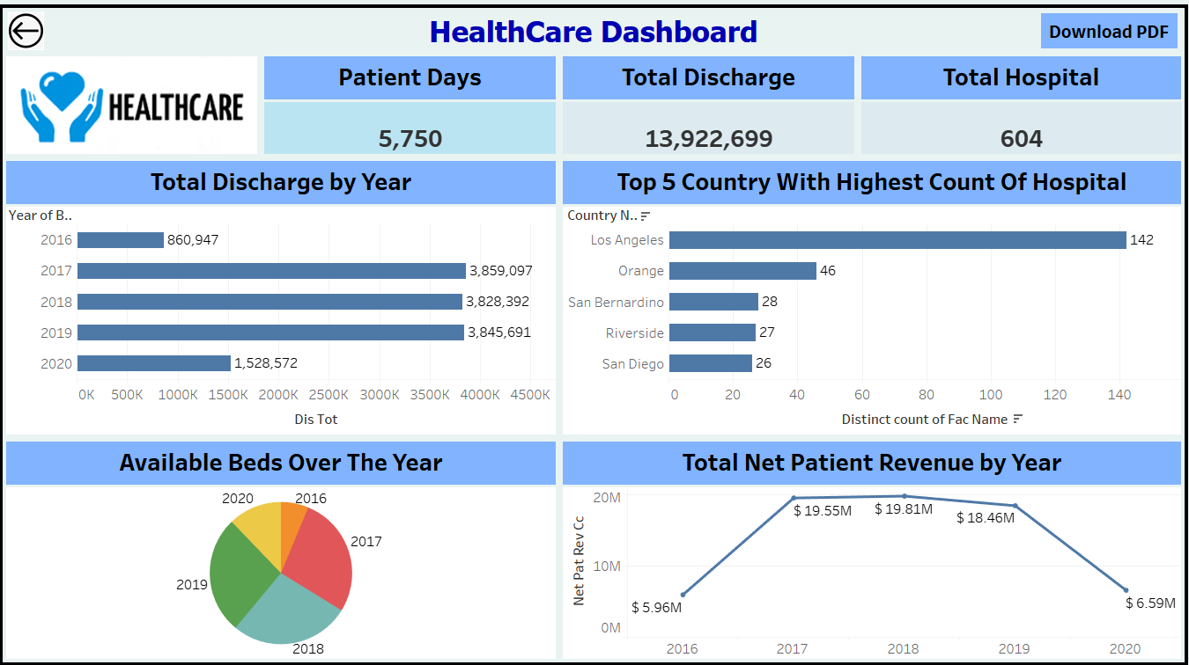
TABLEAU DASHBOARD

Slide 8
KEY TAKEAWAYS
Trend Analysis (2016-2020): Both bad debts and charity care for California hospitals peaked in 2019 before experiencing a sharp decline in 2020, possibly due to the impacts of the COVID-19 pandemic.
Yearly Distribution: The pie chart shows a notable spike in 2017 for a specific metric, followed by a steady decline, with the most significant drop in 2020, indicating a possible global disruption.
City-Wise Bed Availability: Los Angeles has the highest number of available hospital beds (103K), far surpassing other top cities like Oakland (70K) and San Francisco (56K).
Healthcare Capacity: The varying bed availability across major cities underscores the importance of resource allocation, especially in times of increased demand, such as during health crises.
Pandemic Impact: The significant drops in metrics in 2020 across multiple charts suggest the extensive impact of the global COVID-19 pandemic on healthcare systems and associated financials.

Slide 9
CONCLUSION
The data reveals a significant impact of the COVID-19 pandemic on healthcare metrics, with sharp declines in both financial and operational figures in 2020.
The disparities in bed availability across major cities emphasize the critical need for strategic resource management in healthcare to better respond to crises.

Slide 10
THANK YOU

