Slide 1
cloud computing
AI-Generated Presentation

Slide 2

Introduction - cloud computing
Introduction on cloud computing:
- Cloud computing is "a paradigm for enabling network access to a scalable and elastic pool of shareable physical or virtual resources with self-service provisioning and administration on-demand," according to ISO. == Essential Characteristics == In 2011, the National Institute of Standards and Technology (NIST) identified five "essential characteristics" for cloud systems
- Below are the exact definitions according to NIST: On-demand self-service: "A consumer can unilaterally provision computing capabilities, such as server time and network storage, as needed automatically without requiring human interaction with each service provider." Broad network access: "Capabilities are available over the network and accessed through standard mechanisms that promote use by heterogeneous thin or thick client platforms (e.g., mobile phones, tablets, laptops, and workstations)." Resource pooling: " The provider's computing resources are pooled to serve multiple consumers using a multi-tenant model, with different physical and virtual resources dynamically assigned and reassigned according to consumer demand." Rapid elasticity: "Capabilities can be elastically provisioned and released, in some cases automatically, to scale rapidly outward and inward commensurate with demand
- To the consumer, the capabilities available for provisioning often appear unlimited and can be appropriated in any quantity at any time." Measured service: "Cloud systems automatically control and optimize resource use by leveraging a metering capability at some level of abstraction appropriate to the type of service (e.g., storage, processing, bandwidth, and active user accounts)
- Resource usage can be monitored, controlled, and reported, providing transparency for both the provider and consumer of the utilized service. By 2023, the International Organization for Standardization (ISO) had expanded and refined the list.

Slide 3
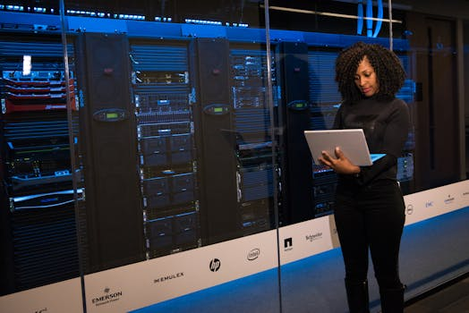
Key Features - cloud computing
Key Features on cloud computing:
- The Cloud Native Computing Foundation (CNCF) is a subsidiary of the Linux Foundation founded in 2015 to support cloud-native computing. == History == It was announced alongside Kubernetes 1.0, an open source container cluster manager, which was contributed to the Linux Foundation by Google as a seed technology
- Founding members include Google, CoreOS, Mesosphere, Red Hat, Twitter, Huawei, Intel, RX-M, Cisco, IBM, Docker, Univa, and VMware
- Today, CNCF is supported by over 450 members. In August 2018 Google announced that it was handing over operational control of Kubernetes to the community.

Slide 4

Benefits - cloud computing
Benefits on cloud computing:
- Cloud computing is "a paradigm for enabling network access to a scalable and elastic pool of shareable physical or virtual resources with self-service provisioning and administration on-demand," according to ISO. == Essential Characteristics == In 2011, the National Institute of Standards and Technology (NIST) identified five "essential characteristics" for cloud systems
- Below are the exact definitions according to NIST: On-demand self-service: "A consumer can unilaterally provision computing capabilities, such as server time and network storage, as needed automatically without requiring human interaction with each service provider." Broad network access: "Capabilities are available over the network and accessed through standard mechanisms that promote use by heterogeneous thin or thick client platforms (e.g., mobile phones, tablets, laptops, and workstations)." Resource pooling: " The provider's computing resources are pooled to serve multiple consumers using a multi-tenant model, with different physical and virtual resources dynamically assigned and reassigned according to consumer demand." Rapid elasticity: "Capabilities can be elastically provisioned and released, in some cases automatically, to scale rapidly outward and inward commensurate with demand
- To the consumer, the capabilities available for provisioning often appear unlimited and can be appropriated in any quantity at any time." Measured service: "Cloud systems automatically control and optimize resource use by leveraging a metering capability at some level of abstraction appropriate to the type of service (e.g., storage, processing, bandwidth, and active user accounts)
- Resource usage can be monitored, controlled, and reported, providing transparency for both the provider and consumer of the utilized service. By 2023, the International Organization for Standardization (ISO) had expanded and refined the list.

Slide 5

Challenges - cloud computing
Challenges on cloud computing:
- Serverless computing is "a cloud service category in which the customer can use different cloud capability types without the customer having to provision, deploy and manage either hardware or software resources, other than providing customer application code or providing customer data
- Serverless computing represents a form of virtualized computing." according to ISO/IEC 22123-2
- Serverless computing is a broad ecosystem that includes the cloud provider, Function as a Service, managed services, tools, frameworks, engineers, stakeholders, and other interconnected elements, according to Sheen Brisals
- == Overview == Serverless is a misnomer in the sense that servers are still used by cloud service providers to execute code for developers

Slide 6

Future Scope - cloud computing
Future Scope on cloud computing:
- Edge computing is a distributed computing model that brings computation and data storage closer to the sources of data
- More broadly, it refers to any design that pushes computation physically closer to a user, so as to reduce the latency compared to when an application runs on a centralized data centre. The term began being used in the 1990s to describe content delivery networks—these were used to deliver website and video content from servers located near users
- In the early 2000s, these systems expanded their scope to hosting other applications, leading to early edge computing services
- These services could do things like find dealers, manage shopping carts, gather real-time data, and place ads.

Slide 7
Conclusion
Key Takeaways:
- Introduction
- Key Features
- Benefits
- Challenges
- Future Scope

